Slide 1
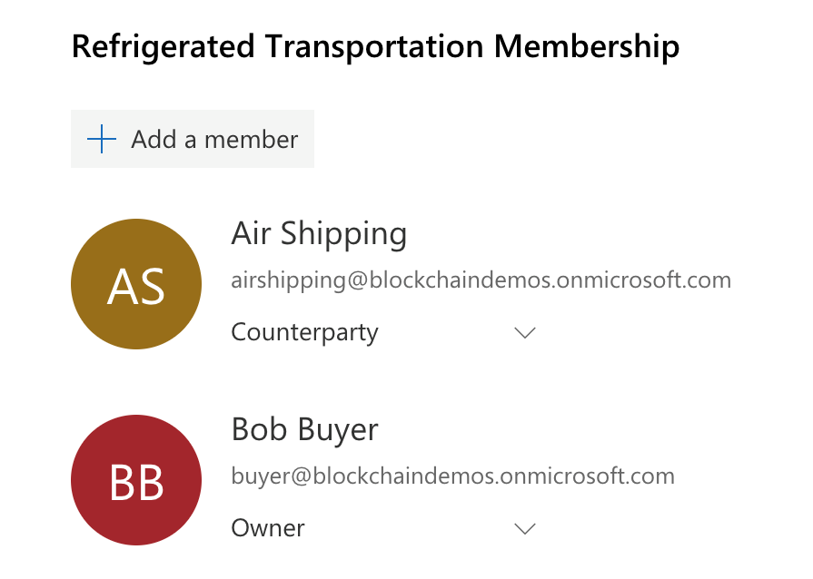
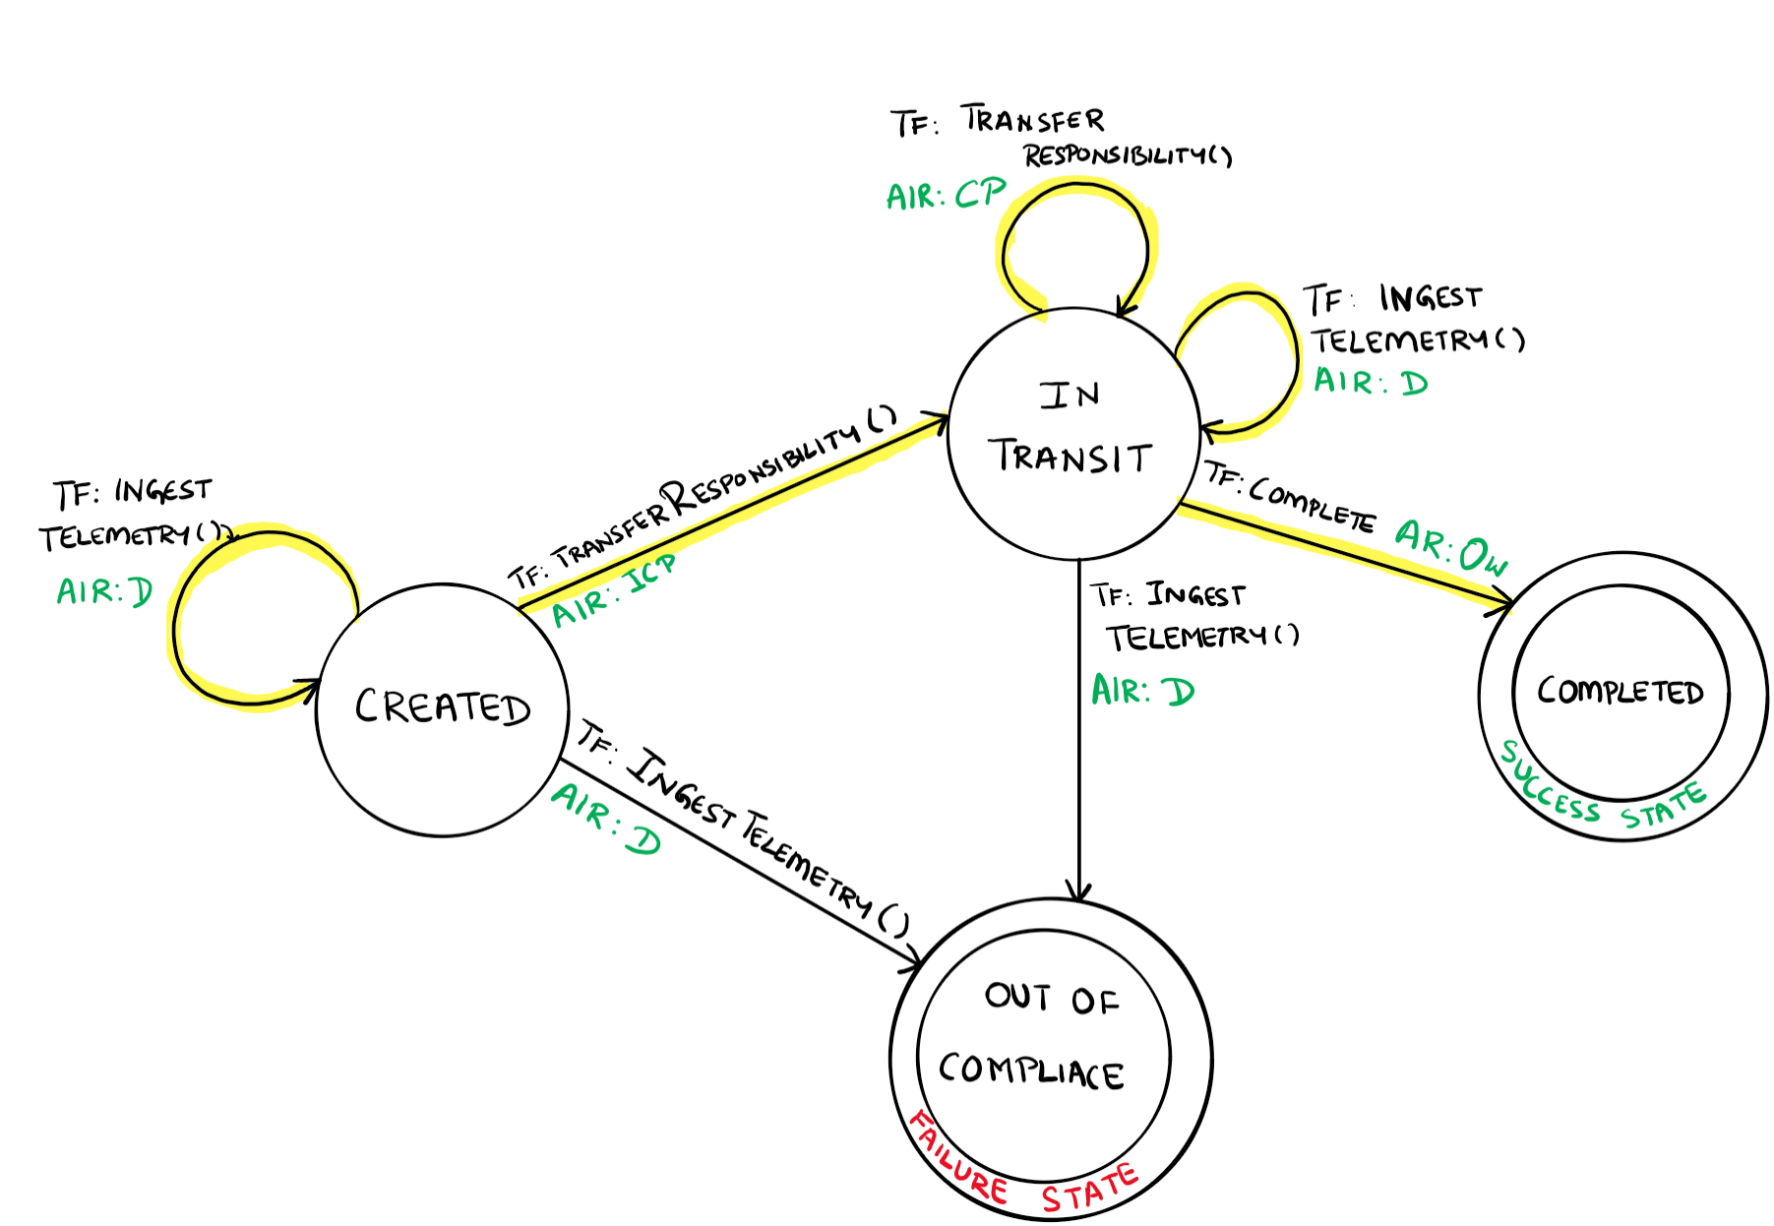
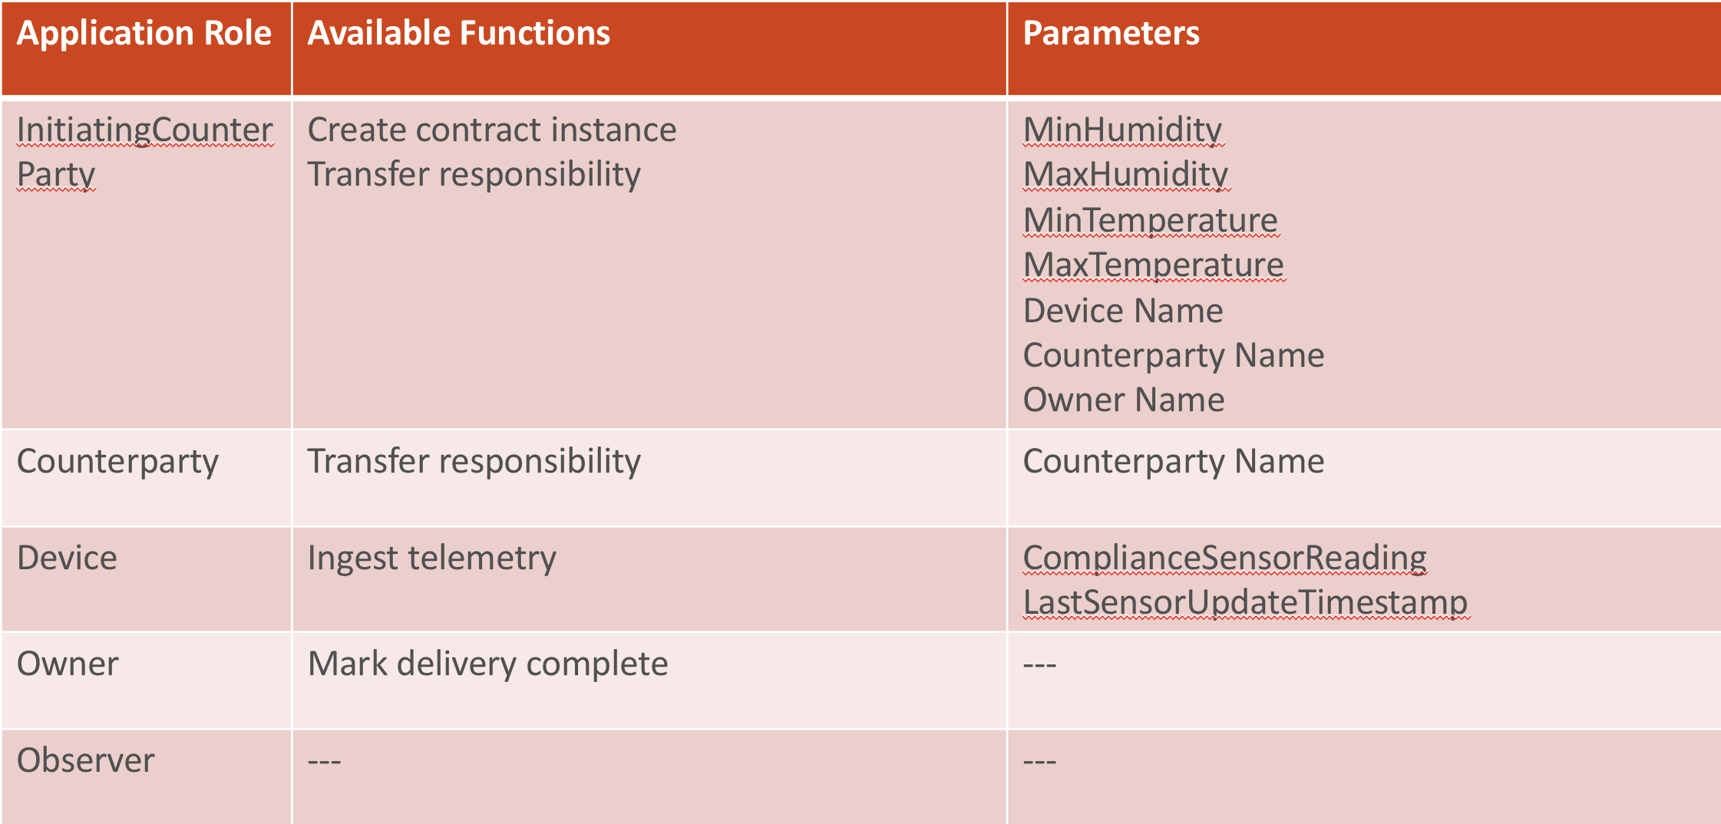
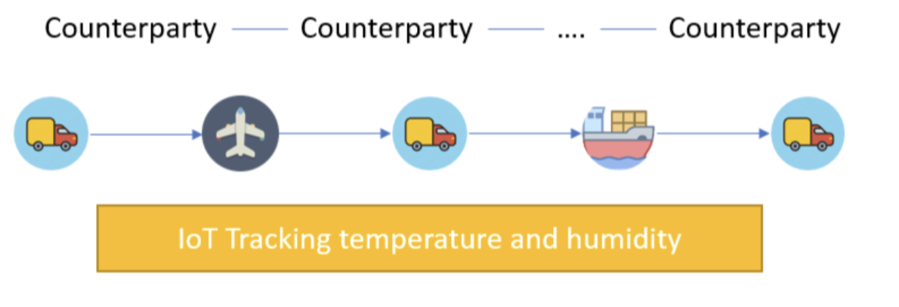
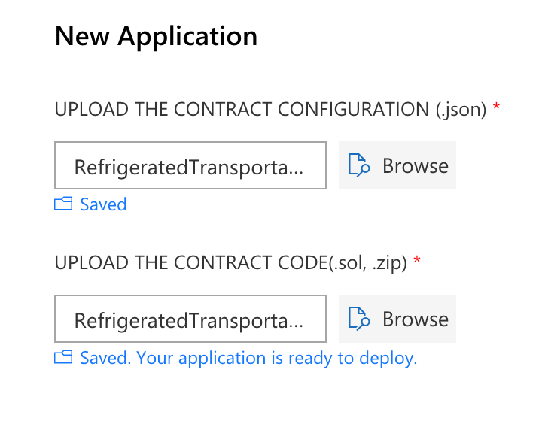
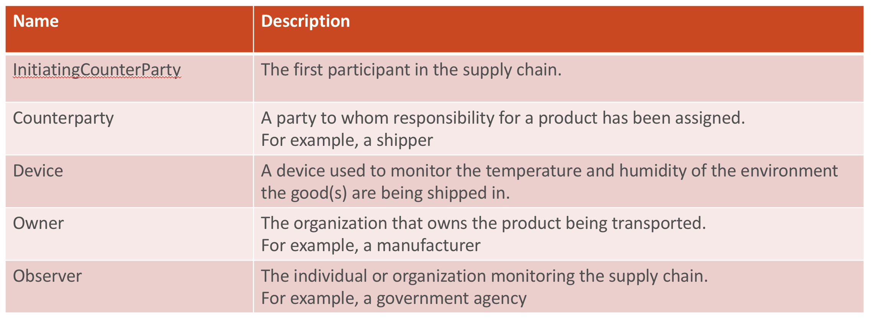
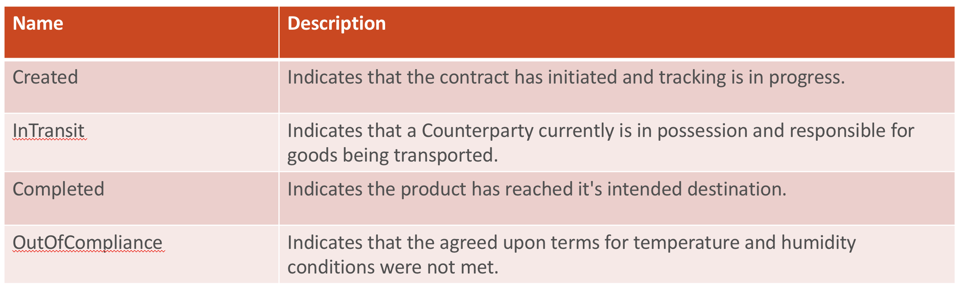
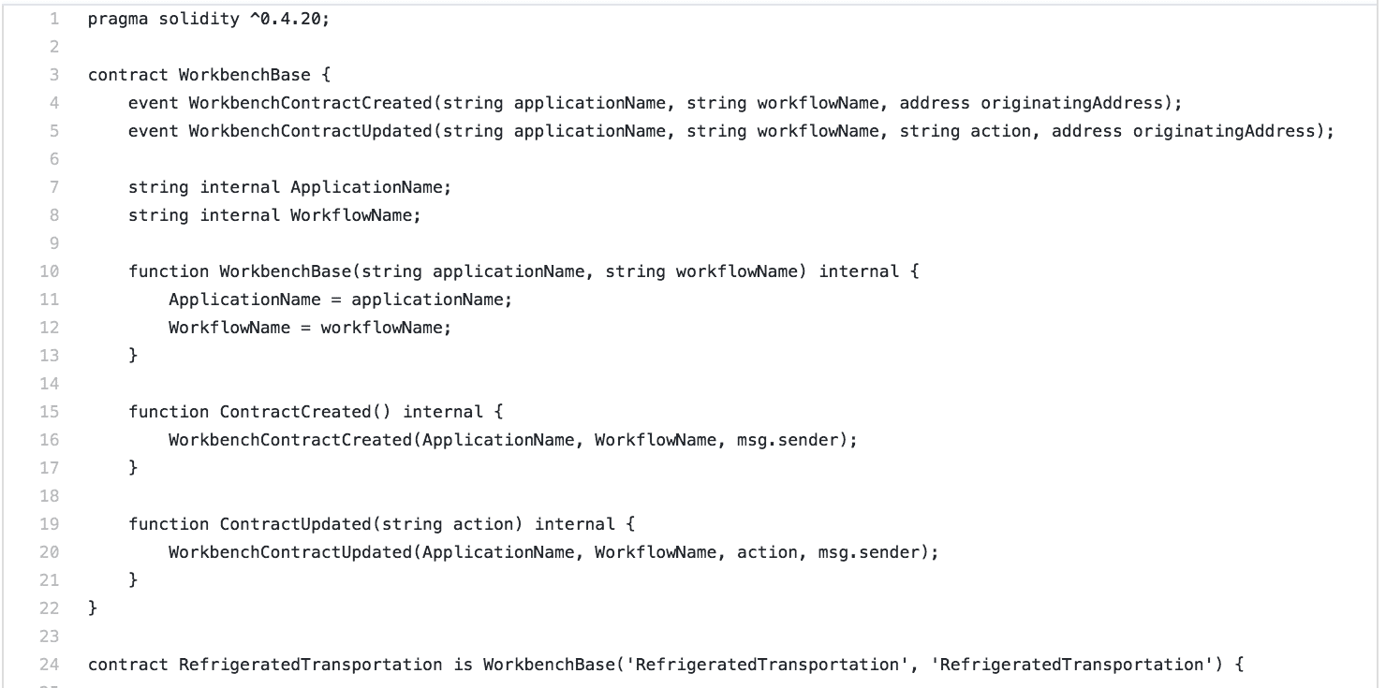
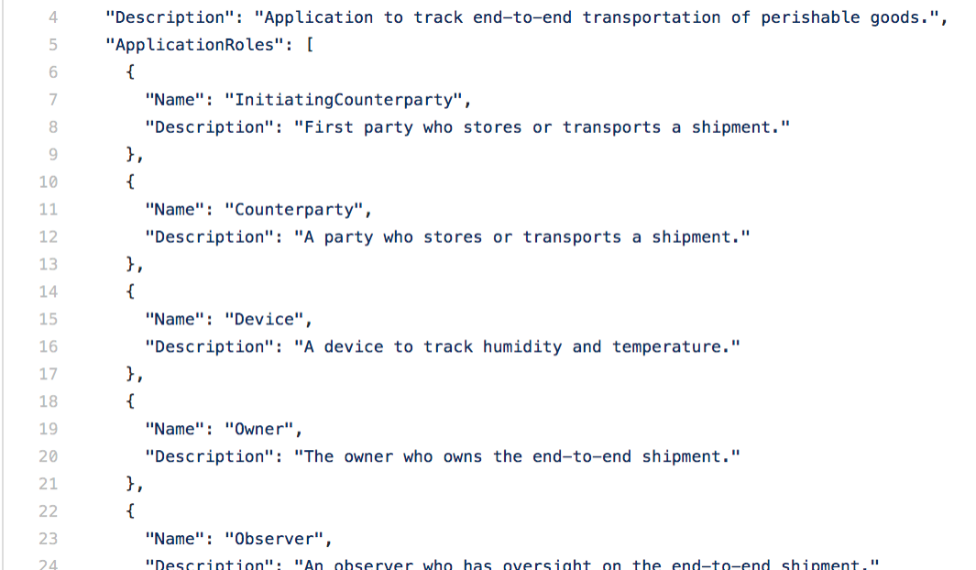
Building a Blockchain App - Process Flow
Step 9 | Add Users and Test
Step 1 | Create Story
Step 4 | Draft Workflow
Step 5 | Specify On-Chain Data
Step 8 | Deploy App
Step 3 | Define Smart
Contract States
Step 2 | Define App Roles
Step 6 | Code Smart Contract
Step 7 | Code Config

Slide 2
Create your application story
Start with a Scenario Overview
The refrigerated transportation smart contract covers a provenance scenario with IoT monitoring. You can think of it as a supply chain transport scenario where certain compliance rules must be met throughout the duration of the transportation process. The initiating counterparty specifies the humidity and temperature range the measurement must fall in to be compliant. At any point, if the device takes a temperature or humidity measurement that is out of range, the contract state will be updated to indicate that it is out of compliance.
Illustrate the desired process flow

Slide 3
Define your application roles
Name | Description
InitiatingCounterParty | The first participant in the supply chain.
Counterparty | A party to whom responsibility for a product has been assigned. For example, a shipper
Device | A device used to monitor the temperature and humidity of the environment the good(s) are being shipped in.
Owner | The organization that owns the product being transported. For example, a manufacturer
Observer | The individual or organization monitoring the supply chain. For example, a government agency
All participants can view the state and details of the contract at any point in time. The counterparty doing the transportation will specify the next counterparty responsible, and the device will ingest temperature and humidity data which gets written to the chain. This allows the Supply Chain Owner and Supply Chain Observer to pinpoint which counterparty did not fulfill the compliance regulations if at any point in the process either the temperature or humidity requirements were not met.

Slide 4
Enumerate all of your smart contract states
Name | Description
Created | Indicates that the contract has initiated and tracking is in progress.
InTransit | Indicates that a Counterparty currently is in possession and responsible for goods being transported.
Completed | Indicates the product has reached it's intended destination.
OutOfCompliance | Indicates that the agreed upon terms for temperature and humidity conditions were not met.
Combine the application story, roles and smart contract states to create a state transition design that articulates the possible flows, and the various transition functions at each state. Each user is only allowed to take certain actions depending on the application role. Instance roles indicate that only the user with the application role assigned to the specific contract is able to take actions on the contract.

Slide 5
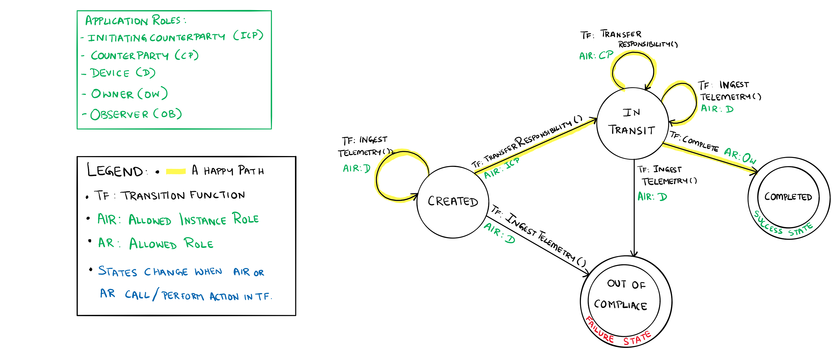
Draft the workflow details as a state transition design
MVP - Solution Development and Deployment​
This contract demonstrates how to collect telemetry information and enforce contract specifics related to conditions during transport. Specifically, receiving and evaluating temperature and humidity data against an agreed upon acceptable range. If the IoT device identifies that the telemetry is out of the acceptable range, the contract will shift into an out of compliance state and appropriate remedies can be sought. In the highlighted happy path, the device ingests readings, which are in compliance throughout the transportation process, while the involved counterparties transfer responsibility until the transportation is completed.

Slide 6
Specify data as parameters relative to roles and functions
Application Role | Available Functions | Parameters
InitiatingCounterParty | Create contract instance Transfer responsibility | MinHumidity MaxHumidity MinTemperature MaxTemperature Device Name Counterparty Name Owner Name
Counterparty | Transfer responsibility | Counterparty Name
Device | Ingest telemetry | ComplianceSensorReading LastSensorUpdateTimestamp
Owner | Mark delivery complete | ---
Observer | --- | ---
Use the workflow details to inform your decisions for a minimum viable set of parameters to store on your distributed ledger.

Slide 7
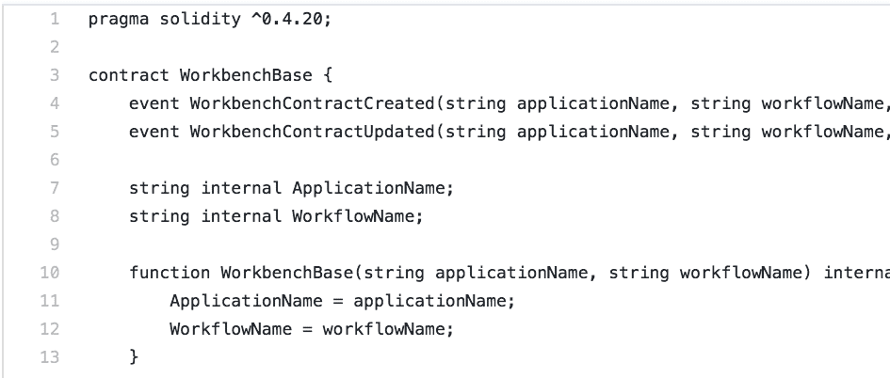
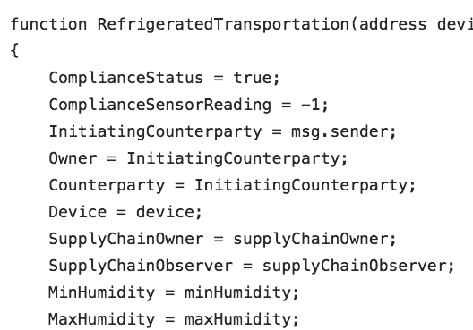
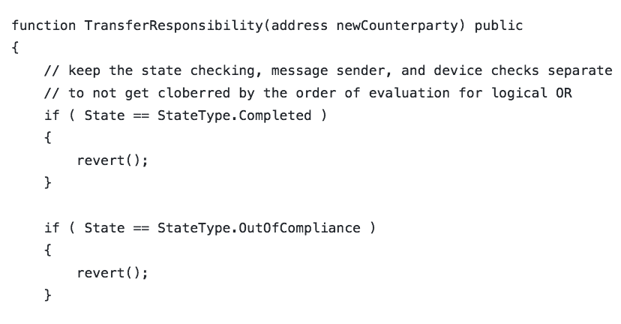
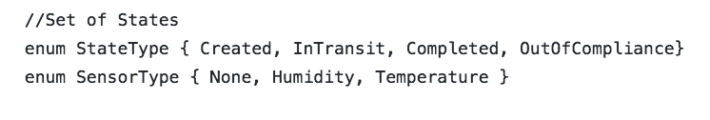
Prepare to write your workflow details as a Solidity Smart Contract
Workbench uses both the configuration file and smart contract code file to create a blockchain application. There is a relationship between what is defined in the configuration and the code in the smart contract.
Contract
State Variables
State variables store values of the state for each contract instance
Constructor
The constructor defines input parameters for a new smart contract instance of a workflow
Functions
Functions are the executable units of business logic within a contract
Pass the application name and the workflow name as arguments
1:1 relationship between contracts and config files
Name matching required
The state variables in your contract must match the workflow properties defined in the configuration file
The constructor is declared as a function with the same name as the contract
Required parameters for the constructor are defined as constructor parameters in the configuration file
The number, order, and type of parameters must match in both files.
Required parameters for the function are defined as function parameters in the configuration file
The number, order, and type of parameters must match in both files.

Slide 8
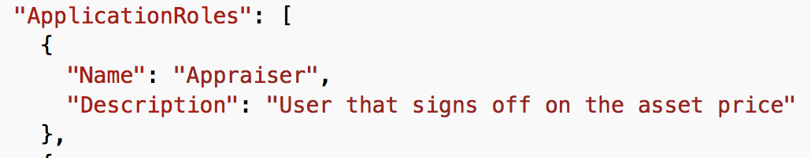
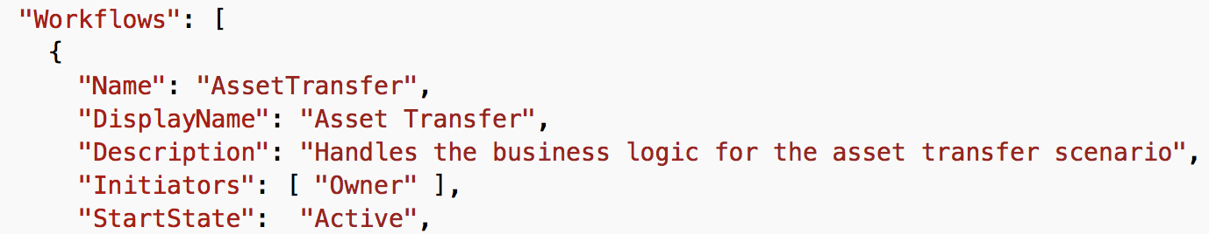
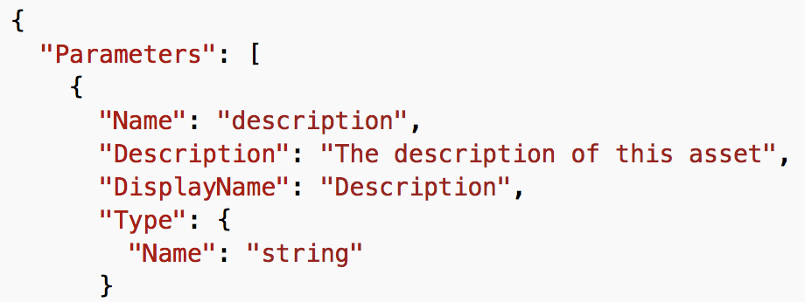
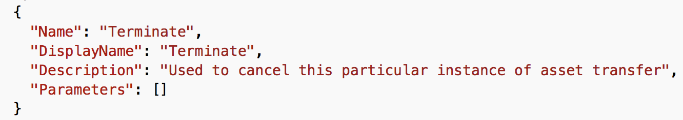
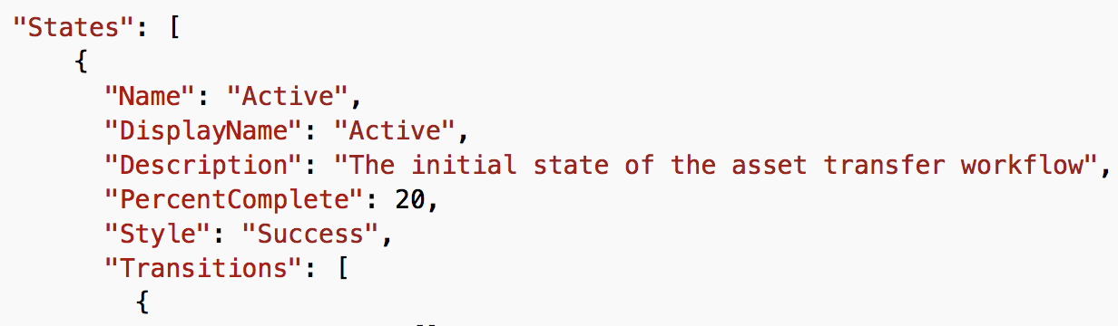
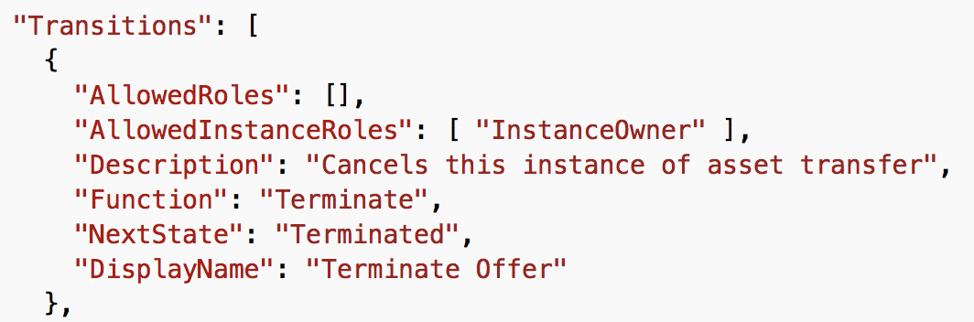
Prepare your Workbench JSON application configuration file
Workflow
Collection of states and actions that models application business logic as a state machine
Constructor
Defines input parameters for an instance of a workflow
Maps to the Parameters column of the chart on the previous slide
Functions
Defines functions that can be executed on the workflow
The corresponding smart contract must use the same Name for the applicable function
States
Transitions
States that define the status within the workflow
Application Roles
Based on Personas
Initiators start the workflow process
Linked to security groups in Azure Active Directory
Participants modify workflow data
Observers have read-only access
Each workflow consists of one or more smart contracts, which represent the business logic in code files.
Maps to the Available Actions on the previous slide
Maps to the current state and target state columns on the previous slide
Available actions to the next state
One or more user roles may perform an action at each state, where an action may transition a state to another state in the workflow
Create JSON configuration file that will contain the following application settings

Slide 9
MVP - Solution Development and Deployment
Group exercise – breaking down an MVP
Individual lab – completing code for the group MVP

Slide 10
Basic Provenance - MVP
The Basic Provenance application expresses a workflow for a simple record of ownership or responsibility.
Basic Provenance starts when an owner wants to track ownership or responsibility for an asset. Whenever a new counterparty takes ownership or responsibility of the asset, the owner transfer responsibility to the counterparty. The counterparty can transfer the responsibility to another counterparty, or the owner can decide to complete the transfers of responsibility.

Slide 11
MVP application roles
Name | Description
HINT: Identify each role required to complete the smart contract and what that role is required to do

Slide 12
Enumerate all of your smart contract states
Name | Description
HINT: Contract states are immutable, and it's best to think of states that must be persisted vs. process states that are passing

Slide 13
MVP functions and parameters
Application Role | Available Functions | Parameters
HINT: Use the minimum viable set of parameters to store on your distributed ledger

Slide 14
Prepare to write your workflow details as a Solidity Smart Contract
Workbench uses both the configuration file and smart contract code file to create a blockchain application. There is a relationship between what is defined in the configuration and the code in the smart contract.
The number, order, and type of parameters must match in both files.
Contract
Pass the application name and the workflow name as arguments
1:1 relationship between contracts and config files
Name matching required
State Variables
State variables store values of the state for each contract instance
The state variables in your contract must match the workflow properties defined in the configuration file
Constructor
The constructor defines input parameters for a new smart contract instance of a workflow
The constructor is declared as a function with the same name as the contract
Required parameters for the constructor are defined as constructor parameters in the configuration file
The number, order, and type of parameters must match in both files.
Functions
Functions are the executable units of business logic within a contract
Required parameters for the function are defined as function parameters in the configuration file

Slide 15
Prepare your Workbench JSON application configuration file
Workflow
Collection of states and actions that models application business logic as a state machine
Constructor
Defines input parameters for an instance of a workflow
Maps to the Parameters column of the chart on the previous slide
Functions
Defines functions that can be executed on the workflow
The corresponding smart contract must use the same Name for the applicable function
States
Transitions
States that define the status within the workflow
Application Roles
Based on Personas
Initiators start the workflow process
Linked to security groups in Azure Active Directory
Participants modify workflow data
Observers have read-only access
Each workflow consists of one or more smart contracts, which represent the business logic in code files.
Maps to the Available Actions on the previous slide
Maps to the current state and target state columns on the previous slide
Available actions to the next state
One or more user roles may perform an action at each state, where an action may transition a state to another state in the workflow
Create JSON configuration file that will contain the following application settings
HINT: Use an existing JSON file to guide your implementation

