Slide 1
Blockchain Ideation

Slide 2






Vision
Design
Develop
Iterate
define
ideate
prototype
test
Notes:
What process should we follow?
User Centered Design is just good design. Always ask why + tell me more, to learn more into the reason and core issues they’re experiencing.

Slide 3
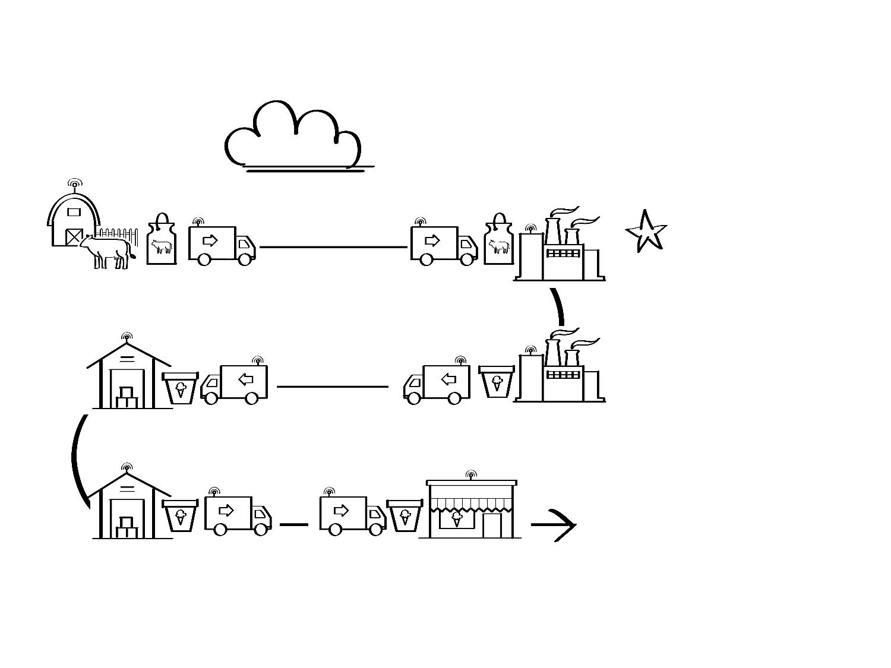
BLOCKCHAIN IN THE ICE CREAM SUPPLY CHAIN
AUTOMATED DATA IS
ADDED TO A SHARED BLOCKCHAIN
LEDGER IN REAL TIME
“THE CLOUD”
BENEFITS
The dairy farmer loads milk onto the shipping company’s temperature-controlled truck.
The shipping company delivers the milk at temperature to the manufacturer.
The shipping company delivers the ice cream at temperature to the warehouse.
The manufacturer loads packaged ice cream back onto the temperature-controlled truck.
The warehouse loads ice cream onto the shipping company’s truck.
The shipping company delivers ice cream at temperature to the grocery store.

Slide 4
Ideation Breakout
Notes:
Ideation Breakout
Have participants break into groups and brainstorm blockchain ideas
15 minutes

Slide 5

Product Vision
Phase 1

Slide 6
What’s the problem we’re trying to solve?
Pick an industry / company
Brainstorm a problem we want to ideate around
Define the problem statement

Slide 7

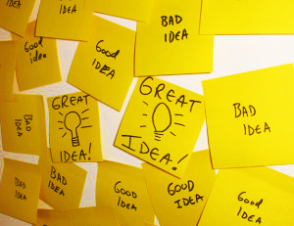
Design / Ideate
[10 mins]
Quantity over quality
Notes:
Activity 2: Rapid Ideation Session
No idea is a bad idea
• Go wild, be creative
• Quantity over quality
• Minimum 20 ideas/team

Slide 8

Develop / Prototype
[10 mins]
Build a representation
Notes:
Activity 5: Let teams Prototype (on paper)
Think: How can you share your idea
Build representation of one or more of your ideas
This is your MVP not your final product

Slide 9
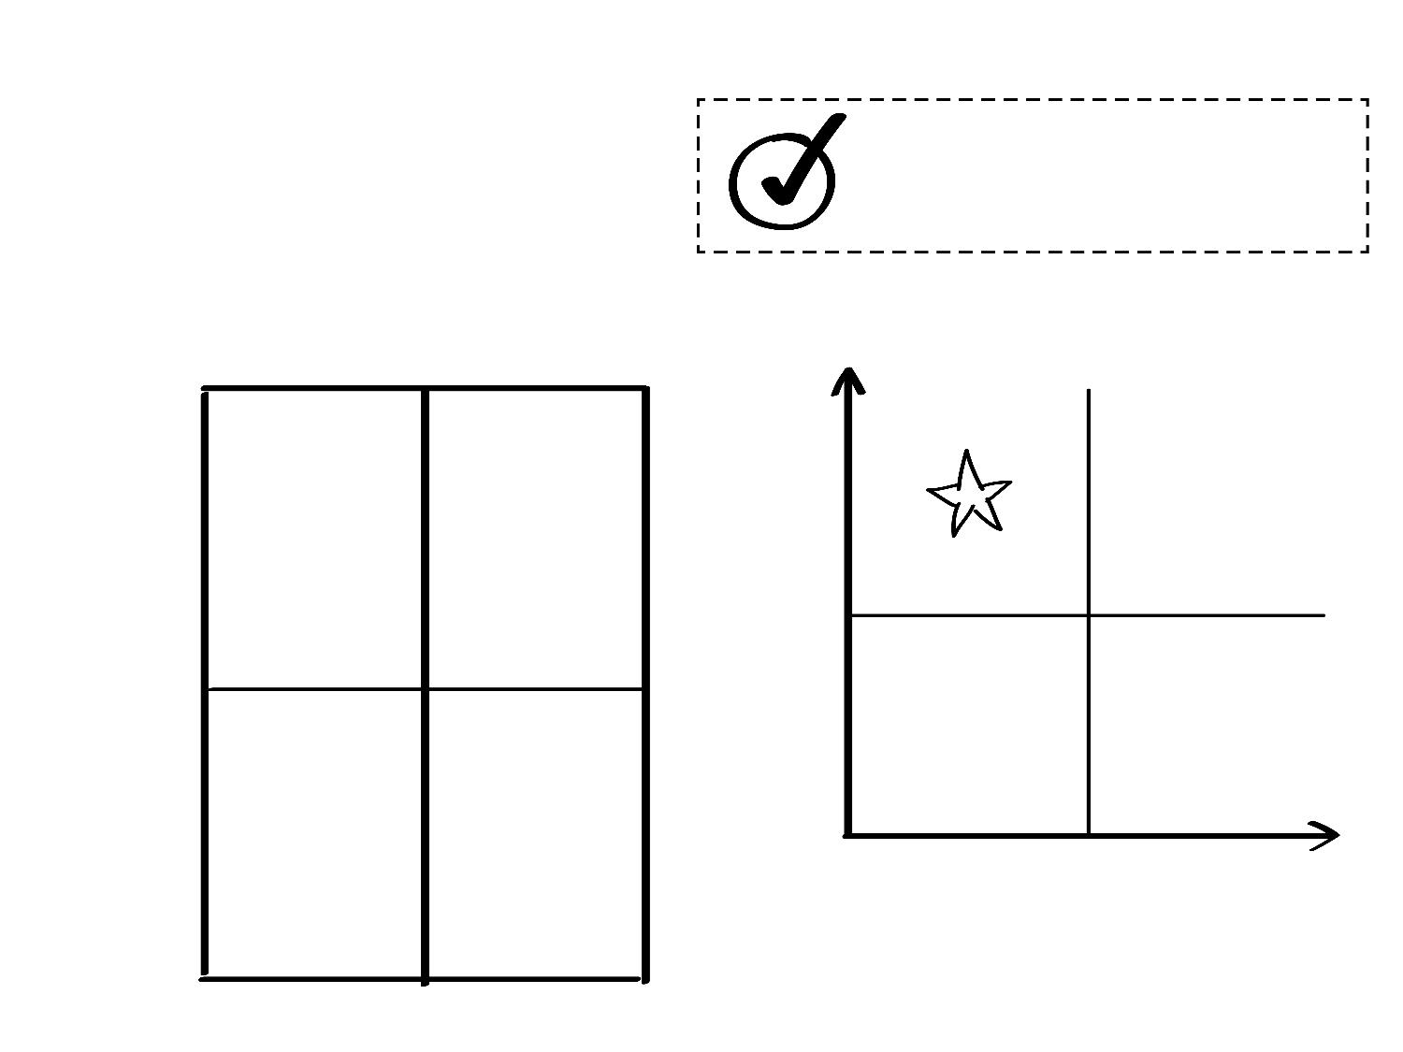
PICK A SCENARIO
NAME OF CHOSEN SCENARIO
EFFICIENCY
DISRUPTIVE
YES,
BLOCKCHAIN
HIGH
WISH LIST
VALUE
LOW
IRRELEVANT
LOW HANGING
FRUIT
NO
or
MAYBE
LOW
HIGH
POTENTIAL BARRIERS
REGULATORY
POLITICAL
BUSINESS
CULTURAL
TECHNICAL
OTHER
Notes:
Start with our top 3 and evaluate which one we want to move forward with

Slide 10
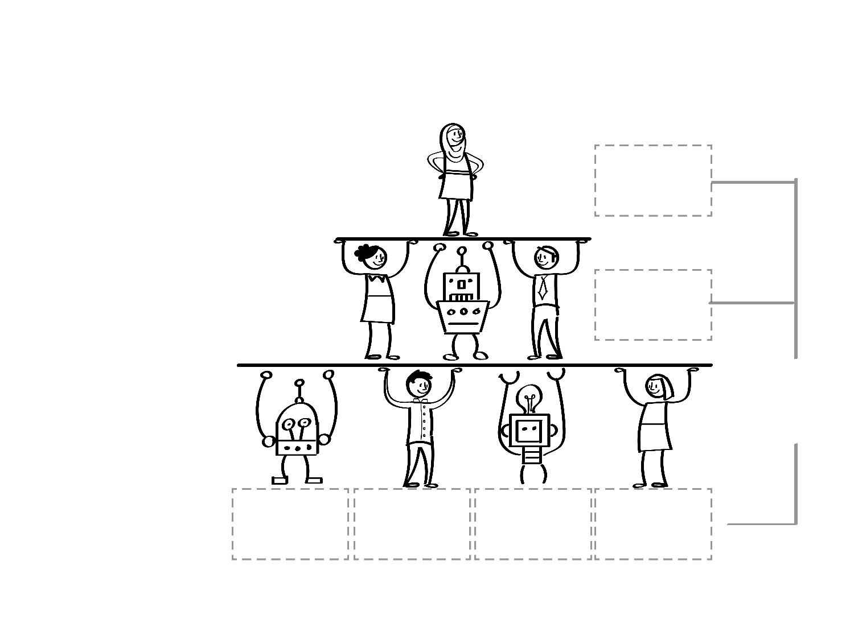
WHO ARE THE PARTICIPANTS?
YOUR
CUSTOMER
YOUR
COMPANY
(PROBABLY ONE PARTICIPANT)
Move your final participant stickies to the top row in the next poster
EXTERNAL
ECOSYSTEM
(CURRENT AND ASPIRATIONAL)

Slide 11
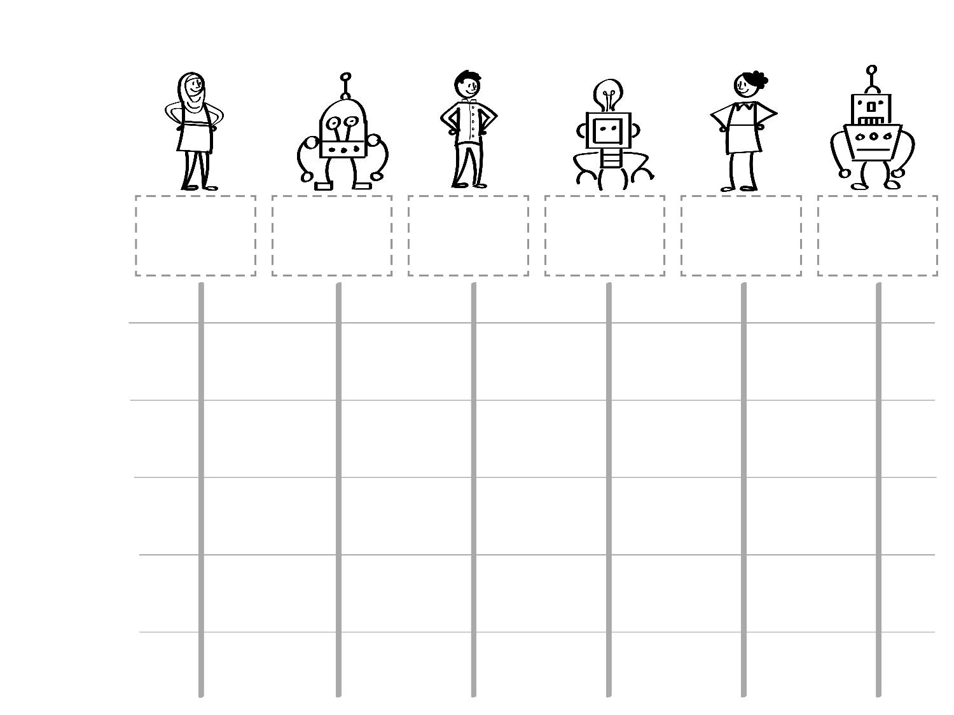
WHAT IS THE WORKFLOW?
PARTICIPANTS
WORKFLOW
STEPS
and
AGREEMENTS

Slide 12
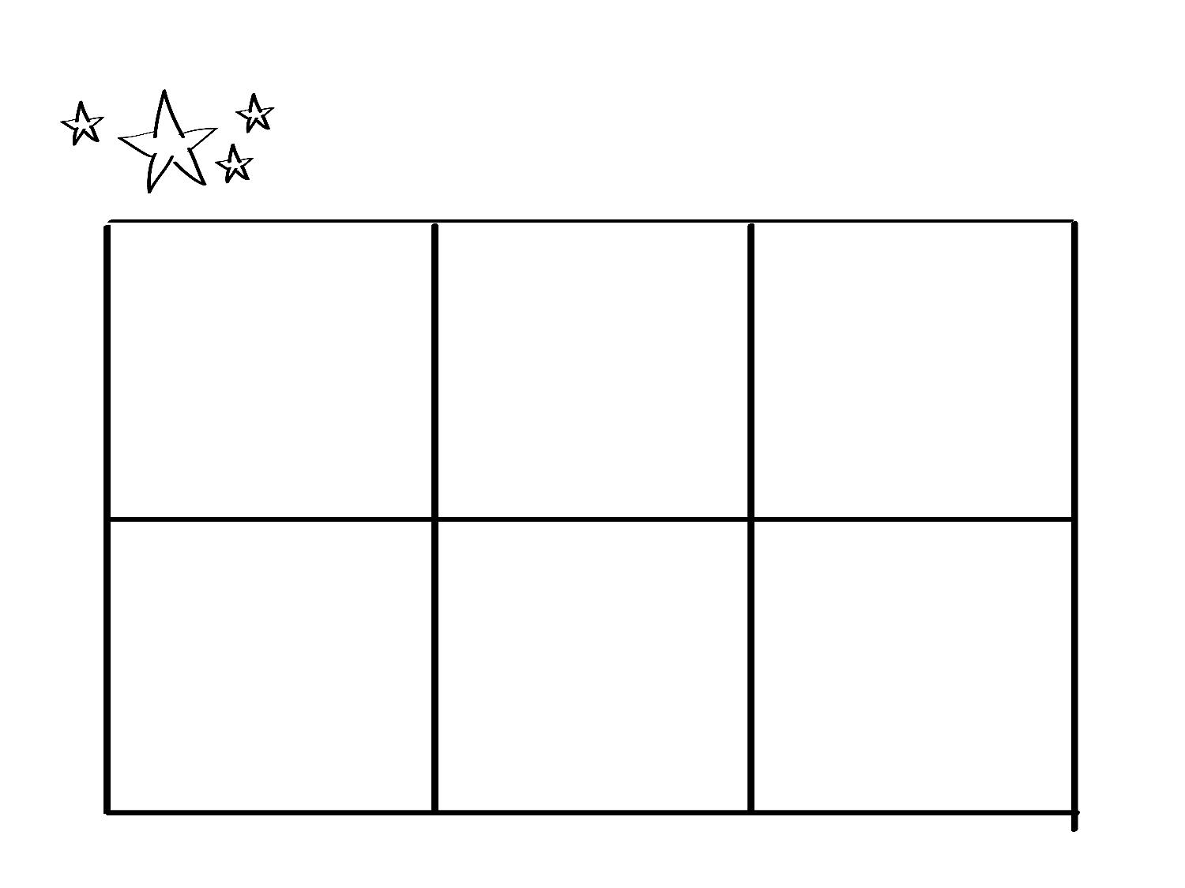
WHAT ARE THE BENEFITS?
ELIMINATE
INTERMEDIARIES
REDUCE FRAUD
DUE TO DATA INTEGRITY
REDUCE
COUNTERPARTY RISK
INCREASE
REVENUE
INCREASE
SAVINGS
OTHER

Slide 13

Iterate / Test
Phase 4

Slide 14
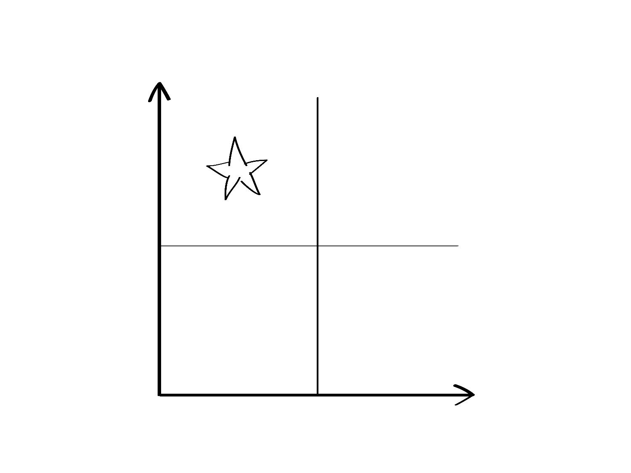
VALIDATION
HIGH
WISH LIST
VALUE
LOW
IRRELEVANT
LOW HANGING
FRUIT
LOW
HIGH
POTENTIAL BARRIERS

Slide 15
Share Ideas
Group
Notes:
Share Ideas
Have participants share their ideas to entire group

