Slide 1
Blockchain Overview

Slide 2

Blockchain is set to transform industries by digitizing trust
“…a sweeping vista of opportunity to reimagine how the financial system can and should work in the Internet era, and a catalyst to reshape that system in ways that are more powerful for individuals and businesses alike”
- Marc Andreessen, A16z
How Blockchain Can Create Owned And Trusted Health Care Records
Why 2019 May Become the Year of Enterprise Blockchain
How Blockchain Technology Could Work in the Insurance Industry
Are You Eating Sustainable Fish? Blockchain May Provide the Answer

Slide 3
Current methods of building trust add friction by design
Move from intermediaries and manual verification methods that are slow and costly…
…To a blockchain network that reduces cost, saves time, and lowers risk

Slide 4
Blockchain streamlines these processes by establishing a secure, shared source of truth
Data is stored in a ledger—
a record of every transaction
Everyone in the network has an individual, identical copy
The ledger can only be updated by network consensus, and information can’t be altered or deleted without the knowledge of the whole network.
Notes:
this is not a replica, you have “the master”

Slide 5
Not all blockchains are the same
Company A
Company B
Public Blockchain Networks:
Bitcoin, Ethereum, etc
Permissioned Blockchain Networks: Quorum (Ethereum), Hyperledger, R3 Corda
Notes:
51%
POW vs POS
supports privacy
Company A can’t see Company B’s data on the blockchain

Slide 6
Blockchain is useful when addressing specific enterprise needs
A business process crosses trust boundaries
Multiple parties work off of the same data
Intermediaries control the single source of the truth
A process involves low-value, manual verification steps
Notes:
not a replacement for a database, not a panacea
the 4 good use cases for blockchain

Slide 7
With use cases and applications spanning across industries
Manufacturing
Retail
Insurance
Banking and Capital Markets
Government
Health
Asset tracking
Real-time auction for supplier contracts
Supply chain transparency
Dynamic commodities pricing
Loyalty tracking
Product provenance
Logistics management
Digital rewards
P2P selling
Ticket purchases
Claims management
MBS/Property payments
Fraud detection
Automated underwriting
Real-time Insurance
Audit compliance
Bond Books
Trade finance
Loan syndication
Post trade settlement
Global payments
Derivatives trading
KYC/AML
Licensing and ID
Benefits distribution
Aid tracking
Military security
Copyrights
Personalized medicine
Records sharing
Compliance
Agricultural authentication
Pharmaceutical purity
Asset Transfer Provenance
Cross-Organizational Workflow
High Assurance Audit
Notes:
Golden Hammer

Slide 8
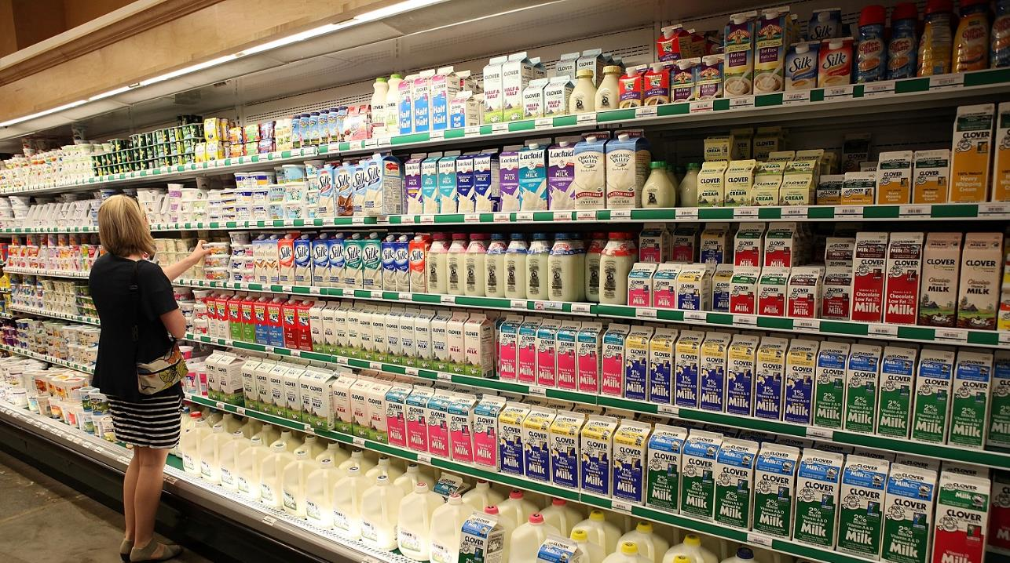
Let’s imagine a food contamination scenario
Notes:
local beef
trust
romaine lettuce

Slide 9

Who’s at fault? The producer? The carrier? The store?

Slide 10
Blockchain in Action: Refrigerated Transportation
PRODUCER
Food Processor
Milk producer supplies Milk to Food Processing Company
The milk product is sealed in an IoT enabled package for shipping
The package has to be maintained at :
Temperature < 10º C
Humidity < 65%
SMART CONTRACT
CARRIER 2
Warehouse
CARRIER 1
The terms of shipping are registered using a smart contract on the Blockchain
11ºC
66%
Retail Store
Consumer
SMART CONTRACT
UPDATED
The conditions of the contract have been violated.
Carrier 2 is liable for penalty as the temperature of the package before it reached the retail store was above the prescribed limit
SHARED LEDGER
Origin
Carrier 1
Warehouse
Carrier 2
8ºC
60%
9ºC
64%
9ºC
64%
11ºC
66%
IoT Enabled
At various points in the journey, the IoT device from the package sends the Temperature & Humidity data which are recorded on the blockchain
Notes:
smart contract: bits of code that run on the network
a state machine that can take action based on a condition
alerts can be fired

Slide 11
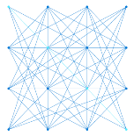
Ledger applications fit into two categories
Workflow applications
streamline cross-party workflows by automatically checking transactions against pre-agreed network rules
Exchange applications
securely track the precise exchange of asset ownership as they are traded across nonlinear paths

Slide 12
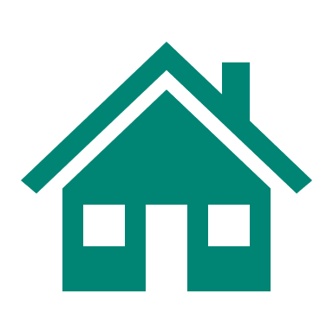
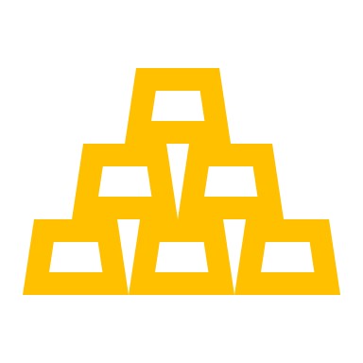

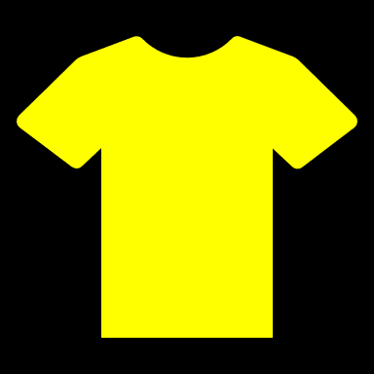



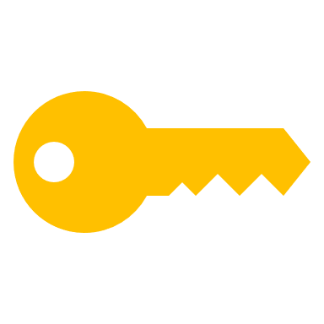
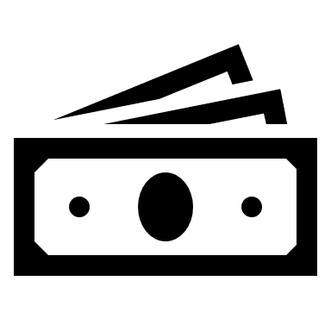

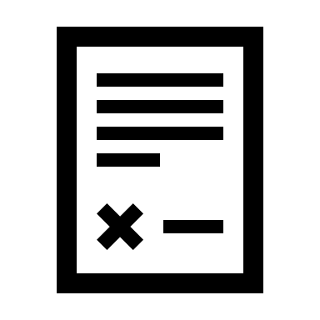
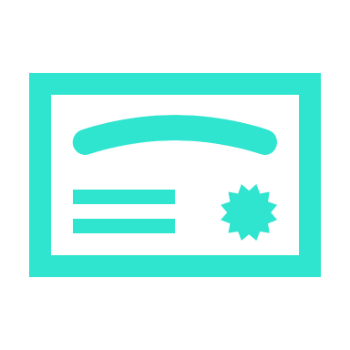
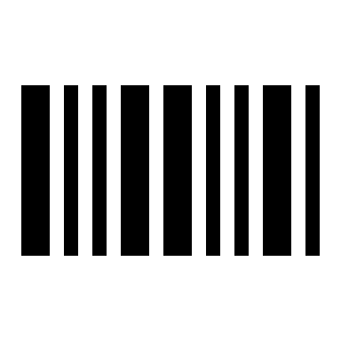
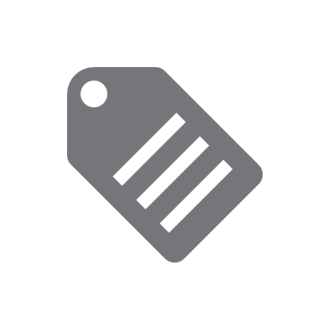

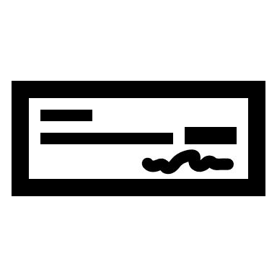
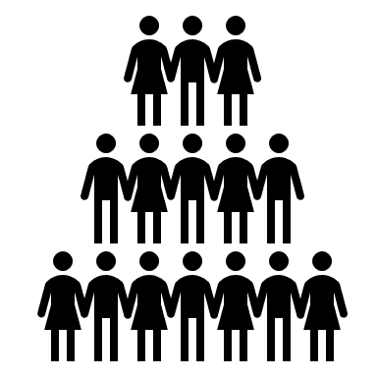
Tokens (and Token Contracts) Are Typically Used in Both
A digital representation of value that is authentic or infeasible to counterfeit, in which ownership is proven and the transfer of value secured using cryptography and a shared database that is trusted by their owners.
Value
non-fungible
fungible
Token
sub-dividable
non-fungible
non-sub-dividable
Each token has an Owner
Represented Value can be a physical or digital asset, property, proof/certificate or authorization, etc.
Token ownership can be transferred or not
Value can be fungible or non-fungible, sub-dividable or not, etc.
Notes:
token: a digital representation of some asset
digitizing assets is efficient and it makes the exchange process between owners much easier
either permanent xchange
or temporary exchange (DRM)

Slide 13
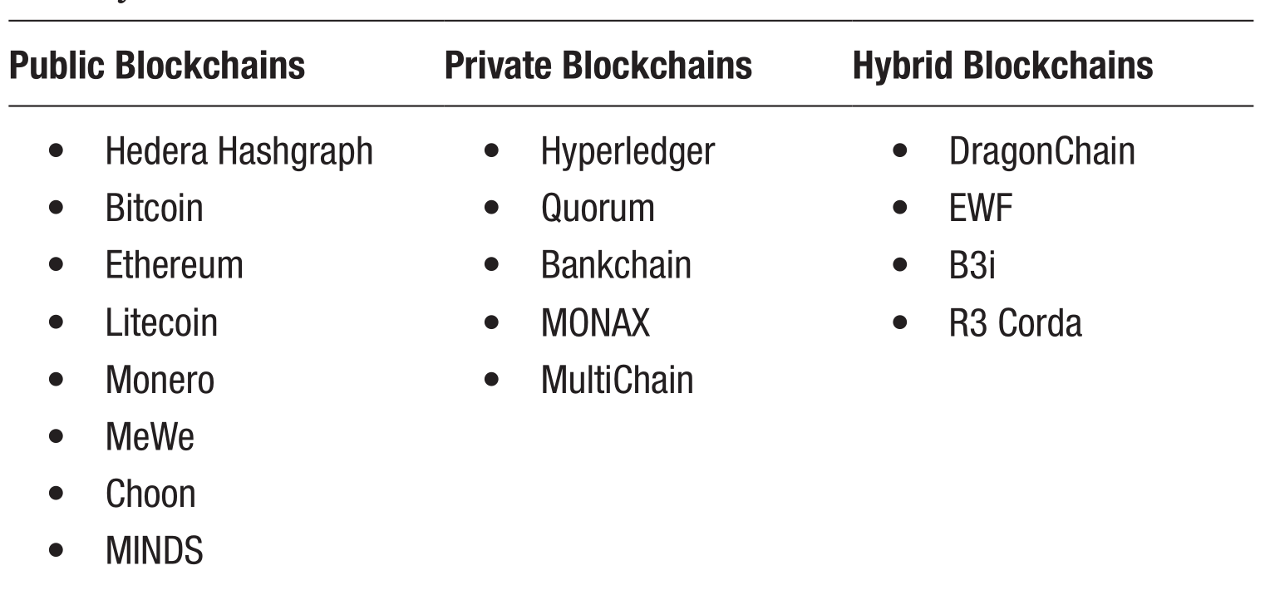
Types of Blockchains

Slide 14
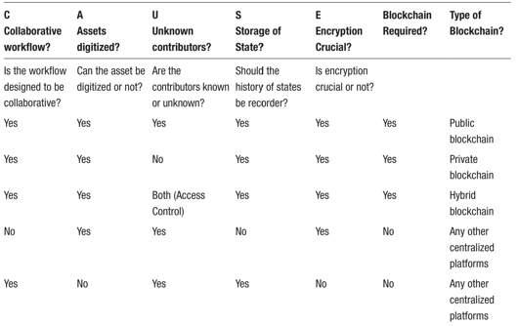
CAUSE matrix : Is blockchain a goof fit for my use case?

