Slide 1
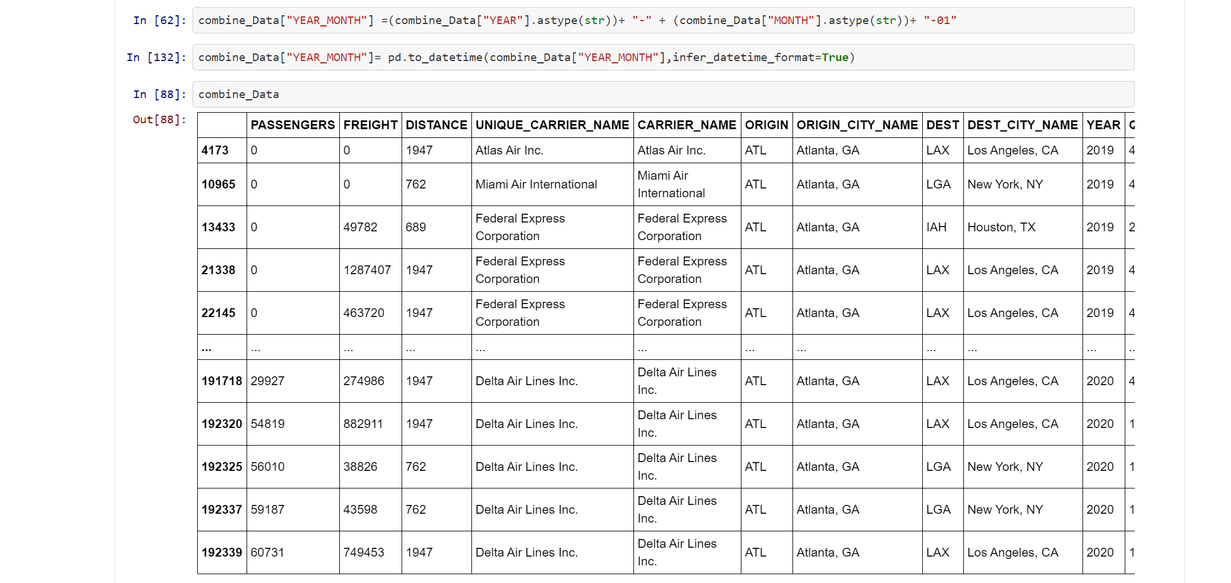
Imported data for 2019 and 2020
We used the code above to combine the data in one table to make more easer to work with when using arima

Slide 2
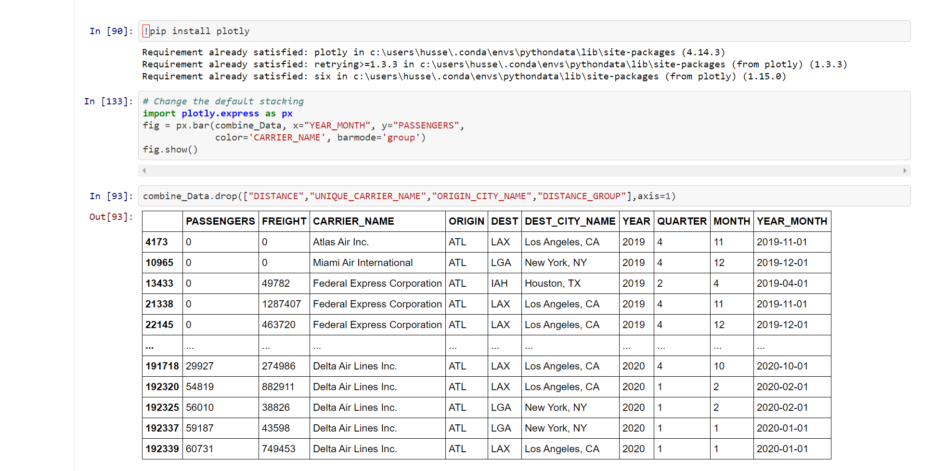
Install plotly in order to study the time analysis view chart
Filtering and cleaning the data
Combined year_month in one cell to make it easier for our data plot

Slide 3
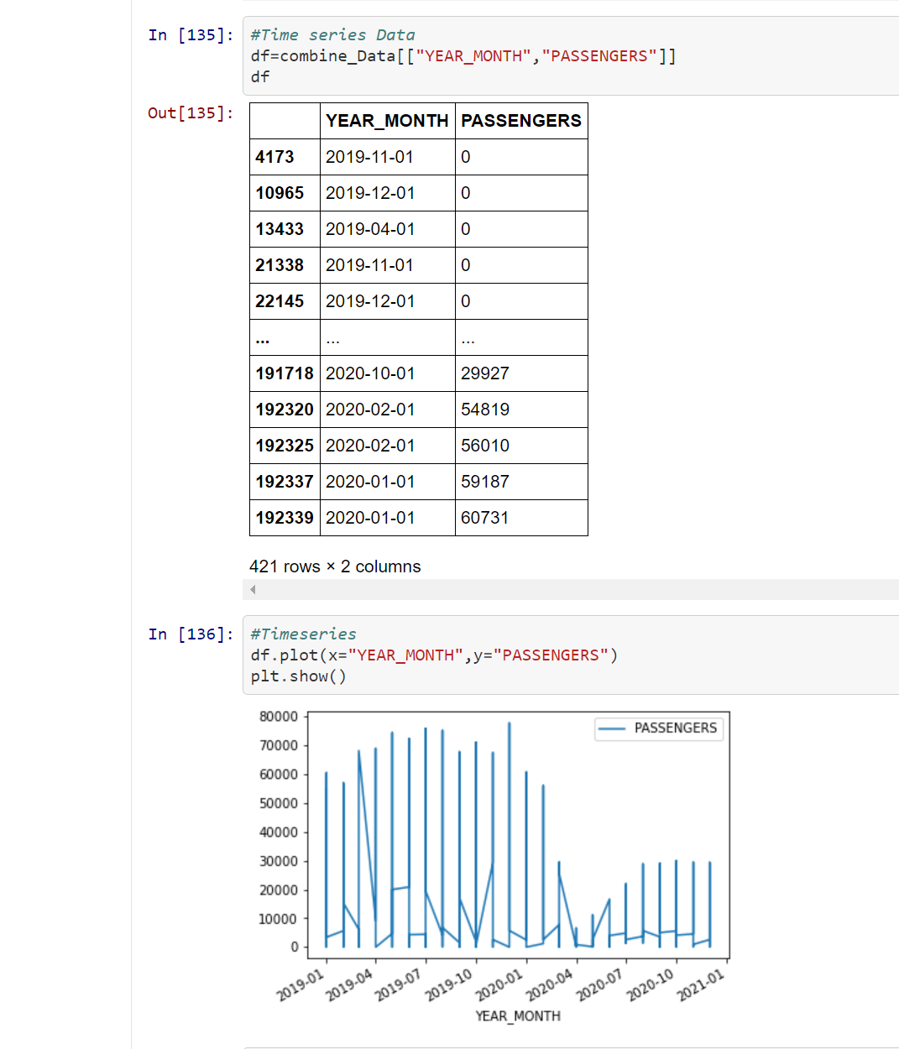
We cleaned up here according to our x-axis and y-axis to make clear for the plot so we can spot the difference between 2019-2020 ( Passenger wise )

Slide 4
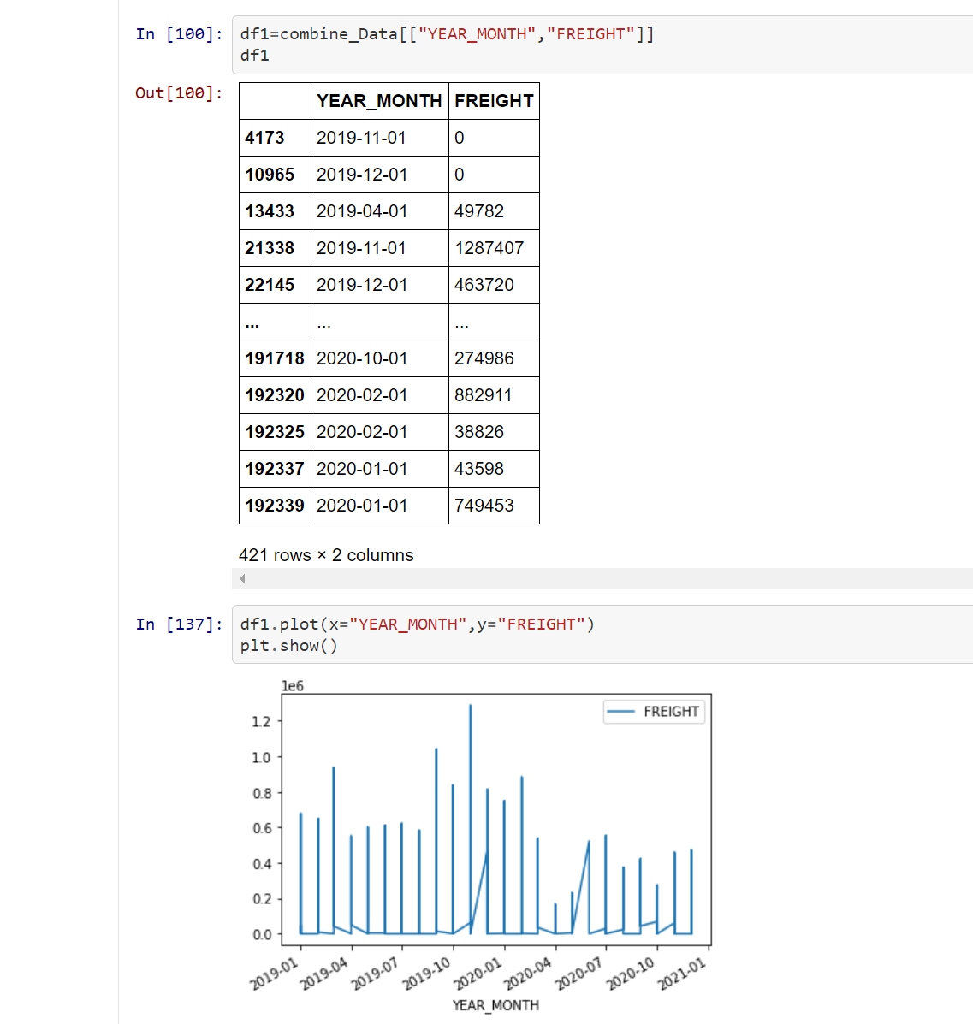
Freight Wise

Slide 5
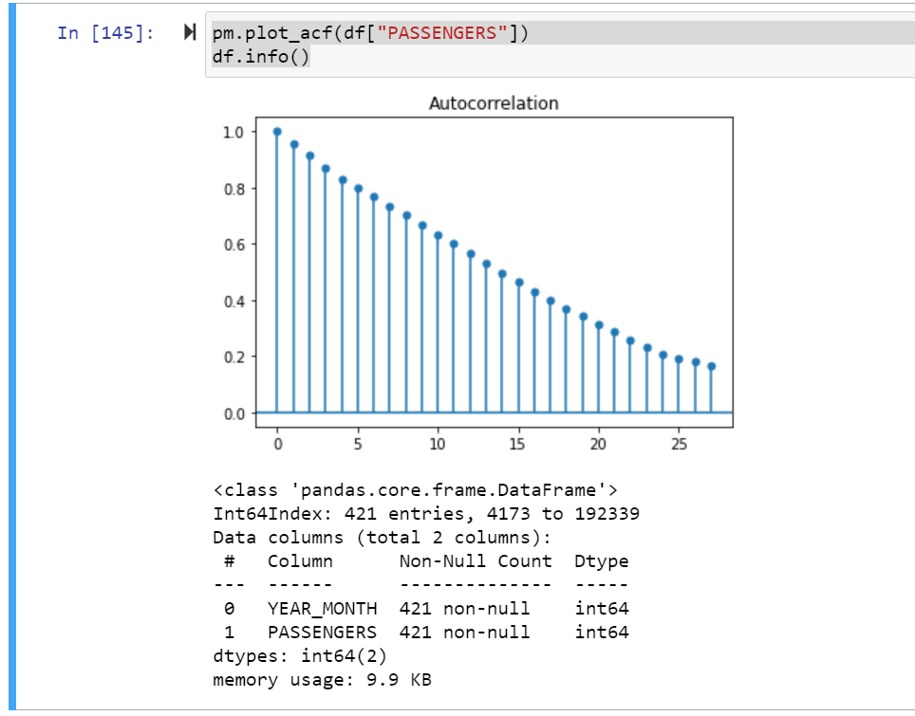
The analysis of the autocorrelation can thereby inform us about the timescale of the fluctuations.

Slide 6
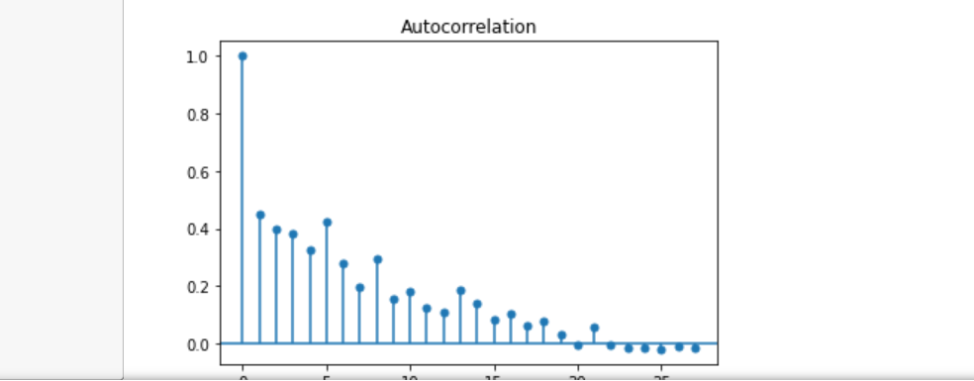
Freight Wise

Slide 7
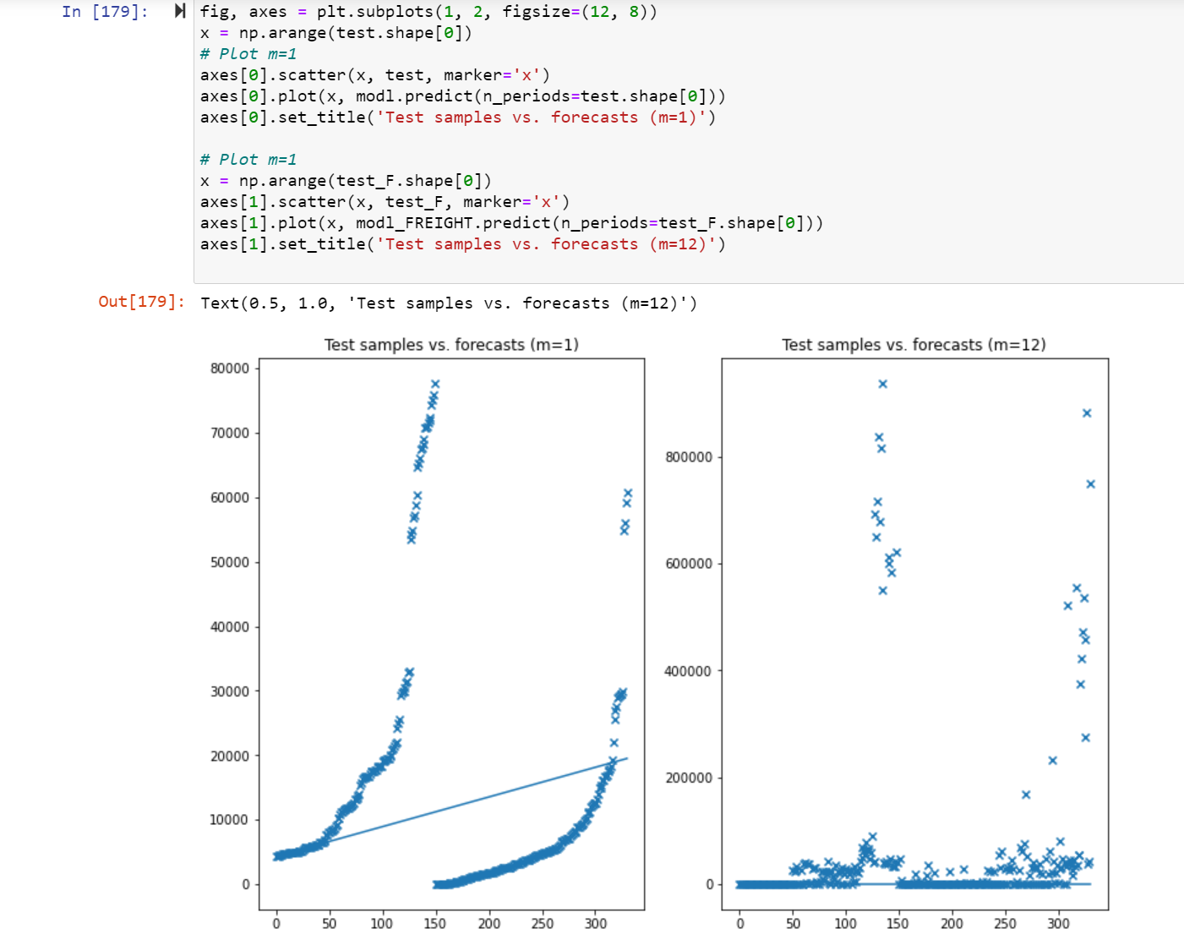
Time analysis for 2019-20 for both passengers ad freight

