Slide 1
























Budget
Time & Age
Individuals
?
Medical
Income & Assets

Slide 2




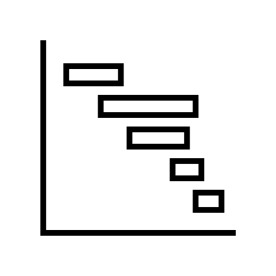



Slide 3
Assets
VEHICLES
Transportation
Budget
HOUSING
Housing
INVESTMENTS
Investments
Retire
RENTAL
Rental
Income
Legend:
tab name
tab section

Slide 4

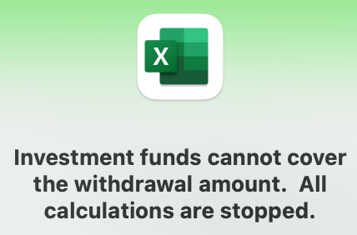
Icon clicked
Calculate for each year of retirement
Does withdrawal meet RMD amount?
Does withdrawal exceed investment balance?
Calculate
income
?
Use retirement start year values
Calculate
budget
YES
NO
?
Update retirement plan
Annual Budget
Total $
NO
Calculate
RMD
Calculate
withdrawal
YES
Investment
Before Tax
Total $
* Increment year
* Calculate inflation
* Calculate COLA(s)
* Calculate R-o-R
Adjust budget
Calculate
income taxes
Investment
After Tax
Total $
Calculate
withdrawal
?
Display message and stop calculations?
NO
YES
Does income plus withdrawal satisfy budget?
Calculate
income taxes

Slide 6



