Slide 1
























Budget
Time & Age
Individuals
?
Medical
Income & Assets

Slide 2
Assets
VEHICLES
Transportation
Budget
HOUSING
Housing
INVESTMENTS
Investments
Retire
RENTAL
Rental
Income
Legend:
tab name
tab section

Slide 3

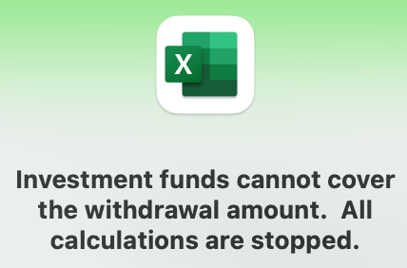
Icon clicked
Calculate for each year of retirement
Does withdrawal meet RMD amount?
Does withdrawal exceed investment balance?
Calculate
income
?
Use retirement start year values
Calculate
budget
YES
NO
?
Update retirement plan
Annual Budget
Total $
NO
Calculate
RMD
Calculate
withdrawal
YES
Investment
Before Tax
Total $
* Increment year
* Calculate inflation
* Calculate COLA(s)
* Calculate R-o-R
Adjust budget
Calculate
income taxes
Investment
After Tax
Total $
Calculate
withdrawal
?
Display message and stop calculations?
NO
YES
Does income plus withdrawal satisfy budget?
Calculate
income taxes

Slide 4
Default tabs
Welcome
Overview
Home
Individuals
Assets
Income
Budget
Retire
Useful Info
Optional tabs
Navigate to theses tabs from the above default tab
EData
Settings
TaxRates
Housing
SS Estimator
Housing
RMD
COLACPI
ImportMsg
Vehicle
TaxRates
Vehicle
LifeTables
ImportMsg
Investments
Rental
Med-Insur
TaxTables
Home tab can also navigate to these default tabs:
Rental
IRMAA
RMDTable
-Individuals
-Assets
-Income
-Budget
-Retire
-Useful Info
Calculators
Notes
Developer tabs
These tabs are only available in the Visual Basic feature whish is accessed from Excel Developer menu option.
Config
HomeChart
Export
Scenarios

Slide 5


Create logo icon with black background removed.

Slide 6




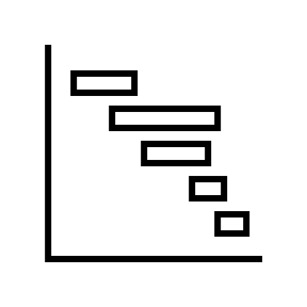



Slide 7
Transportation
Housing
Investments
Rental

