Slide 1
Goals
As much functionality as possible but without adding so much that its unachievable
Create an application that is complete and shippable
As few bugs as possible
Simple, clean interface

Slide 2

Money Cashboard

Slide 3
Planning
Mostly planned back end:
db tables
models/methods,
controllers/views
Trello Board
Class diagram
Planned the front end very early on – created wireframe diagram last Friday

Slide 4
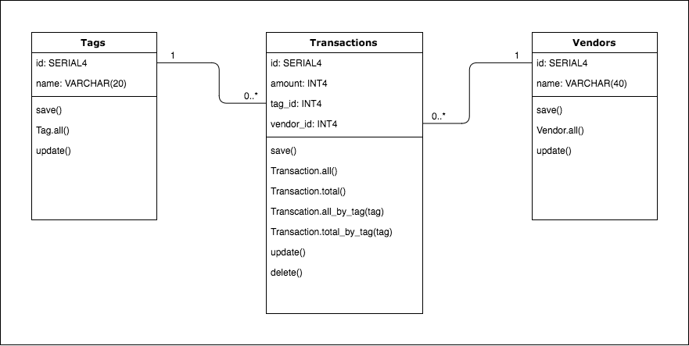
Planning – Class Diagram - Original

Slide 5
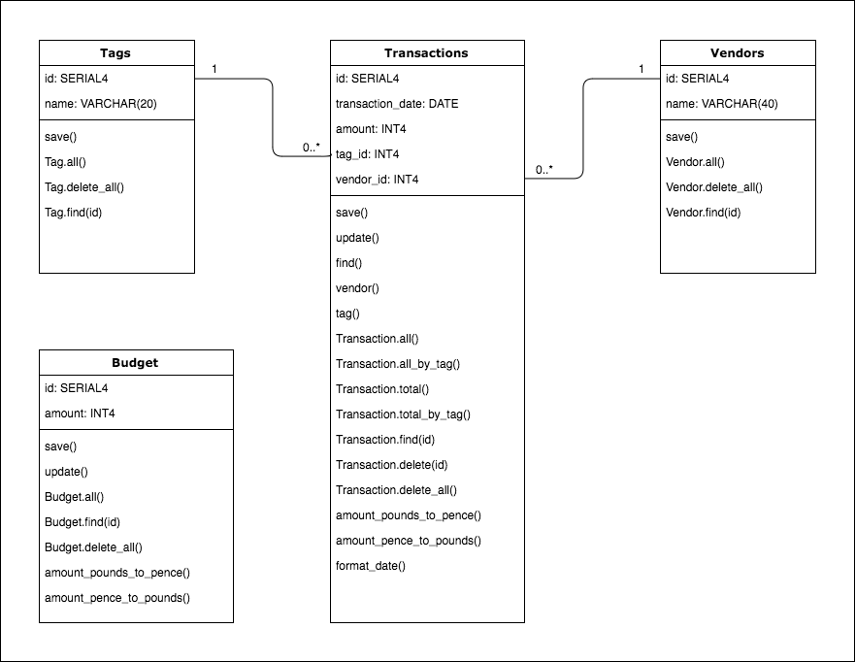
Planning – Class Diagram - Final

Slide 6
Planning – Front End
Proto_persona.pptx
User_requirements.xlsx
User_journeys.xlsx

Slide 7
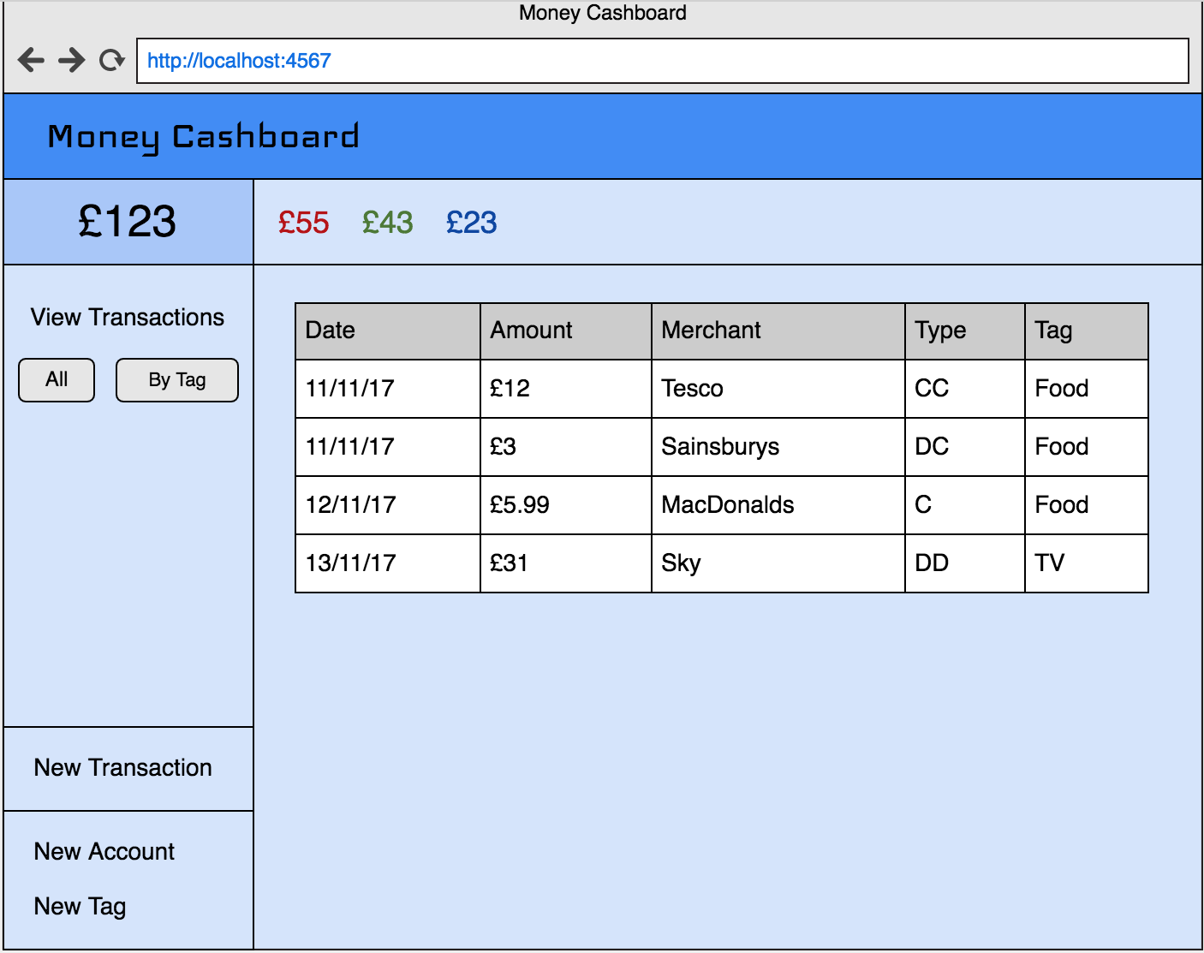
Planning – Wireframe

Slide 8
Demo
Notes:
Show switching between All Transactions and By Tag
Point out total in header
Show adding new transaction (mention: amount in pounds in UI and saves in db in pence)
Show adding new tag and it appears on nav bar (in alphabetical order)
Show editing budget amount and resulting warning and header total changes to red

Slide 9
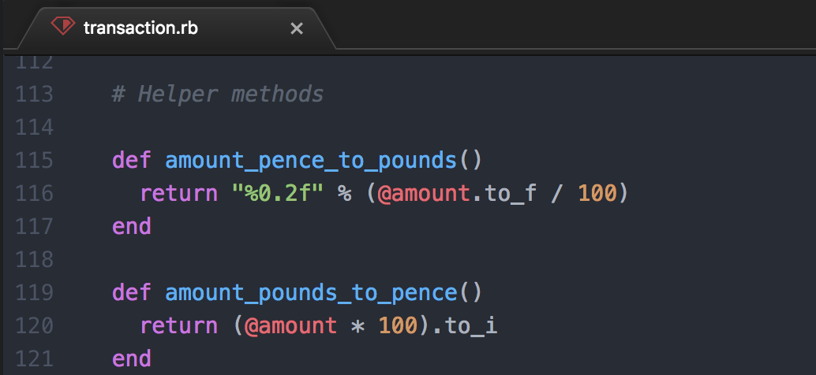
Explain Code – Amount Conversion - Methods

Slide 10
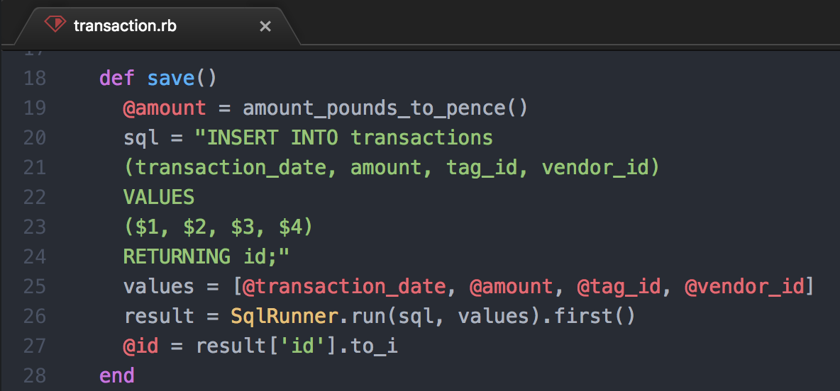
Explain Code – Amount Conversion - Save

Slide 11
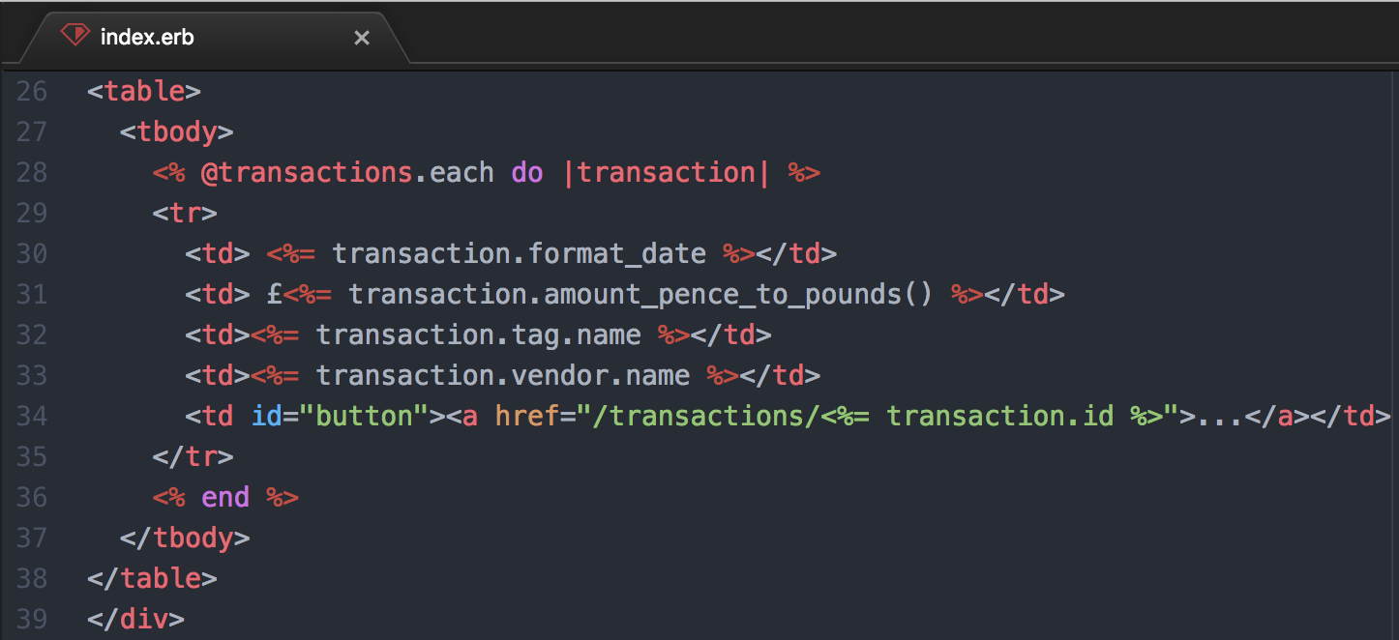
Explain Code – Amount Conversion - View

Slide 12
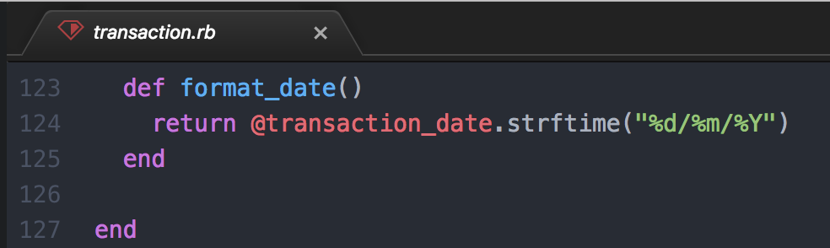
Explain Code – Date Conversion - Method

Slide 13
Explain Code – Date Conversion - View

Slide 14
Improvements
Helper methods (converting pounds/pence & pence/pounds) are duplicated in two models – need to refactor to move them into a separate helper class
Need to improve how the website responds to resizing the browser
Add multiple budgets
Add accounts

Slide 15
Learning Points
Planning is key
Planning the models, methods, controllers, views etc.
Having a clear vision of what the app should look like in the UI
I need to get more outside my comfort zone in the next project (focus more on back end code)
Sinatra is picky about ( ) in erb tags.
This works:
<%= (Transaction.total.to_f() /100) %>
This doesn’t!:
<%= (Transaction.total.to_f /100) %>

