Slide 1
TrueCourse
By: David Medvedev

Slide 2
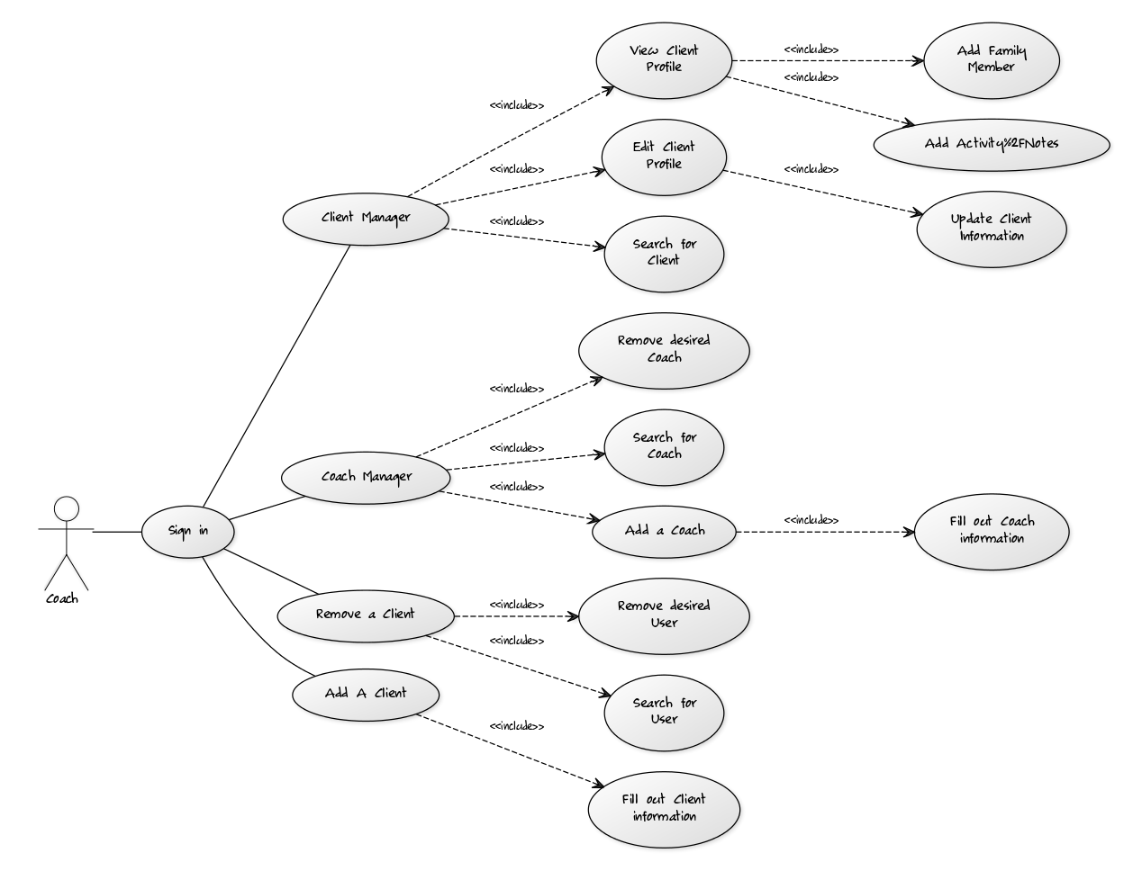
UML Diagram

Slide 3
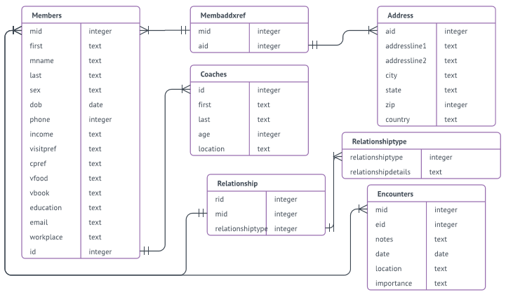
Entity Relationship Diagram

Slide 4
ERD: Members Table
PK: mid – Member’s ID Number
FK: coaches.id – Coach’s ID Number

Slide 5
ERD: Coach Table
PK: id – Coach’s ID Number

Slide 6
ERD: Address Table
PK: aid – Address ID Number

Slide 7
ERD: Member/Address Reference Table
FK: address.aid – Address ID Number
FK: members.mid – Member’s ID Number

Slide 8
ERD: Relationship Table
PK: rid – Relationship ID Number
FK: members.mid – Member’s ID Number
FK: relationshiptype – Relationship Table Reference

Slide 9
ERD: Relationship Type Table
PK: relationshiptype – Relationship Type ID Reference

Slide 10
ERD: Encounters Table
PK: eid – Encounter Instance ID
FK: members.mid – Members ID Number

