Slide 1

Enterprise-Friendly AKS (Azure Kubernetes Service)
🏢 + ☁️ + 🤓 + 🚢 =💰

Slide 2

About Dave

Slide 3
Level set expectations
Based on my experience working with Enterprises using Kubernetes
Assume demos are not production-ready
All code and this presentation are on GitHub
Not all suggestions limited to AKS
I’m not a certified security pro
We’re not going to solve multitenancy problems with Kubernetes
We will dive into some areas, but not all
Automation is a given!

Slide 4
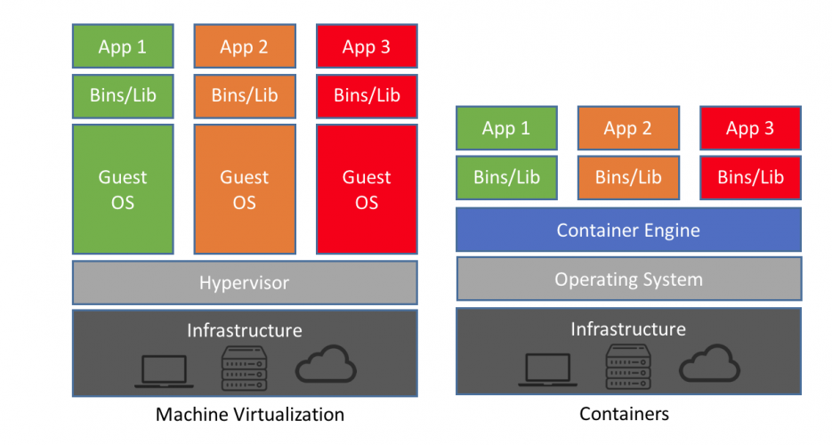
Quick Review: Containers
Image shamelessly taken from https://blog.netapp.com/blogs/containers-vs-vms/

Slide 5
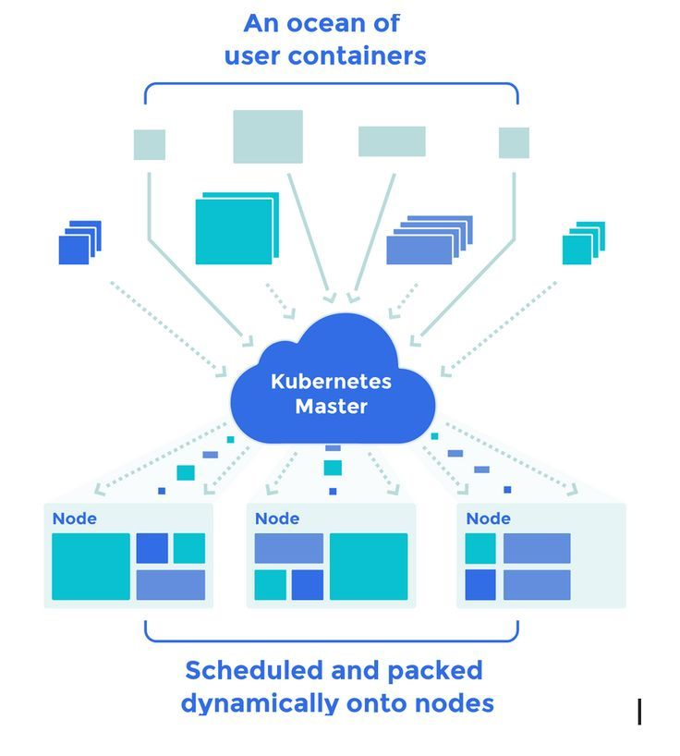
Quick Review: Container Orchestrator e.g. Kubernetes
Image shamelessly taken from Pinterest where it was not credited to the original author ☹
orchestrator

Slide 6
What is it?
Kubernetes is a container orchestrator
Azure Kubernetes Service is Kubernetes platform-as-a-service
Compare with:
Google Kubernetes Engine (GKE) on Google Cloud Platform
Elastic Kubernetes Service (EKS) on Amazon Web Services

Slide 7
Why use Kubernetes
Because everybody else is? 🙄
Containers are great, but hard to deploy and manage on their own
It’s a common platform across clouds and datacenters
API driven and extensible
Helps solve problems with microservice-based applications
Cool new patterns and architectures
Immutable deployments encourage “shipping” 🚢
It’s fun to say “Kubernetes”
https://twitter.com/jamie_gaskins/status/1202529073739776000

Slide 8
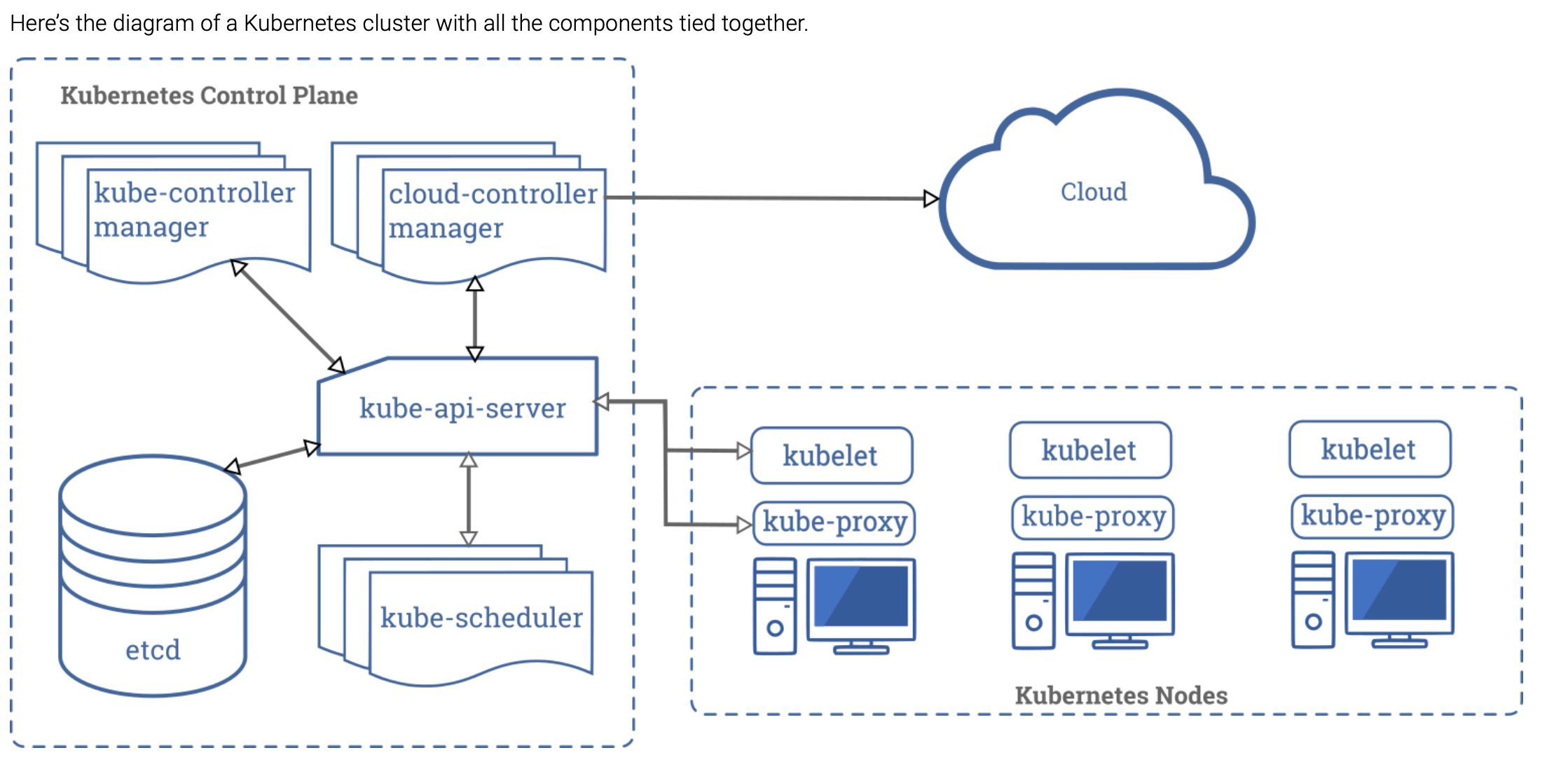
Kubernetes Architecture
https://kubernetes.io/docs/concepts/overview/components/#kubelet

Slide 9
Why use AKS
Kubernetes is hard to setup and manage
https://github.com/kelseyhightower/kubernetes-the-hard-way
Shifts the burden of management to Azure but gives you control
Node updates (kubelet)
Version upgrades
https://github.com/kubernetes/kubernetes/releases
No charge for controller nodes
Integrations with Azure (more to come on that)
Scale out with Azure Container Instances (ACI)

Slide 10
What do Enterprises Want?
Security 🔐
Accountability 🔎
Cost Controls 💰
Governance/Compliance ☂️
Business Continuity and Disaster Recovery 🔥

Slide 11
Security 🔐
* I’m not a security expert

Slide 12
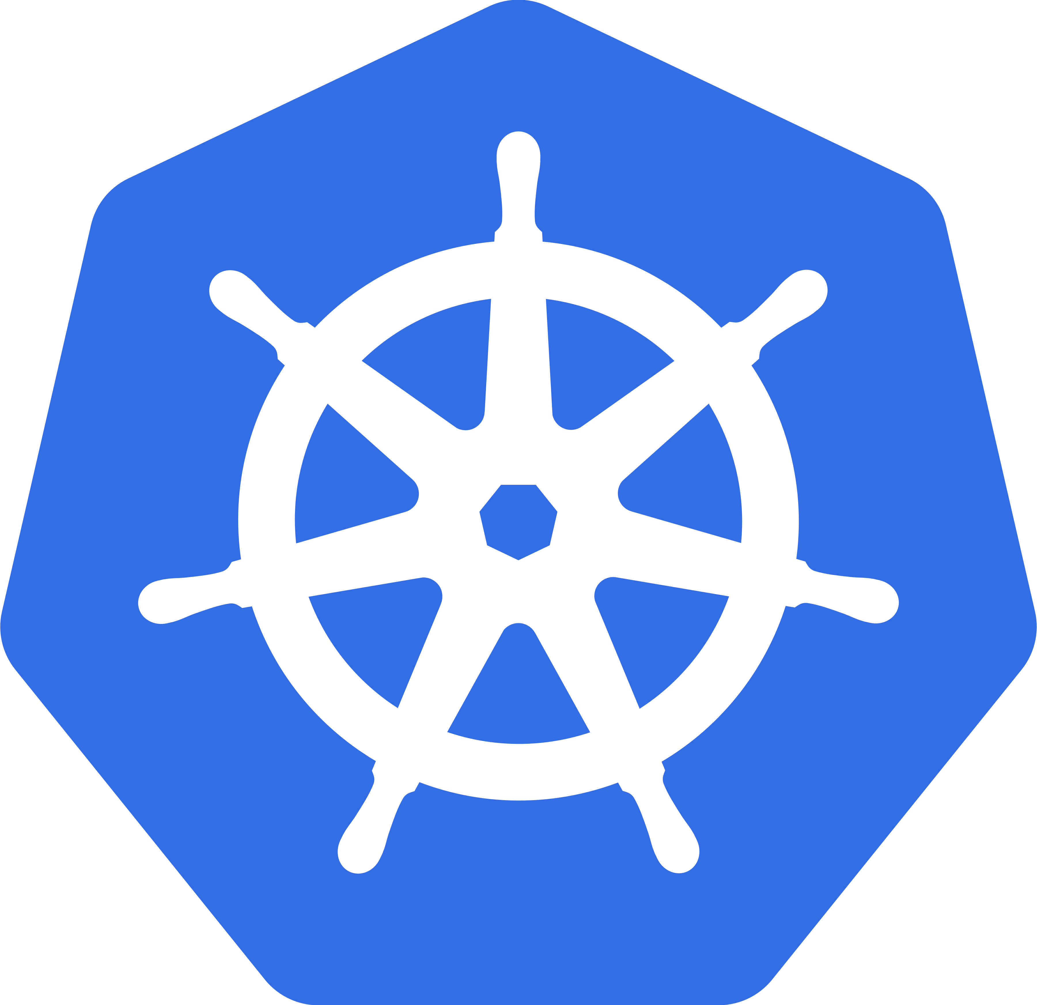
One (HA) Cluster per Tenant
Hard multitenancy in Kubernetes is still in development (Spring 2020)
Kubernetes Multitenancy Working Group
https://blog.jessfraz.com/post/hard-multi-tenancy-in-kubernetes/
Assume one cluster (or HA pair+ of clusters) per tenant
Isolate Production cluster(s)
Product A
develop
Product A
production
Product B
develop
Product B
production

Slide 13


Integrate Kubernetes with Azure Active Directory
Product A
develop
Product A
production
Authorization
Authentication
AAD Integration
Notes:
Demo login flow

Slide 14
Integrate Kubernetes with Azure Active Directory
Enable Kubernetes Role-Based Access Controls (RBAC) at cluster build time
Leverage the built-in Azure Roles to restrict access to a cluster
Understand the difference between the built-in Cluster Admin role and the built-in Cluster-User role
The kubectl plugin manages the login workflow
AKS AADv2 is in preview
Notes:
az role definition list --query "[?contains(roleName, 'Azure Kubernetes Service')]" -o table
az role assignment create --role "Azure Kubernetes Service Cluster User Role" --assignee-object-id $(az ad user list --query "[?contains(displayName, 'Product')].objectId" -o tsv)

Slide 15


Kubernetes RBAC
Product A Cluster
Namespace A
Namespace B
Namespace C
Namespace D
admin

Slide 16
Kubernetes RBAC
Kubernetes has built-in roles too!
Kubernetes Namespaces are a nice security boundary (within your single tenant!)
ClusterRoles can be bound to a namespace for simple reusability
Azure Active Directory objects (users, groups, and service principals*) can be bound to Kubernetes roles

Slide 17
Built-in Kubernetes ClusterRoles
Role | Description
cluster-admin | Full Access Admin
admin | Namespace Admin. Can create roles within the namespace
edit | Can run pods, access secrets, API access within namespace
view | Cannot view secrets

Slide 18
RoleBindings
Kubernetes RoleBindings join a Role or a ClusterRole with a subject
Subjects can users, groups, or service accounts
AAD Object IDs can be mapped as subjects when RBAC is enabled

Slide 19
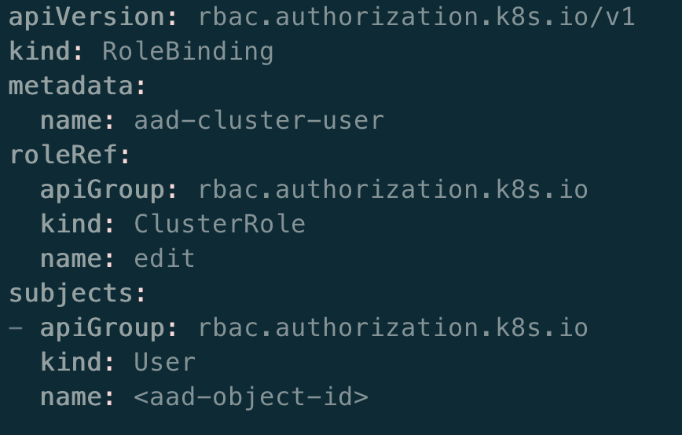
Bind an AAD Object to Kubernetes

Slide 20
Integrate Kubernetes with Azure Active Directory
Product A Cluster
A
B
D
Authorization
Authentication
AAD Integration
Notes:
Demo login flow

Slide 21
Restrict Public Access
Use private cluster feature
Enable Cluster Networking Interface (CNI)
Set API server authorized IP ranges when building the cluster
[Kubernetes] Configure NetworkPolicy manifests to restrict ingress to certain namespaces and labels
Restrict egress traffic
https://docs.microsoft.com/en-us/azure/aks/limit-egress-traffic

Slide 22

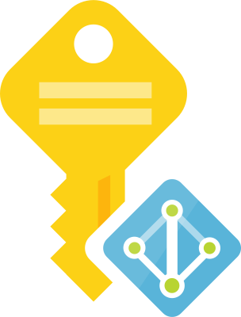
Pod Identities (simplified)
Product A Cluster
Pod
Authorization
Cosmos DB
Retrieve MSI Token
Identity Broker (NMI)

Slide 23
Additional Information
AKS nodes are hardened
Underlying VM hosts are patched daily
You have to reboot your nodes to get those patches

Slide 24
Accountability 🔎

Slide 25
RBAC integration with AAD
kubctl authentication flow forces logins through single sign on portal
Sign-on events are logged in Azure

Slide 26
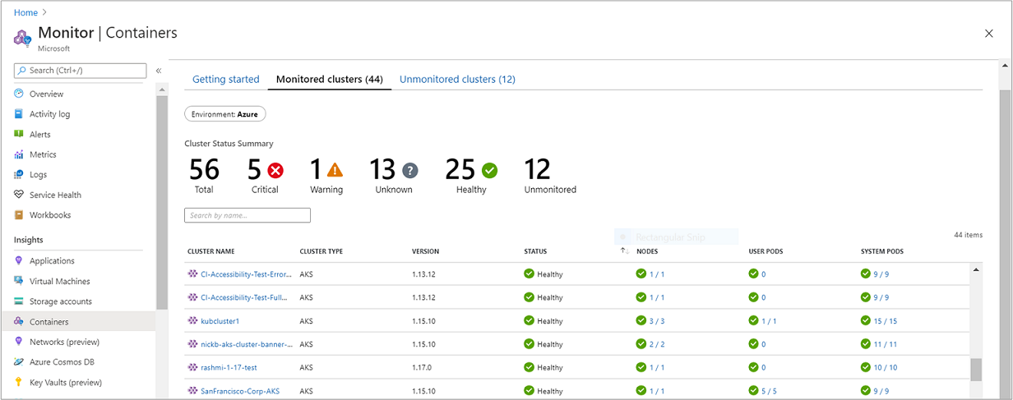
Azure Monitor
Leverage Azure Monitor for Containers
Collect metrics from nodes, clusters, and inventory
Capture stdout/stderr from running containers
Configure Azure alerts for pods using Kubernetes Liveness, Readiness, and Startup Probes

Slide 27
Cost Controls 💰

Slide 28
Benefits of AKS
You don’t pay for master nodes
You don’t have to manage kubelet nodes
You can size your kubelet nodes as you want
Specify minimum number of nodes you want in a cluster
Scale out/in to meet demand
Kubernetes will optimize the use of your nodes (unused CPU means wasted money!)

Slide 29
Scaling
Enable Azure Container Instances (ACI) to horizontally scale your AKS clusters in or out to meet burst demand
Group AKS nodes into nodepools
Manually scale up AKS nodepool VM SKUs

Slide 30
Governance/Compliance ☂️

Slide 31
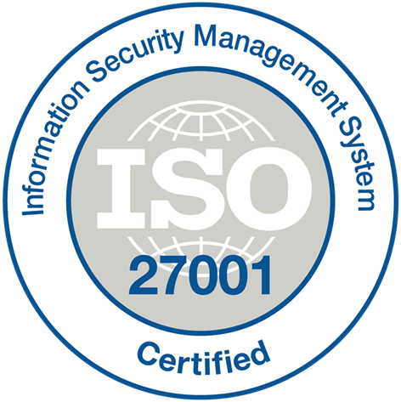
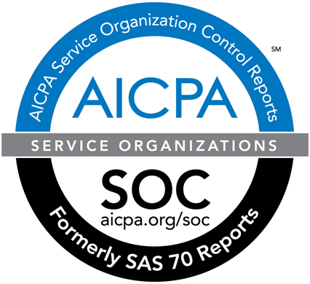



AKS Node Compliance
Compliant with SOC, ISO, PCI, PCI DSS, and HIPAA standards
ISO 27001
SOC 1 Type 2
SOC 2 Type 2
PCI DSS Level 1
HIPAA/ HITECH
ISO 27018

Slide 32
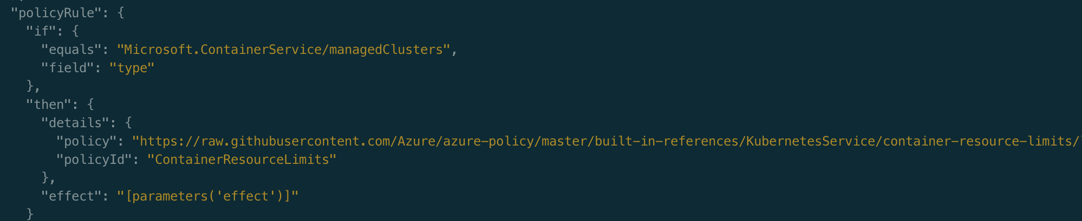
Azure Policy
AKS can be governed with Azure Policy
Restrict region(s) where clusters can be deployed
Restrict the VM sizes for the Kubernetes nodes
Limit network connectivity from the public internet

Slide 33
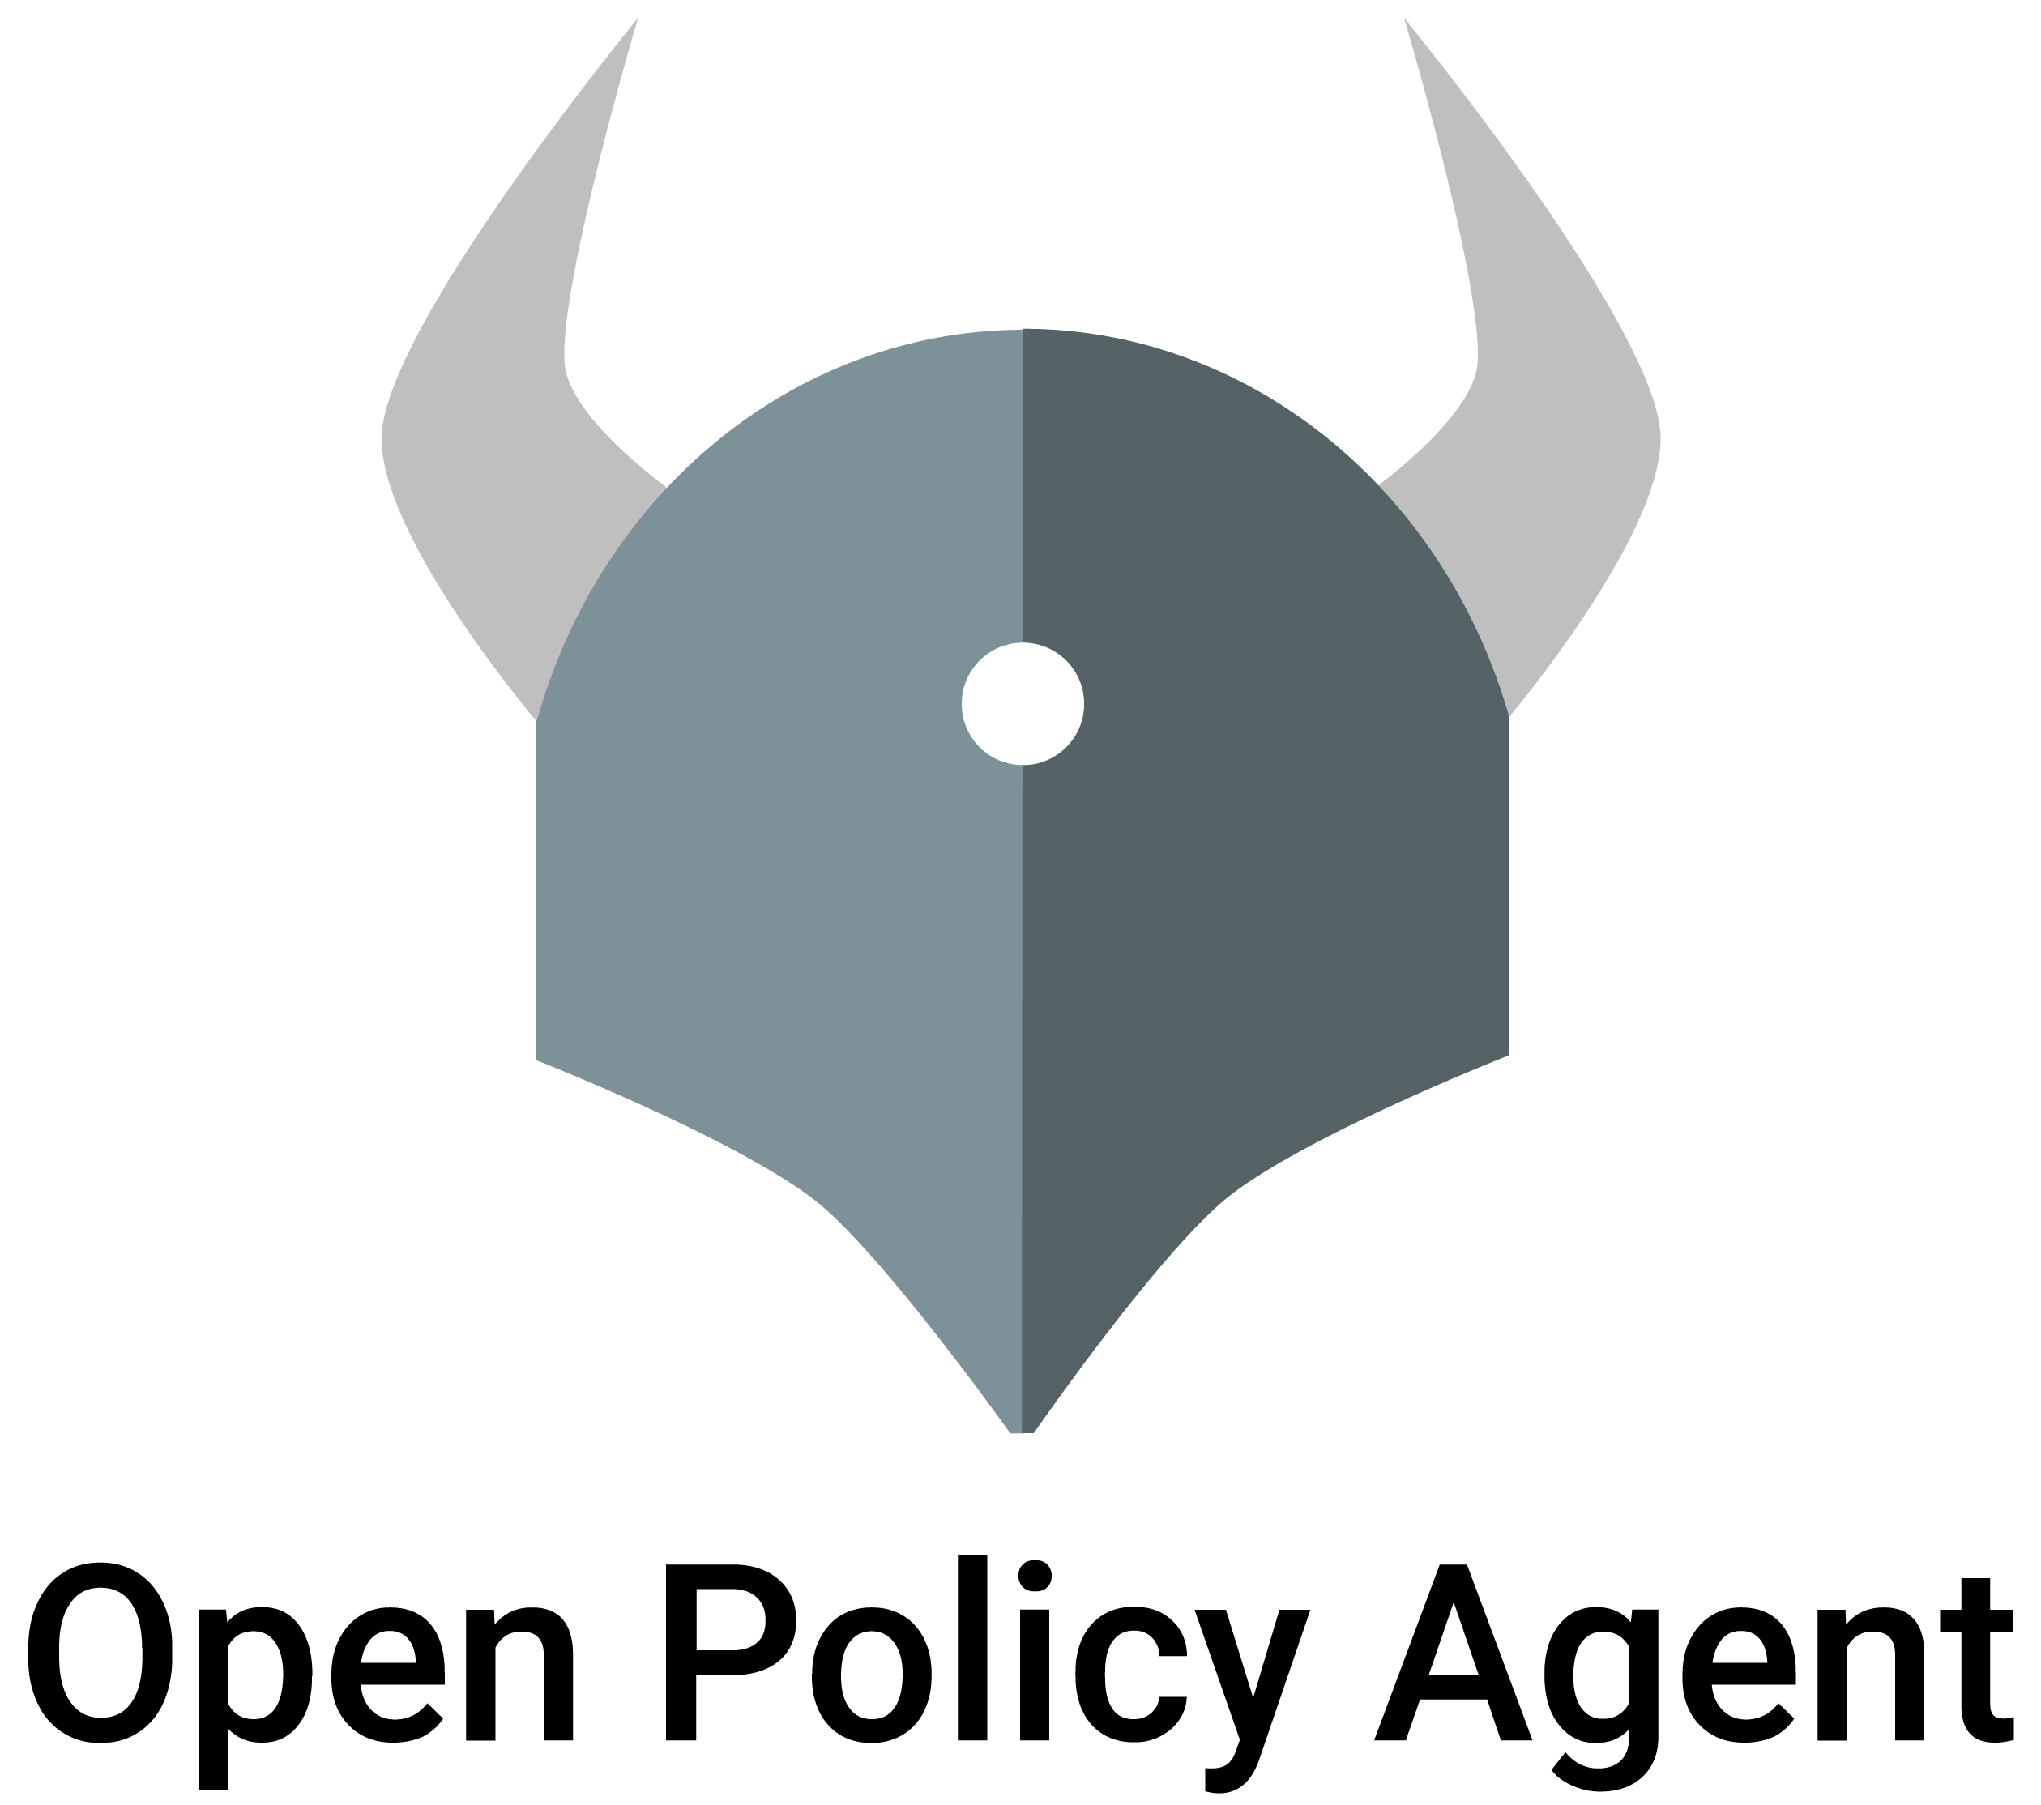
Open Policy Agent for Kubernetes
Kubernetes can enforce policies via the Open Policy Agent
The AKS-specific implementation of this (in preview) is called Azure Policy for Kubernetes
Enforce pod specifications at deployment time
Policies are portable
https://www.openpolicyagent.org

Slide 34
Business Continuity and Disaster Recovery 🔥

Slide 35
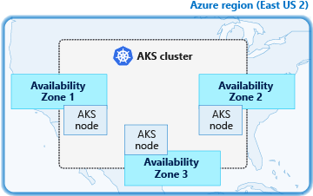
Use Availability Zones

Slide 36

Deploy Clusters in Multiple Regions
East US
Product A
production
from internet
Central US
Traffic Manager
Product A
production

Slide 37
But what about persistent data?
Kubernetes deployments are immutable, which encourages rapid deployment frequency… persistent data does not
Externalize state/data from your containers to reduce mean-time-to-recovery of your container-based services
Leverage globally replicated cloud services to persist data – Azure Files, Cosmos DB, etc.
Let those cloud services handle the data replication and backups/snapshots

Slide 38
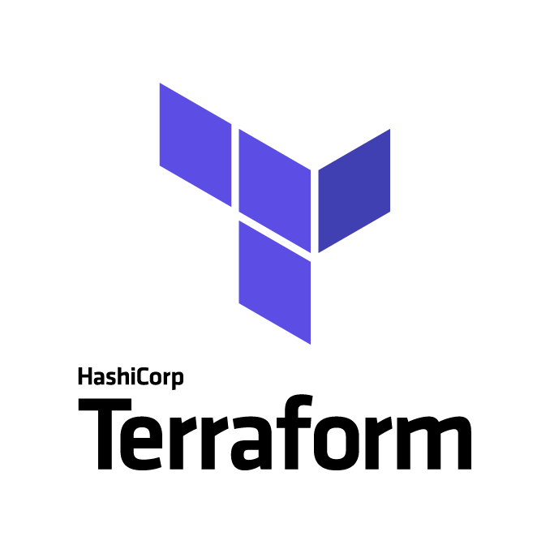
Automate AKS deployments
Terraform supports AKS via the Azure provider
Reduce mean-time-to-recovery and lead time to production
Increase operational excellence
Accelerate operations

Slide 39
Resources 📚

Slide 40
Resources
GitHub Repository for this presentation and accompanying material: https://github.com/daveyb/coazure-enterprise-friendly-aks
Azure AKS Documentation (US): https://docs.microsoft.com/en-us/azure/aks/

Slide 41
Thanks!

