Slide 1
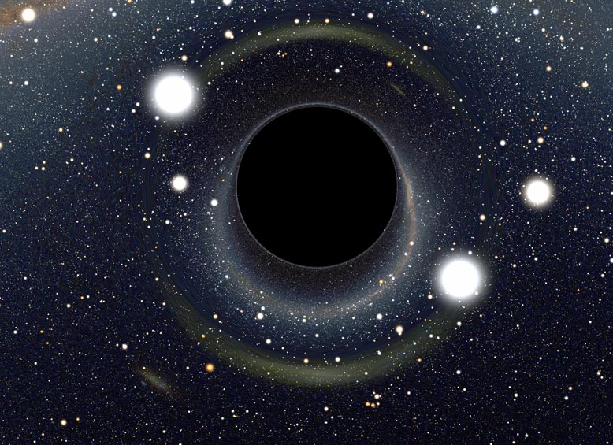
A255: Research Methods in Astrophysics
Seeing the Invisible: stellar mass black hole detection via optical spectroscopy
David W. Proctor

Slide 2
Introduction: Stellar Mass Black Holes in the Milky Way
In regions where stars form, 0.5% of stars are sufficiently massive to turn into a black hole.
In the Milky Way, we see 1x10^9 low mass stars with masses less than 0.5 Msun.
In regions where stars are currently forming, 70% of stars have masses less than 0.5 Msun whose lifetimes are longer than the age of the Universe.

Slide 3
Estimate Number BH in Milky Way
And yet we only have observed 20 stellar mass black holes, all of which we discovered from X-ray emission as they sucked in energy from stars.
The number observed is so much lower than that predicted due to the difficulty of detecting black holes.
Close star-BH binaries are extremely rare.
Micro-lensing of background stars around a BH requires a precise combination of known background star and spotted black hole.
Very rarely, BHs emit ‘gamma-ray bursts’ but we don’t know how/when these happen.
Determining the mass of an unseen companion orbiting a star is another option we have.
Finding such a black hole would give us another detection method besides x-rays.
If we are able to find more BHs, we can drill down on this estimate and have a better picture of our visible, and invisible, universe.

Slide 4
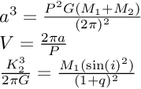
The Process
Part one of the process will be to analyze optical spectral data from a nearby star at five times over the course of a month. If the star is orbiting a massive body, its motion (which we’ll detect from a red shift) will be sinusoidal and described by Kepler’s laws.
The three parameters we need to secure are the mass of the star, the velocity of the star, and its period of orbit. From there, the mass of the black hole can be solved for.
In part two, we’ll question: how did we get this beautiful spectral data? We will go through a few of the key data reduction steps, moving from raw CCD data to a full wavelength -> flux profile like you’re about to see.
Kepler’s Laws let us solve for M_2 if we know M_1, V, and the period.

Slide 5
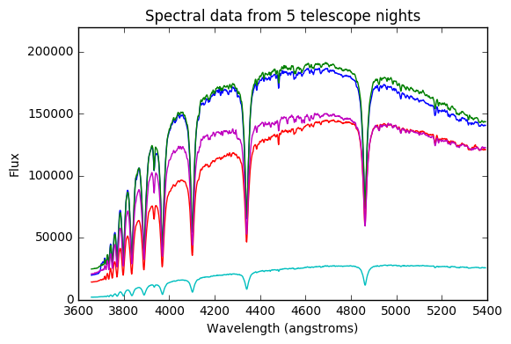
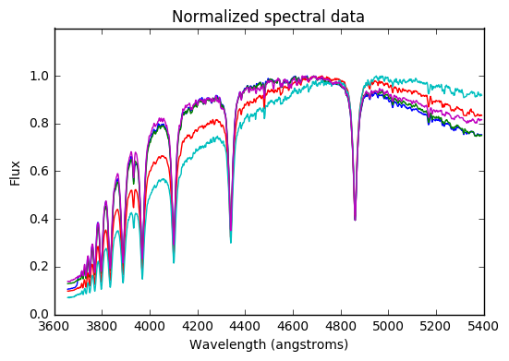
The Spectral Data
We have optical spectral data from five nights over the course of one month from a star that we think might be orbiting a massive body.
We normalize the values so the peaks align for the sake of further comparison in the x direction.

Slide 6

Spectral Resolution, R
The spectral resolution of the data is a measure of how precisely we were able to sample the wavelengths.

Slide 7
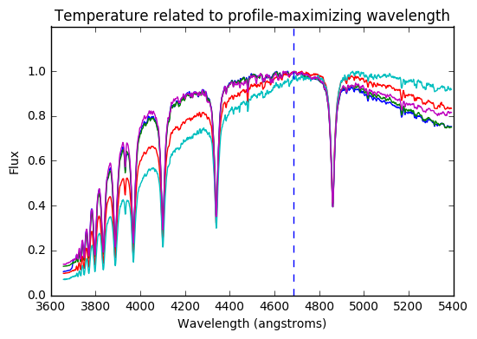


Classifying the star via Wein’s Law
This star is quite similar to our sun. Assuming this is a main sequence star, we can say that temperature roughly corresponds to stellar mass, as per https://en.wikipedia.org/wiki/Stellar_classification

Slide 8
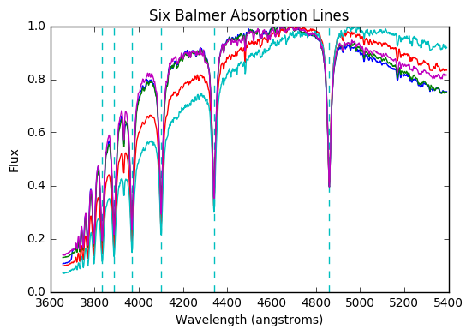
Balmer absorption lines
The downward cuts in the profile are due to quantized electromagnetic absorption of the star atmosphere. Indeed, probably the vast majority of the ‘squiggles’ in the five profiles are due to real absorption lines of various elements, not random noise. We will zoom in on the Balmer sequence large absorption lines in order to estimate star motion.

Slide 9
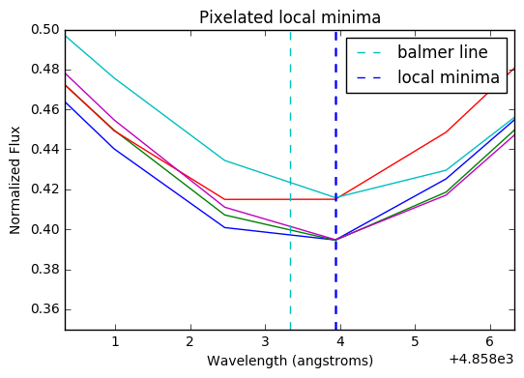
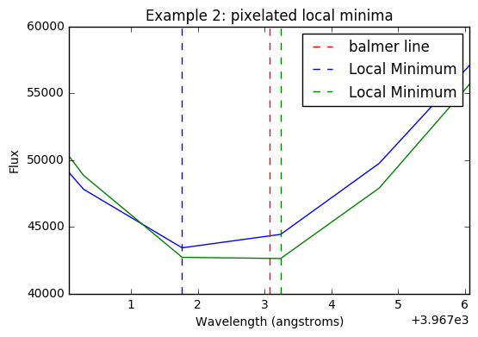
Attempt 1: Measure velocity ‘by eye’
On average, the star is clearly redshifted relative to the earth. However, the relative velocity shift of the star at different points is sub-pixel, meaning simply taking local minima is not precise enough to determine the relative shift between the profiles.
Therefore, computing the absorption lines of each profile ‘programmatically by eye,’ in which we derive local minima, is a non-option.
Counter-intuitively, it would be possible to be more precise by eye, because your eye has the ability to approximate a best fit curve. Example: Your eye can see the circular bottom of a golf ball even though a golf ball is ‘pixelated’ by its dimples.

Slide 10
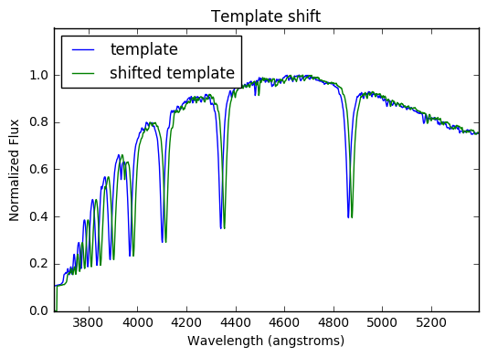
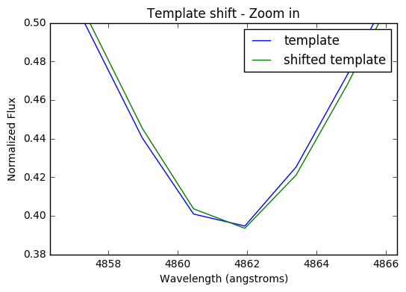
Attempt 2: Measure relative velocity by Chi^2 Fitting
Rather than going further with a ‘by eye’ approach, we will use template fitting to derive the relative velocity shifts between the stars.
We shift a template along the horizontal wavelength axis. Between two templates, we can see whether we’re getting closer by summing chi^2 values. The shift which minimizes chi^2 will then be the one that makes the profiles most similar – the one that best corrects the (albeit sub-pixel) redshift that might exist.

Slide 11
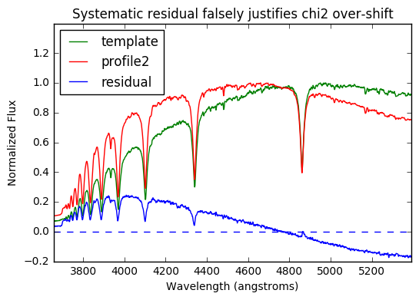
Chi^2: A Caveat
Because no flux calibration was done to this data, even normalizing the data does not correct the one-sided (above on one side, below on the other) residual that can exist between any two profiles (example shown at left). Chi^2, looking to minimize the square of the residual, would demand an over left-shift of the green template in this given example.
The balmer absorption lines, once separated, would be pulling the curves back, so chi^2 would minimize, just not at the right spot.

Slide 12
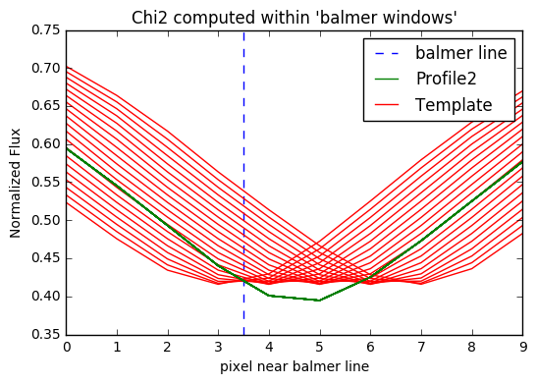
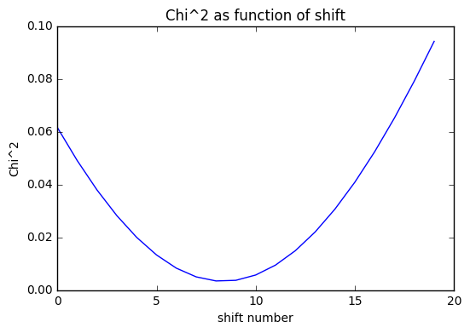
Chi^2 within ‘Balmer Windows’
How do we get around the issue of skew residuals? If we zoom in on ‘balmer windows’—regions of the curve around the large balmer absorption lines, chi2 will be appropriately minimized when the absorption lines overlap (even if one is above the other).
Left, we show the process of shifting a template over twenty .5 pixel increments and show corresponding chi^2.
Then, we increased to 1000 shifts and iterated over all 6 balmer lines to increase precision, and finally repeated the process for each profile, maintaining a common template.

Slide 13
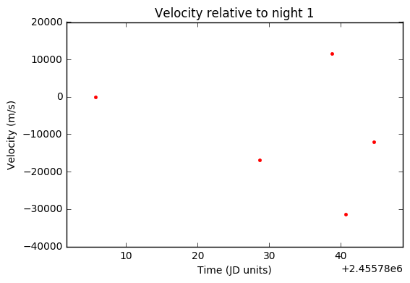
Relative velocities
The largest velocity shift is between nights 3 and 4.

Slide 14
Absolute velocity – velocity in the observed frame
The entire star system is red shifted due to Einstein’s expanding universe theory. If we get the star’s velocity at night one relative to earth, we can add that to all our delta velocities and get the absolute velocity for each star.
I chose to skip the step of finding the absolute velocities, since relative velocities are sufficient to define the period parameter.
One could fit a Gaussian cap, as we do in the data reduction section, on each of the balmer lines, and compare that center to each balmer line to get an absolute red shift.
Further work would be to correct for the motion of the earth during that time.

Slide 15
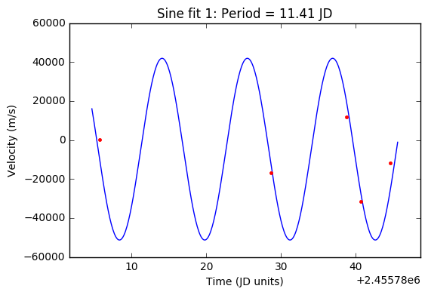
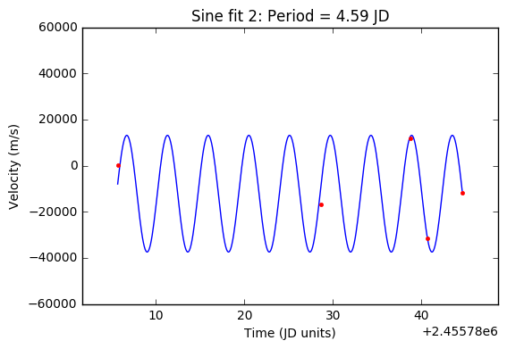
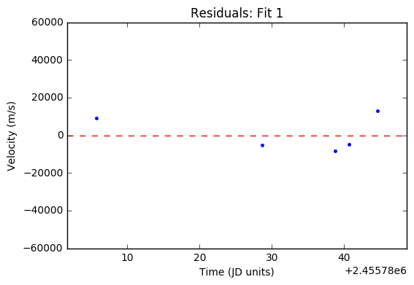
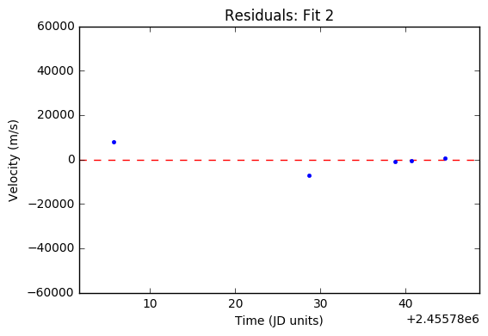
Last free variable: period of motion
We can assume the motion of the star is sinusoidal due to Kepler’s laws. However, five points is insufficient to determining a full sinusoid.
The left has both a larger period and a larger velocity amplitude, which would imply the unseen mass is larger than that suggested by the right.
Either way, the mass of the unseen companion does not approach the mass of a black hole.
If I had to guess, this object could be a small white dwarf or a closely orbiting planet.

Slide 16
Part II: The data reduction
Where did our five wavelength vs. flux profiles come from? These were reduced from raw spectrograph data (a dispersive element such as a prism spreads light onto a CCD detector). We will now take a look at the raw data from one night, and do our best to reduce it as well as our predecessors did.

Slide 17
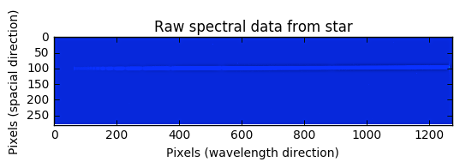
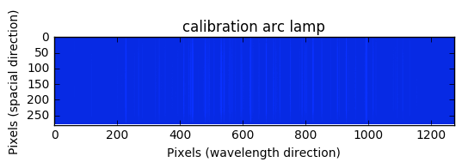
The raw spectral data
The long direction of the CCD corresponds to changing wavelength (it will be our job to figure out how, exactly), and the other corresponds to one spacial direction.
In the top image, not surprisingly the star, the streak near line 100, has flux at all wavelengths.
In the bottom calibration frame, specific emission lamps have been used to create the vertical lines.

Slide 18
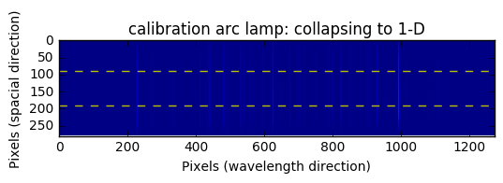
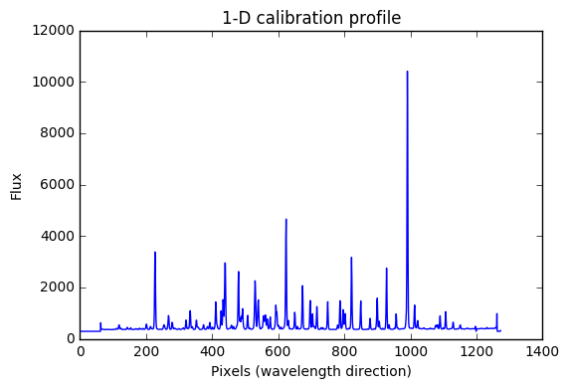
Collapsing the calibration frame
We take one hundred lines from the middle of the frame and median them together to get a single 1-D calibration profile.
We’ve lost the spacial direction, which we don’t care about, and we’ve gained the flux at each ‘column’ – our job now is to map use these emission lines to determine a mapping between pixels and wavelength.

Slide 19
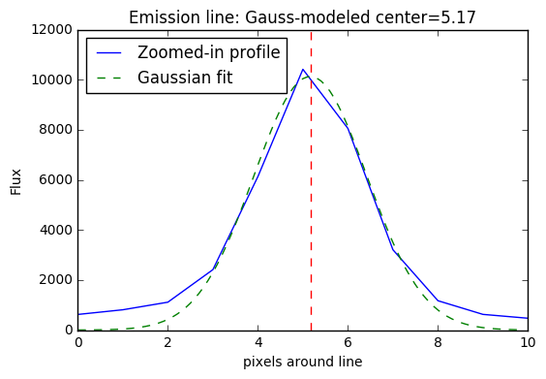
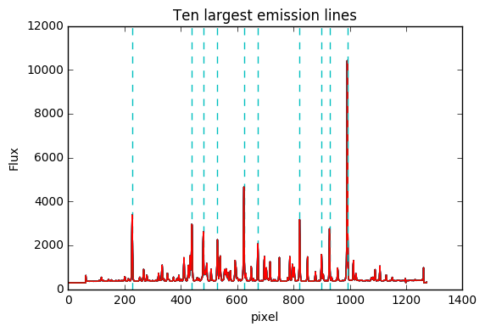
Determining line centers in spectrum
We can use Gaussian fits to get the precise sub-pixel centers of the emission lines upon the 1d spectrum.
We iterated this process for the 10 largest emission lines.
Now that we know the precise decimal pixel value at which these emission lines appear on the CCD, the trick is to find which lamp each came from and therefore which wavelength the pixel maps to.

Slide 20
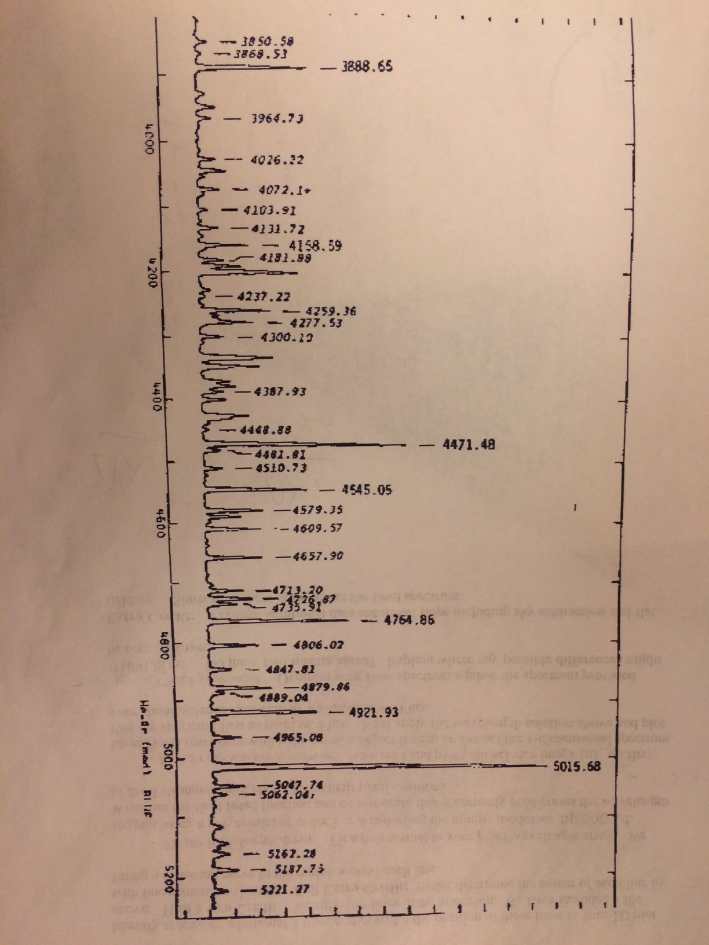
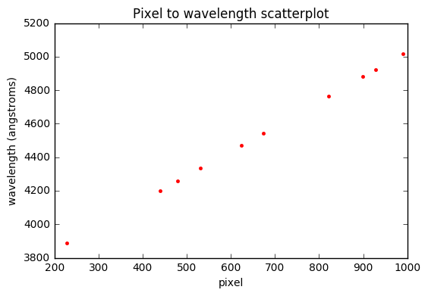
Ten largest lab emission lines
Here we take our ten line centers and we figure out what wavelength they are supposed to be based on prior results from the lab (shown top left).
We then have a list of ordered pairs (pixel, wavelength) for each emission line.
From here, we need a polynomial fit to connect the scatterplot so that we can know the wavelength value of any given pixel.

Slide 21
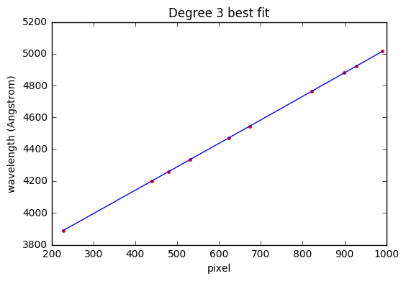
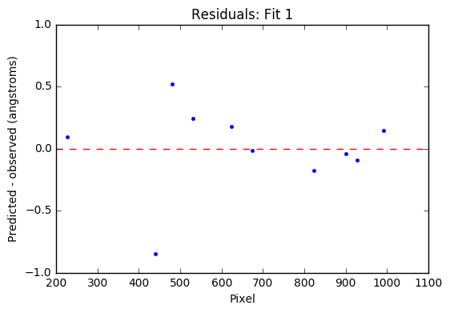
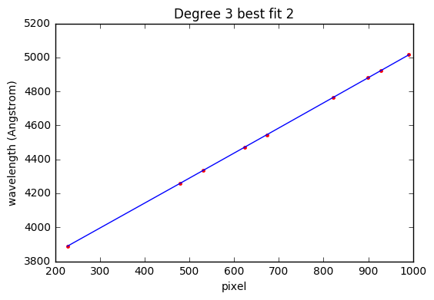
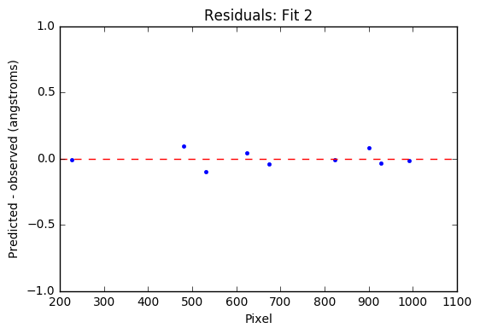
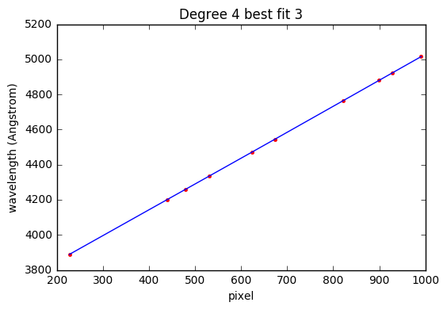
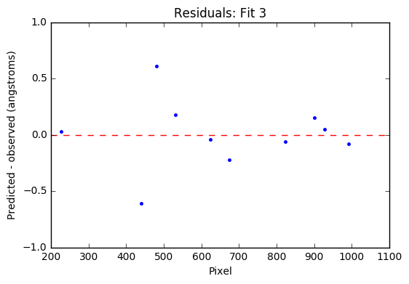
The Wavelength Solution
Attempting to model the data shows us that there is one clear outlier from the rest. Once we remove that point, the new fit has errors in the .1 angstrom range, which is stellar.
Further work would be to derive which order polynomial best fits the data. Because 3 is doing a as good of job as 4, we stop.
Additionally, one could reserve a few known lines to test the fit a posteriori to make sure the fit was functioning predictively.

Slide 22
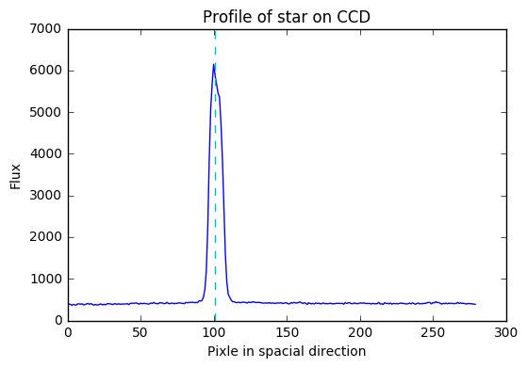
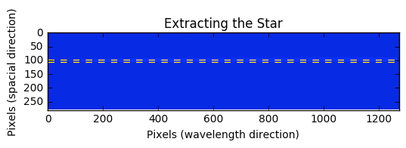
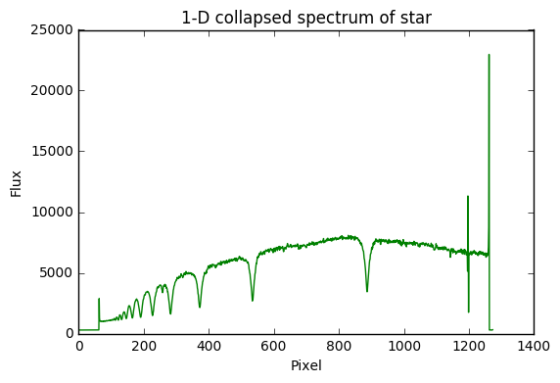
Extracting the Science Data
We can go to the middle of the star’s profile on the CCD by using our gauss fit module.
Then, we median together bands within one standard deviation from the center of the profile.
To be more precise, one would have to allow for a non-horizontal extraction of the star, to account for a skew-CCD
Finally, we plot the 1-D collapsed spectrum of pixel vs. Flux.
All’s left is to apply the wavelength solution to the pixels.

Slide 23
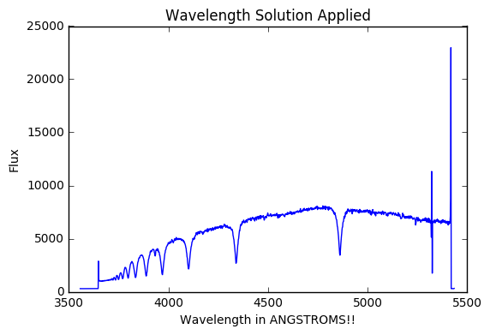
Applying the Wavelength Solution
We use our wavelength solution from before to map pixels onto wavelength. Now we have a picture that’s starting to look a lot like the profiles from before.
The large spikes at right are probably bad pixel rows in the CCD. Hard to correct for besides manually smoothing the data.

Slide 24
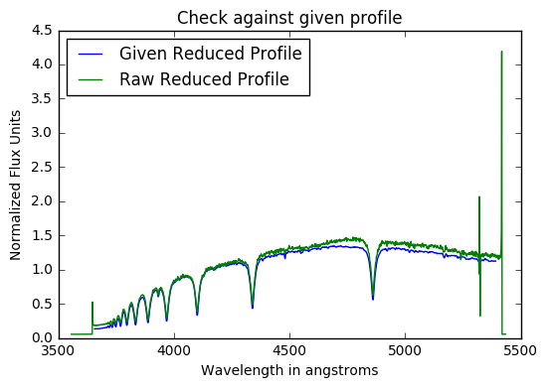
Checking our work
The profile our corrections produced very much resembles that which we were given. We now have a sense of how these data are reduced ‘in real life’.
Another step we can do is apply the flat correction to account for variant pixel sensitivities and perhaps a skew prism.

Slide 25
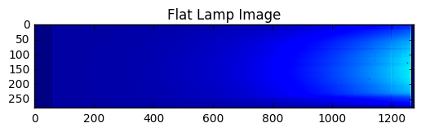
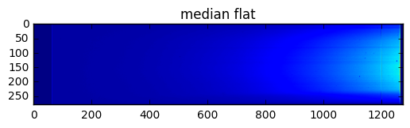
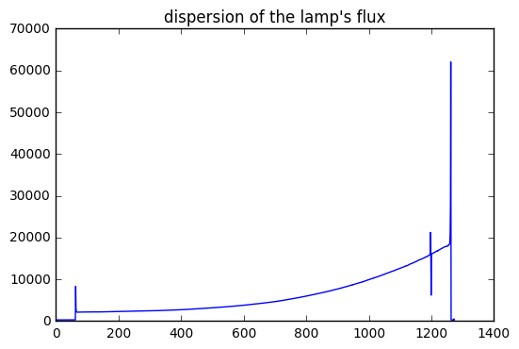
Flat Correction
A flat lamp image is when we take a picture of a lamp that emits at all wavelengths, not just at specific emission points.
Then, we can compare up and down the rows to correct for any skewing of the light by the prism, and any pixels that are over or under sensitive.

Slide 26
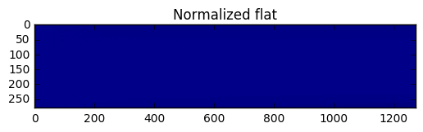
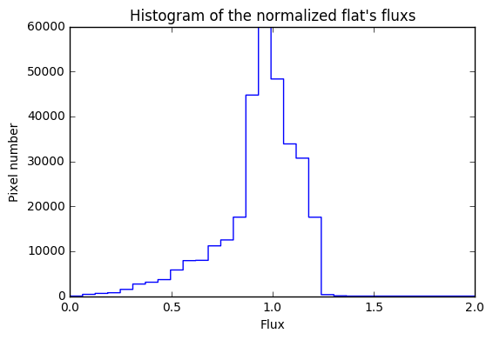
Normalizing the median flat
Because the lamp is brighter at some wavelengths than others, it is very important to normalize the matrix so that each row is given equal weight.
Otherwise, we’d be claiming a pixel was sensitive just because the lamp is brighter at that point.
The mode and mean of the normalized flat is correctly at 1.

Slide 27
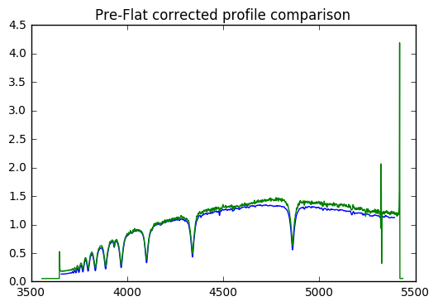
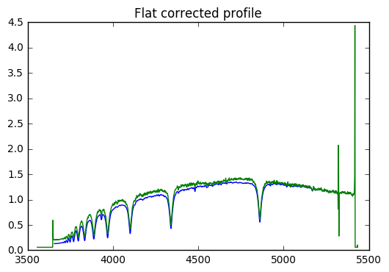
Post Flat Correction Check
The flat correction did not make a huge difference in this case, but it did pull the profiles slightly closer together in shape.
Especially if one corrected for the two outliers at the right of the profile, the profiles would start to look nearly identical.

Slide 28
Conclusion
In part I of the lab, we took for granted that optical spectral data could be reduced to a 1-D wavelength vs. flux profile. We analyzed this reduced data from a star at five different times over the course of a month. We solved each free variable (M_star, V_tangential, and Period) of Newton’s Law of Gravitation in order to determine the mass of an unseen companion.
Although at best we decided the body was smaller than a black hole, the process we underwent is applicable to similar systems.
In part II, we questioned taking for granted that reduced spectral data. We went through the steps of fitting Gaussian hats on the comp data in order to derive a degree 3 mapping between pixels and wavelength. Then, applying that correction to the science data, we arrived at a profile very similar to that which we have been given for part I.
Finally, we looked at one more data reduction step: flat lamping the science image, to correct for a skew prism or a not equally sensitive CCD.
Further work would be to reduce more data to better define the sine curve and therefore the mass of the black hole, and to further reduce the data by applying flux calibrations, biases, darks, and a profile smoothing.

