Slide 1


Slide 2

MASKS!

Slide 3

Yes! 'Da
BLUE

Slide 4
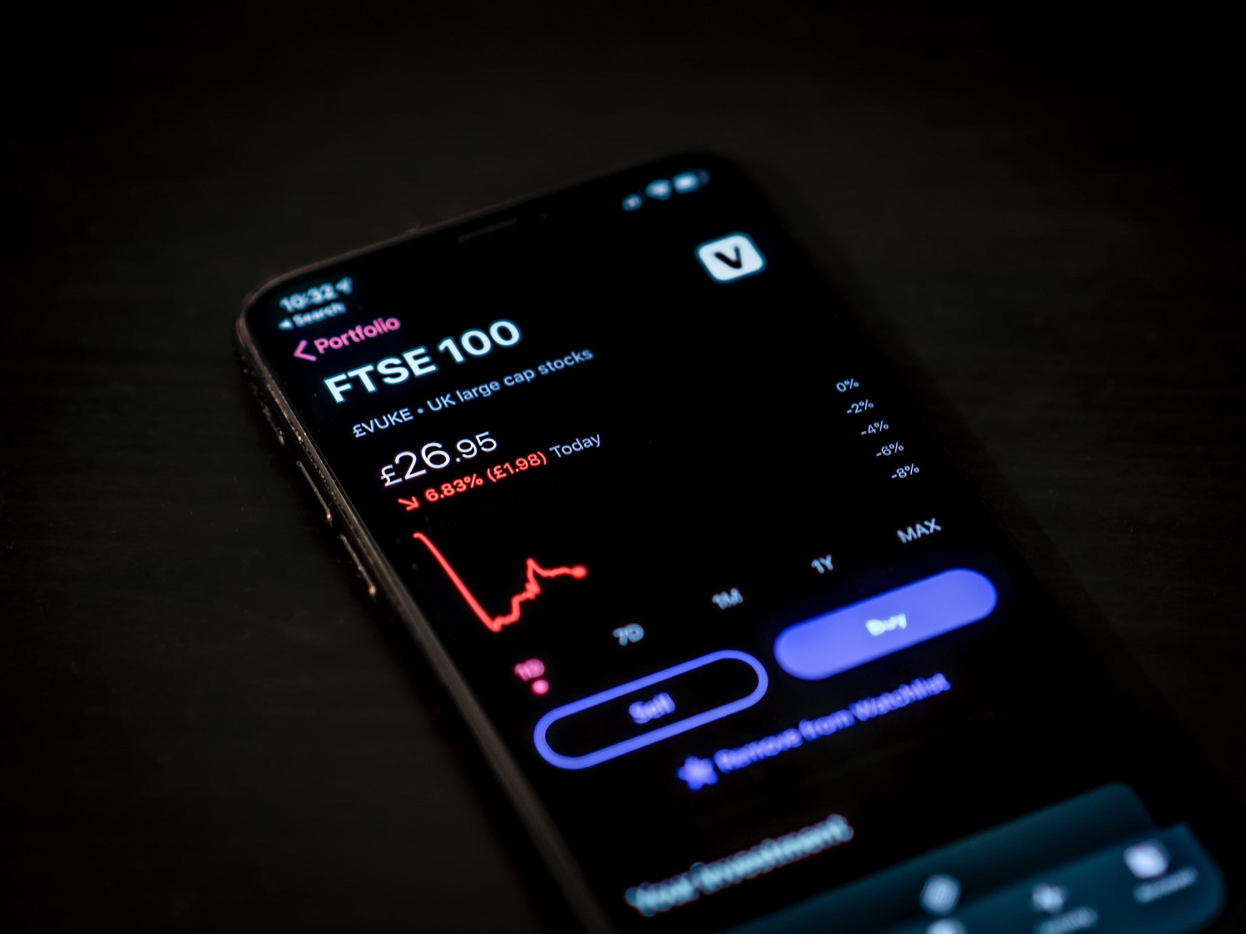
Day Trading
HOW THE COVID-19 HAVE AFFECTED DAY TRADING

Slide 5

HYPOTHESIS
'They use high amounts of leverage and short-term trading strategies to capitalize on small price movements that occur in highly liquid stocks or currencie This statement made us theorize Day Trading will perform better.

Slide 6
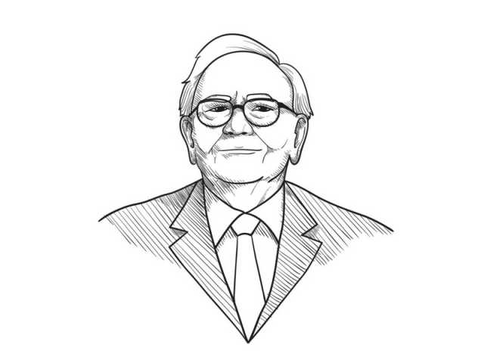
We simply attempt to be fearful when others are greedy nd to be greedy only when others are fearful.

Slide 7
We simply attempt to be fearful when others are greedy and to be greedy only when others are fearful.
Warren Buffet

Slide 8
STOCK MARKET

Slide 9
STOCK
VOLUME

Slide 10
SPL!T 'DA STOCK

Slide 11
This is When a company declares a stock split, the number of shares of that company increases, but the market cap remains the same. Existing shares split, but the underlying value remains the same. As the number of shares increases, price per share goes down.

Slide 12
HOW DOES SPLIT WORK?
Stock split is done to infuse liquidity and to make shares affordable for various investors who could not buy the shares of that company before due to high prices.

Slide 13
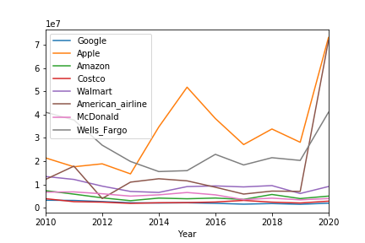
select stock volumes by Year

Slide 14


