Slide 1
Adolescent Substance Abuse
Lindsay Heikkinen, Liz Carnegie, Jackie Kutcher, Toni Debose

Slide 2
http://youtu.be/cskq_zGVSZs
Notes:
I think this would be a good introduction to our presentation..

Slide 3
Epidemiology
Incidence and Prevalence of Substance Abuse:
Increases with age during adolescence.
Peaks in young adulthood.
Although common, substantially increases risk for persistent substance use.

Slide 4
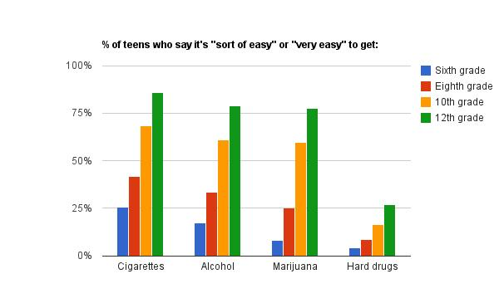
Availability By Age (The State Journal, Frankfort, KY)

Slide 5
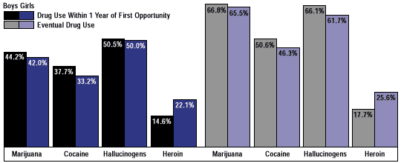
Incidence and Prevalence (NIDA, National Institute on Drug Abuse)

Slide 6
Incidence and Prevalence
The younger the age of abuse, the higher the risk for future dependence.
Social reorientation from family to peers.
Unique brain changes that enhance risk-taking behaviors.
Abuse is three times more likely in youths with psychiatric disorders.

Slide 7
Risk Factors
Socioeconomic Status
Ineffective Parenting
Early Aggressive Behavior
Life Transitions
Academic Failure
Drug Availability

Slide 8
Protective Factors
Strong family bonds
Positively copes with stress
Parental monitoring and involvement
Successful school performance (regular attendance and schooling bonding)
Positive social institutions such as family, school, and community organizations

Slide 9
Interventions - Micro Level
Prevention:
Support Groups: Ala-teen
Project MAGIC
Celebrating Families!
Treatment:
Rehabilitation Centers
inpatient
outpatient
The Ingham County Adolescent Diversion Project

Slide 10
Interventions - Macro Level
Prevention:
The Drug Free Communities (DFC) Program
Preventing youth drug use by creating local data-driven strategies to reduce use in the community
26 Michigan coalitions received grants from ONDCP
National Anti-Drug Media Campaign
consistent and credible messages to youth about drug use and its consequences

Slide 11
Interventions - Macro Level Cont...
Treatment:
Juvenile Drug Courts (JDC)
emerged in 1980’s
16 counties in Michigan
Addiction treatment providers, prosecutors, defense attorneys, law enforcement officers, and parole/probation officers work together to provide needed services to participant

Slide 12
References
National Institute of Drug Abuse. (2007). Understanding Drug Abuse and Addiction: What Science Says. Retrieved from: http://www.drugabuse.gov/publications/teaching-packets/understanding-drug-abuse-addiction/section-ii/5-protective-factors
National Institute of Drug Abuse (2003). Preventing Drug Use among Children and Adolescents- Risks and Protective Factors http://www.drugabuse.gov/publications/preventing-drug-abuse-among-children-adolescents-in-brief/chapter-1-risk-factors-protective-factors/when-how-does-drug-abuse-start-progress
National Center for Children in Poverty; Adolescent Substance Abuse in the U.S. http://www.nccp.org/publications/pub_1008.html
Health and Human Services. (2014). Risk and protective factors. Retrieved from: http://www.mass.gov/eohhs/gov/departments/dph/programs/substance-abuse/providers/prevention/risk-and-protective-factors.html

