Slide 1
Flask Web application for basic biological procedures
David Hidalgo Gil

Slide 2
Background information
Performing basic analyses on the go for non bioinformaticians.
It’s easier to use than a command line and faster to teach
Less fear due to having an interface

Slide 3
Significance and novelty
At the moment my tool can:
FastQ → Fasta
Multiline Fasta → OneLine Fasta
Basic Nucleotide plots
For now Its limited to only 1 file at a time
Need for an ID system and database

Slide 4
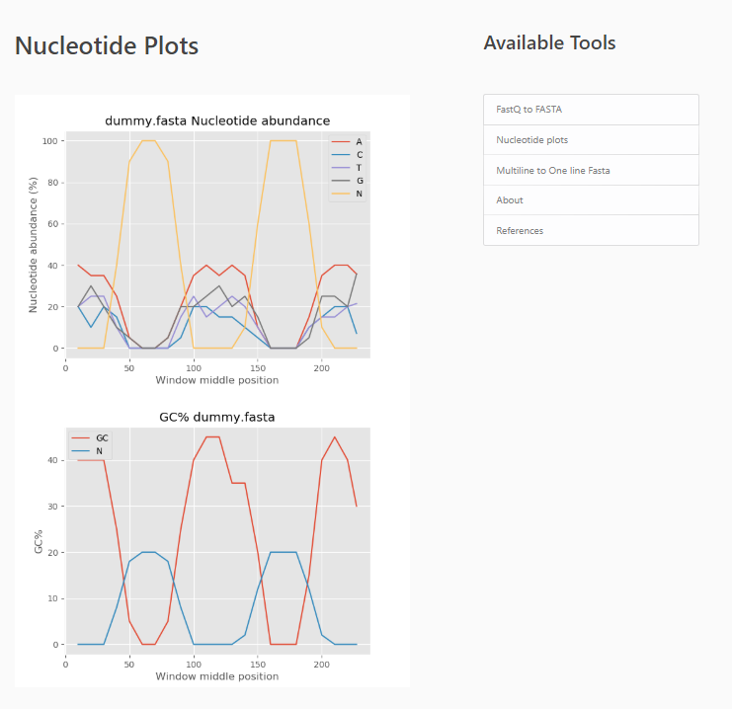
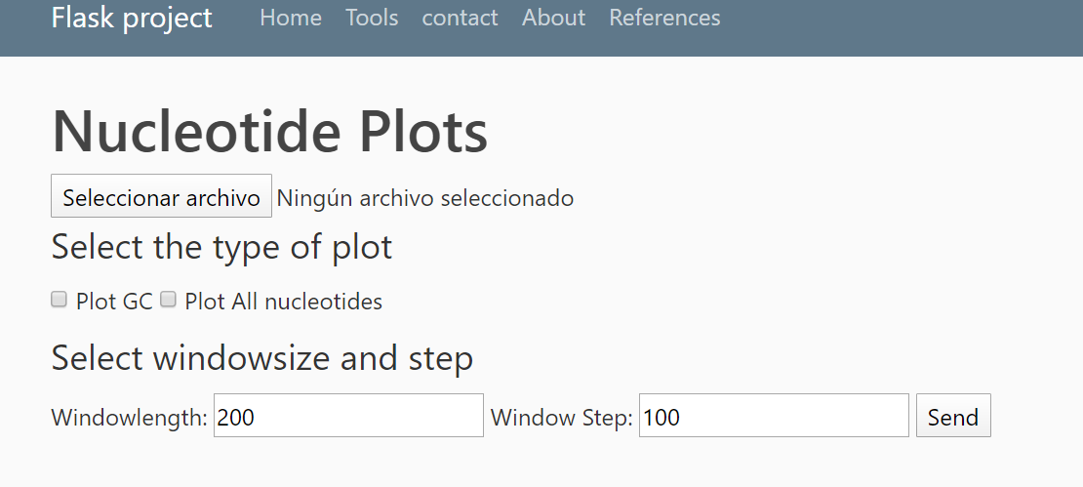
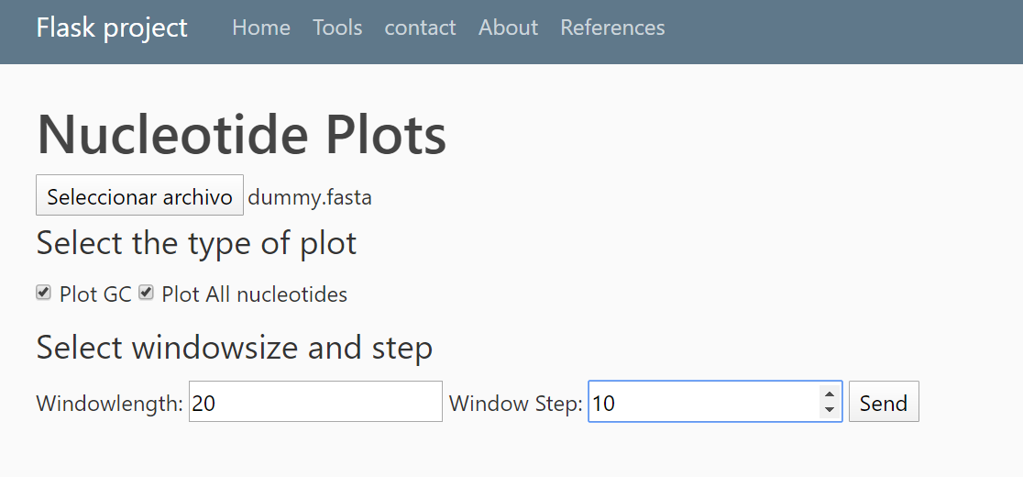
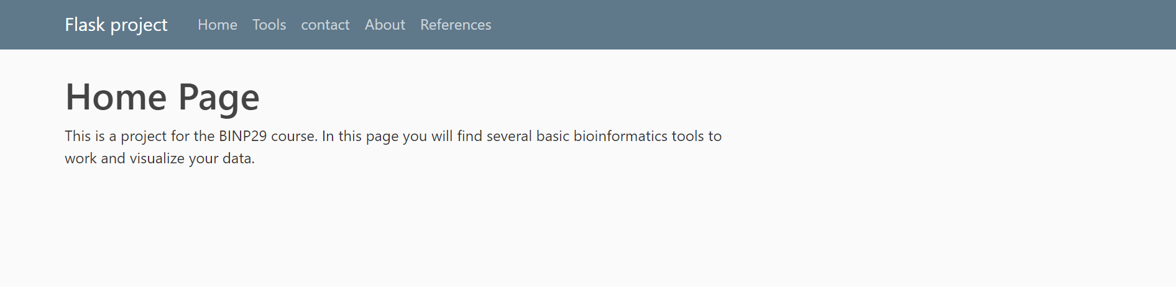
Present your tool

Slide 5
Explain the methodology and technology you used
Algorithms and back end were developed using Python (3.7) using:
Flask
Matplotlib
Os
Werkzeugh utils (security)

Slide 6
Discuss the results and your experience
Developing webpages can be an alternative work environment
This is lacking in the science community
You have to climb the learning curve

Slide 7
Questions?
Project repository

