Slide 1
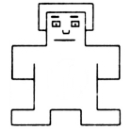
1 | 2 | 3 | 4 | 5 | 6 | 7 | 8 | 9
very unsatisfied with myself |  |  |  |  |  |  |  | very satisfied with myself

