Slide 1



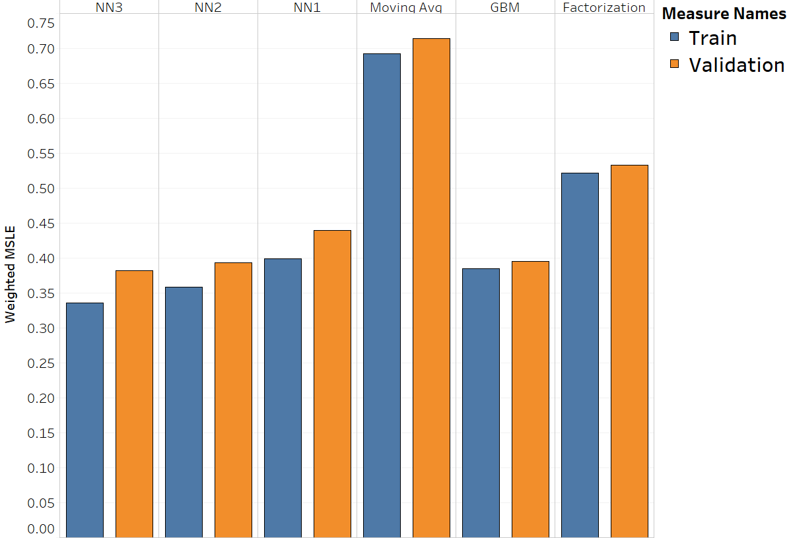

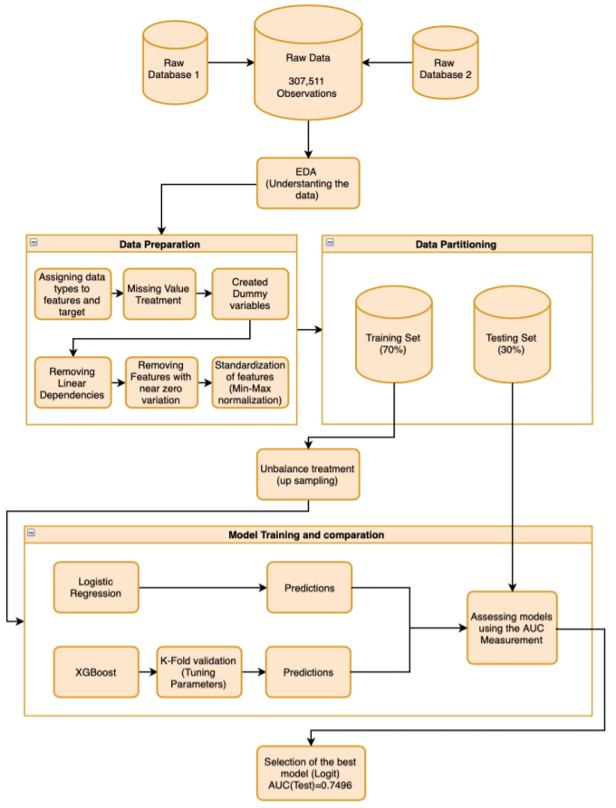

Title of Your Project
BUSINESS IMPLICATIONS
Authors’ Photos Names, Contacts
Purdue University, Daniels School of Business
Your_Email@purdue.edu
You can add QR codes for the authors’ LinkedIn profiles.
EXAMPLE
ABSTRACT
RESEARCH QUESTION
METHODOLOGY
What did you do? Why did you do this project (who cares?)? What did you find you find out? No more than 200 words here.
This paragraph is just a short summary of your project.
• One to two clearly defined research questions
• Business validation of model/solution demonstrated
• Impact (actual or estimated) of using model/solution
• Audience/stakeholder feedback or testimony of business impact
• Future scope aligns with conclusions
• Methods used are appropriate and clear
• Software and technologies used are clear
• Experiments performed support problem and answer questions
ANALYTICS PROBLEM FRAMING
• Problem framed into an analytics problem
• Assumptions are clear
• Appropriate success metrics defined
• Clear justification or approval of approach
2.3 M
5.9 M
50.6 M
11.5 M
2.1 M
50.6
21 M
EXAMPLE
BUSINESS PROBLEM
EXAMPLE
7.9 M
Discuss the business problem as you would in the business understanding phase of CRIPS-DM.
Motivate why is the problem is important …Cite at least two sources from mainstream media, white papers, or blogs that are no older than 2 years old that provide stats that help you motivate your problem.
Maybe add in a pretty illustration of what you’re talk about…Remember a poster is NOT a paper, but a high-level overview of you what you investigated. You are sort of using your poster like a PowerPoint deck and thus will want more BEAUTIFUL figures and CONCISE language.
USE FIGURES / PICTURES / DIAGRAMS TO TELL THE STORY
Produce
Deli
Meat
Grocery
Seafood
Others
Total
Fig 5. Total Net Savings ($) based on predicted OOS instances
CONCLUSIONS & FUTURE WORK
MODELS PERFORMANCE AND EVALUATION
5%
21%
7%
3%
• Model results clear and appropriately evaluated
• Demonstrated how models will/are to be used
• Final model/solution structures or interpretations discussed as necessary
• Areas for improvement identified
Reiterate why the problem is important in a sentence or two.
Provide bulleted answers to your research question(s).
The Random Forest was able to predict intermittent demand with a 15% MAPE, which was 5% better than the currently used model.
All our ML models performed on average 4% better than Croston’s method.
Were there any limitations in your study or future analyses you think might improve your results?
28%
$20-22 million
Missed
72%
EXAMPLE
DATA & EDA
Predicted
Accurately
Opportunity Cost After Prediction
95%
79%
93%
97%
Precision
Overall
Seafood
Bakery
Dairy
• Data sources identified and prioritized
• Data preprocessing clear
• Important or notable data relationships clear
• Reflection of business & analytics problem framing
OOS
Not OOS
Fig 1. The Idea of what you are trying to do
USE FIGURES / PICTURES / DIAGRAMS TO TELL THE STORY
USE FIGURES / PICTURES / DIAGRAMS TO TELL THE STORY
USE FIGURES / PICTURES / DIAGRAMS TO TELL THE STORY
ACKNOWLEDGEMENTS
Provide bulleted list.
XXX
XXX

