Slide 1
In-class Practice Exercises
Multiple Regression

Slide 2
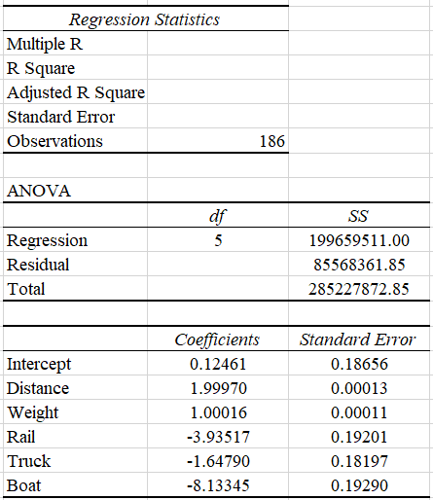
Multiple Regression
Exhibit 2
The analyst conducts a multiple linear regression with transportation cost as the dependent variable, and independent variables of Distance, Weight, and indicator variables for rail transportation, truck transportation, and boat transportation. The (partial) Excel output is reported below.
Among the five (5) predictors included in the analysis, which is estimated to be the most significant predictor of the transportation cost?
A) Boat, because it has the largest absolute regression coefficient.
B) Distance, because its estimated regression coefficient is the largest.
C) Distance, because its correlation with transportation cost is the largest.
D) Distance, because it has the smallest p-value.
E) Cannot be determined based on the given information.

Slide 3
Multiple Regression
Exhibit 2
The analyst conducts a multiple linear regression with transportation cost as the dependent variable, and independent variables of Distance, Weight, and indicator variables for rail transportation, truck transportation, and boat transportation. The (partial) Excel output is reported below.
Among the five (5) predictors included in the analysis, which is estimated to be the most significant predictor of the transportation cost?
A) Boat, because it has the largest absolute regression coefficient.
B) Distance, because its estimated regression coefficient is the largest.
C) Distance, because its correlation with transportation cost is the largest.
D) Distance, because it has the smallest p-value.
E) Cannot be determined based on the given information.

Slide 4
Categorical Independent Variable
Exhibit 2
The analyst conducts a multiple linear regression with transportation cost as the dependent variable, and independent variables of Distance, Weight, and indicator variables for rail transportation, truck transportation, and boat transportation. The (partial) Excel output is reported below.
Suppose that there is a shipment, not in the data set, which is being transported by airplane, weighs 200 pounds, and travels 100 miles. What is the predicted transportation cost for this shipment (rounded to the nearest dollar)?
$400
$386
$396
$420

Slide 5
Categorical Independent Variable
Exhibit 2
The analyst conducts a multiple linear regression with transportation cost as the dependent variable, and independent variables of Distance, Weight, and indicator variables for rail transportation, truck transportation, and boat transportation. The (partial) Excel output is reported below.
Suppose that there is a shipment, not in the data set, which is being transported by airplane, weighs 200 pounds, and travels 100 miles. What is the predicted transportation cost for this shipment (rounded to the nearest dollar)?
$400
$386
$396
$420

Slide 6
Categorical Independent Variable
Exhibit 2
The analyst conducts a multiple linear regression with transportation cost as the dependent variable, and independent variables of Distance, Weight, and indicator variables for rail transportation, truck transportation, and boat transportation. The (partial) Excel output is reported below.
Which of the following is a correct interpretation of the estimated slope coefficients?
For two shipments with the same weight and travelling the same distance, changing the transportation method from airplane to boat is predicted to reduce transportation costs by 8.13.
Changing the transportation method from airplane to boat is predicted to reduce transportation costs by 8.13.
For two shipments with the same weight and travelling the same distance, changing the transportation method from boat to airplane is predicted to reduce transportation costs by 8.13.
For two shipments with the same weight, changing the transportation method from airplane to boat is predicted to reduce transportation costs by 8.13.

Slide 7
Categorical Independent Variable
Exhibit 2
The analyst conducts a multiple linear regression with transportation cost as the dependent variable, and independent variables of Distance, Weight, and indicator variables for rail transportation, truck transportation, and boat transportation. The (partial) Excel output is reported below.
Which of the following is a correct interpretation of the estimated slope coefficients?
For two shipments with the same weight and travelling the same distance, changing the transportation method from airplane to boat is predicted to reduce transportation costs by 8.13.
Changing the transportation method from airplane to boat is predicted to reduce transportation costs by 8.13.
For two shipments with the same weight and travelling the same distance, changing the transportation method from boat to airplane is predicted to reduce transportation costs by 8.13.
For two shipments with the same weight, changing the transportation method from airplane to boat is predicted to reduce transportation costs by 8.13.

Slide 8
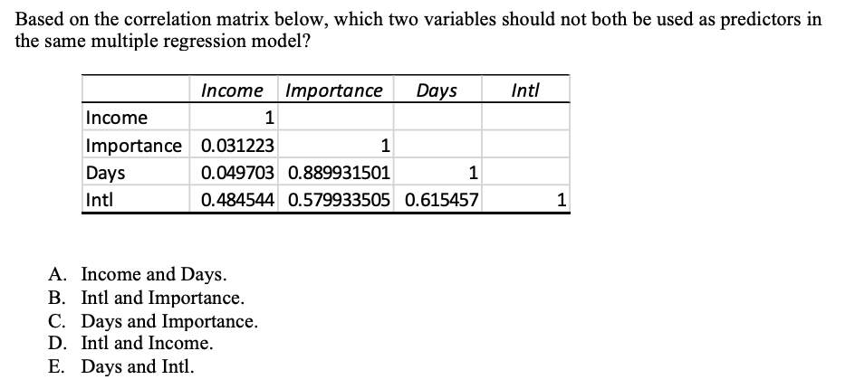
Multicollinearity
A data analyst for a travel company is researching souvenir expenditures. For 40 randomly selected recent travel clients, she records their Souvenir Expenditures ($100), household Income ($1000), the Importance they placed on the vacation (1 – 10), the length of the vacation (Days), and whether the trip was domestic or International (Intl: 0-domestic, 1-international). She is considering least-squares regression models to predict Souvenir Expenditures (Expenditures) from combinations of the other variables.

Slide 9
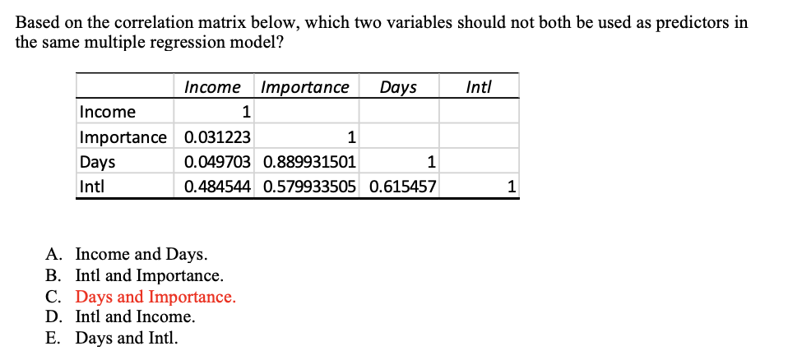
Multicollinearity
A data analyst for a travel company is researching souvenir expenditures. For 40 randomly selected recent travel clients, she records their Souvenir Expenditures ($100), household Income ($1000), the Importance they placed on the vacation (1 – 10), the length of the vacation (Days), and whether the trip was domestic or International (Intl: 0-domestic, 1-international). She is considering least-squares regression models to predict Souvenir Expenditures (Expenditures) from combinations of the other variables.

