Slide 1

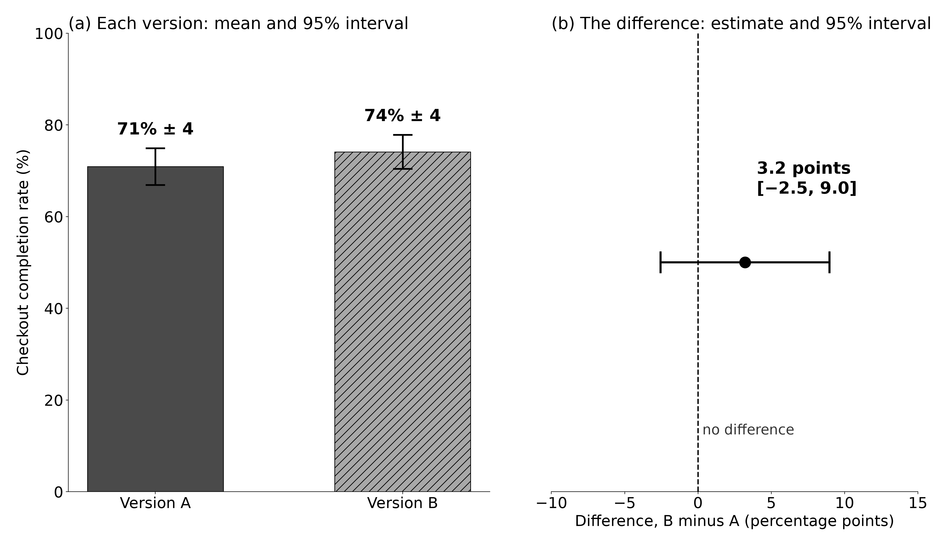
Title: your research problem and its answer
John Martinson
Honors College
Your Name · Your major, Your college · John Martinson Honors College, Purdue University
Faculty mentor: Professor Davi Moreira, Mitch Daniels School of Business · your.email@purdue.edu
PRELIMINARY DRAFT · version 1
HEADLINE Your main finding, with the uncertainty or boundary that changes how a reader should take it.
Simulated example: checkout version B averaged 3.2 points higher than version A, but the 95% interval for that difference runs from −2.5 to 9.0 points (12 weekly samples per version, one store).
THE QUESTION AND WHAT IT ADDS
MAIN RESULT
WHAT IT MEANS, AND WHERE IT STOPS
Your research question, in one sentence that ends with a question mark, and why it matters, and to whom.
What the literature already establishes, from at least two sources you read yourself (Author, Year).
What your project adds to that conclusion.
Your main hypothesis, as you recorded it before the analysis ran. Label any analysis you added later as exploratory.
EXAMPLE · replace it with the figure your notebook produced, and replace its alt text with yours
THIS EVIDENCE SUPPORTS
[your claim, with its verb and its population]
IT DOES NOT YET SUPPORT
[the larger claim a visitor might infer: a cause, a wider population, a longer time]
Answer: your question, in one sentence, no more strongly than the evidence allows.
Uncertainty: how far the estimate could move.
Limitation: the one most likely to change the finding.
Next step: the study that would settle it.
DESIGN: WHAT YOUR CLAIM NEEDS
KIND
☐ Descriptive ☐ Causal. If your aim is prediction, say so here.
REACH
☐ A population beyond your data: name its units, setting, and period. ☐ Unseen cases: which ones, from which population.
Fig. 1. Say what the figure shows and for which units; n = [observations] from [independent units]; the interval's type, level and method; bars start at zero. Source: [notebook], cell [N]. In the example, panel (b) carries the comparison the headline is about: the interval of the difference, not whether the two intervals in (a) overlap.
TARGET
The exact quantity you estimate or predict: outcome, comparison, units, time frame.
SOURCES, AI USE, AND CREDITS
The result, in one or two sentences: the estimate, its units, and the uncertainty it warrants (an interval, or a precise caveat saying why none is warranted), in the words your boundary allows.
AI use, on the poster itself. One line per tool:
[Tool]: used to [purpose]; I [changed / kept what]; I checked it by [method].
Write “No AI used” only if that is true.
WARRANT
What carries the claim across: sampling → a population · assignment or identification (with its assumptions) → a cause · a held-out test against a baseline → unseen cases. Then: what your evidence cannot yet support.
DATA AND MEASUREMENT
References. Three to six sources you opened yourself: Author (Year). Title. Venue. DOI or URL.
Source and route | [archive, URL or DOI, retrieval date; or your collection protocol]
Observations | [number of rows or measurements]
Independent units | [people, sites, groups …] and how observations are grouped
Time window | [from … to …]
Concept → measure | [concept] → [variable or item]; main validity concern
Missing data | [how much, and what you did]
Permissions | [data licence; IRB determination]
CHECKS AND VERIFICATION
Analysis: what you declared before seeing results and why it fits your design; any later change, and why.
Uncertainty: how you computed it, at the level of your independent unit, with any dependence named.
One check: a robustness, sensitivity, or diagnostic check, and what it changed.
Acknowledgments. I thank Professor Davi Moreira for mentoring this project, and the John Martinson Honors College and the Office of Undergraduate Research for the chance to present it. [Thank any data provider, participants, or funder.]
Optional QR + short URL: a text version of this poster
Verification status: [what has been checked, by whom, and when; what is still pending] · Poster version [N], [date]
Preliminary results · HONR 46400 Evidence-Driven Research · Purdue Fall Undergraduate Research Expo 2026

Slide 2
READ ME: how to use this template
This page is hidden, but some export settings still include hidden slides. Export slide 1 only, or delete this page first.
PRINT SPECIFICATION
RULES THE BOARD KEEPS
PANEL → RUBRIC → BOOK
Size: 48 × 36 in, landscape, the Expo's standard 4′ × 3′ board. Do not change the slide size.
Type at print size: title 72 pt or more; headline 44 pt; headings 32 pt; everything substantive, including the compass, the data card, the boundary boxes and the AI disclosure, 24 pt; captions, references, acknowledgments and footer 18 pt. If it does not fit, cut or reorganize. Never shrink below these.
Figures: save each one from your notebook as PNG at 300 dpi at the size it will print, or as PDF or SVG. Never paste a screenshot. Right-click → Edit Alt Text, and write what the figure shows.
Export: export slide 1 only, as a PDF. Open it and check: exactly one page, 48 × 36 in, nothing clipped, no missing figure. Then print one crop at actual size, without “fit to page”, and measure it with a ruler. Screen zoom does not tell you the printed size.
Files: M10: lastname_m10_poster.pptx and lastname_m10_poster.pdf. M11: lastname_m11_posterdraft.pdf. M13: lastname_m13_poster.pdf, the print file, poster only.
No result appears first on the poster. Every result, figure and citation comes from your M9 note and its claim-evidence table. If a check changes a number, keep the submitted note, write a dated corrected version, then update the poster.
Trace what you print. A result you computed traces to its notebook cell; a statistic from a source traces to that source; rounding is documented.
The qualifier travels with the claim, in the same eye-span as the headline.
Causal wording only with a defended identification argument; population wording only with a reach argument.
Two channels for every distinction: a label or a pattern, with colour as a bonus.
Replace every bracket, every prompt and every EXAMPLE item. Panels may move, merge or resize; every kind of information stays.
Draft tag through M11; delete it at the M13 lock. Keep “Preliminary results” in the footer: the project closes in December.
AI: disclose on the poster itself, per tool: purpose, what you changed or kept, how you checked it. The Expo does not accept AI-generated sections or abstracts, or a poster designed by AI without substantial human input. Every AI step also gets a ledger row.
Panel | Rubric | Book
Title · The question and what it adds | 1 | Ch. 1, 7–9
Design: what your claim needs | 2 | Ch. 6–7, 10, 12, 14–19
Data and measurement | 3 | Ch. 13, 20–21
Checks and verification · status line | 4 | Ch. 11, 22–25, 36–37
Main result | 5 | Ch. 32
Headline · What it means, and where it stops | 6 | Ch. 28–29, 35
Sources, AI use, and credits | 7 | Ch. 9, 30
The whole board | 8 | Ch. 32–33
The final poster (M13) is graded with Evidence_Driven_Research_Poster_Rubric.pdf, handed out with this template: eight criteria, 100 points, with hard caps. Read it before you build, not after.

