Slide 1
LogAnalyzer Tool
Target group
Author
Aim
Department

Slide 2

LogAnalyser Tool Introduction
Purpose:
Assist user in analyzing and debugging issue
In helping users better understand the issue log and further analyze the operational data to know an overview of the system
Features:
Data parsing
Dedicated for MeRiT CreateSupportInfo log
Support formats of log files below (more types support is possible in the future)
LogService.txt, Install.txt, mjnxtdebug.log, Protocol.txt, and ProcessLog.csv
Data Visualization
Provide multiple chart generation options
including load/unload time charts, duration charts, CTR, and protocol trend chart.
Visualize open/close status of valves, aiding users in grasping the MSC status.
Data Export (Excel)
For post-analysis and data storage

Slide 3
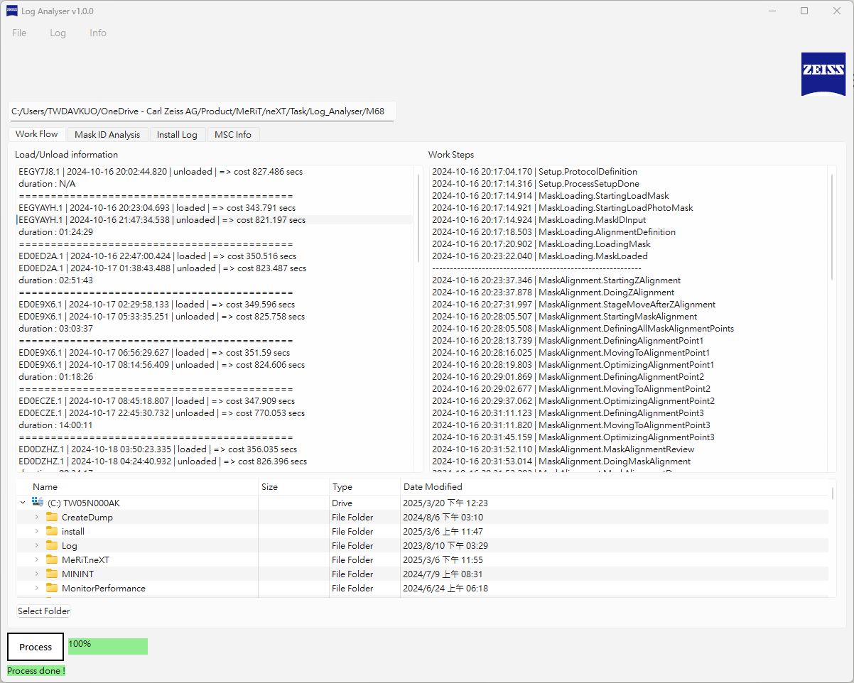
GUI Layout Introduction
Menu bar
Log path
Tool layout introduction:
Menu bar
File - log path select
Log – log type select
About – version information
Function tab
Work flow
Mask ID analysis
Install log
MSC info
Log path
Selected file path
Display panel
Parsed information
Status panel
Information notice
Progress bar
Parsing progress
Function tab
Display panel
Status panel
Progress status

Slide 4
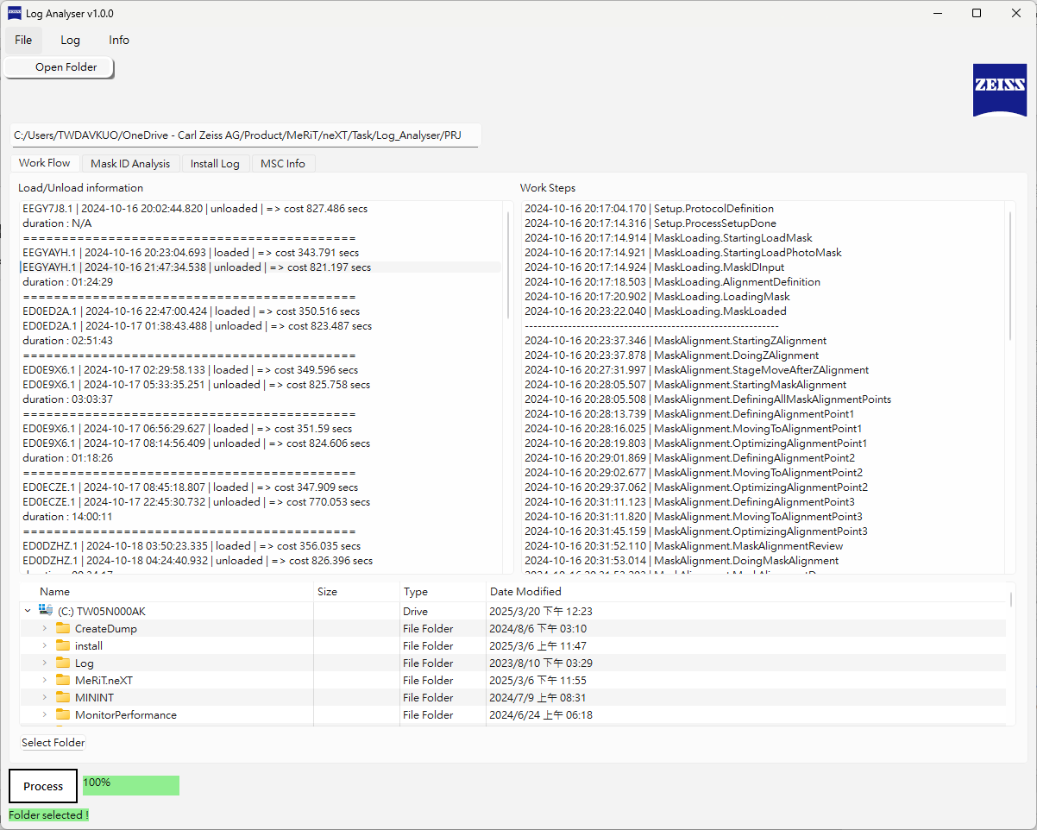
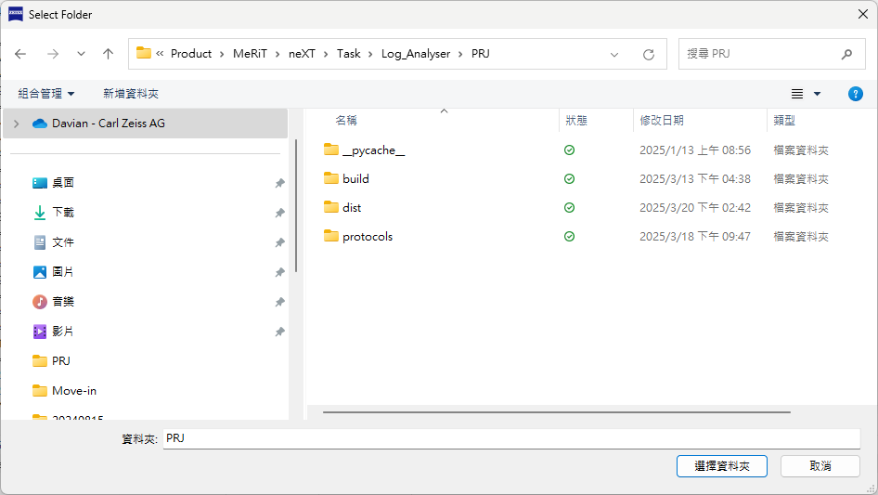
Log Parsing Operation
Select log (1)
Log path select (method 1):
Menu bar -> File -> Open Folder
The path name will be shown after selected
log path after selected

Slide 5
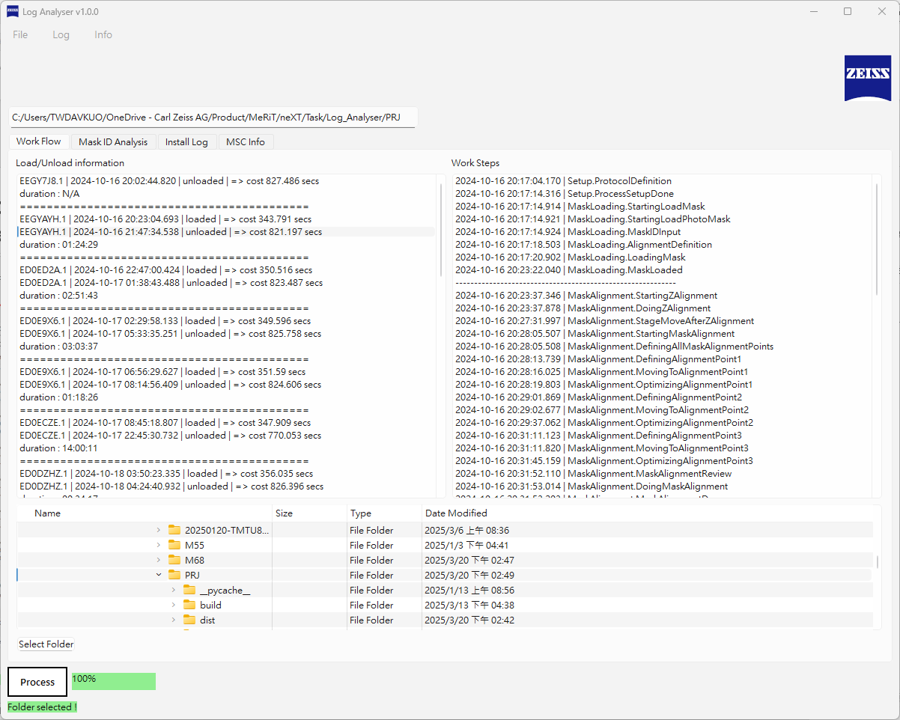
Log Parsing Operation
Select log (2)
Log path select (method 2):
Tree view -> Navigate the file path
The path name will be shown after selected
log path after selected

Slide 6
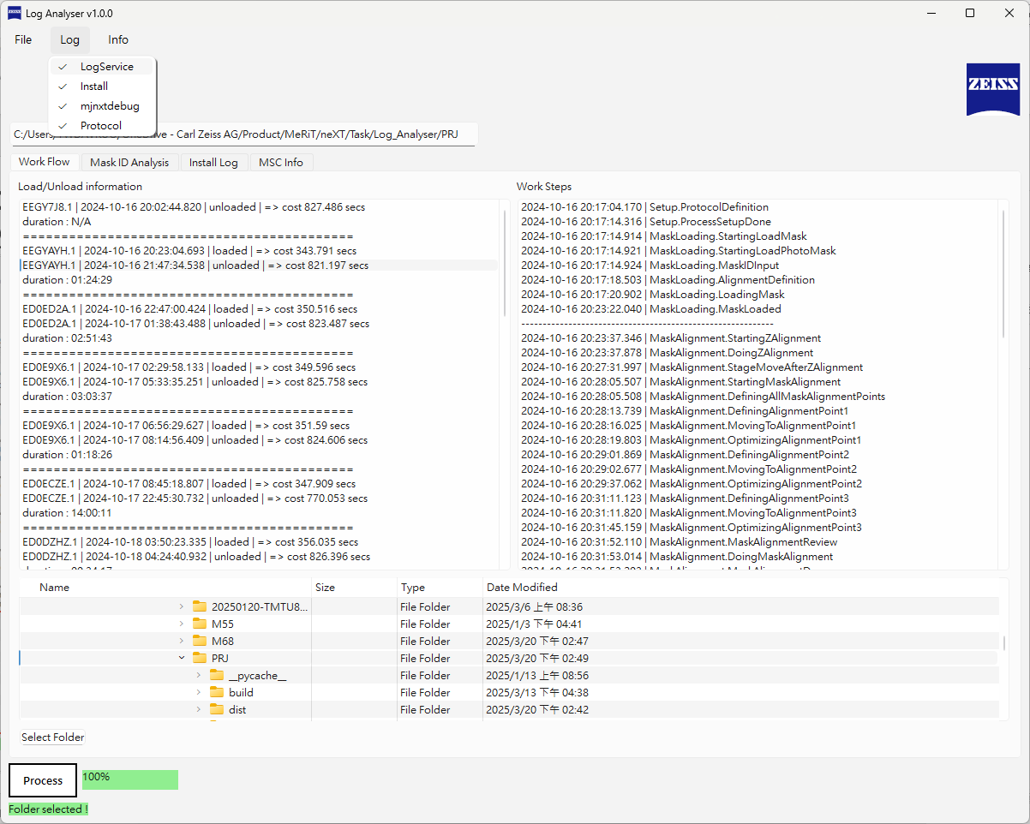
Log Parsing Operation
Select log type
Current supported types
File type select:
Menu bar -> Log -> choose the type below
LogService
Install
mjnxtdebug
Protocol

Slide 7
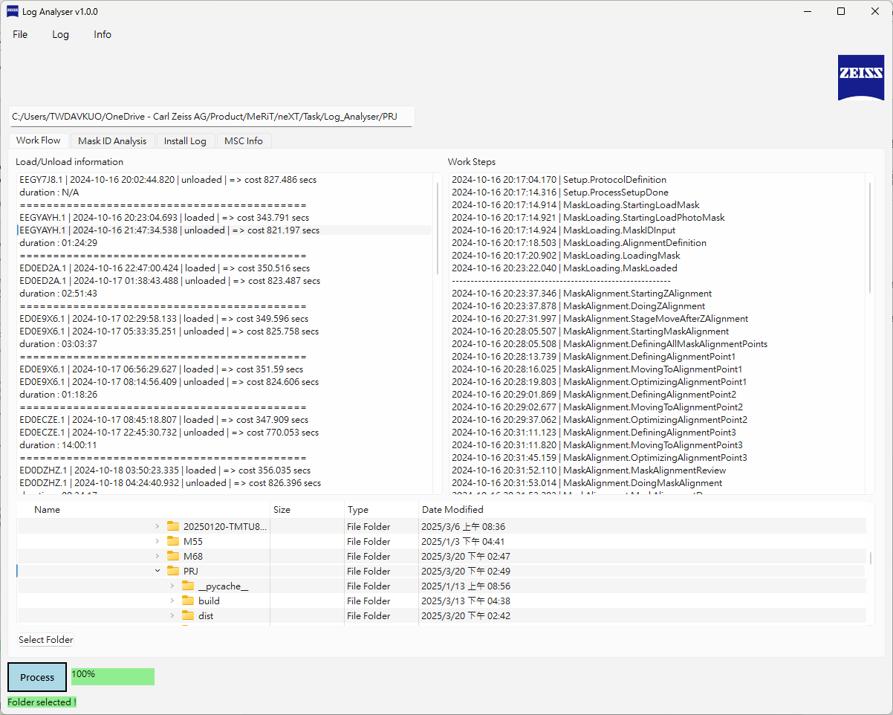
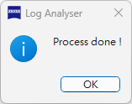
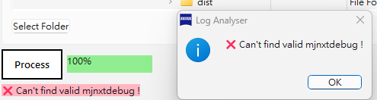
Log Parsing Operation
Parse log file
Log file parse:
Press “Process” button
Through the status panel to check if the file parsing is successful or not
If parsing is completed, the window will pop out
If the error occurs, panel will show the error message and window pop out accordingly
Press “Process”

Slide 8
Work Flow
Function introduction
Work steps display area
WorkFlow Tab:
Load / Unload information area
Loaded / Unloaded timestamp
Load / Unload cost time
Workflow steps area
Depending on the selected item of left area
Display work steps for the specific mask ID
Load/Unload information display area

Slide 9
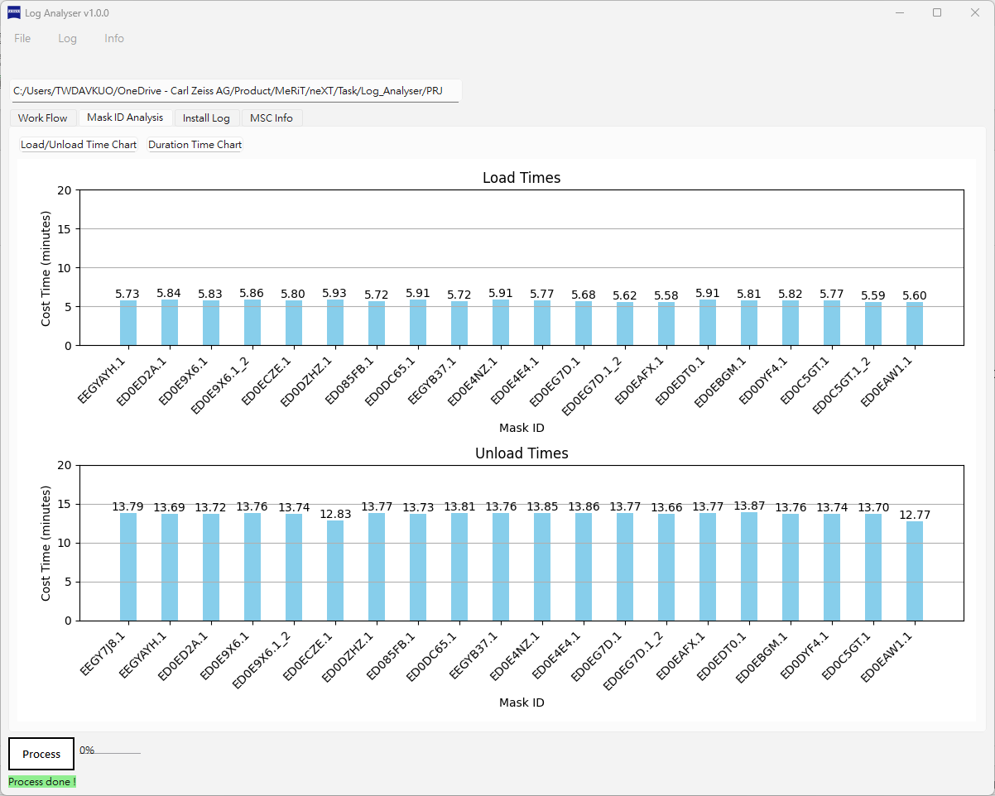
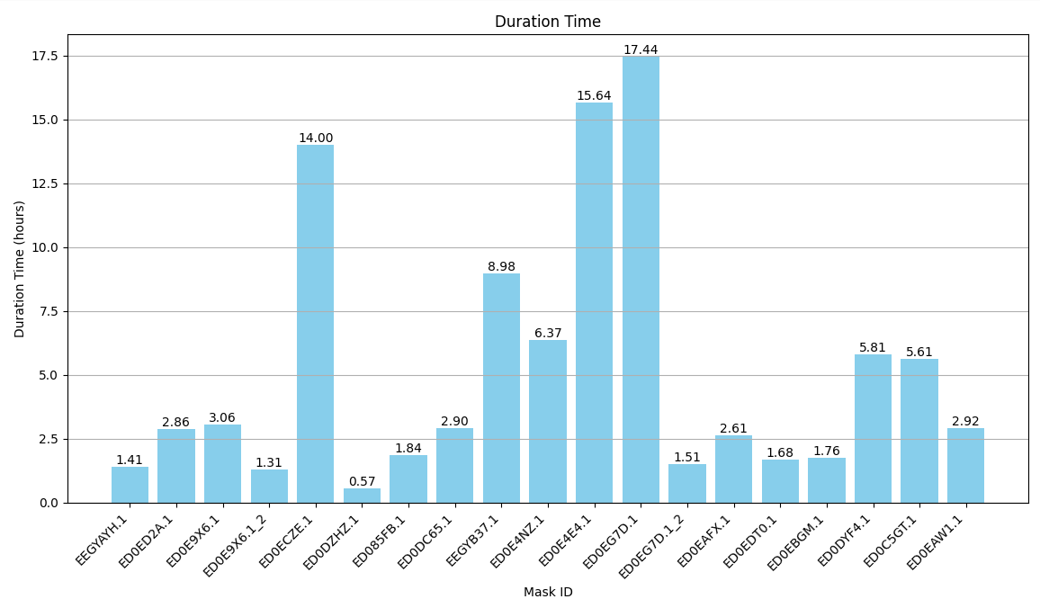
Mask ID Analysis
Function introduction
Mask ID Analysus Tab:
Load/Unload Time Chart button
Show load/unload time information for the specific mask
Duration Time Chart button
Show load/unload duration time for the specific mask

Slide 10
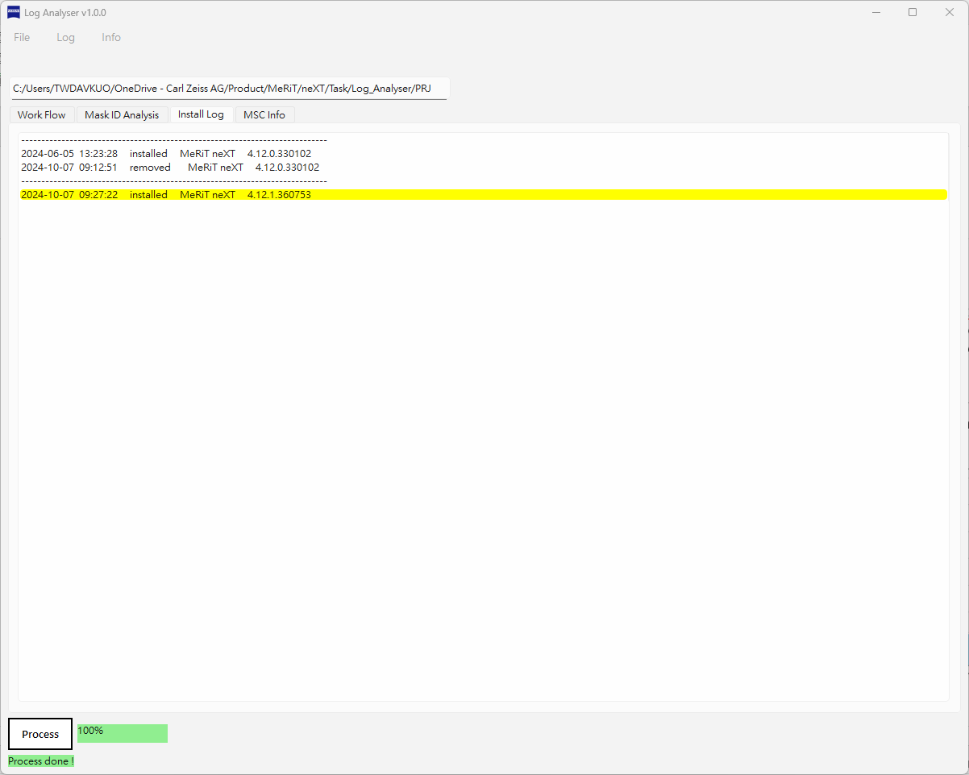
Install Log
Function introduction
Install Log Tab:
Information panel
Show SW installing history

Slide 11
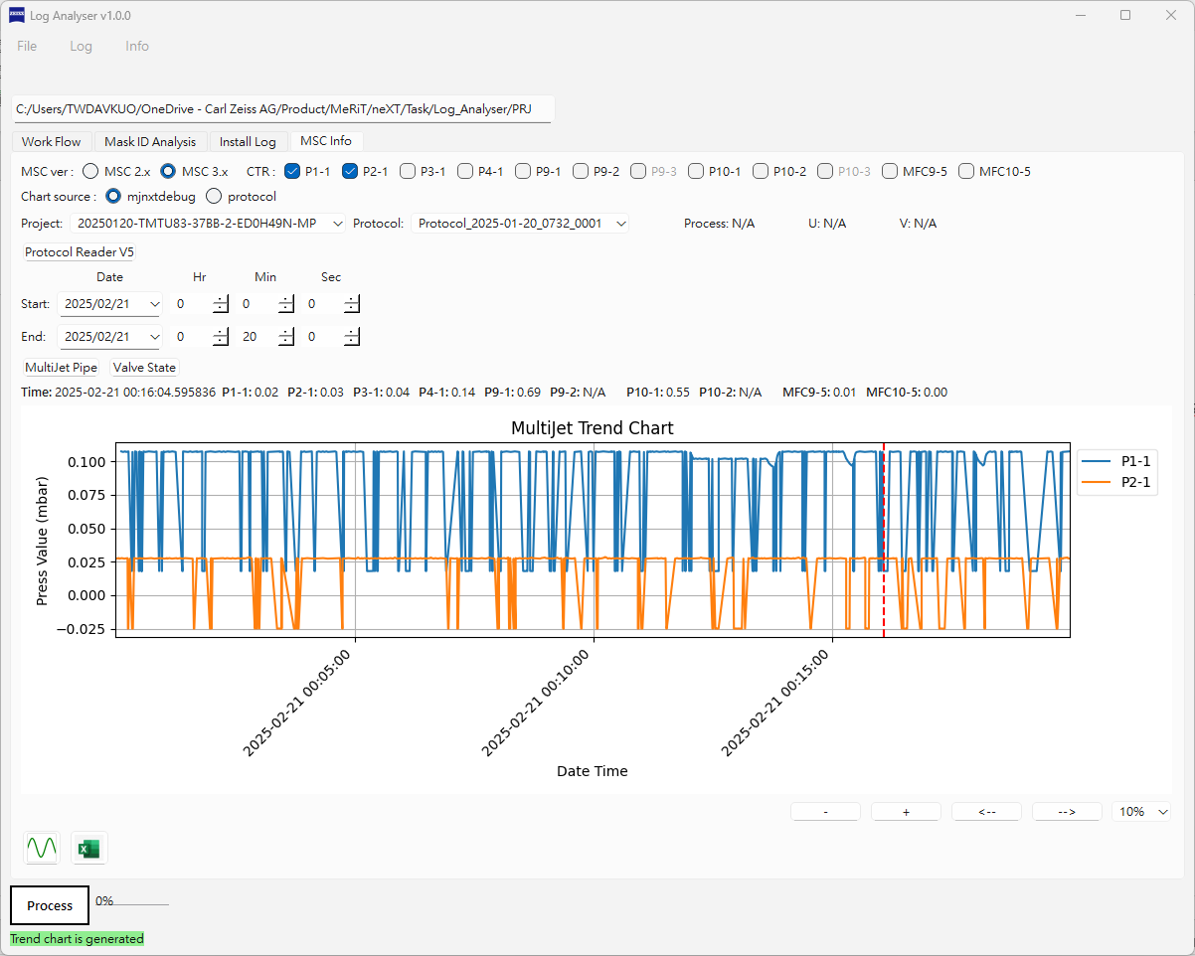
MSC Info
Function introduction
MSC Info Tab:
MSC protocol
Select 2.x or 3.x MSC fw version
CTR/MFC filter
Gauge display filter
Parsing file source
Select the log source is mjnxtdebug.log or protocol.txt
Protocol information
Information from parsed protocol.txt
MSC time filter
Time filtered depends on the mjnxtdebug.log
MSC valve diaggram
Show valve status
Generate chart button
Generate the chart
Export button
Export to Excel
CTR/MFC filter
MSC protocol
Parsing file source
Protocol information
MSC log time filter
MSC valve diagram
Trend chart
Generate chart
Export to Excel

Slide 12
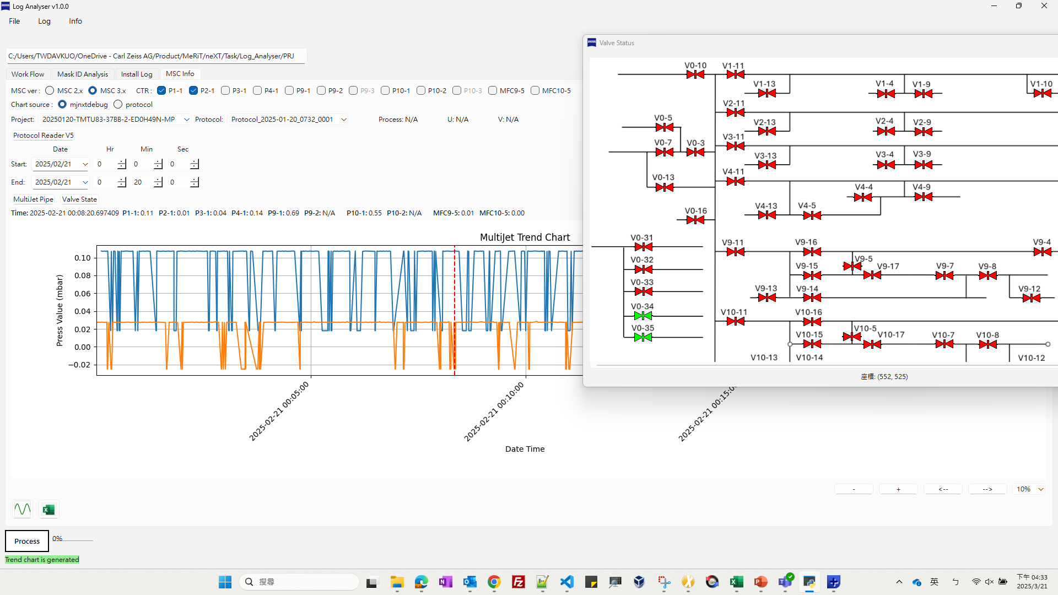
MSC Info
Valve information window
CTR/MFC filter
Valve state window:
Press Valve State button
Valve state will be displayed based on the time slice

