Slide 1
Project 1
Lab Name：VCSDL (Video and Communication System Design Lab)
Advisor： Prof. Kuo Chih Hong
Group： Group 32
Team Members：J.W Wu, J.H Hu

Slide 2
Outline
FIFO
Simulation Results
Verification Techniques and Properties
  Scoreboard3
  SVA Code
Bugs Injection and Re-Verification

Slide 3
Outline
FIFO
Simulation Results
Verification Techniques and Properties
  Scoreboard3
  SVA Code
Bugs Injection and Re-Verification

Slide 4
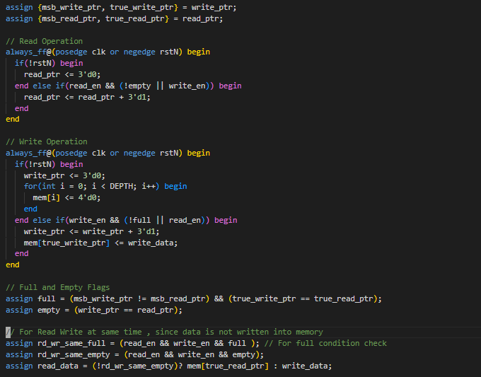
FIFO
讀寫指針以及寫入FIFO內Memory
FIFO source code
實際上指針只需要2bit
為了判別滿邏輯增加1bit
用來判斷是否繞一圈追上讀指針
當讀指針和寫指針相等時為空
當寫指針追上讀指針時為滿
Full Empty 判斷
讀資料操作
支援同時讀寫

Slide 5
Outline
FIFO
Simulation Results
Verification Techniques and Properties
  Scoreboard3
  SVA Code
Bugs Injection and Re-Verification

Slide 6
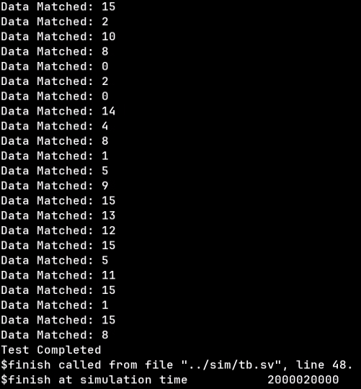
Simulation Results
Target :
  Overflow Detection
  Underflow Detection
  Data Integrity

Slide 7
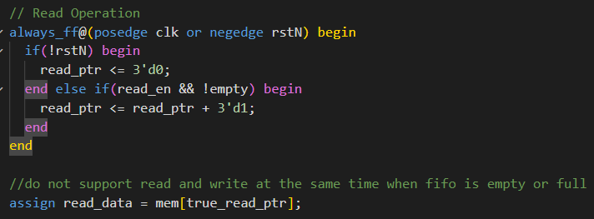
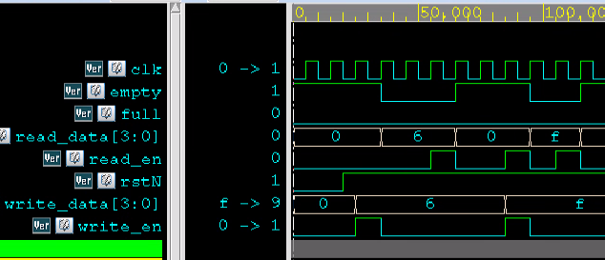
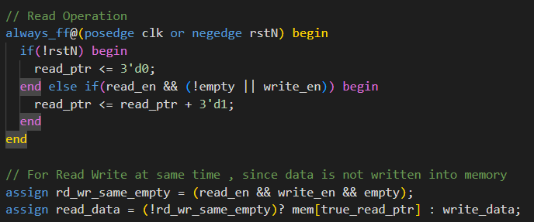
Simulation Results (Only One Case)
沒考慮到同時讀寫情況
如果同時讀寫的話即便在空或滿的情況
也要可以對讀寫指針做操作
同時如果空又同時讀寫的話由於FIFO寫入要花1T
因此加上if else判斷是否空又同時讀寫

Slide 8
Outline
FIFO
Simulation Results
Verification Techniques and Properties
  Scoreboard3
  SVA Code
Bugs Injection and Re-Verification

Slide 9
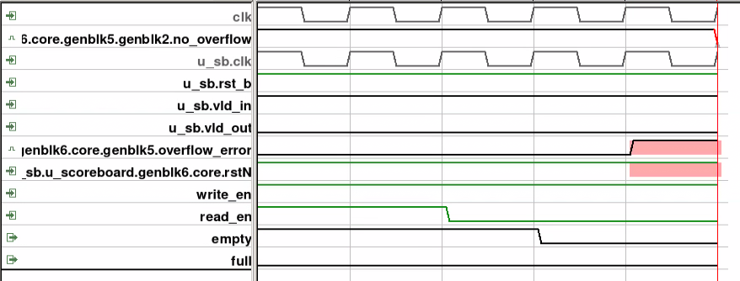
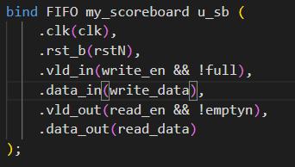
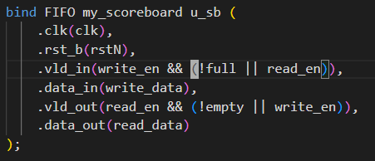
Scoreboard3
Bugs Found : 實際上沒有full但是卻有overflow error
Interface and Binding
How to fix it : 在空或滿且同時讀寫時一樣可以對Scoreboard做操作

Slide 10
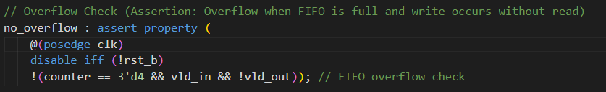
SVA
SVA Property :
在scoreboard資料達到設定的最大數量時不能只進行寫操作不進行讀操作
Property: no_overflow
Jasper Result:

Slide 11
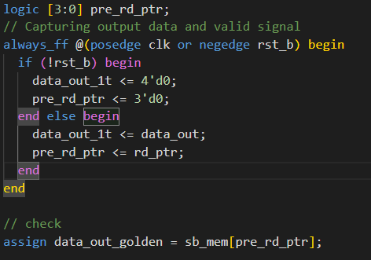
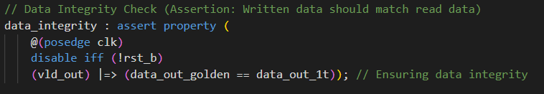
SVA
SVA Property :
把讀出的資料延遲一個cycle，此資料必須和Scoreboard內存的一樣
Property: data_integrity
Jasper Result:

Slide 12
Outline
FIFO
Simulation Results
Verification Techniques and Properties
  Scoreboard3
  SVA Code
Bugs Injection and Re-Verification

Slide 13
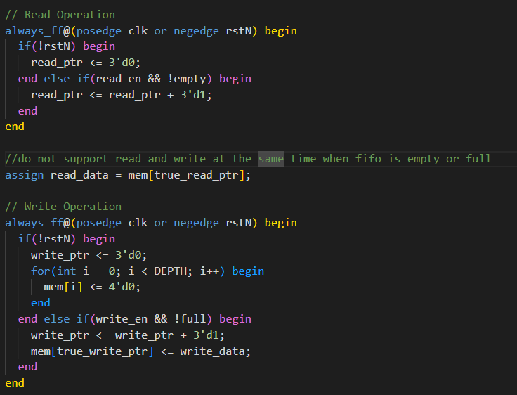
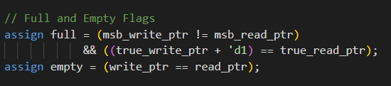
Bugs Injection
What is the bug(s)：
空滿時不能同時讀寫
Full 判斷錯誤

Slide 14
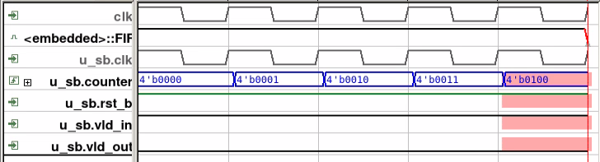
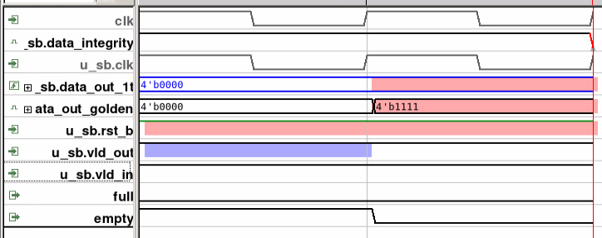
Re-Verification
Jasper Result
Overflow
Data Integrity

Slide 15
Thanks for attention

