Slide 1
SWE 681 / ISA 681
Secure Software Design & Programming:
Lecture 4: Design
Dr. David A. Wheeler
2025-07-28

Slide 2
Outline
EU Cyber Resilience Act (CRA) requires secure design
Saltzer and Schroeder design principles
More in-depth on some design principles (a grab bag!), e.g.:
  Minimize privileges
  Counter TOCTOU issues
Detect, contain, respond
  Including: Design in updates!
NIST SP 800-160 volume 1 list of design principles
Supply chain / reuse
Five Star Automotive Cyber Safety Program (“I am the Cavalry”)
Clouds & how they are implemented
  Containers, virtual machines
Attack (Threat) modeling
Self-protecting software systems

Slide 3
What’s design?
ISO/IEC 12207:2008:
  “Software architectural design.
    For each software item …the implementer shall transform the requirements for the software item into an architecture that describes its top-level structure and identifies the software components.
    It shall be ensured that all the requirements for the software item are allocated to its software components and further refined to facilitate detailed design.”
  “Software detailed design process is to provide a design for the software that implements and can be verified against the requirements…”
In short:
  Determine components (e.g., classes, programming languages, frameworks, database systems, etc.) that you’ll use, and how you’ll use them (interconnections/APIs), to solve the problem

Slide 4
Abstract view of a program
Program
Process Data
(Structured Program Internals)
Input
Output
You are here
Call-out to
other programs
(also consider
input & output issues)

Slide 5
EU Cyber Resilience Act (CRA) requires secure design
Cyber Resilience Act (CRA): European Union (EU) regulation
“Manufacturer must design/develop/produce per I Part I [13(1)]”
  “be designed, developed, and produced to…”
    limit attack surfaces, including external interfaces [I(I)(2)(j))
    reduce the impact of an incident using appropriate exploitation mitigation mechanisms and techniques [I(I)(2)(k))
“Assess cybersecurity risks, apply throughout lifecycle, min. cybersecurity risks [13(2)]”
Source: CRA (Regulation (EU) 2024/2847): https://eur-lex.europa.eu/legal-content/EN/TXT/?uri=CELEX%3A32024R2847

Slide 6
Developing secure software is not new & unknown
Saltzer & Schroeder principles, & many specifics, publicly known since at least 1970s
Problem is that most software developers do not know how to do it
  Attackers, of course, know this
Knowing various principles & rules-of-thumb ahead-of-time can avoid many problems later
  This lecture is all about those various principles & rules-of-thumb
  Principles & rules-of-thumb have trade-offs & exceptions, but knowing them is important

Slide 7
Saltzer and Schroeder design principles (1)
Least privilege
  Each user and program should operate using fewest privileges possible
  Limits the damage from an accident, error, or attack
  Reduces number of potential interactions among privileged programs
    Unintentional, unwanted, or improper uses of privilege less likely
  Extend to the internals of a program: only smallest portion of program which needs those privileges should have them
Economy of mechanism/Simplicity
  Protection system's design should be simple and small as possible
  “techniques such as line-by-line inspection of software and physical examination of hardware that implements protection mechanisms are necessary. For such techniques to be successful, a small and simple design is essential.‘”
  Aka “KISS” principle (``keep it simple, stupid'')

Slide 8
Saltzer and Schroeder design principles (2)
Open design
  The protection mechanism must not depend on attacker ignorance
  Instead, the mechanism should be public
    Depend on secrecy of relatively few (and easily changeable) items like passwords or private keys
  An open design makes extensive public scrutiny possible
  Makes it possible for users to convince themselves system is adequate
  Not realistic to maintain secrecy for distributed system
    Decompilers/subverted hardware quickly expose implementation “secrets”
    Even if you pretend that source code is necessary to find exploits (it isn't), source code has often been stolen and redistributed
    This is one of the oldest and strongly supported principles, based on many years in cryptography
      Kerckhoffs's Law: “A cryptosystem should be designed to be secure if everything is known about it except the key information”
      Claude Shannon (inventor of information theory) restated Kerckhoff's Law as: “[Assume] the enemy knows the system”

Slide 9
Saltzer and Schroeder design principles (3)
Complete mediation (“non-bypassable”)
  Every access attempt must be checked; position the mechanism so it cannot be subverted. For example, in a client-server model, generally the server must do all access checking because users can build or modify their own clients
Fail-safe defaults (e.g., permission-based approach)
  The default should be denial of service, and the protection scheme should then identify conditions under which access is permitted
  More generally, installation should be secure by default
Separation of privilege
  Ideally, access to objects should depend on more than one condition, so that defeating one protection system won't enable complete access

Slide 10
Saltzer and Schroeder design principles (4)
Least common mechanism
  Minimize the amount and use of shared mechanisms (e.g. use of the /tmp or /var/tmp directories)
  Shared objects provide potentially dangerous channels for information flow and unintended interactions
Psychological acceptability / Easy to use
  The human interface must be designed for ease of use so users will routinely and automatically use the protection mechanisms correctly
  Mistakes will be reduced if the security mechanisms closely match the user's mental image of his or her protection goals

Slide 11
Some additional important design principles (my view)
Limited attack surface
  Limit how attackers can get to the software you trust
Input validation with whitelists
  Limit what can enter the system through attack surface
Harden the system
  Defects happen! Design system so a single defect’s less likely to result in complete compromise
These can all be viewed as special cases of minimizing privilege

Slide 12
Design principles…
Any design must also consider other requirements & specific circumstances
Not all details apply to all systems
  Web apps ≠ Local apps ≠ GUI ≠ setuid programs
  But better to know the larger set of issues
We’ll now cover specific design issues
  Several just add details on S&S principles
  Something of a “grab bag” of things to consider

Slide 13
Securing the interface
Interfaces should be
  Minimal (simple as possible)
  Narrow (provide only the functions needed)
  Non-bypassable
Trust should be minimized
Consider limiting the data the user can see
We’ve already discussed filtering input data – trusted components must filter input data from untrusted sources
Code you trust must run in an environment you control, not on a system controlled by an attacker
  Necessary for complete mediation/non-bypassability
  Code run in a browser/client is bypassable if an attacker runs the browser/client (attacker can modify or replace)

Slide 14
BEWARE: Warning signs of bad designs (leading to bypassability)
JavaScript running on the client that does input validation or other security-relevant operations
  Ensure all security-relevant operations (e.g., input validation) is re-performed in a trusted environment (typically on the server)
  In most situations client cannot be trusted; only server is trusted
  Common mistake with big JavaScript frameworks & large mobile apps
  Can be secure, but only if checks are re-performed in a trusted environment
Mobile app does security-relevant input validation (same client-side issue)
Database is directly accessible via the network for use by a client application (web browser, mobile app, etc.)
  Can be secure, but must ensure that all operations the user can possibly perform are acceptable (e.g., control with SQL grant)
  Often better (or necessary) to interpose access instead of providing direct access to database; direct database access may violate least privilege
If the attacker is running your code, the attacker can modify or replace your code – don’t let the attacker control your system!

Slide 15
JavaScript framework example #1
Execution of application-specific JavaScript code, including some security-relevant input validation checks
Files with JavaScript code to be executed on the client (downloaded by user’s web browser on request)
Execution of JavaScript framework/library (e.g., React, Angular, Vue, JQuery, etc.)
Database with API providing direct access to all data to logged-in users
Login mech-anism
Runs in web browser
Runs on trusted server
Is this input validation approach acceptable?
NO! THIS DOES NOT PROVIDE ANY SECURITY!
JavaScript sent to a web browser is executed client-side. This typically makes it trivial to bypass and thus irrelevant for security. This JavaScript may be useful to speed non-malicious responses, but it does not counter attack.

Slide 16
Obfuscated Code is not enough to secure the interface
Obfuscation: deliberate act of creating source or machine code that is (more) difficult for humans to understand
Code sent to client (e.g., JavaScript or Web Assembly) can be first sent through an obfuscator (result aka shrouded or scrambled)
  Minification provides mild level of obfuscation
  Tools focusing on scrambling (jscrambler, etc.) can do more obfuscation
Some naïve developers think no one can de-obfuscate or replace it
Basic problem: If it is obfuscated, it can be de-obfuscated
Obfuscation may slow naïve attacks; it does not prevent attackers from:
  Learning how the code works
  Finding data sent to the code (including any secret keys you send)
  Changing or replacing the code
Obfuscation is inadequate for non-bypassability/security
  Non-bypassability means the attacker can’t bypass it
  Security-relevant code (such as input validation code) needs to run in a trusted environment, not as obfuscated code in an environment that the attacker could control

Slide 17

To run trusted code within an attacker-controlled system…
Don’t do it! Trying to do it is very risky, difficult, & best avoided
Some advanced client-side mechanisms try to do this
  Digital Rights Management (DRM) systems, Trusted Platform Module (TPM), etc. try to enable execution inside client “protected” from owner of client
  Theory: Can trust software running on environment controlled by attacker
  In practice: typically broken quickly (hardware protections can be undone if you physically control the hardware) or bypassed (e.g., videos), even when implemented using specialized teams of experts (you must use such teams)
  Ethical issue: Should you prevent users’ control of the hardware they own?
  If you succeeded & users can’t break it, dangerous to users & society
  Potential liability issue: System owner doesn’t control the system
  Often better to check on server and/or limit physical access to client
Research ongoing to run trusted code on untrusted servers
  Homomorphic encryption: enables computation on encrypted data that remains encrypted, so can compute on server you don’t trust while maintaining confidentiality/integrity (not availability)
  Fully homomorphic encryption is research
  Partial homomorphic encryption (supporting only a subset of operations) currently practical only in very special cases (huge overhead)
Avoid this. Work to run code you’ll trust on on a system you control
Notes:
Terminator head PNG from http://pngimg.com/download/29765
Fair use asserted.
CC-BY-NC 4.0 asserted on image

Slide 18
Minimizing privileges
Strive to provide “least privilege”
  Program components should only have minimum necessary privileges
  Limits damage if attacker breaks in
  Don’t make a program setuid; make it a normal program & require admin login
  Consider breaking into pieces with small trusted pieces
Unix-like systems
  Primary privilege determiner is EUID/EGID
  “Saved” SUID/SGID lets you temporarily disable/re-enable
  “chroot” lets you limit filesystem visibility
This principle has many aspects

Slide 19
Minimize privileges granted
Don’t grant root
  Avoid creating setuid root programs
Option: Create special group
  Grant file access to that group
  Setgid group, or run daemon process as group
Option: Create special user
  Web servers typically do this (“nobody”)
  Better to create group than user – easier to admin group
Option: Limit database rights for application
  Create pseudo-user(s)/groups with limited rights
    E.g., application may only need select or insert
  SQL GRANT …

Slide 20
Minimize time privilege can be used
Permanently give up privilege ASAP
  E.G., set EUID/EGID and SUID/SGID to RUID/RGID
  Web servers do this
    Need root privileges to attach to port 80
    Don’t need them afterwards, so permanently drops
Sometimes can’t do this

Slide 21
Minimize time privilege is active
Temporarily give up privileges
  Can do with setuid(2), seteuid(2), setgroups(2)
Less useful than giving up permanently
  Some attacks can force program to re-assert
  But some attacks can’t, so still helps

Slide 22
Minimize modules granted privileges
Break into parts
  Only some parts (preferably small) have privilege
  Its API limits actions the rest can request
    E.G., “Returns authenticated yes/no” & hides password info
Break up roles, e.g., “admin” vs “user” components
  Give program for user interface far fewer privileges
  Web app: Separate admin interface, different privileges
Traditional GUI: Don’t give privilege to GUI
  GUI toolkits are big
  Instead, GUI talks to separate program with privilege
Create special program that does one small thing

Slide 23
Minimizing privileges:
Limit accessible resources
Put all web program (e.g., CGI) data outside document tree
  So users cannot request data by URL
Minimize resources available
  Limit CPU resources, data space, etc.
  If “goes haywire” can detect & stop sooner
Consider using mechanisms to limit visibility
  E.G., chroot (next), containers, virtual machines

Slide 24
Minimizing privileges:
Mutually suspicious components
In “mutually suspicious components” the system is broken into components…
But the components strictly limit the trust granted to others
Limits damage if one component is subverted
Can be challenging to do in some systems

Slide 25
Chroot & Containers
Unix-like systems (unlike Windows) have a “top” directory “/” (root directory)
“chroot” call can change what “/” refers to in a process (privileged call)
  Attempts to “cd ..” through it don’t work
  Called a “chroot jail”
  Makes large portions of filesystem inaccessible
Must set up, call chroot, cd into chroot jail, close all files, and drop all privileges
Chroot cannot protect against root privileges
Basis for implementing containers (discussed later)

Slide 26
Configure safely/ use safe defaults
Make initial installation secure
  Don’t have a “default” password – force setting
  Start with most restrictive policy until reconfigure
  “Sample” configurations must be secure
    People will use them as starting points
  Installed files not writeable (or readable?) by others
  Make installable by non-root (if practical)
  During install, check assumptions are true
Make it easy to reconfigure while keeping secure
  Make configuration easy in general
  Deny access until specifically granted

Slide 27
Load initialization values safely
If load initialization values, make sure they can’t be subverted
  Ensure attacker can't change which initialization file is used, nor create or modify that file
  If a traditional user application, don’t use current directory – use user’s home directory
If the program is setuid/setgid
  Don’t read any file controlled by the user unless you carefully filter it as an untrusted (potentially hostile) input
  Trusted configuration values should be loaded from somewhere else entirely (typically from a file in /etc)

Slide 28
Minimize file privileges
Minimize who can read
  Should ordinary users be able to read config file?
  Probably not, especially if sensitive info like passwords might be there
  Android: “other user” should not normally have r/w access (different application)
Especially minimize who can write
Consider checking before use
  E.G., stop processing configuration file if arbitrary user can write the file or directory it’s in

Slide 29
Fail safe
Failure will happen
  Design so if (when) program fails, safest possible result occurs
Two possibilities:
  Fail open: Try to fail in a way that allows system to function (choose if availability most important)
  Fail closed: Restrict access on failure, even if it means loss of service (choose if confidentiality or integrity are more important)
“Open/closed” is “like a door” not “like an electrical circuit”

Slide 30
Bad input
Don’t crash when bad input occurs
  That sets up easy DoS
Malformed input should stop processing that request & prep for next request
  Don’t try to “figure out what the user wanted” – if it’s security-related, just deny service
Don’t reply with too much information
  Just “access denied” & log the rest

Slide 31
Avoid race conditions
Race condition'' = “Anomalous behavior due to unexpected critical dependence on the relative timing of events'' [FOLDOC]
  Generally involve one or more processes…
  accessing a shared resource (e.g., file or variable)
  where multiple access isn’t properly controlled
Problems because:
  Sequencing (non-atomic) problems
    Interference often from untrusted processes
    Typically solve by creating locks
  Deadlock/livelock/locking failure
    interference from trusted process, often same program

Slide 32
Sequencing/Non-atomic problems
Modern systems have many processors
  Even if one processor, typically simulate many
Loading/saving shared resource must be controlled
  Shared variable (memory)
  File
  …
If not controlled, may lead to vulnerability

Slide 33
Non-atomic “Add 1”
Process 1
Shared variable x
Process 2
Load x
3
Load x
3
3
Increment Accumulator
Increment Accumulator
4
4
Store x
4
Store x
4
time
Failure to lock means 3+2 = 4!

Slide 34
TOCTOU
Secure programs must:
  Determine if a request should be granted, and
  If ok, act on that request
Must not be possible for untrusted user to change anything relevant between #1 and #2
If can, termed “time of check - time of use” (TOCTOU) race condition
  Often best to just try to perform action (if atomic), and then look at error condition

Slide 35
Atomic actions in filesystem
If filesystem shared, can cause problems
  Don’t use “access(2)” to see if can do something
    Perhaps things will change!
  Just try to open file & check for errors
When creating a file, use open O_CREAT | O_EXCL
  C11 specification added fopen “x” exclusive mode
    Means fopen fails if the file already exists or cannot be created
    Otherwise, the file is created with exclusive (also known as non-shared) access
  Many other languages build on C’s “fopen”
    So this addition simplifies exclusive access

Slide 36
/tmp & /var/tmp directories
Typically shared among processes
  Used for “temporary” files and for sharing data between processes
Be very careful creating files here!!
In any shared directory, repeatedly:
  Create a ``random'' filename
  Open it using O_CREAT | O_EXCL and very narrow permissions (atomically creates the file, else fails)
  Stop repeating when the open succeeds
Otherwise, if attacker can create that file first, attacker owns & controls it

Slide 37
Filesystem: Insecure & secure
By themselves, many library implementations for creating temporary files aren’t secure
  tmpfile(3), mktemp(3), tmpnam(3)
  Shell convention “$$” isn’t secure – predictable filenames!
Instead, wrap in larger (securing) routines
  First, set creation file permissions to limit them
  Create name tempnam(3), try open O_CREAT | O_EXCL
  Repeat previous step until success
mktemp(1) is okay… unless temp cleaning!
  Automated “cleanup” can enable a race condition
  Safely created, temp cleaner erases, attacker creates

Slide 38
Symbolic & hard links
Unix-like systems allow “links”
  Symbolic link
    Stores the name of another file
    Any attempt to open this file redirected by name
  Hard link
    Creates another name for same file
    System counts how many links to file exist
Attackers may create links to existing files
  Trick privileged program into revealing/changing it

Slide 39
Locking
Often program must have exclusive rights (“lock”)
Standard lock problems:
  Deadlocks (“deadly embraces”)
    Process 1 locks A and waits for B; process 2 locks B and waits for A
  Livelocks
  Releasing “stuck” locks if program doesn’t clean up
Many deadlocks/livelocks can be prevented simply:
  Ensure all processes create locks in the same order

Slide 40
Files as locks
Traditional lock on Unix-like systems:
  Create a file to assert a lock
  E.G., /var/run/NAME.pid
  If lock stuck, can easily see (ls) & fix (rm)
  Works fine if O_CREAT|O_EXCL file
    And make sure that file permissions don’t let attacker in
Inside threads, use threading systems’ locks

Slide 41
Avoid sharing
Avoid sharing resources
  No sharing means no race conditions
  No sharing means attack on one might not affect the other
“Covert channels” are surreptitious ways to send data across data boundaries
  Require some sort of sharing

Slide 42
Trust only trustworthy channels
IP address typically forgeable
IP port under attacker control (usually)
Reverse DNS entry (“given this IP address, what is the name?”) usually under attacker control
Emails easily forgeable (unless digitally signed)
  Emailing back & forth, with cryptographically random entries, may be okay for low-value info, but it’s not hard to defeat
Server (including web server) must assume that client (or middleman) is not trustworthy (client can do anything!)
  Client controls HTML “hidden fields”, HTTP_REFERER, & cookies
  These cannot be trusted unless special precautions are taken (e.g., digitally signed, or encrypted using server-only key)
  Usually better off keeping data you care about at the server end in a client/server model

Slide 43
Use internal consistency-checking code
Check that key internal calls and basic state assumptions are valid
  Identify key invariants, and actually check them
Make sure that they stay running in the deployed system

Slide 44
Self-limit resources
Shed/limit excessive loads
Consider setting limit values (e.g., setrlimit(2) to limit resource use
  At least, don’t record debug info like “core” files in deployed systems
  May contain sensitive data

Slide 45
Secure install/configuration
No “default passwords” – force their setting
Ensure executables can’t be changed during normal operation
  Install executables (e.g., web apps) so they are owned by root/special install user, & not writable by others
  Ensure most programs run by others
  Even if that process is broken into, attacker can’t easily subvert executable – no permission!
  This means installation/update requires special permission, often true anyway
Sample files for admins should be secure

Slide 46
Secure install/configuration (2)
Ensure that configuration data is from secured locations
  /etc? $HOME? Environment variables?
  Configuration information should be in directories that can’t be easily accessed (at least write, maybe read). Often /etc
Implement “default deny”

Slide 47
Error reports
Limit error information sent back to user
  Information may help attacker
  Do log problems, in ways not available to potential adversaries
E.G., login failure
  Just tell them “authorization failed” – not “no such user” or “password incorrect” or (worse) “need longer password”

Slide 48
Protect credentials
Never hardcode credentials (e.g., passwords) into code – put credentials in separate place (CWE-259)
Don’t check live credentials into a version control system – they stick around
Encrypt credentials if you send them over network – never send them in the clear
Attackers hunt for credentials!
  NSA “hunts sysadmins” when attacking networks, in particular, they hunt for the “credentials of network administrators and others with high levels of network access and privileges that can open the kingdom to intruders…. [including looking for] hardcoded passwords in software or passwords that are transmitted in the clear” [Zetter2016]
“NSA Hacker Chief Explains How to Keep Him Out of Your System" by Kim Zetter, 2016-01-28, Wired,
a summary of a talk by Rob Joyce, chief of the NSA's Tailored Access Operations (TAO),
http://www.wired.com/2016/01/nsa-hacker-chief-explains-how-to-keep-him-out-of-your-system/

Slide 49
Defense-in-depth
Try to make attacker break multiple countermeasures before attack succeeds, e.g.:
  Buffer overflow countermeasure
  Limited privilege
No guarantee against attack, but can help
  If breaking all is necessary and each measure adds significant effort

Slide 50
Protect, Detect, Respond
Protect: Preventing break-in ahead-of-time is best
  Defense-in-depth: Attacker must break multiple levels
But prevention can’t always succeed
  Persistent attacker will break through layers
  Defender has to “defend everywhere” while attacker may only require one mistake/subversion
NIST Cybersecurity Framework has 5 functions
  Identify, Protect, Detect, Respond, Recover
  Groupable: (Identify &) Protect, Detect, (Respond &) Recover
Also support “detect, contain, respond”
  Protect: Limit privileges, sandboxes, etc.
  Detect: Logging / log analysis, tripwires, etc.
  Response: Record info as justifiable evidence

Slide 51
Design should include an update system to counter vulnerabilities
Vulnerabilities likely to be found later
Attackers often succeed using known vulnerabilities on unpatched systems
  “NSA and other APT attackers don’t rely on zero-day exploits extensively... they don’t have to... so many more vectors [are] easier... [including] known vulnerabilities for which a patch is available but the owner hasn’t installed it.” [Zetter2016]
Users often don’t update if they have to initiate
  92% of the 115K Cisco devices currently connected to the Internet running out-of-date vulnerable software (31% well past support) [Cisco 2016 Annual Security Report]
Plan and design for rapid automatic updates vs. vulnerabilities
  Ensure supply chain (e.g., OEMs, hardware makers, carriers) enable (Android!)
  Consider making updating secure & automatic, with a way for users to opt out if they wish (& a way for them to control rollout separately)
  Beware: Update system can create vulnerabilities; ensure update has a valid digital signature before automatically accepting it
  Safeguard update signing keys; don’t put on an Internet-connected machine
“NSA Hacker Chief Explains How to Keep Him Out of Your System" by Kim Zetter, 2016-01-28, Wired,
a summary of a talk by Rob Joyce, chief of the NSA's Tailored Access Operations (TAO),
http://www.wired.com/2016/01/nsa-hacker-chief-explains-how-to-keep-him-out-of-your-system/
Notes:
https://redmondmag.com/articles/2016/01/26/enterprise-security-confidence-declining.aspx

Slide 52
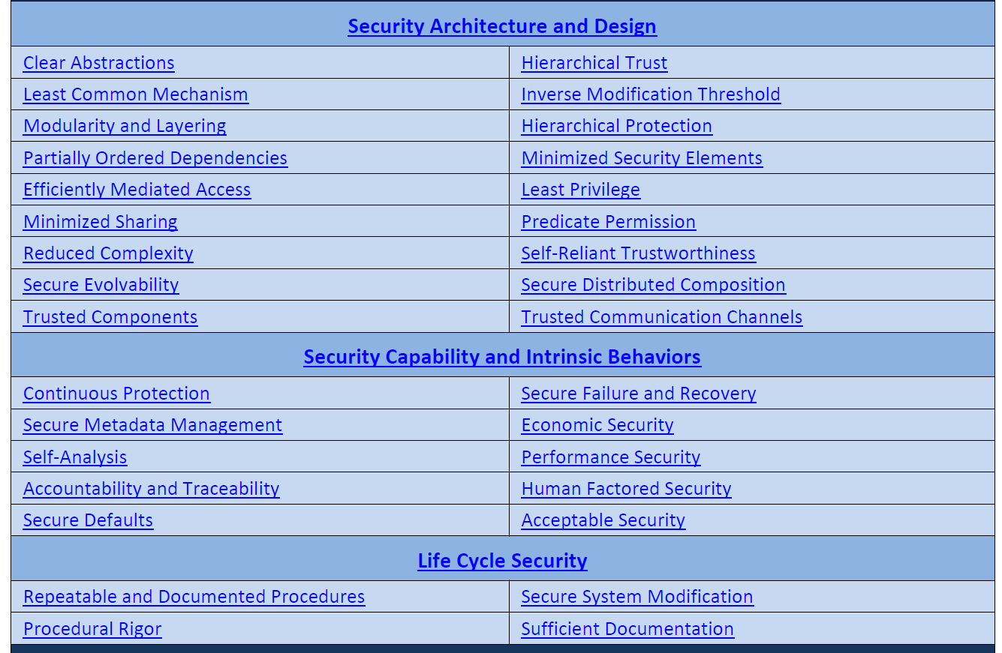
NIST SP 800-160 volume 1 Appendix F (design principles)

Slide 53
Supply chain / reuse
Supply chain = anything from elsewhere & how distributed
  Which components you’ll use, & how, is a design decision
  Important decision: What will you reuse? How get & verify?
  Includes operating system, programming language implementation(s), database systems, any other third-party components
Reused software may have unintentional or intentional vulnerabilities – manage that risk!
Evaluate risk of components before reusing them
  Learn more about component before reusing it
  Consider product, process (development & delivery), people
  What are others saying? What information is available?
  May want to evaluate it yourself (to what depth?)
  Non-OSS often more difficult due to less information
  Many ways to manage risk, once you realize it’s an issue
Establish process to quickly learn of component vulnerabilities & update
  Aids: Package manager, good test suite, conform to its API

Slide 54
Programming language selection
Selecting programming language(s) is a key architectural design choice
Depends on existing software, knowledge, domain, etc.
Where practicable, choose a programming language that reduces the likelihood of security vulnerabilities
  Includes countermeasures for common domain problems
Difficult to create secure software in C/C++
  Default operations are dangerous & provides no built-in mechanism to counter buffer overflows, double-free, etc.
  Syntax easily leads to errors (e.g., == vs. =)
  It is possible to write secure software in C/C++, but must be prepared to spend the time & effort to do it

Slide 55
Five Star Automotive Cyber Safety Program from “I am the Cavalry”
Safety by Design
  Published attestation of Secure Software Development Lifecycle, summarizing your design, development, and adversarial resilience testing programs for products and supply chain
  Supply Chain Rigor; Reduce Attack Surface/Complexity; Independent, Adversarial Testing
Third Party Collaboration
  Published coordinated disclosure policy inviting 3rd-party researchers acting in good faith
Evidence Capture
  Vehicle systems provide tamper evident, forensically-sound logging and evidence capture to facilitate safety investigations?
Security Updates
  Vehicles can be securely updated in a prompt and agile manner
Segmentation and Isolation
  Have a published attestation of the physical and logical isolation measures to separate critical systems from non-critical systems
  “If systems share the same memory, computing, and/or circuitry (as most current generation cars do), these systems allow for loss of life and limb. Such risks are entirely avoidable… Hacking the InfoTainment system should never cause an accident.”
  “Air Gaps: Physical separation is the only way to ensure that non-critical systems can not adversely impact primary, operational, and safety systems…”
  “System Integrity/Recovery: …Earlier detection can reduce the total duration and extent of the compromise as well as catalyze remediation…”
Source: https://www.iamthecavalry.org/domains/automotive/5star/
Notes:
https://www.iamthecavalry.org/domains/automotive/5star/

Slide 56
Cloud computing
Clouds widely used, often misunderstood
  Clouds often cheaper (where appropriate), many variations
  Decisions to use cloud (and how) impact security
NIST Definition of Cloud Computing (NIST SP 800-145):
  Cloud computing is “a model for enabling ubiquitous, convenient, on-demand network access to a shared pool of configurable computing resources (e.g., networks, servers, storage, applications, and services) that can be rapidly provisioned and released with minimal management effort or service provider interaction.”
  Five essential characteristics: On-demand self-service, broad network access, resource pooling, rapid elasticity, and measured service
Virtualization is common, but not required, to be a cloud

Slide 57
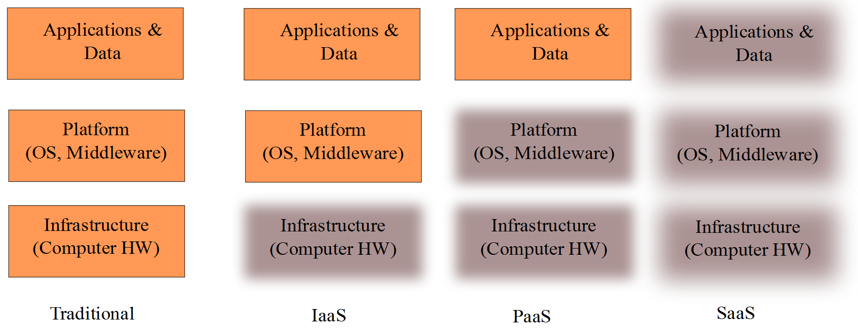
Cloud service models
Infrastructure as a Service (IaaS): “consumer [can] deploy and run arbitrary software [including] operating systems and applications....” Examples: Amazon Web Services (AWS), Windows Azure, Google Compute Engine, and Rackspace Open Cloud. OpenStack is OSS
Platform as a Service (PaaS): “consumer [can deploy] consumer-created or acquired applications...” Examples: Google App Engine, Red Hat OpenShift , Heroku, and Windows Azure Cloud Services. Amazon Web Services (AWS) also supports. OpenShift Origin is OSS
Software as a Service (SaaS): “consumer [can] use the provider’s applications running on a cloud infrastructure...”. Examples: SalesForce, Google docs
Source: NIST Definition of Cloud Computing (NIST SP 800-145)

Slide 58
Different cloud approaches have different security ramifications
Many different isolation mechanisms can implement clouds, e.g.:
  Physically separate (“bare metal clouds”)
  Virtual machines (VMs) (hardware virtualization) – hardware & VMM shared. When attacker breaks VMM or hardware, controls everything
  Containerization (“OS-level virtualization”) – OS kernel also shared. Creates processes with separate namespace (files, net, etc.). However, when attacker breaks OS kernel (bigger API than VMM) or hardware, controls everything
  Multi-user accounts – process tree & filesystem also shared. When attacker breaks privileged program (bigger API), OS, or hardware, controls everything
Who is cloud shared with?
  Public, limited community, private
  Increased sharing tends to lower cost, but also eases attacker access for attack
Who controls your cloud? Can you trust them? What’s the exit cost?
Always do risk management
  Sometimes it’s better to go with lower risk approach (of cloud, or non-cloud)
  Sometimes it’s better to mitigate or accept risk
For more information, see “Cloud Security: Virtualization, Containers, and Related Issues”
by David A. Wheeler, http://www.dwheeler.com/essays/cloud-security-virtualization-containers.html

Slide 59
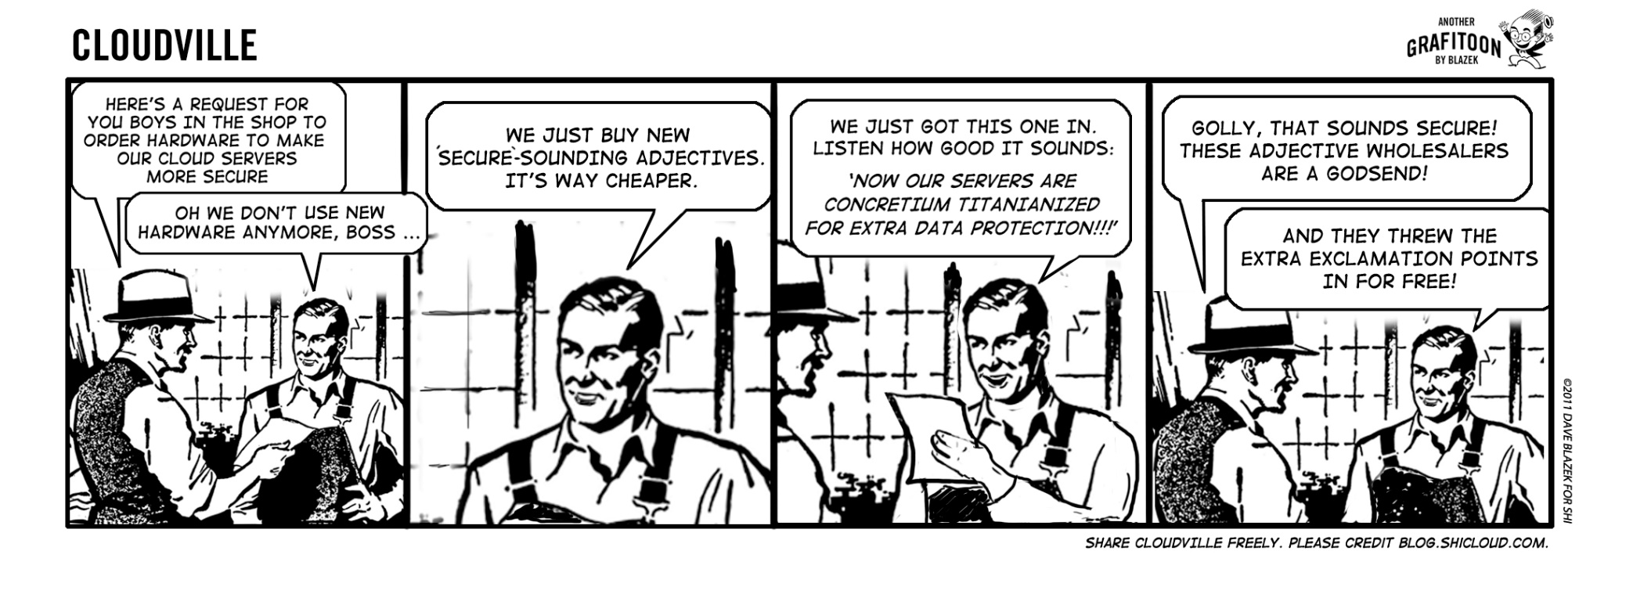
Cloud use is not automatically secure – who’s your supplier?
Dave Blazek, SHI Cloud CLOUDVILLE Cartoon. Licensed
under a Creative Commons Attribution-NoDerivs 3.0 Unported License.
http://readwrite.com/2012/01/15/cartoon-ways-to-improve-cloud
Based on a work at blog.shicloud.com.

Slide 60
Attack (Threat) modeling
When you have an initial design, think like an attacker before implementing it (cheaper!)
Sometimes called “threat modeling” (some object to term as misleading)
Varying approaches, often include:
  Define (security) requirements
  Define architecture/design model (need not be detailed)
  Analyze to identify attacks/security threats
  Determine risk level, select countermeasures
    Including design changes, additional components, etc.
  Keep updating

Slide 61
Analysis approaches
Attacker-centric
  Starts with an attacker
  Evaluates their goals & how they might achieve them (e.g., via entry points)
  Used in CERT attack modeling approach
Design-centric
  Starts with the design of the system: steps through system model, looking for types of attacks against each element
  Used in threat modeling in Microsoft’s Security Development Lifecycle
Asset-centric
  Starts from key assets entrusted to a system

Slide 62
Microsoft STRIDE Approach
Decompose system into relevant (design) components
  Design-centric approach
  Uses simple data flow diagrams, identify trust boundary
Analyze each component for susceptibility to threats
Mitigate the threats
“STRIDE” Threat | Security Property
Spoofing | Authentication
Tampering | Integrity
Repudiation | Non-repudiation
Information disclosure | Confidentiality
Denial of service | Availability
Elevation of privilege | Authorization
http://msdn.microsoft.com/en-us/magazine/cc163519.aspx
Notes:
See also:
http://blogs.msdn.com/b/ptorr/archive/2005/02/22/guerillathreatmodelling.aspx
Book “Threat Modeling” by Frank Swiderski and Window Snyder

Slide 63
CERT Attack Modeling
Create simple design overview
Develop “attack trees” – top is attacker’s objective, decompose down into conditions that achieve that (with AND or OR)
Devise methods to counter attack (build on attack patterns)
E.G., Buffer Overflow Attack Pattern:
  Goal: Exploit buffer overflow vulnerability to perform malicious function on target system
  Precondition: Attacker can execute certain programs on target system
  Attack:
    AND 1. Identify executable program on target system susceptible to buffer overflow vulnerability
    2. Identify code that will perform malicious function when it executes with program’s privilege
    3. Construct input value that will force code to be in program’s address space
    4. Execute program in a way that makes it jump to address at which code resides
  Postcondition: Target system performs malicious function
Source: http://www.cert.org/archive/pdf/01tn001.pdf
Notes:
“Attack Modeling for Information Security and Survivability”
Andrew P. Moore, Robert J. Ellison, Richard C. Linger
March 2001
http://www.cert.org/archive/pdf/01tn001.pdf

Slide 64
Other threat modeling approaches
Process for Attack Simulation and Threat Analysis (PASTA)
  Developed in 2012, risk/asset based approach
Operationally Critical Threat, Asset, and Vulnerability Evaluation (OCTAVE) – from CMU
Trike
  focuses on security auditing from cyber risk perspective
Visual, Agile, and Simple Threat (VAST) modeling

Slide 65
CAPEC
CAPEC = Common Attack Pattern Enumeration and Classification
Attack categories (per CAPEC-1000: Mechanism of Attack)
  Data Leakage Attacks (e.g., Probing an Application Through Targeting its Error Reporting)
  Depletion
  Injection (e.g., SQL injection, command injection)
  Spoofing
  Time and State Attacks
  Abuse of Functionality
  Probabilistic Techniques
  Exploitation of Authentication
  Exploitation of Privilege/Trust
  Data Structure Attacks
  Resource Manipulation
  Physical Security Attacks
Attack patterns:
  Network Reconnaissance
  Social Engineering Attacks
  Supply Chain Attacks
CAPEC can help you
“think like an attacker”,
so you can partly
anticipate what
they will try to do
Source: http://capec.mitre.org/

Slide 66
MITRE ATT&CK
Adversarial Tactics, Techniques, and Common Knowledge (ATT&CK)
  “is a curated knowledge base and model for cyber adversary behavior”
  “reflecting the various phases of an adversary’s attack lifecycle and the platforms they are known to target”
  Developed to describe attacks, but also covers defense
  Behavioral model focused on common cases
  Not exhaustive (CAPEC & CWE cover much more), but does help focus on what’s common
More info: https://www.mitre.org/publications/technical-papers/mitre-attack-design-and-philosophy

Slide 67
Self-protecting software systems
Eric Yuan (former student!), Naeem Esfahani, & Sam Malek (all at GMU) wrote “A systematic survey of self-protecting software systems” (2014)
  “Self-protection, like other self-* properties, allows the system to adapt to the changing environment through autonomic means without much human intervention, and can thereby be responsive, agile, and cost effective.”
  “Systematic literature review… classify and characterize the state-of-the-art research”
  Next several slides based on [Yuan2014]
Notes:
[Yuan2014] Yuan, Eric, Naeem Esfahani, & Sam Malek. “A systematic survey of self-protecting software systems”. ACM Transactions on Autonomous and Adaptive Systems (TAAS), Volume 8 Issue 4, January 2014, Article No. 17.

Slide 68
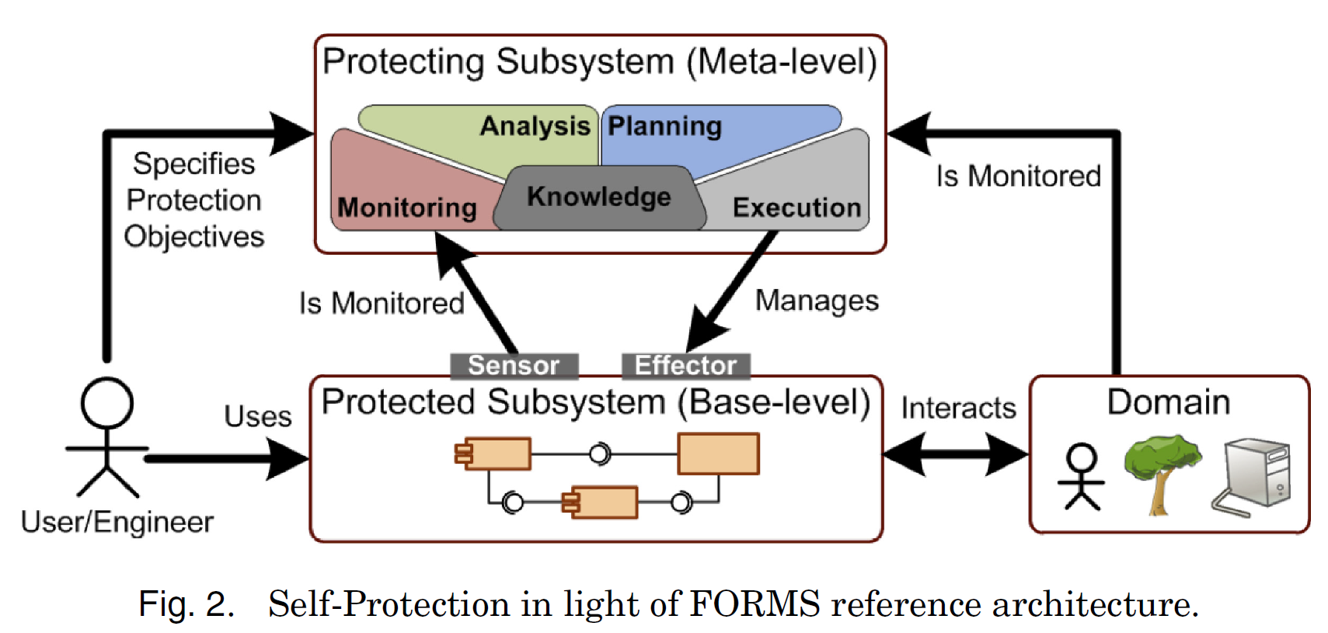
Self-protection: Basic model
Source: [Yuan2014], based on
FORMS formal language of [Weyns2012]

Slide 69
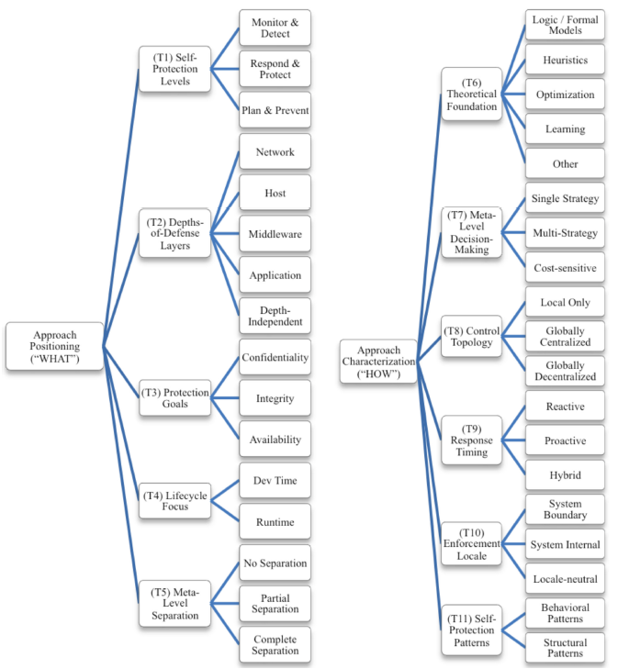
Self-protection: What & How
Source: [Yuan2014]

Slide 70
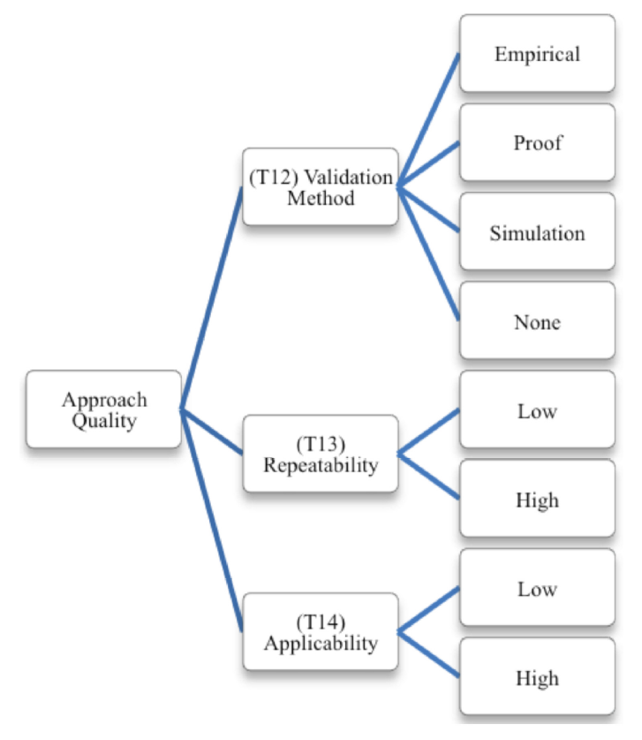
Self-protection: Quality
Source: [Yuan2014]

Slide 71
Conclusions
There are various key design principles
  E.G., Saltzer and Schroeder
Need to design program to counter attack, e.g.:
  Minimize privileges
  Counter TOCTOU issues
Use attack/threat modeling to look for potentially-successful attacks
  Before the attacker tries them
Many design approaches for self-protection
Consider principles & rules-of-thumb in design

Slide 72
Released under CC BY-SA 3.0
This presentation is released under the Creative Commons Attribution-ShareAlike 3.0 Unported (CC BY-SA 3.0) license
You are free:
  to Share — to copy, distribute and transmit the work
  to Remix — to adapt the work
  to make commercial use of the work
Under the following conditions:
  Attribution — You must attribute the work in the manner specified by the author or licensor (but not in any way that suggests that they endorse you or your use of the work)
  Share Alike — If you alter, transform, or build upon this work, you may distribute the resulting work only under the same or similar license to this one
These conditions can be waived by permission from the copyright holder
  dwheeler at dwheeler dot com
Details at: http://creativecommons.org/licenses/by-sa/3.0/
Attribute me as “David A. Wheeler”

