Slide 1
SWE 681 / ISA 681
Secure Software Design & Programming:
Lecture 8: Error Handling, Resource Handling, Debug code, Undefined Behavior, & Obsolete Code
Dr. David A. Wheeler
2020-06-19

Slide 2
Outline
Error handling
  Return codes (primary mechanism in C)
  Exceptions
Resource handling
Debug & assertion code
Undefined behavior
Obsolete/vulnerable libraries/functions
Note: Much of this is based on Chess & West

Slide 3
Example of improper error handling: Ariane 5 flight 501
Rocket Ariane 5 flight 501, 1996-06-04
  Lost control, self-destructed 37 seconds after launch
Control software tried to convert 64-bit floating point “horizontal bias” data into 16-bit signed integer
  Same code had been fine in slower Ariane 4
  Floating point value too large, caused processor trap
  Exception-handling mechanism coded to halt processor
    Implemented due to a “culture within the Ariane programme of only addressing random hardware failures… [which are] handled by a backup system” [Ariane 501 Inquiry Board Report]
    Redundant CPUs didn’t help, running same software
  Failing code wasn’t even required in Ariane 5

Slide 4
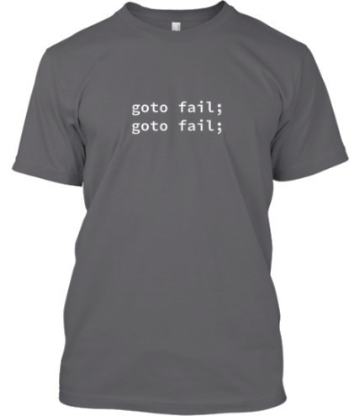
Apple’s iOS and OS X HTTPS
Serious flaw in Apple’s iOS and OS X HTTPS key verification found in 2014
Oddly doubled “goto fail;”:
  if ((err = SSLHashSHA1.update(&hashCtx, &signedParams)) != 0)
  goto fail;
  goto fail;
No curly braces, so second “goto” always executed
  The “fail” logic returns the error (none)
  So function will just succeed for any key offered
Source: https://web.nvd.nist.gov/view/vuln/detail?vulnId=CVE-2014-1266
and https://lwn.net/Articles/588369/
Notes:
T-shirt image from:
http://teespring.com/goto-fail-goto-fail
The T-shirt was a promotion were all proceeds were donated to EFF and FSFE; 258 were sold out of a goal of 10.

Slide 5
GnuTLS certificate validation botch
Serious flaw in GnuTLS certification validation found in 2014
Allowed specially crafted certificates to evade validation
Problem in function check_if_ca()
  Supposed to return true if issuer of the certificate is a certificate authority (CA)
  Prior to 2014 fix, check_if_ca() would return error codes as negative numbers if a problem
  Non-zero return interpreted as a true value by the caller
Fix was made in two places:
  Ensures that check_if_ca() returned zero when there were errors, and
  Also tests return value in verify_crt() for != 1 rather than == 0 (in case)
Source: CVE-2014-0092 and https://lwn.net/Articles/589205/

Slide 6
Error handling
Problems are a fact of life
  Almost any method/procedure/function can have bad things happen (bad data, can’t handle, etc.)
  Result: Huge number of potential error conditions
Improper error handling can produce vulnerabilities, leading to:
  Denial-of-service (e.g., due to bad resource handling or even catastrophic failure)
  Information leakage (e.g., error info gets to attacker)
  Loss of integrity (wrong results)
Two common mechanisms for replying that an error has occurred: Return codes & exceptions

Slide 7
Return codes
Return value may indicate error
  Return values can be overloaded to include return value (if okay) and error code(s)
    “On success returns 0..INT_MAX, error returns -1”
    “On success returns pointer, error returns NULL”
  This is the usual approach in C (since C doesn’t have exception handling)
  Can be (and is often) done in any language

Slide 8
Return code example (C)
#define KEY_NOT_FOUND -1 // Define error code
int binary_search(int A[], int key, int imin, int imax)
{
while (imax >= imin)
{
int imid = midpoint(imin, imax);
if (A[imid] < key)
imin = imid + 1;
else if (A[imid] > key)
imax = imid - 1;
else
return imid;
}
return KEY_NOT_FOUND; // Reply with error code
}
Source: Press, William H.; Flannery,
Brian P.; Teukolsky, Saul A.; Vetterling, William T. (1988),
Numerical Recipes in C: The Art of Scientific Computing,
Cambridge University Press, pp. 98–99, ISBN 0-521-35465-X,
via Wikipedia “Binary Search Algorithm”

Slide 9
C includes many standard functions with return codes, e.g., fprintf
“fprintf” defined in C11 as:
  #include <stdio.h>
  int fprintf(FILE * restrict stream,
  const char * restrict format, ...);
Returns an error code
  “The fprintf function returns the number of characters transmitted, or a negative value if an output or encoding error occurred.”
Widely-used “printf” is just fprintf(stdout, …)
Source: ISO/IEC 9899:2011 C standard (“C11”) sections 7.21.6.1 & 7.21.6.3

Slide 10
Other standard C functions that return error codes
FILE *fopen(…) – open file
  NULL on error
void *malloc(size_t size) – allocate memory
  NULL on error
int close(int fd) - close a file
  0 on success, -1 on error
int fclose(FILE *fp) – closes a file (pointer)
  0 on success, EOF if error
int setuid(uid_t uid) – set effective uid
  0 on success, -1 on error

Slide 11
Problems with error codes (1)
Requires caller check every return value for an error to handle it
  To distinguish between error & valid data
Easy to forget/ignore/mishandle errors
  This is a common mistake
Every method may have different semantics (e.g., different values to indicate “error”)
  Often 0, negative, INT_MAX, NULL … but not always
  Sometimes implementer accidentally defines, as an error value, a valid data value (is INT_MAX possible?)
If new types of errors, must often check every caller to ensure handled correctly

Slide 12
Problems with error codes (2)
Leads to functional logic & error handling being mixed together
  More complicated, leading to mistakes & poorer productivity
  Often fails to properly deallocate resources (memory, files, handles, etc.)
    Beware of functions with multiple exits (e.g., returns); often some paths fail to completely clean up
    Leading to resource loss
Error codes can be difficult to use correctly at scale;
mistakes lead to defects & sometimes security vulnerabilities

Slide 13
Consider putting C error handling at the end of the function
In C, can move error handling to end of function, separating it from functional logic
  Use “goto” to jump to it
  A “goto” is not a sin, you’re simulating exceptions (which are controlled exits)
  Makes it easier to implement recovery actions once they (or error-handling) are non-trivial
  Widely used in Linux kernel, part of its style:
    https://www.kernel.org/doc/Documentation/CodingStyle

Slide 14
Example: Logic & error-handling in line
struct lnode *insert(char *data, int len, struct lnode *list) {
struct lnode *p, *q;
p = (struct lnode *) malloc(sizeof(struct lnode));
if ( NULL == p ) return NULL;
p->str = (char *)malloc(sizeof(char)*len);
if (NULL == p->str ) {
free ( p ); // Must free first!!
return NULL;
}
memcpy ( p->str, data, len );
if (NULL == list) {
p->next = NULL;
list = p;
} else {
q = list;
while(q->next != NULL) {
if (0 == strcmp(q->str,p->str)) {
free(p->str); //Must free first!!
free(p);
return NULL;
}
q = q->next;
}
p->next = q->next;
q->next = p;
}
return list;
}
Source: http://blog.staila.com/?p=114
Notes:
Sample code from: http://blog.staila.com/?p=114

Slide 15
Example: Moving error-handling to end
struct lnode *insert(char *data, int len, struct lnode *list) {
struct lnode *p, *q;
p = (struct lnode *)malloc(sizeof(struct lnode));
if (NULL == p ) goto out; // Can’t allocate
p->str = (char *) malloc(sizeof(char)*len);
if (NULL == p->str ) goto out_free_p;
memcpy( p->str, data, len );
if (NULL == list) {
p->next = NULL;
list = p;
} else {
q = list;
while(q->next != NULL) {
if (0 == strcmp(q->str,p->str))
goto out_free_str;
q = q->next;
}
p->next = q->next;
q->next = p;
}
return list; // success!
out_free_str:
free(p->str);
out_free_p:
free(p);
out:
return NULL;
}
Source: http://blog.staila.com/?p=114
Notes:
Sample code from: http://blog.staila.com/?p=114

Slide 16
Exceptions
Nearly all languages (other than C & Go) have an “exception handling” mechanism
  Java, C#, Python, PHP (5+), Perl, Ruby, Tcl, JavaScript, C++, Ada, Smalltalk, Common Lisp, Scheme (6+), Erlang, Ocaml..
Basic concepts:
  “throw/raise” exception when error detected
  “catch/rescue” exception to handle it
  Might need to define region for “catch” (e.g., “try”)
  Might support “finally/ensure” that is run exception or not
  Often can include other info in exception
Separates functional logic from error handling
Go is an interesting exception for handling exceptions. See “Errors in Go: From denial to Acceptance”
https://evilmartians.com/chronicles/errors-in-go-from-denial-to-acceptance

Slide 17
Example exception format (Java)
Caller:
  try {
  … code that might encounter exception …
  } catch ( FileNotFoundException ex) {
  … code to handle FileNotFoundException …
  } catch (MySpecialException ex) {
  … code to handle MySpecialException …
  // } finally {
  // … code that is executed, regardless …
  // }
Callee:
  … discover some problem …
  throw new MySpecialException("Something special");

Slide 18
Tips for using exceptions securely
At the top level of program/framework (e.g., main event loop):
  Normally, catch all exceptions
  Log, then process next or terminate (process next if can)
  Logs can aid debugging, intrusion detection, etc.
  Don’t reveal detailed information (e.g., stack trace) to untrusted user
    Put detail in logs instead; such detail can greatly aid attacker
Otherwise:
  Be specific about the exceptions you catch
    Usually don’t catch “Exception”, catch a subclass
  Only catch if you can do something appropriate
    Difficult to address resource exhaustion errors
    If exception isn’t part of normal processing, log it too
  Let the other exceptions leak to the top of the program
Attackers will try to trigger exceptions
  Make sure their handlers are secure

Slide 19
Java: Throwable, Error, Exception
Object
Throwable
Any instance can be thrown
Throw & catch these. Indicate
some sort of exceptional problem
Hard failures in
Java VM; normally
not caught (might
try to log & exit)
Error
Exception
Incorrect use of API, e.g.,
NullPointerException;
typically code defect
RuntimeException
In Java any method must catch, or declare that it will throw, checked exceptions
These are all throwables except RuntimeException, Error, & their subclasses
Be specific about what you’ll throw (“throws IOException” not “throws Exception”)
  Makes it clear to callers what they need to catch or declare
Most other languages don’t require, but good to document in comments

Slide 20
Other error handling mechanisms
Type constructors, e.g., Haskell’s “Maybe”:
  data Maybe a = Nothing | Just a
  Returns either “Nothing” or “Just”+value
  Basically error return, but:
    Type system distinguishes value from non-value
    Cannot ignore error value – must extract value from result
Multivalue return, e.g., Go’s “err” conventions
  Functions can return multiple values, one of them can be “err”
  Avoids overloading problems, but you must still check them!
  See: https://blog.golang.org/error-handling-and-go
Call-with-current-continuation (call/cc)
  Originally developed in Scheme
  Takes current “snapshot” of local (non-global) state, calls function with snapshot as parameter
  Any time later can call procedure to invoke “snapshot” to return to that point & return a value from it (> once!)

Slide 21

Resource handling

Slide 22
Resource handling
Many limited resources exist
  Memory, GUI handles, file handles, sockets, disk space, CPU, …
  Most languages automatically manage memory for you, but you still need to manage the other resources
  C/C++/Objective-C/Ada: Must also manage memory
Failure to manage (release) resources properly
  Can lead to denial-of-service, poor performance, & sometimes serious errors (via misdirection)
  Often difficult to debug (works fine in small scale)
Resource leaks often caused by incorrect error handling
  We’ve already discussed dealing with error codes in C – putting resource handlers at the end of the function may help
May also need to limit CPU & disk space consumption

Slide 23
C++ constructor/destructor
Constructor called with object created
Destructor called when object goes out of scope
Can use for resource management
  Ensure all resources allocated in constructor are released in its corresponding destructor
  Only applies to that object – other allocations in that function aren’t managed by them
Beware: If copying an object doesn’t duplicate its resource, then destroying the original object and its copy will try to deallocate the same resource twice
  If copying the object does duplicate the resource, that duplication is not going to happen by itself – you have to write code to do that
Approach won’t directly work in Java for resource management
  Java does have “finalize” method, but it’s called at the discretion of the garbage collector… often far later, & maybe never

Slide 24
Finally blocks
“Finally” blocks (C++, Java, etc.) execute after try block whether or not catch was used
  Potentially useful for returning resources
When using in Java:
  Declare resources outside the try block (so that they will be in scope in the “finally” block)
  Initialize those resources before try (typically as part of the declaration)
  In “finally” block, verify that the resource has been allocated/consumed, and if it has, deallocate/release
  Beware that statements in “finally” may themselves throw exceptions

Slide 25
Example: “finally” block in Java
Finally block example:
static String readFirstLineFromFileWithFinallyBlock(String path)
throws IOException {
BufferedReader br = new BufferedReader(new FileReader(path));
try {
return br.readLine();
} finally {
if (br != null) br.close();
}
}
If methods “readLine and close both throw exceptions, then the method readFirstLineFromFileWithFinallyBlock throws the exception thrown from the finally block; the exception thrown from the try block is suppressed.”
Source: http://docs.oracle.com/javase/tutorial/essential/exceptions/tryResourceClose.html

Slide 26
Problems using Java “finally” for resource deallocation
Historically, “finally” recommended approach for Java for exceptions + resource handling
  However, easy trap: “return”ing from finally block will suppress exceptions, even completely unhandled ones!!
  In Java, consider using try-with-resources instead (Java SE 7 capability)

Slide 27
Java try-with-resources
Java try-with-resources automatically releases system resources when no longer needed
  try statement that declares one or more resources
  Ensures each resource closed at the end of the statement
  Resource = object that must be closed after the program is finished with it. Any object that implements java.lang.AutoCloseable, including implementers of java.io.Closeable
  Much easier to use correctly than finally blocks
  Must ensure that object to be managed implements AutoCloseable
Example:
  static String readFirstLineFromFile(String path) throws IOException {
  try (BufferedReader br = new BufferedReader(new FileReader(path))) {
  return br.readLine();
  }
  }
Source: http://docs.oracle.com/javase/tutorial/essential/exceptions/tryResourceClose.html

Slide 28
Preventing information leaks from error reports
Note: “information leak” != “resource leak”
Again, at the top level of program (e.g., main event loop), catch all exceptions
  Log, & don’t say much to untrusted user
Configure “error pages” in web servers/frameworks to say little to users
  “An error occurred” ok
  Being friendly is fine, link to front page is fine
  Do not reveal internal state or other information that might help attacker

Slide 29
Debug & assertion code

Slide 30
Debug handling
Developers often insert code solely to gain visibility (trace execution, show state, etc.)
  To debug, simplify testing, gain understanding
  By itself, that’s fine
Don’t leave this code (enabled) in production
  Much more likely to lead to defects & security vulnerabilities, since not designed in
Segregate & make it easy to remove
  E.G., #ifdef DEBUG … #endif
Consider logging some of this info & designing it in
  Eases debugging production systems
  See discussion of logging systems (earlier presentation)

Slide 31
Assertions (“Always happen”)
Assertions, e.g., assert(), are useful for sanity checking of program state
  Checks at run-time [Java: assert statement. C/C++: assert(), Node.js assert()]
  If assertion fails, throws exception (because current state “can’t happen”)
If attacker can cause assertion to fail, may lead to application exit or other behavior more severe than necessary
  E.G., if an assert() occurs in one server connection, & all other connections also dropped, can lead to a denial of service.
Where practical:
  Avoid allowing an attacker to trigger an assertion. In particular, do not use assertions for input validation of untrusted input
  Limit scope of assert response (exception handler) to attacker’s session (e.g., crash that connection, not all connections, if assertion fails)
Example of bad use of assertion (Java):
  String email = request.getParameter("email_address");
  assert email != null // Can be triggered by attacker
For more see CWE-617 (Reachable Assertion)

Slide 32
Undefined behavior (and friends)

Slide 33
Undefined behavior (and friends)
Some languages have some constructs whose behavior is not fully defined
C (and C++ and Objective-C) have:
  huge number of undefined behaviors (buffer overflows are just one special case of the general problem)
  unsafe semantics for undefined behavior – anything can happen
Intended improve performance, but can make it difficult to ensure program works correctly
Modern optimizers increasingly cause programs with undefined behavior to have dangerous results
We’ll focus on C here

Slide 34
C standard has three categories of less-defined behavior
3.4.1 implementation-defined behavior: unspecified behavior where each implementation documents how the choice is made
  EXAMPLE An example of implementation-defined behavior is the propagation of the high-order bit when a signed integer is shifted right.
3.4.3 undefined behavior: behavior, upon use of a nonportable or erroneous program construct or of erroneous data, for which this International Standard imposes no requirements
  NOTE Possible undefined behavior ranges from ignoring the situation completely with unpredictable results, to behaving during translation or program execution in a documented manner characteristic of the environment (with or without the issuance of a diagnostic message), to terminating a translation or execution (with the issuance of a diagnostic message).
  EXAMPLE An example of undefined behavior is the behavior on integer overflow.
3.4.4 unspecified behavior: use of an unspecified value, or other behavior where this International Standard provides two or more possibilities and imposes no further requirements on which is chosen in any instance
  EXAMPLE An example of unspecified behavior is the order in which the arguments to a function are evaluated.
A list of each of them is in the C standard, annex J
Source: Information technology -- Programming languages – C, ISO/IEC 9899:2011, published 2011-12-08 (aka “C11”),
section 3 (terms, definitions, and symbols)

Slide 35
In C, undefined behavior means anything can happen
With undefined behavior, “Anything at all can happen; the Standard imposes no requirements. The program may fail to compile, or it may execute incorrectly (either crashing or silently generating incorrect results), or it may fortuitously do exactly what the programmer intended.” [C FAQ]
“If any step in a program’s execution has undefined behavior, then the entire execution is without meaning.”
  “This is important: it’s not that evaluating (1<<32) has an unpredictable result, but rather that the entire execution of a program that evaluates this expression is meaningless.”
  “It’s not that the execution is meaningful up to the point where undefined behavior happens: the bad effects can actually precede the undefined operation.” [Regehr]; see also [Raymond2014]
[Regehr] Regehr, John. A Guide to Undefined Behavior in C and C++, Parts 1-3. http://blog.regehr.org/archives/213
[Raymond2014] Raymond, Chen. “Undefined behavior can result in time travel (among other things, but time travel is the funkiest)” , 2014-06-27, https://devblogs.microsoft.com/oldnewthing/20140627-00/?p=633

Slide 36
Examples of undefined behaviors
Pointer
  Dereferencing a NULL pointer
  Using pointers to objects whose lifetime has ended
  Dereferencing a pointer that has not yet been definitely initialized
  Performing pointer arithmetic that yields a result outside the boundaries (either above or below) of an array.
  Dereferencing the pointer at a location beyond the end of an array
Buffer overflows
  Reading or writing to an object or array at an offset that is negative, or beyond the size of that object (stack/heap overflow)
Integer Overflows
  Signed integer overflow
  Evaluating an expression that is not mathematically defined
  Left-shifting values by a negative amount (right shifts by negative amounts are implementation defined)
  Shifting values by an amount greater than or equal to the number of bits in the number
http://stackoverflow.com/questions/367633/what-are-all-the-common-undefined-behaviours-that-a-c-programmer-should-know-a

Slide 37
What really happens with undefined code?
C compilers are allowed to assume that undefined behaviors cannot happen
  Market pressures for performance encourage this
  Ever-more-aggressive optimizations are increasingly adding dependencies on this assumption
  Leads to faster code but also turns previously-working code into broken code
C compilers are no longer “high level assemblers”
  They implement a complex model

Slide 38
A trivial division by 0 example
Trivial example from Linux kernel lib/mpi/mpi-pow.c:
  if (!msize)
  msize = 1 / msize; /* provoke a signal */
On gcc with x86, generated signal as expected
On gcc with PowerPC, does not generate exception
On clang, no code generated at all
  Division by 0 is undefined behavior
  Since this “can’t” happen, the compiler presumes that on this branch msize != 0
  Since this branch only occurs when msize == 0, it must be impossible, and compiler removes everything as dead code
[Wang2012] Wang, Xi, et al., Undefined Behavior: What Happened to My Code?,
APSys ‘12, 2012, ACM, https://pdos.csail.mit.edu/papers/ub:apsys12.pdf

Slide 39
Optimizer reordering creates debugging snares
void bar (void);
int a;
void foo3(unsigned y, unsigned z)
{
bar();
a = y%z;
}
void bar(void)
{
setlinebuf(stdout);
printf ("hello!\n");
}
int main(void)
{
foo3(1,0);
return 0;
}
On many compilers, when optimizing this will crash without printing “hello” first because foo3 will compute before calling bar().
C compilers are allowed to reorder anything without side-effects, and undefined behaviors don’t need to be considered as side effects.
Source: [Regehr]

Slide 40
(Simplified) Linux kernel security flaw from undefined behavior
static void __devexit agnx_pci_remove (struct pci_dev *pdev)
{
struct ieee80211_hw *dev = pci_get_drvdata(pdev);
struct agnx_priv *priv = dev->priv;
if (!dev) return;
... do stuff using dev ...
}
Sample simplified Linux kernel code with a security defect.
The “dev->priv” presumes dev is non-null. That means that if “dev” is null, we have undefined behavior. In this case, the C compiler presumed that dev is not null, and threw away the “if (!dev) return” code.
The gcc flag -fno-delete-null-pointer-checks forces the retention of such checks
Source: [Regehr]. https://isc.sans.edu/diary/A+new+fascinating+Linux+kernel+vulnerability/6820

Slide 41
Pointer arithmetic:
Easily becomes undefined behavior
int vsnprintf(char *buf, size_t size, …) {
char *end;
/* Reject out-of-range values early... */
if (WARN_ON_ONCE((int) size < 0)) return 0;
end = buf + size;
/* Make sure end is always >= buf */
if (end < buf) { ... }
...
}
Linux kernel’s
lib/vsprintf.c
Source:
[Wang2012]
The C standard states that when an integer is added to or subtracted from a pointer, the result must be a pointer to the same object, or just one past the end of the object; otherwise the behavior is undefined
By this assumption, pointer arithmetic never wraps, and the compiler can perform algebraic simplification on pointer comparisons
Both gcc & clang simplify “(buf + size) < buf” to “size < 0”; on 32-bit clang will eliminate whole branch (size_t is unsigned to always true)
Linux kernel uses -fno-strict-overflow to prevent check removal

Slide 42
Clang-compiled program executes function never called (undef issue)
#include <cstdlib>
typedef int (*Function)();
static Function Do;
static int EraseAll() {
return system("rm -rf /");
}
void NeverCalled() {
Do = EraseAll;
}
int main() {
return Do();
}
main:
movl $.L.str, %edi
jmp system
.L.str:
.asciz "rm -rf /"
This always runs “rm –rf /”, even though NeverCalled() is never called.
The value of Do() is never set, so execution behavior of the program is undefined.
Source: “Why undefined behavior may call a never-called function”, Krister Walfridsson, September 4, 2017, https://kristerw.blogspot.com/2017/09/why-undefined-behavior-may-call-never.html

Slide 43
Things have changed in C/C++!
“Recently we have seen spectacular advances in compiler optimisation.
Spectacular in that large swathes of existing previously-working code have been discovered, by diligent compilers, to be contrary to the published C standard, and ‘optimised’ into non-working machine code.
In fact, it turns out that there is practically no existing C code which is correct according to said standards (including C compilers themselves).
Real existing code does not conform to the rules now being enforced by compilers. Indeed often it can be very hard to write new code which does conform to the rules, even if you know what the rules are and take great care.”
Recommended changing Debian’s “default compiler options to favour safety, and provide more traditional semantics.”
Source: Ian Jackson (UK), “Subject: Re: Packaging of static libraries”,
13 Apr 2016 13:29:05 +0100, https://lwn.net/Articles/684420/

Slide 44
Countermeasures for C/C++/etc. undefined behavior
LEARN what’s undefined, avoid those constructs, check each line as you write it
Enable and heed compiler warnings, preferably using multiple compilers
  E.G., gcc/clang -Wall -Wextra
Use static analyzers (like Clang’s, Coverity, etc.) to get even more warnings
Use compiler-supported checks (often dynamic); for example:
  gcc/clang -ftrapv generates code to trap signed integer overflows
  Sanitizers, e.g., -fsanitize=address (ASan), -fsanitize=unsigned-integer-overflow,
  -fsanitize=undefined (aka UndefinedBehaviorSanitizer or UBSan)
  gcc/clang -fcatch-undefined-behavior (but it won’t ALWAYS detect them!)
Use tools like Valgrind to get additional dynamic checks
If undefined only when preconditions unmet, document pre/postconditions
Use assertions to verify functions’ pre/postconditions hold (beware – can cause)
Particularly in C++, use high-quality data structure libraries
Consider compiler flags to change undefined behavior (safer C dialect)
  (gcc or clang) -fwrapv (wrap signed integer overflow), -fno-strict-overflow, -fno-strict-aliasing flag, -fno-delete-null-pointer-checks
  Try to avoid depending on these (kills portability), but can be useful as a mitigation
Avoid inappropriate use of these languages (do you need them for this task?)
Source: [Regehr], [Lattner] Lattner, Chris. What Every C Programmer Should Know About Undefined Behavior.
http://blog.llvm.org/2011/05/what-every-c-programmer-should-know.html
http://developerblog.redhat.com/2014/10/16/gcc-undefined-behavior-sanitizer-ubsan/

Slide 45
Complications for C signed overflow
Overflow of signed integers is undefined behavior in C
  No, it doesn’t “just wrap” (use unsigned)
GCC -fwrapv wraps signed integer overflow
  But often this hides a bug (often shouldn’t wrap)
GCC & clang support sanitizer
  “-f-sanitize=signed-overflow” warns/errors
  Not ideal: If with runtime warnings build size grows ~6%; without warnings just crashes on error
Source: https://lwn.net/Articles/798913/

Slide 46
Other languages
Java typically requires specific behaviors
  E.g., class-level variables always initialized
Java sometimes allows one of a small set of behaviors
  Like C “implementation-defined” or “unspecified”
  E.g., floating point without strictfp
Ada has a few undefined behaviors
  Very few, most easy to counter
Undefined behavior is usually less of an issue in languages where performance is less central
  A key reason it’s hard to write secure code in C, C++, or Objective-C

Slide 47
Obsolete/vulnerable libraries and functions
Notes:
Many of the following slides are derived from “Countering Vulnerable/Obsolete Software Libraries” by David A. Wheeler, IDA Non-standard (NS) document D-4706, cleared for public release on 2012-07-18. Permission to include this material granted by Margaret Myers on 2013-04-15.
It is based on “The Unfortunate Reality of Insecure Libraries” by Jeff Williams & Arshan Dabirsiaghi, published March 2012.

Slide 48
Obsolete/Insecure Libraries:
The problem
Modern applications typically depend on many libraries
  Library vulnerabilities can undermine application security
  When vulnerabilities found, libraries normally updated to fix them
  Libraries updated for other reasons, obsoleting older versions
“The Unfortunate Reality of Insecure Libraries” by Jeff Williams & Arshan Dabirsiaghi, published March 2012, examined real-life organization/ application library use:
  When applications updated, many libraries they depend on or use are not updated, leading
  Result: Applications/organizations use obsolete libraries, including those with known vulnerabilities
  Customers/users often have no way to know they are at risk
“The Unfortunate Reality of Insecure Libraries” - problem is pervasive: https://www.aspectsecurity.com/uploads/downloads/2012/03/Aspect-Security-The-Unfortunate-Reality-of-Insecure-Libraries.pdf
Following slides derived from “Countering Vulnerable/Obsolete Software Libraries”
by David A. Wheeler, IDA Non-standard (NS) document D-4706

Slide 49
“Unfortunate reality” data set
Sonatype maintains “Central Repository”
  Many Java applications download libraries from this
  Provides unusual view into how libraries are actually used
For analysis, used sample of 31 libraries
  1,261 versions (~41 versions/library)
  61,807 companies downloaded libraries
  Library instances downloaded 113,939,538 times
Data source: open source software (OSS) Java libraries
  No reason to think that different languages, or platforms, or proprietary licenses, would be significantly different
  Aspect security’s experience in evaluating “hundreds of custom applications” leads them to believe the results would apply equally – this is not just a “Java problem” or “OSS problem”
By Aspect Security in partnership with Sonatype

Slide 50
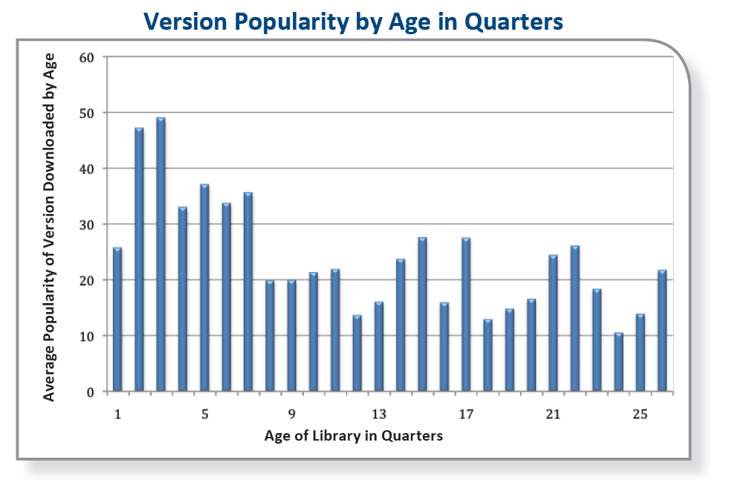
“Unfortunate reality”: Applications continue to use obsolete libraries
“If people were updating their libraries, [older libraries’ popularity would] drop to zero within the first two years. [But popularity extends] over six years.
One possible explanation is that some projects, perhaps new development efforts, tend to use the latest version of a library [and then] incremental releases of legacy applications are not being updated to use the latest versions of libraries…”
[Williams 2012]

Slide 51
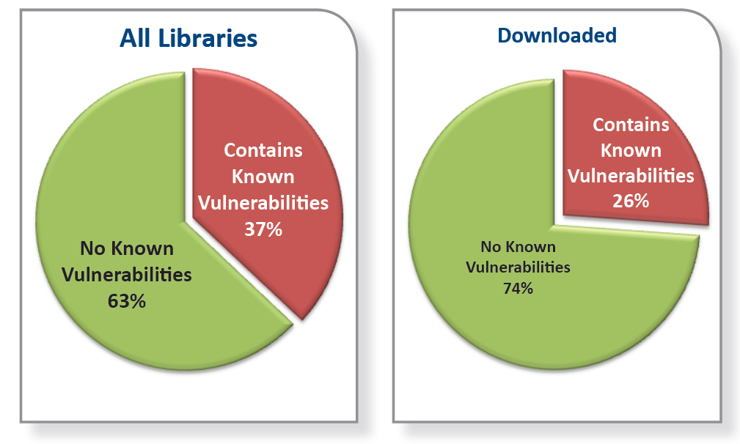
“Unfortunate reality”: Obsolete libraries lead to vulnerable ones
Of the 1,261 versions of the 31 libraries, 37% had known vulnerabilities.
26% of the library downloads were of those known-vulnerable versions of libraries
[Williams 2012]

Slide 52
“Unfortunate reality”: Developers could update but often don’t
Dependency management = process used by developers “to identify which libraries their project directly depends on, and recursively determining all of the further dependencies that those libraries require”
“Dependency management.. could enable organizations to keep libraries more up-to-date, gain awareness of security vulnerabilities in libraries more quickly, and ensure that libraries have appropriate licenses”
[But] “Even though there have been ample demonstrations of the cost of not controlling supply chains in other industries, little has been done to establish this control in the software industry
  … organizations typically have strong patch management processes for software products, [libraries] are typically not part of these processes.
  In virtually all development organizations, updates to libraries are handled on an ad-hoc basis, by development teams.”
[Williams 2012]

Slide 53
“Unfortunate reality” recommendations
“Any organization building critical software applications protect itself against these risks by taking steps to inventory, analyze, control, and monitor the use of libraries across the organization”:
  INVENTORY: Gather information about your current library situation
  ANALYZE: Check the project and the source for yourself
  CONTROL: Restrict the use of unapproved libraries
    Blocking direct access frequently results in worse “workarounds”
    Instead, use governance process, sandbox, guidelines
  MONITOR: Keep libraries up-to-date
[Williams 2012]

Slide 54
Check for obsolete/vulnerable libraries and platforms!
Check & update at least on initial selection & each significant update cycle
  You are responsible for what components you use/depend on
  This is part of the “cost” of using off-the-shelf components
  Some tools can help identify obsolete components, & web searches can help
  Don’t force users to use obsolete/vulnerable libraries/platforms
Struts 1 is end-of-life’d (Struts 2 available for years)
  “Struts 1 had its last release - version 1.3.10 - in December 2008…. users should not rely on a properly maintained framework state when utilizing Struts 1 in projects” [Apache]
  “Q: Given a major security problem or a serious bug is reported for Struts 1 in near future, can we expect a new release with fixes? A: … Actually no…”
  http://struts.apache.org/struts1eol-announcement.html
Windows XP & Office 2003 – don’t require these either!!
  “Windows XP SP3 and Office 2003 will go out of support on April 8, 2014. If your organization has not started the migration… you are late…” (2013-04)
  http://www.microsoft.com/en-us/windows/endofsupport.aspx

Slide 55
Equifax
Apache Struts critical vulnerability CVE-2017-5638 fixed on March 6, 2017
Equifax failed to update, even 2 months later
  Even though they manage sensitive data
In mid-May, attack on Equifax began, leading to exfiltration of very sensitive data on ~143 million US customers
Source: “Failure to patch two-month-old bug led to massive Equifax breach: Critical Apache Struts bug was fixed in March. In May, it bit ~143 million US consumers”, Dan Goodin , 9/13/2017
https://arstechnica.com/information-technology/2017/09/massive-equifax-breach-caused-by-failure-to-patch-two-month-old-bug/

Slide 56
Apache: Monitor & rapidly update reused software
“Our general advice to businesses and individuals [using any] open or closed source supporting library in their software products and services is as follows:
Understand which supporting frameworks and libraries are used in your software products and in which versions. [track] security announcements affecting [them]
Establish a process to quickly roll out a security fix release of your… product once supporting frameworks or libraries needs to be updated for security reasons… think in terms of hours or a few days, not weeks or months. Most breaches … are caused by failure to update [known vulnerable] software components…
Any complex software contains flaws. Don't [assume] that supporting software products are flawless, especially in terms of security vulnerabilities.
Establish security layers. It is good software engineering practice to have individually secured layers... A breach into the presentation layer should never empower access to significant or even all back-end information resources.
Establish monitoring for unusual access patterns… there are a lot of open source and [proprietary] products available to detect such patterns and give alerts…”
Source: “Apache Struts Statement on Equifax Security Breach”, 2017-09-09, René Gielen
Vice President, Apache Struts https://blogs.apache.org/foundation/entry/apache-struts-statement-on-equifax

Slide 57
Tools can help!
“Origin analysis” tools can examine software
  Determine what components are inside it, and which versions
  Many can determine if there are publicly-known vulnerabilities in those components
    E.g., by comparing to National Vulnerability Database
Package managers (OS & language level)
  Enable you to track & rapidly update software (including components within a larger system)
Automated test frameworks / test suites
  Quickly determine that you can deploy your update
  Remember negative tests (test what should not happen)
How quickly do you learn of a vulnerable component, update it, & deploy it to production? You must be faster than the attacker (hours..days)!

Slide 58
Obsolete functions/methods
Even if using current library, may be using obsolete functions/methods
CWE-477: Use of Obsolete Functions
  “The code uses deprecated or obsolete functions, which suggests that the code has not been actively reviewed or maintained”
  Sometimes security vulnerability directly, but even if not, may suggest other problems
  E.G.: C getpw() can overflow its buffer, so deprecated; should use getpwuid() instead

Slide 59
Sample Assurance Case: CII Best Practices BadgeApp
Implementation Architecture:
  https://github.com/coreinfrastructure/cii-best-practices-badge/blob/master/doc/implementation.md
Assurance case:
  https://github.com/coreinfrastructure/best-practices-badge/blob/master/doc/security.md
Video discussing BadgeApp assurance case:
  https://www.youtube.com/watch?v=5a5D4d6hcEY
Paper on assurance cases (with this as example):
  A Sample Security Assurance Case Pattern by David A. Wheeler, https://www.ida.org/idamedia/Corporate/Files/Publications/IDA_Documents/ITSD/2019/P-9278.pdf , Dec 2018
This is just an example to show what a real-world assurance case looks like

Slide 60
Conclusions
Be careful handling errors!
  Return codes can be error-prone. Check every function for what it returns, & handle it
  Exceptions: Catch what you can handle, catch rest at top of program, don’t leak info to untrusted users
Prevent information leaks & resource leaks
Make it easy to remove debug code
Handle assertions properly
Rapidly detect & resolve publicly-known vulnerable components
  Must be faster than attackers; tools can help
Avoid obsolete/deprecated libraries & functions
  Plan to periodically review & update

Slide 61
Released under CC BY-SA 3.0
This presentation is released under the Creative Commons Attribution-ShareAlike 3.0 Unported (CC BY-SA 3.0) license
You are free:
  to Share — to copy, distribute and transmit the work
  to Remix — to adapt the work
  to make commercial use of the work
Under the following conditions:
  Attribution — You must attribute the work in the manner specified by the author or licensor (but not in any way that suggests that they endorse you or your use of the work)
  Share Alike — If you alter, transform, or build upon this work, you may distribute the resulting work only under the same or similar license to this one
These conditions can be waived by permission from the copyright holder
  dwheeler at dwheeler dot com
Details at: http://creativecommons.org/licenses/by-sa/3.0/
Attribute me as “David A. Wheeler”

