Slide 1
SWE 781
Secure Software Design and Programming
Static Code Analysis
Ron Ritchey, Ph.D.
&
David A. Wheeler, PhD
Note: This lecture’s materials provided by Brian Chess and Jacob West
Copyright Ronald W. Ritchey 2007, All Rights Reserved

Slide 2
Special Thanks
Today’s course materials were provided by Brian Chess and Jacob West of Fortify
They have been reformatted to remain consistent with the materials presented in the class but are otherwise (mostly) unmodified.
Full disclosure: I wrote “Flawfinder”, which they also mention
Context: There two major ways to find security defects
  Dynamic (run it): Pros, Cons
  Static
    Manual (human) – individual, or as a group. Pros, cons
      See my book on Software Inspection, etc.
    Automated static analysis – the point of today
      Not perfect, but scales, and that matters
  These can be combined, and in practice you need both
Copyright Ronald W. Ritchey 2007, All Rights Reserved

Slide 3
Security in the Development Lifecycle
Plan
Build
Test
Field
Firewalls
Intrusion Detection
Penetration testing
Copyright Ronald W. Ritchey 2007, All Rights Reserved

Slide 4
Security in the Development Lifecycle
Plan
Build
Test
Field
Architectural Risk Assessment
Code Review
Security Testing
Copyright Ronald W. Ritchey 2007, All Rights Reserved

Slide 5
Static Analysis is not a new idea
Many existing implementations
  RATS
  Flawfinder
  ITS4
(+) Good
  Help security experts audit code
  A place to collect knowledge about bad coding practices
(-) Bad
  NOT BUG FINDERS
  Not helpful without security expertise
Copyright Ronald W. Ritchey 2007, All Rights Reserved

Slide 6
Advanced Static Analysis Tools: Prioritization
int main(int argc, char* argv[]) {
  char buf1[1024];
  char buf2[1024];
  char* shortString = "a short string";
  strcpy(buf1, shortString); /* eh. */
  strcpy(buf2, argv[0]); /* !!! */
...
Copyright Ronald W. Ritchey 2007, All Rights Reserved

Slide 7
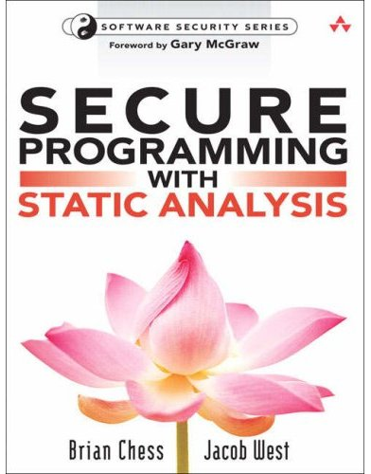
Static Analysis Is Good For Security
Fast compared to manual review
Fast compared to testing
Complete, consistent coverage
Brings security knowledge with it
Makes security review process
easier for non-experts
Copyright Ronald W. Ritchey 2007, All Rights Reserved

Slide 8
No Silver Bullet
Static Analysis Limitations
  Does not understand architecture
  Does not understand application semantics
  Does not understand social context
Copyright Ronald W. Ritchey 2007, All Rights Reserved

Slide 9
The Many Faces of Static Analysis
Type checking
Style checking
Program understanding
Program verification / Property checking
Bug finding
Security review
Copyright Ronald W. Ritchey 2007, All Rights Reserved

Slide 10
Type Checking
Taken for granted
Imperfect:
short s = 0;
int i = s; /* the type checker allows this */
short r = i; /* false positive: this will cause a
type checking error at compile time.*/
/* false negative:
passes type checking, fails at runtime (Java) */
Object[] objs = new String[1];
objs[0] = new Object();
Copyright Ronald W. Ritchey 2007, All Rights Reserved

Slide 11
Style Checking
Pickier than type checker, might look at
  Whitespace
  Naming
  Deprecated functions
gcc -Wall does some style checking
  typedef enum { red, green, blue } Color;
  char* getColorString(Color c) {
  char* ret = NULL;
  switch (c) {
  case red:
  printf("red");
  }
  return ret;
  }
Tools
  Lint, PMD
Copyright Ronald W. Ritchey 2007, All Rights Reserved

Slide 12
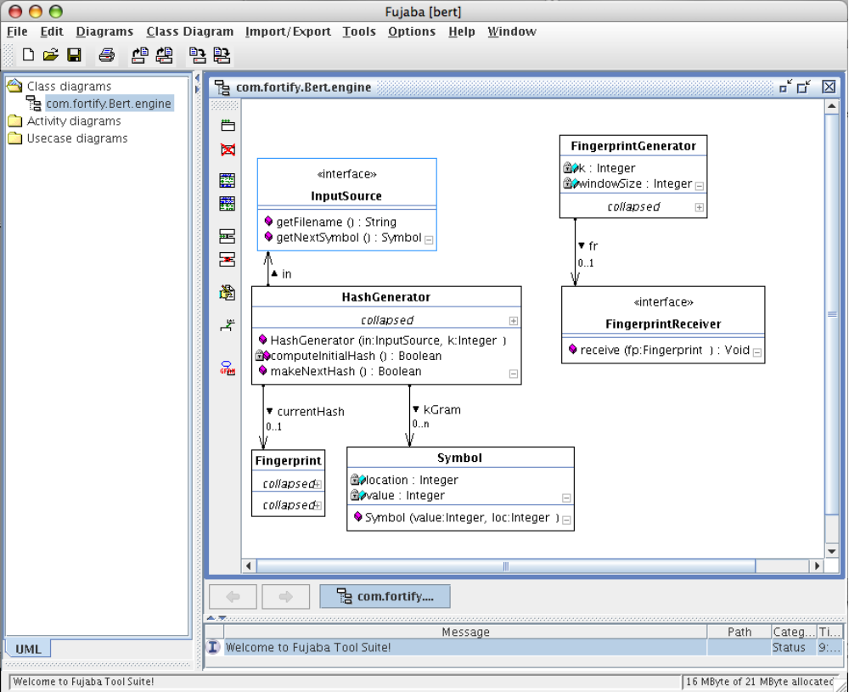
Program Understanding
Help make sense of a large codebase
Tools:
  Fujaba
  Klockwork
  CAST Systems
More sophisticated:
  Hatha Systems’ Knowledge Refinery
Copyright Ronald W. Ritchey 2007, All Rights Reserved

Slide 13
Program Verification / Property Checking
*Prove* that a program has particular properties
Partial specification -> property checking
Often focuses on temporal safety properties
Example: allocated memory must always be freed
  inBuf = (char*) malloc(bufSz);
    if (inBuf == NULL)
    return -1;
    outBuf = (char*) malloc(bufSz);
    if (outBuf == NULL)
  return -1; /* memory leak */
Soundness
  Aspires to “Sound WRT the specification”: reports a bug if one exists
Tools:
  Praxis, PolySpace, GrammaTech
Copyright Ronald W. Ritchey 2007, All Rights Reserved

Slide 14
Bug Finding
More sophisticated than a style checker
Less ambitious than program verification
Search code for “bug idioms”
Find high-confidence, low noise results
(low false positives)
Soundness
  Aspires to “Sound WRT counterexample”: never reports a bug that isn’t a bug
Tools:
  FindBugs, Coverity, Klocwork, Prefast
Example: double checked locking *
if (fitz == null) {
  synchronized (this) {
  if (fitz == null) {
  fitz = new Fitzer();
  }
  }
}
* http://www.cs.umd.edu/~pugh/java/memoryModel/DoubleCheckedLocking.html
Copyright Ronald W. Ritchey 2007, All Rights Reserved

Slide 15
Security Review
Focus on finding exploitable code
Find high-risk code constructs for review
(low false negatives)
Tools
  Simple text scan: RATS, ITS4, FlawFinder
  Deeper analysis: Fortify Software (HP), Ounce Labs (IBM), Coverity, PMD, FindBugs, …
Copyright Ronald W. Ritchey 2007, All Rights Reserved

Slide 16
A Peek Inside a Static Analysis Tool
Analyzer
Front
End
System
Model
Results
Viewer
Analyzer
src
Analyzer
Modeling
Rules
Security
Properties
Copyright Ronald W. Ritchey 2007, All Rights Reserved

Slide 17
Critical Attributes
Analysis algorithms
Language support
Capacity
  Ability to gulp down millions of lines of code
Rule set
  Modeling
  Security properties
Results management
  Prioritization of issues
  Control over what to check for
  Don’t show the same bad result twice
Copyright Ronald W. Ritchey 2007, All Rights Reserved

Slide 18
Parsing
Language support
  One language/compiler is straightforward
  Lots of combinations is harder
Could analyze compiled code…
  Everybody has the binary
  No need to guess how the compiler works
  No need for rules
…but
  Decompilation can be difficult
  Loss of context hurts. A lot.
  Remediation requires mapping back to source anyway
Copyright Ronald W. Ritchey 2007, All Rights Reserved

Slide 19
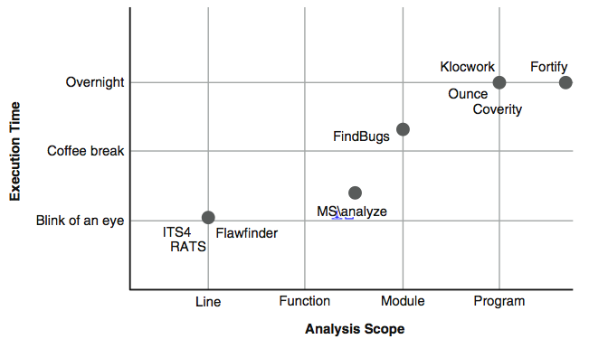
Scope vs. Performance
Copyright Ronald W. Ritchey 2007, All Rights Reserved

Slide 20
Analysis / Rules: Structural
Identify bugs in the program's structure
Example: calls to gets()
Structural rule:
FunctionCall: function is [name == "gets"]
Copyright Ronald W. Ritchey 2007, All Rights Reserved

Slide 21
Analysis / Rules: Structural
Identify bugs in the program's structure
Example: memory leaks caused by realloc()
buf = realloc(buf, 256);
Structural rule:
FunctionCall c1: (
c1.function is [name == "realloc"] and
c1 in [AssignmentStatement: rhs is c1 and
lhs == c1.arguments[0]
]
)
Copyright Ronald W. Ritchey 2007, All Rights Reserved

Slide 22
Analysis Techniques: Taint Propagation
Trace potentially tainted data through the program
Report locations where an attacker could take advantage of a vulnerable function or construct
Real-world cases usually cross method boundaries
= getInputFromNetwork();
copyBuffer( , );
exec( );
buff
newBuff
buff
newBuff
(command injection)
Copyright Ronald W. Ritchey 2007, All Rights Reserved
Notes:
put together context, knowledge,and abstraction

Slide 23
Analysis / Rules: Dataflow Source Rule
Following interesting values through the program
Example: Command injection vulnerability
Source rule:
Function: getInputFromNetwork()
Postcondition: return value is tainted
= getInputFromNetwork();
copyBuffer( , );
exec( );
buff
newBuff
buff
newBuff
Copyright Ronald W. Ritchey 2007, All Rights Reserved

Slide 24
Analysis / Rules: Dataflow Pass-Through Rule
Following interesting values through the program
Example: Command injection vulnerability
Pass-through rule:
Function: copyBuffer()
Postcondition: if the second argument is tainted, then
the first argument becomes tainted
= getInputFromNetwork();
copyBuffer( , );
exec( );
buff
newBuff
buff
newBuff
Copyright Ronald W. Ritchey 2007, All Rights Reserved

Slide 25
Analysis / Rules: Dataflow Sink Rule
Following interesting values through the program
Example: Command injection vulnerability
Sink rule:
Function: exec()
Precondition: the first argument must not be tainted
= getInputFromNetwork();
copyBuffer( , );
exec( );
buff
newBuff
buff
newBuff
Copyright Ronald W. Ritchey 2007, All Rights Reserved

Slide 26
Analysis / Rules: Control Flow
start
Look for dangerous sequences
Example: Double-free vulnerability
initial
state
while ((node = *ref) != NULL) {
*ref = node->next;
free(node);
if (!unchain(ref)) {
break;
}
}
if (node != 0) {
free(node);
return UNCHAIN_FAIL;
}
(other
operations)
free(x)
freed
(other
operations)
free(x)
error
Copyright Ronald W. Ritchey 2007, All Rights Reserved

Slide 27
Analysis / Rules: Control Flow
start
initial
state
Look for dangerous sequences
Example: Double-free vulnerability
while ((node = *ref) != NULL) {
*ref = node->next;
free(node);
if (!unchain(ref)) {
break;
}
}
if (node != 0) {
free(node);
return UNCHAIN_FAIL;
}
(other
operations)
free(x)
freed
(other
operations)
free(x)
error
Copyright Ronald W. Ritchey 2007, All Rights Reserved

Slide 28
Analysis / Rules: Control Flow
start
initial
state
Look for dangerous sequences
Example: Double-free vulnerability
while ((node = *ref) != NULL) {
*ref = node->next;
free(node);
if (!unchain(ref)) {
break;
}
}
if (node != 0) {
free(node);
return UNCHAIN_FAIL;
}
(other
operations)
free(x)
freed
(other
operations)
free(x)
error
Copyright Ronald W. Ritchey 2007, All Rights Reserved

Slide 29
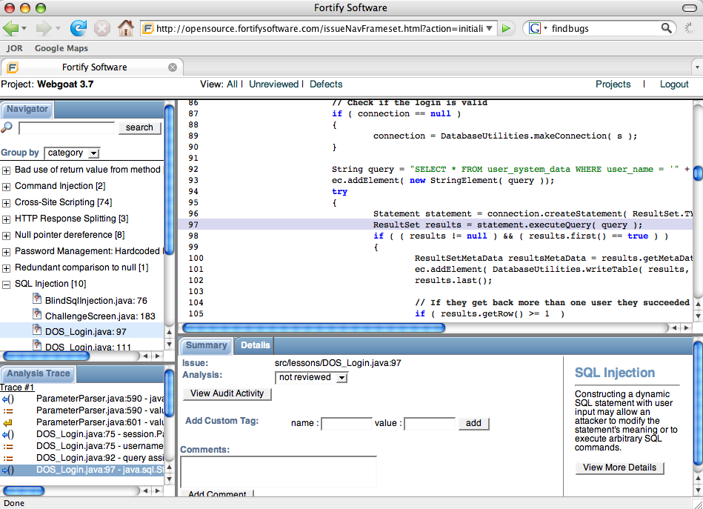
Interface
Must convince programmer that there’s a bug in the code
Different interfaces for different scenarios:
  Security auditor parachutes in to 2M line program
  Programmer reviews own code
  Programmers share code review responsibilities
Interface is just as important as analysis
Don’t show same bad result twice
Try this at home: Java Open Review
http://opensource.fortifysoftware.com
Copyright Ronald W. Ritchey 2007, All Rights Reserved

Slide 30
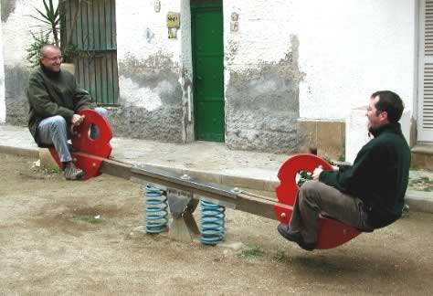
Only Two Ways to Go Wrong
  The tool that
  cried “wolf!”
False positives
  Incomplete/inaccurate model
  Conservative analysis
False negatives
  Incomplete/inaccurate model
  Missing rules
  “Forgiving” analysis
Missing a
detail can kill.
Developer
Auditor
Copyright Ronald W. Ritchey 2007, All Rights Reserved

Slide 31
Adopting a Static Analysis Tool
1) Some culture change required
  More than just another tool
  Often carries the banner for software security program
  Pitfall: the tool doesn’t solve the problem by itself
2) Define the playing field
  Choose specific objectives
  Build a gate
3) Do training up front
  Software security training more important than tool training
  Tool training is helpful too
Copyright Ronald W. Ritchey 2007, All Rights Reserved

Slide 32
Adopting a Static Analysis Tool
4) Start small
  Do a pilot rollout to a friendly dev group
  Build on your success
5) Go for the throat
  Tools detect lots of kinds of issues. Turn most of it off.
  Focus on easy-to-understand, highly relevant problems.
6) Appoint a champion
  Make sure there is a point person on the dev team
  Choose a developer who knows a little about everything
Copyright Ronald W. Ritchey 2007, All Rights Reserved

Slide 33
Adopting a Static Analysis Tool
7) Measure the outcome
  Keep track of tool findings.
  Keep track of outcome (issues fixed).
8) Make it your own
  Investigate customization
  Map tool against internal security standards. Best case scenario:
    The tools reinforce company coding guidelines
    Company coding guidelines are written with automated checking in mind
9) The first time around is the worst
  Budget 2x typical cycle cost.
  Typical numbers: 10% of time for security, 20% for the first time
Copyright Ronald W. Ritchey 2007, All Rights Reserved

Slide 34

Conventions
Algorithms
Design
Data
Structures
Protocols
<Your Code>
Platform
Libraries
Language
Copyright Ronald W. Ritchey 2007, All Rights Reserved

Slide 35
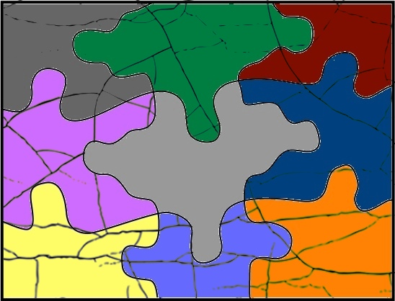
Conventions
Algorithms
Design
Data
Structures
Protocols
<Your Code>
Platform
Libraries
Language
Copyright Ronald W. Ritchey 2007, All Rights Reserved

Slide 36
The Buck Stops With Your Code
Security problems everywhere you look
  Languages, libraries, frameworks, platforms, etc
Right answer
  Better languages, libraries, frameworks, platforms, etc
Realistic answer
  Build secure programs
  out of insecure pieces
Conventions
Design
Algorithms
Data
Structures
Protocols
<Your Code>
Libraries
Language
Platform
Copyright Ronald W. Ritchey 2007, All Rights Reserved

Slide 37
Summary
Security is now part of programming.
For auditors: static analysis makes code review efficient.
For programmers: static analysis brings security expertise.
Critical components:
  Algorithm
  Rules
  Interface
  Adoption Plan
Copyright Ronald W. Ritchey 2007, All Rights Reserved

Slide 38
Questions?
Copyright Ronald W. Ritchey 2007, All Rights Reserved

