Slide 1
Fully Countering Trusting Trust through Diverse Double-Compiling (DDC)
David A. Wheeler
November 18, 2009
http://www.dwheeler.com/trusting-trust
This presentation contains the views of the author and does not necessarily indicate endorsement by IDA, the U.S. government, or the U.S. DoD.
Notes:
Hello, my name is David A. Wheeler. This is my public defense of my PhD dissertation, “Fully Countering Trusting Trust through Diverse Double-Compiling (DDC)”.
In summary, there is a computer attack called the “trusting trust” attack, and until now there’s been no effective countermeasure to it. My dissertation describes a countermeasure, DDC, and shows that DDC is an effective countermeasure to the trusting trust attack.

Slide 2
Outline
1&2. Introduction & Background
    (including dissertation thesis)
3. Description of threat
4. Informal description of DDC
5. Formal proof
6. Methods to increase diversity
7. Demonstrations of DDC (Tinycc, Lisp, GCC)
8. Practical challenges
9. Conclusions and ramifications
Presentation generally follows
dissertation outline (+ additional background)

Slide 3
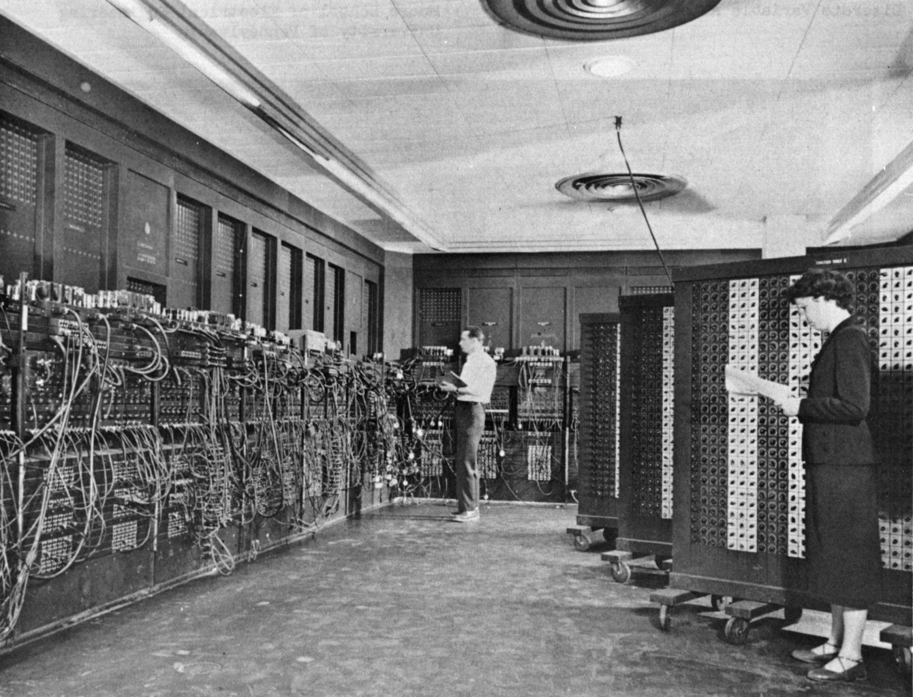
ENIAC (Operational July 1946)
First general-purpose electronic computer
Programmed by patch cables and switches
  Could take days to reprogram
Notes:
ENIAC stands for “Electronic Numerical Integrator And Computer”
Picture from (2009-11-08):
http://en.wikipedia.org/wiki/ENIAC

Slide 4
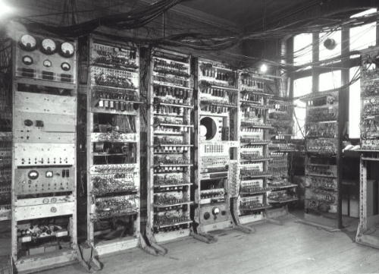
Manchester Small-Scale Experimental Machine [“Baby”] (June 1948)
First stored-program computer (memory held the program as well as the data it was working on)
  Could (re)load programs quickly
  Computer can generate computer programs
Notes:
This is the original SSEM of 1949. Picture from Manchester SSEM photo gallery:
http://www.cs.man.ac.uk/CCS/ssem/ssemgall.htm
Per Wikipedia, The ENIAC was modified to also be a stored-program computer; the ENIAC ran its first program as a stored-program computer on September 16, 1948, running a program by Adele Goldstine for John von Neumann. “This modification reduced the speed of ENIAC by a factor of six and eliminated the ability of parallel computation, but as it also reduced the reprogramming time to hours instead of days, it was considered well worth the loss of performance. Also analysis had shown that due to differences between the electronic speed of computation and the electromechanical speed of input/output, almost any practical real world problem was completely I/O bound even without making use of the original machine's parallelism and most would still be I/O bound even after the speed reduction from this modification.”

Slide 5
Executables, Source, Compilers
Compiler: An executable that translates source code into an executable
Source code aka source: Data that is a representation of a program that can be translated into an executable. Typically
human-readable
Compilation
process
Other
inputs
Executable: Data that can be directly executed by a computing environment (real or virtual). Aka “binary”
Compilers ease development & modification of software...
but with risks that were only revealed later

Slide 6
Executables can be corrupted
Corrupted executable: An executable that does not correspond to its putative source code
  An executable e corresponds to source code s iff execution of e always behaves as specified by s when the execution environment of e behaves correctly
Maliciously corrupted executable: Intentionally-created corrupted executable
We can find maliciously corrupted executables by
compiling again & seeing if the results match, right?
No, not always.

Slide 7
Trusting Trust attack
Critical
program
source
Analysis
program
source
Compiler
source
Trustworthy
source
code...
login
Symbolic debugger
C compiler
Compiler executable
(maliciously corrupted)
can produce maliciously corrupted executables
Perpetuates
Critical
program
Analysis
program
Compiler
executable
1974: Karger & Schell first described (obliquely)
1984: Ken Thompson. Demo’d. Undetected
Fundamental security problem

Slide 8
Definition of “trusting trust” attack
Trusting trust attack =
An attack in which:
  “the attacker attempts to disseminate a compiler executable that produces corrupted executables,
  at least one of those produced corrupted executables is a corrupted compiler, and
  the attacker attempts to make this situation self-perpetuating”
Notes:
The attack may also insert other Trojan horse(s) – software that appears to the user to perform a desirable function but facilitates unauthorized access into and/or exploitation of the user’s computer system.

Slide 9
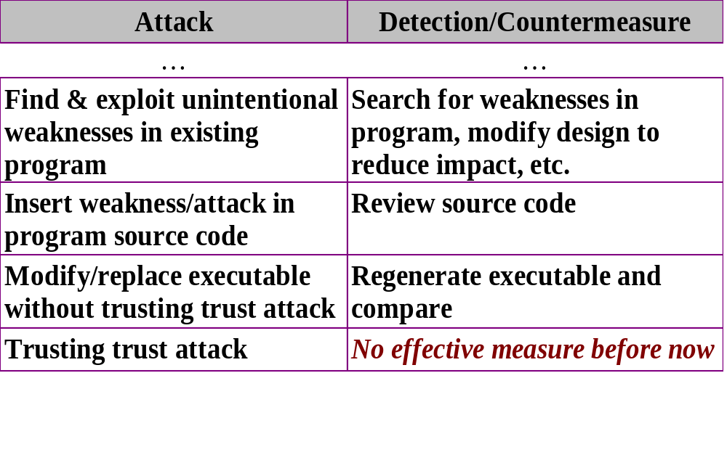
Other attacks exist, but tend to have detection techniques/countermeasures

Slide 10
Problem Importance
“Trusting trust” has been treated as if it were a fundamental computer security “axiom”
  Attack that “can’t” be countered
  Decades of no adequate solution
  “Computer security is hopeless”
Attackers have incentive to use it at some point if uncounterable
  Huge benefits: possibly control nearly all computers worldwide
  Risks low: undetectable (til now!)
  Costs often low...medium (vary by circumstance)
    Even if costs were high, to some it’d be worth it
Irrational to trust computers unless resolved

Slide 11
Some related background
“Simple” solutions ineffective
  Manual analysis impractical (size, change)
  Interpreted languages—merely moves attack
Draper 1984: “Paraphrase” compiler could filter
  No way to confirm if countered
McDermott 1984: Paraphrase compiler could be reduced-function, could add irrelevant functions
Proof of compiler correctness

Slide 12
Compiler bootstrap test
“Compiler bootstrap test” is a common test for detecting compiler errors
  Formally described in Goerigk 1999
  If c(s,e) is the result of compiling source s using compiler executable e, m is a correct “bootstrap” compiler, m0=c(s,m), m1=c(s,m0), m2=c(s,m1), all compilations terminate, m0 and s are both correct and deterministic, and the underlying hardware works correctly, then m1=m2 (passes test)
If m1≠m2, an assumption is wrong (fails test)
  Often the wrong assumption is “s is correct”, making this a helpful test
A corrupted compiler can pass this test
  Passing test doesn’t prove correctness
m
1
m0
s
2
m1
3
m2

Slide 13
Dissertation Thesis
The trusting trust attack can be detected and effectively countered using the “Diverse Double-Compiling” (DDC) technique, as demonstrated by:
a formal proof that DDC can determine if source code and generated executable code correspond
a demonstration of DDC with four compilers (a small C compiler, a small Lisp compiler, a small maliciously corrupted Lisp compiler, and a large industrial-strength C compiler, GCC), and
a description of approaches for applying DDC in various real-world scenarios

Slide 14
3. Description of threat
Attacker motivation
  Successful “trusting trust” attack enables control of all systems compiled by that compiler
  Until this work, essentially undetectable
Attack depends on:
  Trigger: Condition determined by an attacker in which a malicious event is to occur (e.g., when malicious code is to be inserted into a compiled program)
  Payload: Code that performs the malicious event (e.g., the inserted malicious code and the code that causes its insertion)
  Non-discovery: Victims don’t detect attack

Slide 15
4. Informal description of diverse double-compiling (DDC)
Idea created by Henry Spencer in 1998
  Uses a different (diverse) trusted* compiler
  Two compilation steps
    Compile source of “parent” compiler
    Use results to compile source of compiler-under-test
  If DDC result bit-for-bit identical to compiler-under-test c_{A}, then source and executable correspond
    Testing for bit-for-bit equality is easy
  Source code may include malicious/erroneous code, but now we can review source instead
Before this work:
  Never examined/justified in detail
  Never tried
* We will define “trusted” soon

Slide 16
Diverse double-compiling (DDC)
DDC Process
Claimed Origin
c_{T}: executable
(trusted compiler)
c_{GP} : executable
(grandparent)
s_{P}: source
(of parent
c_{P}?)
e1effects
ePeffects
s_{P}: source
(of parent c_{P}?)
1
e1: environment
o1
eP: env.
stage1
c_{P}
s_{A}: source
(of c_{A}?)
e2effects
s_{A}: source
(of c_{A}?)
eAeffects
2
e2: environment
o2
eA: env.
stage2: executable;
to run on
eArun: environment
c_{A}: executable; compiler
under test, to run on
eArun: environment
compare

Slide 17
Assumptions (informal)
DDC performed by trusted programs/processes
  Includes trusted compiler c_{T}, trusted environments, trusted comparer, trusted acquirers for c_{A}, s_{P}, s_{A}
  Trusted = justified confidence that it does not have triggers and payloads that would affect the results of DDC. Could be malicious, as long as DDC is unaffected
Correct languages (Java compiler for Java source)
Compiler defined by s_{P} is deterministic (same inputs always produce same outputs)
  Real compilers typically deterministic
    Non-deterministic compilers hard to test & can’t use compiler bootstrap test

Slide 18
DDC does not assume that different compilers produce identical executables
Different compilers typically produce different executables
But given this C source:
And two different properly-working C compilers:
  Resulting executables will usually differ
  Running those executables should produce “4” (modulo text encoding, & presuming certain other assumptions)
#include <stdio.h> main() { printf("%d\n", 2+2); }

Slide 19
Special case: Self-parenting compiler
If source s_{P} = s_{A}, termed “self-parenting”
My 2005 ACSAC paper explained DDC for this case
Dissertation generalizes 2005 paper
  DDC no longer requires it, it’s simply a special case
DDC Process
Claimed Origin
c_{T}
c_{GP}
e1effects
ePeffects
1
e1
o1
eP
s_{P} = s_{A}
stage1
s_{P} = s_{A}
c_{P}
e2effects
eAeffects
2
e2
o2
eA
compare
stage2
c_{A}

Slide 20
Why not always use the trusted compiler?
May not be suitable for general use
  May be slow, produce slow code, generate code for a different CPU, be costly, have undesirable license restrictions, may lack key functions, etc.
  In particular, a simple easily-verified compiler (with limited functionality & optimizations) could be used
Using a different compiler greatly increases confidence that source & executable correspond
  Attacker must now subvert multiple executables and executable-generation processes to avoid detection
  DDC can be performed multiple times, using different compilers and/or different environments, increasing difficulty of undetected attack

Slide 21
N-version programming is fundamentally different from DDC
Common Specification
Program1
Program2
Program3
...
Input1, Input2,
Input3, ...
Same
inputs
Same
inputs
.1
.2
.3
Output1, Output2,
Output3, ...
Output1, Output2,
Output3, ...
Output1, Output2,
Output3, ...
Compare
N-version: Multiple programs implement same specification, receive same inputs—outputs equal? Independence of errors doesn’t hold!
DDC: Different purpose—detect when not common specification
  Trusting trust attack not a tiny accidental difference (tricky!)
  Trusted compiler selected as unlikely to include same attack
DDC: Single input (pair of source code)/output, not all possible I/O

Slide 22
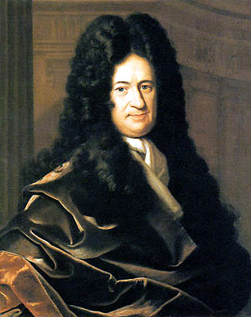
Can we create a strong justification that DDC counters trusting trust?
2005 ACSAC paper has informal justification
  Can we do better? Not the first with this concern...
“The only way to rectify our reasonings is to make them as tangible as those of the Mathematicians, so... when there are disputes... we can simply say: Let us calculate... to see who is right.”
– Gottfried Leibniz, The Art of Discovery (1685)
Notations & deductive systems now exist that are sufficient for our purpose
Notes:
The work of many (George Boole, Gottlob Frege,Giuseppe Peano, and others) led to the development of notations & deductive systems that can, in some cases, rigorously specify assumptions and then calculate conclusions sufficient for our purposes.
Leibniz image from Wikipedia.

Slide 23
5. Formal proof
Gold
Standard
Dissertation provides a formal proof for DDC
  More rigor than the informal justification in the 2005 ACSAC paper (though based on it)
  Uses classical First-Order Logic (FOL) with equality
    Very widely accepted/used
    Not new logic system – models circumstance
Tools: Prover9 & Ivy
  Including why you should believe the proofs
Three proofs
Correct goals & assumptions?

Slide 24
Tools: Prover9 & Ivy
Prover9 accepts assumptions and goals in first-order logic (FOL)
  If it can prove goal, outputs proof (by contradiction)
  DDC modeled using prover9 representation of FOL
Ivy (separate tool) can verify prover9 proof
  DDC proofs are ivy-verified!
  Ivy is itself proved using ACL2
Prover9, Ivy, & ACL2 are open source software
  Open to review by all
Proofs also hand-verified (myself & co-workers)
Excellent evidence that when the assumptions are true, the conclusions must follow

Slide 25
Three proofs
Proof 1: “If DDC produces the same executable as the compiler-under-test c_{A}, then source code s_{A} corresponds to the executable c_{A}” (5 assumptions, 19 steps)
  (stage2 = cA) -> exactly_correspond(cA, sA, lsA, eArun).
Proof 2: “Under benign conditions and cP_corresponds _to_sP, the DDC result stage2 and the compiler-under-test c_{A} will be the same” (9 assumptions, 30 steps)
  stage2 = cA.
Proof 3: “When there’s a benign environment & a grandparent compiler, proof 2 assumption cP_corresponds_to_sP is true” (3 assumptions, 10 steps)
  exactly_correspond(cP, sP, lsP, eA).
Discovered need for 3 proofs as proofs were developed

Slide 26
Correct goals & assumptions?
This can’t be shown formally
Reasons to believe correct goals & assumptions:
  Assumptions proven consistent (mace4 can create model that satisfies them)
  Based on informal justification in peer-reviewed ACSAC paper, which no one has refuted
  Author, co-workers, committee have reviewed
  All demonstration results explainable by proofs
  Formalization process forced clarification that there were multiple claims to prove; suggests insight from proof
  Proofs clearly fit together
    #3: If benign + a grandparent, then cP_corresponds_to_sP
    #2: If benign + cP_corresponds_to_sP, then stage2 = cA
    #1: If stage2 = cA, then cA and sA correspond

Slide 27
6. Methods to increase diversity
To gain justified confidence in the trusted compiler c_{T} & the DDC environments we could perform a complete formal proof of them... but this is difficult
Another, often simpler method is diversity:
  Diversity in compiler implementation
  Diversity in time (e.g., c_{T} developed long before)
  Diversity in environment
  Diversity in source code input (mutated source)
    Semantics-preserving mutations
    Non-semantics-preserving mutations

Slide 28
7. Demonstrations of DDC
tcc (TinyCC): C compiler (ACSAC paper)
2 Goerigk Lisp compilers
  One uncorrupted
  One maliciously corrupted
GCC (scales up)

Slide 29
tcc
Performed on small C compiler, tcc (ACSAC)
  Separate runtime library, handle in pieces
tcc defect: fails to sign-extend 8-bit casts
  x86: Constants -128..127 can be 1 byte (vs. 4)
  tcc detects this with a cast (prefers short form)
  tcc bug – cast produces wrong result, so tcc compiled-by-self always uses long form
tcc junk bytes: long double constant
  Long double uses 10 bytes, stored in 12 bytes
  Other two “junk” bytes have random data
Fixed tcc, technique successfully verified fixed tcc
Used verified fixed tcc to verify original tcc
It works!
Notes:
The tcc defect (fails to sign-extend) causes the failure of proof #3 assumption cGP_compiles_sP:
all EnvEffects accurately_translates(cGP, lsP, sP, EnvEffects, eP, eA).
This, in turn, causes the failure of proof #2 assumption cP_corresponds_to_sP.
The tcc junk bytes cause a failure in proof #2 assumption sP_portable_and_deterministic; since the values aren’t set, the results are not guaranteed to match between executions between implementations.

Slide 30
Diverse double-compilation of tcc
(Runtime)
tcc
libtcc1
s_{libtcc1}
0:0
Self-
regen?
Compare1
(Rest of
compiler)
0:1
s_{tcc}
c(s_{tcc},tcc)
c(s_{libtcc1},tcc)
gcc
1:0
Stage1
1:1
Must handle real compilers in pieces;
the approach works
c(s_{libtcc1},gcc)
c(s_{tcc},gcc)
Compare2
2:0
2:1
Stage2
Diverse Double-compile
c(s_{tcc},c(s_{tcc},gcc))
c(s_{libtcc1},c(s_{tcc},gcc))

Slide 31
Goerigk Lisp compilers
Pair of Lisp compilers, “correct” & “incorrect”
  “Incorrect” implemented the trusting trust attack
  Ported to Common Lisp
DDC applied
  “Correct” compiler compared correctly, as expected
  Executable based on “incorrect” source code did not match the DDC results when DDC used the “correct” source code, as expected
    “Diff” between results revealed that the “incorrect” executable was producing different results, in particular for a “login” program
    Tip-off that executable is probably malicious
Notes:
DDC detected the difference because proof #2 assumption definition_cA was not true—that is, compiler cA had not been generated by the putative process from the “correct” source code, but instead was created by compiling the “incorrect” source code.

Slide 32
GCC
GNU Compiler Collection (GCC) is widely-used compiler in industry – shows DDC scales up
  Many languages; for demo, chose C compiler
Used Intel C++ compiler (icc) as trusted compiler
  Completely different compiler
Fedora didn’t record info to reproduce executable
Created C compiler executable to capture all necessary data & use that as compiler under test
  Chose GCC version 3.0.4 as compiler under test
  “gcc” is a front-end that runs the real compiler programs; C compiler is actually cc1
  Code outside of GCC (including linker, assembler, archiver, etc.) considered outside compiler

Slide 33
DDC applied to GCC (simplified)
DDC Process
Claimed Origin
c_{T}: executable : icc
(trusted compiler)
c_{GP} : GCC in Fedora 9
1
o1
s_{P}=s_{A} : source
of GCC 3.0.4
s_{P}=s_{A} : source
of GCC 3.0.4
stage1
c_{P}
2
o2
stage2: executable;
to run on
eArun: environment
c_{A}: executable; compiler
under test, to run on
eArun: environment
compare

Slide 34
GCC (continued)
Challenges:
  “Master result” pathname embedded in executable (so made sure it was the same)
  Tool semantic change (“tail +16c”)
  GCC did not fully rebuild when using its build process (libiberty library not rebuilt)
    This took time to trace back & determine cause
Once corrected, DDC produced bit-for-bit equal results as expected
Notes:
The “master result” pathname is set by the DEST environment variable. From a formal proof perspective, the contents of the DEST environment variable are an input to the compilation process, and thus can be considered part of the source code. If the value used during DDC is different than the value used to create the original parent and compiler under test, we would be compiling different source code, violating assumptions definition_stage1 and/or definition_stage2 (see section 5.7.1). This demonstrates that successfully duplicating executables using DDC may require extremely detailed information about the compilation. It might be better if the compiler did not embed such information in its executable, to reduce the amount of data that must be duplicated.
For the “tail” command, when the environment variable _POSIX2_VERSION is not set, assumption cT_compiles_sP is untrue, so the results of proof #2 do not apply. In short, the trusted compiler must be configured so that it can compile source sP.
For libiberty, this meant that assumption definition_stage2 was not true: stage2 is not the result of compiling the source code with the result of stage1. Instead, stage2 is an amalgamation of some recompilation, plus a straight copy that violated the assumption. Since this assumption was not true, the results of proof #2 do not apply.

Slide 35
8. Practical challenges
Limitations
  Depends on confidence DDC process elements (trusted compiler, environment, etc.) not include triggers/payloads
  DDC only applies to the specific executable under test; use cryptographic hashes to identify it
  Source code may have malicious code; DDC only shows that there is “nothing hidden in the executable”
  If DDC result is different from compiler under test, at least one of proof #2’s assumptions has been violated... but it may not be obvious which one(s)
Non-determinism
Difficulty in finding alternative trusted compilers
Countering “pop-up” attacks
  Re-run DDC on every executable release

Slide 36
8. Practical challenges (continued)
Multiple sub-components: See tcc
Inexact comparison
Interpreters/recompilation dependency loops
Untrusted environment & broadening DDC application
  Operating system+compiler as “compiler under test”
Trusted build agents
Application problems with current distributions
  Inadequate information for DDC
  Prelink, ccache
Finding maliciously misleading code

Slide 37
How can an attacker counter DDC?
Must falsify a DDC assumption, for example:
Swap DDC result with c_{A} during DDC process (!)
  Defender can protect DDC environment
Make compiler-under-test ≠ compiler used
  If environment may provide inaccurate compiler under test, defender can extract without using environment
  If environment may run different compiler, defender can redefine “compiler” to include environment & apply DDC
Subvert trusted compiler/trusted environment(s)
  Challenge: Don’t usually know what they’ll be
  Defender can use DDC multiple times
    Attacker must subvert them all, while defender only needs to protect at least one—unusual for defender

Slide 38
9. Conclusions and ramifications
DDC can show that source and executable correspond
  Executable may have errors or be malicious, but these can be found by examining source (easier)
DDC primarily useful to those who have access to the source code (advantage for open source software)
Policy implications – for compilers of critical software:
  Require information to do DDC?
  Require use of (unpatented) language standards?
Potential future work: Recompiling whole OS
The trusting trust attack can be detected
and effectively countered by DDC

Slide 39
Summary of formal proofs

Slide 40
Classical First-Order Logic (FOL)
-A not A, A. --A equivalent to A
A & B A and B, A ∧ B
A | B A or B, A ∨ B
A -> B A implies B, A → B, if A then B, (-A)|B
all X ... for all X … , ∀ X … ; notation is optional
Initial uppercase is variable, else constant
Examples
man(X) -> mortal(X). % “All men are mortal.”
man(socrates). % “Socrates is a man.”
% This is enough to prove:
mortal(socrates). % “Socrates is mortal.”

Slide 41
Proof #1
Proof #1 proves goal:
  source_corresponds_to_executable
  I.E., if DDC recreates the compiler-under-test, then the compiler source and executable correspond
It requires 5 assumptions:
  definition_stage1
  definition_stage2
  cT_compiles_sP
  define_exactly_correspond
  sP_compiles_sA
This is the heart of DDC

Slide 42
Proof #1 Goal: source_corresponds_to_executable
(stage2 = cA) ->
exactly_correspond(cA, sA, lsA, eArun).
where predicate exactly_correspond(Executable, Source, Lang, RunOn) is true iff Executable exactly implements source code Source when interpreted as language Lang and run on environment RunOn.

Slide 43
definition_stage1 and definition_stage2
stage1 = compile(sP, cT, e1effects, e1, e2).
stage2 = compile(sA, stage1, e2effects, e2, eArun).
where compile(Source, Compiler, EnvEffects, RunOn, Target) represents compiling Source with the Compiler, running it in environment RunOn but targeting the result for environment Target. When Compiler runs, it uses Source and EnvEffects as input; EnvEffects models the inputs (data and timing) from the environment, which may vary between executions while still conforming to the language definition (e.g., random number generators, heap allocation addresses, thread exec order, etc.).

Slide 44
cT_compiles_sP
all EnvEffects accurately_translates(cT, lsP, sP, EnvEffects, e1, e2).
Trusted compiler cT is a compiler for language lsP, and it will accurately translate sP if run in environment e1, regardless of EnvEffects. cT targets (generates code for) environment e2.
Thus, you can’t use a Java compiler to compile C (directly)!
You can use the random number generator, but the results have to be an accurate translation (even if it’s not the same each time).

Slide 45
define_exactly_correspond
accurately_translates(Compiler, Lang, Source, EnvEffects, ExecEnv, TargetEnv) ->
exactly_correspond(
compile(Source, Compiler, EnvEffects, ExecEnv, TargetEnv),
Source, Lang, TargetEnv).
If some Source (in language Lang) is compiled by a compiler that accurately translates it, then the resulting executable exactly corresponds to the original Source.
exactly_correspond(Executable, Source, Lang, RunOn) iff Executable exactly implements source code Source in language Lang when run on RunOn.

Slide 46
sP_compiles_sA
accurately_translates(GoodCompilerLangP, lsP, sP, EnvEffectsMakeP, ExecEnv, TargetEnv) ->
accurately_translates(
compile(sP, GoodCompilerLangP, EnvEffectsMakeP, ExecEnv, TargetEnv),
lsA, sA, EnvEffectsP, TargetEnv, eArun).
Source sP (written in language lsP) must define a compiler that, if accurately compiled (by some GoodCompilerLangP), would be suitable for compiling sA.

Slide 47
Proof #2
Proof #1 not useful if goal (equality) never occurs
Proof #2 proves that equality will occur in a benign environment given reasonable assumptions:
  Goal always_equal: cA = stage2.
Requires 9 assumptions:
  4 same: definition_stage1, definition_stage2, cT_compiles_sP, define_exactly_correspond
    Unused from previous: sP_compiles_sA
  definition_cA
  cP_corresponds_to_sP (see proof 3!)
  define_compile
  sP_portable_and_deterministic
  define_portable_and_deterministic
Notes:
Interestingly, we do not need the assumption sP_compiles_sA for this proof. The assumption definition_cA requires, as a side-effect, that sP terminate when it compiles sA. If sP terminates but fails to compile sA, the results will still be equal; in this case the processes will produce equal error messages, which is probably not useful but it does not invalidate the proof. If sP terminates and successfully compiles sA, then again, the results will be equal if this section’s assumptions hold. This would be true even if sP has one or more defects that affect compiling sA; in such a case, if all the assumptions of proof #2 hold, then compiler under test cA and the result of DDC will be identical and have the same defects. Note that this last case does not invalidate DDC; the purpose of DDC is to determine if source and executable correspond, not to prevent all possible defects.

Slide 48
definition_cA and cP_corresponds_to_sP
cA = compile(sA, cP, eAeffects, eA, eArun).
exactly_correspond(cP, sP, lsP, eA).
The first follows from the figure.
The second is an assumption based on the figure. It is phrased this way so that no grandparent cGP is strictly required (perhaps the compilation was done by hand). Proof #3 will show how we can prove this is true if there is a grandparent cGP.

Slide 49
define_compile
compile(Source, Compiler, EnvEffects, RunOn, Target) = extract(converttext(run(Compiler, retarget(Source, Target), EnvEffects, RunOn), RunOn, Target)).
For proof #2, we need more information about compilation, and we must deal with potentially-different text encodings.
To compile, retarget source for target, then run Compiler, input Source, on RunOn. Convert text format from “RunOn” to “Target”, and extract only executables.

Slide 50
sP_portable_and_deterministic
portable_and_deterministic(sP, lsP, retarget(sA, eArun)).
sP is deterministic: Same input produces same output. Avoids all non-deterministic capabilities of language lsP, or uses them only in ways that will not affect the output of the program.
sP is portable; it only uses the portable constructs of lsP (the ones that are true on different environments)
The above only need to be true when compiling the retargeted sA

Slide 51
define_portable_and_deterministic
( portable_and_deterministic(Source, Language, Input) &
exactly_correspond(Executable1, Source, Language, Environment1) &
exactly_correspond(Executable2, Source, Language, Environment2)) ->
( converttext(run(Executable1, Input, EnvEffects1, Environment1), Environment1, Target) =
converttext(run(Executable2, Input, EnvEffects2, Environment2), Environment2, Target))
If source code deterministic & portable, and two executables both exactly correspond to it, then those executables - when given the same input - produce the same output when run on their respective environments (convert text to Target format). This only needs to be true for the specific input Input.

Slide 52
Example of define_portable_and_deterministic
Given this portable C source:
  #include <stdio.h>
  main() {
    int a;
    scanf("%d", &a);
    a = a + 1;
    printf("%d\n", a);
  }
And different, correct, deterministic C compilers:
  Resulting executables will usually differ
  Running executables produces the same results (modulo text encoding) if the input does not cause portability issues (e.g., portable range of int)

Slide 53
Proof #3
Proof #3 proves cP_corresponds_to_sP when there’s a grandparent (common case) & benign circumstances:
  exactly_correspond(cP, sP, lsP, eA).
This was an assumption of proof #2
  Separately-proved assumption so we don’t have to have a grandparent cGP
Requires 3 assumptions:
  1 reused: define_exactly_correspond
  definition_cP
  cGP_compiles_sP

Slide 54
definition_cP and cGP_compiles_sP
cP = compile(sP, cGP, ePeffects, eP, eA).
all EnvEffects accurately_translates(cGP, lsP, sP, EnvEffects, eP, eA).
These are just like definition_cA (follows from figure) and cT_compiles_sP.

Slide 55
Backup

Slide 56
What does DDC not address?
Passing DDC process shows source and executable, not that executable non-malicious
  Still useful – now you can focus on source review
Less useful if source review can’t find malicious code
  Concern is “maliciously misleading” source code
  Believe maliciously misleading can be countered, but fully addressing this is out of scope
  DDC still helpful in countering unintentional error
Determining if corruption is intentional (malicious)
DDC results will differ if proof #2 assumptions do not hold... but finding out why can be difficult
  Scale and complexity. Still, can do it, even with GCC

Slide 57
Contributions to the field
“Trusting trust” is a serious, well-known attack
  Considered unsolveable since 1974. “Paraphrase” & “recompile” approach might fix, or might introduce the problem
  Could not accumulate non-corruption evidence
  Henry Spencer had promising idea, but no evidence
Dissertation establishes a useful countermeasure:
  Describes process & assumptions in detail
  Formally proves
  Demonstrates it can be done (inc. large, malicious)
  Explains how to expand & apply in varying cases
Major result in computer security – crushes what was considered a fundamental vulnerability

Slide 58
Timestamps
Some formats (e.g., “.a”) embed timestamps
  Makes compiling non-deterministic (recompiling produces different results)
Simple solution: use formats that don’t
  ELF “.o” format does not include timestamps
If had to handle embedded timestamps:
  Could use “=” operator modified to ignore them
    But must then show that these timestamps do not affect execution (more difficult)
  Could rig functions for getting current time so that they produced repeatable results

Slide 59
What have I learned?
Formal methods & tools
  Much greater understanding of specification languages and notations
  Consider the “weakest” useful notation, e.g., first-order vs. higher-order (more automatable)
  Prefer a prover with verifier
  Start with simple world model, prove, then build up
“Foundations of mathematics” issues of 1900s
  “Trusting trust” attack builds on self-reference, as does Liar’s paradox, Russell’s paradox, etc.
  The logic systems that were built in the process of addressing them (FOL, etc.) also helped here!
Debugging big compilers is painful

Slide 60
Key to large proof graphs
Rectangles are assumptions
Octagon is goal
Rest are steps; arrows flow into uses
Proof-by-contradiction
  Negates goal, then shows that it leads to “always false” $F.

Slide 61
ACSAC paper: Big positive splash!
Published Proceedings of the Twenty-First Annual Computer Security Applications Conference (ACSAC), Dec 2005, “Countering Trusting Trust through Diverse Double-Compiling”
Immediately became required reading in at least two Spring 2006 courses
  Northern Kentucky University's CSC 593
  GMU’s IT 962
Referenced in Bugtraq, comp.risks (Neumann's Risks digest), Lambda the ultimate, SC-L (the Secure Coding mailing list), LinuxSecurity.com, Chi Publishing's Information Security Bulletin, Wikipedia, OWASP
Bruce Schneier's weblog and Crypto-Gram

Slide 62
Ken Thompson’s comments
> good to hear from you. i have, of coarse, read your DDC [ACSAC] paper. from a theoretical point of view, i think it is very nice...
> but from a practical point, i think the cure is at least as bad as the disease.†
Makes 3 points about DDC per ACSAC paper
  He had not read dissertation at the time, since it had just come out
  Reasonable comments, but I believe there are reasonable responses too
†Capitalization & punctuation as per Thompson

Slide 63
Ken Thompson’s comments (continued)
> 1. there are very few people in a position to widely install and distribute a 'trust' bug. i think the threat is close to zero. certainly the threat is much smaller than the distribution of binary-only code that is so prevalent on the net today. how do you know that one of the norton updates, microsoft patches, flash or adobe downloads doesnt contain malicious code? routinely you get megabytes of code off the net and then type your system password to install it. if i were a bad guy, i would take the path of least resistance and buy off someone at adobe.
Few people that are supposed to be in such a position, but subversion of development environments can yield many more
“Binary-only” code historically widespread, but OSS gaining
Yes, there are other attacks that are currently easier, but there are known detection techniques & countermeasures for the others
  If suppliers & users decide countering them is important, such techniques can be applied...
  But no point if there’s an undetectable/uncounterable attack

Slide 64
Ken Thompson’s comments (continued)
> 2. there are a lot more targets than just the C compiler and there are a lot more disease vectors than the C compiler. there is SH, C++, CPP, LD, LIBC, AS, AR, LINUX, JAVA, PYTHON, etc, etc, etc. each of these would have to be generated from scratch with a separate trusted vector. each one would be more difficult than your TCC example, while all of them would be close to impossible. i dont know how to even find all the potential targets.
Dissertation uses GCC C compiler, which is more complex
True that it’s not trivial, but now that DDC exists:
  Developers can include DDC as one of their tests
  Developers can write software to simplify DDC (e.g., standards)
Can grow to apply DDC to entire Linux distribution
  That would be adequate for many
If no executable stored (e.g., many interpreted languages like SH), there’s no issue; there is no hidden executable for the attack
  In some cases (e.g., Python), erasing caches eliminates attack

Slide 65
Ken Thompson’s comments (continued)
> 3. operationally, it will be hard to keep the trusted vectors all up to date. a lot of the targets are moving targets that are distributed from one source. getting and maintaining a trusted version will be hard. keeping everything working will be super-human.
If “trusted vectors”=“trusted compilers”, not serious problem
  Only need to compile one/few programs; little to keep up
  Performance is irrelevant
  Developers of software-under-test may limit the code constructs (e.g., standards, easily-implemented) to ease DDC application
If “trusted vectors”=“tested compilers”, not serious problem
  DDC is detection technique, so it can be used after-the-fact
  Attackers won't know when DDC will be used & will know that they can be detected, greatly reducing attack incentive
> again, i really enjoyed your paper. thanks for thinking of me.
I thank Thompson for (1) A clear explanation & demo of the attack, and (2) creating Unix—both are key contributions to the field

Slide 66
Problems unsolved with Fedora Core
(and probably true in general)
Lots of “Edison successes”
Vendor does not record exact recompilation info
  Compilers & libraries written by different people, unsync
  “Good practice” says change one component at a time, and once it works don’t change it (inc. its binary)
    Different library binaries built at different times by different versions of compiler, inc. in-house versions
    Exact order of recompilations not recorded, so no way to reproduce exactly what’s distributed
    Even if did, multi-week runs not helpful
  Massive transitive dependencies
    FC4 gcc build depends on XFree86, not on CD
    Result: compiler depends on fontconfig (!)
Without exact info, cannot regenerate compiler
  Vendors won’t capture info or change process until demo’d
Solution: Simulate distribution to capture info

Slide 67
Broader implications
Practical counter for trusting trust attack
Can expand to TCB, whole OS, & prob. hardware
Governments could require info for evals
  Receive all source code, inc. build instructions:
    Of compilers: so can check them this way
    Of non-compilers: check by recompiling
  Could establish groups to check major compiler releases for subversion
Insist languages have public unpatented specifications (anyone can implement, any license)
Source code examination now justifiable

Slide 68
Early use of proof tools
First proofs by hand
  Painful to do without tracking environments
  Easily argued against: “Error somewhere”
PVS: Nice tool!
  Supports higher-order logic (HOL)
    Compilers are functions... that produce other compilers/functions
  Supports typing (counters some errors)
  Required much manual “steering” to get proofs
    Obtained some proofs, but still painful
  No separate verification tool
  Over time, found did not need HOL or types
    Simpler logic → more-automated tools

Slide 69

Self-reference & feedback are powerful, but can lead to problems & paradoxes
Russell’s
paradox
“This sentence is false”
Notes:
Self-reflection & feedback can be powerful. Some of M.C. Escher’s works, such as “drawing hands” (shown), are intriguing examples of feedback and self-reflection in art.
“This sentence is false” is an example of the “liar paradox”. These can be traced back to Greek philosopher Eubulides of Miletus who lived in the fourth century BC, who reportedly asked: “A man says that he is lying. Is what he says true or false?”. (It’s related to statements by Greek philosopher Eubulides, whose fictional character Epimenides, a Cretan, reportedly stated: “The Cretans are always liars”. It’s not clear that this was intended to be a paradox; this could simply be a false statement.)
Russell’s paradox, discovered by Bertrand Russell in 1901, showed that the naive set theory of Frege leads to a contradiction. Here’s a simplified version of it, per Wikipedia 2009-11-12: “Let us call a set "abnormal" if it is a member of itself, and "normal" otherwise. For example, take the set of all squares. That set is not itself a square, and therefore is not a member of the set of all squares. So it is "normal"... Now we consider the set of all normal sets, R. Attempting to determine whether R is normal or abnormal is impossible: If R were a normal set, it would be contained in the set of normal sets (itself), and therefore be abnormal; and if it were abnormal, it would not be contained in the set of normal sets (itself), and therefore be normal. This leads to the conclusion that R is both normal and abnormal: Russell's paradox.”

Slide 70
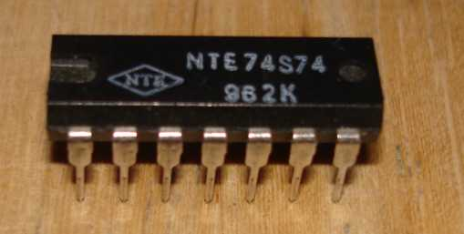
Hardware
BIOS/microcode is software
  DDC still applies trivially
DDC unnecessary to counter direct subversion of hardware components (not trusting trust attack)
If hardware is subverted so it intentionally subverts the implementation process of other software/hardware, that is a trusting trust attack
  Appears that we can apply DDC, but there are some issues...
Notes:
Image from Wikipedia.: 74s74.jpg

Slide 71
Applying DDC to hardware to counter trusting trust attack
Requires 2nd implementation as trusted compiler
  Alternative hardware compiler, simulated chip & simulator
Requires “equality” test
  Tool: Perhaps scanning electron microscope, scanning transmission electron microscope (STEM), use focused ion beam, or a tool that performs optical phase array shifting
  Maybe use superposition—detect phase changes (diffraction)
  Issue: Real chips have defects – false positive issues
Requires knowing correct result (legal problems)
  Often cell libraries provided to engineer are not the same as what is used in the chip... “real” libraries proprietary
  “IP cores” hide information about chip subcomponents
  Quantum effect error corrections for very high densities considered proprietary by correctors
Only shows the chip-under-test is good
Notes:
Typically Verilog or VHDL is compiled into GDS2 (also called GDSC2). That’s encrypted and sent to the foundry. The foundry then goes through many steps to create chip; each step creates an opportunity for mischief.

Slide 72
For more information
For more information, see:
  http://www.dwheeler.com/trusting-trust
Credits: All photographic images are from Wikipedia, except for the picture of “Baby”. That picture is from the Manchester SSEM photo gallery: http://www.cs.man.ac.uk/CCS/ssem/ssemgall.htm
The images are used on the basis of U.S. “fair use”:
Purpose/character: The presentation purpose is nonprofit educational use
Nature of the work: Images of Baby and ENIAC used as facts
Amount in containing work: The images are a small proportion of the work
Effect on market: No expected effect on their market value
This presentation is released under the Creative Commons CC-BY-SA 3.0 license (unported), which is the same as Wikipedia and thus there cannot be a license issue with any Wikipedia figures.

