Slide 1
Why OSS/FS? Look at the Numbers!
  David A. Wheeler
  August 9, 2005
  http://www.dwheeler.com/numbers
  http://www.dwheeler.com/oss_fs_why.html
This presentation contains the views of the author and does not necessarily indicate endorsement by IDA, the U.S. government, or the U.S. DoD.
Notes:
This is an annotated presentation titled “Why Open Source Software / Free Software (OSS/FS) Look at the Numbers!” You can get the current copy of this presentation at “http://www.dwheeler.com/numbers”. This presentation is a summary of a much larger paper by the same title. That larger paper is available at http://www.dwheeler.com/oss_fs_why.html.
This presentation contains the views of the author and does not necessarily indicate endorsement by IDA, the U.S. government, or the U.S. DoD.

Slide 2
Outline of Quantitative Information on OSS/FS*
Quantitive measures justify considering OSS/FS
Background
Quantitative measures
  Market Share
  Reliability
  Performance
  Scalability
  Security
  Total cost of ownership
Non-quantitative
Conclusions
*OSS/FS: Open Source Software / Free Software; aka Libre Software, Livre Software, FLOSS, FOSS
Notes:
As you can guess from the title, this is a survey of many quantitative studies involving OSS/FS. The purpose of this survey is to convince you to consider using OSS/FS when you’re looking for software. Some sites provide a few anecdotes on why you should use OSS/FS, but I (and many others) find such anecdotes unconvincing. Instead, this presentation emphasizes quantitative measures (such as experiments and market studies) to justify why using OSS/FS products is in many circumstances a reasonable or superior approach. I should note that while I find much to like about OSS/FS, I’m not a rabid advocate; I use both proprietary and OSS/FS products myself. Vendors of proprietary products often work hard to find numbers to support their claims; this material provides a useful antidote of hard figures to aid in comparing proprietary products to OSS/FS. Hopefully it’s enough to convince you to consider OSS/FS alternatives when you are acquiring software.
This presentation, as well as the paper it summarizes, shows a set of quantitative data, grouped into the following categories: market share, reliability, performance, scalability, security, and total cost of ownership. It briefly notes some of the non-quantitative reasons people choose OSS/FS, and closes with conclusions.
OSS/FS is also known as open source software (OSS), Free Software (FS), Free-Libre/Open Source Software (FLOSS) or Free/Open Source Software (FOSS). Some people who use the term “Free Software” (where “free” means “freedom” not “no cost”) have different motivations than those who use the term “open source software,” but those distinctions aren’t the focus of this talk. Many OSS/FS projects are commercial, so do not confuse “OSS/FS” with “non-commercial.”

Slide 3
Background
In 2000, many claims about OSS/FS, yet their advocates gave little evidence
Investigated & found there was evidence
Collection now widely-referenced
  California Performance Review, 2004
  Google “open source software” #5
Challenges:
  Vendor-funded studies (conflict of interest)
  Some proprietary licenses forbid speech
Numbers can't prove “always better”
Notes:
Before 2000, many were claiming that OSS/FS had a large number of advantages, including lower total cost of ownership (due to licensing differences), reliability (due to mass peer review), and so on.. Yet their advocates provided little evidence for their claims. I investigated and found that there was evidence that at least some OSS/FS programs did very well by various measures, yet there was no single place where this data could be found. So I ended up collecting it, and that set has become substantial.
This work is now widely referenced. The 2004 California Performance Review, for example, cited my work, and a Google search on “open source software” places my paper at number 5 (a very high placement). I say this as evidence that many others have found this collection of information useful.
There are challenges to any work like this. There are a number of vendor-funded studies. Vendor-sponsored studies are often rigged (no matter who the vendor is) to make the vendor look good instead of being fair comparisons. There is a fundamental conflict-of-interest in such studies, and there are many ways to rig a study. Also, some proprietary software licenses forbid public benchmarks or critiques unless the vendor approves it, and some lawmakers have allowed this chilling of free speech. As a result, some data is harder to get.
Numbers cannot prove “OSS/FS is always better,” nor is that my goal. Indeed, depending on your criteria for “better,” you can generally make that untrue. But that isn’t my purpose. My goal is to simply convince you that OSS/FS is worth investigating for your particular circumstance, using a mountain of evidence.

Slide 4
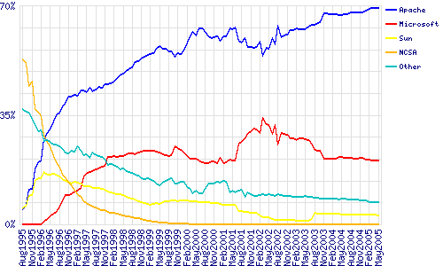
Market Share: Web Servers
OSS/FS dominates web serving.
May 2005: Apache 69.37%, IIS 20.54%
[Netcraft survey of 63,532,742 sites]
Notes:
We’ll start first by looking at the data on market share. Many people think that a product is only a winner if it has significant market share. This is lemming-like, but there’s some rationale for this: products with big market shares get applications, trained users, and momentum that reduces future risk. Herd animals are protected by the herd; the same can be said of using products with significant market share. As we’ll see, there are number of markets where OSS/FS has a significant presence. In some other cases, the number is smaller but the trend is increasing; trends in some ways are more important, because they help us predict what is likely to be dominant in the future.
Here we see market share (as measured by domain names) of various web servers. For as long as such markets have been measured, OSS/FS programs have always dominated this market. Early on the original NCSA web server dominated until Apache came; Apache has dominated the web server market ever since. Note that it’s not even a close contest; Apache simply dominates the other market players, with nearly 70% of this market, and the trends suggest that this is unlikely to change in the near future.
This data is provided by Netcraft, http://www.netcraft.com. Other surveys, independent of Netcraft, show the same thing: Apache is the dominant web server, and it is OSS/FS.

Slide 5
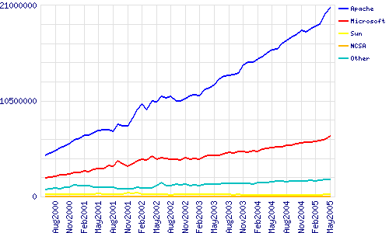
Market Share: Web Servers
Active Sites: Apache 70.09%, IIS 22.45% [Netcraft]
Notes:
Here’s more Netcraft data, which measures web server market share in a slightly different way.
One problem with measuring web server market share is that some domain names have a website, but the website is not being actively used. Such websites are simply placeholders (e.g., speculative domain name purchasers or planned websites that have not yet appeared). More recently Netcraft has been separately tracking “active sites,” that is, sites that are not simply placeholders. Apache does quite well here too; Apache has over 70% of the market by this measure. This chart also shows the raw number of servers (instead of percentages). This shows even more remarkably how many web sites are run by the OSS/FS program Apache, and how their numbers are rapidly growing.

Slide 6
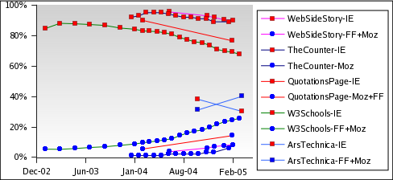
Web Browsers: Growing Fast
Mozilla/Firefox use growing, esp. among web/ technical community (who make web content!)
Firefox #1 @Ars Technica
Notes:
What about Web browsers? Here, Internet Explorer has dominated, but it is now losing market share. This trend is important; we will all be living the future, not the present, and trends help us understand what that future will be like.
Different surveys produce different results, because they use different sample populations, but all agree on one point: Mozilla/Firefox is gaining market share, and Internet Explorer is losing it. This is particularly obvious at blogging sites (heavy users of web browsers) and technical people (who will be developing your next web servers). These leading-edge people have switched even more dramatically, suggesting that this may simply be the leading edge of a larger trend. For example, by February 2005, more clients were using Firefox than Internet Explorer at the technical site “Ars Technica.”

Slide 7
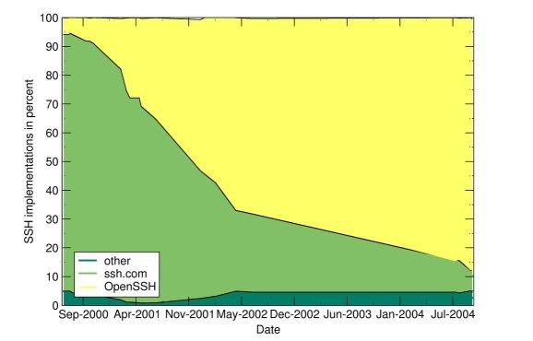
Other Market Share Examples
GNU/Linux #2 server OS sold 99, 00, 01 (24%, 27%, 25%)
DNS: bind supports 95% of reverse-lookups [Manning]
PHP #1 server-side scripting language [Netcraft]
Sendmail #1 Email server [Bernstein]
  Sendmail 42%, Microsoft Exchange 18%
OpenSSH #1 SSH (87.9% Sep04)
~5% Summer 2000,
50% November 2001 [scanssh]
Open Source DBMS (MySQL, PostgreSQL, and Firebird) used by 64% of developers and database administrators of those who use OSS/FS – February 2005 [Evans Data Corp.]
OpenOffice.org in 2004 had 14% large enterprise office systems market (MS 95% overall) [CSC]
OpenSSH
Notes:
There are many other quantitative studies that discuss market share:
GNU/Linux has been the #2 server operating system, in terms of volume, in at least 1999, 2000, and 2001.
The Domain Name Service (DNS) is critical to having a working Internet. Manning realized that although “ordinary” queries would be hard to survey, “reverse-lookup” queries are relatively easy to survey – and he found that 95% of all such queries are serviced by bind, an OSS/FS program.
Sendmail is still the #1 program used to transfer email; it’s OSS/FS.
OpenSSH is an important program used to securely control computers remotely. In 2000 the OSS/FS version was rarely used compared to proprietary implementations; by 2004 there were almost no proprietary implementations left in use.
OSS/FS database management systems (DBMSs) have become wildly popular
OpenOffice.org has become a widely-used office suite, especially since it works on Windows, GNU/Linux, Unix, and MacOS. While Microsoft Office still has far more total users, OpenOffice.org had 14% of the large enterprise office systems market in 2004.

Slide 8
Reliability
Fuzz studies found
OSS/FS applications
significantly more
reliable [U Wisconsin]
GNU/Linux vs. Windows NT 10 mo study [ZDNet]
  NT crashed every 6 weeks; both GNU/Linuxes, never
IIS web servers >2x downtime vs. Apache [Syscontrol AG]
Survey of 6MLOC: OSS “maintainability index” equal & sometimes better vs. closed [Samoladas in CACM, Oct 2004]
OSS/FS: More modular [MacCormack, Harvard Bus. School]
6%, 9%
23%, 28%
Weakened test
Notes:
We now come to studies about reliability. Study after study shows that OSS/FS can be extremely reliable.
One of the broadest reliability studies that covered OSS/FS were the “fuzz studies” of the University of Wisconsin. Here they ran many different programs, sending the programs large sets of random values. A program would “pass” this test if it didn’t crash or “hang” (stay stuck for a long time) – regardless of whether it got the “right” answer. This simple approach can test any program, in a fair way, and since “correct” answers aren’t needed a massive number of test cases can be used. In theory, no program should fail such a trivial test, but that’s not how things worked out. Of a set of Unix programs, 28% failed; when they tried again 5 years later, 23% failed (including some of the same failures).
In their second series of tests they also tested OSS/FS programs, and they were astonished. Compared to Unix’s 23%, only 9% of the OSS/FS programs failed, and when they used the GNU subset (which were more mature) only 6% failed. In contrast, the Windows results were disturbing: every Windows program failed. When they changed the test conditions to make a weaker test for the Windows programs, the programs were still far more likely to fail than their competition.
ZDNet ran a test of two GNU/Linux systems against Windows NT, with exactly the same requests for 10 months. NT crashed every 6 weeks; Linux, never. This also explains why such studies are rare – they take a long time to run.
Syscontrol AG found that IIS servers were down twice as much as Apache. Various code studies have found OSS/FS have better code measures, and better code is correlated with better reliability.

Slide 9
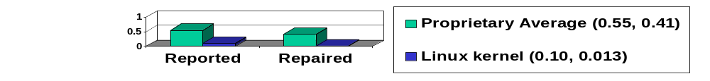
Reliability (2)
Automated defect detection analysis:
  Linux kernel: of 5.7MSLOC, only 985 detected (>5000 expected, 80% fewer) [Coverity]
  MySQL: 0.09 defects/KSLOC vs. 0.57 average defects/KSLOC avg. 200 proprietary [Reasoning]
  Linux kernel TCP/IP had smaller defect density [Reasoning]
Notes:
There are a number of tools that attempt to do automated defect detection analysis. They can also be used to estimate the number of probable defects in code, and then those values can be compared.
The Linux kernel and MySQL have been analyzed by such tools, and found that the density of errors (the likelihood that a given line has a defect) is far lower in these OSS/FS programs than for typical proprietary programs.

Slide 10
Performance: GNU/Linux
Performance varies widely by circumstance!
GNU/Linux with Samba faster fileserving at Windows' own file protocols [PC Magazine]
  Nov 2001, top end, 130MB/sec vs. 78MB/sec
  April 2002, performance 2x; 4x many clients
GNU/Linux fastest (untuned systems) [Sys Admin]
Larger is
better
Smaller is
better
Notes:
Performance varies widely by circumstance, so any such measures need to be considered skeptically. You must measure performance for your particular circumstance to determine performance in that case, where that is important. Still, available performance measures suggest that OSS/FS can have good performance.
PC Magazine found that (OSS/FS) GNU/Linux served Windows’ file serving protocols faster than Windows did in 2001 and 2002.
Sys Admin measured several systems (without “tuning” them, that is, without working hard to configure them for maximum performance). The GNU/Linux systems did the best at both email performance and disk input/output.

Slide 11
Performance: DBMSs
eWeek Labs/PC Labs 2002 DBMS evaluation
  Unusual; most DBMS licenses forbid publication
  MySQL (OSS/FS) did very well
DB2: up to 500 @ 580 users,
then dropped to ~210
(Larger is better)
(Smaller is better)
Notes:
In 2002 something extraordinary happened – there was a published DBMS evaluation. This is unusual because the licenses of many companies (such as Oracle) forbid them, but eWeek Labs/PC Labs challenged companies to sue.
Here Oracle does slightly better than OSS/FS MySQL, but only slightly, and Oracle costs orders of magnitude more money than MySQL. MySQL handily beats its other rivals.

Slide 12
Scalability
GNU/Linux and NetBSD support more hardware platforms & performance ranges than any other
  PC hardware, PDAs, mainframes, clusters, supercomputers
60% of supercomputers run GNU/Linux
[March 2005 Forbes, ref. Top500.org]
OSS/FS can develop large software systems
  Red Hat Linux 7.1 had 30million SLOC
  Represents approximately 8,000 person-years
  To re-develop proprietary, $1 Billion USD
  (a “Gigabuck”) [Wheeler]
Notes:
Another kind of measure is “scalability,” but there are different meanings for the term.
If the issue is what has the widest computing platform range (from small computer to supercomputer) then OSS/FS has no competition. GNU/Linux and NetBSD, both OSS/FS, support more hardware platforms and performance ranges than any other.
Most (60%) of the supercomputers of world run the OSS/FS operating system GNU/Linux. It is not a hobbyist’s toy.
It’s also clear that OSS/FS can develop large systems. I found that Red Hat Linux 7.1, now a very old distribution, had 30 million physical source lines of code (SLOC). It represented approximately 8,000 person-years and $1 Billion U.S. dollars (if it had to be redeveloped in a traditional proprietary manner). This “billion” is one thousand million dollars, or as I term it, a “Gigabuck.”

Slide 13
Security
J.S. Wurzler hacker insurance costs 5-15% more for Windows than for Unix or Linux
Windows websites disproportionately vulnerable
Bugtraq vulnerability 99-00: Smallest is OpenBSD, Windows largest (Don't quintuple-count!)
Worst vulnerabilities (takeover): Apache 0, IIS 8
(Jun98-Jun01)
Browser “unsafe” days in 2004: 98% Internet Explorer, 15% Mozilla/Firefox
Category
Proprietary
OSS/FS
Defaced
66% (Windows)
17% (GNU/Linux)
Deployed Systems
49.6% (Windows)
29.6% (GNU/Linux)
Deployed websites (by name)
24.81% (IIS)
66.75% (Apache)
Notes:
Security is obviously a very important topic, and one that is very difficult to measure. Still, there are measures that suggest that OSS/FS can be quite secure compared to its competition.
Insurance company J.S. Wurzler sells “hacker insurance”; based on its actuarial data, it gives Unix and Linux systems a discount since they’re less risky to insure.
Windows sites are disproportionately vulnerable to attack.
A count of Bugtraq vulnerabilities in 1999-2000 found the smallest to be the OSS/FS OpenBSD, while Windows had the most. Warning: several reporters have independently made the same mistake, quintuple-counting the same vulnerability.
I studied the time period June 1998 to June 2001 for takeover vulnerabilities, and found that Apache did very well (no such vulnerabilities!) while Microsoft’s competing IIS did poorly by comparison.
One study of browser vulnerabilities in 2004 counted the number of days where a vulnerability to the worst kind of attack (execution of program from a remote attacker) was publicly known, yet there was no patch available to fix it. Microsoft’s Internet Explorer did absurdly poorly – it was unsafe 98% of the time. There were only 7 days (in October) where Internet Explorer could be safely used. Mozilla/Firefox had this problem only 15% of the days, even better than the 17% by the proprietary program Opera.

Slide 14
Security (2)
Unpatched networked systems: 3 months Linux, hours Windows (variance minutes ... months)
[Honeynet.org, Dec 2004]
  Windows SP2 believed to be better than previous versions of Windows
50% Windows vulnerabilities are critical, vs. 10% in Red Hat [Nicholas Petreley, Oct 2004]
Viruses primarily Windows phenomenon
  60,000 Windows, 40 Macintosh, 5 for commercial Unix versions, 40 for Linux
91% broadband users have spyware on their home computers (proprietary OS) [National Cyber Security Alliance, May 2003] vs. ~0% on OSS/FS
Notes:
Honeynet.org did a study and found that while Linux systems tended to take 3 months to crack, in general Windows systems could only last for “hours” on the Internet before they were taken over.
Nicholas Petreley studied vulnerabilities, and found that the Windows systems’ vulnerabilities tended to be more serious: 50% of the Windows vulnerabilities were critical, compared to 10% for Red Hat.
And of couse, viruses and spyware are essentially only seen on proprietary systems.

Slide 15
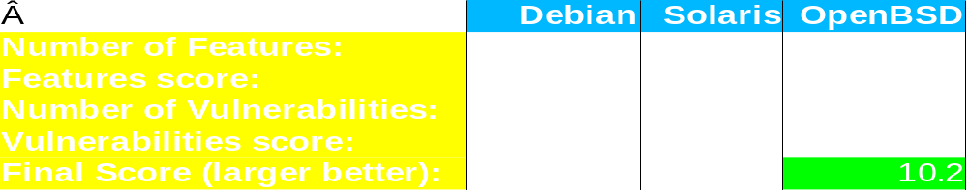
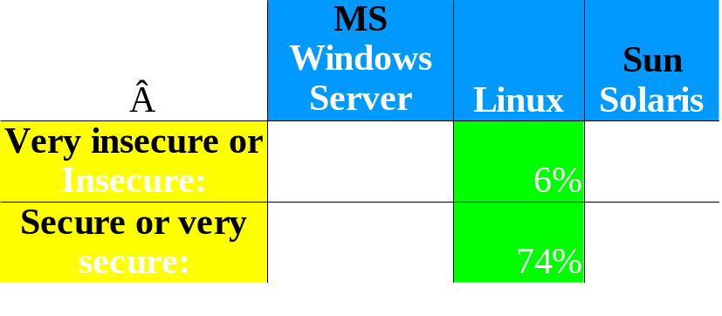
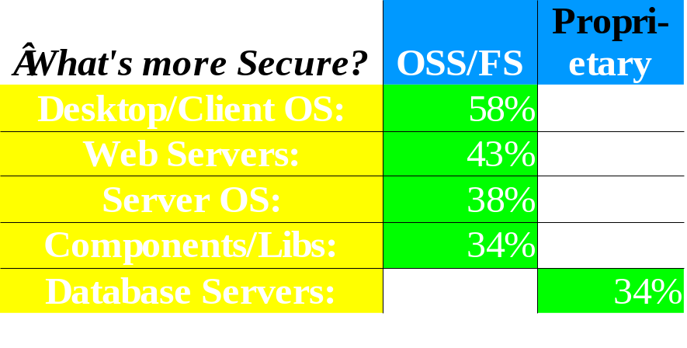
Security (3)
OSS/FS systems scored better on security [Payne, Information Systems Journal 2002]
Survey of 6,344 software development managers April 2005 favored OSS/FS [BZ Research]
Notes:
Payne did a study of Debian, Solaris, and OpenBSD. At the time Solaris was proprietary; Debian and OpenBSD were OSS/FS. By Paynes’ measures, OpenBSD did by far the best; Solaris, the worst.
BZ research did a survey of 6,344 software development managers, and found that in the managers’ experience, the OSS/FS programs tended to be better (with one exception, database servers, which was a somewhat close 34% to 21%).

Slide 16
Total Cost of Ownership (TCO): Background
TCO multifaceted; for software-based system: [CSC]
  Direct software costs (purchase, maintenance, support)
  Indirect software costs (license admin, audit)
  Hardware (purchase/upgrade, maintenance, dispose)
  Staffing (project management, systems engineering, administration (e.g., purchasing), systems admin)
  Support (install, troubleshoot, casual learning, training)
  Downtime
TCO sensitive to circumstances
  Helpful for single decision, hard to generalize
  Anything has a lower TCO for some circumstance
  Architecture matters!: Independent clients, X-terms, stateless, cluster, etc. May be best deployed differently
Really “Total Cost to Lease,” esp. for proprietary
Notes:
“Total cost of ownership” (TCO) is in theory a simple measure – it’s just the cost of a solution over a period of time. TCO depends on many values including factors like staffing, support, and downtime.
TCO is extremely sensitive to specific circumstances. As a result, TCO values can be extremely helpful for making a specific decision (for that circumstance), but can be hard to generalize to other circumstances. Indeed, just about any approach has a lower TCO for some circumstance.
In particular, note TCO is sensitive to the proposed system architecture. OSS/FS systems can often be deployed in different ways, and may be best deployed in one of those alternative architectures. Approaches such as using “X terminals,” “stateless clients,” and “clusters” should be considered where appropriate.
The term TCO is common but misleading for most software, especially for proprietary software, because software users usually don’t own the software they use and thus don’t have the rights of ownership. It might be more accurate to say that proprietary software users often “lease” or “rent” the software. Unless you arrange to have a software program’s copyright transferred to you, you do not actually own the software – you only own a license to run the software in certain limited ways. Unlike owning a physical product, with nearly all proprietary software you cannot modify the software to suit your needs, nor examine the product to understand what it does, nor publish benchmarks or reviews without vendor approval, and often cannot (sub)lease, resell, or redistribute the product. In contrast, you can execute these ownership-like rights with OSS/FS. These kinds of limits make proprietary software use more like a lease or a rent.

Slide 17
TCO: General OSS/FS
OSS/FS costs less to acquire than proprietary
  E.G., Web server, Windows $3610 vs. $156
Some other factors also tend to be lower
  Lower upgrade costs, can use cheaper hardware
  Avoids license management & litigation
  Downtime less: more modular, remove unneeded [CSC]
Maintenance/Support: Varies, can be competed
Cybersource: TCO 24%-34% less w/OSS/FS
InfoWorld Survey of CTOs:
  60% CTOs: >$50K/yr savings
  32% CTOs: > $250K/yr savings (inc. above)
Survey of companies > $5M revenue[InternetWeek/InformationWeek]
  39%: OSS/FS costs 25% to 50% less
  27%: OSS/FS costs 50% to 75% less
Notes:
Some factors do often drive OSS/FS costs to be lower. OSS/FS is almost universally cheaper to acquire initially and to upgrade. Hardware requirements are often lower. One often-forgotten issue is that license management and litigation is far simpler for OSS/FS. CSC reports that downtime tends to be less; since OSS/FS is more modular, it’s easy to remove unneeded components, and a component that isn’t there can’t fail.
Maintenance and support can be acquired for both OSS/FS and proprietary. OSS/FS can be supported through its project boards, but many businesses decide to pay for support. In this case support can be more or less expensive than for the proprietary software; the good news is that the support can be competed, tending to lower prices for support.
Cybersource found that the TCO tended be lower with OSS/FS.
An InfoWorld survey of Chief Technical Officers (CTOs) found that they were saving money; 32% (about 1/3) say they were saving $250,000 or more a year.
InternetWeek/InformationWeek’s survey of companies found that most believed that OSS/FS cost less, anywhere from 25% to 75% less than proprietary programs.

Slide 18
TCO: Specific Examples
Measured Web server TCO of GNU/Linux is 40% (<1/2) of Windows' and 14% of Solaris' [RFG]
Amazon.com: $17M savings in 1Q via Linux
UK Gov't Becta* 3yr study: OSS/FS savings significant in primary & secondary schools
  Secondaries reduce IT overheads by 24%
  (inc. software, hardware, and support costs)
  Primary schools cut computer costs by nearly half, primarily from support but also hardware
Willamette U. Library $41K vs. $100-150K using networked X terminals [Murphy]
Netproject: Desktop Linux 35% (save 65%!) of Windows
Largo, FL: $1M/yr savings thin clients
*Becta: British Educational Communications and Technology Association
Notes:
Above is a list of some of the many who have reported saving money using OSS/FS. Amazon.com credits this with saving their business; the savings were enough to turn losses into profits.
Largo, Florida is an interesting case; they report a $1million/year savings due to OSS/FS, deployed using thin clients.
I no longer try to keep up with the many individual reports of money saved by particular organizations by using OSS/FS. There are simply too many such reports to track.

Slide 19
Non-Quantitative
To many, non-quantitative advantages of OSS/FS are more important, e.g.:
  Social/ethical/moral reasons
  Avoids risks of single source solutions/lock-in
    Create reversible decision: can switch/self-support if price jacked up, maliciously changes interface, drops support, needs change (can get data), …
  (Can) avoid security risks of monocultures
  Supports domestic IT infrastructure
  Long-term data retention (format not secret)
  Many believe it encourages innovation
  Avoids license management and litigation
  Greater flexibility
    Can change software (inc. via hiring) to meet needs
Notes:
This is a survey of quantitative studies. However, before I close, I do want to clearly state that many people find some of the non-quantitative reasons for using OSS/FS to be more important.
The Free Software Foundation and others have long argued that choosing Free Software is necessary for social, ethical, and moral reasons.
Clearly, OSS/FS avoids risks of a single source solution or lock-in. If the support becomes too expensive, you can always switch, since you have the code necessary to perform that switch.
There have been a number of studies giving good evidence that OSS/FS encourages innovation. I do not have time to dig into that in this presentation; see my paper for more such information.
Some other non-quantitative reasons are listed above.

Slide 20
Conclusions
OSS/FS in many cases have measurable advantages over proprietary competition
Consider using OSS/FS software when acquiring
Don't disadvantage OSS/FS in policy
  Be wary of vendor lock-in
  Prefer open standards (publicly held, multi-vendor support, don’t require patents)
  Beware of “vendor pays” assumptions (CC)
  Software patents justified?
For more detailed information, see
http://www.dwheeler.com/oss_fs_why.html
Notes:
Clearly OSS/FS in many cases are measurably equivalent to, or superior to, their proprietary competition. Thus, when you are acquiring software, you should consider your OSS/FS options. Since OSS/FS rarely respond to requests for proposals (RFPs), you should certainly not assume that posting an RFP will get the best options; you may need to search for your best options.
If you are involved in setting policies, you should be careful to not disadvantage OSS/FS in policy. Be wary of vendor lock-in, which may impair your ability to switch to a better alternative if one is available. Instead, prefer open standards (ones that are publicly held, supported by multiple vendors, and don’t require patents to implement). Beware of “vendor pays” assumptions—those may not be reasonable for OSS/FS projects. And indeed, all of this raises doubts about the value of software patents, which disproportionately harm OSS/FS projects. There is no evidence that they actually help the software industry, but a great deal of evidence that software patents are fundamentally harmful.
For more information, see the paper at http://www.dwheeler.com/oss_fs_why.html

Slide 21
Backup Slides
Introduction to OSS
  Basics, history, OSS vs. FS, licenses, development model
Unnecessary fears
Acronyms
Interesting sites/documents

Slide 22
Basics of Open Source Software (OSS) / Free Software (FS)
Open Source Software / Free Software (OSS/FS) programs have licenses giving users the freedom:
  to run the program for any purpose,
  to study and modify the program, and
  to freely redistribute copies of either the original or modified program (without royalties, etc.)
Not non-commercial, not necessarily free-of-charge
  Often supported via commercial companies
Synonyms: Libre software, FLOS software (FLOSS)
Antonyms: proprietary software, closed software

Slide 23
History of Open Source Software / Free Software
1950s, 1960s: Software freely distributed
~1970s: Rise of proprietary software
1984: Richard M. Stallman establishes “Free Software Foundation”, creates “General Public License” (GPL)
1990s: Increasing Internet availability enables developer coordination
1997: Eric Raymond’s “Cathedral & the Bazaar” explains new approaches; term “Open Source Software” coined

Slide 24
Open Source Software vs.
“Free Software”
First named “Free Software” by Stallman
  Free as in Freedom
  Officially defined by “Free Software Definition”
  Not necessarily zero price; confused many
New term coined: “Open Source Software”
  Officially defined by the “Open Source Definition” (a long 9-point list)
  Practically all OSS software is also FS
Terms sometimes indicate motivations
  FS: emphasize ethical/social issues
  OSS: technical superiority/flexibility
  OSS often used due to “zero price” confusion

Slide 25
Major OSS/FS Licenses
Many licenses, but 4 dominate
BSD-new & MIT license: anything but sue
  Can incorporate code into proprietary software
  Financial incentive to use, but not aid project
General Public License (GPL): “Copyleft”
  If distribute, must distribute source code or provide written offer to do so
  Cannot link (embed) into proprietary software
Lesser/Library GPL - a compromise
  Must distribute source code/written offer, but only of component itself
  Can link into proprietary software
Public domain is OSS/FS, but rare

Slide 26
OSS/FS Development Model
Improvements (as source code) and evaluation results: User as Developer
Developer
Trusted
Developer
Bug Reports
Trusted
Repository
Source Code →
Distributor
User
“Stone soup development”
OSS/FS users typically use software without paying licensing fees
OSS/FS users typically pay for training & support (competed)
OSS/FS users are responsible for developing new improvements &
any evaluations that they need; often cooperate/pay others to do so
Notes:
This figures shows a typical development model for OSS?FS. Arbitrary developers (who are typically users or represent users) submit their proposed changes to trusted developers for a given project. Those trusted developers are allowed to make changes to a trusted repository, the “master” copy used by others for the project. Users acquire release-ready versions of the master copy directly, or via 3rd-party “distributors” (who typically combine a set of projects and provide support).
Users can feed back suggestions and requests. A small subset of users may decide (for their own reasons) to make substantive changes or evaluations; such users begin to transform their role and become a new developer.
Typically OSS/FS users don’t pay for license fees, but they do pay for training and support. OSS/FS users also pay (through time and/or money) for any new improvements, including any evaluations that they need.

Slide 27
Unnecessary Fears
Proprietary software always better supported? No.
  Non-traditional support (mailing lists, etc.)
  Pay for traditional support, and can compete it
Proprietary more legal rights? No.
  Who do you sue? Nobody, in either case
OSS/FS economically viable? Yes.
  Many business models
  Customers can band together

Slide 28
Unnecessary Fears
Will programmers starve? No.
  Estimated 95% software not developed for sale
  Companies hire programmers to make changes for themselves
  Widespread use of OSS/FS moves software development into a service (not product) model
OSS/FS compatible with capitalism? Yes.
  OSS/FS development involves trade: code for code
  OSS/FS business often based on payment for support or commoditizing complements of products
OSS/FS mean no competition? No.
  KDE vs. GNOME, emacs vs. vim

Slide 29
Unnecessary Fears
Will OSS/FS destroy intellectual property? No.
  Usually, complaint is about GPL
  GPL trades you the right to freely incorporate their code into your software in exchange for the right to freely incorporate your code [which incorporates their code] into theirs
  Intellectual property traded for other intellectual property
  Microsoft sells GPL'ed software, sponsored several OSS/FS projects

Slide 30
Unnecessary Fears
Viewing and changing source code valuable for non-programmers? Surprisingly, yes.
  “Would you buy a car with the hood welded shut? If not, what do you know about modern … engine technology?” [Bob Young]
  Consumers demand this so they can have control over their product support, instead of dealers
Anti-Microsoft campaign? No, not by all.
  Jun02, 831 projects use Visual Basic; 8867 projects work on Windows [SourceForge]
  Microsoft has been repeatedly asked to join community
  Microsoft long used, and now develops OSS/FS
  Microsoft has sold GPL'ed software

Slide 31
Acronyms
COTS: Commercial Off-the-Shelf (either proprietary or OSS)
DoD: Department of Defense
HP: Hewlitt-Packard Corporation
JTA: Joint Technical Architecture (list of standards for the DoD); renamed to DISR
OSDL: Open Source Development Labs
OSS: Open Source Software
RFP: Request for Proposal
RH: Red Hat, Inc.
U.S.: United States
Trademarks belong to the trademark holder.

Slide 32
Interesting Documents/Sites
“Why OSS/FS? Look at the Numbers!” http://www.dwheeler.com/oss_fs_why.html
“Use of Free and Open Source Software in the US Dept. of Defense” (MITRE, sponsored by DISA)
President's Information Technology Advisory Committee (PITAC) -- Panel on Open Source Software for High End Computing, October 2000
“Open Source Software (OSS) in the DoD,” DoD memo signed by John P. Stenbit (DoD CIO), May 28, 2003
Center of Open Source and Government (EgovOS) http://www.egovos.org/
OpenSector.org http://opensector.org
Open Source and Industry Alliance http://www.osaia.org
Open Source Initiative http://www.opensource.org
Free Software Foundation http://www.fsf.org
OSS/FS References http://www.dwheeler.com/oss_fs_refs.html
Notes:
Here are some interesting related documents and sites.
This presentation is (C) Copyright 2005 David A. Wheeler. You may distribute unmodified and modified derivative copies of this document in electronic form, print form, or any other medium, under certain conditions; in particular, this work is “copylefted”. You can release unmodified or modified versions under any one or more of the following copylefting licenses (unless you specifically say otherwise, any derivative work is released under the same terms as this document):
1. Creative Commons Attribution-ShareAlike 2.5 License. Under this license, you are free to (1) copy, distribute, display, and perform the work; (2) make derivative works; and (3) to make commercial use of the work. However, this freedom is under the following conditions: (by:) Attribution. You must attribute the work in the manner specified by the author or licensor. (sa) Share Alike. If you alter, transform, or build upon this work, you may distribute the resulting work only under a license identical to this one. For any reuse or distribution, you must make clear to others the license terms of this work. Any of these conditions can be waived if you get permission from the copyright holder.
2. GNU General Public License (GPL) version 2 or greater.
3. GNU Free Documentation License (GFDL) version 1.2 or later.
It’s not a license condition, but please include a reference tohttp://www.dwheeler.com/numbers & http://www.dwheeler.com/oss_fs_why.html.

