Slide 1
Why Free-Libre /
Open Source Software (FLOSS)?
Look at the Numbers!
Dr. David A. Wheeler
May 30, 2011
http://www.dwheeler.com/numbers
http://www.dwheeler.com/oss_fs_why.html
This presentation contains the views of the author and does not necessarily indicate endorsement by IDA, the U.S. government, or the U.S. DoD.
Notes:
This is an annotated presentation titled “Why Free-Libre / Open Source Software (FLOSS)? Look at the Numbers!” You can get the current copy of this presentation at “http://www.dwheeler.com/numbers”. This presentation is a summary of a much larger paper with a similar title, “Why Open Source Software / Free Software (OSS/FS)? Look at the Numbers!” That larger paper is available at http://www.dwheeler.com/oss_fs_why.html.
This presentation contains the views of the author and does not necessarily indicate endorsement by IDA, the U.S. government, or the U.S. DoD.

Slide 2
Outline of Quantitative Information on FLOSS*
Quantitive measures justify considering FLOSS
Background
Quantitative measures (older & newer)
  Market Share
  Reliability
  Scalability
  Security
  Total cost of ownership
Other
Miscellaneous & Parting Comments
*FLOSS: Free-Libre / Open Source Software / Free Software; aka Open Source Software (OSS), Free Software (FS), OSS/FS, Libre or Livre Software, FOSS
Notes:
As you can guess from the title, this is a survey of many quantitative studies involving Free-Libre / Open Source Software (FLOSS). Broadly speaking, FLOSS programs have licenses giving users the freedom to run the program for any purpose, to study and modify the program, and to freely redistribute copies of either the original or modified program (without royalties, etc.).
The purpose of this survey is to convince you to consider using FLOSS when you’re looking for software. Some sites provide a few anecdotes on why you should use FLOSS, but I (and many others) find such anecdotes unconvincing. Instead, this presentation emphasizes quantitative measures (such as experiments and market studies) to justify why using FLOSS products is in many circumstances a reasonable or superior approach. I should note that while I find much to like about FLOSS, I’m not a rabid advocate; I use both proprietary and FLOSS products myself. Vendors of proprietary products often work hard to find numbers to support their claims; this material provides a useful antidote of hard figures to aid in comparing proprietary products to FLOSS. Hopefully it’s enough to convince you to consider FLOSS alternatives when you are acquiring software.
This presentation, as well as the paper it summarizes, shows a set of quantitative data, grouped into the following categories: market share, reliability, performance, scalability, security, and total cost of ownership. It briefly notes some of the non-quantitative reasons people choose FLOSS, and closes with conclusions.
FLOSS is also known as open source software (OSS), Free Software (FS), Open Source Software / Free Software (OSS/FS), or Free/Open Source Software (FOSS). Some people who use the term “Free Software” (where “free” means “freedom” not “no cost”) have different motivations than those who use the term “open source software,” but those distinctions aren’t the focus of this talk. Many FLOSS projects are commercial, so do not confuse “FLOSS” with “non-commercial.”

Slide 3
Background
In 2000, many claims about FLOSS, yet their advocates gave little evidence
  Investigated & found there was evidence
Collection now widely-referenced
  California Performance Review, 2004
Challenges:
  Vendor-funded studies (conflict of interest)
  Some proprietary licenses claim to forbid speech
  Some reports expensive & can’t be republished
Numbers can’t prove “always better”
Notes:
Before 2000, many were claiming that FLOSS had a large number of advantages, including lower total cost of ownership (due to licensing differences), reliability (due to mass peer review), and so on.. Yet their advocates provided little evidence for their claims. I investigated and found that there was evidence that at least some FLOSS programs did very well by various measures, yet there was no single place where this data could be found. So I ended up collecting it, and that set has become substantial.
This work is now widely referenced. The 2004 California Performance Review, for example, cited my work, and a Google search on “open source software” places my paper at number 5 (a very high placement). I say this as evidence that many others have found this collection of information useful.
There are challenges to any work like this. There are a number of vendor-funded studies. Vendor-sponsored studies are often rigged (no matter who the vendor is) to make the vendor look good instead of being fair comparisons. There is a fundamental conflict-of-interest in such studies, and there are many ways to rig a study. Also, some proprietary software licenses forbid public benchmarks or critiques unless the vendor approves it, and some lawmakers have allowed this chilling of free speech. As a result, some data is harder to get.
Numbers cannot prove “FLOSS is always better,” nor is that my goal. My goal is to simply convince you that FLOSS is worth investigating for your particular circumstance, by using a mountain of evidence.

Slide 4
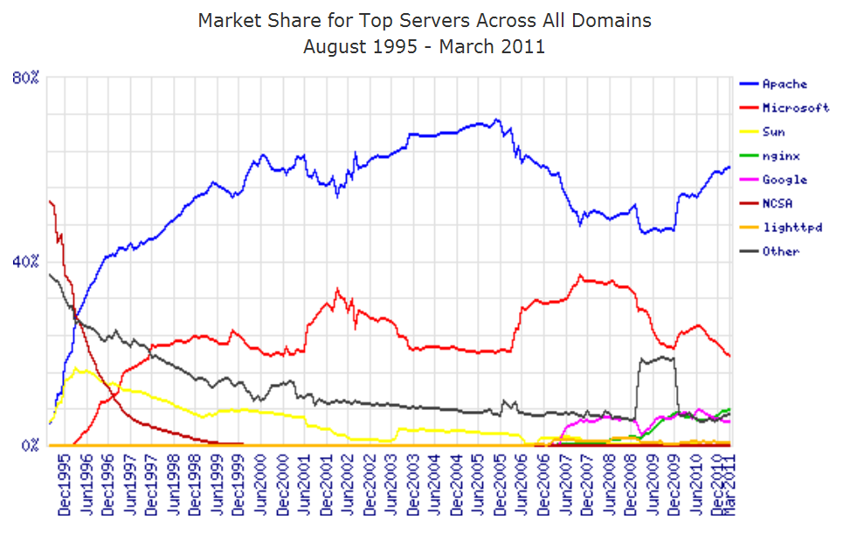
Market Share: Web Servers
FLOSS dominates web serving & has from the beginning. March 2011: Apache 60.31%, IIS 19.34%
[Netcraft March 2011 survey of 298,002,705 sites]
Notes:
We’ll start first by looking at the data on market share. Many people think that a product is only a winner if it has significant market share. This is lemming-like, but there’s some rationale for this: products with big market shares get applications, trained users, and momentum that reduces future risk. Herd animals are protected by the herd; the same can be said of using products with significant market share. As we’ll see, there are number of markets where FLOSS has a significant presence. In some other cases, the number is smaller but the trend is increasing; trends in some ways are more important, because they help us predict what is likely to be dominant in the future.
Here we see market share (as measured by domain names) of various web servers. For as long as such markets have been measured, FLOSS programs have always dominated this market. Early on the original NCSA web server dominated until Apache came; Apache has dominated the web server market ever since. Note that it’s not even a close contest; Apache simply dominates the other market players, with nearly 70% of this market, and the trends suggest that this is unlikely to change in the near future.
This data is provided by Netcraft, http://www.netcraft.com. Other surveys, independent of Netcraft, show the same thing: Apache is the dominant web server, and it is OSS/FS.

Slide 5
Market Share: SSL web servers
Netcraft’s latest public SSL survey (Jan 2009)
https://ssl.netcraft.com/ssl-sample-report/
“Netscape once dominated...
Microsoft soon caught up
and passed... [and now the]
most popular choice of
SSL web servers is
the open source
Apache server.”

Slide 6
Market Share: Operating Systems for SSL-enabled Web servers
Netcraft’s latest public SSL survey (Jan 2009)
https://ssl.netcraft.com/ssl-sample-report/

Slide 7
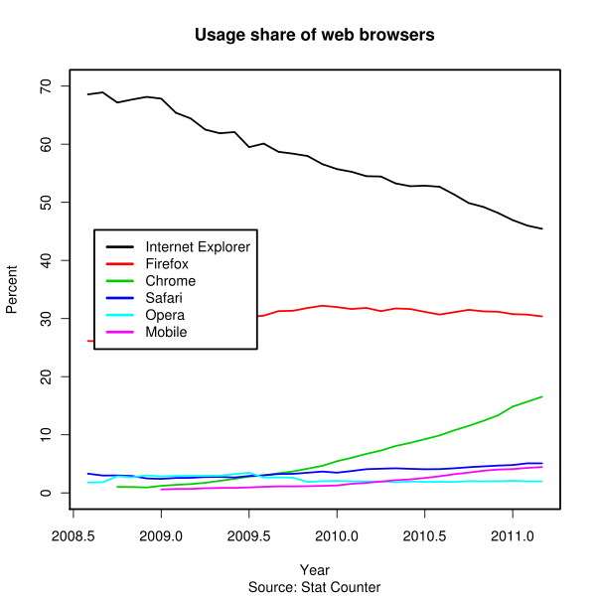
Market share: Web browsers (Statcounter)
Statcounter – Hits from 3 million sites
FLOSS (Firefox+Chrome)
growing
Notes:
This and the next few charts are from:
http://en.wikipedia.org/wiki/Usage_share_of_web_browsers

Slide 8
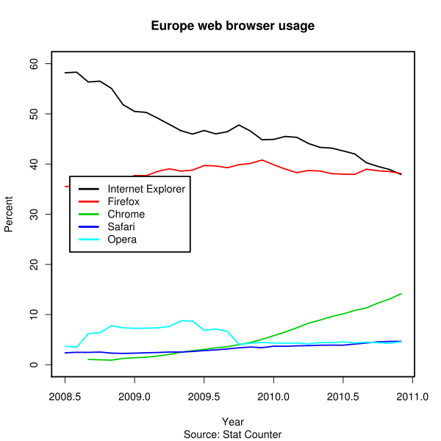
Market share: Web browsers (Statcounter – European users)
Statcounter – European users
Firefox leads; FLOSS has
a commanding lead

Slide 9
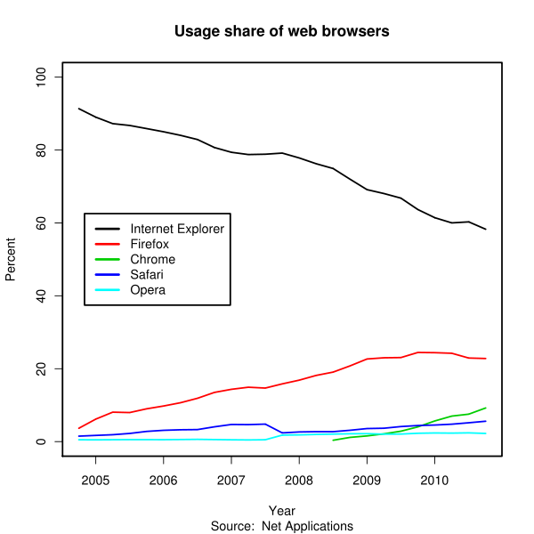
Market share: Web browsers (Net Applications)
40,000 websites, weighted by users/country
Weighting uses CIA data; new CIA data caused them to recalculate, weighting Chinese users more heavily and thus changing old share estimates (!)
Notes:
More about the weird re-calculation based on new CIA data
http://www.zdnet.com/blog/networking/internet-explorer-gains-web-browser-market-share-from-firefox/743

Slide 10
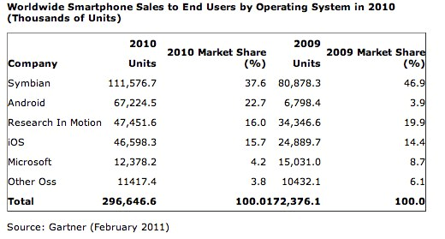
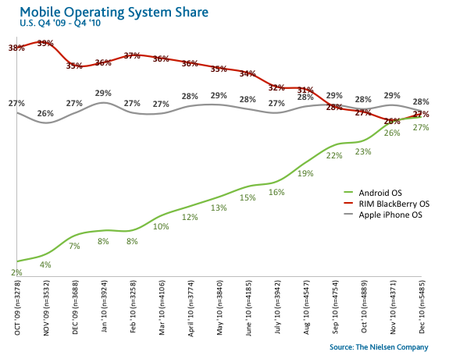
Market Share: Smart phones – Linux-based Android’s powerful growth
3-month period ending Nov 2010 in U.S.: RIM 33.5% (fell 4.1%), Android 26% (grew 6.4%), Apple 25% (grew <1%), Microsoft 9% (fell 1.8%), Palm 3.9% (fell 0.7%) [Comscore via InformationWeek 2011]
Notes:
Comscore figures from:
http://www.informationweek.com/news/smb/mobile/showArticle.jhtml?articleID=229000356
Gartner figures from:
http://www.readwriteweb.com/archives/android_market_share_numbers_questioned.php
Nielson chart posted at:
http://androidheadlines.com/2011/02/android-os-market-share-rises-to-27-tied-with-blackberry-os.html/smartphone-os-share1

Slide 11

Other Market Share Examples
Of the top 500 supercomputers on Nov 2010, 93% (465) are FLOSS (Linux or Open Solaris) [top500.org]
DNS: bind supports 95% of reverse-lookups [Manning]
Sendmail #1 Email server [Bernstein]
  Sendmail 42%, Microsoft Exchange 18%
OpenSSH #1 SSH – FLOSS can take over quickly. ~5% Summer 2000, 50% Nov 2001, 87.9% by Sep 2004 [scanssh]
Notes:
There are many other quantitative studies that discuss market share:
GNU/Linux has been the #2 server operating system, in terms of volume, in at least 1999, 2000, and 2001.
The Domain Name Service (DNS) is critical to having a working Internet. Manning realized that although “ordinary” queries would be hard to survey, “reverse-lookup” queries are relatively easy to survey – and he found that 95% of all such queries are serviced by bind, an FLOSS program.
Sendmail is still the #1 program used to transfer email; it’s FLOSS.
OpenSSH is an important program used to securely control computers remotely. In 2000 the FLOSS version was rarely used compared to proprietary implementations; by 2004 there were almost no proprietary implementations left in use.
FLOSS database management systems (DBMSs) have become wildly popular
OpenOffice.org has become a widely-used office suite, especially since it works on Windows, GNU/Linux, Unix, and MacOS. While Microsoft Office still has far more total users, OpenOffice.org had 14% of the large enterprise office systems market in 2004.

Slide 12
Reliability
Fuzz studies found
FLOSS applications
significantly more
reliable [U Wisconsin]
GNU/Linux vs. Windows NT 10 mo study [ZDNet]
  NT crashed every 6 weeks; both GNU/Linuxes, never
IIS web servers >2x downtime vs. Apache [Syscontrol AG]
Survey of 6MLOC: FLOSS “maintainability index” equal & sometimes better vs. closed [Samoladas in CACM, Oct 2004]
FLOSS: More modular [MacCormack, Harvard Bus. School]
6%, 9%
Weakened test
23%, 28%
45%, 100%
Notes:
We now come to studies about reliability. Study after study shows that FLOSS can be extremely reliable.
One of the broadest reliability studies that covered FLOSS were the “fuzz studies” of the University of Wisconsin. Here they ran many different programs, sending the programs large sets of random values. A program would “pass” this test if it didn’t crash or “hang” (stay stuck for a long time) – regardless of whether it got the “right” answer. This simple approach can test any program, in a fair way, and since “correct” answers aren’t needed a massive number of test cases can be used. Thus, unlike most studies, this study broadly compares a large sample of FLOSS programs against a large sample of proprietary programs (instead of just individual comparisons). In theory, no program should fail such a trivial test, but that’s not how things worked out. Of a set of Unix programs, 28% failed; when they tried again 5 years later, 23% failed (including some of the same failures).
In their second series of tests they also tested FLOSS programs, and they were astonished. Compared to Unix’s 23%, only 9% of the FLOSS programs failed, and when they used the GNU subset (which were more mature) only 6% failed. In contrast, the Windows results were disturbing: every Windows program failed. When they changed the test conditions to make a weaker test for just the Windows programs, the Windows programs were still far more likely to fail (with this easier test) than their competition (even though they were measured in harsher way).
ZDNet ran a test of two GNU/Linux systems against Windows NT, with exactly the same requests for 10 months. NT crashed every 6 weeks; Linux, never. This also explains why such studies are rare – they take a long time to run.
Syscontrol AG found that IIS servers were down twice as much as Apache. Various code studies have found FLOSS have better code measures, and better code is correlated with better reliability.

Slide 13
Reliability (2)
Automated defect detection analysis:
  Linux kernel: of 5.7MSLOC, only 985 detected (>5000 expected, 80% fewer) [Coverity]
  MySQL: 0.09 defects/KSLOC vs. 0.57 average defects/KSLOC avg. 200 proprietary [Reasoning]
  Linux kernel TCP/IP had smaller defect density [Reasoning]
Notes:
There are a number of tools that attempt to do automated defect detection analysis. They can also be used to estimate the number of probable defects in code, and then those values can be compared.
The Linux kernel and MySQL have been analyzed by such tools, and found that the density of errors (the likelihood that a given line has a defect) is far lower in these FLOSS programs than for typical proprietary programs.

Slide 14
Scalability
GNU/Linux and NetBSD support more hardware platforms & performance ranges than any other
  PC hardware, mobile phones, mainframes, clusters, supercomputers, ...
Again, 93% of supercomputers use an OSS OS [Top500.org]
FLOSS can develop large software systems
  2001: Red Hat Linux 7.1 had 30million SLOC: 8,000 person-years & $1B USD [Wheeler]
  2008: Fedora 9 had 204.5million SLOC: 60,000 person-years & $10.8B USD [Linux Foundation]
Notes:
Another kind of measure is “scalability,” but there are different meanings for the term.
If the issue is what has the widest computing platform range (from small computer to supercomputer) then FLOSS has no competition. GNU/Linux and NetBSD, both FLOSS, support more hardware platforms and performance ranges than any other.
Most of the supercomputers of world run the FLOSS operating system GNU/Linux. In March 2005 it was 60%, and by November 2005 it was 78%; in both cases the fastest computer in the world ran the FLOSS GNU/Linux. Clearly FLOSS is not limited to being a toy.
It’s also clear that FLOSS can develop large systems. I found that Red Hat Linux 7.1, now a very old distribution, had 30 million physical source lines of code (SLOC). It represented approximately 8,000 person-years and $1 Billion U.S. dollars (if it had to be redeveloped in a traditional proprietary manner). This “billion” is one thousand million dollars, or as I term it, a “Gigabuck.”

Slide 15
FLOSS Development Model
Improvements (as source code) and evaluation results: User as Developer
Developer
Trusted
Developer
Bug Reports
Trusted
Repository
Source Code →
Distributor
User
“Stone soup development”
FLOSS users typically use software without paying licensing fees
FLOSS users typically pay for training & support (competed)
FLOSS users are responsible for developing new improvements &
any evaluations that they need; often cooperate/pay others to do so
Notes:
This figures shows a typical development model for OSS?FS. Arbitrary developers (who are typically users or represent users) submit their proposed changes to trusted developers for a given project. Those trusted developers are allowed to make changes to a trusted repository, the “master” copy used by others for the project. Users acquire release-ready versions of the master copy directly, or via 3rd-party “distributors” (who typically combine a set of projects and provide support).
Users can feed back suggestions and requests. A small subset of users may decide (for their own reasons) to make substantive changes or evaluations; such users begin to transform their role and become a new developer.
Typically FLOSS users don’t pay for license fees, but they do pay for training and support. FLOSS users also pay (through time and/or money) for any new improvements, including any evaluations that they need.

Slide 16
Security
May 2011 study analyzed 17 packages and found proprietary software had no security advantage; they were roughly only equal with FLOSS:
  “in terms of the severity of vulnerabilities, the type of development of vulnerability disclosure over time, and vendors' patching behavior” [Guido Schryen, CACM]
Browser unsafe days (known unpatched vulnerability)
  2004: 98% Internet Explorer, 15% Mozilla Firefox
  2006: 78% Internet Explorer, 2% Mozilla Firefox
Windows websites disproportionately vulnerable
Category
Proprietary
FLOSS
Defaced
66% (Windows)
17% (GNU/Linux)
Deployed Systems
49.6% (Windows)
29.6% (GNU/Linux)
Deployed websites (by name)
24.81% (IIS)
66.75% (Apache)
Notes:
Security is obviously a very important topic, and one that is very difficult to measure. Still, there are measures that suggest that FLOSS can be quite secure compared to its competition.
Guido Schryen’s “Is Open Source Security a Myth?” (Communications of the ACM, May 2011) shows that OSS security is not a myth. The author looked at the NIST National Vulnerability Database, selected 17 packages, and found that by this measure they were similar. http://cacm.acm.org/magazines/2011/5/ 107687-is-open-source-security-a-myth/abstract
Insurance company J.S. Wurzler sells “hacker insurance”; based on its actuarial data, it gives Unix and Linux systems a discount since they’re less risky to insure.
Windows sites are disproportionately vulnerable to attack.
A count of Bugtraq vulnerabilities in 1999-2000 found the smallest to be the FLOSS OpenBSD, while Windows had the most. Warning: several reporters have independently made the same mistake, quintuple-counting the same vulnerability.
I studied the time period June 1998 to June 2001 for takeover vulnerabilities, and found that Apache did very well (no such vulnerabilities!) while Microsoft’s competing IIS did poorly by comparison.
One study of browser vulnerabilities in 2004 counted the number of days where a vulnerability to the worst kind of attack (execution of program from a remote attacker) was publicly known, yet there was no patch available to fix it. Microsoft’s Internet Explorer did absurdly poorly – it was unsafe 98% of the time. There were only 7 days (in October) where Internet Explorer could be safely used. Mozilla/Firefox had this problem only 15% of the days, even better than the 17% by the proprietary program Opera.

Slide 17
Security (2)
Unpatched networked systems: 3 months Linux, hours Windows (variance minutes ... months)
[Honeynet.org, Dec 2004]
50% Windows vulnerabilities are critical, vs. 10% in Red Hat [Nicholas Petreley, Oct 2004]
Viruses primarily Windows phenomenon
  60,000 Windows, 40 Macintosh, 5 for commercial Unix versions, 40 for Linux
91% broadband users have spyware on their home computers (proprietary OS) [National Cyber Security Alliance, May 2003] vs. ~0% on FLOSS
Notes:
Honeynet.org did a study and found that while Linux systems tended to take 3 months to crack, in general Windows systems could only last for “hours” on the Internet before they were taken over.
Nicholas Petreley studied vulnerabilities, and found that the Windows systems’ vulnerabilities tended to be more serious: 50% of the Windows vulnerabilities were critical, compared to 10% for Red Hat.
And of couse, viruses and spyware are essentially only seen on proprietary systems.

Slide 18
Security (3)
FLOSS systems scored better on security [Payne, Information Systems Journal 2002]
Survey of 6,344 software development managers April 2005 favored FLOSS [BZ Research]
Notes:
Payne did a study of Debian, Solaris, and OpenBSD. At the time Solaris was proprietary; Debian and OpenBSD were FLOSS. By Paynes’ measures, OpenBSD did by far the best; Solaris, the worst.
BZ research did a survey of 6,344 software development managers, and found that in the managers’ experience, the FLOSS programs tended to be better (with one exception, database servers, which was a somewhat close 34% to 21%).

Slide 19
Total Cost of Ownership (TCO): Background
TCO multifaceted; for software-based system: [CSC]
  Direct software costs (purchase, maintenance, support)
  Indirect software costs (license admin, audit)
  Hardware (purchase/upgrade, maintenance, dispose)
  Staffing (project management, systems engineering, administration (e.g., purchasing), systems admin)
  Support (install, troubleshoot, casual learning, training)
  Downtime
TCO sensitive to circumstances & time horizon
  Helpful for single decision, hard to generalize
  Anything has a lower TCO for some circumstance
  Architecture matters!: Independent clients, X-terms, stateless, cluster, etc. May be best deployed differently
Proprietary software is really “Total Cost to Lease”
Notes:
“Total cost of ownership” (TCO) is in theory a simple measure – it’s just the cost of a solution over a period of time. TCO depends on many values including factors like staffing, support, and downtime.
TCO is extremely sensitive to specific circumstances. As a result, TCO values can be extremely helpful for making a specific decision (for that circumstance), but can be hard to generalize to other circumstances. Indeed, just about any approach has a lower TCO for some circumstance.
In particular, note TCO is sensitive to the proposed system architecture. FLOSS systems can often be deployed in different ways, and may be best deployed in one of those alternative architectures. Approaches such as using “X terminals,” “stateless clients,” and “clusters” should be considered where appropriate.
The term TCO is common but misleading for most software, especially for proprietary software, because software users usually don’t own the software they use and thus don’t have the rights of ownership. It might be more accurate to say that proprietary software users often “lease” or “rent” the software. Unless you arrange to have a software program’s copyright transferred to you, you do not actually own the software – you only own a license to run the software in certain limited ways. Unlike owning a physical product, with nearly all proprietary software you cannot modify the software to suit your needs, nor examine the product to understand what it does, nor publish benchmarks or reviews without vendor approval, and often cannot (sub)lease, resell, or redistribute the product. In contrast, you can execute these ownership-like rights with FLOSS. These kinds of limits make proprietary software use more like a lease or a rent.

Slide 20
TCO: General FLOSS
FLOSS usually costs less to acquire than proprietary
  E.G., Web server, Windows $3610 vs. $156
Some other factors also tend to be lower
  Lower upgrade costs, can use cheaper hardware
  Avoids license management & litigation
  Downtime less: more modular, remove unneeded [CSC]
Maintenance/Support: Varies, can be competed
Cybersource: TCO 24%-34% less w/FLOSS
InfoWorld Survey of CTOs:
  60% CTOs: >$50K/yr savings
  32% CTOs: > $250K/yr savings (inc. above)
Survey of companies > $5M revenue [InternetWeek/InformationWeek]
  39%: FLOSS costs 25% to 50% less
  27%: FLOSS costs 50% to 75% less
Notes:
Some factors do often drive FLOSS costs to be lower. FLOSS is almost universally cheaper to acquire initially and to upgrade. Hardware requirements are often lower. One often-forgotten issue is that license management and litigation is far simpler for FLOSS. CSC reports that downtime tends to be less; since FLOSS is more modular, it’s easy to remove unneeded components, and a component that isn’t there can’t fail.
Maintenance and support can be acquired for both FLOSS and proprietary. FLOSS can be supported through its project boards, but many businesses decide to pay for support. In this case support can be more or less expensive than for the proprietary software; the good news is that the support can be competed, tending to lower prices for support.
Cybersource found that the TCO tended be lower with FLOSS.
An InfoWorld survey of Chief Technical Officers (CTOs) found that they were saving money; 32% (about 1/3) say they were saving $250,000 or more a year.
InternetWeek/InformationWeek’s survey of companies found that most believed that FLOSS cost less, anywhere from 25% to 75% less than proprietary programs.

Slide 21
TCO: Specific Examples
Measured Web server TCO of GNU/Linux is 40% (<1/2) of Windows' and 14% of Solaris' [RFG]
Amazon.com: $17M savings in 1Q via Linux
UK Gov't Becta* 3yr study: FLOSS savings significant in primary & secondary schools
  Secondaries reduce IT overheads by 24%
  (inc. software, hardware, and support costs)
  Primary schools cut computer costs by nearly half, primarily from support but also hardware
Willamette U. Library $41K vs. $100-150K using networked X terminals [Murphy]
Netproject: Desktop Linux 35% (save 65%!) of Windows
Largo, FL: $1M/yr savings thin clients
*Becta: British Educational Communications and Technology Association
Notes:
Above is a list of some of the many who have reported saving money using FLOSS. Amazon.com credits this with saving their business; the savings were enough to turn losses into profits.
Largo, Florida is an interesting case; they report a $1million/year savings due to FLOSS, deployed using thin clients.
I no longer try to keep up with the many individual reports of money saved by particular organizations by using FLOSS. There are simply too many such reports to track.

Slide 22
FLOSS developers experienced & get paid
Average age 30 & 11 years experience [BCG]
In 2004, 37,000 of last 38,000 changes in Linux kernel were from those paid to develop them
At least 70% of Linux kernel developers paid to do so as of Dec 2010 [Linux Foundation]
UC Irvine survey found core FLOSS contributor salaries 5-15% higher than average [Scacchi]
“Developers with a specialization in [the LAMP stack] can get 30-40% pay increase...” because of the “huge wave of people embracing open source technologies” [Kirven 2008]
Notes:
http://www.crn.com/news/channel-programs/206900235/report-open-source-adoption-increases-app-dev-pay.htm">Nathan Eddy's "Report: Open Source Adoption Increases App Dev Pay" (2008)</a>

Slide 23
Other
To many, other (often non-quantitative) advantages of FLOSS are more important, e.g.:
  Social/ethical/moral reasons
  Avoids risks of single source solutions/lock-in
    Create reversible decision: can switch/self-support if price jacked up, maliciously changes interface, drops support, needs change (can get data), …
  (Can) avoid security risks of monocultures
  Supports local/domestic IT infrastructure
  Long-term data retention (format not secret)
  Many believe it encourages innovation
  Avoids license management and litigation
  Greater flexibility
    Can change software (inc. via hiring) to meet needs
Notes:
This is a survey of quantitative studies. However, before I close, I do want to clearly state that many people find some of the non-quantitative reasons for using FLOSS to be more important.
The Free Software Foundation and others have long argued that choosing Free Software is necessary for social, ethical, and moral reasons.
Clearly, FLOSS avoids risks of a single source solution or lock-in. If the support becomes too expensive, you can always switch, since you have the code necessary to perform that switch.
There have been a number of studies giving good evidence that FLOSS encourages innovation. I do not have time to dig into that in this presentation; see my paper for more such information.
Some other non-quantitative reasons are listed above.

Slide 24
FLOSS is Commercial!!!
Many OSS projects supported by commercial companies
  Red Hat, Novell, IBM, Microsoft, ...
Big money in OSS companies
  Citrix bought XenSource ($500 million), Red Hat bought JBoss ($350 million), ...
  IBM reports invested $1B in 2001, made it back in 2002
  Venture capital: $1.44B in OSS 2001-2006 [InfoWorld]
Paid developers
OSS licenses/projects approve of commercial support
U.S. Law (41 USC 403), FAR, & DFARS commercial definition
U.S. copyright law (17 USC 101) “financial gain” definition
Sell service/hw, commoditize complements, avoid costs

Slide 25
Misleading term:
“Intellectual Property”
Laws on software often called “intellectual property rights” (IPR): Copyright, trademark, patent, trade secret, ...
“Intellectual property” term extremely misleading
  If I take your car, you have no car
  If I copy your software.. you still have the software
  Formal term: non-rivalrous
Failure to understand differences leads to mistaken thinking
  Knowledge & physical property fundamentally different
  In OSS & government contracts often many parties have rights
  U.S. Constitution permits exclusive rights only for limited times, only “to promote the progress of science and useful arts”
Instead, say “intellectual rights” and “intellectual works”
  Avoids mis-thinking & clarifies that all parties have rights

Slide 26
Parting Comments
FLOSS in many cases have measurable advantages over proprietary competition
Consider using FLOSS software when acquiring
Don't disadvantage FLOSS in policy
  Be wary of vendor lock-in
  Prefer open standards (publicly held, multi-vendor support, don’t require patents)
  Beware of “vendor pays” assumptions (CC)
  Software patents justified?
For more detailed information, see
http://www.dwheeler.com/oss_fs_why.html
Notes:
Clearly FLOSS in many cases are measurably equivalent to, or superior to, their proprietary competition. Thus, when you are acquiring software, you should consider your FLOSS options. Since FLOSS rarely respond to requests for proposals (RFPs), you should certainly not assume that posting an RFP will get the best options; you may need to search for your best options.
If you are involved in setting policies, you should be careful to not disadvantage FLOSS in policy. Be wary of vendor lock-in, which may impair your ability to switch to a better alternative if one is available. Instead, prefer open standards (ones that are publicly held, supported by multiple vendors, and don’t require patents to implement). Beware of “vendor pays” assumptions—those may not be reasonable for FLOSS projects. And indeed, all of this raises doubts about the value of software patents, which disproportionately harm FLOSS projects. There is no evidence that they actually help the software industry, but a great deal of evidence that software patents are fundamentally harmful.
For more information, see the paper at http://www.dwheeler.com/oss_fs_why.html

Slide 27
Backup Slides
Introduction to FLOSS
  Basics, history, OSS vs. FS, licenses, development model
Unnecessary fears
Acronyms
Interesting sites/documents

Slide 28
Basics of FLOSS: Free-Libre /
Open Source Software (OSS)
Free-Libre / Open Source Software (FLOSS) programs have licenses giving users the freedom:
  to run the program for any purpose,
  to study and modify the program, and
  to freely redistribute copies of either the original or modified program (without royalties, etc.)
Not non-commercial, not necessarily free-of-charge
  Often supported via commercial companies
Synonyms: Libre software, FLOS, OSS/FS
Antonyms: proprietary software, closed software

Slide 29
History of FLOSS
1950s, 1960s: Software freely distributed
~1970s: Rise of proprietary software
1984: Richard M. Stallman establishes “Free Software Foundation”, creates “General Public License” (GPL)
1990s: Increasing Internet availability enables developer coordination
1997: Eric Raymond’s “Cathedral & the Bazaar” explains new approaches; term “Open Source Software” coined

Slide 30
“Open Source Software” vs.
“Free Software”
First named “Free Software” by Stallman
  Free as in Freedom
  Officially defined by “Free Software Definition”
  Not necessarily zero price; confused many
New term coined: “Open Source Software”
  Officially defined by the “Open Source Definition” (a long 9-point list)
  Practically all OSS software is also FS
Terms sometimes indicate motivations
  FS: emphasize ethical/social issues
  OSS: technical superiority/flexibility
  OSS often used due to “zero price” confusion

Slide 31
Major FLOSS Licenses
Many licenses, but 4 dominate
BSD-new & MIT license: anything but sue
  Can incorporate code into proprietary software
  Financial incentive to use, but not aid project
General Public License (GPL): “Copyleft”
  If distribute, must distribute source code or provide written offer to do so
  Cannot link (embed) into proprietary software
Lesser/Library GPL - a compromise
  Must distribute source code/written offer, but only of component itself
  Can link into proprietary software
Public domain is FLOSS, but rare

Slide 32
Unnecessary Fears
Proprietary software always better supported? No.
  Non-traditional support (mailing lists, etc.)
  Pay for traditional support, and can compete it
Proprietary more legal rights? No.
  Who do you sue? Nobody, in either case
FLOSS economically viable? Yes.
  Many business models
  Customers can band together

Slide 33
Unnecessary Fears
Will programmers starve? No.
  Estimated 95% software not developed for sale
  Companies hire programmers to make changes for themselves
  Widespread use of FLOSS moves software development into a service (not product) model
FLOSS compatible with capitalism? Yes.
  FLOSS development involves trade: code for code
  FLOSS business often based on payment for support or commoditizing complements of products
FLOSS mean no competition? No.
  KDE vs. GNOME, emacs vs. vim

Slide 34
Unnecessary Fears
Will FLOSS destroy intellectual property? No.
  Usually, complaint is about GPL
  GPL trades you the right to freely incorporate their code into your software in exchange for the right to freely incorporate your code [which incorporates their code] into theirs
  Intellectual property traded for other intellectual property
  Microsoft sells GPL'ed software, sponsored several FLOSS projects

Slide 35
Unnecessary Fears
Viewing and changing source code valuable for non-programmers? Surprisingly, yes.
  “Would you buy a car with the hood welded shut? If not, what do you know about modern … engine technology?” [Bob Young]
  Consumers demand this so they can have control over their product support, instead of dealers
Anti-Microsoft campaign? No, not by all.
  Jun02, 831 projects use Visual Basic; 8867 projects work on Windows [SourceForge]
  Microsoft has been repeatedly asked to join community
  Microsoft long used, and now develops FLOSS
  Microsoft has sold GPL'ed software

Slide 36
Performance: GNU/Linux
Performance varies widely by circumstance!
GNU/Linux with Samba faster fileserving at Windows' own file protocols [PC Magazine]
  Nov 2001, top end, 130MB/sec vs. 78MB/sec
  April 2002, performance 2x; 4x many clients
GNU/Linux fastest (untuned systems) [Sys Admin]
Larger is
better
Smaller is
better
Notes:
Performance varies widely by circumstance, so any such measures need to be considered skeptically. You must measure performance for your particular circumstance to determine performance in that case, where that is important. Still, available performance measures suggest that FLOSS can have good performance.
PC Magazine found that (FLOSS) GNU/Linux served Windows’ file serving protocols faster than Windows did in 2001 and 2002.
Sys Admin measured several systems (without “tuning” them, that is, without working hard to configure them for maximum performance). The GNU/Linux systems did the best at both email performance and disk input/output.

Slide 37
Performance: DBMSs
eWeek Labs/PC Labs 2002 DBMS evaluation
  Unusual; most DBMS licenses forbid publication
  MySQL (FLOSS) did very well
DB2: up to 500 @ 580 users,
then dropped to ~210
(Larger is better)
(Smaller is better)
Notes:
In 2002 something extraordinary happened – there was a published DBMS evaluation. This is unusual because the licenses of many companies (such as Oracle) forbid them, but eWeek Labs/PC Labs challenged companies to sue.
Here Oracle does slightly better than FLOSS MySQL, but only slightly, and Oracle costs orders of magnitude more money than MySQL. MySQL handily beats its other rivals.

Slide 38
Acronyms
COTS: Commercial Off-the-Shelf (either proprietary or OSS)
DoD: Department of Defense
HP: Hewlett-Packard Corporation
JTA: Joint Technical Architecture (list of standards for the DoD); renamed to DISR
OSDL: Open Source Development Labs
OSS: Open Source Software
RFP: Request for Proposal
RH: Red Hat, Inc.
U.S.: United States
Trademarks belong to the trademark holder.

Slide 39
Interesting Documents/Sites
“Why OSS/FS? Look at the Numbers!” (larger paper) http://www.dwheeler.com/oss_fs_why.html
“Use of Free and Open Source Software in the US Dept. of Defense” (MITRE, sponsored by DISA)
President's Information Technology Advisory Committee (PITAC) -- Panel on Open Source Software for High End Computing, October 2000
“Open Source Software (OSS) in the DoD,” DoD memo signed by John P. Stenbit (DoD CIO), May 28, 2003
Center of Open Source and Government (EgovOS) http://www.egovos.org/
OpenSector.org http://opensector.org
Open Source and Industry Alliance http://www.osaia.org
Open Source Initiative http://www.opensource.org
Free Software Foundation http://www.fsf.org
OSS/FS References http://www.dwheeler.com/oss_fs_refs.html
Notes:
Here are some interesting related documents and sites.

Slide 40
Presentation License
This presentation (C) Copyright 2005-2011 David A. Wheeler. You may distribute unmodified and modified derivative copies; pick from any of these:
  Creative Commons Attribution-ShareAlike License version 2.5 or greater
  GNU GPL version 2 or greater
  GNU Free Documentation License (GFDL) version 1.2 or greater
Please include a reference to http://www.dwheeler.com/numbers and http://www.dwheeler.com/oss_fs_why.html
Notes:
This presentation is (C) Copyright 2005 David A. Wheeler. You may distribute unmodified and modified derivative copies of this document in electronic form, print form, or any other medium, under certain conditions; in particular, this work is “copylefted”. You can release unmodified or modified versions under any one or more of the following copylefting licenses (unless you specifically say otherwise, any derivative work is released under the same terms as this document):
1. Creative Commons Attribution-ShareAlike License version 2.5 or greater. Under this license, you are free to (1) copy, distribute, display, and perform the work; (2) make derivative works; and (3) to make commercial use of the work. However, this freedom is under the following conditions: (by:) Attribution. You must attribute the work in the manner specified by the author or licensor. (sa) Share Alike. If you alter, transform, or build upon this work, you may distribute the resulting work only under a license identical to this one. For any reuse or distribution, you must make clear to others the license terms of this work. Any of these conditions can be waived if you get permission from the copyright holder.
2. GNU General Public License (GPL) version 2 or greater.
3. GNU Free Documentation License (GFDL) version 1.2 or greater.
It’s not a license condition, but please include a reference tohttp://www.dwheeler.com/numbers & http://www.dwheeler.com/oss_fs_why.html.

