Slide 1

Open Source Software
(OSS or FLOSS) and the U.S. Department Of Defense (DoD)
DACS Webinar
February 11, 2008
Presenter: David A. Wheeler
Institute for Defense Analyses (IDA)
Organizer: Thomas McGibbon
Director, Data & Analysis Center for Software (DACS)
ITT Corp

Slide 2
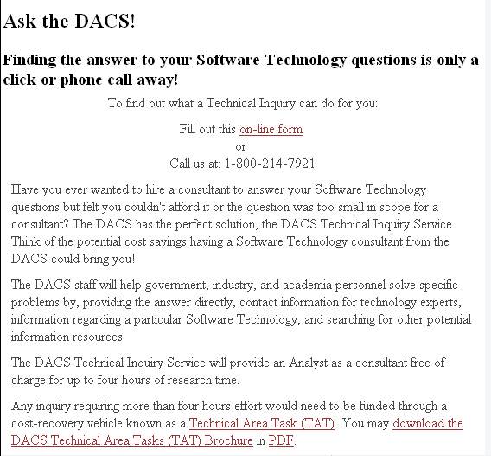
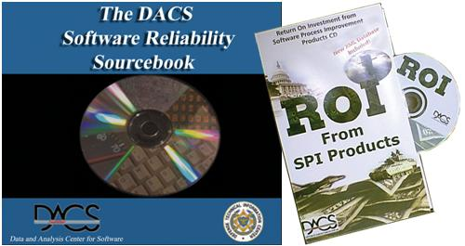
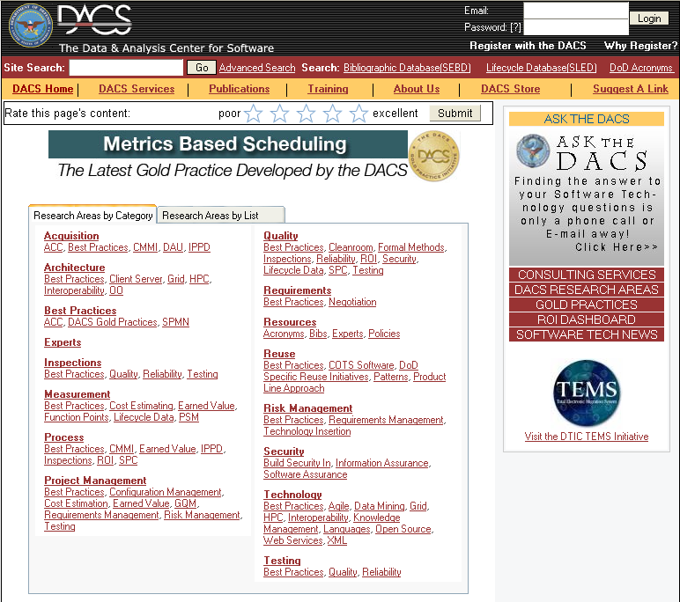
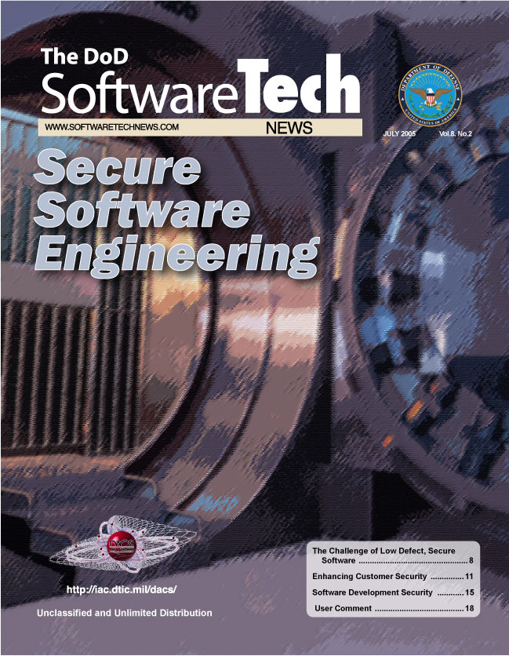
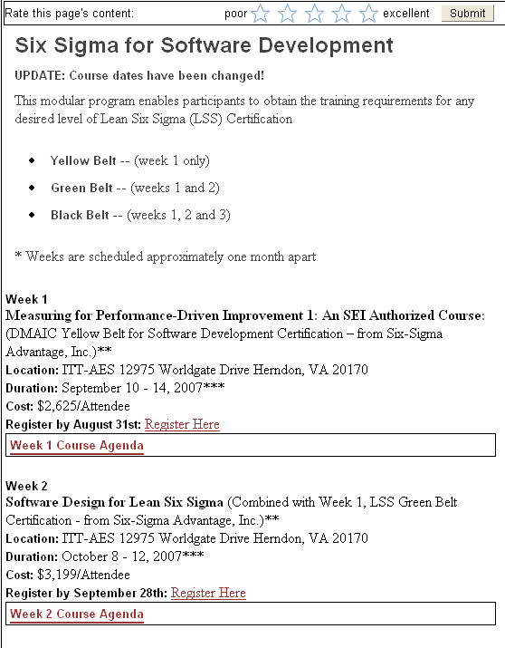
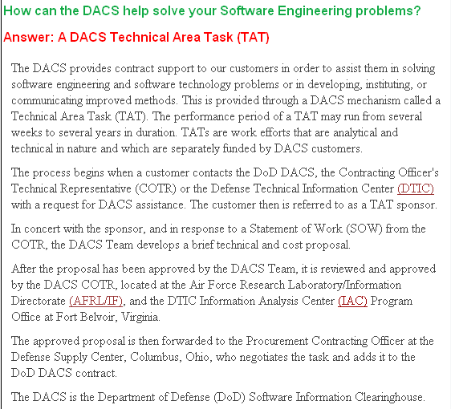
About The Data & Analysis Center for Software
About the DACS
A formal organization, chartered by the DoD to collect, analyze and disseminate scientific and technical data to the Software Engineering community.
DACS Products
Tech Inquiry Service
DACS Web Resources
Technical Journal
Consulting Services
DACS Training
Courses

Slide 3
Open Source Software
(OSS or FLOSS) and the
U.S. Department of Defense (DoD)
  David A. Wheeler
  February 11, 2008
  http://www.dwheeler.com/oss-dod-webinar2008.html
This presentation contains the views of the author and does not indicate endorsement by IDA, the U.S. government, or the U.S. Department of Defense.

Slide 4
What is Open Source Software (OSS)?
OSS: software licensed to users with these freedoms:
  to run the program for any purpose,
  to study and modify the program, and
  to freely redistribute copies of either the original or modified program (without royalties, etc.)
Original term: “Free software” (confused with no-price)
Other synonyms: libre sw, free-libre sw, FOSS, FLOSS
  OSS most common in DoD (I often use “FLOSS” to non-DoD)
Antonyms: proprietary software, closed software
Widely used; OSS #1 or #2 in many markets
  “… plays a more critical role in the DoD than has generally been recognized.” [MITRE 2003]
Not non-commercial
[For details see “Free Software Definition” & “Open Source Definition”]

Slide 5
Why would governments use or create OSS (value for government)?
Can evaluate in detail, lowering risk
  Can see if meets needs (security, etc.)
  Mass peer review typically greatly increases quality/security
  Aids longevity of records, government transparency
Can copy repeatedly at no additional charge (lower TCO)
  Support may have per-use charges (compete-able)
Can share development costs with other users
Can modify for special needs & to counter attack
  Even if you’re the only one who needs the modification
Control own destiny: Freedom from vendor lock-in, vendor abandonment, conflicting vendor goals, etc.
In many cases, OSS approaches have the potential to increase functionality, quality, and flexibility, while lowering cost and development time

Slide 6
Typical OSS development model
Improvements (as source code) and evaluation results: User as Developer
Developer
Development
Community
Trusted
Developer
Bug Reports
Trusted
Repository
Source Code →
Distributor
“Stone soup development”
User
OSS users typically use software without paying licensing fees
OSS users typically pay for training & support (competed)
OSS users are responsible for paying/developing new improvements &
any evaluations that they need; often cooperate with others to do so
Goal: Active development community (like a consortium)

Slide 7
Outline
Myths about Open Source Software (OSS)
  Myth: OSS same as open systems/standards
  Myth: OSS is non-commercial
  Myth: OSS is unreliable
  Myth: OSS forbidden by DoD policy
  Some other myths
OSS and security
Comparing GOTS, COTS proprietary, COTS OSS
Evaluating COTS OSS & proprietary – same, different
OSS licenses
Starting OSS project
  Inc. how to select a license when writing OSS
OSS non-challenges, challenges, & bottom line

Slide 8
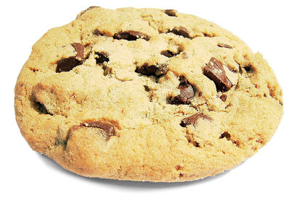
The magic cookie parable
Have a magic cookie!
  One will supply all food needs for a whole year, first one $1
  but there’s a catch...
Dependence is a security problem
  Not attacking MS/RH/etc. Need suppliers; not dependence on 1
Only a few IT strategies that counter dependency:
  Open systems/open standards
  Open source software (sometimes confused with open systems)
  Build & own yourself (GOTS): Too expensive to do everywhere
  Combination
[Cookie image by Bob Smith, released under CC Attribution 2.5 license]
Notes:
The “catch” is that after you eat the magic cookie, all other food will become poisonous to you, forever. Oh, and there’s only one manufacturer. Anyone want to bet that next year it will only cost $1?

Slide 9
Open systems and open standards
Open System = “A system that employs modular design, uses widely supported and consensus based standards for its key interfaces, and has been subjected to successful V&V tests to ensure the openness of its key interfaces”. [DoD OSJTF]
  Open systems require open standards
  Counter dependency only if competing marketplace of replaceable components. “Standards exist to encourage & enable multiple implementations” [Walli]
Governments widely view open systems as critically necessary
  DoD Directive 5000.1: “shall be employed, where feasible”
  European Commission – major policy thrust
    “guidance needs to focus on open standards”
Greater interoperability & flexibility, lower costs, higher security, ...
Open systems & open source software:
  Work well together; both strategies for reducing dependency
  Not the same thing

Slide 10
Nearly all OSS are commercial items / COTS
Nearly all OSS are commercial items, & if extant, COTS
U.S. Law (41 USC 403), FAR, & DFARS: OSS is commercial!
  Commercial item is “(1) Any item, other than real property, that is of a type customarily used by the general public or by non-governmental entities for purposes [not government-unique], and (i) Has been sold, leased, or licensed to the general public; or (ii) Has been offered for sale, lease, or license to the general public... (3) [Above with] (i) Modifications of a type customarily available in the commercial marketplace; or (ii) Minor modifications… made to meet Federal Government requirements...”
  Intentionally broad; "enables the Government to take greater advantage of the commercial marketplace” [DoD AT&L]
Dept. of the Navy “OSS Guidance” (June 5, 2007) confirms
OSS projects seek improvements = financial gain
  17 USC 101: “financial gain” inc. “receipt, or expectation of receipt, of anything of value, including the receipt of other copyrighted works.”
OMB Memo M-03-14: Commercial software, OSS support
Important because U.S. Law (41 USC 403), FAR, DFARS require preference of commercial items (inc. COTS) & NDI:
  Agencies must “(a) Conduct market research to determine [if] commercial items or nondevelopmental items are available … (b) Acquire [them] when… available … (c) Require prime contractors and subcontractors at all tiers to incorporate, to the maximum extent practicable, [them] as components...”

Slide 11
OSS is clearly commercial by other measures too
Many OSS projects supported by commercial companies
  IBM, Sun, Red Hat (solely OSS, market cap $4.3B), Novell, Microsoft (WiX, IronPython, SFU, Codeplex site)
Big money in OSS companies
  Citrix bought XenSource ($500 million), Sun buying MySQL ($1 billion), Red Hat bought JBoss ($350 million), ...
  IBM reports invested $1B in 2001, made it back in 2002
  Venture capital invested $1.44B in OSS 2001-2006 [InfoWorld]
Paid developers
  Linux: 37K/38K changes; Apache: >1000 committers, 1 unpaid
OSS licenses/projects approve of commercial support
Sell service/hw, commoditize complements, avoid costs
Use COTS/NDI because users share costs – OSS does!
[See http://www.dwheeler.com/essays/commercial-floss.html]
Notes:
“SFU” is “Services for Unix”, nee Interix (the relationship is more complex; see their sites for more information). Parts of SFU are covered by the GPL (see “Customizing Microsoft Windows Services for UNIX Installation”). Microsoft has historically railed against the GPL, as being a license that will destroy the software industry, but this claim is obvious nonsense – it was at the same time selling GPL’ed software, and it is still competing with commercial companies whose products are based on GPL software (e.g., Linux kernel). Nowadays, Microsoft is actively courting OSS developers through Codeplex.
The 37K/38K numbers for Linux are from 2004.

Slide 12
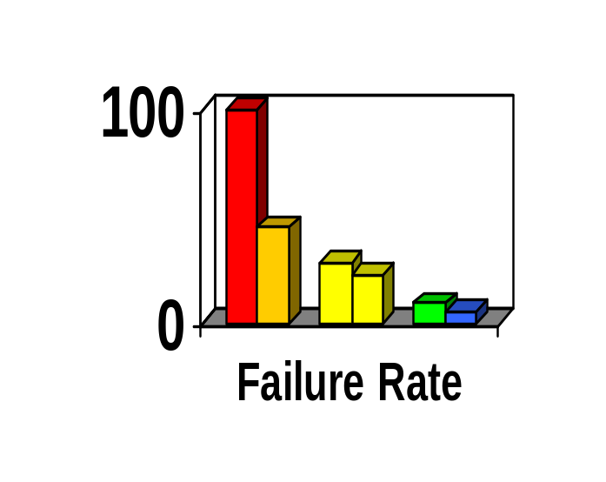
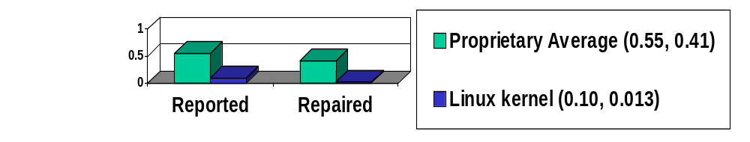
OSS often very reliable
Fuzz studies found OSS apps
significantly more reliable [U Wisconsin]
  Proprietary Unix failure rate: 28%,23%
  OSS: Slackware Linux 9%, GNU utilities 6%
  Windows: 100%; 45% if forbid certain Win32 message formats
IIS web servers >2x downtime of Apache [Syscontrol AG]
Linux kernel TCP/IP had smaller defect density [Reasoning]
[See http://www.dwheeler.com/oss_fs_why.html]

Slide 13
OSS consistent with DoD policy
DoD memo "Open Source Software (OSS) in the Department of Defense (DoD)" (2003)
  OSS is fine if meets usual requirements
  Must comply with licenses (OSS ≠ proprietary, GPL ok)
  Tries to counter bias against “new” approach
OMB M-04-16 “Software Acquisition” (July 1, 2004)
Dept. of the Navy “OSS Guidance” (June 5, 2007)
Some misunderstand DoDD 8500.1/DoDI 8500.2 DCPD-1 as forbidding OSS...

Slide 14
DoDD 8500.1/DoDI 8500.2 DCPD-1 does not apply to OSS
DoDD 8500.1/DoDI 8500.2 DCPD-1 "Public Domain Software Controls” does not apply to OSS
  "Binary or machine executable ... software products and other software products with limited or no warranty such as those commonly known as freeware or shareware are not [to be] used in DoD information systems ..." don’t stop here!
  "[because they’re] difficult or impossible to review, repair, or extend, given that the Government does not have access to the original source code and there is no owner who could make such repairs on behalf of the Government."
  Clearly doesn’t apply to OSS – source code is available
    this is abandoned binary-only
  Confirmed by General Desktop Application STIG
    DoDI 5200.2 section E3.2.6 references DISA/NSA guides
    STIG Version 3, Release 1 (09 March 2007), section 2.4

Slide 15
A few other myths...
Myth: OSS unsupported
  Businesses support OSS. Red Hat, Novell, HP, Sun, IBM, DMSolutions, SourceLabs, OpenLogic, Carahsoft, ...
  Community support often good; 1997 InfoWorld “Best Technical Support” award won by Linux User Community
Myth: Only programmers care about software licenses
  Bob Young: “Would you buy a car with the hood welded shut?... We demand the ability to open the hood... because it gives us, the consumer, control over [what] we’ve bought ... [if a dealer] overcharges us, won’t fix the problem... or refuses to install [something, others] would be happy to have our business”
Myth: Developers just (inexperienced) college students
  BCG study: Average OSS developer 30yrs old, 11yrs experience
Myth: OSS is no cost
  Training, support, transition, etc. are not free-of-cost
  Competition often produces lower TCO & higher ROI for OSS
Notes:
The list of companies here is not an endorsement of any particular company, and is certainly not exclusive. The point here is simply that if you want commercial support for open source software, there are a lot of companies who will be happy to provide commercial support.

Slide 16
Extreme security claims for OSS
Extreme claims
  “OSS is always more secure”
  “Proprietary is always more secure”
Reality: Neither OSS nor proprietary always better
  Some specific OSS programs are more secure than their competing proprietary competitors
  Include OSS options when acquiring, then evaluate
There is a principle that gives OSS a potential advantage…

Slide 17
Open design:
A security fundamental
Saltzer & Schroeder [1974/1975] - Open design principle
  the protection mechanism must not depend on attacker ignorance
OSS better fulfills this principle
Security experts perceive OSS advantage
  Bruce Schneier: “demand OSS for anything related to security”
  Vincent Rijmen (AES): “forces people to write more clear code & adhere to standards”
  Whitfield Diffie: “it’s simply unrealistic to depend on secrecy for security”

Slide 18
Problems with hiding source & vulnerability secrecy
Hiding source doesn’t halt attacks
  Presumes you can keep source secret
    Attackers may extract or legitimately get it
  Dynamic attacks don’t need source or binary
    Observing output from inputs sufficient for attack
  Static attacks can use pattern-matches against binaries
  Source can be regenerated by disassemblers & decompilers sufficiently to search for vulnerabilities
  “Security by Obscurity” widely denigrated
Hiding source slows vulnerability response
Vulnerability secrecy doesn’t halt attacks
  Vulnerabilities are a time bomb and are likely to be rediscovered by attackers
  Brief secrecy works (10-30 days), not months/years

Slide 19
Can “security by obscurity” be a basis for security?
“Security by Obscurity” can work, but iff:
  Keeping secret actually improves security
  You can keep the critical information a secret
For obscurity itself to give significant security:
  Keep source secret from all but a few people. Never sell or reveal source to many. E.G.: Classify
  Keep binary secret; never sell binary to outsiders
    Use software protection mechanisms (goo, etc.)
    Remove software binary before exporting system
  Do not allow inputs/outputs of program to be accessible by others – no Internet/web access
Incompatible with off-the-shelf development approaches
  Fine for (custom) classified software, but that’s costly
Proprietary software can be secure – but not this way

Slide 20
Proprietary advantages?
Not really
Experienced developers who understand security produce better results
  Experience & knowledge are critical, but...
  OSS developers often very experienced & knowledgeable too (BCG study: average 11yrs experience, 30 yrs old) – often same people
Proprietary developers higher quality?
  Dubious; OSS often higher reliability, security
  Market rush often impairs proprietary quality
No guarantee OSS is widely reviewed
  True! Unreviewed OSS may be very insecure
  Also true for proprietary (rarely reviewed!). Check it!
Can sue vendor if insecure/inadequate
  Nonsense. EULAs forbid, courts rarely accept, costly to sue with improbable results, you want sw not a suit

Slide 21
OSS Security Preconditions
(Unintentional vulnerabilities)
Developers/reviewers need security knowledge
  Knowledge more important than licensing
People have to actually review the code
  Reduced likelihood if niche/rarely-used, few developers, rare computer language, not really OSS
  More contributors, more review
    Is it truly community-developed?
  Review really does happen
    Tool vendors: Coverity, Fortify, etc.
    Review projects: OpenBSD, Debian Security Audit, ...
    Project-specific: Mozilla bounty, etc.
Problems must be fixed
  Far better to fix before deployment
  If already deployed, need to deploy fix
Notes:
Username “politically” password “correct” was a major Interbase backdoor, hidden for years when it was proprietary, and found quickly soon after it was releaesd as FLOSS. It’s not known if, or how widely, this was exploited before it was revealed.

Slide 22
Inserting malicious code & OSS: Basic concepts
“Anyone can modify OSS, including attackers”
  Actually, you can modify proprietary programs too… just use a hex editor. Legal niceties not protection!
  Trick is to get result into user supply chain
  In OSS, requires subverting/misleading the trusted developers or trusted repository/distribution…
  and no one noticing the public malsource later
Different threat types: Individual...nation-state
Distributed source aids detection
Large community-based OSS projects tend to have many reviewers from many countries
  Makes undetected subversion more difficult
  Consider supplier as you would proprietary software
  Risk larger for small OSS projects

Slide 23
Malicious code & OSS
OSS repositories demonstrate great resilience vs. attacks
  Linux kernel (2003); hid via “= instead of ==”
    Attack failed (CM, developer review, conventions)
  SourceForge/Apache (2001), Debian (2003)
  Countered & restored via external copy comparisons
Malicious code can be made to look unintentional
  Techniques to counter unintentional still apply
  Attacker could try to work around tools... but for OSS won't know what tools will be used!
Borland InterBase/Firebird Back Door
  user: politically, password: correct
  Hidden for 7 years in proprietary product
  Found after release as OSS in 5 months
  Unclear if malicious, but has its form
Notes:
For more on the Linux kernel attack of 2003, see:
http://www.linux.com/feature/32539
http://web.archive.org/web/20051122074510/kerneltrap.org/node/1584
The attack on SourceForge and Apache in 2001 (by “Fluffy Bunny”):
http://www.businessweek.com/technology/content/jul2001/tc20010726_509.htm
http://www.securityfocus.com/news/215
note that this was detected by the OSS community, and that they were able to recover and verify the source code (due to distributed development)‏
The break-in on Debian in 2003, including their verification of their repository:
http://www.debian.org/News/2003/20031202

Slide 24
DoD cyber security requires OSS
“One unexpected result was the degree to which Security depends on FOSS. Banning FOSS would
remove certain types of infrastructure components (e.g., OpenBSD) that currently help support network security.
... limit DoD access to—and overall expertise in—the use of powerful FOSS analysis and detection applications that hostile groups could use to help stage cyberattacks.
... remove the demonstrated ability of FOSS applications to be updated rapidly in response to new types of cyberattack.
Taken together, these factors imply that banning FOSS would have immediate, broad, and strongly negative impacts on the ability of many sensitive and security-focused DoD groups to defend against cyberattacks.” - Use of Free and Open Source Software in the US Dept. of Defense (MITRE, sponsored by DISA), Jan. 2, 2003
“In cyberspace, coding is maneuver” - Jim Stogdill; see http://www.slideshare.net/jstogdill/coding-is-maneuver

Slide 25
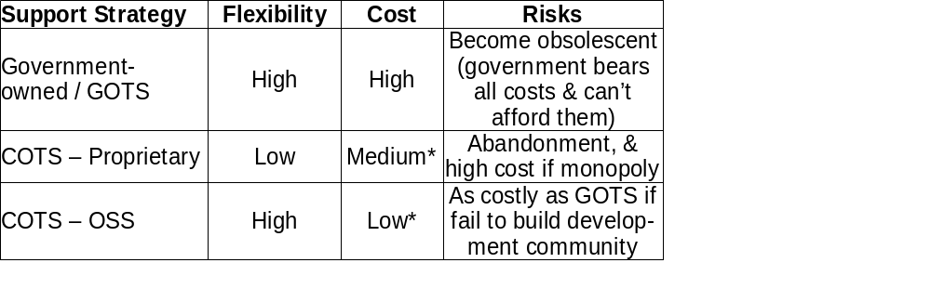
Comparing GOTS, COTS Proprietary, and COTS OSS
OSS is not always the right answer...
but it’s clear why it’s worth considering
(both reusing OSS and creating new/modified OSS)

Slide 26
Evaluating Existing COTS: What’s the Same? (OSS vs. Proprietary)
Negotiate best options with all parties, then select
Evaluate by winnowing out top candidates for your needs
  Identify candidates, Read Reviews, Compare (briefly) to needs through criteria, Analyze top candidates
Evaluation criteria – same (though data sources differ)
  Functionality, total cost of ownership, support, maintenance/ longevity, reliability, performance, scalability, flexibility, legal/license (inc. rights and responsibilities – OSS always gives right to view/ modify/ redistribute ), market share, other
Warranty & indemnification (“who do you sue?”)
  Generally disclaimed by both proprietary & OSS licenses
  Red Hat, HP, Novell offer Linux system indemnification
Pay for installation, training, support (time and/or money)
Developer trustworthiness usually unknown
  Mitigation: Can review OSS code & sometimes proprietary
  Mitigation: Supplier due diligence; often main OSS developers and integrators determinable
  Remember: Selling company often not developer

Slide 27
Evaluating Existing COTS: What’s Different? (OSS vs. Proprietary)
Process/code openness means more & different sources of evaluation information for COTS OSS
  Bug databases, mailing list discussions, detailed documentation, CM changes, source
  Anyone (inc. you) can evaluate in detail (or pay to)
  See http: //www.dwheeler.com/oss_fs_eval.html
Proprietary=pay/use, OSS=pay/improvement
  In OSS, pay can be time and/or money
Support can be competed & changed
  OSS vendors, government support contracts, self
OSS can be modified & redistributed
  New option, but need to know when to modify
  Forking usually fails; generally work with community

Slide 28
Evaluating COTS OSS:
Some specific differences
Functionality
  If doesn’t meet needs, determine cost to add what’s missing
Cost: Include all costs over long period, for all options
  Transition, training, support, additional proprietary licenses, etc.
  Long-term thinking critical; OSS may be more expensive at first (from transition & changes) yet be less expensive long-term (from upgrade & proprietary license fees from additional units)
Support: May be >1 viable option!
  Project-focused/sponsor, OSS support, industry-specific support (e.g., government contractor), community+self support
  If >1 viable option, treat as separate options
Reliability: Automatic test suite provided?
Security: Coverity/Fortify scan, OpenBSD/Debian audit...
License: Is it really OSS? (OSI & FSF approved license)

Slide 29
Quick Aside: “Intellectual Rights”
Laws on software often called “intellectual property rights” (IPR)
  Copyright, trademark, patent, trade secret, ...
IPR term extremely misleading
  If I take your car, you have no car
  If I copy your software.. you still have the software
  Formal term: non-rivalrous
  Failure to understand differences leads to mistaken thinking, especially regarding OSS
Knowledge & physical property fundamentally different
  U.S. Constitution permits exclusive rights only for limited times, solely “to promote the progress of science and useful arts”
Use term “intellectual rights” instead
  Avoids mis-thinking & clarifies that all parties have rights
Notes:
The set of laws governing software are typically called “intellectual property rights” laws, but this term is very misleading. Knoweldge - including software - is really nothing like traditinoal property. If I take your car, you don’t have the car; but if I copy software, you still have the software. Using terms like “intellectual property rights” can make people unable to see what is different about software, and limits their thinking. I prefer the term “intellectual rights”, because now you can focus on the rights of each party, instead of simply who is the “owner”.

Slide 30
Types of OSS licenses
Copyright law: Must have permission to copy software
  Permission is given by a license
  Proprietary software: Pay for a license to use a copy/copies
  OSS licenses grant more rights, but still conditional licenses
Over 100 OSS licenses, but only a few widely used
Can be grouped into three categories (differing goals):
  Permissive: Can make proprietary versions (MIT, BSD-new)
  Weakly protective: Can’t distribute proprietary version of this component, but can link into larger proprietary work (LGPL)
  Strongly protective: Can’t distribute proprietary version or directly combine (link) into proprietary work (GPL)
The most popular OSS licenses tend to be compatible
  Compatible = you can create larger programs by combining software with different licenses (must obey all of them)
Notes:
Of the various laws, the one that we’ll focus on is copyright law.

Slide 31
FLOSS License Slide:
Determining License Compatibility
Weakly
Protective
Strongly
Protective
Permissive
Public Domain
LGPLv2.1
GPLv2
MIT/X11
LGPLv2.1+
GPLv2+
BSD-new
LGPLv3 (+)
GPLv3 (+)
Apache 2.0
MPL 1.1
Affero GPLv3
A→B means A can
be merged into B
See http://www.dwheeler.com/essays/floss-license-slide.html

Slide 32
Starting OSS Project
Check usual project-start requirements
  Is there a need, no/better solution, TCO, etc.
  Examine OSS approach; similar to GOTS, with greater opportunity for cost-sharing, but greater openness
Purpose is cost-sharing: remove barriers to entry
  Use common license well-known to be OSS (GPL, LGPL, MIT/X, BSD-new) – don’t write your own license, it’s a common road to failure & very hard to overcome
  Establish project website (mailing list, tracker, source)
  Document scope, major decisions
  Use typical infrastructure, tools, etc. (e.g., SCM)
  Maximize portability, avoid proprietary langs/libraries
  Must run - Small-but-running better than big-and-not
  Establish vetting process(es) before government use
    Government-paid lead? Testing? Same issues: proprietary
Many articles & books on subject

Slide 33
Most Popular OSS Licenses
Most OSS projects GPL
GPL incompatibility foolish (MPL, BSD-old)
Over 3/4 OSS projects use a top 10 license
"Do not write a new license if it is possible to use [an existing common one]... many different and incompatible licenses works to the detriment of OSS because fragments of one program can not be used in another...” - Bruce Perens
  Top ten licenses by project
  [Freshmeat 2007-07-31]
See http://www.dwheeler.com/essays/gpl-compatible.html

Slide 34
Criteria for picking OSS license
(If new/changed software)
Actually OSS: Both OSI & FSF approved license
Legal issues
  Public domain (PD) if US government employee on clock
  Otherwise avoid PD; use “MIT” for same result (lawsuits)
If modification of existing project code, include its license
  Otherwise cannot share costs with existing project
Encourage contributions: Use common existing license
Maximize future flexibility/reuse: Use GPL-compatible one!
Best meets goal:
  Use of new tech/standard: Permissive (MIT – alt., BSD-new)
  $ savings/longevity/common library: Weakly protective (LGPL)
  $ savings/longevity/common app: Strongly protective (GPL)
Meets expected use (Mix with classified? proprietary?)

Slide 35
OSS licensing suggestions
(if new/changed software)
Recommended short list: MIT/X, LGPL, GPL
Avoid (unless modifying pre-existing software):
  Artistic: Old version too vague, others better
  MPL: GPL-incompatible
  BSD-old: GPL-incompatible, obsolete (BSD-new replaces)
Prefer MIT/X over BSD-new
  MIT license simpler & thus easier to understand
  BSD-new adds “can’t use my name in ads”, unclear legal value
Caution: Apache 2.0 license compatible GPLv3, not GPLv2
GPL: Version 2 or version 3?
  Widest use is “GPL2+”; projects slowly transitioning to 3
  Auto-transition (“GPLv2+”) - at least establish upgrade process
Sometimes: Copyright assignment, dual-license
To control just name/brand, use trademark (not copyright)

Slide 36
Examples of U.S. government-sponsored OSS development (1 of 2)
BSD TCP/IP implementation: BSD (-old, later -new)
  Maximize use of new tech/standard (TCP/IP, basis of Internet)
Expect: Public Domain
  Legally required - government (NIST) employee, on clock
SELinux: GPL
  Reuse existing components (Linux kernel)
GNAT: GPL (Ada compiler), GPL+exception (library)
  Library: weakly protective license – clearly permits use by proprietary/classified apps, yet keeps library itself OSS
  Reuse past components (gcc compiler)
  Encourage use of standard (Ada)
  Cost savings/longevity of app - previous Ada compilers $$$$$
Workforce Connections/EZRO: GPL
  Probably for cost savings/longevity of app

Slide 37
Examples of U.S. government-sponsored OSS development (2 of 2)
Evergreen (library management): GPL
  U.S. state government (Georgia Public Library Service)
  Probably for cost savings/longevity of app
  Could not find existing application with needed functionality
Delta3D (display/simulation engine): Mostly LGPL
  MOVES Institute - Naval Postgraduate School
  Cost savings/longevity/max use of library
  Proprietary $300K..$1000K/application, follow-on requires another fee - could not afford to field developed simulations
    “[by] owning the IP... if [customers] want to do a version 2, they have to come back to you. It guarantees... downstream revenue.” - Doug Whatley, CEO Breakaway Games [JDMS, July 2006, http://www.scs.org/pubs/jdms/vol3num3/ JDMSIITSECvol3no3McDowell143-154.pdf]
  Flexibility important - enables modification as needed

Slide 38
DoD Open Technology Development
“Open Technology Development Roadmap Plan”
  Apr 2006
  http://www.acq.osd.mil/jctd/articles/OTDRoadmapFinal.pdf
Three goals:
  Leverage open source infrastructure and technologies
  Apply open source collaborative technologies
  Change the default acquisitions and development behavior to default to technology services vs. products
Implementation strategy:
  Crawl: Open standards, interfaces, data
  Walk: Open source & concept methodology
  Run: Service/DoD/Industry source repositories

Slide 39
OSS non-challenges
COTS support if no traditional vendor
  Compete-able in traditional fashion
License compliance
  Usually much easier than proprietary: Illegal becomes legal
    Distributing unchanged program encouraged by OSS
    Distributing changed program encouraged by OSS... but may require some actions (attribution, re-release)
  Different, so need education (PMs, developers, lawyers)‏
OSS in classified systems
  Unchanged programs: non-issue, use as-is
  Privately modify if permitted by license
    Ok if (1) permissive or (2) protective & don’t “distribute”*
    Usually unwise - bear large maintenance costs
  Put classified material in data tables / plug-ins
  Layer/modularize into separate unlinked pieces
  Either better for confidentiality - reduce need for access
Notes:
* = The term “distribute” here is a legal technical term. Many lawyers would agree that someone working for the government (work-for-hire) to develop the software, and then giving it to the government, is not distributing.. but that can be up to debate. (The GPL version 3 makes it clear that this is not distributing, for that license, and since there’s no contradictory language in GPLv2, it could be argued that this is a clarification and could apply to GPLv2.) But releasing that system to another government, or to the public, would be distributing.

Slide 40
OSS challenges
Ensuring OSS fairly considered in acquisitions
  Some acquisition processes/policies not updated for OSS
  Policy noncompliance (FAR’s market research, “OSS neutral”)
  Many PMs unfamiliar with OSS: don’t consider using or creating
  Many OSS projects ignore solicitations & RFPs
  Favor proposals with OSS – more rights
Different economics: Pay-up-front for improvements
  Some policies presume proprietary COTS’ pay-per-use model
  Can pay in $ or time, can compete, can cost-share with other users
Transition costs if pre-existing system
  Especially if dependent on proprietary formats/protocols/APIs
  Use open standards so can switch (multi-vendor, no ‘RAND’ patents)
    Emphasize web-based apps/SOA/platform-neutral – & test it!
  Vendor lock-in often increases TCO; transition may be worthwhile

Slide 41
Bottom line
Neither OSS nor proprietary always better
  But clearly many cases where OSS is better
  By definition, OSS gives more rights to its user community
Policies must not ignore or make it difficult to use OSS where applicable
  Can be a challenge because of radically different assumptions & approach
Include OSS options when acquiring, then evaluate
  Consider both reusing existing and developing new OSS
  Considering OSS is the law... and it’s a good idea
Q&A time...
http://www.dwheeler.com/oss-dod-webinar2008.html

Slide 42
Backup slides

Slide 43
Examples of OSS in U.S. government
Use – pervasive
  OSS “plays a more critical role in the DoD than has generally been recognized”; inc. Linux, Samba, Apache, Perl, GCC, GNAT, XFree86, OpenSSH, bind, and sendmail. [MITRE 2003]
  “devIS saves its clients a minimum of $100,000 per contract by using OSS” [NewsForge]
  Often unaware it’s OSS
Government-paid improvements of OSS
  OpenSSL (CC evaluation), Bind (DNSSEC), GNAT, …
Government-developed OSS
  BSD TCP/IP suite, Security-Enhanced Linux (SELinux), OpenVista, Expect, EZRO, Evergreen (Georgia), …
U.S. federal policies explicitly neutral: OSS, or not, is fine
  OMB memo M-04-16, DoD memo “OSS in DoD”
  Examine all licenses before commit (GPL fine)
Notes:
MITRE 2003 study:
devIS saves money: http://www.newsforge.com/business/03/01/28/1829254.shtml?tid=3
See also:
http://www.egovos.org/rawmedia_repository/996791d5_0fc8_4324_87c6_ac1b61c672eb?/document.pdf
http://www.devis.com/News/CIC_2006/
(notes EZRO)‏
MITRE 2003 paper is tricky to find, it’s in many places but the URLs keep changing. Author has copy on own site that seems to stay put:
http://www.terrybollinger.com/dodfoss/dodfoss_pdf_hyperlinked.pdf
“OSS in DoD”:
http://iase.disa.mil/oss-in-dodmemo.pdf
M-04-16:
http://www.whitehouse.gov/omb/memoranda/fy04/m04-16.html

Slide 44
What are open standards?
Not just “open mouth”. Merged Perens'/Krechmer's/EC's definition:
1. Availability: available for all to read and implement
2. Maximize End-User Choice: Create a fair, competitive market for implementations; NOT lock the customer in. Multiple implementors
3. No Royalty: Free for all to implement, with no royalty or fee
4. No Discrimination: Don't favor one implementor over another (open meeting, consensus/no domination, due process)
5. Extension or Subset: May be extended or offered in subset form
6. Predatory Practices: May employ license terms that protect against subversion of the standard by embrace-and-extend tactics
7. One World: Same standard for the same capability, world-wide
8. On-going Support: Supported until user interest ceases
9. No or nominal cost for specification (at least; open access?)
See http://www.dwheeler.com/essays/opendocument-open.html
Notes:
It's been said that “any vendor with an open mouth has an open system.” Thankfully, various smart people have worked to figure out what customers mean when they say they want open standards. The most popular definition of the term is Bruce Perens'; other popular ones include Ken Krechmer's and the European Commission's. They are all trying to describe the same thing, so by merging their individual definitions, I think we end up with a better, more encompassing definition than any one by itself (each one notes important issues another doesn't).
See http://www.dwheeler.com/essays/opendocument-open.html for an explanation of how each of these points was derived, and an example of their application to a real standard.
In the late 1980s there was some debate about the “no royalty” requirement, but that's widely accepted now in the software arena. After all, open standards must not discriminate, and royalty-bearing standards always discriminate (they completely prevent open source software implementations, which are dominant or #2 in a vast number of markets, and they always discriminate against any developer outside the club of those who hold some of the patents requiring royalties).
Nowadays the question is on specification costs. At one time, it was considered acceptable to charge fees for specifications, but as third world countries increasingly use standards, more and more standards are used for an application, and the need publication fees has completely vanished, this is becoming unjustifiable. The IETF, W3C, OASIS, and others have shown that there is no need for fees to acquire standards, and in a few years' time it will probably become required that open standards be available for free (and possibly as open source specifications). This is another example of the basic “no discrimination” requirement creating a new derived requirement, as more people use standards.

Slide 45
Most popular OSS licenses
Many licenses, but most use GPL, and over 3/4 projects use top 10
"Do not write a new license if it is possible to use [an existing common license]... many different and incompatible licenses works to the detriment of OSS because fragments of one program can not be used in another program with an incompatible license.” - Bruce Perens
Top Ten OSS Licenses
GPL: 65.50%
LGPL: 6.53%
BSD-old: 2.93%
BSD-new: 2.86%
MIT: 1.67%
Artistic: 1.55%
Public Domain: 1.15%
Apache 2.0: 0.86%
MPL: 0.72%
Apache (orig.): 0.56%
[Freshmeat 2007-07-31]

Slide 46
What's high assurance software?
“High assurance software”: has an argument that could convince skeptical parties that the software will always perform or never perform certain key functions without fail... convincing evidence that there are absolutely no software defects.
  Formal methods, deep testing. CC EAL 6+
  Today, extremely rare. Critical safety/security
Medium assurance software: not high assurance, but significant effort expended to find and remove important flaws through review, testing, and so on. CC EAL 4-5
  No proof it's flawless, just effort to find and fix

Slide 47
High assurance
Many OSS tools that support developing HA
  CM: CVS, Subversion (SVN), git, Mercurial, ...
  Testing: opensourcetesting.org lists 275 tools Apr 2006, inc. Bugzilla (tracking), DejaGnu (framework), gcov (coverage), ...
  Formal methods: ACL2, PVS, Prover9/Mace4, Isabelle, Alloy, ...
  Analysis implementation: Common LISP (GNU Common LISP (GCL), CMUCL, GNU CLISP), Prolog (GNU Prolog, SWI-Prolog, Ciao Prolog, YAP), Standard ML, Haskell (GHC, Hugs), ...
  Code implementation: C (gcc), Ada (gcc GNAT), ...
HA OSS: Almost never tried (proprietary rare too)
OSS should be better for HA – hope to see in future
  In mathematics, proofs are often wrong, so only peer review of proofs valid [De Millo,Lipton,Perlis]. OSS!

Slide 48
Formal methods & OSS
Formal methods applicable to OSS & proprietary
Difference: OSS allows public peer review
  In mathematics, peer review often finds problems in proofs; many publicly-published proofs are later invalidated
  Expect true for software-related proofs, even with proof-checkers (invalid models/translation, invalid assumptions/proof methods)
  Proprietary sw generally forbids public peer review
Formal methods challenges same
  Few understand formal methods (anywhere)
  Scaling up to “real” systems difficult
  Costs of applying formal methods—who pays?
    May be even harder for OSS
    Not easy for proprietary either

Slide 49
OSS security (1)
Browser “unsafe” days in 2004: 98% Internet Explorer, 15% Mozilla/Firefox (half of Firefox’s MacOS-only)
IE 21x more likely to get spyware than Firefox [U of Wash.]
Faster response: Firefox 37 days, Windows 134.5 days
Evans Data: Linux rarely broken, ~virus/Trojan-free
Serious vulnerabilities: Apache 0, IIS 8 / 3yrs
J.S. Wurzler hacker insurance costs 5-15% more for Windows than for Unix or Linux
Bugtraq vulnerability 99-00: Smallest is OpenBSD, Windows largest (Don't quintuple-count!)
Windows websites more vulnerable in practice
Category
Proprietary
OSS
Defaced
66% (Windows)
17% (GNU/Linux)
Deployed Systems
49.6% (Windows)
29.6% (GNU/Linux)
Deployed websites (by name)
24.81% (IIS)
66.75% (Apache)

Slide 50
OSS security (2)
Unpatched networked systems: 3 months Linux, hours Windows (variance minutes ... months)
[Honeynet.org, Dec 2004]
  Windows SP2 believed to be better than previous versions of Windows
50% Windows vulnerabilities are critical, vs. 10% in Red Hat [Nicholas Petreley, Oct 2004]
Viruses primarily Windows phenomenon
  60,000 Windows, 40 Macintosh, 5 for commercial Unix versions, 40 for Linux
91% broadband users have spyware on their home computers (proprietary OS) [National Cyber Security Alliance, May 2003] vs. ~0% on OSS

Slide 51
OSS security (3)
OSS systems scored better on security [Payne, Information Systems Journal 2002]
Survey of 6,344 software development managers April 2005 favored OSS [BZ Research]

Slide 52
Common Criteria & OSS
Common Criteria (CC) can be used on OSS
  Red Hat Linux, Novell/SuSE Linux, OpenSSL
CC matches OSS imperfectly
  CC developed before rise of OSS
  Doesn’t credit mass peer review or detailed code review
  Requires mass creation of documentation not normally used in OSS development
Government policies discriminate against OSS
  Presume that vendor will pay hundreds of thousands or millions for a CC evaluation (“big company” funding)
    Presumes nearly all small business & OSS insecure
  Presume that “without CC evaluation, it’s not secure”
  Need to fix policies to meet real goal: secure software
    Government-funded eval in exchange for free use?
    Multi-agency/government funding?
    Alternative evaluation processes?

Slide 53
Evaluating OSS?
Look for evidence
First, identify your security requirements
Look for evidence at OSS project website
  User’s/Admin Guides: discuss make/keep it secure?
  Process for reporting security vulnerabilities?
  Cryptographic signatures for current release?
  Developer mailing lists discuss security issues and work to keep the program secure?
  Active community
Use other information sources where available
  E.G., CVE… but absence is not necessarily good
  External reputation (e.g., OpenBSD)
See http://www.dwheeler.com/oss_fs_eval.html

Slide 54
Concluding remarks
OSS options should always be considered
  Both choosing COTS OSS & creating new OSS project
  Components or even whole project (depending on need)
  Not always best choice, but foolish to ignore
OSS can be very flexible & often lowers costs
  Directly and as competition to non-OSS (keep options open!)
OSS raises strategic questions for governments
  How pool users to start OSS projects when appropriate?
  Educating PMs on OSS, deploying fully open architectures
  Research: default to OSS (with some common OSS license)
  Eliminating software patents
Projects should change to consider OSS approaches:
  PM education: OSS differences, fears, always consider option
  Classified systems: separate data & program, layer programs
  Open standards so can change later (e.g., browser-neutral)
    Require & operationally demonstrate that can switch components

Slide 55
Interesting Documents/Sites
“Why OSS/FS? Look at the Numbers!” http://www.dwheeler.com/oss_fs_why.html
“Use of Free and Open Source Software in the US Dept. of Defense” (MITRE, sponsored by DISA)
President's Information Technology Advisory Committee (PITAC) -- Panel on Open Source Software for High End Computing, October 2000
“Open Source Software (OSS) in the DoD,” DoD memo signed by John P. Stenbit (DoD CIO), May 28, 2003
Center of Open Source and Government (EgovOS) http://www.egovos.org/
OpenSector.org http://opensector.org
Open Source and Industry Alliance http://www.osaia.org
Open Source Initiative http://www.opensource.org
Free Software Foundation http://www.fsf.org
OSS/FS References http://www.dwheeler.com/oss_fs_refs.html

Slide 56
Acronyms (1)‏
BSD: Berkeley Software Distribution
COTS: Commercial Off-the-Shelf (either proprietary or OSS)
DFARS: Defense Federal Acquisition Regulation Supplement
DISR: DoD Information Technology Standards and Profile Registry
DoD: Department of Defense
DoDD: DoD Directive
DoDI: DoD Instruction
EULA: End-User License Agreement
FAR: Federal Acquisition Regulation
FLOSS: Free-libre / Open Source Software
FSF: Free Software Foundation (fsf.org)
GNU: GNU’s not Unix
GOTS: Government Off-The-Shelf (see COTS)
GPL: GNU General Public License
HP: Hewlett-Packard Corporation
IPR: Intellectual Property Rights; use “Intellectual Rights” instead
IT: Information Technology
LGPL: GNU Lesser General Public License

Slide 57
Acronyms (2)‏
MIT: Massachusetts Institute of Technology
MPL: Mozilla Public License
NDI: Non-developmental item (see COTS)
OMB: Office of Management & Budget
OSDL: Open Source Development Labs
OSI: Open Source Initiative (opensource.org)
OSJTF: Open Systems Joint Task Force
OSS: Open Source Software
PD: Public Domain
PM: Program Manager
RFP: Request for Proposal
RH: Red Hat, Inc.
ROI: Return on Investment
STIG: Security Technical Implementation Guide
TCO: Total Cost of Ownership
U.S.: United States
USC: U.S. Code
V&V: Verification & Validation
Trademarks belong to the trademark holder.

