Slide 1
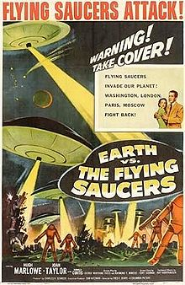

Why the GPL might not Destroy the Universe
A soothing antidote
for the
panicked masses
Dr. David A. Wheeler
MIL-OSS 2011 IGNITE Session
Version 2011-09-02
Notes:
This is an “IGNITE” style presentation, in which there are 15 seconds per slide and 20 slides, for a total of 5 minutes. Also, it must be entertaining.
David A. Wheeler may be contacted at dwheeler, at ida dot org.
Note: The images used here all are considered “fair use”:
1. “The purpose and character of the use, including whether such use is of a commercial nature or is for nonprofit educational purposes” – the work is for nonprofit educational purposes
2. “the nature of the copyrighted work;” – The original copyrighted works are for other purposes, typically movies for entertainment. In contrast, the use here is as humorous illustrative support for serious technical discussions, and thus are fundamentally transformative.
3. “the amount and substantiality of the portion used in relation to the copyrighted work as a whole” - These images as presented in the presentation are smaller, lower-quality versions of the real images. In many cases they are single images (snippets) from entire movies.
4. “the effect of the use upon the potential market for or value of the copyrighted work.” – the use of these images does not in any way reduce the potential market for, or value of, the copyrighted work. In particular, it does not supersede or substitute the use of the original work. In fact, if anything they increase their value, since they remind viewers about them.
The Godzilla image is from the 1954 film “Godzilla”. Cut from Wikipedia entry on Godzilla.
http://en.wikipedia.org/wiki/File:Godzilla_collage.jpg
http://en.wikipedia.org/wiki/Earth_vs._the_Flying_Saucers

Slide 2
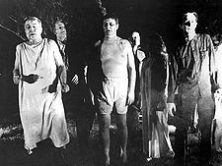
The “crisis”
The GNU General Public License (GPL) will come in the night and:
  Burn your crops!
  Kill your children!
  And worse, steal your “intellectual property”!
It makes you release all your software publicly!
Businesses will collapse!
Programmers will starve!
PANIC NOW!!!!
The “viral” GPL
Notes:
GNU = GNU’s not Unix, a project of the Free Software Foundation (FSF)
The Zombies picture is from Romero's influential “Night of the Living Dead”; see http://en.wikipedia.org/wiki/Horror_film

Slide 3
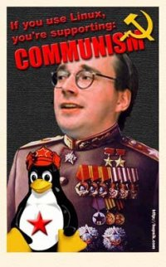

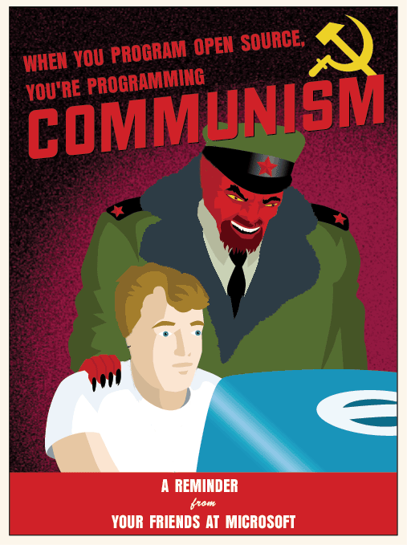

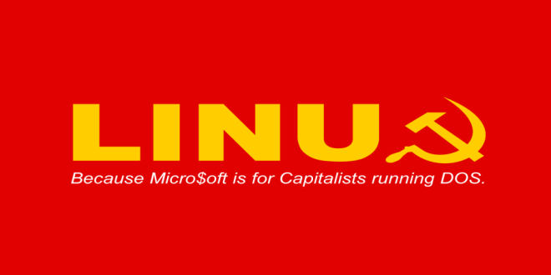
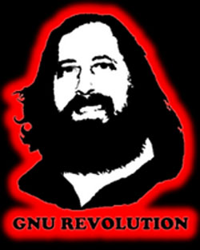

GPL (or OSS) is COMMUNISM!
Protect your family! Your livestock!
Notes:
OSS = Open Source Software
“When you program open source, you’re programming COMMUNISM”
http://www.flickr.com/photos/daviderickson/718933691/
CC BY-SA 2.0
“If you use Linux, you’re supporting: COMMUNISM”
http://www.facebook.com/group.php?gid=2324963220
“Linux: Because Micro$soft is for Capitalists running DOS”
http://an1r0n.deviantart.com/art/Linux-Communism-66194392
Reversed copyright flag is from:
“Bill Gates: Free Culture advocates = Commies”
by Xeni Jardin on Wednesday, Jan 5th at 8:30pm
http://boingboing.net/2005/01/05/bill-gates-free-cult.html
Reverse-copyright worker’s logo from:
by Xeni Jardin
http://boingboing.net/2005/01/06/creative-commies.html

Slide 4

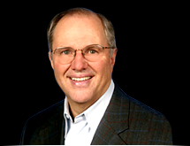


Microsoft to the rescue!!
Thankfully Microsoft has alerted red-blooded Americans!
  Bill Gates: free culture advocates “modern-day sort of communists” & “Do you understand the GPL?... they’re pretty stunned when the Pac-Man-like nature of it is described to them”
  Craig Mundie: “When the resulting (GPL) software product is distributed, its creator must make the entire source code base freely available to everyone, at no additional charge. This viral aspect of the GPL poses a threat to the intellectual property of any organization making use of it [and] fundamentally undermines the independent commercial software sector…”
  Steve Ballmer: “Linux is a cancer that attaches itself in an intellectual property sense to everything it touches”
  Jim Allchin: OSS (or at least government-developed GPL) is un­American, a threat to innovation, & a direct attack on IP
(All quotes here from 2001-2002)
Notes:
“Modern-day sort of communists” quote from “Bill Gates: Free Culture advocates = Commies” by Xeni Jardin, Wednesday, Jan 5th at 8:30pm, http://boingboing.net/2005/01/05/bill-gates-free-cult.html
“GPL Pacman will eat your business, warns Gates: Timely warning from The Great Engulfer himself” by John Lettice , 20th June 2001 14:06 GMT, http://www.theregister.co.uk/2001/06/20/gpl_pacman_will_eat_your/
Craig Mundie’s speech, plus commentary, is available here:
http://mindplusplus.wordpress.com/2002/10/26/my_response_to__1/
“Ballmer: ‘Linux is a cancer’: Contaminates all other software with Hippie GPL rubbish” by Thomas C Greene, 2nd June 2001 18:19 GMT,
http://www.theregister.co.uk/2001/06/02/ballmer_linux_is_a_cancer/
Clarifications on Jim Allchin’s comments are in:
“Microsoft Defends Jim Allchin's Comments” by Seumas, Feb 21, 2001 at 11:23:39 AM EST
http://www.kuro5hin.org/?op=displaystory;sid=2001/2/21/41423/3184
“Microsoft, co-author of the Linux kernel”
http://www.dwheeler.com/blog/2011/07/14/#microsoft-linux-author
Images of Bill Gates, Craig Mundie, and Jim Allchin courtesy of Microsoft’s press material:
http://www.microsoft.com/presspass/exec/craig/
http://www.microsoft.com/presspass/exec/jim/default.mspx
http://www.microsoft.com/presspass/exec/billg/

Slide 5
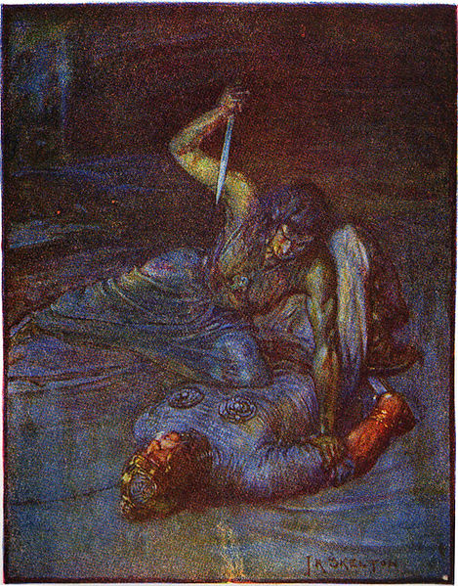
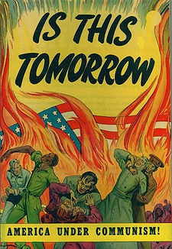
But Microsoft is abandoning the cause!
Microsoft’s “Windows Services for Unix” includes GPL!
Microsoft 5th-largest corporate contributor to
Linux kernel version 3.0 (2011) – GPL!
Microsoft has partly abandoned the anti-GPL cause
  Making money is more important?!?
  Where is their commitment to capitalism?!?
How could Microsoft attack such a righteous cause?
Notes:
For more on Services for Unix:
http://www.dwheeler.com/oss_fs_why.html#anti-microsoft
Microsoft contribution to Linux:
http://www.dwheeler.com/blog/2011/07/14/#microsoft-linux-author
http://www.microsoft.com/presspass/features/2009/Jul09/07-20LinuxQA.mspx
http://arstechnica.com/microsoft/news/2009/07/microsoft-aims-at-vm-market-with-linux-kernel-code-offering.ars
The “Is this Tomorrow” image is from a 1947 comic book, see: http://en.wikipedia.org/wiki/McCarthyism
The “illustration of the water witch trying to stab Beowulf” has no copyright. It is from: Marshall, Henrietta Elizabeth (1908). Stories of Beowulf, 59. T.C. & E.C. Jack. 1908. J. R. Skelton.
http://commons.wikimedia.org/wiki/File:Stories_of_Beowulf_water_witch_trying_to_stab_beowulf.jpg

Slide 6

The GPL will cause all businesses to collapse! Programmers will starve!
Well, except Red Hat
and Google
and all other businesses that adjust to the changing business environment
and the programmers
  70% of the (GPL) Linux kernel developers are provably being paid to do so as of 2010 (probably more)
  “Now corporate America is getting involved in the (OSS) development process… they start out as a user, but when their needs outstrip existing software, they migrate from being mere users to being developers” - Brian Elliott Finley
Notes:
The “Screaming Woman” image is so common I can’t find the original source. It’s black & white, so it’s almost certainly quite old. This image is from:
http://www.cracked.com/funny-7660-10-most-implausible-unpleasant-infuriating-ways-sci-fi-shows-kill-off-main-characters/
It’s also at, for example:
http://champagneliving.net/6-ways-to-save-at-the-pump/%20/woman-screaming
Linux Foundation's December 2010 report "Linux Kernel Development: How Fast it is Going, Who is Doing It, What They are Doing, and Who is Sponsoring It“ by Jonathan Corbet, Greg Kroah­Hartman, and Amanda McPherson. http://www.linuxfoundation.org/docs/lf_linux_kernel_development_2010.pdf
Brian Elliott Finley’s quote from “Corporate Open Source Collaboration?” http://clustering.foundries.sourceforge.net/article.pl?sid=02/08/19/1426245
The extracted Red Hat logo posted by:
http://opensource-sidh.blogspot.com/2011/08/myth-and-truth-about-red-hat-open.html

Slide 7
Yet the experts aren’t panicking
“There is a misconception that the Government is always obligated to distribute the source code of any modified open source software (OSS) to the public, and therefore that OSS should not be integrated or modified for use in classified or other sensitive DoD systems.”
  – “Clarifying Guidance Regarding OSS,” 2009,
  http://cio-nii.defense.gov/sites/oss/
“There is no DoD policy forbidding or limiting the use of software licensed under the GNU General Public License (GPL)… The DoD already uses a wide variety of software licensed under the GPL… This should not be surprising; the DoD uses OSS extensively, and the GPL is the most popular OSS license. ”
  – DoD OSS FAQ, http://cio-nii.defense.gov/sites/oss/
Government even releases GPL’ed code (e.g., NSA’s SELinux)
Notes:
SELinux = Security-Enhanced Linux

Slide 8
… and the GPL is the most popular OSS license (maybe there’s a reason)
  Top ten licenses by project per Freshmeat 2007-07-31
  http://www.dwheeler.com/essays/gpl-compatible.html
Even many of the other top 10 OSS licenses are GPL-compatible
“The GPL sufficiently dominates in DoD applications for a ban on GPL to closely approximate a full ban of all [OSS]… a DoD policy that bans any use of FOSS products would likely have … largely negative… short-term and long-term impacts on DoD” [MITRE2003]
Notes:
LGPL = Lesser GPL
BSD = Berkeley Software Distribution
MIT = Massachusetts Institute of Technology
PD = Public Domain (copyright version)
MPL = Mozilla Public License
[MITRE2003]: “Use of Free and Open-Source Software (FOSS) in the U.S. Department of Defense”, 2003 Study by MITRE Corporation performed for DoD, http://cio-nii.defense.gov/sites/oss/

Slide 9
Many GPL “problems” stem from:
Misunderstandings
  GPL never says “distribute everything you do to the public”
A mistaken faith in “security through obscurity”
Not realizing different licenses emphasize freedom of different recipients
Incompatibility with your current business model
  Maybe it’s not the GPL that is your problem

Slide 10
Issue 1: Misunderstandings
Two versions: 2 (GPLv2) and 3 (GPLv3)
GPLv2 really says: “You may copy and distribute the Program…[in] executable form… provided that you also:
  Accompany it with the complete corresponding machine-readable source code, which must be distributed… or
  Accompany it with a written offer, valid for at least three years, to give … a complete machine-readable copy of the corresponding source code” …
GPLv3 similar
Most GPLv2 say “version 2 or later”

Slide 11
GPL is a trade
Put more simply, the GPL says:
  “You can make improvements to my work…”
  “but in exchange, all recipients (transitively) of the modified version must have the same rights you received”
  Like a consortia, without lots of legal overhead
The term “intellectual property” is really misleading
  Software isn’t physical property!
  Thinking it is will lead you to false conclusions
  Use “data rights” (federal term) or “intellectual rights” instead
Legally-enforceable sharing
Notes:
For more about the problems of the term “intellectual property” see:
http://www.dwheeler.com/essays/intellectual-rights-not-intellectual-property.html

Slide 12
Sharing? That looks familiar
DoDD 8320.02: “Data is an essential enabler of network-centric warfare (NCW) and shall be made visible, accessible, and understandable to any potential user in the Department of Defense as early as possible in the life cycle to support mission objectives.”
“All I really need to know about how to live and what to do and how to be I learned in kindergarten. Wisdom was not at the top of the graduate school mountain, but there in the sand pile at school.….
  Share everything
  Play fair
  Don't hit people
  Put things back where you found them…”
    - All I really need to know I learned in Kindergarten, Robert Fulghum
Notes:
DoDD = DoD Directive

Slide 13
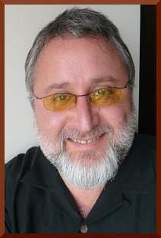
Is requiring that source be shared really that awful?
“Many FLOSS developers prefer the GPL, because they believe [it]
  (1) provides a better quid-pro-quo for developers
  (2) establishes collaboration between people and companies better than consortia
  (3) protects their work in today’s less-than-kind environment, and/or
  (4) encourages increasing the amount of Free Software.”
Linux (GPL) market growing, *BSD are not
NetApp’s improvements to BSD-licensed code are not contributed back but its improvements to GPL-licensed code have been (Jeremy Allison’s “Freedom Fighters”)
BSD-style licenses are “a really good license for your competitor to use” – Eben Moglen
http://www.dwheeler.com/essays/gpl-compatible.html
Notes:
FLOSS = Free / Libre / Open Source Software
*BSD is an abbreviation for the various BSD-derived distributions, particuarly FreeBSD, NetBSD, and OpenBSD.
Eben Moglen’s picture from: http://moglen.law.columbia.edu/

Slide 14
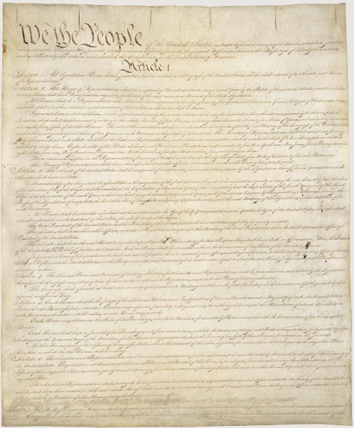
GPL sharing only applies when there’s a “distribution”
Performing work-for-hire (e.g., contracting) is not distribution if all rights return to hirer
  Directly clarified in GPLv3
Copying within the U.S. federal government generally considered not distribution - within organization
  It’s a single organization,
  created by the U.S. Constitution
  DoD 2009 “Clarifying guidance
  regarding OSS” (2)(2)(e)
  implies this
Notes:
“Clarifying guidance regarding OSS”
http://cio-nii.defense.gov/sites/oss/2009OSS.pdf
Image of U.S. Constitution from:
http://www.archives.gov/exhibits/charters/constitution.html

Slide 15
Often a non-event for modular systems
“Distribution” can only happen if your program is linked
So make your systems modular (they should be already)
  Then they aren’t linked
Use modularity techniques
  Separate layers
  Separate data from program (unclass program, classified data)
  Define clean interfaces

Slide 16
Classification
Again, often a non-issue
There is no requirement that a modified GPL program be released to the public
You only need to give source to the recipient of executables
  Classified GPL executables are okay!
  Only give classified GPL executables to those authorized to have classified material
  If there’s a “distribution” they can then have the source

Slide 17
Issue 2: Mistaken belief in security through obscurity
Attackers generally don’t need source
  Executables are typically enough
  So is the ability to send input & see the results
  If hiding source was that helpful, proprietary programs wouldn’t be broken
Remember, you can create source from executables
  Hiding source inhibits change (to inhibit competing suppliers)
  It does little to prevent finding vulnerabilities
“Security through obscurity” is nonsense unless you can keep everything secret
  Source, executable, and inputs/outputs

Slide 18
Issue 3: Not realizing different licenses emphasize freedom of different recipients
Permissive
(BSD-style)
Original
Author
Recipient 2 or
Original author
Recipient 1
Releases
as OSS
Free to do anything,
including distribute a derivative without any freedoms
May have no freedoms in derivative work
Strong
Copyleft
(GPL)
Original
Author
Recipient 2 or
Original author
Recipient 1
Releases
as OSS
Free to do anything,
except distribute a derivative without any freedoms
Free to do anything,
except distribute a derivative without any freedoms
GPL & BSD both provide freedom,
but emphasize freedoms of different recipients

Slide 19
Issue 4: GPL is incompatible with some business models
“All of the major [OSS] licenses, including GPL, permit commercial sale of [OSS] software” [MITRE2003]
GPL incompatible with business models that require that customers:
  Cannot review source code
  Cannot repair/improve
  Cannot have alternative suppliers
Lock-in models can be lucrative…
  But customers like having these freedoms
  You’ll need to compensate, & even then…
  Competitors might offer these freedoms as a competitive advantage
Notes:
MITRE 2003 report is at: http://cio-nii.defense.gov/sites/oss/

Slide 20
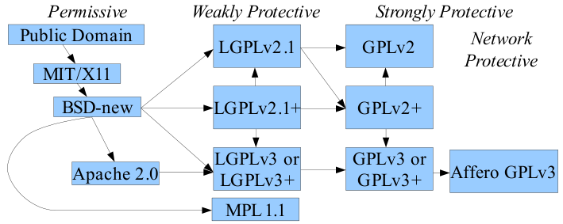
Picking an OSS license
If modification of existing project code, include its license
Use a common, existing, GPL-compatible license
Best meets your goal:
  Use of new tech/standard: Permissive (MIT, BSD-new, Apache)
  $ savings/longevity/common library: Weakly protective (LGPL)
  $ savings/longevity/common app: Strongly protective (GPL)
Notes:
FLOSS license slide is from:
http://www.dwheeler.com/essays/floss-license-slide.html

Slide 21
Conclusions
Not everything should be GPL’ed
But people need to get over the fear of the GPL
  Learn what it actually means
GPL is a “least common denominator” standard OSS license, enabling collaboration
Less FUD, more cooperation
Notes:
FUD = fear, uncertainty, and doubt

Slide 23
About the presentation
This is an IGNITE presentation for MIL-OSS 2011
  2011-08-30, scheduled for 5:30pm-7pm, given 9:10pm
Ignite presentation rules:
  20 slides only - no sound, no video, etc. Pics/text only
  Slides changed automatically every 15 seconds
  5 minutes total
For more on the format:
  http://www.speakingaboutpresenting.com/content/fast-ignite-presentation/
References/credits are in the slide notes

