Slide 1
Open Source Software
(OSS or FLOSS) and the
U.S. Department of Defense (DoD)
Dr. David A. Wheeler
dwheeler @ ida . org
2012-08-15
Copyright Notice
© 2012 Institute for Defense Analyses
Released under Creative Commons CC BY 3.0 license
Notes:
This presentation was CLEARED for open publication on May 14, 2012, by the Office of Security Review, Department of Defense. Clearance was recommended by OUSD(AT&L)DIR ARA/EI, Bradrick Oeth, IDA Contracting Officers’ Representative, of the office “ODD, Enterprise Information and OSD Studies” and agency OUSD(AT&L) DIR ARA/EI. OSR case 12-S-1973.
The email address of Dr. David A. Wheeler is dwheeler at ida dot org.
Text quotations and images are believed to meet established fair use criteria (17 U.S.C. §107), and are being used in “in a scholarly or technical work, for illustration or clarification of the author’s observations. . . .” See United States Copyright Office, FL-102 (June 2012).
This presentation is released under the Creative Commons Attribution 3.0 Unported (CC BY 3.0) license.
You are free:
* to Share — to copy, distribute and transmit the work
* to Remix — to adapt the work
* to make commercial use of the work
Under the following conditions:
* Attribution — You must attribute the work in the manner specified by the author or licensor (but not in any way that suggests that they endorse you or your use of the work).
With the understanding that:
* Waiver — Any of the above conditions can be waived if you get permission from the copyright holder.
* Public Domain — Where the work or any of its elements is in the public domain under applicable law, that status is in no way affected by the license.
* Other Rights — In no way are any of the following rights affected by the license:
- Your fair dealing or fair use rights, or other applicable copyright exceptions and limitations;
- The author's moral rights;
- Rights other persons may have either in the work itself or in how the work is used, such as publicity or privacy rights.
http://creativecommons.org/licenses/by/3.0/

Slide 2
Outline
Competition & Federal Government 101
OSS: What, how developed, why government cares
History of OSS & DoD
  MITRE study, DoD 2009 OSS policy memo, OTD
Countering myths
Open Technology Development
OSS licensing

Slide 3

The magic cookie parable
Have a magic cookie!
  One will supply all food needs for a whole year, first one $1
  but there’s a catch...
    Can only eat magic cookies (everything else poisonous afterwards)
    There is only one supplier of magic cookies
    Think it’ll be $1 next year?
Dependence on single supplier is a security problem
  Not attacking suppliers… need suppliers… not dependence on 1
Only a few IT strategies that counter dependency:
  Build & control it yourself (expensive!)
  Open systems/open standards
  Open source software (sometimes confused with open systems)
  Combination
[Cookie image by Bob Smith, released under CC Attribution 2.5 license]

Slide 4
U.S. federal government acquisition 101 (grossly simplified)
U.S. Federal
Government
Constitution
Law (US Code)
Regulations, incl.
Federal Acquisition
Regulation (FAR)
Executive
Legislative
Judicial
Branch
Regulations, incl.
DoD FAR
Supplement (DFARS)
Defense
Homeland
Security
State
Department
…
…
PM
Request for Proposal
Proposals Submitted
Contract Awarded
Local regulations…
Lead Contractor
Subcontractors
…
Sub-subcontractors
Notes:
The U.S. federal government is divided into three branches; the executive branch is divided into a number of departments and agencies. The Department of Defense (DoD) is further divided, typically down to program/project managers (PMs), who often have lead contractors, who often have subcontractors at one or more tiers.
Legally, these are governed at the top by the U.S. Constitution. Under this is the law (including the codified law – the US Code), and under this are various regulations such as the Federal Acquisition Regulation (FAR) that governs most acquisitions. There are often more and more local regulations, for example, the DoD has its DoD FAR Supplement (DFARS) that supplements the FAR.
Contractors are typically acquired through a 3-step process: The government sends out a request for proposal, proposals are submitted by various proposers, and then the government selects the “best” one and awards a contract. This is grossly oversimplified.
Federal IT dashboard is available at: http://www.itdashboard.gov/
(No hypertext link policy found.)
The records retrieved 2012-04-16 report that, among the IT major project investments of FY2012,
$75.0B was spent in the Executive branch; $33.8B in defense.
Gartner says Worldwide IT spending in 2011 $3661B (IT services $845B, Enterprise SW $267B), in 2012 $3751B
(IT services $856B, $472B) http://www.zdnet.com/blog/service-oriented/analysts-bullish-on-it-spending-where-will-the-money-go/8779
(No hypertext link policy found when searching for “link” in their FAQ.)

Slide 5
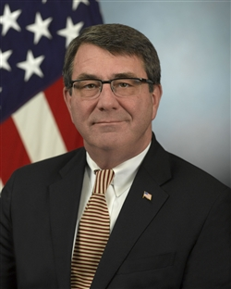
Competition is critical to the DoD
“Promote Real Competition. Real competition is the single most powerful tool available to the Department to drive productivity… I require a presentation of a competitive strategy for each program at each Milestone… require open systems architectures and set rules for acquisition of technical data rights… to ensure sustained consideration of competition…”
  Source: “Better Buying Power: Guidance for Obtaining Greater Efficiency and Productivity in Defense Spending”, Ashton B. Carter, Sep 14, 2010
Notes:
Image from: http://www.defense.gov/bios/biographydetail.aspx?biographyid=186
No special terms of use were found, including for hyperlinks.

Slide 6
What is Open Source Software (OSS)?
OSS: software licensed to users with these freedoms:
  to run the program for any purpose,
  to study and modify the program, and
  to freely redistribute copies of either the original or modified program (without royalties to original author, etc.)
Original term: “Free software” (confused with no-price)
Other synonyms: libre sw, free-libre sw, FOSS, FLOSS
  OSS most common in DoD (I often use “FLOSS” to non-DoD)
Antonyms: proprietary software, closed software
Widely used; OSS #1 or #2 in many markets
  “… plays a more critical role in the DoD than has generally been recognized.” [MITRE 2003]
Not non-commercial; OSS almost always commercial

Slide 7
Typical OSS development model
Improvements (as source code) and evaluation results: User as Developer
Developer
Development
Community
Trusted
Developer
Bug Reports
Trusted
Repository
Source Code →
Distributor
“Stone soup development”
User
OSS users typically use software without paying licensing fees
OSS users typically pay for training & support (competed)
OSS users are responsible for paying/developing new improvements &
any evaluations that they need; often cooperate with others to do so
Goal: Active development community (like a consortium)

Slide 8
Why government use/create OSS?
Reasons follow from the definition
Can evaluate in detail, lowering risk
  Can see if meets needs (security, etc.)
  Mass peer review typically greatly increases quality/security
  Aids longevity of records, government transparency
Can copy at no additional charge (lower TCO)
  Support may have per-use charges (compete-able)
Can share development costs with other users
Can modify for special needs & to counter attacks
  Even if you’re the only one who needs the modification
Control own destiny: Freedom from vendor lock-in, vendor abandonment, conflicting vendor goals, etc.
In many cases, OSS approaches have the potential to increase functionality, quality, and flexibility, while lowering cost and development time

Slide 9
Why would contractors use/develop OSS?
Same list as previous, plus...
OSS use—similar advantages to use of proprietary commercial item
  Competitive advantage (if uses & others don’t), because shared development of item across many users (cost, time, quality, innovation) tends to produce better results
  Can focus on problem not lower-level issues (if everyone uses)
  Avoids risks of depending on proprietary commercial items
    Proprietary third-party: Vendor lock-in risks (costs, abandon,...)
    A contractor: All other contractors will avoid (to avoid the risk of complete dependence on a direct competitor), inhibiting sharing
OSS development: First-mover advantage
  First one to release defines architecture & has best expertise in the OSS component, leading to competitive advantage

Slide 10
Government: Comparing GOTS, COTS Proprietary, and COTS OSS
Support Strategy | Cost | Flexibility | Risks
Government-owned / GOTS | High | High | Become obsolescent (government bears all costs & can’t afford them)
COTS – Proprietary | Medium* | Low | Abandonment & *high cost if monopoly
COTS – OSS | Low* | High | *As costly as GOTS if fail to build/work with dev. community
OSS is not always the right answer...
but it’s clear why it’s worth considering
(both reusing OSS and creating new/modified OSS)
COTS = Commercial Off-the-Shelf
GOTS = Government Off-the-Shelf

Slide 11




Early OSS history
1980s: FSF founded, Berkeley Unix & TCP/IP
1998: Term “OSS” created
2001-2002: Public claims OSS or GPL “dangerous”
  Bill Gates: free culture advocates “modern-day sort of communists” & “Do you understand the GPL?... they’re pretty stunned when the Pac-Man-like nature of it is described to them”
  Craig Mundie: “When the resulting (GPL) software product is distributed, its creator must make the entire source code base freely available to everyone, at no additional charge. This viral aspect of the GPL poses a threat to the intellectual property of any organization making use of it [and] fundamentally undermines the independent commercial software sector…”
  Steve Ballmer: “Linux is a cancer that attaches itself in an intellectual property sense to everything it touches”
  Jim Allchin: OSS (or at least government-developed GPL) is un‒American, a threat to innovation, & a direct attack on IP
Notes:
Quotations are from the following sources:
“Modern-day sort of communists” quote from “Bill Gates: Free Culture advocates = Commies” by Xeni Jardin, Wednesday, Jan 5th at 8:30pm, http://boingboing.net/2005/01/05/bill-gates-free-cult.html
Boing Boing’s general policy (http://boingboing.net/policies) links to its “policy” for hypertext linking, which mocks the idea of having a policy on hypertext linking (e.g., “Boing Boing doesn't believe in linking policies. They're dangerous, have no basis in law, and they break the norms that make the Web possible”) (http://boingboing.net/2004/10/04/boing-boing-has-a-li.html).
“GPL Pacman will eat your business, warns Gates: Timely warning from The Great Engulfer himself” by John Lettice , 20th June 2001 14:06 GMT, http://www.theregister.co.uk/2001/06/20/gpl_pacman_will_eat_your/
The terms and conditions of “http://www.theregister.co.uk/2008/09/30/reg_ts_and_cs/” do not limit the use of hypertext links.
Craig Mundie’s speech, plus commentary, is available here:
http://mindplusplus.wordpress.com/2002/10/26/my_response_to__1/
No hypertext linking policy is noted there.
“Ballmer: ‘Linux is a cancer’: Contaminates all other software with Hippie GPL rubbish” by Thomas C Greene, 2nd June 2001 18:19 GMT,
http://www.theregister.co.uk/2001/06/02/ballmer_linux_is_a_cancer/
Clarifications on Jim Allchin’s comments are in:
“Microsoft Defends Jim Allchin's Comments” by Seumas, Feb 21, 2001 at 11:23:39 AM EST
http://www.kuro5hin.org/?op=displaystory;sid=2001/2/21/41423/3184
There is no evidence of a hypertext linking policy at: http://www.kuro5hin.org/special/faq
“Microsoft, co-author of the Linux kernel”
http://www.dwheeler.com/blog/2011/07/14/#microsoft-linux-author
The hypertext linking policy says “You don't need to ask permission to link to the material on my website; just link to it.” (http://www.dwheeler.com/aboutsite.html)
Images of Bill Gates, Craig Mundie, and Jim Allchin courtesy of Microsoft’s press material:
http://www.microsoft.com/presspass/exec/craig/
http://www.microsoft.com/presspass/exec/jim/default.mspx
http://www.microsoft.com/presspass/exec/billg/
The website terms of use do not say anything about quoting hypertext links (http://www.microsoft.com/About/Legal/EN/US/IntellectualProperty/Copyright/default.aspx).
The list of quotes given here, and the underlining, were previously reported in the IDA presentation “Why the GPL might not Destroy the Universe”.

Slide 12
History of OSS in DoD
Jan 2003: MITRE study “Use of FOSS in DoD” released
  OSS already in wide use!
May 2003: DoD OSS policy memo
July 2004: OMB memo “Software Acquisition”
Apr 2006: OTD Roadmap
June 2007: Navy “OSS Guidance” (OSS = commercial)
Oct 2009: Updated DoD policy memo, + FAQ
May 2011: Open Technology Development (OTD): Lessons Learned & Best Practices for Military Software
Oct 2011: Updated “Application Security & Development Security Technical Implementation Guide (STIG)”

Slide 13
MITRE 2003 study
“The main conclusion of the analysis was that FOSS software plays a more critical role in the DoD than has generally been recognized. FOSS applications are most important in four broad areas:”
  Infrastructure Support: “banning FOSS products would… result in a significant short-term cost spike… no evidence [of] benefits”
  Software Development: Alternatives often costly or none exist
  Security: Security depends on FOSS, see next slide
  Research: “DoD research would [be] seriously damaged by a ban on FOSS… [it extends] limited budgets… provides resources [with] no equivalent commercial alternatives… [and] provides a form of ‘active publishing’ that researchers use to share not just printed results, but software that can be immediately used to support further work”
“Neither the survey nor the analysis supports the premise that banning or seriously restricting FOSS would benefit DoD security or defensive capabilities. To the contrary, the combination of an ambiguous status and largely ungrounded fears that it cannot be used with other types of software are keeping FOSS from reaching optimal levels of use.”
Notes:
All quotes here from the MITRE study “Use of FOSS in DoD”

Slide 14
MITRE 2003 study: Security & OSS
“One unexpected result was the degree… Security depends on FOSS. Banning [it would]:
remove certain types of infrastructure components (e.g., OpenBSD) that currently help support network security.
... limit DoD access to—and overall expertise in—the use of powerful FOSS analysis and detection applications that hostile groups could use to help stage cyberattacks.
... remove the demonstrated ability of FOSS applications to be updated rapidly in response to new types of cyberattack.
Taken together, these factors imply that banning FOSS would have immediate, broad, and strongly negative impacts on the ability of many sensitive and security-focused DoD groups to defend against cyberattacks.” - Use of Free and Open Source Software in the US Dept. of Defense (MITRE, sponsored by DISA), Jan. 2, 2003
Later summarized: “In cyberspace, coding is maneuver” - Jim Stogdill; see http://www.slideshare.net/jstogdill/coding-is-maneuver
Notes:
All quotes here from the MITRE study “Use of FOSS in DoD”.
The slideshare.net site terms of use do not say anything about quoting hypertext links (http://www.slideshare.net/terms).

Slide 15
DoD 2009 OSS policy memo (1)
“Clarifying Guidance Regarding OSS” (Oct 16, 2009):
In almost all cases, OSS meets the definition of “commercial computer software” and shall be given appropriate statutory preference in accordance with 10 USC 2377…
Executive agencies, including the DoD, are required to conduct market research [which should] include OSS… There are positive aspects of OSS that should be considered…
DoDI8500.2 control “DCPD-1 Public Domain Software Controls,” doesn’t forbid the use of OSS
Ensure that the plan for software support (e.g., commercial or Government program office support) is adequate for mission need.
Government is not always obligated to distribute the source code of any modified OSS to the public

Slide 16
DoD 2009 OSS policy memo (2)
Software source code and associated design documents are “data”… and therefore shall be shared across the DoD as widely as possible
Software items, including code fixes and enhancements, developed for the Government should be released to the public (such as under an open source license) when:
  The project manager, program manager, or other comparable official determines that it is in the Government’s interest to do so, such as through the expectation of future enhancements by others.
  The Government has the rights to reproduce and release the item, and to authorize others to do so.
  The public release of the item is not restricted by other law or regulation

Slide 17
Positive OSS aspects stated in DoD 2009 OSS memo (1)
“The continuous and broad peer-review enabled by publicly available source code supports software reliability and security efforts through the identification and elimination of defects that might otherwise go unrecognized by a more limited core development team.
The unrestricted ability to modify software source code enables the Department to respond more rapidly to changing situations, missions, and future threats.
Reliance on a particular software developer or vendor due to proprietary restrictions may be reduced by the use of OSS, which can be operated and maintained by multiple vendors, thus reducing barriers to entry and exit.
Open source licenses do not restrict who can use the software or the fields of endeavor in which the software can be used. Therefore, OSS provides a net-centric licensing model that enables rapid provisioning of both known and unanticipated users.

Slide 18
Positive OSS aspects stated in DoD 2009 OSS memo (2)
Since OSS typically does not have a per-seat licensing cost, it can provide a cost advantage in situations where many copies of the software may be required, and can mitigate risk of cost growth due to licensing in situations where the total number of users may not be known in advance.
By sharing the responsibility for maintenance of OSS with other users, the Department can benefit by reducing the total cost of ownership for software, particularly compared with software for which the Department has sole responsibility for maintenance (e.g., GOTS).
OSS is particularly suitable for rapid prototyping and experimentation, where the ability to ‘test drive’ the software with minimal costs and administrative delays can be important.”
“While these considerations may be relevant, they may not be the overriding aspects to any decision… Ultimately, the software that best meets the needs and mission of the Department should be used, regardless of whether the software is open source.”

Slide 19
Myth: OSS is non-commercial.
Reality: OSS is commercial (1)
Nearly all OSS are commercial items, & if extant, COTS
U.S. Law (41 USC 403), FAR, & DFARS
  Commercial item is “(1) Any item, other than real property, that is of a type customarily used by the general public or by non-governmental entities for purposes [not government-unique], and (i) Has been sold, leased, or licensed to the general public; or (ii) Has been offered for sale, lease, or license to the general public... (3) [Above with] (i) Modifications of a type customarily available in the commercial marketplace; or (ii) Minor modifications…”
  Intentionally broad; "enables the Government to take greater advantage of the commercial marketplace” [DoD AT&L]
Confirmed by DoD “Clarifying Guidance Regarding OSS” (Oct 16, 2009) & Navy “OSS Guidance” (June 5, 2007)

Slide 20
Myth: OSS is non-commercial.
Reality: OSS is commercial (2)
OSS projects seek improvements = financial gain per
  17 USC 101: “financial gain” inc. “receipt, or expectation of receipt, of anything of value, including the receipt of other copyrighted works.”
OMB Memo M-03-14: Commercial software, OSS support
Important because U.S. Law (41 USC 403), FAR, DFARS require preference of commercial items (inc. COTS) & NDI:
  Agencies must “(a) Conduct market research to determine [if] commercial items or nondevelopmental items are available … (b) Acquire [them when available] (c) Require prime contractors and subcontractors at all tiers to incorporate, to the maximum extent practicable, [them] as components...”

Slide 21
Myth: OSS is non-commercial.
Reality: OSS is commercial (3)
Many OSS projects supported by commercial companies
  IBM, Red Hat (solely OSS, market cap $4.3B), Novell, Microsoft (WiX, IronPython, SFU, Codeplex site)
Big money in OSS companies
  Citrix bought XenSource ($500 million), Red Hat bought JBoss ($350 million), ...
  IBM reports invested $1B in 2001, made it back in 2002
  Venture capital invested $1.44B in OSS 2001-2006 [InfoWorld]
Paid developers
  Linux: 37K/38K changes; 70%+ of its developers paid to do it
  Apache: >1000 committers, 1 unpaid
OSS licenses/projects approve of commercial support
Sell service/hw, commoditize complements, avoid costs
Use COTS/NDI because users share costs – OSS does!

Slide 22
Watch your language
In a US government context, never say nonsense like:
“Open source software or commercial software”
Instead, say:
“Commercial software, including proprietary and open source software, …”

Slide 23
Myth: OSS conflicts with DoDD 8500.1/DoDI 8500.2 DCPD-1
DoDD 8500.1/DoDI 8500.2 DCPD-1 "Public Domain Software Controls” often misinterpreted
  “Binary or machine executable ... software products and other software products with limited or no warranty such as those commonly known as freeware or shareware are not [to be] used in DoD information systems ...” don’t stop here!
  “[because they’re] difficult or impossible to review, repair, or extend, given that the Government does not have access to the original source code and there is no owner who could make such repairs on behalf of the Government.”
Clearly doesn’t apply to OSS – source code is available
  Applies to abandoned binary-only. OSS is not freeware
  NIST Special Publication (SP) 800-53 rev 3 in “Software usage restrictions” is much clearer

Slide 24
Myth: OSS = Open standards.
Reality: Different, yet compatible
Open System = “A system that employs modular design, uses widely supported and consensus based standards for its key interfaces, and has been subjected to successful V&V tests to ensure the openness of its key interfaces”. [DoD OSJTF]
  Open systems require open standards
  Counter dependency only if competing marketplace of replaceable components. “Standards exist to encourage & enable multiple implementations” [Walli]
Governments widely view open systems as critically necessary
  DoD Directive 5000.1: “shall be employed, where feasible”
  European Commission – major policy thrust
  “guidance needs to focus on open standards”
Greater interoperability & flexibility, lower costs, higher security, ...
Open systems/open standards & open source software:
  Work well together; both strategies for reducing dependency
  Not the same thing

Slide 25
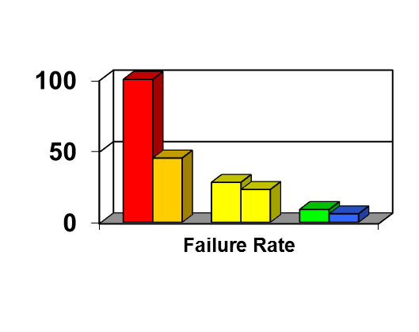
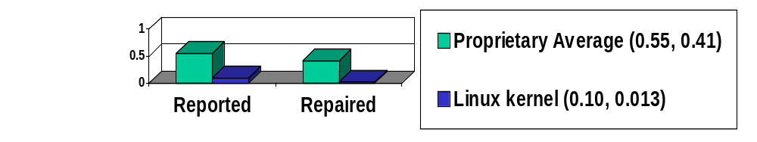
Myth: OSS always unreliable
Reality: OSS often very reliable
Fuzz studies found OSS apps
significantly more reliable [U Wisconsin]
  Proprietary Unix failure rate: 28%,23%
  OSS: Slackware Linux 9%, GNU utilities 6%
  Windows: 100%; 45% if forbid certain Win32 message formats
IIS web servers >2x downtime of Apache [Syscontrol AG]
Linux kernel TCP/IP had smaller defect density [Reasoning]

Slide 26
Myth: OSS always insecure
Extreme claims
  “OSS is always more secure”
  “Proprietary is always more secure”
Reality: Neither OSS nor proprietary always better
  Some specific OSS programs are more secure than their competing proprietary competitors
  Include OSS options when acquiring, then evaluate
There is a security principle that gives OSS a potential advantage: “Open design principle”
  “The protection mechanism must not depend on attacker ignorance” [Saltzer & Schroeder, 1974/1975]
Assume nothing; evaluate specific products

Slide 27
A few other myths...
Myth: OSS unsupported
  Businesses support OSS. Red Hat, Novell, HP, IBM, DMSolutions, SourceLabs, OpenLogic, Carahsoft, ...
  Community support often good; 1997 InfoWorld “Best Technical Support” award won by Linux User Community
Myth: Only programmers care about software licenses
  Bob Young: “Would you buy a car with the hood welded shut?... We demand the ability to open the hood... because it gives us, the consumer, control over [what] we’ve bought ... [if a dealer] overcharges us, won’t fix the problem... or refuses to install [something, others] would be happy to have our business”
Myth: Developers just (inexperienced) college students
  BCG study: Average OSS developer 30yrs old, 11yrs experience
Myth: OSS is no cost
  Training, support, transition, etc. are not free-of-cost
  Competition often produces lower TCO & higher ROI for OSS

Slide 28
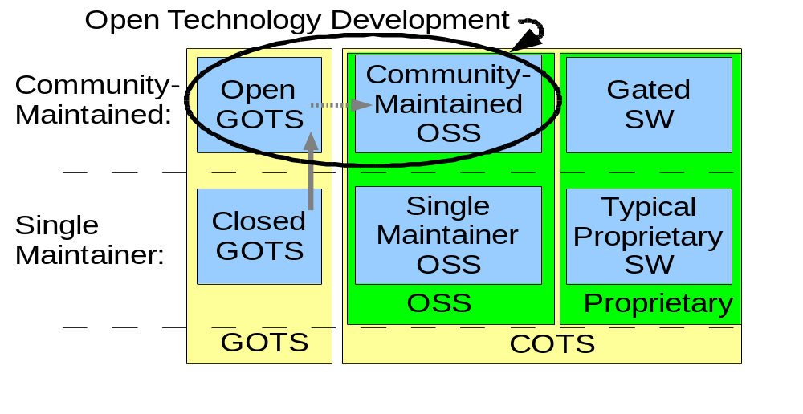
Open Technology Development
Working to increase community-developed software (including OSS), not just using it
Notes:
This figure is from “Open Technology Development (OTD): Lessons Learned & Best Practices for Military Software”, OSD Report, May 2011, http://dodcio.defense.gov/Portals/0/Documents/FOSS/OTD-lessons-learned-military-signed.pdf
No hypertext linking policy found.

Slide 29
Other government OSS policies (sample)
Consumer Financial Protection Bureau’s Source Code Policy
  Two parts, “use of external OSS” & “Redistribution”
  Liberally reuses DoD 2009 policy
  http://www.consumerfinance.gov/developers/sourcecodepolicy/
New Hampshire, HB418 (2012)
  Requires consideration of OSS in all acquisitions
Notes:
No hypertext linking policy was found starting from: http://www.consumerfinance.gov/developers/sourcecodepolicy

Slide 30
Quick aside: “Intellectual rights”
Software laws often called “intellectual property rights”
  Copyright, trademark, patent, trade secret, ...
“Property” term extremely misleading
  If I take your car, you have no car
  If I copy your software.. you still have the software
  Formal term: non-rivalrous
  Failure to understand differences of physical property vs. intellectual works leads to mistaken thinking, including re: OSS
Knowledge & physical property fundamentally different
  U.S. Constitution permits exclusive rights only for limited times, solely “to promote the progress of science and useful arts”
Use term “intellectual rights” or “data rights” instead
  Avoids mis-thinking & clarifies that all parties have rights
  If you do say “property” understand why it can mislead

Slide 31
Types of OSS licenses
Copyright law: Must have permission to copy software
  Permission is given by a license
  Proprietary software: Pay for a license to use a copy/copies
  OSS licenses grant more rights, but still conditional licenses
Over 100 OSS licenses, but only a few widely used
Can be grouped into three categories (differing goals):
  Permissive: Can make proprietary versions (MIT, BSD-new)
  Strongly protective: Can’t distribute proprietary version or combined (linked) into proprietary work; if give someone the binary, must give them the source if asked (GPL)
  Weakly protective: Can’t distribute proprietary version of this component, but can link into larger proprietary work (LGPL)
The most popular OSS licenses tend to be compatible
  Compatible = you can create larger programs by combining software with different licenses (must obey all of them)

Slide 32
FLOSS License Slide:
Determining License Compatibility
Weakly
Protective
Strongly
Protective
Permissive
Public Domain
LGPLv2.1
GPLv2
MIT/X11
LGPLv2.1+
GPLv2+
BSD-new
LGPLv3 (+)
GPLv3 (+)
Apache 2.0
MPL 1.1
Affero GPLv3
A→B means A can
be merged into B

Slide 33
Conclusions
Federal government, including DoD, uses OSS widely
OSS is practically always “commercial software”
  Federal organizations & their contractors (at all tiers) are required to consider using it
More DoD OSS information (memo, FAQ, etc.):
  http://dodcio.defense.gov/Home/Topics/UseofFreeOpenSourceSoftwareFOSS.aspx
Collaborative software development
  Have done it… the challenge is doing more

Slide 34
Backup slides

Slide 35
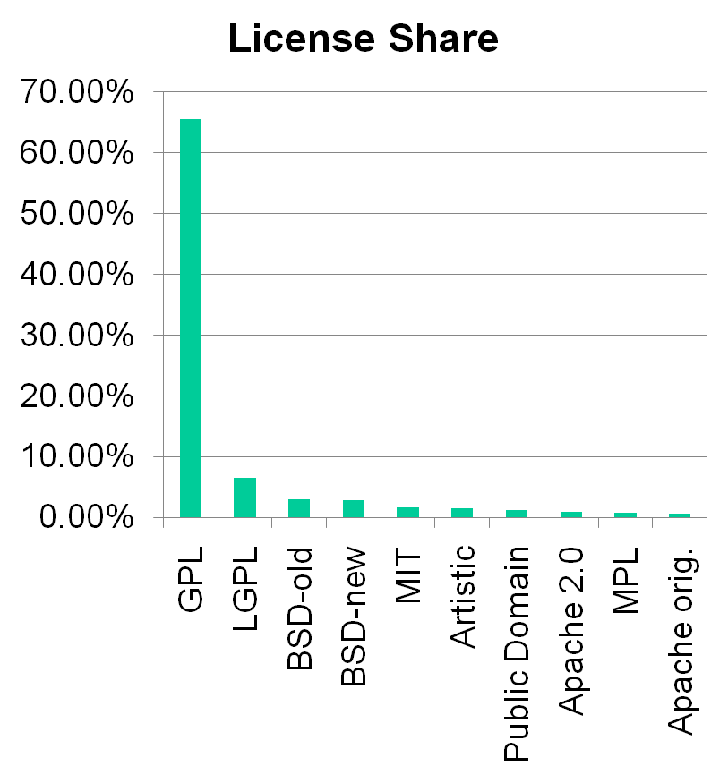
Most Popular OSS licenses
Most OSS projects GPL
GPL incompatibility foolish (MPL, BSD-old)
Over 3/4 OSS projects use a top 10 license
"Do not write a new license if it is possible to use [an existing common one]... many different and incompatible licenses works to the detriment of OSS because fragments of one program can not be used in another...” - Bruce Perens
Top ten licenses by project
[Freshmeat 2007-07-31]

Slide 36
Common OSS programs
Apache, lighttpd (“lighty”) – Web servers
Mozilla Firefox, Google Chrome – Web browsers
OpenOffice.org/LibreOffice – Office suite
VLC – Media viewer
Audacity – Sound editor
GIMP – Graphic editor
MySQL, PostgreSQL – RDBMSs
Linux – Operating system kernel (term also used for whole operating systems built on the kernel)
GCC & GNAT – Compilers
Perl, Python, PHP, Ruby – Scripting languages
Many more & growing. Fedora 9 (2008)=$10.9B of effort [Linux Foundation], my older 2001 study RHL7.1 = $1B effort

Slide 37
Myth: OSS always or never more secure
Extreme claims
  “OSS is always more secure”
  “Proprietary is always more secure”
Reality: Neither OSS nor proprietary always better
  Some specific OSS programs are more secure than their competing proprietary competitors
  Include OSS options when acquiring, then evaluate
There is a principle that gives OSS a potential advantage…

Slide 38
Open design:
A security fundamental
Saltzer & Schroeder [1974/1975] - Open design principle
  the protection mechanism must not depend on attacker ignorance
OSS better fulfills this principle
Security experts perceive OSS advantage
  Bruce Schneier: “demand OSS for anything related to security”
  Vincent Rijmen (AES): “forces people to write more clear code & adhere to standards”
  Whitfield Diffie: “it’s simply unrealistic to depend on secrecy for security”
Assume nothing; evaluate specific products

Slide 39
Problems with hiding source & vulnerability secrecy
Hiding source doesn’t halt attacks
  Presumes you can keep source secret
    Attackers may extract or legitimately get it
  Dynamic attacks don’t need source or binary
    Observing output from inputs sufficient for attack
  Static attacks can use pattern-matches against binaries
  Source can be regenerated by disassemblers & decompilers sufficiently to search for vulnerabilities
  “Security by Obscurity” widely denigrated
Hiding source slows vulnerability response
Vulnerability secrecy doesn’t halt attacks
  Vulnerabilities are a time bomb and are likely to be rediscovered by attackers
  Brief secrecy works (10-30 days), not months/year

Slide 40
Can “security by obscurity” be a basis for security?
“Security by Obscurity” can work, but iff:
  Keeping secret actually improves security
  You can keep the critical information a secret
For obscurity itself to give significant security:
  Keep source secret from all but a few people. Never sell or reveal source to many. E.G.: Classify
  Keep binary secret; never sell binary to outsiders
    Use software protection mechanisms (goo, etc.)
    Remove software binary before exporting system
  Do not allow inputs/outputs of program to be accessible by others – no Internet/web access
Incompatible with off-the-shelf development approaches
  Fine for (custom) classified software, but that’s costly
Proprietary software can be secure – but not this way

Slide 41
Proprietary advantages? Not really
Experienced developers who understand security produce better results
  Experience & knowledge are critical, but...
  OSS developers often very experienced & knowledgeable too (BCG study: average 11yrs experience, 30 yrs old) – often same people
Proprietary developers higher quality?
  Dubious; OSS often higher reliability, security
  Market rush often impairs proprietary quality
No guarantee OSS is widely reviewed
  True! Unreviewed OSS may be very insecure
  Also true for proprietary (rarely reviewed!). Check it!
Can sue vendor if insecure/inadequate
  Nonsense. EULAs forbid, courts rarely accept, costly to sue with improbable results, you want sw not a suit

Slide 42
OSS Security Preconditions
(Unintentional vulnerabilities)
Developers/reviewers need security knowledge
  Knowledge more important than licensing
People have to actually review the code
  Reduced likelihood if niche/rarely-used, few developers, rare computer language, not really OSS
  More contributors, more review
    Is it truly community-developed?
  Review really does happen
    Tool vendors: Coverity, Fortify, etc.
    Review projects: OpenBSD, Debian Security Audit, ...
    Project-specific: Mozilla bounty, etc.
Problems must be fixed
  Far better to fix before deployment
  If already deployed, need to deploy fix

Slide 43
Inserting malicious code & OSS: Basic concepts
“Anyone can modify OSS, including attackers”
  Actually, you can modify proprietary programs too… just use a hex editor. Legal niceties not protection!
  Trick is to get result into user supply chain
  In OSS, requires subverting/misleading the trusted developers or trusted repository/distribution…
  and no one noticing the public malsource later
Different threat types: Individual...nation-state
Distributed source aids detection
Large community-based OSS projects tend to have many reviewers from many countries
  Makes undetected subversion more difficult
  Consider supplier as you would proprietary software
  Risk larger for small OSS projects

Slide 44
Malicious code & OSS
OSS repositories demo great resilience vs. attacks
  Linux kernel (2003); hid via “= instead of ==”
    Attack failed (CM, developer review, conventions)
  SourceForge/Apache (2001), Debian (2003)
Countered & restored via external copy comparisons
Malicious code can be made to look unintentional
  Techniques to counter unintentional still apply
  Attacker could try to work around tools... but for OSS won't know what tools will be used!
Borland InterBase/Firebird Back Door
  user: politically, password: correct
  Hidden for 7 years in proprietary product
  Found after release as OSS in 5 months
  Unclear if malicious, but has its form

Slide 45
GNU General Public License (GPL)
Two versions of GPL: version 2 and version 3 (very similar)
You can arbitrarily use & internally modify GPL’d software
If you distribute^{v2}/convey^{v3} an executable to another party:
  Must give/offer recipient the corresponding source code. GPLv3:
    “You may charge any price or no price for each copy that you convey, and you may offer support or warranty protection for a fee.”
  Must give same rights to recipient. GPLv3:
    “Each time you convey a covered work, the recipient automatically receives a license from the original licensors, to run, modify and propagate that work, subject to this License…
    You may not impose any further restrictions on the exercise of the rights granted or affirmed under this License. For example, you may not impose a license fee, royalty, or other charge for exercise of rights granted under this License...”
    Preamble: “if you distribute copies… whether gratis or for a fee, you must pass on to the recipients the same freedoms that you received”

Slide 46
Does the GPL Require
Release to the Public?
“The GPL does not require you to release your modified version, or any part of it. You are free to make modifications and use them privately, without ever releasing them.
This applies to organizations (including companies), too; an organization can make a modified version and use it internally without ever releasing it outside the organization.
But if you release the modified version to the public in some way, the GPL requires you to make the modified source code available to the program’s users, under the GPL.
Thus, the GPL gives permission to release the modified program in certain ways, and not in other ways; but the decision of whether to release it is up to you” – GPL FAQ (FSF)

Slide 47
Acronyms (1)
BSD: Berkeley Software Distribution
COTS: Commercial Off-the-Shelf (either proprietary or OSS)
DFARS: Defense Federal Acquisition Regulation Supplement
DISR: DoD Information Technology Standards and Profile Registry
DoD: Department of Defense
DoDD: DoD Directive
DoDI: DoD Instruction
EULA: End-User License Agreement
FAR: Federal Acquisition Regulation
FLOSS: Free-libre / Open Source Software
FSF: Free Software Foundation (fsf.org)
GNU: GNU’s not Unix
GOTS: Government Off-The-Shelf (see COTS)
GPL: GNU General Public License
HP: Hewlett-Packard Corporation
IPR: Intellectual Property Rights; use “Intellectual Rights” instead
IT: Information Technology
LGPL: GNU Lesser General Public License

Slide 48
Acronyms (2)
MIT: Massachusetts Institute of Technology
MPL: Mozilla Public License
NDI: Non-developmental item (see COTS)
OMB: Office of Management & Budget
OSDL: Open Source Development Labs
OSI: Open Source Initiative (opensource.org)
OSJTF: Open Systems Joint Task Force
OSS: Open Source Software
PD: Public Domain
PM: Program Manager
RFP: Request for Proposal
RH: Red Hat, Inc.
ROI: Return on Investment
STIG: Security Technical Implementation Guide
TCO: Total Cost of Ownership
U.S.: United States
USC: U.S. Code
V&V: Verification & Validation
Trademarks belong to the trademark holder.

Slide 49
Released under CC BY 3.0 License
This presentation is released under the Creative Commons Attribution 3.0 Unported (CC BY 3.0) license.
You are free:
  to Share — to copy, distribute and transmit the work
  to Remix — to adapt the work
  to make commercial use of the work
Under the following conditions:
  Attribution — You must attribute the work in the manner specified by the author or licensor (but not in any way that suggests that they endorse you or your use of the work).
With the understanding that:
  Waiver — Any of the above conditions can be waived if you get permission from the copyright holder.
  Public Domain — Where the work or any of its elements is in the public domain under applicable law, that status is in no way affected by the license.
Other Rights — In no way are any of the following rights affected by the license:
  Your fair dealing or fair use rights, or other applicable copyright exceptions and limitations;
  The author's moral rights;
  Rights other persons may have either in the work itself or in how the work is used, such as publicity or privacy rights.
Details: http://creativecommons.org/licenses/by/3.0/

