Slide 1
Open Source Software (OSS)
David A. Wheeler
March 12, 2007
This presentation contains the views of the author and does not indicate endorsement by IDA, the U.S. government, or the U.S. Department of Defense.

Slide 2
Outline
Introduction to OSS
  What is it?
  Nearly all OSS is commercial off-the-shelf (COTS)
  Typical OSS development model
Value to government
  Why would governments use or create OSS?
  OSS Challenges
  Examples of use
Selecting COTS OSS: What’s the Same? Different?
Starting OSS project
Security
Foolish vs. Sensible Policies
Remarks

Slide 3
What is Open Source Software (OSS)?
OSS: software licensed to users with these freedoms:
  to run the program for any purpose,
  to study and modify the program, and
  to freely redistribute copies of either the original or modified program (without royalties, etc.)
Synonyms: libre software, Free software*, FOSS, FLOSS
Antonyms: proprietary software, closed software
Widely used; OSS #1 or #2 in many markets
  “… plays a more critical role in the DoD than has generally been recognized.” [MITRE 2003]
Not non-commercial…
* The term “Free software” sometimes means OSS, and sometimes instead means “no charge”

Slide 4
Nearly all OSS is
Commercial Off-the-Shelf (COTS)
Federal Acquisition Regulation (FAR) prefers COTS and NDI; commercial item = “licensed to general public”:
  Agencies must “(a) Conduct market research to determine [if] commercial items or nondevelopmental items are available … (b) Acquire [them] when… available … (c) Require prime contractors and subcontractors at all tiers to incorporate, to the maximum extent practicable, [them] as components...”
  Commercial item is “(1) Any item, other than real property, that is of a type customarily used by the general public or by non-governmental entities for purposes [not unique to a government], and (i) Has been sold, leased, or licensed to the general public; or (ii) Has been offered for sale, lease, or license to the general public... (3) [Above with] (i) Modifications of a type customarily available in the commercial marketplace; or (ii) Minor modifications… made to meet Federal Government requirements. ”
  True for nearly all off-the-shelf (OTS) OSS, so it’s commercial item/COTS
OSS projects usually seek improvements = financial gain
  U.S. Code Title 17, section 101 defines “financial gain” as including “receipt, or expectation of receipt, of anything of value, including the receipt of other copyrighted works.”
Many OSS projects supported by commercial companies
  IBM, Sun, Red Hat, Novell, Microsoft (WiX, IronPython, SFU, Codeplex site)
Often developers paid (2004: 37K/38K Linux changes)
OSS licenses and projects approve of commercial support
Use COTS/NDI because users share costs – OSS does!
Notes:
“SFU” is “Services for Unix”, nee Interix (the relationship is more complex; see their sites for more information). Parts of SFU are covered by the GPL (see “Customizing Microsoft Windows Services for UNIX Installation”). Microsoft has historically railed against the GPL, as being a license that will destroy the software industry, but this claim is obvious nonsense – it was at the same time selling GPL’ed software, and it is still competing with commercial companies whose products are based on GPL software (e.g., Linux kernel).

Slide 5
OSS Development Model
Improvements (as source code) and evaluation results: User as Developer
Developer
Trusted
Developer
Bug Reports
Trusted
Repository
Source Code →
Distributor
User
“Stone soup development”
OSS users typically use software without paying licensing fees
OSS users typically pay for training & support (competed)
OSS users are responsible for developing new improvements &
any evaluations that they need; often cooperate/pay others to do so
Notes:
Development model
User
User as developer
Developer
Trusted developer
Trusted repository
Distributor
Stone soup development
Source code
Licensing fees
Training
Support
Evaluations
Improvements
Cooperate

Slide 6
Why would governments use or create OSS (value for government)?
Can evaluate in detail, lowering risk
  Can see if meets needs (security, etc.)
  Mass peer review typically greatly increases quality/security
  Aids longevity of records, government transparency
Can copy repeatedly at no additional charge (lower TCO)
  Support may have per-use charges (compete-able)
Can share development costs with other users
Can modify for special needs & to counter attack
  Even if you’re the only one who needs the modification
Control own destiny: Freedom from vendor lock-in, vendor abandonment, conflicting vendor goals, etc.
In many cases, OSS approaches have the potential to increase functionality, quality, and flexibility, while lowering cost and development time

Slide 7
OSS Challenges
Ensuring OSS fairly considered in acquisitions
  Some acquisition processes/policies not updated for OSS
  Policy noncompliance (FAR’s market research, “OSS neutral”)
  Many PMs unfamiliar with OSS: don’t consider using or creating
  Many COTS OSS projects ignore solicitations & RFPs
Different economics: Pay-up-front for improvements
  Some policies presume proprietary COTS’ pay-per-use model
  Can pay in $ or time, can compete, can cost-share with other users
Transition costs if pre-existing system
  Especially if dependent on proprietary formats/protocols/APIs
  Use open standards so can switch (multi-vendor, no ‘RAND’ patents)
  Web-based apps/SOA help if open stds (browser/platform-neutral)
  Vendor lock-in often increases TCO; transition may be worthwhile
COTS support if no traditional vendor (compete-able)
License compliance (easier but different: education)
Cannot release classified code as OSS
  Can build classified systems with/incl. OSS: tables, layers, licenses

Slide 8
Examples of OSS in U.S. Government
Use – pervasive
  OSS “plays a more critical role in the DoD than has generally been recognized”; inc. Linux, Samba, Apache, Perl, GCC, GNAT, XFree86, OpenSSH, bind, and sendmail. [MITRE 2003]
  “devIS saves its clients a minimum of $100,000 per contract by using OSS” [NewsForge]
  Often unaware it’s OSS
Government-paid improvements of OSS
  OpenSSL (CC evaluation), Bind (DNSSEC), GNAT, …
Government-developed OSS
  BSD TCP/IP suite, Security-Enhanced Linux (SELinux), OpenVista, Expect, EZRO, Evergreen (Georgia), …
U.S. federal policies explicitly neutral: OSS, or not, is fine
  OMB memo M-04-16, DoD memo “OSS in DoD”
  Examine all licenses before commit (GPL fine)
Notes:
MITRE 2003 study:
devIS saves money: http://www.newsforge.com/business/03/01/28/1829254.shtml?tid=3
See also:
http://www.egovos.org/rawmedia_repository/996791d5_0fc8_4324_87c6_ac1b61c672eb?/document.pdf
http://www.devis.com/News/CIC_2006/
(notes EZRO)
MITRE 2003 paper is tricky to find, it’s in many places but the URLs keep changing. Author has copy on own site that seems to stay put:
http://www.terrybollinger.com/dodfoss/dodfoss_pdf_hyperlinked.pdf
“OSS in DoD”:
http://iase.disa.mil/oss-in-dodmemo.pdf
M-04-16:
http://www.whitehouse.gov/omb/memoranda/fy04/m04-16.html

Slide 9
Selecting COTS: What’s the Same? (OSS vs. Proprietary)
Negotiate best options with all parties, then select
Evaluate by winnowing out top candidates for your needs
  Identify candidates, Read Reviews, Compare (briefly) to needs through criteria, Analyze top candidates
Evaluation criteria - same
  Functionality, total cost of ownership, support, maintenance/ longevity, reliability, performance, scalability, flexibility, legal/license (inc. rights and responsibilities – OSS always gives right to view, modify, and redistribute ), mkt share, other
Warranty & indemnification (“who do you sue?”)
  Generally disclaimed by both proprietary & OSS licenses
Pay for installation, training, support (time and/or money)
Developer trustworthiness usually unknown
  Mitigation: Can review OSS code & sometimes proprietary
  Mitigation: Supplier due diligence; often main OSS developers and integrators determinable
  Remember: Selling company often not developer

Slide 10
Selecting COTS: What’s Different? (OSS vs. Proprietary)
Process/code openness means more&different sources of evaluation information for COTS OSS
  Bug databases, mailing list discussions, …
  Anyone (inc. you) can evaluate in detail
  See http: //www.dwheeler.com/oss_fs_eval.html
Proprietary=pay/use, OSS=pay/improvement
  In OSS, pay can be time and/or money
Support can be competed & changed
  OSS vendors, government support contracts, self
OSS can be modified & redistributed
  New option, but need to know when to modify
  Forking usually fails; generally work with community

Slide 11
Starting OSS Project
Check usual project-start requirements
  Is there a need, no/better solution, TCO, etc.
  Examine OSS approach; similar to GOTS, with greater opportunity for cost-sharing, but greater openness
Purpose is cost-sharing: remove barriers to entry
  Use common license well-known to be OSS (GPL, LGPL, MIT/X, BSD-new) – don’t write your own license
  Establish project website (mailing list, tracker, source)
  Document scope, major decisions
  Use typical infrastructure, tools, etc. (e.g., SCM)
  Maximize portability, avoid proprietary langs/libraries
  Must run - Small-but-running better than big-and-not
  Establish vetting process(es) before government use
    Government-paid lead? Testing? Same issues: proprietary
Many articles & books on subject

Slide 12
Security
Neither OSS nor proprietary are always more secure
  Many specific OSS programs are significantly more secure; see quantitative studies “Why…” at http://www.dwheeler.com
OSS advantage: Open design principle
  Saltzer & Schroeder [1974/1975], “Protection mechanism must not depend on attacker ignorance”
Hiding source code doesn’t impede attacks
  “Security by Obscurity” requires real secret-keeping: can’t give access to source code, executable program, or website
Attackers can modify OSS and proprietary software
  Trick is to get that modified version into supply chain
  OSS: subverting/misleading/becoming the trusted developers or trusted repository/distribution, and none notice attack later
OSS security requirements:
  Developers/reviewers need security knowledge
  People have to actually review the code: yes, it really happens!
  Problems must be fixed, fixes deployed

Slide 13
Foolish vs. Sensible Policies
Foolish: “No OSS” or “No GPL”
  Tremendous competitive/strategic disadvantage
  Essentially the same idea as “no COTS” decades ago
Often focused on General Public License (GPL):
  ~ “Someone given binary must get source code too”
  GPL is most popular OSS license by far (52%-88%)
  Some proprietary companies advocate “no GPL” as veiled anti-OSS campaign, to inhibit competition
Sensible: “Examine OSS & proprietary options, then review all their licenses before including”
  Ensure all licenses are compatible with intended use
  Proprietary EULAs sometimes worse than OSS licenses
  GPL often fine once considered in context
  Examine supplier – again, for OSS and proprietary

Slide 14
Concluding Remarks
OSS options should always be considered
  Both choosing COTS OSS & creating new OSS project
  Components or even whole project (depending on need)
  Not always best choice, but foolish to ignore
OSS can be very flexible & often lowers costs
  Directly and as competition to non-OSS (keep options open!)
OSS raises strategic questions for governments
  How pool users to start OSS projects when appropriate?
  Educating PMs on OSS, deploying fully open architectures
  Research: default to OSS (with some common OSS license)
  Eliminating software patents
Projects should change to consider OSS approaches:
  PM education: OSS differences, fears, always consider option
  Classified systems: separate data & program, layer programs
  Open standards so can change later (e.g., browser-neutral)
    Require & operationally demonstrate that can switch components

Slide 15
Security Backup Slides

Slide 16
Extreme claims
Extreme claims
  “FLOSS is always more secure”
  “Proprietary is always more secure”
Reality: Neither FLOSS nor proprietary always better
  Some specific FLOSS programs are more secure than their competing proprietary competitors
Include FLOSS options when acquiring, then evaluate

Slide 17
FLOSS Security (1)
Browser “unsafe” days in 2004: 98% Internet Explorer, 15% Mozilla/Firefox (half of Firefox’s MacOS-only)
IE 21x more likely to get spyware than Firefox [U of Wash.]
Faster response: Firefox 37 days, Windows 134.5 days
Evans Data: Linux rarely broken, ~virus/Trojan-free
Serious vulnerabilities: Apache 0, IIS 8 / 3yrs
J.S. Wurzler hacker insurance costs 5-15% more for Windows than for Unix or Linux
Bugtraq vulnerability 99-00: Smallest is OpenBSD, Windows largest (Don't quintuple-count!)
Windows websites more vulnerable in practice
Category
Proprietary
FLOSS
Defaced
66% (Windows)
17% (GNU/Linux)
Deployed Systems
49.6% (Windows)
29.6% (GNU/Linux)
Deployed websites (by name)
24.81% (IIS)
66.75% (Apache)

Slide 18
FLOSS Security (2)
Unpatched networked systems: 3 months Linux, hours Windows (variance minutes ... months)
[Honeynet.org, Dec 2004]
  Windows SP2 believed to be better than previous versions of Windows
50% Windows vulnerabilities are critical, vs. 10% in Red Hat [Nicholas Petreley, Oct 2004]
Viruses primarily Windows phenomenon
  60,000 Windows, 40 Macintosh, 5 for commercial Unix versions, 40 for Linux
91% broadband users have spyware on their home computers (proprietary OS) [National Cyber Security Alliance, May 2003] vs. ~0% on FLOSS

Slide 19
FLOSS Security (3)
FLOSS systems scored better on security [Payne, Information Systems Journal 2002]
Survey of 6,344 software development managers April 2005 favored FLOSS [BZ Research]

Slide 20
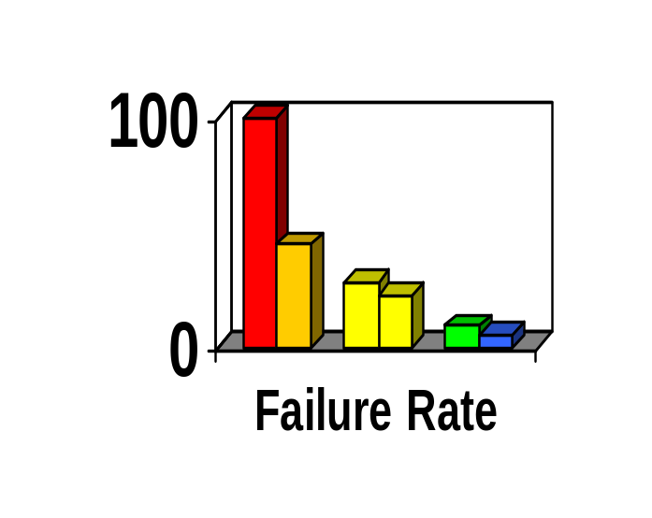
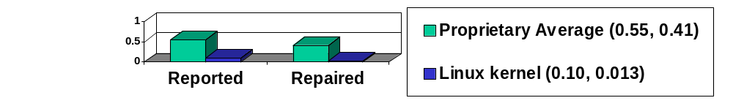
Reliability
Fuzz studies found FLOSS apps
significantly more reliable [U Wisconsin]
  Proprietary Unix failure rate: 28%,23%
  FLOSS: Slackware Linux 9%, GNU utilities 6%
  Windows: 100%; 45% if forbid certain Win32 message formats
GNU/Linux vs. Windows NT 10 mo study [ZDNet]
  NT crashed every 6 weeks; both GNU/Linuxes, never
IIS web servers >2x downtime of Apache [Syscontrol AG]
Linux kernel TCP/IP had smaller defect density [Reasoning]
Notes:
Reliability
Fuzz
GNU/Linux
Windows
Crash
Downtime
TCP/IP
Defect
Defect density

Slide 21
FLOSS Always More Secure?
No: Sendmail, bind 4
Must examine case-by-case
  But there is a principle that gives FLOSS a potential advantage…

Slide 22
Open design:
A security fundamental
Saltzer & Schroeder [1974/1975] - Open design principle
  the protection mechanism must not depend on attacker ignorance
FLOSS better fulfills this principle
Security experts perceive FLOSS advantage
  Bruce Schneier: “demand OSS for anything related to security”
  Vincent Rijmen (AES): “forces people to write more clear code & adhere to standards”
  Whitfield Diffie: “it’s simply unrealistic to depend on secrecy for security”

Slide 23
Problems with hiding source & vulnerability secrecy
Hiding source doesn’t halt attacks
  Presumes you can keep source secret
    Attackers may extract or legitimately get it
  Dynamic attacks don’t need source or binary
    Observing output from inputs sufficient for attack
  Static attacks can use pattern-matches against binaries
  Source can be regenerated by disassemblers & decompilers sufficiently to search for vulnerabilities
  Secrecy inhibits helpers, while not preventing attackers
  “Security by Obscurity” widely denegrated
Hiding source slows vulnerability response
Vulnerability secrecy doesn’t halt attacks
  Vulnerabilities are a time bomb and are likely to be rediscovered by attackers
  Brief secrecy works (10-30 days), not months/years

Slide 24
Can “Security by Obscurity” be a basis for security?
“Security by Obscurity” can work, but iff:
  Keeping secret actually improves security
  You can keep the critical information a secret
For obscurity itself to give significant security:
  Keep source secret from all but a few people. Never sell or reveal source to many. E.G.: Classify
  Keep binary secret; never sell binary to outsiders
    Use software protection mechanisms (goo, etc.)
    Remove software binary before exporting system
  Do not allow inputs/outputs of program to be accessible by others – no Internet/web access
Useless in most cases!
  Incompatible with proprietary off-the-shelf model
Proprietary software can be secure – but not this way

Slide 25
FLOSS Security Preconditions
(Unintentional vulnerabilities)
Developers/reviewers need security knowledge
  Knowledge more important than licensing
People have to actually review the code
  Reduced likelihood if niche/rarely-used, few developers, rare computer language, not really FLOSS
  More contributors, more review
    Is it truly community-developed?
  Evidence suggests this really happens! (next)
Problems must be fixed
  Far better to fix before deployment
  If already deployed, need to deploy fix
Notes:
Username “politically” passowrd “correct” was a major Interbase backdoor, hidden for years when it was proprietary, and found quickly soon after it was releaesd as FLOSS. It’s not known if, or how widely, this was exploited before it was revealed.

Slide 26
Is FLOSS code ever examined? Yes.
Most major FLOSS projects have specific code reviews; some have rewards
  Mozilla Security Bug Bounty Program ($500)
  Linux: hierarchical review, “sparse” tool
Disseminated review groups (second check):
  OpenBSD (for OpenBSD)
  Debian-audit (for Debian Linux)
Static analysis tool vendors test using FLOSS
Vulnerability Discovery and Remediation, Open Source Hardening Project (DHS/Coverity/Stanford)
Many independents (see Bugtraq, etc.)
Business case: Must examine to change (reason to review)
Users' increased transparency encourages examination & feedback

Slide 27
Evaluating FLOSS?
Look for evidence
First, identify your security requirements
Look for evidence at FLOSS project website
  User’s/Admin Guides: discuss make/keep it secure?
  Process for reporting security vulnerabilities?
  Cryptographic signatures for current release?
  Developer mailing lists discuss security issues and work to keep the program secure?
  Active community
Use other information sources where available
  E.G., CVE… but absence is not necessarily good
  External reputation (e.g., OpenBSD)
See http://www.dwheeler.com/oss_fs_eval.html

Slide 28
Proprietary advantages… not necessarily
Experienced developers who understand security produce better results
  Experience & knowledge are critical, but...
  FLOSS developers often very experienced & knowledgeable too (BCG study: average 11yrs experience, 30 yrs old) – often same people
Proprietary developers higher quality?
  Dubious; FLOSS often higher reliability,security
  Market rush often impairs proprietary quality
No guarantee FLOSS is widely reviewed
  True! Unreviewed FLOSS may be very insecure
  Also true for proprietary (rarely reviewed!). Check it!
Can sue vendor if insecure/inadequate
  Nonsense. EULAs forbid, courts rarely accept, costly to sue with improbable results, you want sw not a suit

Slide 29
Inserting malicious code & FLOSS: Basic concepts
“Anyone can modify FLOSS, including attackers”
  Actually, you can modify proprietary programs too… just use a hex editor. Legal niceties not protection!
  Trick is to get result into user supply chain
  In FLOSS, requires subverting/misleading the trusted developers or trusted repository/distribution…
  and no one noticing the public malsource later
Different threat types: Individual...nation-state
Distributed source aids detection
Large community-based FLOSS projects tend to have many reviewers from many countries
  Makes attacks more difficult
  Consider supplier as you would proprietary software
  Risk larger for small FLOSS projects

Slide 30
Malicious attack approaches:
FLOSS vs. proprietary
Repository/distribution system attack
  Traditional proprietary advantage: can more easily disconnect repository from Internet, not shared between different groups
    But development going global, so disconnect less practical
  Proprietary advantage: distribution control
  OSS advantage: Easier detection & recovery via many copies
Malicious trusted developers
  OSS slight advantage via review, but weak (“fix” worse!)
  OSS slight advantage: More likely to know who developers are
  Reality: For both, check who is developing it!
Malicious untrusted developer
  Proprietary advantage: Fewer untrusted developers
    Sub-suppliers, “Trusted” developers may be malicious
  OSS long-term advantages: Multiple reviewers (more better)
Unclear winner – No evidence proprietary always better

Slide 31
Examples: Malicious code & FLOSS
Linux kernel attack – repository insertion
  Tried to hide; = instead of ==
  Attack failed (CM, developer review, conventions)
Debian/SourceForge repository subversions
  Countered & restored by external copy comparisons
Often malicious code made to look like unintentional code
  Techniques to counter unintentional still apply
  Attacker could devise to work around tools... but won't know in FLOSS what tools are used!
Borland InterBase/Firebird Back Door
  user: politically, password: correct
  Hidden for 7 years in proprietary product
  Found after release as FLOSS in 5 months
  Unclear if malicious, but has its form

Slide 32
Security Preconditions
(Malicious vulnerabilities)
Counter Repository/distribution system attack
  Widespread copies, comparison process
  Evidence of hardened repository
  Digitally signed distribution
Counter Malicious trusted developers
  Find out who's developing your system (always!)
Counter Malicious untrusted developer
  Strong review process
    As with unintentional vulnerabilities: Security-knowledgeable developers, review, fix what's found
  Update process, for when vulnerabilities found

Slide 33
High Assurance
High assurance (HA) software:
  Has an argument that could convince skeptical parties that the software will always perform or never perform certain key functions without fail... convincing evidence that there are absolutely no software defects. CC EAL 6+
  Significant use of formal methods, high test coverage
  High cost – requires deep pockets at this time
  A few OSS & proprietary tools to support HA dev
  Few proprietary, even fewer OSS HA at this time
Theoretically OSS should be better for HA
  In mathematics, proofs are often wrong, so only peer review of proofs valid [De Millo,Lipton,Perlis]. OSS!
HA developers/customers very conservative & results often secret, so rarely apply “new” approaches like OSS... yet
  Cannot easily compare in practice... yet

Slide 34
Can FLOSS be applied to custom systems?
Effective FLOSS systems typically have built a large development community
  Share costs/effort for development & review
  Same reason that proprietary off-the-shelf works: Multiple customers distribute costs
Custom systems can be built from FLOSS (& proprietary) components
If no pre-existing system, sometimes can create a generalized custom system
  Then generalized system FLOSS, with a custom configuration for your problem
  Do risk/benefit analysis before proceeding

Slide 35
Bottom Line
Neither FLOSS nor proprietary always better
  But clearly many cases where FLOSS is better
FLOSS use increasing industry-wide
  In some areas, e.g., web servers, it dominates
Policies must not ignore or make it difficult to use FLOSS where applicable
  Can be a challenge because of radically different assumptions & approach
Include FLOSS options when acquiring, then evaluate

Slide 36
Quantitative Studies - Backup Slides

Slide 37
Outline of Quantitative Information on OSS/FS
Quantitatively show “consider using OSS/FS software”:
  Market Share
  Reliability
  Performance
  Scalability
  Security
  Total cost of ownership
  Non-quantitative
Numbers won't show OSS/FS always technically better
This presentation does not necessarily represent the views of the U.S. Government or U.S. DoD, & is based on personal work

Slide 38
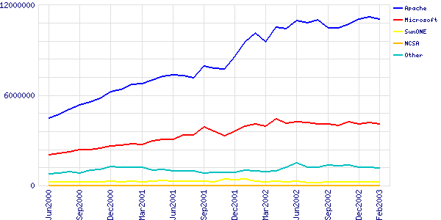
Market Share: Web Servers
Active Sites: Apache 66.75%, Microsoft IIS 24.81% in Feb 2003 (counting by name; 35.86M sites)
For SSL, Apache 53.97%, IIS 34.85% Sep02
Notes:
Market share
Web servers
Webservers
Apache
Microsoft IIS
IIS
SSL

Slide 39
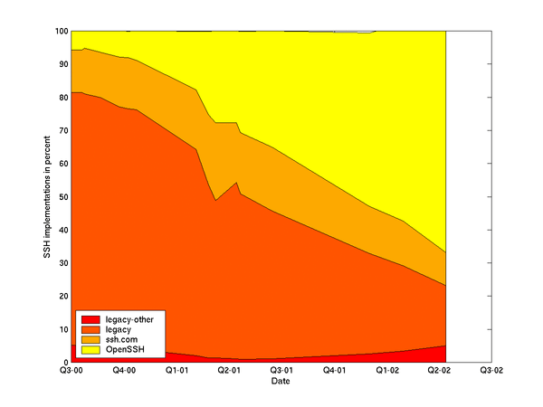
Other Market Share Examples
GNU/Linux #2 webserver OS Jun01
  GNU/Linux 29.6%, Windows 49.6%, BSDs 6.1%
GNU/Linux #2 server OS sold 99, 00, 01 (24%, 27%, 25%)
DNS: bind supports 95% of reverse-lookups
PHP #1 server-side scripting language
Sendmail #1 Email server
  Sendmail 42%, Microsoft Exchange 18%
OpenSSH #1 SSH (66.8% Apr02)
Small (1.7-3.8%) 2002 desktop share
  Microsoft 92% in 2000, but usable OSS/FS apps just released in 2002, so could change over time
Notes:
Market Share
GNU/Linux
Linux
Windows
BSDs
DNS
Bind
PHP
Sendmail
Openssh
SSH
Desktop

Slide 40
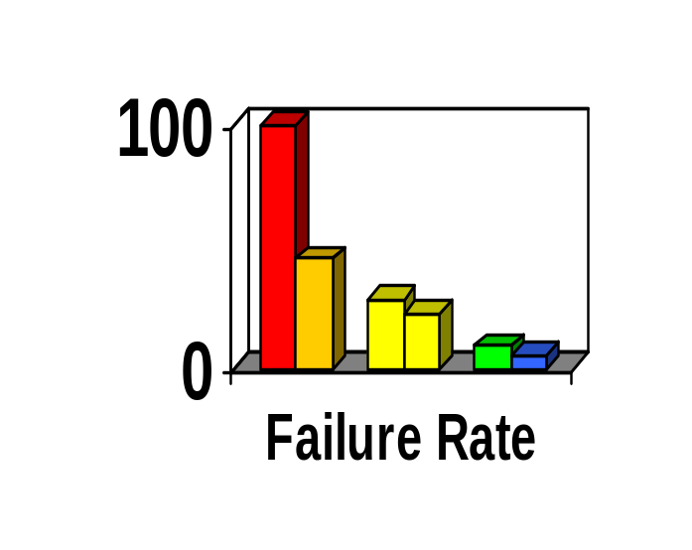
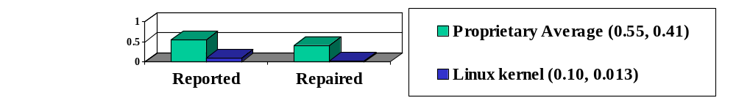
Reliability
Fuzz studies found OSS/FS apps
significantly more reliable [U Wisconsin]
  Proprietary Unix failure rate: 28%,23%
  OSS/FS: Slackware Linux 9%, GNU utilities 6%
  Windows: 100%; 45% if forbid certain Win32 message formats
GNU/Linux vs. Windows NT 10 mo study [ZDNet]
  NT crashed every 6 weeks; both GNU/Linuxes, never
IIS web servers >2x downtime of Apache [Syscontrol AG]
Linux kernel TCP/IP had smaller defect density [Reasoning]
Notes:
Reliability
Fuzz
GNU/Linux
Windows
Crash
Downtime
TCP/IP
Defect
Defect density

Slide 41
Performance
Performance always varies by circumstance
TPC-C: GNU/Linux faster than Windows
PC Magazine: GNU/Linux with Samba faster fileserving at Windows' own file protocols
  Nov 2001, top end, 130MB/sec vs. 78MB/sec
  April 2002, performance 2x; 4x many clients
Sys Admin: untuned GNU/Linux fastest
Measure
GNU/Linux
Solaris on Intel
FreeBSD
Windows 2000
Email (M msg/hr)
1.3
1
0.9
0.9
Disk I/O (seconds)
542
3990
2398
613
Notes:
Performance
GNU/Linux
Windows
Samba
Fastest

Slide 42
Scalability
GNU/Linux and NetBSD support more hardware platforms & performance ranges
  PC hardware, PDAs, mainframes, clusters, supercomputers
OSS/FS can develop large software systems
  Red Hat Linux 7.1 had 30million SLOC
  Represents approximately 8,000 person-years
  To re-develop proprietary, $1 Billion USD
Notes:
Scaleability
Hardware
Supercomputer
Mainframe
PDA
Source lines of code
SLOC
Gigabuck

Slide 43
Security
J.S. Wurzler hacker insurance costs 5-15% more for Windows than for Unix or Linux
Windows websites disproportionately vulnerable
Bugtraq vulnerability: Smallest is OpenBSD, Windows largest (Don't quintuple-count!)
Worst vulnerabilities (takeover): Apache 0, IIS 8
(Jun98-Jun01)
OSS/FS not invulnerable!
Category
Proprietary
OSS/FS
Defaced
66% (Windows)
17% (GNU/Linux)
Deployed Systems
49.6% (Windows)
29.6% (GNU/Linux)
Deployed websites (by name)
24.81% (IIS)
66.75% (Apache)
Notes:
Security
Insurance
Vulnerable
Vulnerability
Defaced
Bugtraq
Apache
Website

Slide 44
Total Cost of Ownership (TCO)
TCO multifaceted & sensitive to circumstances
OSS/FS costs less to acquire than proprietary
  E.G., Web server, Windows $3610 vs. $156
Some other factors also tend to be lower
  Lower upgrade costs, can use cheaper hardware
  Avoids license management & litigation
Cybersource: TCO 24%-34% less w/OSS/FS
InfoWorld Survey of CTOs:
  60% CTOs: >$50K/yr savings
  32% CTOs: > $250K/yr savings (inc. above)
Notes:
Total Cost of Ownership
TCO
Cost
Money
budget
Acquisition
Chief technical officer
CTO
Infoworld

Slide 45
Non-Quantitative
To many, non-quantitative advantages of OSS/FS are more important
  Social/ethical/moral reasons
  Avoids risks of single source solutions
    Reversible decision: can switch or self-support if vendor jacks up price, maliciously changes interface, drops support, …
  (Can) avoid security risks of monocultures
  Avoids license management and litigation
  Supports domestic IT infrastructure
  Many believe it encourages innovation
  Greater flexibility
    Can change software (or hire its change) to meet needs
Notes:
Non-quantitative
Social
Ethical
Moral
Single source
Monocultures
License management
Litigation
Innovation
Flexibility
Reversible decision

Slide 46
Conclusions on Quantitative OSS/FS Information
Many, many cases where OSS/FS programs have some measurable advantage over proprietary competition
Consider using OSS/FS software when acquiring software
For more detailed information, see
http://www.dwheeler.com/oss_fs_why.html

Slide 47
Conclusions
Many similarities and differences in acquisition for OSS
  Need to know & handle differences, challenges
Need to know how to evaluate OSS
  General approach similar
  Ways to acquire information differ
Quantitative evidence that OSS is worth considering
  I don’t think it’s always the right answer, but it’s always worth considering

Slide 48
Miscellaneous Backup Slides

Slide 49
Major OSS/FS Licenses
Many licenses, but 4 dominate
BSD-new & MIT license: anything but sue
  Can incorporate code into proprietary software
  Financial incentive to use, but not aid project
General Public License (GPL): “Copyleft”
  If distribute, must distribute source code or provide written offer to do so
  Cannot link (embed) into proprietary software
Lesser/Library GPL - a compromise
  Must distribute source code/written offer, but only of component itself
  Can link into proprietary software
Public domain is OSS/FS, but rare

Slide 50
GPL Use Widespread
GPL has widespread use, other licenses far less common
  Freshmeat.net (2003): 69.66% GPL, 5.29% LGPL, 4.82% BSD licenses (combined)
  SourceForge.net (2003): 71% GPL, 10% LGPL, 7% BSD
  Red Hat Linux 7.1: 50.36% GPL solely (55.3% dual), 8.28% MIT, 7.64% LGPL
  FSF free software directory (2002): 87.9% GPL, 6.6% LGPL, 2.0% BSD or BSD-like, 1.9% Artistic, 0.3% MIT
  MITRE DoD survey (2003): 52% GPL, 6% BSD, 5% Apache, 4% various "Community“, 3% LGPL
Many big OSS projects changed to GPL-compatible
  Python, vim, Mozilla, Zope, BSD, Apache (?), Qt, Wine, Alfresco
XFree86 project died trying to become GPL-incompatible
Avoid GPL-incompatible OSS licenses (risk of failure)
Use common compatible licenses for new OSS projects
  In particular: GPL, LGPL, MIT/X, or BSD-new

Slide 51
Unnecessary Fears
Will OSS/FS destroy intellectual property? No.
  Usually, complaint is about GPL
  GPL trades you the right to freely incorporate their code into your software in exchange for the right to freely incorporate your code [which incorporates their code] into theirs
  Intellectual property traded for other intellectual property
  Microsoft sells GPL'ed software
Notes:
Unnecessary fears
Intellectual property
GPL
Microsoft

Slide 52
Unnecessary Fears
Viewing and changing source code valuable for non-programmers? Surprisingly, yes.
  “Would you buy a car with the hood welded shut? If not, what do you know about modern … engine technology?” [Bob Young]
  Consumers demand this so they can have control over their products, instead of dealers
Anti-Microsoft campaign? No, not by all.
  Jun02, 831 projects use Visual Basic; 8867 projects work on Windows [SourceForge]
  Microsoft has been repeatedly asked to join community
  Microsoft sells GPL'ed software
Notes:
Unnecessary fears
Source code
Microsoft
Anti-Microsoft
GPL

Slide 53
Acronyms
COTS: Commercial Off-the-Shelf (either proprietary or OSS)
DoD: Department of Defense
HP: Hewlitt-Packard Corporation
JTA: Joint Technical Architecture (list of standards for the DoD); being renamed to DISR
OSDL: Open Source Development Labs
OSS: Open Source Software
RFP: Request for Proposal
RH: Red Hat, Inc.
U.S.: United States
Trademarks belong to the trademark holder.

Slide 54
Interesting Documents/Sites
“Why OSS/FS? Look at the Numbers!” http://www.dwheeler.com/oss_fs_why.html
“Use of Free and Open Source Software in the US Dept. of Defense” (MITRE, sponsored by DISA)
President's Information Technology Advisory Committee (PITAC) -- Panel on Open Source Software for High End Computing, October 2000
“Open Source Software (OSS) in the DoD,” DoD memo signed by John P. Stenbit (DoD CIO), May 28, 2003
Center of Open Source and Government (EgovOS) http://www.egovos.org/
OpenSector.org http://opensector.org
Open Source and Industry Alliance http://www.osaia.org
Open Source Initiative http://www.opensource.org
Free Software Foundation http://www.fsf.org
OSS/FS References http://www.dwheeler.com/oss_fs_refs.html

