Slide 1
Open Source Software (OSS) and Software Assurance
David A. Wheeler
March 28, 2006
This presentation contains the views of the author and does not indicate endorsement by IDA, the U.S. government, or the U.S. Department of Defense.

Slide 2
Definition: Open Source Software (OSS) / Free Software (FS)
Open Source Software / Free Software (OSS/FS) programs have licenses giving users the freedom:
  to run the program for any purpose,
  to study and modify the program, and
  to freely redistribute copies of either the original or modified program (without royalties, etc.)
Not non-commercial, not necessarily no-charge
  Often supported via commercial companies
Synonyms: Libre software, FLOS, FLOSS
Antonyms: proprietary software, closed software

Slide 3
Definition: Software Assurance
“Software assurance (SwA) relates to the level of confidence that software functions as intended and is free of vulnerabilities, either intentionally or unintentionally designed or inserted as part of the software.”

Slide 4
Outline
Introduction: OSS development
Extreme claims
Statistics on Security & Reliability
Open design: A security fundamental
  Problems with hiding source & vulnerabilities
OSS Security Preconditions
Proprietary advantages… not necessarily
Special topics: Inserting malicious code, OSS bottom line
Backup: Common criteria, Formal methods

Slide 5
Typical OSS/FS Development Model
Development
Community
Improvements (as source code) and evaluation results: User as Developer
Developer
Trusted
Developer
Bug Reports
Trusted
Repository
Source Code →
Distributor
User
“Stone soup development”
OSS/FS users typically use software without paying licensing fees
OSS/FS users typically pay for training & support (competed)
OSS/FS users are responsible for developing new improvements &
any evaluations that they need; often cooperate/pay others to do so
Notes:
Development model
User
User as developer
Developer
Trusted developer
Trusted repository
Distributor
Stone soup development
Source code
Licensing fees
Training
Support
Evaluations
Improvements
Cooperate

Slide 6
Extreme claims
Extreme claims
  “OSS is always more secure”
  “Proprietary is always more secure”
Reality: Neither OSS nor proprietary always better
  Some specific OSS programs are more secure than their competing proprietary competitors

Slide 7
OSS Security (1)
Browser “unsafe” days in 2004: 98% Internet Explorer, 15% Mozilla/Firefox (half of Firefox’s MacOS-only)
IE 21x more likely to get spyware than Firefox [U of Wash.]
Faster response: Firefox 37 days, Windows 134.5 days
Evans Data: Linux rarely broken, ~virus/Trojan-free
Serious vulnerabilities: Apache 0, IIS 8 / 3yrs
J.S. Wurzler hacker insurance costs 5-15% more for Windows than for Unix or Linux
Bugtraq vulnerability 99-00: Smallest is OpenBSD, Windows largest (Don't quintuple-count!)
Windows websites more vulnerable in practice
Category
Proprietary
OSS/FS
Defaced
66% (Windows)
17% (GNU/Linux)
Deployed Systems
49.6% (Windows)
29.6% (GNU/Linux)
Deployed websites (by name)
24.81% (IIS)
66.75% (Apache)

Slide 8
OSS Security (2)
Unpatched networked systems: 3 months Linux, hours Windows (variance minutes ... months)
[Honeynet.org, Dec 2004]
  Windows SP2 believed to be better than previous versions of Windows
50% Windows vulnerabilities are critical, vs. 10% in Red Hat [Nicholas Petreley, Oct 2004]
Viruses primarily Windows phenomenon
  60,000 Windows, 40 Macintosh, 5 for commercial Unix versions, 40 for Linux
91% broadband users have spyware on their home computers (proprietary OS) [National Cyber Security Alliance, May 2003] vs. ~0% on OSS/FS

Slide 9
OSS Security (3)
OSS/FS systems scored better on security [Payne, Information Systems Journal 2002]
Survey of 6,344 software development managers April 2005 favored OSS/FS [BZ Research]
Borland InterBase/Firebird Back Door
  user: politically, password: correct
  Hidden for 7 years in proprietary product
  Found after release as OSS in 5 months

Slide 10
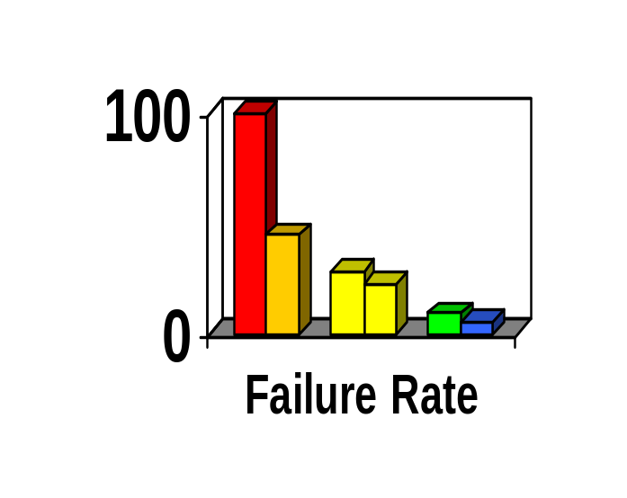
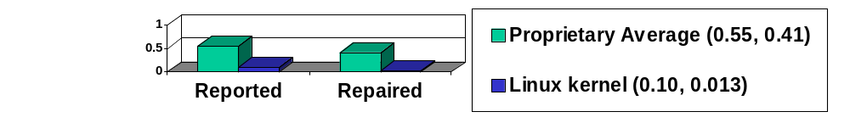
Reliability
Fuzz studies found OSS/FS apps
significantly more reliable [U Wisconsin]
  Proprietary Unix failure rate: 28%,23%
  OSS/FS: Slackware Linux 9%, GNU utilities 6%
  Windows: 100%; 45% if forbid certain Win32 message formats
GNU/Linux vs. Windows NT 10 mo study [ZDNet]
  NT crashed every 6 weeks; both GNU/Linuxes, never
IIS web servers >2x downtime of Apache [Syscontrol AG]
Linux kernel TCP/IP had smaller defect density [Reasoning]
Notes:
Reliability
Fuzz
GNU/Linux
Windows
Crash
Downtime
TCP/IP
Defect
Defect density

Slide 11
OSS Always More Secure?
No: Sendmail, bind 4
Must examine case-by-case
  But there is a principle that gives OSS a potential advantage…

Slide 12
Open design:
A security fundamental
Saltzer & Schroeder [1974/1975] - Open design principle
  the protection mechanism must not depend on attacker ignorance
OSS better fulfills this principle
Security experts perceive OSS advantage
  Bruce Schneier: “demand OSS for anything related to security”
  Vincent Rijmen (AES): “forces people to write more clear code & adhere to standards”
  Whitfield Diffie: “it’s simply unrealistic to depend on secrecy for security”

Slide 13
Problems with hiding source & vulnerability secrecy
Hiding source doesn’t halt attacks
  Dynamic attacks don’t need source or binary
  Static attacks can use pattern-matches against binaries, disassembled & decompiled results
  Presumes you can keep source secret
    Attackers may extract or legitimately get it
  Secrecy inhibits helpers, while not preventing attackers
Hiding source slows vulnerability response
Vulnerability secrecy doesn’t halt attacks
  Vulnerabilities are a time bomb and are likely to be rediscovered by attackers
  Brief secrecy works (10-30 days), not months/years

Slide 14
OSS Security Preconditions
Developers/reviewers need security knowledge
  Knowledge more important than licensing
People have to actually review the code
  Reduced likelihood if niche/rarely-used, few developers, rare computer language, not really OSS
  More contributors, more review
  Evidence suggests this really does happen!
Problems must be fixed
Notes:
Username “politically” passowrd “correct” was a major Interbase backdoor, hidden for years when it was proprietary, and found quickly soon after it was releaesd as OSS. It’s not known if, or how widely, this was exploited before it was revealed.

Slide 15
Is OSS code ever examined? Yes.
Most major OSS projects have specific code reviews; some have rewards
  Mozilla Security Bug Bounty Program ($500)
  Linux: hierarchical review, “sparse” tool
Disseminated groups (second check):
  OpenBSD (for OpenBSD)
  Debian-audit (for Debian)
Static analysis tool vendors
Vulnerability Discovery and Remediation, Open Source Hardening Project (DHS/Coverity/Stanford)
Many independents (see Bugtraq, etc.)

Slide 16
Evaluating? Look for evidence
First, identify your security requirements
Look for evidence at OSS project website
  User’s/Admin Guides: discuss make/keep it secure?
  Process for reporting security vulnerabilities?
  Cryptographic signatures for current release?
  Developer mailing lists discuss security issues and work to keep the program secure?
Use other information sources where available
  E.G., CVE… but absence is not necessarily good
  External reputation (e.g., OpenBSD)
See http://www.dwheeler.com/oss_fs_eval.html

Slide 17
Proprietary advantages… not necessarily
Experienced developers who understand security produce better results
  Experience & knowledge are critical, but...
  OSS developers often very experienced & knowledgeable too (BCG study: average 11yrs experience, 30 yrs old) – often same people
Proprietary developers higher quality?
  Dubious; OSS often higher reliability,security
  Market rush often impairs proprietary quality
No guarantee OSS is widely reviewed
  True! & unreviewed OSS may be very insecure
  Also true for proprietary (rarely reviewed!)

Slide 18
Inserting Malicious Code & OSS
“Anyone can modify OSS, including attackers”
  Actually, you can modify proprietary programs too… just use a hex editor. Legal niceties not protection!
  Trick is to get result into user supply chain
  In OSS/FS, requires subverting/misleading the trusted developers or trusted repository…
  and no one noticing the public malsource later
Linux kernel attack failed (CM, developer review, and conventions all detected)
Distributed source aids detection
Large OSS projects tend to have many reviewers from many countries, making attack more difficult
  Consider supplier as you would proprietary software
  Risk larger for small OSS projects

Slide 19
Bottom Line
Neither OSS nor proprietary always better
  But clearly many cases where OSS is better
OSS use increasing industry-wide
  In some areas, e.g., web servers, it dominates
Policies must not ignore or make it difficult to use OSS where applicable
  Can be a challenge because of radically different assumptions & approach

Slide 20
Backup Slides

Slide 21
Common Criteria & OSS
Common Criteria (CC) can be used on OSS
  Red Hat Linux, Novell/SuSE Linux
CC matches OSS imperfectly
  CC developed before rise of OSS
  Doesn’t credit mass peer review or detailed code review
  Requires mass creation of documentation not normally used in OSS development
Government policies discriminate against OSS
  Presume that vendor will pay hundreds of thousands or millions for a CC evaluation (“big company” funding)
    Presumes nearly all small business & OSS insecure
  Presume that “without CC evaluation, it’s not secure”
  Need to fix policies to meet real goal: secure software
    Government-funded evaluation for free use/support?
    Multi-Government funding?
    Alternative evaluation processes?

Slide 22
Formal Methods & OSS
Formal methods applicable to OSS & proprietary
Difference: OSS allows public peer review
  In mathematics, peer review often finds problems in proofs; many publicly-published proofs are later invalidated
  Expect true for software-related proofs, even with proof-checkers (invalid models/translation, invalid assumptions/proof methods)
  Proprietary sw generally forbids public peer review
Formal methods challenges same
  Few understand formal methods (anywhere)
  Scaling up to “real” systems difficult
  Costs of applying formal methods—who pays?
    May be even harder for OSS
    Not easy for proprietary either

Slide 23
MITRE 2003 Report
“One unexpected result was the degree to which Security depends on FOSS. Banning FOSS would remove certain types of infrastructure components (e.g., OpenBSD) that currently help support network security. It would also limit DoD access to—and overall expertise in—the use of powerful FOSS analysis and detection applications that hostile groups could use to help stage cyberattacks. Finally, it would remove the demonstrated ability of FOSS applications to be updated rapidly in response to new types of cyberattack. Taken together, these factors imply that banning FOSS would have immediate, broad, and strongly negative impacts on the ability of many sensitive and security-focused DoD groups to defend against cyberattacks.”
“Use of Free and Open Source Software in the US Dept. of Defense” (MITRE, sponsored by DISA), Jan. 2, 2003, http://www.egovos.org/

Slide 24
Acronyms
COTS: Commercial Off-the-Shelf (either proprietary or OSS)
DoD: Department of Defense
HP: Hewlitt-Packard Corporation
JTA: Joint Technical Architecture (list of standards for the DoD); being renamed to DISR
OSDL: Open Source Development Labs
OSS: Open Source Software
RFP: Request for Proposal
RH: Red Hat, Inc.
U.S.: United States
Trademarks belong to the trademark holder.

Slide 25
Interesting Documents/Sites
“Why OSS/FS? Look at the Numbers!” http://www.dwheeler.com/oss_fs_why.html
“Use of Free and Open Source Software in the US Dept. of Defense” (MITRE, sponsored by DISA)
President's Information Technology Advisory Committee (PITAC) -- Panel on Open Source Software for High End Computing, October 2000
“Open Source Software (OSS) in the DoD,” DoD memo signed by John P. Stenbit (DoD CIO), May 28, 2003
Center of Open Source and Government (EgovOS) http://www.egovos.org/
OpenSector.org http://opensector.org
Open Source and Industry Alliance http://www.osaia.org
Open Source Initiative http://www.opensource.org
Free Software Foundation http://www.fsf.org
OSS/FS References http://www.dwheeler.com/oss_fs_refs.html

