Slide 1

Speech Outline (I):
Auditing Closed-Source Software
Using reverse engineering in a security context
Legal considerations
Introduction to the topic: Different
approaches to auditing binaries
Review of C/C++ programming mistakes
and how to spot them in the binary
Demonstration of finding a vulnerability in
a binary
--- Break ---
© 2001 by HalVar Flake

Slide 2
Speech Outline (II):
Auditing Closed-Source Software
Using reverse engineering in a security context
Problems encountered in the OOP world
manual structure & class reconstruction
automated structure & class reconstruction
automating the process of scanning for
suspicious constructs
Free time to answer questions and discuss
the topic
© 2001 by HalVar Flake

Slide 3
Legal considerations
Technically, the reverse engineer breaks the license
agreement between him and the software vendor, as
he is forced to accept upon installation that he will not
reverse engineer the program.
The vendor could theoretically sue the reverse engineer
and revoke the license.
Depending on your local law, there are different ways
to defend your situation:
© 2001 by HalVar Flake

Slide 4
Legal considerations (EU)
EU Law:
1991 EC Directive on the Legal Protection of
Computer Programs
Section 6 grants the right to decompilation for
interoperability purposes
Section 5.3 grants the right to decompilation for
error correction purposes
Under EU Law, these rights cannot be contracted away.
© 2001 by HalVar Flake

Slide 5
Legal considerations (USA)
US Law:
Final form of DMCA includes exceptions to
copyright for:
Reverse engineering for interoperability
Encryption research
Security testing
One should ask his lawyer if these rights can be
contracted away.
© 2001 by HalVar Flake

Slide 6
Why audit binaries ?
If you‘re a blackhat:
Many interesting systems (Firewalls) run closed-source software
New security vulnerabilities are every Administrators nightmare
If you‘re a whitehat:
You can annoy vendors by finding problems in their code
You can get an idea how secure a particular application‘s code is
© 2001 HalVar Flake

Slide 7
Approach A: Stress Testing
Long strings of data are more or less randomly generated and sent
to the application, usually trying to overflow every single string
that gets parsed by a certain protocol.
Pros:
Stress testing tools are re-usable for a given protocol
Will work automatically with little to no supervision
Do not require specialized personnel to use
Cons:
The analyzed protocol needs to be known in advance
Complex problems involving several conditions at once
will be missed
Undocumented options and backdoors will be missed
© 2001 by HalVar Flake

Slide 8
Approach B: Manual Audit
A reverse engineer carefully reads the disassembly of the program,
tediously reconstructing the program flow and spotting programming
errors. This was the approach Joey__ demonstrated at BlackHat Singapore.
Pros:
Even the most complex issues can be spotted
Cons:
The process involved is incredibly time-consuming
and nearly infeasible for large applications
A highly skilled and specialized auditor is needed
The danger is inherent that an auditor will burn out
    and thus miss obvious problems
© 2001 by HalVar Flake

Slide 9
Approach C: Looking for suspicious constructs
The reverse engineer tries to identify suspicious code construcs, then works
his way backwards through the application to determine how this code is reached.
Pros:
Reasonable depth: Even relatively complex issues can
be uncovered
Saves time/work in comparison to Approach B
The process of identifying suspicious code constructs
can be partially automated
Cons:
Not all problems will be uncovered
Needs highly specialized auditor
Reading code backwards is very time consuming and
can be frustrating
If nothing is found, the auditor is back to Approach B
© 2001 by HalVar Flake

Slide 10
Skills the auditor needs
A good understanding of assembly language
and compiler internals
Good knowledge of C/C++ and the coding
mistakes that lead to security vulnerabilities
Only a good C/C++ code auditor can be a
good binary auditor
Lots and lots of endurance, patience and
time
© 2001 by HalVar Flake

Slide 11

Tools the auditor needs
As Disassembler:
IDA Pro by Ilfak Guilfanov
www.datarescue.com
Can disassemble x86, SPARC, MIPS and much more ...
Includes a powerful scripting language
Can recognize statically linked library calls
Features a powerful plug-in interface
Features CPU Module SDK for self-developed CPU modules
Automatically reconstructs arguments to standard calls via
type libraries, allows parsing of C-headers for adding new
standard calls & types
... much more ...
© 2001 by HalVar Flake

Slide 12
strcpy() and strcat()
C/C++ code auditing recap
Old news:
Any call to strcpy() or strcat() copying non-static
strings without proper bounds checking beforehand
has to be considered dangerous.
© 2001 by HalVar Flake

Slide 13
sprintf() and vsprintf()
C/C++ code auditing recap
Old news:
Any call to sprintf() or a homemade function that
uses vsprintf() and expands user-supplied data into
a buffer by just using “%s“ in the format string
is dangerous.
© 2001 by HalVar Flake

Slide 14
The *scanf() function family
C/C++ code auditing recap
Old news:
Any call to any member of the *scanf() function
family which uses the „%s“ format character in the
format string to parse user-supplied data into a
buffer is dangerous.
© 2001 by HalVar Flake

Slide 15
The strncpy() pitfall
C/C++ code auditing recap
While strncpy supports size checking, it does not
guarantee NUL-termination of the destination buffer.
So in cases where the code includes something like
strncpy(destbuff, srcbuff, sizeof(destbuff));
problems will arise.
© 2001 by HalVar Flake

Slide 16
The strncpy() pitfall
C/C++ code auditing recap
Source string
\x0
data
After copying the source into a smaller buffer, the
destination string is not properly terminated any more.
Destination string
data with a \x0 somewhere
Any subsequent operations which expect the string to
be terminated will work on the data behind our original
string as well.
© 2001 by HalVar Flake

Slide 17
The strncat() pitfall
C/C++ code auditing recap
As with strncpy(), strncat() supports size checking,
but guarantees the proper termination of the string
after the last byte has been written.
Furthermore, the fact that strncat() will usually need
to handle with dynamic values for len increases the
risk for cast screwups.
© 2001 by HalVar Flake

Slide 18
The strncat() pitfall
C/C++ code auditing recap
Consider code like this:
strncat(dest, src, sizeof(dest)-strlen(dest));
This will write an extra NUL behind the end of dest if
the maximum size is fully utilized.
(so-called poison-null-byte)
© 2001 by HalVar Flake

Slide 19
The strncat() pitfall
C/C++ code auditing recap
Furthermore, one has to be careful about handling the
dynamic size_t len parameter:
void foo(char *source1, char *source2)
{
char buff[100];
strncpy(buff, source1, sizeof(buff)-1);
strncat(buff, source2, sizeof(buff)-strlen(source1)-1);
}
© 2001 by Thomas Dullien aka HalVar Flake

Slide 20
Cast Screwups
C/C++ code auditing recap
void func(char *dnslabel)
{
char buffer[256];
char *indx = dnslabel;
int count;
count = *indx;
buffer[0] = '\x00';
while (count != 0 && (count + strlen (buffer)) < sizeof (buffer) - 1)
{
strncat (buffer, indx, count);
indx += count;
count = *indx;
}
}
© 2001 by HalVar Flake

Slide 21
Format String Vulnerabilities
C/C++ code auditing recap
Any call that passes user-supplied input directly to a
*printf()-family function is dangerous. These calls can
Also be identified by their argument deficiency.
Consider this code:
printf(„%s“, userdata);
printf(userdata);
Argument deficiency
© 2001 by HalVar Flake

Slide 22
- x86 Assembly Recap -
C/C++ code auditing recap
void *memcpy(void *dest, void *src, size_t n);
Assembly representation:
push 4
mov eax, unkn_40D278
push eax
lea eax, [ebp+var_458]
push eax
call _memcpy
© 2001 by HalVar Flake

Slide 23

strcpy() and strcat()
Finding it in the disassembly
The source is variable, not a static string
This call targets a stack buffer
© 2001 by HalVar Flake

Slide 24
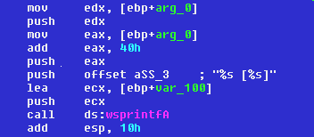
sprintf() and vsprintf()
Finding it in the disassembly
Target buffer is a stack buffer
Format string containing „%s“
Expanded strings are not static and not fixed in length
© 2001 by HalVar Flake

Slide 25
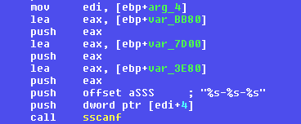
The *scanf() function family
Finding it in the disassembly
Format string contains „%s“
Data is parsed into stack buffers
© 2001 by HalVar Flake

Slide 26
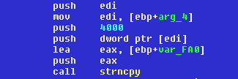
The strncpy()/strncat() pitfall
Finding it in the disassembly
Copying data into a stack buffer again ...
If the source is larger than n (4000 bytes),
no NULL will be appended
© 2001 by HalVar Flake

Slide 27
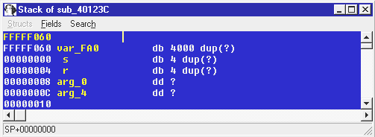
The strncpy()/strncat() pitfall
Finding it in the disassembly
The target buffer is only n bytes long
© 2001 by HalVar Flake

Slide 28

The strncat() pitfall
Finding it in the disassembly
Dangerous handling of len parameter
© 2001 by HalVar Flake

Slide 29
Cast Screwups
Finding it in the disassembly
Generally any function that uses a size_t for copying memory into a buffer. (strncpy(), strncat(), fgets())
The size_t has to be generated on run-time and must not be hardcoded
The size_t has be subtracted from or it has to be loaded via a movsx assembler instruction beforehand
© 2001 by HalVar Flake

Slide 30
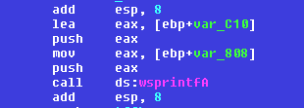
Format String Vulnerabilities
Finding it in the disassembly
Argument deficiency
Format string is a dynamic variable
© 2001 by HalVar Flake

Slide 31
Why go after iWS SHTML again ?
An Example: iWS 4.1 SHTML
Earlier research has shown that the “ improved“ SHTML parsing code has not been written with security in mind
Since it was written before the wide publication of format string bugs, it has probably not been audited for it yet
I already had the file disassembled and on my box, disassembly takes way too long ☺
© 2001 by HalVar Flake

Slide 32
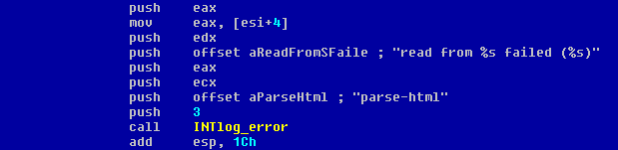
The INTlog_error() call
An Example: iWS 4.1 SHTML
printf()-like parsing of arguments
Minimum stack correction for a dynamic format
string is 0x1C – 4 = 0x18
© 2001 by HalVar Flake

Slide 33
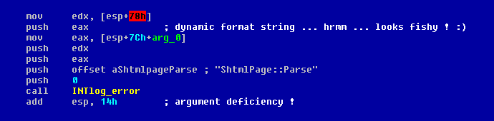
A suspicious construct
An Example: iWS 4.1 SHTML
The format string is dynamic
We have an argument deficiency as 0x14 < 0x18
© 2001 by HalVar Flake

Slide 34
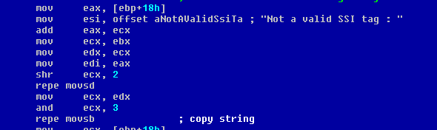
Creating the format string (I)
An Example: iWS 4.1 SHTML
Creates the string passed to INTlog_error()
© 2001 by HalVar Flake

Slide 35
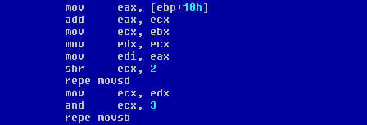
Creating the format string (II)
An Example: iWS 4.1 SHTML
Some string-class size checking
Bingo ! Afterwards, user-supplied data is appended
© 2001 by HalVar Flake

Slide 36
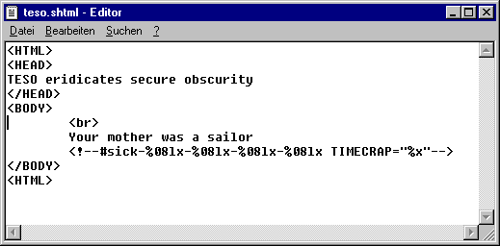
Creating the SHTML file
An Example: iWS 4.1 SHTML
An invalid SSI tag to trigger the error logging routine
© 2001 by HalVar Flake

Slide 37
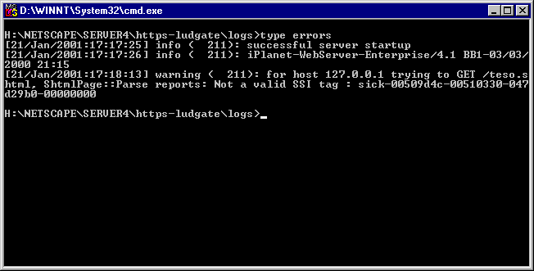
The happy end ☺
An Example: iWS 4.1 SHTML
Exploitable user-supplied format string bug in iWS 4.1
SHTML parsing
© 2001 by HalVar Flake

Slide 38
--- BREAK ---
© 2001 by HalVar Flake

Slide 39
A simple sprintf()-scanning script
Advanced topics: Automation
Things to check for in a sprintf()-call:
    Does the call expand a string using “%s“ ?
    Does the call target a stack buffer ?
    Does the call suffer from an argument
    deficiency ?
    If so, is the format string dynamic ?
© 2001 by HalVar Flake

Slide 40
Getting the stack correction
Advanced topics: Automation
static GetStackCorr(lpCall)
{
while((GetMnem(lpCall) != "add")&&(GetOpnd(lpCall, 0) != "esp"))
lpCall = Rfirst(lpCall);
return(xtol(GetOpnd(lpCall, 1)));
}
Trace the code further until an „add esp, somevalue“ is found
Convert the somevalue to a number and return it
© 2001 by HalVar Flake

Slide 41
Retrieving a string
Advanced topics: Automation
static GetBinString(eaString)
{
auto strTemp, chr;
strTemp = "";
chr = Byte(eaString);
while((chr != 0)&&(chr != 0xFF))
{
strTemp = form("%s%c", strTemp, chr);
eaString = eaString + 1;
chr = Byte(eaString);
}
return(strTemp);
}
Zero the string
Get a byte
Until either a NULL or a 0xFF is found, append one byte at
a time to the string, then return the string.

Slide 42
Retrieving argument n
Advanced topics: Automation
We must take the following steps to retrieve
argument n to a certain function call:
Locate the n-th push before a call
if an immediate value is pushed, return that
value (or the offset)
if a register is push, find where it was last
written to and return the value it was loaded
with.
© 2001 by HalVar Flake

Slide 43
(source)
static GetArg(lpCall, n)
{
auto TempReg;
while(n > 0)
{
lpCall = RfirstB(lpCall);
if(GetMnem(lpCall) == "push")
n = n-1;
}
if(GetOpType(lpCall, 0) == 1)
{
TempReg = GetOpnd(lpCall, 0);
lpCall = RfirstB(lpCall);
while(GetOpnd(lpCall, 0) != TempReg)
lpCall = RfirstB(lpCall);
return(GetOpnd(lpCall, 1));
}
else return(GetOpnd(lpCall, 0));
}
Trace back until the
n-th push is found
Is the pushed operand
a register ?
Find where the
register was last
accessed ...
... and return the value
which was pushed ...
© 2001 by HalVar Flake

Slide 44
(source)
static AuditSprintf(lpCall)
{
auto fString, fStrAddr, buffTarget;
buffTarget = GetArg(lpCall, 1);
fString = GetArg(lpCall, 2);
if(strstr(fString, "offset") != -1)
fString = substr(fString, 7, -1);
fStrAddr = LocByName(fString);
fString = BinStrGet(fStrAddr);
if(GetStackCorr(lpCall) < 12)
if(strlen(fString) < 2)
Message("%lx --> Format String Problem ?\n", lpCall);
if(strstr(fString, "%s") != -1)
if(strstr(buffTarget, "var_") != -1)
Message("%lx --> Overflow problem ? \"%s\"\n", lpCall, fString);
}
Clean up the arguments
Check for argument deficiency
Check for a dynamic
format string
Check for „%s“ in format string
Check if the target is a stack variable
© 2001 by HalVar Flake

Slide 45
(source)
static main()
{
auto FuncAddr, xref;
FuncAddr = AskAddr(-1, "Enter address:");
xref = Rfirst(FuncAddr);
while(xref != -1)
{
if(GetMnem(xref) == "call")
AuditSprintf(xref);
xref = Rnext(FuncAddr, xref);
}
xref = DfirstB(FuncAddr);
while(xref != -1)
{
if(GetMnem(xref) == "call")
AuditSprintf(xref);
xref = DnextB(FuncAddr, xref);
}
}
Ask auditor to enter the
address of the sprintf( )
Call the auditing function
once for each call to sprintf( )
Repeat for all indirect calls
© 2001 by HalVar Flake

Slide 46
A simple strncpy()-scanning script
Advanced topics: Automation
Things to check for in a strncpy()-call:
    Is the target buffer a stack variable ?
    Is the maxlen parameter equal to the
    estimated size of the target buffer ?
    Is the source buffer a non-static string ?
© 2001 by HalVar Flake

Slide 47
Estimating Stack Buffer size
Advanced topics: Automation
static StckBuffSize(lpCall, cName)
{
auto frameID, ofs, count;
frameID = GetFrame(lpCall);
while(strstr(cName, "+") != -1)
cName = substr(cName, strstr(cName, "+")+1, strlen(cName));
cName = substr(cName, 0, strlen(cName)-1);
ofs = GetMemberOffset(frameID, cName);
count = ofs + 1;
while(GetMemberName(frameID, count) == "")
count = count + 1;
count = count-ofs;
return count;
}
Clean up name
Walk stackframe
until another var is
found
© 2001 by HalVar Flake

Slide 48
The AudStrncpy()-function
Advanced topics: Automation
static AudStrncpy(lpCall)
{
auto buffTarget, buffSrc, maxlen;
auto srcString;
buffTarget = GetArg(lpCall, 1);
buffSrc = GetArg(lpCall, 2);
maxlen = GetArg(lpCall, 3);
if(StckBuffSize(lpCall, buffTarget) <= xtol(maxlen))
{
if(strlen(BinStrGet(LocByName(buffSrc)))<2)
Message("Suspicious strncpy() at %lx !\n", lpCall);
}
}
Retrieve arguments
Check stack buffer size
against maxlen
Check for
non-static
source buffer
© 2001 by HalVar Flake

Slide 49
Structure reconstruction (I)
Advanced topics
Frequently, large structures on the heap are used to hold connection data, error strings and the like.
IDA cannot yet reconstruct those structures
In order to check strncpy() and similar calls one has to estimate the size of individual structure members
© 2001 by HalVar Flake

Slide 50
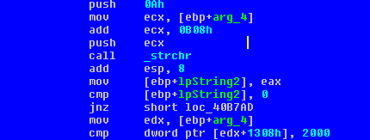
Structure reconstruction (II)
Advanced topics
Access to structure members
© 2001 by HalVar Flake

Slide 51
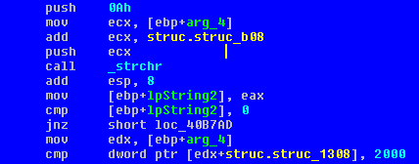
Automated struc reconstruction
Automating the boring parts
Reconstructed struc members which
can now be named as we wish
© 2001 by HalVar Flake

Slide 52
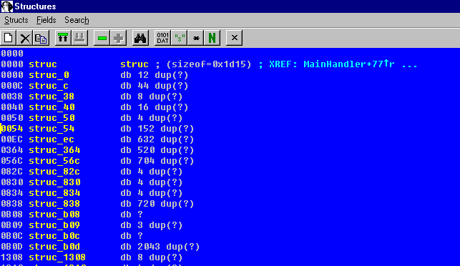
bas_objrec.idc results
Automating the boring parts
© 2001 by HalVar Flake

Slide 53
Problems with auditing OOP
C++ specific topics
Since the class data structure is unknown, estimating buffer size is hard. This leads to problems when analyzing certain function calls (e.g. strncpy())
Most overflows/problems occur in heap memory
If dangerous constructs exist, it is hard to evaluate the risk they pose as it is difficult to determine what is overwritten
© 2001 by HalVar Flake

Slide 54
Reconstructing classes
C++ specific topics
Many classes have a vtable that list all methods for that class. This table gives the reverse engineer a list of functions that all operate upon the same structure (the class itself). By using something like the bas_objrec.idc script, one can reconstruct the class data structure and thus reconstruct the member boundaries.
© 2001 by HalVar Flake

Slide 55
RE-oriented webpages
Further reading
http://www.datarescue.com
Home of the IDA Pro disassembler
http://archive.csee.uq.edu.au/csm/decompilation/
Cristina Cifuentes Decompilation page
http://www.backerstreet.com/rec/rec.htm
REC – Reverse engineering compiler
© 2001 by HalVar Flake

Slide 56
Open discussion concerning reverse engineering ☺
Advanced topics
© 2001 by HalVar Flake

