Slide 1
SWE 681 / ISA 681
Secure Software Design & Programming
Lecture 1: Introduction
Dr. David A. Wheeler
2026-01-24

Slide 2
Outline
Why is most software insecure?
Must consider security throughout lifecycle
Information security principles/terminology
Weakness groupings
Risk management/assurance cases
Processes vs. phases/stages
Overview of Unix/Linux/POSIX

Slide 3
Why is insecure software a serious problem?
Insecure software may:
  Release private/secret information (Confidentiality)
  Corrupt information (Integrity)
  Lose service (Availability)
Costing:
  money
  time
  trust
  lives

Slide 4
Why is most software insecure?
Few developers know how to develop secure software
  Most schools don’t have it in their curricula
    If it is, it’s optional/graduate level, not required undergrad
  Programming books/courses don’t teach it
  Some common operations intrinsically dangerous (esp. C/C++)
  Most developers don’t think like an attacker
    “How could this be attacked?” – be slightly paranoid
  Developers don’t learn from others’ security mistakes
    Most vulnerabilities caused by same mistakes over 40+ years
    We’ll learn about common errors… so you won’t make them
Customers can’t easily evaluate software security
Security often not seriously considered
  E.g., in contracts, requirements, & evaluation criteria
Managers don’t always resource/train adequately
There are many other reasons, too.

Slide 5
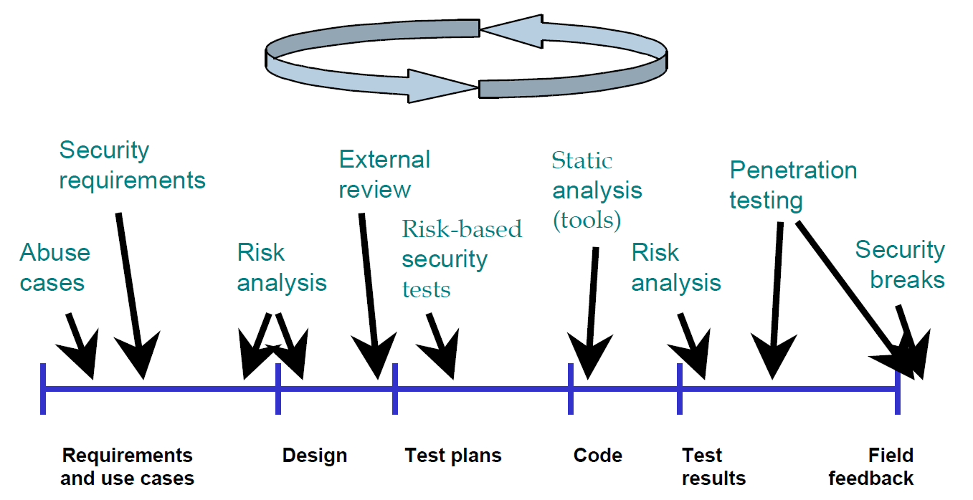
Must consider security throughout lifecycle
Developing secure software requires actions throughout lifecycle
  “Defense-in-breadth”
This class focuses on design & implementation (code)
Source: “Improving Security Across the Software Development Lifecycle – Task Force Report”, April 1, 2004. http://www.cyberpartnership.org/init.html; based on Gary McGraw 2004, IEEE Security and Privacy. Fair use asserted.

Slide 6
What do other organizations do? BSIMM Survey
Building Security in Maturity Model (BSIMM)
  Study (survey) of software security initiatives of various organizations
  Shows % of various activities among 109 organizations surveyed
  https://www.bsimm.com/
4 domains (divided in 12 practices, divided into many activities)
  Governance: Practices that help organize, manage, and measure a software security initiative
  Intelligence: Practices that result in collections of corporate knowledge used in carrying out software security activities
  Secure Software Development Lifecycle (SSDL) Touchpoints: Practices associated with analysis and assurance of particular software development artifacts and processes.
  Deployment: Practices that interface with traditional network security and software maintenance organizations
Again, this class covers a subset (focusing on SSDL)
Developing secure software requires more than design & code... but you need those fundamentals

Slide 7
Information Security Principles and Terminology

Slide 8
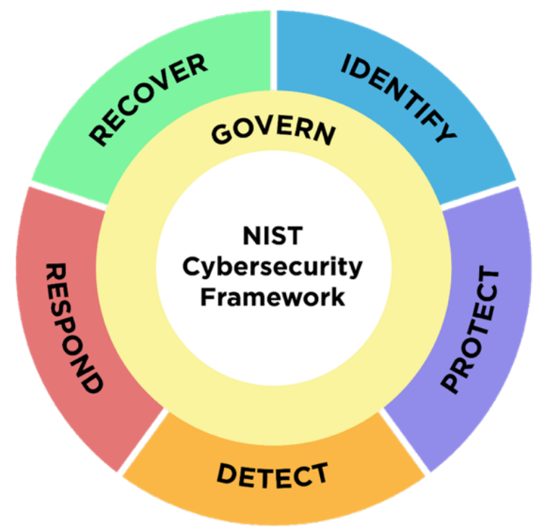
NIST Cybersecurity Framework
(for organizations)

Slide 9
NIST Cybersecurity Framework 1.0 (for organizations)
Function | Category
IDENTIFY (ID) | Asset Management (ID.AM): The data, personnel, devices, systems, and facilities that enable the organization to achieve business purposes are identified and managed consistent with their relative importance to business objectives and the organization’s risk strategy.
 | Business Environment (ID.BE): The organization’s mission, objectives, stakeholders, and activities are understood and prioritized; this information is used to inform cybersecurity roles, responsibilities, and risk management decisions.
 | Governance (ID.GV): The policies, procedures, and processes to manage and monitor the organization’s regulatory, legal, risk, environmental, and operational requirements are understood and inform the management of cybersecurity risk.
 | Risk Assessment (ID.RA): The organization understands the cybersecurity risk to organizational operations (including mission, functions, image, or reputation), organizational assets, and individuals.
 | Risk Management Strategy (ID.RM): The organization’s priorities, constraints, risk tolerances, and assumptions are established and used to support operational risk decisions.
PROTECT (PR) | Access Control (PR.AC): Access to assets and associated facilities is limited to authorized users, processes, or devices, and to authorized activities and transactions.
 | Awareness and Training (PR.AT): The organization’s personnel and partners are provided cybersecurity awareness education and are adequately trained to perform their information security-related duties and responsibilities consistent with related policies, procedures, and agreements.
 | Data Security (PR.DS): Information and records (data) are managed consistent with the organization’s risk strategy to protect the confidentiality, integrity, and availability of information.
 | Information Protection Processes and Procedures (PR.IP): Security policies (that address purpose, scope, roles, responsibilities, management commitment, and coordination among organizational entities), processes, and procedures are maintained and used to manage protection of information systems and assets.
 | Maintenance (PR.MA): Maintenance and repairs of industrial control and information system components is performed consistent with policies and procedures.
 | Protective Technology (PR.PT): Technical security solutions are managed to ensure the security and resilience of systems and assets, consistent with related policies, procedures, and agreements.
DETECT (DE) | Anomalies and Events (DE.AE): Anomalous activity is detected in a timely manner and the potential impact of events is understood.
 | Security Continuous Monitoring (DE.CM): The information system and assets are monitored at discrete intervals to identify cybersecurity events and verify the effectiveness of protective measures.
 | Detection Processes (DE.DP): Detection processes and procedures are maintained and tested to ensure timely and adequate awareness of anomalous events.
RESPOND (RS) | Response Planning (RS.RP): Response processes and procedures are executed and maintained, to ensure timely response to detected cybersecurity events.
 | Communications (RS.CO): Response activities are coordinated with internal and external stakeholders, as appropriate, to include external support from law enforcement agencies.
 | Analysis (RS.AN): Analysis is conducted to ensure adequate response and support recovery activities.
 | Mitigation (RS.MI): Activities are performed to prevent expansion of an event, mitigate its effects, and eradicate the incident.
 | Improvements (RS.IM): Organizational response activities are improved by incorporating lessons learned from current and previous detection/response activities.
RECOVER (RC) | Recovery Planning (RC.RP): Recovery processes and procedures are executed and maintained to ensure timely restoration of systems or assets affected by cybersecurity events.
 | Improvements (RC.IM): Recovery planning and processes are improved by incorporating lessons learned into future activities.
 | Communications (RC.CO): Restoration activities are coordinated with internal and external parties, such as coordinating centers, Internet Service Providers, owners of attacking systems, victims, other CSIRTs, and vendors.
Notes:
See: https://www.nist.gov/cyberframework

Slide 10
NIST Cybersecurity Framework
(for organizations)
As 3 topics:
Identify
  Asset management, risk assessment, …
Protect
  Access control, protective technology, …
Detect
  Security Continuous Monitoring, …
Respond
  Analysis, mitigation, …
Recover
  Improvements, communications, …
Govern
Protect
Detect
Respond

Slide 11
Attacker, Cracker, Hacker
Attack: “Any kind of malicious activity that attempts to collect, disrupt, deny, degrade, or destroy information system resources or the information itself.” [National Information Assurance (IA) Glossary, CNSS 4009]
Attacker: Someone who attacks a system (without authorization)
Cracker: “an individual who attempts to access computer systems without authorization” (type of attacker) [RFC 1392]
Hacker: “A person who delights in having an intimate understanding of the internal workings of a system, computers and computer networks in particular” [RFC 1392]
  NOTE: Hacker ≠ attacker
  Most hackers don’t attack systems
  Many attackers aren’t hackers (might not be clever or knowledgeable)
  Common journalist mistake

Slide 12
Many types of attackers
Criminals (for money)
Terrorists
Governments
Crackers (often for pleasure)
…
We want to prevent their attacks from succeeding!
It is harder to defend vs. well-resourced adversary:
  What are their resources?
  What are they trying to do (so we can counter)?

Slide 13
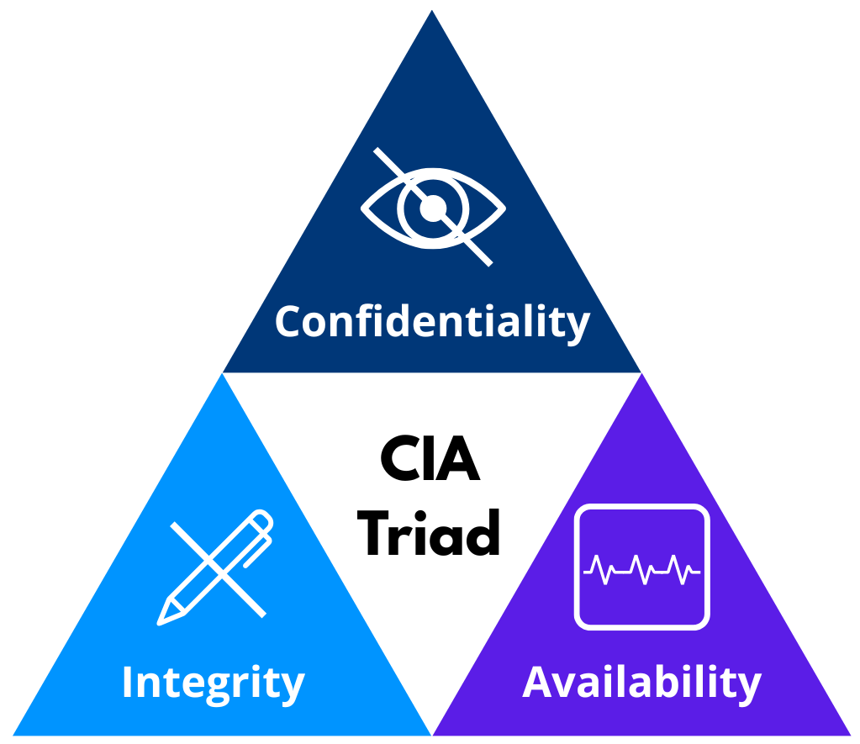
What is security?
Notes:
This ”CIA Triad” picture is from Linux Foundation OpenSSF “Secure Software Development” (LFD121). CC-BY-4.0, by David Harmon and David A. Wheeler.

Slide 14
Security objectives
Typical security objectives (CIA triad):
  Confidentiality: “No unauthorized read”
  Integrity: “No unauthorized modification (write/delete)”
  Availability: “Keeps working in presence of attack”
    vs. “Denial of Service” (DoS) attack
    “Distributed Denial of Service (DDoS)” attack is resource vs. resource
      Make harder to take down, recover quickly when stop(ped)
Sometimes separately-listed objectives or supporting mech:
  Non-repudiation (of sender and/or receiver)
  Privacy (e.g., protecting user identity)
  Auditing/accountability/logging
  Identity & [identity] authentication (I&A), authorization
    Last two abbreviated as AuthN and AuthZ

Slide 15
[User] Authentication
Proving the identity of a user (might be a program!)
Authentication is basis of an authorization decision
  All objectives depend on if you’re authorized
  So authentication is fundamental
Authentication approaches (first 3 traditional):
  Something you know (passwords)
  Something you have (key, token)
  Something you are (biometrics)
  Somebody you know (vouching) – often forgotten
Most common approach: Passwords (“something you know”) to prove username (identity)
  Passkeys sometimes replacing; ensure you can port them
Strong authentication = more than one approach
  Two-factor = two different approaches both required
Notes:
“Fourth-Factor Authentication: Somebody You Know” by
John Brainard, Ari Juels, Ronald L. Rivest, Michael Szydlo, Moti Yung
CCS’06, October 30–November 3, 2006, Alexandria,Virginia, USA.
Copyright 2006 ACM1-59593-518-5/06/0010

Slide 16
All authentication systems have problems
First three authentication approaches can also be described as:
  Something you forgot
  Something you lost
  Something you cease to be
Be aware of each systems’ problems
  Recovery mechanisms can be biggest weakness
  Choose approach(es) appropriate to task
Source: “Security” (post) by JasterBobaMereel (1102861), in reply to
Amazon Wants To Replace Passwords With Selfies and Videos Tuesday March 15, 2016 @09:33AM (#51699623)
https://it.slashdot.org/comments.pl?sid=8881629&cid=51699623

Slide 17
Authorization
Once you have user identity and authentication, you can determine what they’re authorized to do
Discretionary Access Control
  Data has owner, owner decides who can do what
Mandatory Access Control
  Data has certain properties, some access rights cannot be granted even by owner (e.g., classification)
Role Based Access Control (RBAC)
  Assigns users into roles (static or dynamic)
  Access granted to the role, not directly to the user
  Sometimes membership restrictions (receiving clerk must not be purchasing agent)

Slide 18
Auditing/Accountability/Logging
Record system actions, esp. security-relevant ones (e.g., log in)
Detect unusual activity that might signal attack or exploitation
  So you can take action: Disconnect that connection, take down system, prosecute, …
  May help recovery or preventing future exploitation (by knowing what happened)
  Operational systems often send logs elsewhere
    If system subverted, older log entries can’t be changed

Slide 19
Defense-in-depth/breadth
Defense in depth: Having multiple defense mechanisms (“layers”) in place, so that an attacker has to defeat multiple mechanisms to perform a successful attack
Defense in breadth: Applying approaches to develop secure software throughout the lifecycle

Slide 20
Trustworthiness vs. trust
“Trustworthiness implies that something is worthy of being trusted”
“Trust merely implies that you trust something, whether it is trustworthy or not”
  Trust is a decision
  You should only trust things that have adequate evidence of being trustworthy
Source: Definitions from “Principled Assuredly Trustworthy Composable Architectures“ by Peter Neumann, 2004

Slide 21
Weaknesses & Vulnerabilities
Weakness: A type of defect/flaw that might lead to a failure to meet security objectives
Vulnerability: “Weakness in an information system, system security procedures, internal controls, or implementation that could be exploited by a threat source” [CNSS 4009]

Slide 22
Weakness classifications
Software is vulnerable because of some weakness that is exploitable
  Typically vulnerability is unintentional
  Usually the weakness (type/kind of flaw) has occurred thousands of times before
We’ll spend lots of time learning about weaknesses – so you won’t make the same mistakes
Many weakness classification systems exist
  Common Weakness Enumeration (CWE) – merged
  “Seven pernicious kingdoms”, etc.
  Key is to learn what these weaknesses are

Slide 23
Common Weakness Enumeration (CWE)
Common Weakness Enumeration (CWE) = list of software weaknesses
Weakness = Type of vulnerabilities
CWE-120 = Buffer Copy without Checking Size of Input (“Classic Buffer Overflow”)
Common naming system
  Useful as “common name” (e.g., tool coordination)
  Does have some structuring/organization (slices, graphs, parents/children)… but that’s not its strength
More info: http://cwe.mitre.org

Slide 24
Seven Pernicious Kingdoms
Input Validation and Representation
API Abuse
Security Features
Time and State
Error Handling
Code Quality
Encapsulation
Source: Tsipenyuk, Chess, and McGraw,
“Seven Pernicious Kingdoms: A Taxonomy of Software Security Errors”,
Proceedings SSATTM, 2005

Slide 25
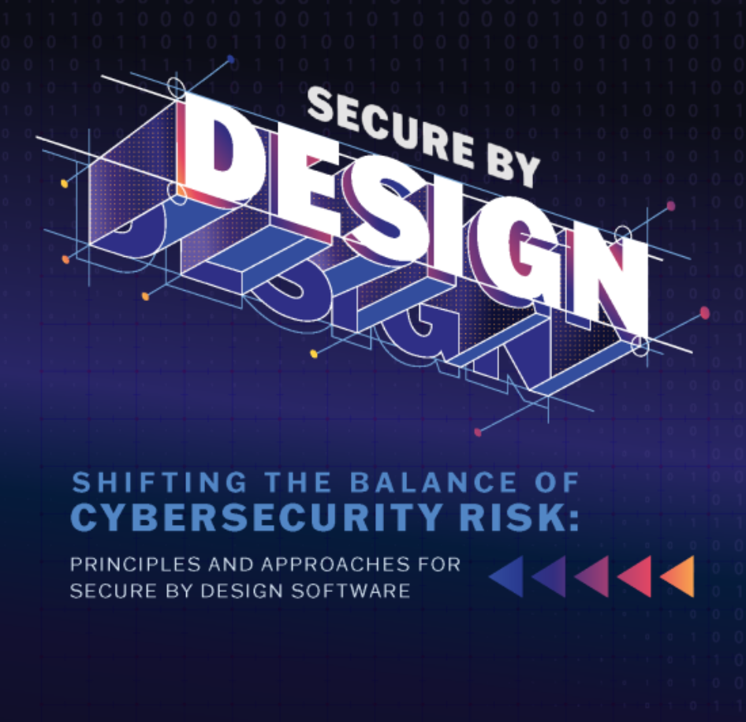
Secure by Design
CISA and 17 U.S. and international partners
  Published “Shifting the Balance of Cybersecurity Risk: Principles and Approaches for Secure by Design Software” in Oct 2023
  Aka “Secure by Design” paper
Emphasizes the need for software to be:
  Secure by design
    ID prevalent threats & protect against them
  Secure by default
    E.g., have “loosening” not “hardening” guides
Source: https://www.cisa.gov/resources-tools/resources/secure-by-design

Slide 26
Abstract view of a program
Program
Process Data
(Structured Program Internals)
Input
Output
Call-out to
other programs
(also consider
input & output issues)

Slide 27
Risk Management &
Assurance Cases

Slide 28
Risk
Risk = Likelihood & impact of unwanted event
  E.g., of a loss, injury, death, etc.
ISO Guide 73 defines as “deviation”
  ISO: Deviation from expected, positive or negative
  Most people restrict “risk” to negative impacts – I recommend using “risk” to only refer to negatives
If likelihood is 100% it’s a problem, not a risk
  If you wait until a risk becomes a problem, it’s often too late to address it
  Thus, important identify & address risks early

Slide 29
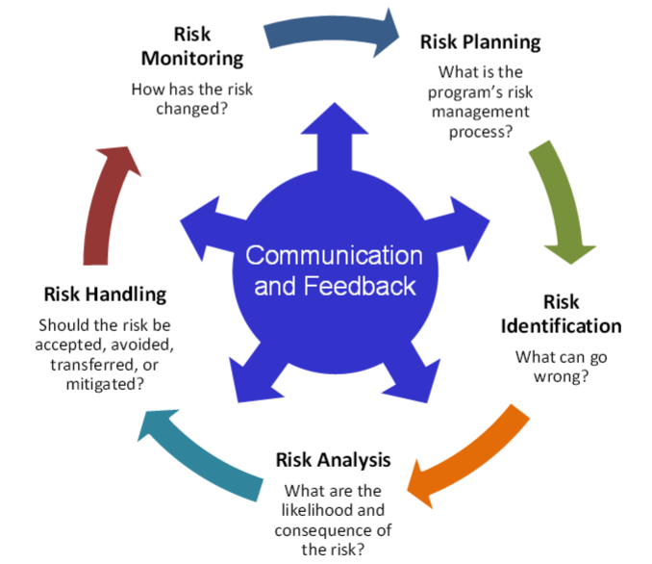
Risk Management should be part of the entire system lifecycle
Risk management process:
Communication and consultation
Establishing the context
Risk assessment
  Risk identification
  Risk analysis
  Risk evaluation
Risk Treatment
Source: ISO 31000:2009
Source: DoD Risk, Issue, and Opportunity Management
Guide for Defense Acquisition Programs, January 2017,
http://www.acq.osd.mil/se/docs/2017-RIO.pdf
Potential impacts of security vulnerabilities are a risk
  Manage that risk as part of risk management
  If complex to communicate, assurance case can help
Notes:
DoD Risk, Issue, and Opportunity Management Guide for Defense Acquisition Programs, June 2015
http://bbp.dau.mil/docs/RIO-Guide-Jun2015.pdf
The 2015 DoD document is an update of the Risk Management Guide for DoD Acquisition, DoD, August 2006

Slide 30
Possible risk responses
(with some of their names)
Avoid / eliminate
  Ensure risk can’t happen. Best, not always practical
Control / reduce / mitigate
  Limit system privileges so if attacker “takes over” a program, that program cannot do everything
  Limit data available on potentially-attacked system
  Detect/respond/recover (quickly)
    Recover quickly when network denial-of-service ends
    Maintain protected backups, easy restore mechanism
Transfer / share (e.g., outsourcing, insurance)
Assume / accept / retain (budget for it!)
Notes:
Sources:
Risk Management Guide for DoD Acquisition, Sixth Edition (Version 1.0), 2006.
Dorfman, Mark S. (2007). Introduction to Risk Management and Insurance (9 ed.). Englewood Cliffs, N.J: Prentice Hall. ISBN 0-13-224227-3.

Slide 31
The key point about risks
You cannot eliminate all risks!
  Wonderful goal, not (affordably) achievable
You can manage them

Slide 32
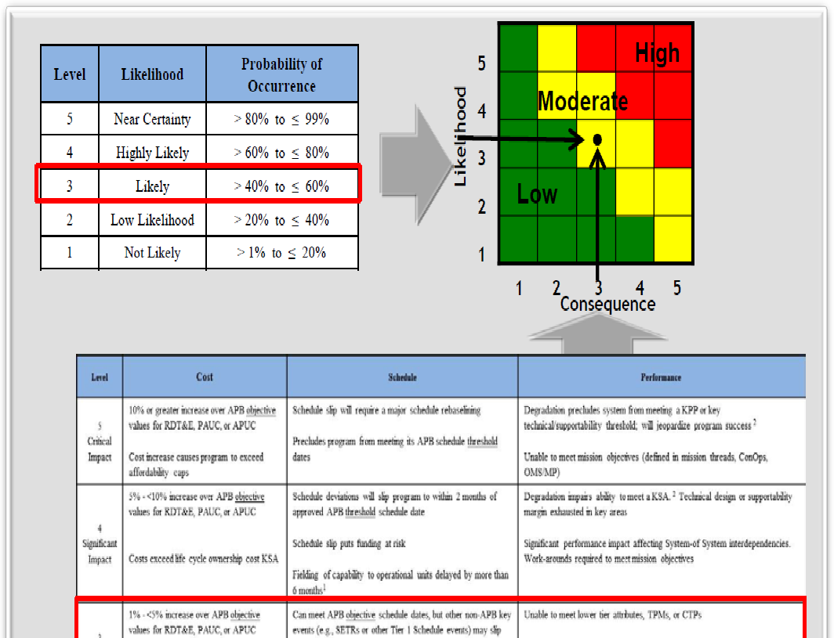
Combining Risk info: Qualitative Risk Analysis / Risk Matrix
Easy to explain & apply
Widely used
“Bins” can hide info (poor resolution)
Often subjective (errors, ambiguous inputs/outputs)
Many argue ineffective for decisions (properly allocating resources)
Source: DoD Risk, Issue, and Opportunity Management Guide for Defense Acquisition Programs, January 2017, http://www.acq.osd.mil/se/docs/2017-RIO.pdf ; “What’s Wrong with Risk Matrices?”
by Louis Anthony (Tony) Cox, Jr., Risk Analysis, Vol. 28, No. 2, 2008.

Slide 33
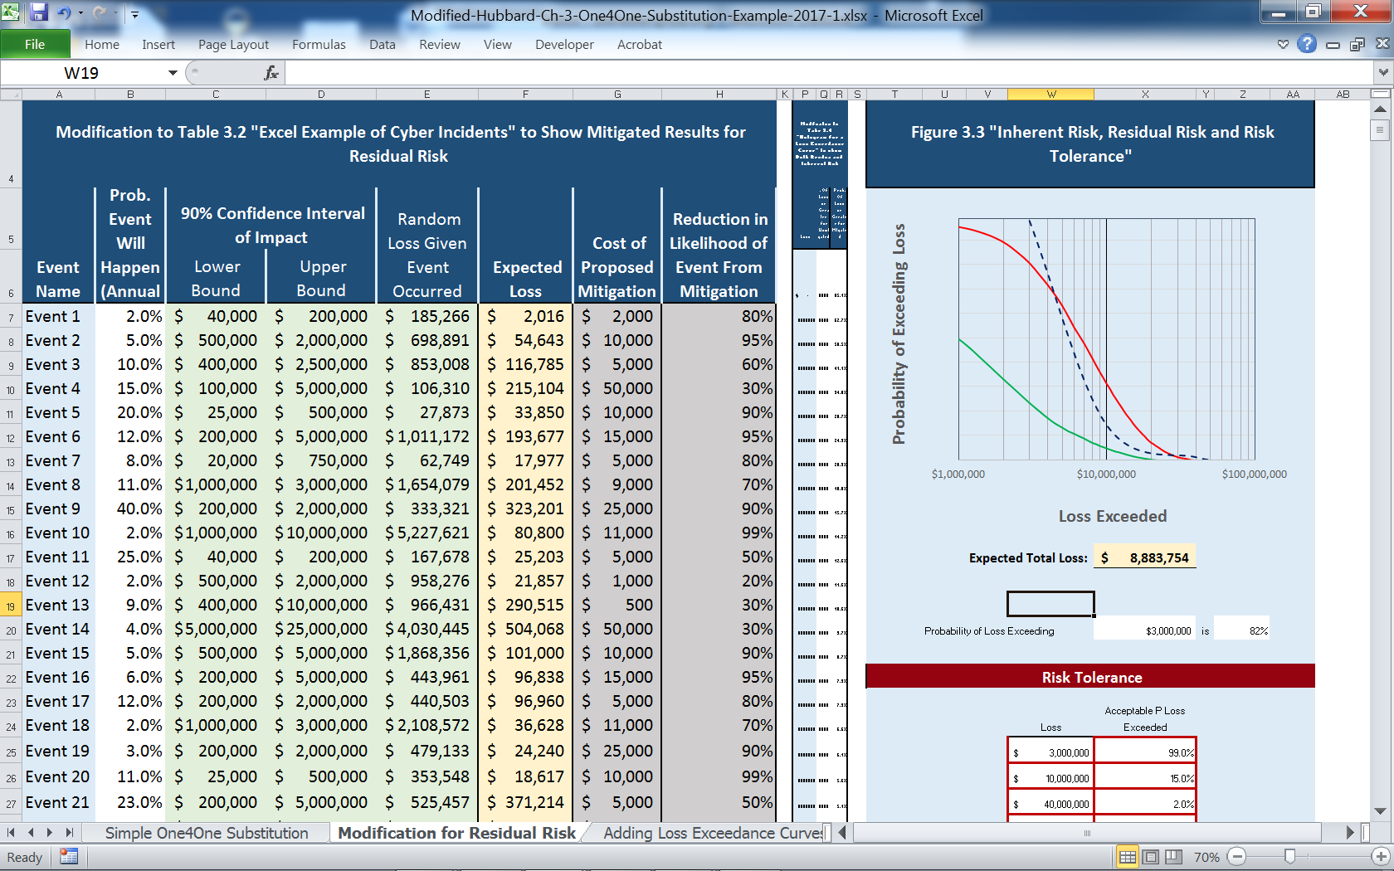
Quantitative risk analysis (1 way)
Monte Carlo simulations
Summary
Source: How to Measure Anything in Cybersecurity Risk by Hubbard & Seiersen, 2016
Notes:
How to Measure Anything in Cybersecurity Risk by Douglas W. Hubbard & Richard Seiersen, 2016.
Spreadsheet is magnified version fo tab 2 of first spreadsheet available from:
http://www.howtomeasureanything.com/cybersecurity/

Slide 34
Quick review: Why is this a joke? (Give two reasons)
“The only system which is truly secure is one which is switched off and unplugged locked in a titanium lined safe, buried in a concrete bunker, and is surrounded by nerve gas and very highly paid armed guards.”
-- Gene Spafford, Director, Computer Operations, Audit, and Security Technology (COAST) Project, Purdue University
Ignores availability – security is more than confidentiality & integrity
Ignores risk management – real systems must manage risk, not eliminate absolutely all risks (since that’s not possible)
Notes:
https://www.se.rit.edu/~jrv/personal/quotes.html

Slide 35
Assurance case
(ISO/IEC 15026)
Assurance = Grounds for justified confidence that a claim has been/will be achieved (but how communicate that?)
ISO/IEC 15026-2:2011 specifies defines structure & contents of an assurance case
  Facilitates stakeholder communications, engineering decisions
  Typically for claims such as safety & security
ISO doesn’t mandate a graphical notation; primarily 3 in use:
  Claims, Arguments & Evidence (CAE) – very simple
  Goal Structuring Notation (GSN) – sophisticated, can be complicated
  Structured Assurance Case Metamodel (SACM) – combines attributes
An assurance case includes:
  Claim(s): Top-level claim(s) for a property of a system or product
  Arguments: Systematic argumentation justifying this claim
  Evidence/assumptions: evidence & explicit assumptions underlying argument

Slide 36
Structure of an assurance case
Claim
(Conclusions, uncertainty)
Argument
Justification of
Argument
Sub-claim
Evidence
Assumption
  “Arguing through multiple levels of subordinate claims, this structured argumentation connects the top-level claim to the evidence and assumptions.”
This figure shows “Claims, Arguments & Evidence" (CAE) graphical notation

Slide 37
Structured Assurance Case Metamodel (SACM) Notation
ID
Statement
ID
ID
Statement
Statement
Claim
ArgumentReasoning
(Argument)
ArtifactReference
(e.g., evidence)
ID
Package [ID]
Statement
AssertedInference /
AssertedEvidence
(same direction as CAE)
AssertedContext
AsCitedClaim
(external claim)

Slide 38
Security-specific example of an assurance case (moderate threat)
CAE
notation
System is adequately secure against moderate threats
Off-the-shelf (OTS)/platform includes
OS, libraries, & services (e.g., RDBMS);
Discuss reputation, evaluation(s),
supply chain used, config hardening,
patch process, …
Claim:
System design counters or reduces impact of most vulnerabilities
Most vulnerabilities are due to likely/ common weaknesses (defect types), & custom sw is unlikely to have them
OTS/ platform is secure
System security verification found no issues
All un-trusted inputs id’d and checked by strict white-lists
Compo-nents given limited privilege, so break-ins less likely to have significant harm
Passwords stored as salted hashes, not clear text, so attacker cannot easily reuse them if acquired
Static analysis results ok
Dynamic analysis results ok
Identified list of likely weak-nesses
All developers trained in likely weaknesses & how to avoid them
All likely weak-nesses have specific counter-measures
…
All SQL statements prepared
Buffer overflows not possible in selected programming language

Slide 39
ISO/IEC 15026 is intentionally limited
Does not place requirements on the quality of the contents of an assurance case
  Assurance case provides structure to record claims, arguments, & evidence
  Stakeholders decide if it’s enough
    Powerful terms: “All” / “highest priority” / “most important”
Does not require the use of a particular terminology or graphical representation. Notations in use include:
  Claims, Arguments and Evidence (CAE) notation
  Goal Structuring Notation (GSN)
Does not specify where or how data stored/managed
Does not require that all information be in 1 place
  Point to info elsewhere (URLs/filenames)

Slide 40
Good assurance cases
Good assurance case makes it easier to agree “enough’s been done”
  Supports decisions (“we’ve done/did enough”)
Use powerful terms: “All” / “highest priority” / “most important”
  Work to identify (& justify) “these are all the important cases”
  Then show “we’ve addressed all important cases”
  Like much testing, “create a graph & cover it”
“A list of stuff you did” is not very convincing (I expect better!)
  Organize the argument!
Useful resource:
  A Sample Security Assurance Case Pattern by David A. Wheeler, https://www.ida.org/idamedia/Corporate/Files/Publications/IDA_Documents/ITSD/2019/P-9278.pdf , Dec 2018

Slide 41
Processes vs. stages/phases
ISO/IEC/IEEE 12207:2017, Systems and software engineering — Software life cycle processes
  Identifies processes in software, which are the same as ISO/IEC/IEEE 15288 (system life cycle processes)
Processes aren’t stages/phases
  Process = “set of interrelated or interacting activities that transforms inputs into outputs”
  Stage (aka phase) = “period within the life cycle of an entity that relates to the state of its description or realization” [relate to major progress and achievement milestones…] [i.e., period of time]
In practice processes occur in parallel

Slide 42
12207/15288 processes
Agreement processes:
  Acquisition, Supply
Organizational project-enabling processes:
  Life Cycle Model Management, Infrastructure Management, Portfolio Management, Human Resource Management, Quality Management, and Knowledge Management
Technical management processes:
  Project planning, Project assessment and control, Decision management, Risk management, Configuration management, Information management, Measurement, Quality assurance
Technical processes:
  Business or mission analysis, Stakeholder needs and requirements definition, Systems/Software requirements definition, Architecture definition, Design definition, System analysis, Implementation, Integration, Verification, Transition, Validation, Operation, Maintenance, Disposal
Remember: These processes are not done in lockstep; they run in parallel

Slide 43
Ethical, Legal, and Regulatory Issues

Slide 44
Ethics (Overall)
Ethics
  Ethics == philosophical study of moral phenomena
  investigates “normative questions about what people ought to do or which behavior is morally right” https://en.wikipedia.org/wiki/Ethics
Ancient/timeless area of study. Modern emphasis:
  “Tuskegee Study of Untreated Syphilis in the Negro Male”
    US medical study performed in 1932–1972
    No consent, treatment withheld, 100/400 subjects died
    When revealed, massive outcry leading to many changes
  Ethical Principles and Guidelines for the Protection of Human Subjects of Research aka Belmont report, 1978-9
    3 principles: Respect for persons, Beneficence, Justice
    Basis for Common Rule (45 CFR 46), which governs US federally funded research
Sources: https://en.wikipedia.org/wiki/Tuskegee_Syphilis_Study
https://www.hhs.gov/ohrp/regulations-and-policy/belmont-report/read-the-belmont-report/index.html
Notes:
https://en.wikipedia.org/wiki/Tuskegee_Syphilis_Study
https://www.hhs.gov/ohrp/regulations-and-policy/belmont-report/read-the-belmont-report/index.html

Slide 45
Menlo Report
Menlo Report’s formal name is Ethical Principles Guiding Information and Communication Technology Research
From Dept. of Homeland Security, August 2012
Guidance on how to apply Belmont report to research in ICT field
Principle | Application
Respect for Persons | Participation as a research subject is voluntary, and follows from informed consent. Treat individuals as autonomous agents and respect their right to determine their own best interests. Respect individuals who are not targets of research yet are impacted. Individuals with diminished autonomy, and who are incapable of deciding for themselves, are entitled to protection.
Beneficence | Do not harm. Maximize probable benefits and minimize probable harms. Systematically assess both risk of harm and benefit.
Justice | Each person deserves consideration in how to be treated, and the benefits of research should be fairly distributed according to individual need, effort, societal contribution, and merit. Selection of subjects should be fair, and burdens should be allocated equitably among impacted subjects.
Respect for Law & Public Interest | Engage in legal due diligence. Be transparent in methods and results. Be accountable for actions. [This principle was added, not formally in Belmont]
Source: https://www.dhs.gov/sites/default/files/publications/CSD-MenloPrinciplesCORE-20120803_1.pdf

Slide 46
Software Engineering Code of Ethics and Professional Practice
Jointly approved by the ACM and the IEEE-CS as the standard for teaching and practicing software engineering, 1990s-2000
Short version: “Software engineers shall commit themselves to making the analysis, specification, design, development, testing and maintenance of software a beneficial and respected profession. In accordance with their commitment to the health, safety and welfare of the public, software engineers shall adhere to the following Eight Principles:
  1. PUBLIC – Software engineers shall act consistently with the public interest.
  2. CLIENT AND EMPLOYER – Software engineers shall act in a manner that is in the best interests of their client and employer consistent with the public interest.
  3. PRODUCT – Software engineers shall ensure that their products and related modifications meet the highest professional standards possible.
  4. JUDGMENT – Software engineers shall maintain integrity and independence in their professional judgment.
  5. MANAGEMENT – Software engineering managers and leaders shall subscribe to and promote an ethical approach to the management of software development and maintenance.
  6. PROFESSION – Software engineers shall advance the integrity and reputation of the profession consistent with the public interest.
  7. COLLEAGUES – Software engineers shall be fair to and supportive of their colleagues.
  8. SELF – Software engineers shall participate in lifelong learning regarding the practice of their profession and shall promote an ethical approach to the practice of the profession.”
Source: https://www.acm.org/code-of-ethics/software-engineering-code

Slide 47
Example: Hypocrite Commits from U of Minnesota (UMN) Researchers
2020 Aug 9..21: “Hypocrite Commits” sent from UMN researchers to Linux kernel
  Attempted to introduce vulnerabilities to see if they would be detected by review process
  Sent to kernel developers from false identities without consent, notice, or ethics review
2020 Nov: Draft paper is published, ethics issues raised
2021 Apr: Linux Foundation sends letter to UMN, paper retracted from formal publication
2021 May 6: IEEE statement on how paper violated ethical guidelines
Good news: Linux kernel code review process worked
  All UMN intentionally-vulnerable buggy patches were caught and not accepted
  Note: One patch was accepted because it was unintentionally correct
Led to re-review of 435 UMN commits by 85 Linux kernel developers
  Confirmed that all intentionally-vulnerable patches with vulnerabilities were rejected
  One intended to be vulnerable, but had a bug making it valid & was accepted
Many other projects used extra time for re-reviews, uncertain if they’d been attacked
UMN: Reputation damage, no pub credit, temp ban from kernel, must train PIs on ethics
  Ban = extra level of external review before any changes considered by main project
Ethical issues (comparing with Menlo report):
  Lack of informed Consent/Autonomy (reviewers & secondary stakeholders)
  Beneficence / Balancing risks and benefits (unnecessary; some take proposals into production early)
Sources: “Report on University of Minnesota Breach-of-Trust Incident” https://lore.kernel.org/all/202105051005.49BFABCE@keescook/
“IEEE S&P’21 Program Committee Statement Regarding The “Hypocrite Commits” Paper” https://www.ieee-security.org/TC/SP2021/downloads/2021_PC_Statement.pdf, “Greg Kroah-Hartman bans University of Minnesota from Linux development for deliberately buggy patches” https://www.zdnet.com/article/greg-kroah-hartman-bans-university-of-minnesota-from-linux-development-for-deliberately-buggy-patches/

Slide 48
EU Cyber Resilience Act (CRA)
Cyber Resilience Act (CRA) is EU regulation 2024/2847
  Entered into force on 10 December 2024
  Must report publicly exploited vulns/incidents 11 Sep 2026
  Whole regulation applies 11 Dec 2027
  Penalties: Up to max(€15M, 2.5% of worldwide annual)
CRA establishes general requirements for:
  Making products with digital elements (PDEs) available on the EU market
    Software, hardware, anything with them, & its “remote data processing solution”
    Does not include pure websites & non-commercial items (as defined by CRA)
  Risk management, design, development, & production for cybersecurity
  Vulnerability reporting, severe incident reporting, & vulnerability handling
Manufacturer = “a natural or legal person who develops or manufactures PDEs or has PDEs designed, developed or manufactured, and markets them under its name or trademark…”
  It doesn’t matter where the manufacturer is – does it go to the EU?
For more, see free course Understanding the European Union (EU) Cyber Resilience Act (CRA) (LFEL1001) (materials from it)
Source: CRA (Regulation (EU) 2024/2847): https://eur-lex.europa.eu/legal-content/EN/TXT/?uri=CELEX%3A32024R2847

Slide 49
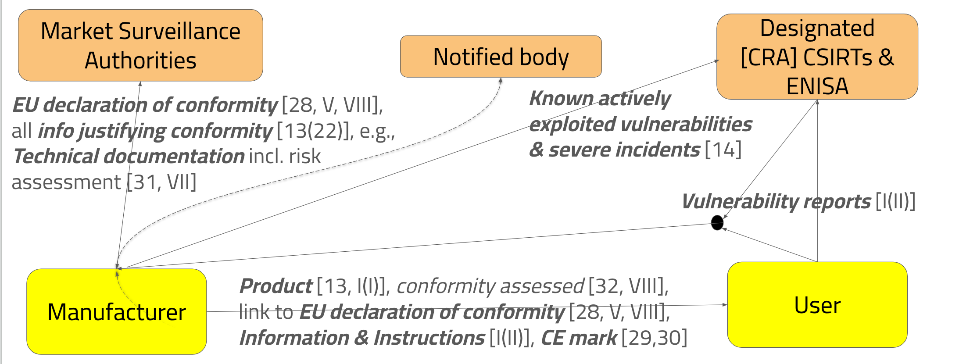
CRA: Manufacturer interactions
Source: Understanding the European Union (EU) Cyber Resilience Act (CRA) (LFEL1001)

Slide 50
CRA: Manufacturer obligation highlights
Design, develop & produce per essential cybersecurity requirements in I Part I [13(1)]
Assess cybersecurity risks, apply throughout lifecycle, min. cybersecurity risks [13(2)]
Document/update cybersecurity risk assessment [13(3-4)]
Exercise due diligence when integrating 3rd party components including OSS [13(5)]
If component vulnerability found, report to component maintainer [13(6)]
Various vulnerability reporting & handling (usually 5+ year), see Annex I Part II [13(8)]
Create technical documentation per article 31 & annex VII [13(12)]
Designate vulnerability single point-of-contact [13(17)]
Info for user per Annex II [13(18)]
Assess conformity per article 32 & Annex VIII
Must report vulnerabilities & incidents per article 14 (below)

Slide 51
European General Data Protection Regulation (GDPR)
Protects personal data of subjects who are in the European Union (EU)
  “any information relating to an identified or identifiable natural person (‘data subject’)
Guarantees rights to:
  Access (Art. 15): Data subjects can ask whether their personal data is being processed. If it is, they can receive “access” to the data (e.g., a copy or screenshot of it) and information regarding the processing.
  Rectification (Art. 16): Data subjects can have inaccurate data updated and corrected.
  Erasure (a.k.a “Right to be Forgotten”) (Art. 17): In certain circumstances, data subjects can have their personal data erased.
  Restriction of Processing (Art. 18): In certain circumstances, data subjects can restrict processing of their personal data. It can still be stored, unless a “Right to Erasure” request was also made.
  Data Portability (Art. 20): In certain circumstances, data subjects can have their personal data exported (e.g., provided to the data subject or a third party in a structured, commonly used and machine-readable format).
  Object (Art. 21): In certain circumstances, particularly for direct marketing and profiling purposes, data subjects can object to having their personal data processed.
Substantial fines for non-compliance

Slide 52
US/Other
US has various privacy laws/regulations for specific situations
  Family Educational Rights and Privacy Act of 1974 (FERPA) for student education records
  Health Insurance Portability and Accountability Act of 1996 (HIPAA) for health-related data
  Children’s Online Privacy Protection Act of 1998 (COPPA) for data related to children
  Fair and Accurate Credit Transactions Act of 2003 (FACTA) for some financial data
  US Privacy Act of 1974 (5 U.S.C. 552a) mandates how US federal agencies must maintain records about individuals who are US citizens and lawful permanent resident aliens
Federal Risk and Authorization Management Program (FedRAMP)
  US federal government-wide program, a standardized approach to security assessment, authorization, and continuous monitoring
  for cloud products and services used by federal agencies
Payment Card Industry Data Security Standard (PCI DSS)
  a set of security standards developed by the PCI Security Standards Council (PCI SSC)
  entities involved in payment card processing must adhere to
  purpose: protect cardholder data and prevent fraud

Slide 53
Unix/Linux/POSIX

Slide 54
Basics of Unix/Linux/POSIX
Our focus on secure apps/server software
  Not on creating secure operating systems (same principles)
Must understand security model of supporting components (e.g., OS and DBMS)
Focus on Unix/Linux/POSIX model, used in:
  Linux-based (Red Hat Enterprise, Fedora, Ubuntu, Debian, Android, …)
  Unix (*BSDs, Solaris, AIX, …)
  MacOS & iOS
We will call these “Unix-like” systems
MS Windows’ model is different in detail, though in many cases very similar (many analogies)

Slide 55
Kernel vs. User space
Usually implemented as:
  Kernel: Low-level software that connects to hardware & implements basic constructs
  User space: Processes that run programs
    Some processes have special privileges
    Some long-running processes provide services (daemons)
User space
Kernel
Kernel

Slide 56
Users & Groups
Each user is assigned user id (UID) – an integer
  UID 0 (“root user”) can override security controls
  File /etc/passwd lists username and its UID
Users belong to at least one group
  Each group has a name and group id (GID) – integer
  In practice, GID 0 also has special privileges
  Modern systems allow users to belong to many groups
  File /etc/group lists groupname, GID, membership
  Often a special group exists for just that user
Separate different users in a multi-user system
Android: Applications have different UID/GID

Slide 57
Processes
A process = a running program
  Same program may be run by >1 process
  Process may have multiple threads of control
Processes inherit most attributes & rights from creating process, often all the way back to the creating user
See running processes with command line:
  ps -ef
Processes have various attributes

Slide 58
Process Attributes
RUID, RGID: Real UID, GID of process’ user
EUID, EGID: Effective UID, GID – what is actually used for security tests (not always RUID, RGID).
SUID, SGID: Saved UID, GID – a UID, GID that can be switched to (so you can enable/disable privileges)
FSUID, FSGID: (Linux only) UID and GID used for filesystem checks UID, GID
Supplemental groups: List of groups process is a member of
Umask: Used to set default permissions of created files
File system root (where it thinks “/” is; not the same as user root)
Pointer to current directory (used with relative pathnames)

Slide 59
Files
Files, aka filesystem objects (FSOs), can be read from or written to. Files may be:
  Regular (ordinary) file, character special file, block special file, FIFO special file, symbolic link, socket, and directory
Pathname: A sequence of bytes to identify a file
  Absolute pathnames start with “/” (the “root directory”)
  Regular pathnames don’t –begin at current directory
  Sequence of pathname components (filenames) and “/” (directory separator)
  What many call “filenames” are officially “pathname components”
  Different pathnames may refer to the same file
    You can create multiple alias names to the same underlying file
    If you “remove” a file, it may still be there via another path
  Filenames & pathnames not necessarily character string
    Byte sequences may be illegal/meaningless in current (or other) locale

Slide 60
Files have attributes
Owner UID and GID: Who owns this file?
  Only owner can change file’s UID and GID
Permission bits: What rights are granted?
  User: read (r), write (w), execute (x)
  Group: read (r), write (w), execute (x)
  Other: read (r), write (w), execute (x)
  Sticky (t) for directory: Remove/rename of its files may only be done by owner of directory or that file
Attributes that grant rights when run:
  Setuid: When run, set EUID to owner UID
  Setgid: When run, set EGID to owner GID

Slide 61
Applying permission bits
The most specific permission set is used
  If process UID is file UID, the file “user” permissions are used to determine if can r,w,x.
  If a process GID (including supplemental groups) is a file GID, the file “group” permissions are used
  Otherwise, the “other” set is used
For files, this is straightforward
  E.G., process P tries to write to file F. If process P has UID u, and file owner is also u, then the “user” permission “write” is checked

Slide 62
Permission bits of directories
Directories are implemented as ordinary files with special capabilities
  This may help you understand permission meaning
Directory permissions are:
  Read (r): can see the filenames in it
  Write (w): Can add/remove/rename its filenames
  Execute (x): Can look up (use) a filename in it

Slide 63
Seeing file permissions
The “ls -l” command lists files + other info
-rw-rw-r--. 1 dwheeler dwheeler 21 Aug 22 2012 junk.txt
Left-hand side:
  Type of file (-=ordinary, d=directory, …)
  User permissions (rwx); s for x if executable & setuid
  Group permissions (rwx); s for x if executable & setgid
  Other permissions (rwx); t for x if executable & sticky
  “-” for permission not granted
- | r | w | x | r | w | x | r | w | x
Type
User
Group
Other

Slide 64
Setting file permissions
Command-line utility to set permissions:
  chmod new-permissions list-of-files
New-permissions can be:
  Set permissions: [ugo]=[rwx]
  Remove permissions: [ugo]-[rwx]
  Add permissions: [ugo]+[rwx]
For example:
  chmod go-wx somefile

Slide 65
Setting file permissions (2)
To set or see permissions, faster in octal (!!)
  Add up read=4, write=2, execute=1
  Write each digit down
For example:
  User read+write… 4+2=6
  Group read… 4=4
  Others none.. 0
For final command, just write user/group/other digit:
  chmod 640 my-secret-sauce
Other examples:
  777=rwxrwxrwx (everyone has all permissions – avoid this)
  755=rwxr-xr-x (user can do all; group/other can read & execute)

Slide 66
When are permission values used?
File permissions on checked on file open
  Not on every read/write
Permissions are checked on system calls from user process to the kernel, e.g.:
  open – open file
  creat – create new file
  rename – rename the file
  link – create a new name (hard link) for a file
  unlink – remove the link (if this is the last one, it’s deleted)
  symlink – create a symbolic link (a name that points elsewhere)
  socket – create an endpoint for communication
  mknod – make a special file (e.g., a named pipe)

Slide 67
Additional permission systems
Some systems have additional permission systems layered on top
Security-Enhanced Linux (SELinux)
  Originally developed by NSA
  Deployed by default in RHEL, CentOS, Fedora
  Variant (SEAndroid) deployed in Android 4.3 & enforcing 4.4+
  Every file system object (per metadata) & process has a type label
  Every kernel request checks if that interaction ok
  Amusing introduction available in “The SELinux coloring book”
AppArmor
  Deployed by default in Ubuntu & SuSE Linux
  Rights granted using file system path name, not inode metadata
    Hard links to same contents are different to AppArmor (& same in SELinux)
  Emphasis on simplicity & not fine-grained control
    E.g., originally only controlled read, write, append, execute, lock, and link
Notes:
“The SELinux coloring” is available via http://blog.linuxgrrl.com/2014/04/16/the-selinux-coloring-book/

Slide 68
Unix-like documentation
Historically in “man pages” in sections:
  1 Executable programs or shell commands
  2 System calls (functions provided by the kernel)
  3 Library calls (functions within program libraries)
  8 System administration commands
E.G., “ls(1)” is the page about the program “ls”
Sometimes the same name reused, so often used to distinguish
  chmod(1) is the user program
  chmod(2) is the system call that chmod(1) uses

Slide 69
Sockets (for TCP/IP)
Server
Client
Sockets represent network communication endpoints
Today, network == Internet protocol (IP), and usually TCP (creates illusion of data flow)
If you want to encrypt it, typically build encryption on top
socket()
socket()
bind()
listen()
connect()
Establish
connection
accept()
read()/
write()
read()/
write()
close()/
shutdown()
close()/
shutdown()

Slide 70
What we’ll cover in the course
We’ll be covering key guidelines
  What to do…
  … and what not to do
Designing & implementing secure software is more than just knowing common mistakes
  But vast majority of vulnerabilities are caused by common mistakes (“weaknesses”)
  We’ll spend significant time understanding them & learning how to prevent them

Slide 71
Any questions?

Slide 72

Backup material

Slide 73
Quotas & Limits
Useful for preventing denial of service attacks
Beware: Terms “soft limit” and “hard limit”
File system quotas on each “mountpoint” (where disk is added)
  Hard limit (actual maximum)
  Soft limit (can be temporarily exceeded)
  Can limit the total blocks and the total number of files
  Per user and/or per group
  See quota(1), quotactl(2), quotaon(8)
Process resource limits (rlimit/setrlimit)
  Hard limit: Cannot be exceeded by normal user
  Soft limit: Cannot be exceeded, but can be raised/lowered up to hard limit
  RLIMIT_CPU: Maximum CPU time
  RLIMIT_DATA: Maximum data size
  Also: File size, number of child processes, number of open files, etc.
  See getrlimit(2), setrlimit(2), and getrusage(2), sysconf(3), and ulimit(1)

Slide 74
Auditing/Logging: Syslog/rsyslog/…
Unix/Linux/POSIX systems often record system logs by appending to a text file
  E.G., /var/log/messages
Stored Simple Format
  Date Time Machine-name service: report
    Aug 28 14:23:20 dwheeler3-pc dbus[923]: [system] Successfully activated service 'net.reactivated.Fprint'
Logger can be configured (what to log & where)
Programs call syslog(3) to report something that might be logged

Slide 75
Syslog priority levels
Programs assign a priority level to each message [POSIX 2008]:
  LOG_EMERG - A panic condition, reported to all processes
  LOG_ALERT - A condition that should be corrected immediately
  LOG_CRIT - A critical condition
  LOG_ERR - An error message
  LOG_WARNING - A warning message
  LOG_NOTICE - A condition requiring special handling
  LOG_INFO - A general information message
  LOG_DEBUG - A message useful for debugging programs
Administrators can configure what’s done with them

Slide 76
Pluggable Authentication Modules (PAM)
Implemented in many Unix-like systems
Separates modules for system authentication from application
  Typical: Directory “/etc/pam.d” has a config file for each application that needs authentication
File identifies modules to use for 4 operations:
  account: Determines whether the user is allowed to access the service, whether their passwords has expired, etc.
  auth: Authentication (is user is who they claim to be?)
  password: Change authentication (e.g., password)
  session: What to do before and/or after user is authenticated
Key application call:
  pam_authenticate: Authenticate user given “password”

Slide 77
Example: YubiKey
YubiKey: Physical device, plugs into USB port, pretends to be (an additional) keyboard
User moves cursor to “password” position and presses button on Yubikey
On Button press, generates and “types in” a one-time password + ENTER
Server verifies; if verifies, that password can’t be reused
Internally works on shared-secret key with AES
Shared secret used to encrypt a “serial number” that‘s incremented
Sources: http://lwn.net/Articles/409031/ http://yubico.com/products/yubikey/

Slide 78
Password Problems
User-created passwords often easily guessed
  Often based on user name, personal traits, etc.
  Often based on dictionaries with trivial substitutions
  Often too short
Yet system-generated passwords often too hard to remember
How many passwords do you have to remember?
  If browser stores them, what if browser is subverted?
  If reuse, breaking into one breaks into many
Often passwords can be captured or discovered
  E.g., keyloggers, confuse users into thinking they’re on different site

Slide 79
Attackers vs. passwords
Capture password
  Keyloggers, network eavesdropping, shoulder surfing
  Break into server, capture passwords, reuse elsewhere
Brute force attack
  Try all combinations
Dictionary attacks
  Guess passwords using a password dictionary + permutations
  Password dictionaries widely available
    Include multiple human languages, terms from wide interests (e.g., Shakespeare and Star Trek), etc.

Slide 80
Defending passwords
Encrypt connection carrying passwords
Require “good” passwords when user tries to set one
  Long enough (most important), different symbol types, etc.
  Check against dictionaries of “bad” passwords
On server, don’t store passwords as clear text
  Store as “iterated salted hashes” so attacker cannot use directly
  We’ll discuss iterated salted hashes later in course (crypto)
Make it hard for attacker to exploit “lost my password”
Alert user when the password is changed
  E.G., via email

Slide 81
Alternatives to passwords
Algorithms
  One-time passwords
  Shared secret
  Public key cryptography
Hardware

Slide 82
One-time passwords
Password list – must use in order, can’t reuse
  Give user a list, cross off each one as used
Pros:
  Counters network eavesdropping, shoulder surfing
  Cheap to implement; tiny state to store at server
Cons:
  Harder to distribute list
  Compromise of list allows impersonation
  Users hate them (when implemented by hand)

Slide 83
Shared secret
User & server have shared secret
Authentication process:
  Server generates nonce (random number), sends to client
  Client encrypts nonce with secret, sends back
  Server also encrypts, compares with client value
  If same, user must know the secret – ok!
Pros:
  Prevents network eavesdropping
Cons:
  If secret compromised, user can be impersonated

Slide 84
Public key cryptography
Use “public key cryptography”
  User has two numbers, “public key” & “private key”
  Server knows public key of users
Authentication process:
  Server generates/sends random nonce to client
  Client encrypts nonce with private key, sends back
  Server decrypts with public key, if match, ok!
Pros: Provides non-repudiation of client key
Cons: If user’s private key compromised, user can be impersonated

Slide 85
Separate hardware devices / software applications
Challenge-response: Server sends number (nonce), devices receives and generates response, response sent back to server
    Could implement shared-secret or public key
Time-based challenge-response: Uses current time to determine what to send to server
    Aka Time-based One-time Password (TOTP)
    Server and token have to have time synchronized
    Widely used in phone applications
Smartcards: Contains user credentials
    Better ones never yield credentials outside card

Slide 86
Will passwords disappear? Doubtful in the near term
“Hey, have you seen [insert thing here]? It's totally going to kill passwords! No, it's not.”
  “Despite its many flaws, the one thing that the humble password has going for it over technically superior alternatives is that everyone understands how to use it. Everyone.”
  “If your [password-replacement] product is so awesome, have you stopped to consider why no one is using it?” [Hunt]
“We evaluate two decades of proposals to replace text passwords… Our comprehensive approach leads to key insights about the difficulty of replacing passwords… no known scheme come[s] close to providing all desired benefits: none even retains the full set of benefits that legacy passwords already provide… many academic proposals have failed to gain traction because researchers rarely consider a sufficiently wide range of real-world constraints.”
Passkeys promising, but not yet portable (lock-in danger)
They’ll be mostly replaced someday, but it’s not as easy as you might think
Source: “Here's Why [Insert Thing Here] Is Not a Password Killer” by Troy Hunt, 2018-11-05,
https://www.troyhunt.com/heres-why-insert-thing-here-is-not-a-password-killer/
“The Quest to Replace Passwords: A Framework for Comparative Evaluation of Web Authentication Schemes”
by Joseph Bonneau et al, 2012 IEEE Symposium on Security and Privacy,

Slide 87
Discussion
What changes might you make to the sample assurance case on the previous slide?
  Given what you know now; obviously you’ll learn more as we go through the class!
Later in the class we’ll see an example of an assurance case for a real system

Slide 88
Released under CC BY-SA 3.0
This presentation is released under the Creative Commons Attribution-ShareAlike 3.0 Unported (CC BY-SA 3.0) license
You are free:
  to Share — to copy, distribute and transmit the work
  to Remix — to adapt the work
  to make commercial use of the work
Under the following conditions:
  Attribution — You must attribute the work in the manner specified by the author or licensor (but not in any way that suggests that they endorse you or your use of the work)
  Share Alike — If you alter, transform, or build upon this work, you may distribute the resulting work only under the same or similar license to this one
These conditions can be waived by permission from the copyright holder
  dwheeler at dwheeler dot com
Details at: http://creativecommons.org/licenses/by-sa/3.0/
Attribute me as “David A. Wheeler”

