Slide 1
Evaluating Open Source Software (OSS)
David A. Wheeler
March 12, 2004
This presentation contains the views of the author and does not indicate endorsement by IDA, the U.S. government, or the U.S. Department of Defense.

Slide 2
Outline
Introduction to OSS
  Basics, history, OSS vs. FS, licenses, development
Government acquisitions of COTS OSS vs. proprietary products
  Same, different, challenges, remarks
How to evaluate OSS
  Identify, read reviews, compare, analyze
  Functionality, cost, market share, support, maintenance, reliability, performance, scaleability, useability, security, flexibility, legal/license
Quantitative evidence for consideration

Slide 3
Basics of Open Source Software (OSS) / Free Software (FS)
Open Source Software / Free Software (OSS/FS) programs have licenses giving users the freedom:
  to run the program for any purpose,
  to study and modify the program, and
  to freely redistribute copies of either the original or modified program (without royalties, etc.)
Not non-commercial, not necessarily free-of-charge
  Often supported via commercial companies
Synonyms: Libre software, FLOS software (FLOSS)
Antonyms: proprietary software, closed software

Slide 4
History of Open Source Software / Free Software
1950s, 1960s: Software freely distributed
~1970s: Rise of proprietary software
1984: Richard M. Stallman establishes “Free Software Foundation”, creates “General Public License” (GPL)
1990s: Increasing Internet availability enables developer coordination
1997: Eric Raymond’s “Cathedral & the Bazaar” explains new approaches; term “Open Source Software” coined

Slide 5
Open Source Software vs.
“Free Software”
First named “Free Software” by Stallman
  Free as in Freedom
  Officially defined by “Free Software Definition”
  Not necessarily zero price; confused many
New term coined: “Open Source Software”
  Officially defined by the “Open Source Definition” (a long 9-point list)
  Practically all OSS software is also FS
Terms sometimes indicate motivations
  FS: emphasize ethical/social issues
  OSS: technical superiority/flexibility
  OSS often used due to “zero price” confusion

Slide 6
Major OSS/FS Licenses
Many licenses, but 4 dominate
BSD-new & MIT license: anything but sue
  Can incorporate code into proprietary software
  Financial incentive to use, but not aid project
General Public License (GPL): “Copyleft”
  If distribute, must distribute source code or provide written offer to do so
  Cannot link (embed) into proprietary software
Lesser/Library GPL - a compromise
  Must distribute source code/written offer, but only of component itself
  Can link into proprietary software
Public domain is OSS/FS, but rare

Slide 7
OSS/FS Development Model
Improvements (as source code) and evaluation results: User as Developer
Developer
Trusted
Developer
Bug Reports
Trusted
Repository
Source Code →
Distributor
User
“Stone soup development”
OSS/FS users typically use software without paying licensing fees
OSS/FS users typically pay for training & support (competed)
OSS/FS users are responsible for developing new improvements &
any evaluations that they need; often cooperate/pay others to do so
Notes:
Development model
User
User as developer
Developer
Trusted developer
Trusted repository
Distributor
Stone soup development
Source code
Licensing fees
Training
Support
Evaluations
Improvements
Cooperate

Slide 8
Outline
Introduction to OSS
  Basics, history, OSS vs. FS, licenses, development
Government acquisitions of COTS OSS vs. proprietary products
  Same, different, challenges, remarks
How to evaluate OSS
  Identify, read reviews, compare, analyze
  Functionality, cost, market share, support, maintenance, reliability, performance, scaleability, useability, security, flexibility, legal/license
Quantitative evidence for consideration

Slide 9
Same (OSS vs. Proprietary)
Negotiate best options with all parties, then select
  Good: Israeli government’s process
  Unwise: Media reports of Newham Borough Council’s
Evaluation criteria
  Functionality, cost, market share, support, maintenance/longevity, reliability, performance, scalability, flexibility, legal/license (inc. rights and responsibilities), other
Warranty & indemnification
  Disclaimed by both proprietary & OSS licenses (generally)
  Indemnification exception: Linux (OSDL, HP, RH, Novell)
Developer trustworthiness usually unknown
  Can review OSS code & sometimes proprietary
OSS gives rights to view, modify, and redistribute

Slide 10
Different (OSS vs. Proprietary)
Process&code openness means more&different sources of evaluation information
  Bug databases, mailing list discussions, …
  Anyone can review/comment on design
  Anyone (inc. you) can evaluate source code for security
  See http: //www.dwheeler.com/oss_fs_eval.html
Proprietary=pay/use, OSS=pay/improvement
  In either case pay for installation, training, support
  In OSS, pay can be time and/or money
Support can be competed & changed
  OSS vendors, government support contracts, self
OSS can be modified & redistributed
  New option, but need to know when to modify
  Forking usually fails; generally work with community

Slide 11
OSS Challenges
Ensuring OSS considered in acquisitions
  Acquisition processes developed before OSS rise
  Many OSS projects don’t respond to solicitations&RFPs
Ensuring license compliance
  No use requirements. Education needed on redistributing copyleft (but easier than proprietary)
CC security evaluations (no funding model)
  Government-funded evaluation for free use/support?
  Multi-Government funding (@enterprise license level)
Support if there’s no traditional vendor
Dependence on proprietary formats/protocols
  Use open standards. DoD JTA (DISR) wants: mature, not proprietary, publicly held, multi-vendor commercial support, international>national, don’t require patents, …
  Government policy issue: software patents justified?

Slide 12
Remarks
OSS options should always be considered
OSS can be very flexible & often lower costs
  Directly and as competition
Need to understand differences to apply OSS
OSS raises strategic questions for governments
  Level-playing-field (e.g., U.S. DoD)
  Other: Industrial policy (encourage local services & research), counter dependency on external entity, transparency in government, longevity of records, …
Need creativity
  Risk mitigation, not risk avoidance
  Hybrid OSS/proprietary, paying for OSS improvements, or starting OSS project (esp. in research or standards-setting) might be the best option in your case

Slide 13
Outline
Introduction to OSS
  Basics, history, OSS vs. FS, licenses, development
Government acquisitions of COTS OSS vs. proprietary products
  Same, different, challenges, remarks
How to evaluate OSS
  Identify, read reviews, compare, analyze
  Functionality, cost, market share, support, maintenance, reliability, performance, scaleability, useability, security, flexibility, legal/license
Quantitative evidence for consideration

Slide 14
Evaluating OSS
Steps for evaluating OSS and proprietary are essentially the same. My process:
  Identify candidates
  Read reviews
  Compare (briefly) to needs
    Functionality, cost, market share, support, maintenance, reliability, performance, scaleability, useability, security, flexibility, legal/license
  Analyze top candidates in more depth
But many differences in the details
  Different information available
  Support can be competed
  Can be modified, redistributed
  Outlay costs per improvement, not per seat

Slide 15
Identify Candidates
Ask co-workers, experts at hand…
Internet search
  By product type
  By product name + “competitor”
  By searching for all product names
Specialized sites
  Freshmeat
  Sourceforge
Generally Recognized as Mature (GRAM)

Slide 16
My OSS GRAM List
OS: GNU/Linux, FreeBSD, OpenBSD
Network: Apache (web server), bind, Mailman, Samba, Postfix (Sendmail)
RDBMS: MySQL, PostgreSQL
Desktop: Evolution, (Netscape’s) Mozilla, OpenOffice.org (& Gnumeric), GIMP
Development: Bugzilla, CVS (Subversion), Emacs & vim, gcc & GNAT & Perl & Python & PHP, JBoss (J2EE), Zope
GUI: GNOME, KDE, XFree86
Security: Nessus (net-based vuln. scan), Nmap, OpenSSH, OpenSSL, Snort (intrusion detection)
“LAMP”

Slide 17
Read Reviews
Internet search for sets of names
Specialized site ratings (Freshmeat, etc.)
  Beware of bias, but esp. here
Market share as review
  Google popularity as proxy
  Beware, what you really want to know is future popularity, to reduce risk
Read reviews first
  May help identify important attributes you didn’t even know were important

Slide 18
Compare to Needs
Briefly compare leading programs’ attributes to your needs
  Triage, if there are many options
Typical attributes
  Functionality, cost, (market share,) support, maintenance, reliability, performance, scaleability, useability, security, flexibility, legal/license

Slide 19
Functionality
Does it do what you want it to do?
  OSS project website typically describes capability
Will it integrate well in your environment?
  Some may require Unix client; others a Unix-like server (much simpler); others portable
Missing functionality?
  Can do without? Supplement procedurally? Use a sidecar program?
  Can/should you add it?

Slide 20
Cost
Consider all costs
  Not just initial licensing & license upgrade fees
  Installation, training, support/maintenance, transition costs, hardware
    Transition issues discussed in “Interchange of Data Administration Open Source Migration Guidelines”
  Beware under and over estimation
Other issues
  Vendor lock-in, followed by price raising
  Use in one project can spread enterprise-wide; consider what it will cost if that happens

Slide 21
Support/Maintenance/Longevity
Training, installing, answering user questions, fixing/improving product
OSS has several choices:
  Traditional commercial support
    Compete. Prefer those directly involved
  Support in-house
  Depend on development/user community
Project Website gives clues for vitality

Slide 22
Reliability, Performance, Scaleability, Useability
Many active users often indicates some reliability
Trying it yourself is best measure
Useability:
  Many OSS programs divided into “GUI” and “command line/programmer” interface; make sure you measure the right thing!
  Many use web browser, but that’s no guarantee
  GNOME Human Interface Guidelines / KDE user interface guidelines compliance

Slide 23
Security
Identify your security requirements
  Confidentiality, integrity, availability, non-repudiation, audit, identification & authentication, …
Look for evidence that security is seriously considered by developers
  Mailing list discussions
  Signatures of releases
  Reputation (OpenBSD)
  Common Criteria eval rare (no funding model)

Slide 24
Flexibility
OSS has a fundamental advantage
  After all, OSS code can be modified
  Modified directly or by paying for it
But some are easier to extend than others
  Look for extensible architectures: plug-ins, programmer API, command language, modular designs

Slide 25
Legal/license Issues
Don’t ignore proprietary EULA when comparing with OSS
Both OSS & proprietary licenses disclaim legal liability
Proprietary: License audits
Check if OSS program is really OSS
Many OSSs copyleft; make sure it’s okay, and educate developers on requirements

Slide 26
In-Depth Analysis of Top Candidates
Get the top candidates, try on representative work loads
Pilots, build up from less critical situations
Enterprise licenses/negotiating rates
Special analyses:
  Adding functionality/re-invigorating project
  Starting your own project (!)
  Software security

Slide 27
Outline
Introduction to OSS
  Basics, history, OSS vs. FS, licenses, development
Government acquisitions of COTS OSS vs. proprietary products
  Same, different, challenges, remarks
How to evaluate OSS
  Identify, read reviews, compare, analyze
  Functionality, cost, market share, support, maintenance, reliability, performance, scaleability, useability, security, flexibility, legal/license
Quantitative evidence for consideration

Slide 28
Outline of Quantitative Information on OSS/FS
Quantitatively show “consider using OSS/FS software”:
  Market Share
  Reliability
  Performance
  Scalability
  Security
  Total cost of ownership
  Non-quantitative
Numbers won't show OSS/FS always technically better
This presentation does not necessarily represent the views of the U.S. Government or U.S. DoD, & is based on personal work

Slide 29
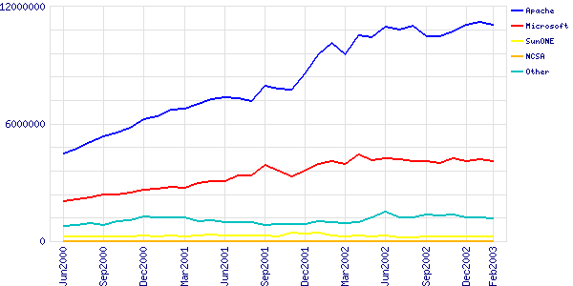
Market Share: Web Servers
Active Sites: Apache 66.75%, Microsoft IIS 24.81% in Feb 2003 (counting by name; 35.86M sites)
For SSL, Apache 53.97%, IIS 34.85% Sep02
Notes:
Market share
Web servers
Webservers
Apache
Microsoft IIS
IIS
SSL

Slide 30
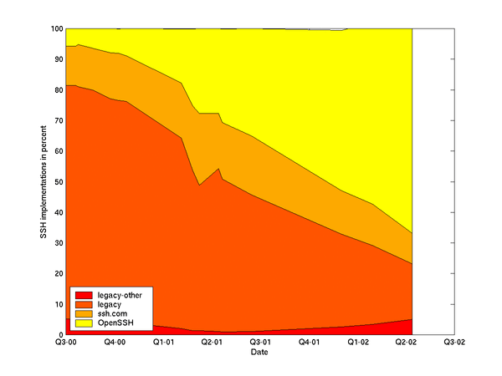
Other Market Share Examples
GNU/Linux #2 webserver OS Jun01
  GNU/Linux 29.6%, Windows 49.6%, BSDs 6.1%
GNU/Linux #2 server OS sold 99, 00, 01 (24%, 27%, 25%)
DNS: bind supports 95% of reverse-lookups
PHP #1 server-side scripting language
Sendmail #1 Email server
  Sendmail 42%, Microsoft Exchange 18%
OpenSSH #1 SSH (66.8% Apr02)
Small (1.7-3.8%) 2002 desktop share
  Microsoft 92% in 2000, but usable OSS/FS apps just released in 2002, so could change over time
Notes:
Market Share
GNU/Linux
Linux
Windows
BSDs
DNS
Bind
PHP
Sendmail
Openssh
SSH
Desktop

Slide 31
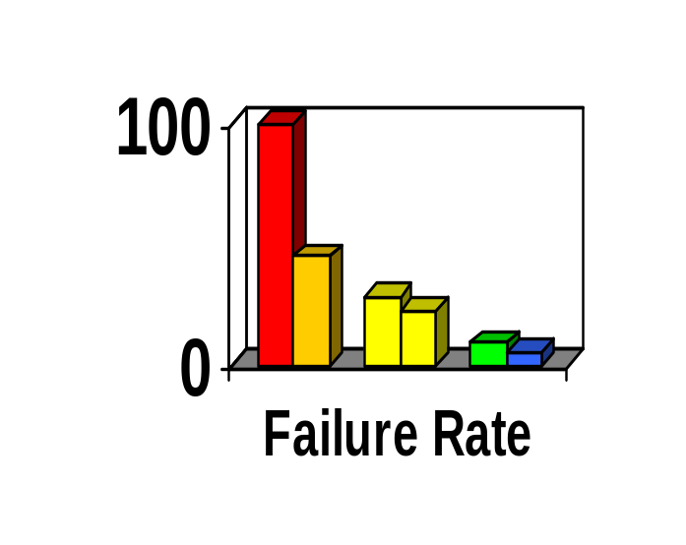
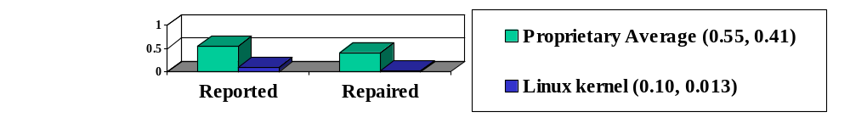
Reliability
Fuzz studies found OSS/FS apps
significantly more reliable [U Wisconsin]
  Proprietary Unix failure rate: 28%,23%
  OSS/FS: Slackware Linux 9%, GNU utilities 6%
  Windows: 100%; 45% if forbid certain Win32 message formats
GNU/Linux vs. Windows NT 10 mo study [ZDNet]
  NT crashed every 6 weeks; both GNU/Linuxes, never
IIS web servers >2x downtime of Apache [Syscontrol AG]
Linux kernel TCP/IP had smaller defect density [Reasoning]
Notes:
Reliability
Fuzz
GNU/Linux
Windows
Crash
Downtime
TCP/IP
Defect
Defect density

Slide 32
Performance
Performance always varies by circumstance
TPC-C: GNU/Linux faster than Windows
PC Magazine: GNU/Linux with Samba faster fileserving at Windows' own file protocols
  Nov 2001, top end, 130MB/sec vs. 78MB/sec
  April 2002, performance 2x; 4x many clients
Sys Admin: untuned GNU/Linux fastest
Measure
GNU/Linux
Solaris on Intel
FreeBSD
Windows 2000
Email (M msg/hr)
1.3
1
0.9
0.9
Disk I/O (seconds)
542
3990
2398
613
Notes:
Performance
GNU/Linux
Windows
Samba
Fastest

Slide 33
Scalability
GNU/Linux and NetBSD support more hardware platforms & performance ranges
  PC hardware, PDAs, mainframes, clusters, supercomputers
OSS/FS can develop large software systems
  Red Hat Linux 7.1 had 30million SLOC
  Represents approximately 8,000 person-years
  To re-develop proprietary, $1 Billion USD
Notes:
Scaleability
Hardware
Supercomputer
Mainframe
PDA
Source lines of code
SLOC
Gigabuck

Slide 34
Security
J.S. Wurzler hacker insurance costs 5-15% more for Windows than for Unix or Linux
Windows websites disproportionately vulnerable
Bugtraq vulnerability: Smallest is OpenBSD, Windows largest (Don't quintuple-count!)
Worst vulnerabilities (takeover): Apache 0, IIS 8
(Jun98-Jun01)
OSS/FS not invulnerable!
Category
Proprietary
OSS/FS
Defaced
66% (Windows)
17% (GNU/Linux)
Deployed Systems
49.6% (Windows)
29.6% (GNU/Linux)
Deployed websites (by name)
24.81% (IIS)
66.75% (Apache)
Notes:
Security
Insurance
Vulnerable
Vulnerability
Defaced
Bugtraq
Apache
Website

Slide 35
Total Cost of Ownership (TCO)
TCO multifaceted & sensitive to circumstances
OSS/FS costs less to acquire than proprietary
  E.G., Web server, Windows $3610 vs. $156
Some other factors also tend to be lower
  Lower upgrade costs, can use cheaper hardware
  Avoids license management & litigation
Cybersource: TCO 24%-34% less w/OSS/FS
InfoWorld Survey of CTOs:
  60% CTOs: >$50K/yr savings
  32% CTOs: > $250K/yr savings (inc. above)
Notes:
Total Cost of Ownership
TCO
Cost
Money
budget
Acquisition
Chief technical officer
CTO
Infoworld

Slide 36
Non-Quantitative
To many, non-quantitative advantages of OSS/FS are more important
  Social/ethical/moral reasons
  Avoids risks of single source solutions
    Reversible decision: can switch or self-support if vendor jacks up price, maliciously changes interface, drops support, …
  (Can) avoid security risks of monocultures
  Avoids license management and litigation
  Supports domestic IT infrastructure
  Many believe it encourages innovation
  Greater flexibility
    Can change software (or hire its change) to meet needs
Notes:
Non-quantitative
Social
Ethical
Moral
Single source
Monocultures
License management
Litigation
Innovation
Flexibility
Reversible decision

Slide 37
Conclusions on Quantitative OSS/FS Information
Many, many cases where OSS/FS programs have some measurable advantage over proprietary competition
Consider using OSS/FS software when acquiring software
For more detailed information, see
http://www.dwheeler.com/oss_fs_why.html

Slide 38
Conclusions
Many similarities and differences in acquisition for OSS
  Need to know & handle differences, challenges
Need to know how to evaluate OSS
  General approach similar
  Ways to acquire information differ
Quantitative evidence that OSS is worth considering
  I don’t think it’s always the right answer, but it’s always worth considering

Slide 39
Backup Slides

Slide 40
GNU/Linux on the Desktop?
GNU/Linux: 1.7% or 3.8% client OS, 2002
  Useful OSS/FS basic applications were unavailable
  GNU/Linux+proprietary basic apps has no advantages: still proprietary, can't run most apps
Situation Changed in 2002:
  Useful OSS/FS basic applications just became available in 2002 (Open Office, Mozilla, Evolution, ...)
  Microsoft raised prices (76% cost up 20%-300%)
  Governments re-emphasize desire for open systems
If GNU/Linux ran Windows apps, 58% switch immediately + 25% switch within a year [ZDNet survey]
Notes:
Desktop
GNU/Linux
Mozilla
Open Office
Evolution
Windows

Slide 41
Unnecessary Fears
Proprietary software always better supported? No.
  Non-traditional support (project mailing lists, etc.)
  Pay for traditional support, and can compete it
Proprietary more legal rights? No.
  Who do you sue? Nobody, in either case
OSS/FS economically viable? Yes.
  Many business models
  Customers can band together
Notes:
Unnecessary fears
Support
Legal rights
Economic viability

Slide 42
Unnecessary Fears
Will programmers starve? No.
  Estimated 95% software not developed for sale
  Companies hire programmers to make changes for themselves
  Widespread use of OSS/FS moves software development into a service (not product) model
OSS/FS compatible with capitalism? Yes.
  OSS/FS development involves trade: code for code
  OSS/FS business often based on payment for support or commoditizing complements of products
OSS/FS mean no competition? No.
  KDE vs. GNOME, emacs vs. vim
Notes:
Unnecessary fears
Starving programmers
Capitalism
Competition

Slide 43
Unnecessary Fears
Will OSS/FS destroy intellectual property? No.
  Usually, complaint is about GPL
  GPL trades you the right to freely incorporate their code into your software in exchange for the right to freely incorporate your code [which incorporates their code] into theirs
  Intellectual property traded for other intellectual property
  Microsoft sells GPL'ed software
Notes:
Unnecessary fears
Intellectual property
GPL
Microsoft

Slide 44
Unnecessary Fears
Viewing and changing source code valuable for non-programmers? Surprisingly, yes.
  “Would you buy a car with the hood welded shut? If not, what do you know about modern … engine technology?” [Bob Young]
  Consumers demand this so they can have control over their products, instead of dealers
Anti-Microsoft campaign? No, not by all.
  Jun02, 831 projects use Visual Basic; 8867 projects work on Windows [SourceForge]
  Microsoft has been repeatedly asked to join community
  Microsoft sells GPL'ed software
Notes:
Unnecessary fears
Source code
Microsoft
Anti-Microsoft
GPL

Slide 45
Acronyms
COTS: Commercial Off-the-Shelf (either proprietary or OSS)
DoD: Department of Defense
HP: Hewlitt-Packard Corporation
JTA: Joint Technical Architecture (list of standards for the DoD); being renamed to DISR
OSDL: Open Source Development Labs
OSS: Open Source Software
RFP: Request for Proposal
RH: Red Hat, Inc.
U.S.: United States
Trademarks belong to the trademark holder.

Slide 46
Interesting Documents/Sites
“Why OSS/FS? Look at the Numbers!” http://www.dwheeler.com/oss_fs_why.html
“Use of Free and Open Source Software in the US Dept. of Defense” (MITRE, sponsored by DISA)
President's Information Technology Advisory Committee (PITAC) -- Panel on Open Source Software for High End Computing, October 2000
“Open Source Software (OSS) in the DoD,” DoD memo signed by John P. Stenbit (DoD CIO), May 28, 2003
Center of Open Source and Government (EgovOS) http://www.egovos.org/
OpenSector.org http://opensector.org
Open Source and Industry Alliance http://www.osaia.org
Open Source Initiative http://www.opensource.org
Free Software Foundation http://www.fsf.org
OSS/FS References http://www.dwheeler.com/oss_fs_refs.html

