Slide 1
Why Open Source Software /
Free Software (OSS/FS)?
Look at the Numbers!
David A. Wheeler
dwheeler@dwheeler.com
Based on http://www.dwheeler.com/oss_fs_why.html

Slide 2
What is OSS/FS?
Open Source Software / Free Software (OSS/FS) programs have licenses giving users the freedom:
  to run the program for any purpose,
  to study and modify the program, and
  to freely redistribute copies of either the original or modified program (without royalties, etc.)
Not non-commercial, not just free-of-charge
  Often supported via commercial companies
Synonyms: Libre software, FLOSS
Antonyms: proprietary software, closed software

Slide 3
Outline
Quantitative measures showing that you should consider using OSS/FS software
  Market Share
  Reliability
  Performance
  Scalability
  Security
  Total cost of ownership
  Non-quantitative
Numbers won't show OSS/FS always technically better

Slide 4
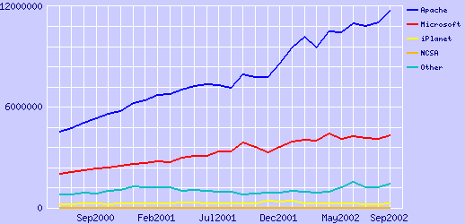
Market Share: Web Servers
Apache 66.04%, IIS 24.18% Active Sites in Sep02 (counting by name; 35.7M sites)
For SSL, Apache 53.97%, IIS 34.85% Sep02

Slide 5
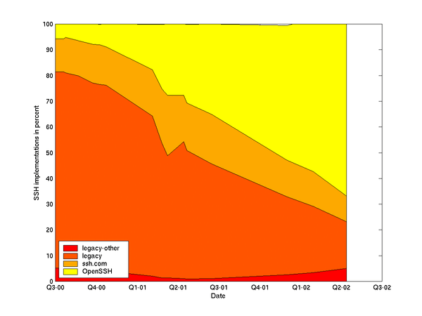
Other Market Share Examples
GNU/Linux #2 webserver OS Jun01
  GNU/Linux 29.6%, Windows 49.6%, BSDs 6.1%
GNU/Linux #2 server OS sold 99, 00, 01 (24%, 27%, 25%)
DNS: bind supports 95% of reverse-lookups
PHP #1 server-side scripting language
Sendmail #1 Email server
  Sendmail 42%, Microsoft Exchange 18%
OpenSSH #1 SSH (66.8% Apr02)
Trivial desktop share
  But usable OSS/FS apps just became available in 2002

Slide 6
Reliability
Fuzz studies found OSS/FS applications significantly more reliable
  Proprietary Unix failure rate: 23%
  OSS/FS: Slackware Linux 9%, GNU utilities 6%
  Windows: 45%; 100% for random Win32 messages
GNU/Linux vs. Windows NT 10-month study:
  NT crashed every 6 weeks, GNU/Linuxes, never
IIS web servers >2x downtime of Apache

Slide 7
Performance
TPC-C: GNU/Linux faster than Windows
PC Magazine: GNU/Linux with Samba faster fileserving at Windows' own file protocols
  Nov 2001, top end, 130MB/sec vs. 78MB/sec
  April 2002, performance 2x; 4x many clients
Sys Admin: GNU/Linux faster than Solaris on Intel, FreeBSD, Windows 2000 (all untuned)
  Email: 1.3M emails/hour, 1, 0.9, 0.9
  Disk I/O: 542s, 3990, 2398, 613

Slide 8
Scalability
GNU/Linux and NetBSD support more hardware platforms & performance ranges
  PC hardware, PDAs, mainframes, clusters, supercomputers
OSS/FS can develop large software systems
  Red Hat Linux 7.1 had 30million SLOC
  Represents approximately 8,000 person-years
  To re-develop proprietary, $1 Billion USD

Slide 9
Security
J.S. Wurzler hacker insurance costs 5-15% more for Windows instead of Unix or Linux
Windows websites disproportionately defaced
  Defaced: 66% Windows, 17% GNU/Linux
  Systems: 49.6% Windows, 29.6% GNU/Linux
Bugtraq vulnerability: Smallest is OpenBSD, Windows largest (Don't double-count!)
Worst vulnerabilities: Apache 0, IIS 8
(Jun98-Jun01)
OSS/FS not invulnerable!

Slide 10
Total Cost of Ownership
OSS/FS costs less to acquire
  E.G., Web server, Windows $3610 vs. $156
Other facts lower costs
  Lower upgrade costs, can use cheaper hardware
  Avoids license management/suits/litigation
Cybersource: TCO 24%-34% less w/OSS/FS
InfoWorld: 60% CTOs >$50K/yr savings; 32% CTOs > $250K/yr savings

Slide 11
Non-Quantitative
To many, non-quantitative advantages of OSS/FS are more important
  Social/ethical/moral reasons
  Avoids risks of single source solutions
  Avoids security risks of monocultures
  Avoids license management and litigation
  Supports domestic IT infrastructure
  Many believe it encourages innovation
  Greater flexibility

Slide 12
Conclusions
Many, many cases where OSS/FS programs have a measurable advantage over proprietary competition
Consider using OSS/FS software when acquiring software

Slide 13
Backup Slides

Slide 14
GNU/Linux on the Desktop?
GNU/Linux: 1.7% or 3.8% client OS, 2002
  Useful OSS/FS basic applications were unavailable
  GNU/Linux+proprietary basic apps has no advantages: still proprietary, can't run most apps
Situation Changed in 2002:
  Useful OSS/FS basic applications became available in 2002 (Open Office, Mozilla,...)
  Microsoft raised prices (76% cost up 20%-300%)
  Governments re-emphasize want open systems
If GNU/Linux ran Windows apps, 58% switch immediately + 25% switch within a year [ZDNet survey]

Slide 15
Unnecessary Fears
Proprietary software better supported? No.
  Non-traditional support (email, etc.)
  Pay for traditional support, and can compete it
Proprietary more legal rights? No.
  Who do you sue? Nobody, in either case
OSS/FS economically viable? Yes.
  Many business models
  Customers can band together

Slide 16
Unnecessary Fears
Will programmers starve? No.
  Estimated 95% software not developed for sale
  Companies hire programmers to make changes for themselves
OSS/FS compatible with capitalism? Yes.
OSS/FS mean no competition? No
  KDE vs. GNOME, emacs vs. vim

Slide 17
Unnecessary Fears
Will OSS/FS destroy intellectual property? No.
  Usually, complaint is about GPL
  GPL trades you the right to freely incorporate their code into your software in exchange for the right to freely incorporate your code [which incorporates their code] into theirs
  Intellectual property traded for other intellectual property
  Microsoft sells GPL'ed software

Slide 18
Unnecessary Fears
Viewing and changing source code valuable for non-programmers? Surprisingly, yes.
  Would you buy a car with the hood welded shut? If not, what do you know about modern engine technology?
  Consumers demand this so they can have control over their products, instead of dealers
Anti-Microsoft campaign? No.
  Jun02, 831 projects Visual Basic; 8867 projects work on Windows
  Microsoft sells GPL'ed software

