Slide 1
Open Source Software (OSS) and Security
David A. Wheeler
March 15, 2004
This presentation contains the views of the author and does not indicate endorsement by IDA, the U.S. government, or the U.S. Department of Defense.

Slide 2
Outline
Extreme claims
Open design: A security fundamental
Problems with hiding source & vulnerability secrecy
Proprietary advantages… not necessarily
Common criteria evaluation challenges
OSS bottom line

Slide 3
Extreme claims
Extreme claims
  “OSS is always more secure”
  “Proprietary is always more secure”
Reality: Neither OSS nor proprietary always better

Slide 4
Open design:
A security fundamental
Saltzer & Schroeder [1974/1975] - Open design principle
OSS better fulfills this principle
Security experts perceive OSS advantage
  Bruce Schneier, Vincent Rijmen (AES), Whitfield Diffie, ...

Slide 5
Problems with hiding source & vulnerability secrecy
Hiding source doesn’t halt attacks
  Dynamic attacks
  Static attacks (binaries, disassemblers, decompilers)
  Can’t keep source secret
  Inhibits help
Vulnerability secrecy doesn’t halt attacks
  Rediscovery
  Days works, not years

Slide 6
Proprietary advantages… not necessarily
Experienced developers who understand security produce better results
Proprietary developers higher quality?
No guarantee OSS is widely reviewed

Slide 7
Common Criteria and OSS
Common Criteria (CC) can be used on OSS
CC matches OSS imperfectly
Government policies discriminate against OSS

Slide 8
OSS bottom line
OSS security preconditions
  Developers/reviewers need security knowledge
    Knowledge more important than licensing
  People have to actually review the code
  Problems must be fixed
OSS: less secure, later more secure (~yr)
Neither OSS nor proprietary always better
Notes:
Username “politically” passowrd “correct” was a major Interbase backdoor, hidden for years when it was proprietary, and found quickly soon after it was releaesd as OSS. It’s not known if, or how widely, this was exploited before it was revealed.

Slide 9
Detailed Slides

Slide 10
Outline
Extreme claims
Open design: A security fundamental
Problems with hiding source & vulnerability secrecy
Proprietary advantages… maybe
Common criteria evaluation challenges
OSS bottom line

Slide 11
Extreme claims
Extreme claims
  “OSS is always more secure”
  “Proprietary is always more secure”
Reality: Neither OSS nor proprietary always better

Slide 12
Open design:
A security fundamental
Saltzer & Schroeder [1974/1975] - Open design principle
  the protection mechanism must not depend on attacker ignorance
OSS better fulfills this principle
Security experts perceive OSS advantage
  Bruce Schneier: “demand OSS for anything related to security”
  Vincent Rijmen (AES): “forces people to write more clear code & adhere to standards”
  Whitfield Diffie: “it’s simply unrealistic to depend on secrecy for security”

Slide 13
Problems with hiding source & vulnerability secrecy
Hiding source doesn’t halt attacks
  Dynamic attacks don’t need source or binary
  Static attacks can use pattern-matches against binaries, disassembled & decompiled results
  Presumes you can keep source secret
    Attackers may extract or legitimately get it
  Secrecy inhibits those who wish to help, while not preventing attackers
Vulnerability secrecy doesn’t halt attacks
  Vulnerabilities are a time bomb and are likely to be rediscovered by attackers
  Brief secrecy works (10-30 days), not years

Slide 14
Proprietary advantages… not necessarily
Experienced developers who understand security produce better results
  Experience & knowledge are critical, but...
  OSS developers often very experienced & knowledgeable too (BCG study: average 11yrs experience, 30 yrs old)
Proprietary developers higher quality?
  Dubious; OSS often higher reliability
  Market rush impairs proprietary quality
No guarantee OSS is widely reviewed
  True! & unreviewed OSS may be very insecure
  Also true for proprietary (rarely reviewed!)

Slide 15
Common Criteria and OSS
Common Criteria (CC) can be used on OSS
  Red Hat Linux, SuSE Linux (FIPS 140-2: OpenSSL)
CC matches OSS imperfectly
  CC developed before rise of OSS
  Doesn’t credit mass peer review or detailed code review
  Requires mass creation of documentation not normally used in OSS development
Government policies discriminate against OSS
  Presume that vendor will pay hundreds of thousands or millions for a CC evaluation (“big company” funding)
    Presumes nearly all small business & OSS insecure
  Presume that “without CC evaluation, it’s not secure”
  Need to fix policies to meet real goal: secure software
    Government-funded evaluation for free use/support?
    Multi-Government funding?
    Alternative evaluation processes?

Slide 16
OSS bottom line
OSS security preconditions
  Developers/reviewers need security knowledge
    Knowledge more important than licensing
  People have to actually review the code
    Reduced likelihood if niche/rarely-used, few developers, rare computer language, not really OSS
    More contributors, more review
  Problems must be fixed
OSS: less secure, later more secure (~yr)
  Borland InterBase/Firebird (user: politically)
Neither OSS nor proprietary always better
Notes:
Username “politically” passowrd “correct” was a major Interbase backdoor, hidden for years when it was proprietary, and found quickly soon after it was releaesd as OSS. It’s not known if, or how widely, this was exploited before it was revealed.

Slide 17
Backup Slides

Slide 18
Basics of Open Source Software (OSS) / Free Software (FS)
Open Source Software / Free Software (OSS/FS) programs have licenses giving users the freedom:
  to run the program for any purpose,
  to study and modify the program, and
  to freely redistribute copies of either the original or modified program (without royalties, etc.)
Not non-commercial, not necessarily free-of-charge
  Often supported via commercial companies
Synonyms: Libre software, FLOS software (FLOSS)
Antonyms: proprietary software, closed software

Slide 19
Extreme claims
(and counterexamples)
“OSS is always more secure”
  Counterexample: Sendmail
“Proprietary is always more secure”
  Counterexample: Windows & IIS
  Vulnerabilities: Apache 0, IIS 8 over 3yrs
  J.S. Wurzler hacker insurance costs 5-15% more for Windows than for Unix or Linux
  Windows websites more vulnerable
Category
Proprietary
OSS/FS
Defaced
66% (Windows)
17% (GNU/Linux)
Deployed Systems
49.6% (Windows)
29.6% (GNU/Linux)
Deployed websites (by name)
24.81% (IIS)
66.75% (Apache)

Slide 20
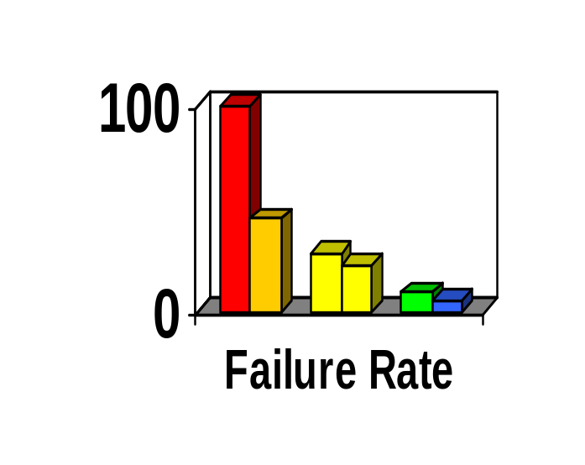
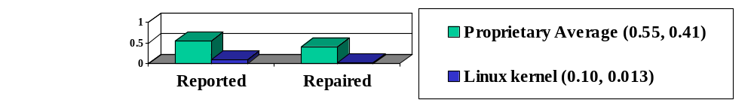
Reliability
Fuzz studies found OSS/FS apps
significantly more reliable [U Wisconsin]
  Proprietary Unix failure rate: 28%,23%
  OSS/FS: Slackware Linux 9%, GNU utilities 6%
  Windows: 100%; 45% if forbid certain Win32 message formats
GNU/Linux vs. Windows NT 10 mo study [ZDNet]
  NT crashed every 6 weeks; both GNU/Linuxes, never
IIS web servers >2x downtime of Apache [Syscontrol AG]
Linux kernel TCP/IP had smaller defect density [Reasoning]
Notes:
Reliability
Fuzz
GNU/Linux
Windows
Crash
Downtime
TCP/IP
Defect
Defect density

Slide 21
OSS/FS Development Model
Improvements (as source code) and evaluation results: User as Developer
Developer
Trusted
Developer
Bug Reports
Trusted
Repository
Source Code →
Distributor
User
“Stone soup development”
OSS/FS users typically use software without paying licensing fees
OSS/FS users typically pay for training & support (competed)
OSS/FS users are responsible for developing new improvements &
any evaluations that they need; often cooperate/pay others to do so
Notes:
Development model
User
User as developer
Developer
Trusted developer
Trusted repository
Distributor
Stone soup development
Source code
Licensing fees
Training
Support
Evaluations
Improvements
Cooperate

Slide 22
Acronyms
COTS: Commercial Off-the-Shelf (either proprietary or OSS)
DoD: Department of Defense
HP: Hewlitt-Packard Corporation
JTA: Joint Technical Architecture (list of standards for the DoD); being renamed to DISR
OSDL: Open Source Development Labs
OSS: Open Source Software
RFP: Request for Proposal
RH: Red Hat, Inc.
U.S.: United States
Trademarks belong to the trademark holder.

Slide 23
Interesting Documents/Sites
“Why OSS/FS? Look at the Numbers!” http://www.dwheeler.com/oss_fs_why.html
“Use of Free and Open Source Software in the US Dept. of Defense” (MITRE, sponsored by DISA)
President's Information Technology Advisory Committee (PITAC) -- Panel on Open Source Software for High End Computing, October 2000
“Open Source Software (OSS) in the DoD,” DoD memo signed by John P. Stenbit (DoD CIO), May 28, 2003
Center of Open Source and Government (EgovOS) http://www.egovos.org/
OpenSector.org http://opensector.org
Open Source and Industry Alliance http://www.osaia.org
Open Source Initiative http://www.opensource.org
Free Software Foundation http://www.fsf.org
OSS/FS References http://www.dwheeler.com/oss_fs_refs.html

