Slide 1
Introduction to Metamath-lamp
Part 1
David A. Wheeler
2023-06-24
This presentation is released under the Creative Commons Attribution 4.0 International License (CC BY 4.0)
Notes:
For more information on the license, see https://creativecommons.org/licenses/by/4.0/
You are free to:
* Share — copy and redistribute the material in any medium or format
* Adapt — remix, transform, and build upon the material for any purpose, even commercially.
The licensor cannot revoke these freedoms as long as you follow the license terms.
Under the following terms:
* Attribution — You must give appropriate credit, provide a link to the license, and indicate if changes were made. You may do so in any reasonable manner, but not in any way that suggests the licensor endorses you or your use.
* No additional restrictions — You may not apply legal terms or technological measures that legally restrict others from doing anything the license permits.

Slide 2
What are Metamath &
Metamath-lamp?
“Metamath is a simple and flexible computer-processable language that supports rigorously verifying, archiving, and presenting mathematical proofs.”*
  Extremely simple – not tied to any axioms
    Database = text file of axioms & proven theorems; most popular is “set.mm”
  Metamath proofs’ steps are only axioms or previously-proved theorems (!)
  Many tools support Metamath; doesn’t require a "canonical" tool
  Proofs stay proven
  Metamath is a top system in Formalizing 100 Theorems challenge
Metamath-lamp: A proof assistant for Metamath
  Don’t need to install anything – just use your web browser
  Works well on smartphones
  Open source software (MIT license)
* Metamath Home Page, https://us.metamath.org
Notes:
“Mathematicians are human; they can make mistakes. A verifier greatly increases the likelihood that a proof is correct, & also reveals the steps that traditional approaches hide.
For comparison, see “the next generation of proof assistants” by Freek Wiedijk, 2010-08-31
http://www.cs.ru.nl/~freek/talks/lsfa.pdf
For more comparisons see other works by Freek Wiedijk

Slide 3
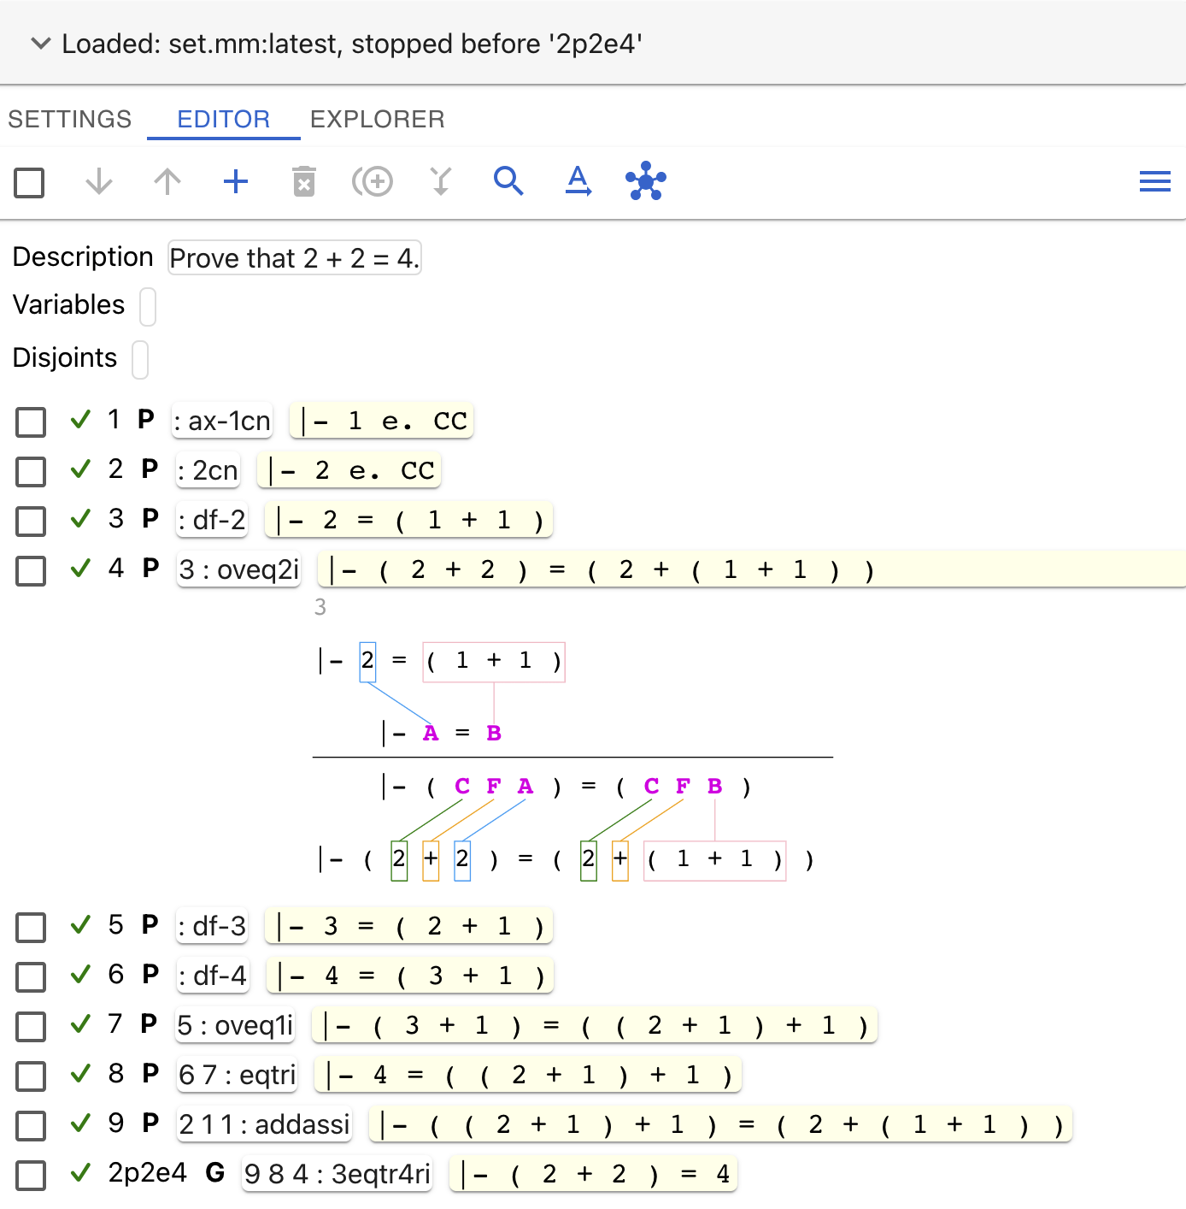
Metamath-lamp Screenshot
Context (which database?)
Tab bar
Editor command icon bar
Fundamental proof information
Proof steps
Can generate visualizations
Documentation available at https://lamp-guide.metamath.org

Slide 4
Formula syntax
Produces HTML or TeX, with traditional symbols
To edit, typically must use ASCII representation
In set.mm (most common database), infix expressions must be surrounded by parentheses
  Function application is the infix operator `
  Exception: Predicates with class parameters, e.g., =, ≠ ∈
|-
⊢
Turnstile; “Proves…”; “It’s true that…”
ASCII
Traditional
Meaning
e.
∈
“is element of...”
=/=
≠
not equal to
/\
∧
and
\/
∨
or
->
→
Implication; “if … then ...”
CC
ℂ
Set of complex numbers

Slide 5
Variables
ASCII | Traditional | Meaning
ph, ps, ch, th, ... | φ, ψ, χ, θ, ... | Wff (well-formed formula). Sequence of 1+ symbols that evaluates to true or false
A, B, C, D, ... | A, B, C, D, ... | Class variable. Sequence of 1+ symbols that may or may not represent a set (object). Numbers are sets!
x, y, z, w, ... | x, y, z, w, ... | Set variable; substitutions must be a set variable
In some cases, may need to declare that variables are distinct (see documentation)

