Slide 1
SWE 681 / ISA 681
Secure Software Design & Programming:
Lecture 3: Low-level attacks
(Buffer overflow and friends)
Dr. David A. Wheeler
2024-07-29

Slide 2
Outline
Memory safety is important
Buffer overflow (a kind of memory safety problem)
  What’s a buffer overflow?
  How do attackers exploit buffer overflows?
  Potential solutions
Related memory safety & low-level issues
  Improper Restriction of Op’s within the Bounds of a Memory Buffer
  Format strings
  Double-frees
Hash collisions
  We must drill down to how computer systems work at the assembly code level.
  Only then can we really understand (1) how buffer overflows are exploited,
  and (2) the pros & cons of potential solutions

Slide 3
Abstract view of a program
Program
Process Data
(Structured Program Internals)
Input
Output
You are here
Call-out to
other programs
(also consider
input & output issues)

Slide 4
Memory safety
Memory safety is:
  “the state of being protected from [bugs and vulnerabilities] when dealing with memory access, such as buffer overflows and dangling pointers.” [Wikipedia]
  “an entity [that] (1) never references a memory location outside the address space allocated by or for that entity, and (2) never executes instructions outside the code areas created by the compiler & linker…” [Dhurjati 2003]
E.g., a program is memory unsafe if it can:
  Read or write out-of-bounds memory (e.g., buffer overflows)
  Read or write memory after deallocation (“use after free”)
Notes:
Wikipedia: https://en.wikipedia.org/w/index.php?title=Memory_safety&oldid=1172149640 retrieved 2023-09-10
Dhurjati, Dinakar; Kowshik, Sumant; Adve, Vikram; Lattner, Chris (1 January 2003). "Memory safety without runtime checks or garbage collection" (PDF). Proceedings of the 2003 ACM SIGPLAN conference on Language, compiler, and tool for embedded systems. ACM. pp. 69–80. doi:10.1145/780732.780743. ISBN 1581136471. S2CID 1459540. Retrieved 13 March 2017.

Slide 5
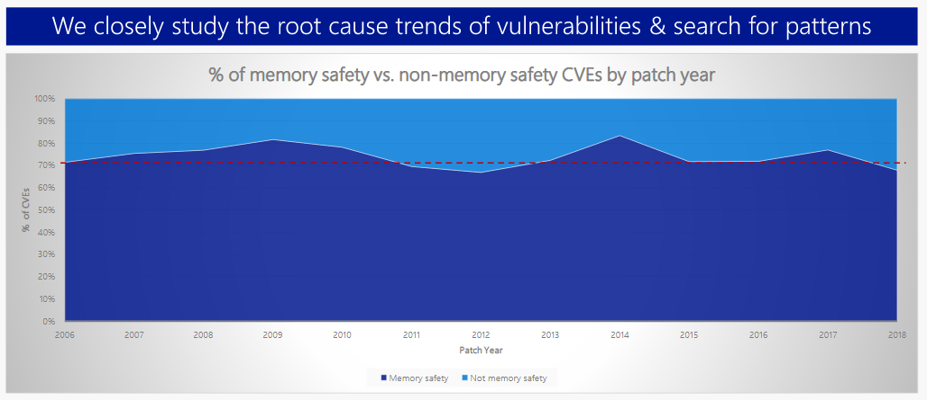
70% of Microsoft’s vulnerabilities are memory safety issues
~70% of Microsoft vulnerabilities 2006-2018 memory safety issues
Source: “Microsoft: 70 percent of all security bugs are memory safety issues” by Catalin Cimpanu, 2019-02-11,
https://www.zdnet.com/article/microsoft-70-percent-of-all-security-bugs-are-memory-safety-issues/

Slide 6
Memory safety is a big problem elsewhere, too
60-70% of vulnerabilities in iOS and macOS are memory safety vulnerabilities.
Google estimated that 90% of Android vulnerabilities are memory safety issues
In 2020, a team at Google reported 70% of all "severe security bugs" in Google Chromium were caused by memory safety problems
An analysis of 0-days that were discovered being exploited in the wild found that more than 80% of the exploited vulnerabilities were memory safety issues
Source: https://www.memorysafety.org/docs/memory-safety/
Notes:
Wikipedia: https://en.wikipedia.org/w/index.php?title=Memory_safety&oldid=1172149640 retrieved 2023-09-10

Slide 7
Memory safety:
The problem is C and C++
Almost all programming languages are memory-safe
  Including Ada, Bourne shell (including bash), C#, D, Dart, Delphi/Object Pascal, Fortran, Go, Haskell, Java, JavaScript, Julia, Lisp, Logo, MATLAB, Objective-C, PHP, Perl, Powershell, Prolog, Python, R, Ruby, Rust, SQL, Scala, Scratch, Visual Basic .NET, Visual Basic Classic
  Compiler warning and/or runtime exception for memory safety error
  Some have “escape valves” that briefly disable memory safety; that’s fine if they’re designed so it’s rarely needed/used
  Memory safety isn’t usually a problem for web apps; they’re typically written in memory safe languages
A very few languages are not memory safe
  C, C++, Objective-C, Vala, Forth, assembly language
  C & C++ extremely common, leading to massive problems for those who have a lot of C and/or C++ code

Slide 8
Other languages don’t give immunity to memory safety issues
Some languages/compilers allow disabling protection (review those parts carefully)
  Including languages Rust, C#, and Ada
Most language implementations are in C/C++
Many libraries/components/OSs include C/C++ components inside them
  It’s nearly impossible to not have some C or C++
Choosing a memory-safe language helps – but not completely

Slide 9
Does a memory-safe language eliminate all vulnerabilities?
NO
There are many kinds of vulnerabilities that are not related to memory safety
You can have vulnerabilities in any language
However, avoiding memory safety errors in C and C++ is extremely hard in larger programs, leading to endless vulnerabilities

Slide 10
What’s a buffer overflow?
Buffer overflow is a specific kind of memory safety error
Buffer overflow is an event that occurs when :
  Fixed-length data buffer (e.g., string)
  At least one value intended for buffer is written outside that buffer's boundaries (usually past its end)
    Some definitions also include reading outside buffer
Can occur when reading input or later processing data
Buffer overflows = buffer overruns. Subtypes include:
  Stack overrun. Buffer in stack; attack is called “stack smashing”
  Heap overrun. Buffer in heap; attack is called “heap smashing”
Noted in “Computer Security Technology Planning Study” (1972)
Very common problem
If exploitable
  Attacker can often completely control program
  Attacker can typically cause denial-of-service
    Many defenses simply downgrade from “control program” to DoS
Notes:
“Computer Security Technology Planning Study” , James P. Anderson, 1972, page 61: "The code performing this function does not check the source and destination addresses properly, permitting portions of the monitor to be overlaid by the user. This can be used to inject code into the monitor that will permit the user to seize control of the machine." (Page 61)

Slide 11
Buffer overflow incidents
(just a sample!)
1988: Morris worm – took down Internet
  Includes buffer overflow via gets() in fingerd
1998: University of Washington IMAP (mail) server
1999: RSA crypto reference implementation
  Subverted PGP, OpenSSH, Apache’s ModSSL, etc.
2001: Code Red worm – buffer overflow in Microsoft’s Internet Information Services (IIS) 5.0
2003: SQL Slammer worm compromised machines running Microsoft SQL Server 2000
~2008: Twilight hack – unlocks Wii consoles
  Creates an absurdly-long horse name for “The Legend of Zelda: Twilight Princess” that includes a program

Slide 12
Buffer overflows are a particular kind of memory safety problem
Almost all programming languages (even those designed before C) have protections against buffer overflows
  In a few cases they detect & prevent the overflow (e.g., by raising an exception): Ada strings, Pascal
  Most auto-resize the buffer today (or raise exception if they can’t): Java, JavaScript, Python, Ada unbounded_string, etc.
No protections are automatic in C or C++
  If you carefully use C++ you can avoid some problems, but C++ by itself guarantees nothing
  We need to see in detail why this happens in C

Slide 13
First, some C details
\0 termination
C arrays
Trivial C program with buffer overflow

Slide 14
C string \0-termination
C strings terminated with \0 character (byte value 0)
Many operating systems and components built with C
  Interfaces inherit semantic “strings end with \0”
  Some components don’t handle \0 embedded in string gracefully, even language can
  Note that UTF-16/UTF-32 include many byte 0s
Note that \0 takes space – account for it!
  Overwriting can make it appear that string doesn’t end
Formal name is NUL character
  NUL often confused with NULL “null pointer” (different!)
  Sometimes called ASCIIZ, but that’s a mouthful
  Let’s call this character “NIL” or \0 to reduce confusion
H | e | l | l | o | \0

Slide 15
C arrays
C arrays allocate a fixed size of memory
  E.G., for a buffer
  “char” arrays used for string of characters
Arrays should be “long enough”
  For the characters to be stored
  Including the terminating NIL
E.g., “char x[10];” allocates array x
  An array of 10 chars
  Enough to store 9 characters + terminating NIL

Slide 16
Trivial C program with a buffer overflow
#include <stdio.h>
int main(int argc, char* argv[]) {
char command[10]; // Only 10 bytes for command (including termination char)
printf("Your command?\n");
gets(command); // gets provides no protection against buffer overflow
printf("Your command was: %s\n", command);
}
$ ./my-command
Your command? Test
Your command was: Test
$ ./my-command
Your command? ZZZZZZZZZZZZZZZZZZZZZZZZZZZZZZZZZZZZZZZZZZZZZZZZZZZZZZZZZ

Slide 17
How does the attack work?
Need to understand basics of how computer systems work at machine level to understand:
  How buffer overflow attacks work
  How defenses work (including how effective they are)
Following based on “Smashing The Stack For Fun And Profit” by Aleph One (Elias Levy)
  Describes how to exploit buffer overrun on stack
Modern systems are usually more complex
  Many have partial defenses built in – only partial!
  Need to understand the basics first

Slide 18
Notional process memory map
Lower-numbered
addresses
Text (compiled program code)
Often
read-
only
Initialized
global “data”
Set on
code
load
This diagram shows
how stacks grow on
Intel x86s & others;
some grow other way.
Multi-threaded programs
have multiple stacks
Used
for global
constants
& variables
Uninitialized
global “data”
Warning: Some
diagrams elsewhere
show lower-numbered
addresses at the bottom
Heap grows, e.g.,
due to “new” or malloc()
Heap
(dynamically allocated)
Heap pointer
Stack (procedure/ method calls)
Stack pointer (SP)
(current top of stack)
Higher-numbered
addresses
Stack grows, e.g.,
due to procedure call

Slide 19
Abstract data type “Stack”
“Stack”: Abstract Computer Science concept
  “A stack of objects has the property that the last object placed on the stack will be the first object removed. This property is commonly referred to as last in, first out queue” (LIFO).
Minimum stack operations:
  PUSH: Add an element to the top of the stack
  POP: Removes the last element at the top of the stack (returning it) and reduces stack size by one

Slide 20
“Stack” in a process memory map
Memory area set aside to implement calls to a procedure/function/method/subroutine
  For now we’ll use these terms interchangeably
  In C the term is “function”
Stack is used to implement control flow
  When you call a procedure, where it “came from” is pushed on stack
  When a procedure returns, the “where I came from” is popped from stack; system starts running code there
Stack also used for other data (in many cases)
  Parameters passed to procedures
  Procedure local variables
  Return values from procedure

Slide 21
Why use stacks for procedure calls?
First compiled languages (e.g., FORTRAN) did not use stacks
  Stored, with procedure, where program “came from”
  Result: Procedures could not call themselves, directly or indirectly, as that would overwrite stored info
  Extremely limiting, easy to get wrong
If procedures can arbitrarily call other procedures
  Need to store old state so can return back
  Need dynamic allocation for call (frame) sequences
  Stack is flexible & efficient

Slide 22
CPUs typically track two stack values
Stack pointer: Value of “top” of stack
  Where last data was stored on stack, possibly +/- 1 depending on architecture conventions
  Modified when data pushed/popped
    May even be modified during expression calculation
Frame pointer: Value of “this frame”
  Simplifies accessing parameters & local variables
  Points inside stack to where “this procedure” starts
  Modified on entry/exit of a procedure

Slide 23
Calling a procedure
Given this C program:
void main() {
f(1,2,3);
}
The invocation of f() might generate assembly:
  pushl $3 ; constant 3
  pushl $2 ; Most C compilers push in reverse order by default
  pushl $1
  call f
“call” instruction pushes instruction pointer (IP) on stack
  In this case, the position in “main()” just after f(…)
  Saved IP named the return address (RET)
  CPU then jumps to start of “function”

Slide 24
Stack:
After push of value 3
Lower-numbered
addresses
Higher-numbered
addresses
Stack pointer (SP)
(current top of stack)
3

Slide 25
Stack:
After push of value 2
Lower-numbered
addresses
Stack pointer (SP)
(current top of stack)
2
Higher-numbered
addresses
3
Stack grows, e.g.,
due to procedure call

Slide 26
Stack:
After push of value 1
Lower-numbered
addresses
Stack pointer (SP)
(current top of stack)
1
2
Higher-numbered
addresses
3
Stack grows, e.g.,
due to procedure call

Slide 27
Stack:
Immediately after call instruction
Lower-numbered
addresses
Return address in main()
Stack pointer (SP)
(current top of stack)
1
2
Higher-numbered
addresses
3
Stack grows, e.g.,
due to procedure call

Slide 28
Function prologue
Imagine f() has local variables, e.g. in C:
void f(int a, int b, int c) {
char buffer1[5];
char buffer2[10];
strcpy(buffer2, "This is a very long string!!!!!!!");
}
Typical x86-32 assembly on entry of f() (“prologue”):
pushl %ebp ; Push old frame pointer (FP)
movl %esp,%ebp ; New FP is old SP
subl $20,%esp ; New SP is after local vars
; “$20” is calculated to be >= local var space
In the assembly above, “;” introduces a comment to end of line

Slide 29
Stack:
Immediately after call instruction
Lower-numbered
addresses
Return address in main()
Stack pointer (SP)
(current top of stack)
1
2
Higher-numbered
addresses
3
Stack grows, e.g.,
due to procedure call

Slide 30
Stack:
After prologue
Lower-numbered
addresses
Stack pointer (SP)
(current top of stack)
Local array “buffer2”
Local array “buffer1”
Frame pointer (FP) –
use this to access
local variables &
parameters
Saved (old) frame pointer
Return address in main()
1
2
Higher-numbered
addresses
3
Stack grows, e.g.,
due to procedure call

Slide 31
Stack:
Overflowing buffer2
Lower-numbered
addresses
Stack pointer (SP)
(current top of stack)
Local array “buffer2”
Local array “buffer1”
Overwrite
Frame pointer (FP) –
use this to access
local variables &
parameters
Saved (old) frame pointer
Return address in main()
1
2
Higher-numbered
addresses
3
Stack grows, e.g.,
due to procedure call

Slide 32
What happens if we write past the end of buffer2?
Overwrites whatever is past buffer2!
  As you go further, overwrite higher addresses
Impact depends on system details
In our example, can overwrite:
  Local values (buffer1)
  Saved frame pointer
  Return value (changing what we return to)
  Parameters to function
  Previous frames

Slide 33
Common buffer overflow attack
Send data that is too large, or will create overlarge data
Overlarge data overwrites buffer
  Modifies return value, to point to something the attacker wants us to run
  Maybe with different parameters, too
On return, runs attacker-selected code
But it gets worse…

Slide 34
Inserting code in the buffer overflow attack (e.g., shell code)
Attacker can also include machine code that they want us to run
If they can set the “return” value to point to this malicious code, on return the victim will run that code
  Unless something else is done
Significant portion of “Smashing the Stack” paper describes how to insert such code

Slide 35
Stack:
One possible result after attack
Lower-numbered
addresses
Stack pointer (SP)
(current top of stack)
Local array “buffer2”
Malicious code
Local array “buffer1”
Frame pointer (FP) –
use this to access
local variables &
parameters
Saved (old) frame pointer
Return address in main()
Ptr to malicious code
1
2
Higher-numbered
addresses
3
Stack grows, e.g.,
due to procedure call

Slide 36
Stack:
One possible result after attack
Lower-numbered
addresses
Stack pointer (SP)
(current top of stack)
Local array “buffer2”
NOP sleds let attacker jump anywhere to attack; real ones often more complex (to evade detection)
NOP sled: \x90\x90\x90\x90\x90….
Shellcode: \xeb\x1f\x5e\x89\x76\x08\x31\xc0\x88\x46\x07\x89\x46\x0c\xb0\x0b\x89\xf3\x8d\x4e\x08\x8d\x56\x0c\xcd\x80\x31\xdb\x89\xd8\x40\xcd\x80\xe8\xdc\xff\xff\xff/bin/sh
Local array “buffer1”
Frame pointer (FP) –
use this to access
local variables &
parameters
Shellcode often has odd constraints, e.g., no byte 0
Saved (old) frame pointer
Return address in main()
Ptr to malicious code
1
2
Higher-numbered
addresses
3
Stack grows, e.g.,
due to procedure call

Slide 37
Other types of attacks possible with a stack buffer overflow
Make “return” point to existing code that the attacker wants us to run now
  E.G., invoke a shell, debug code
  Perhaps modify parameters
Change value of adjacent local variables
Change value of parameters
... and so on

Slide 38
On “Smashing the stack…”
Please read for understanding
Our goal is not to actually perform the attack, so skim those details
  Don’t need to create assembly code!
  Don’t need to be able to create exploit
Understand that overwriting past the end of a buffer can have devastating consequences
  Details depend on details of system
  Yes, attackers really do understand this

Slide 39
Smashing elsewhere
“Heap” contains dynamically-allocated data
  “new” (Java/C++), malloc (C), etc.
“Data” contains global data
  Including key infrastructure control values
If attacker can overwrite beyond buffer, can control other values (e.g., stored afterwards)
  Values of other structures
  Heap: Heap maintenance data (e.g., what’s free/used)
  Even 1 character overwrite can be devastating
Details are system-dependent
  But attackers can typically exploit them too
  Basic issue same as smashing the stack

Slide 40
Obvious solution in C
“Obvious” solution when using C is to always check bounds
However…

Slide 41
Many C functions don’t check bounds (examples)
gets(3) – reads input without checking. Don’t use it!
strcpy(3) – strcpy(dest, src) copies from src to dest
  If src longer than dest buffer, keeps writing!
strcat(3) – strcat(dest, src) appends src to dest
  If src + data in dest longer than dest buffer, keeps writing!
scanf() family of input functions – many dangerous options
  scanf(3), fscanf(3), sscanf(3), vscanf(3), vsscanf(3), vfscanf(3)
  Many options don’t control max length (e.g., bare “%s”)
Many other dangerous functions, e.g.:
  realpath(3), getopt(3), getpass(3)
  streadd(3), strecpy(3), and strtrns(3)
It’s not just functions; ordinary loops can overflow

Slide 42
And C’s integer overflow semantics make overflow more likely
Integers in C (and many other languages) use a fixed maximum number of bits
  Unsigned integers if exceeded wrap around to 0
  Signed integers, if exceeded, are undefined; anything or nothing is possible. Many compilers have a nonstandard mode to wrap around to negatives
  C/C++ give no warning/exception
Buffer size calculations’ integers can wrap!
  This can make buffer overflow attacks even more likely... and more dangerous
  Calculate, then check resulting value before use

Slide 43
Two alternatives: Bounds-checking & resize automatically
Bounds-checking to stop overwrite; then if oversized:
  Stop processing input
    Reject and try again, or even halt program (turns into DoS)
  Truncate data. Common approach, but has issues:
    Terminates text “in the middle” at place of attacker’s choosing
    Can strip off critical data, escapes, etc. at the end
    Can break in the middle of multi-byte character
      UTF-8 character can take many bytes
      UTF-16 usually 2 bytes/character, but not if it’s outside BMP
    Way better to truncate than to allow easy buffer overflow attack
    Some routines truncate & return indicator so you can stop processing input
  If bounds-checking, best to truncate & then handle overflow as error
Resize automatically (move string if necessary)
  This is what most languages do automatically (other than C)
  Must deal with “too large” data
  C: Requires more code changes/complexity in existing code
  C/C++: Dynamic allocation manual, so new risks (double-free)

Slide 44
Solution 1: Traditional C solutions (bounds-checking routines)
Depend mostly on strncpy(3), strncat(3), sprintf(3), snprintf(3)
  First three are especially hard to use correctly
char *strncpy(char *DST, const char *SRC, size_t LENGTH)
  Copy string of bytes from SRC to DST
  Up to LENGTH bytes; if less, NIL-fills
char *strncat(char *DST, const char *SRC, size_t LENGTH)
  Find end of string in DST (\0)
  Append up to LENGTH characters in SRC there
int sprintf(char *STR, const char *FORMAT, ...);
  FORMAT is a mini-language that defines what to write
  Results put into sprintf
  FORMAT can include length control information
int snprintf(char *STR, const char *FORMAT, ...);

Slide 45
Solution 1: Traditional C solution - Strncpy/strncat problems
Hard to use correctly
  Do not NIL-terminate the destination string if the source string length is at least equal to the destination’s
    So often need to write a NIL afterwards to make sure it’s there
  strncat must be passed the amount of space left available, a computation easy to get wrong
  Neither have simple signal of an overflow
strncpy(3) has big performance penalty vs. strcpy(3)
  strncpy(3) NIL-fills remainder of the destination
  Big performance penalty, typically for no good reason
Like all bounds-checking, can terminate “in the middle”
  Leading to potentially malformed data
  Yet difficult to detect when it happens

Slide 46
Solution 1: Traditional C solution – sprintf problems
Use sprintf’s format string to set maximum
  Can set string “precision” field to set maximum length
  E.G. "%.10s" means “<= 10 bytes” (notice “.”)
    NIL written… unless it’s maximum size ☹
    So you need to write the NIL afterwards, & everyone forgets it
  Beware: "%10s" (without “.”) sets min field width
    Useless for preventing buffer overflow
  If the size is given as a precision of "*", then you can pass the maximum size as a parameter
    sprintf(dest, "%.*s", maxlen, src);
  Controls sizes of individual parameters
Easy to get wrong, hard to get right

Slide 47
Solution 1: Traditional C solution – snprintf (easier bounds-checking)
int snprintf(char * s, size_t n, const char * format, ...);
  Writes output to buffer “s” up to n chars (no easy buffer overflow)
  Always writes \0 at end if n>=1 (hooray!)
  Must provide format string for even trivial cases, don’t let attacker control format string
  Returns “length that would have been written” or negative if error, so result-checking can be slightly annoying
  Even if “n” is short & data source long, it will keep reading input to its end (to determine the return value).
  This can be inefficient or a security problem if an input string is long or not necessarily \0-terminated (since it always reads to end)
One of the best solutions for fixed-buffer, traditional C
Sample:
  len = snprintf(buf, buflen, "%s", original_value);
  if (len < 0 || len >= buflen) … // handle error/truncation

Slide 48
Solution 1: Traditional C solution (continued): snprintf + precision
What if you want to limit the output, detect truncation, and limit the number of bytes read?
  snprintf usually keeps reading (to report its return value)
Good traditional option is snprintf and precision spec
Sample:
  len = snprintf(dest, destsize, "%.*s", (int) srcsize, src)
  if (len < 0 || len >= buflen) … // handle error/truncation
Notes:
  You need the “(int)” – easily forgotten
  “src” need not be \0-terminated, it’ll stop reading after “srcsize” bytes (and \0-terminate the destination)
  In some circumstances can use destsize as srcsize
  If need to determine if src lacks \0, may need to check specially

Slide 49
Solution 2: strlcpy/strlcat
(bounds-checking)
Simple routines for writing “no more than X bytes”
  Easier to use correctly than strncpy/strncat
  E.G., Always \0-terminates if dest has any space
  strlcpy doesn’t \0-fill, unlike strncpy (good!)
  Easy to detect if terminates “in the middle”
    Returns “bytes would have written” like snprintf
  Usage: if (strlcpy(dest, src, destsize) >= destsize) … // truncation!
  From OpenBSD developers
However
  Truncates “in the middle” like traditional functions – doesn’t resize
    Check if truncation matters to you (at least it’s easy to check)
  Keeps reading from input even after dest size filled, like snprintf
    That’s a problem if src not \0-terminated!
  Strlcat has to find end-of-string (“Schlemeil the painter”) – not normally issue
  Only two routines; many others are troublesome
  Not universally available

Slide 50
Solution 3: C++ std::string class (resize)
If using C++, avoid using char* strings
Instead, use std::string class
  Automatically resizes
  Avoids buffer overflow
However, beware of conversion
  Often need to convert to char* strings
    E.g., when interacting with other systems
  Once converted, problems return
  Conversion is automatic
Doesn’t help C (C++ only)

Slide 51
Solution 4: asprintf / vasprintf
(resizing)
asprintf() and vasprintf() are analogs of sprintf(3) and vsprintf(3), except auto-allocate a new string
  int asprintf(char **strp, const char *fmt, ...);
  int vasprintf(char **strp, const char *fmt, va_list ap);
  Pass pointer to free(3) to deallocate
  Returns # of bytes “printed”; -1 if error
Simple to use, doesn’t terminate results in middle (“resize”)
  char *result;
  asprintf(&result, “x=%s and y=%s\n", x, y);
Widely used to get things done without buffer overflows
In POSIX (though not C standard); are in GNU and *BSD (inc. Apple)
  Trivial to recreate on others, e.g., Windows (< 20 LOC)
Wide use can easily lead to memory leaks
FreeBSD sets strp to NULL on error, others don’t

Slide 52
Solution 5: Various other C libraries
Many C libraries have been devised to provide new functions that handle strings gracefully:
  Glib (not glibc): Basis of GTK+, resizable & bounded
  Apache portable runtime (APR): resizable & bounded
  SafeStr
Problem: Not standard, everyone does it differently
  Making it harder to combine code, work with others

Slide 53
Solution 6: C11 Annex K
(bounds-checking)
C11 standard adds bounds-checking interfaces
  Creates “safer” versions of C functions
  Limits lengths of results
E.G., strcpy_s(s1, s1max, s2);
  Copies s2 to s1.
  Doesn’t do “useless NIL” fill
  On error, calls runtime-constraint handler function, controlled by set_constraint_handler_s(). This handler can permit returns
  If it returns, returns 0 if ok, nonzero if a constraint failed
  A key constraint: s1max > strnlen_s(s2, s1max)
Does not automatically resize
Generally unsupported, best to avoid use today

Slide 54
Solution 7: memccpy
(bounds-checking)
POSIX includes memccpy:
  void* memccpy (void* restrict dst, const void* restrict src, int c, size_t n);
  Copies up to n bytes from src to dst until c (e.g. ' \0') is found (which is copied)
  Returns a pointer to just past the copy of the specified character c (avoiding “Schlemeil”)
  Note: You still have to calculate n (# bytes to copy)
Adopted by C standard committee in 2019
Source: Efficient string copying and concatenation in C by Martin Sebor, August 12, 2019, https://developers.redhat.com/blog/2019/08/12/efficient-string-copying-and-concatenation-in-c/

Slide 55
Solution 7: memccpy – efficient & slightly easier, but still painful
Example: copy & concatenate with error-checking:
// dsize is the space *available* in d, including \0
size_t dsize = sizeof(d); // if d is an array
// ...
char *p = memccpy (d, s1, '\0', dsize);
dsize -= (p - d - 1);
if (dsize <= 0) goto overflow; // handle overflow
char *q = memccpy (p - 1, s2, '\0', dsize);
dsize -= (q - (p - 1) - 1);
if (dsize <= 0) goto overflow; // handle overflow
Slightly easier than some other efficient techniques, but still painful

Slide 56
Solution 8: ISO TR 24731-2 (resize)
ISO TR 24731-2 defines some dynamic functions
Can create a “string stream” - a memory buffer instead of an open file
  Can create using fmemopen(), open_memstream(), or open_wmemstream()
  Then can use standard functions such as sprintf(), sscanf(), etc. with them
  Dynamically allocates and resizes as necessary
  “getline” automatically resizes to read a line
Available in some systems (e.g., Linux)

Slide 57
Compilation solutions
Don’t need to modify source code
  But do need source code (recompile it)
Some approaches
  Canary-based
  Libsafe
  Compiler-inserted alternatives (FORTIFY_SOURCE)
  “Address sanitizer” (ASan) to be discussed later
    ASan has a higher performance/memory cost

Slide 58
Canary-based approach
(from Stackguard)
“Stackguard” (Cowan) implemented “canary-based approach”
  Insert “canary” value on stack, located before return value
  Before returning, check that canary untouched
  Make canary hard to forge (random / tricky value)
Adds some overhead on procedure call/return
  Often varying heuristics to determine when to apply
  Overhead relatively low
ProPolice
  Like Stackguard, but also reorders values
GCC -fstack-protector*
  -fstack-protector adds canary if local char array >= N long (N defaults to 8)
  -fstack-protector-strong adds canary in additional cases, e.g., -if local variable address is taken or passed, or if there’s an any array (ChromeOS uses this)
  -fstack-protector-all adds canary to all functions (performance hit!)
Microsoft /GS flag based on stackguard
Notes:
-fstack-protector-strong:
http://www.outflux.net/blog/archives/2014/01/27/fstack-protector-strong/
http://gcc.gnu.org/ml/gcc-patches/2012-06/msg00974.html
http://article.gmane.org/gmane.linux.kernel/1632488

Slide 59
Libsafe (library-level)
Partial defense
Wraps checks around some common traditional C functions. Wrapper:
  Examines current stack & frame pointers
  Denies attempts to write data to stack that overwrite the return address or any of the parameters
Limitations:
  Only protects certain library calls
  Only protects the return address & parameters on stack, e.g., heap overflows are still possible
  Cannot rely on it being there
  Thwarted by some compiler optimizations

Slide 60
-D_FORTIFY_SOURCE=2 (gcc)
GCC’s -D_FORTIFY_SOURCE=2 built into compiler
  Replaces some string/memory manipulation function calls with bounds-checking version & inserts bound
    Documentation lists: memcpy(3), mempcpy(3), memmove(3), memset(3), stpcpy(3), strcpy(3), strncpy(3), strcat(3), strncat(3), sprintf(3), snprintf(3), vsprintf(3), vsnprintf(3), and gets(3)
  Sometimes compile-time check, rest run-time
  Unlike libsafe, has more info on expected bound
Ubuntu & Fedora by default use both ‐D_FORTIFY_SOURCE=2 and -fstack-protector
Notes:
See “man 7 feature_test_macros” of gcc.
https://idea.popcount.org/2013-08-15-fortify_source/

Slide 61
Some Runtime/OS-level defenses
Non-executable stack (cannot execute code in stack)
  Makes program somewhat harder to attack
  Attacker can counter, e.g., set return value to existing code
  Typically per-program: Some programs depend on executable stacks (e.g., to efficiently implement nested procedure thunks)
Address Space Layout Randomization (ASLR)
  Move stack, heap, each library text to “random” locations in memory
  Hardens against attack (e.g., harder to find useful return value)
  Attacker can counter, e.g., with “NOP sled”
    Long sequence of do-nothing, so jumping anywhere there works
  May require PIE compilation, best if per-function sections (-ffunction-sections)
  Some areas hard to randomly move
  Can impose overhead (esp. if every execution randomizes)
  Can create hard-to-find bugs
“Guard pages” after the end of memory allocations
  Useful for heap-based buffers. OpenBSD malloc(), valgrind, electric fence, …
  Can detect accesses that go all the way to guard page, and can rig allocation to make this more likely
See: https://lwn.net/Articles/798913/

Slide 62
Grow stack other way?
Grow stack other direction
  Some CPUs do this natively
  Can implement in software if CPU doesn’t
Does make some attacks harder, but:
  Only affects some attacks on stack
  Some buffers deeper in stack, attack still works
  If not native to CPU, slower & doesn’t integrate with existing code

Slide 63
Countermeasure/ counter-countermeasure
Most modern systems include partial countermeasures against buffer overflow attack
  Randomize locations, etc.
  But these countermeasures are, in general, circumventable by attacker
  Countermeasure/CCM escalation
Best approach, by far, is to ensure code isn’t vulnerable to buffer overflow in first place
  Everything else is second best
  “Easiest” approach: Avoid programming languages (C, C++) and unsafe modes that lack memory safety
    If speed is critical, consider languages like Rust & Ada
    If speed is important, consider languages like Java & C#

Slide 64
Related attacks
Improper Restriction of Op’s within the Bounds of a Memory Buffer (CWE-119)
  The software performs operations on a memory buffer, but it can read from or write to a memory location that is outside of the intended boundary of the buffer
  Buffer overwrites are a special case
Format string attacks
Double-free

Slide 65
Some relevant CWE entries
CWE-118: Improper Access of Indexable Resource ('Range Error')
The software does not restrict or incorrectly restricts operations within the boundaries of a resource that is accessed using an index or pointer, such as memory or files.
CWE-119: Improper Restriction of Op’s within the Bounds of a Memory Buffer
The software performs operations on a memory buffer, but it can read from or write to a memory location that is outside of the intended boundary of the buffer.
CWE-120: Buffer Copy without Checking Size of Input ('Classic Buffer Overflow')
The program copies an input buffer to an output buffer without verifying that the size of the input buffer is less than the size of the output buffer, leading to a buffer overflow.
CWE-125: Out-of-bounds Read
The software reads data past the end, or before the beginning, of the intended buffer.
CWE-787: Out-of-bounds Write
The software writes data past the end, or before the beginning, of the intended buffer.
CWE-121: Stack-based Buffer Overflow
CWE-122: Heap-based Buffer Overflow
Source: Common Weakness Enumeration (CWE) version 2.8
Notes:
This lists some of the CWEs related to buffer overflows. CWE has a parent/child structure, but it’s not always a clean taxonomy. For example, buffer copies are really a kind of out-of-bounds buffer write. A buffer copy on a stack-based buffer overflow really maps to both CWE-120 and CWE-121.

Slide 66
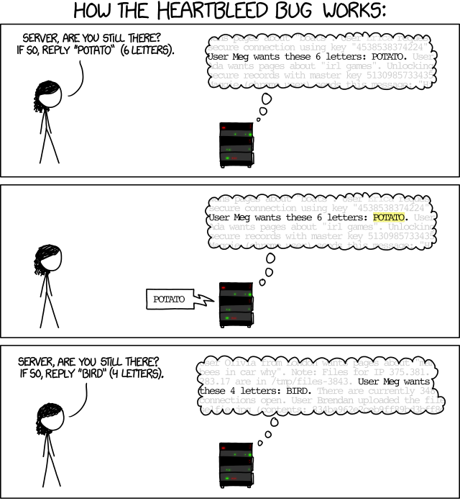
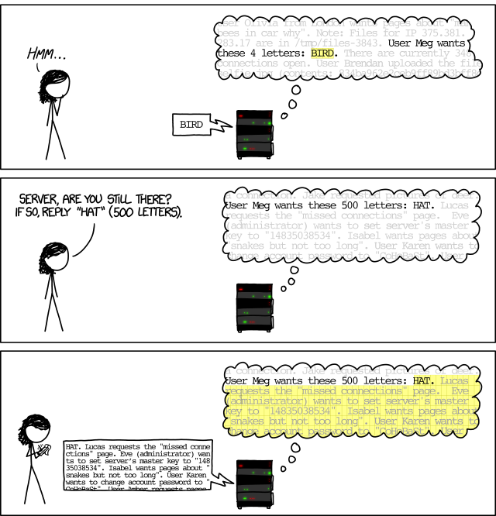
Heartbleed (OpenSSL): An example of failed restriction from reading (CWE-125)
Source: Randall Munroe, XKCD, “Heartbleed Explanation”, https://xkcd.com/1354/
For more on Heartbleed and how it could have been prevented, see David A. Wheeler,
“How to Prevent the next Heartbleed”, http://www.dwheeler.com/essays/heartbleed.html

Slide 67
Format string attacks
printf() family & scanf() family have “format strings”
  Mini-languages to define output/input
  Many programs allow attackers to control the data in this mini-language (yes, that’s stupid)
  Never allow attacker to control format string!
printf() – output formatter
  Attacker can make excess output, ➔ buffer overflow
  Attacker can expose secret data (e.g., canary)
  %n lets attacker overwrite arbitrary memory
scanf() – input formatter
  Attacker can accept too much data, ➔ buffer overflow
  Attacker can determine what data enters system
Related to: CWE-134: Uncontrolled Format String

Slide 68
Double-free
C/C++ do not include automatic garbage collection
  Once done with allocated memory, must manually free it
  More efficient execution, but more work for programmer
  If “free” allocation > once, can corrupt internal data structures
    Leading to subversion
    Like buffer overflow, attacks require detailed knowledge of computers
    Using dynamic allocation to counter buffer overflows creates this risk
  See CWE-415: Double Free, CWE-416: Use After Free
Boehm Garbage Collector (GC) automates but conservative
  May not deallocate memory it “should”
Most other languages include automatic garbage collection & don’t have this problem
  Java, Python, Perl, etc., all have automatic GC
  Ada has manual GC, but need for it is much less

Slide 69
Do not create your own memory allocation system
Some C programs re-implement memory allocation system internally for speed (e.g., “slab allocators”)
But many defensive & testing systems modify/override default memory allocator, e.g., malloc() and new
  E.G., create guard pages afterwards to detect accesses beyond allocated region
  Thus, if you create your own allocation system, these tools will fail to detect problems they’d otherwise detect
Early reports claimed that OpenSSL Heartbleed vulnerability undetected because of this
  Turned out to be untrue, but raised profile of the problem
  http://www.dwheeler.com/essays/heartbleed.html

Slide 70
Address Sanitizer (ASan):
Compilation-time countermeasure
“Address Sanitizer” (ASan) available in LLVM & gcc as “-fsanitize=address”
  Counters buffer overflow (global/stack/heap), use-after-free, & double-free
    Can also detect use-after-return, memory leaks. In rare cases doesn’t detect above list
    Counters some other C/C++ memory issues, but not read-before-write
  73% measured average CPU overhead (often 2x), 2x-4x memory overhead
    Overhead low given how it works, but still significant (hw support could help!)
    Overhead sometimes acceptable overhead, e.g., fuzz testing (Chromium & Firefox)
  More info: http://code.google.com/p/address-sanitizer/
    Esp. “AddressSanitizer: A Fast Address Sanity Checker” by Konstantin Serebryany, Derek Bruening, Alexander Potapenko, & Dmitry Vyukov (Google), USENIX ATC 2012
Uses “shadow bytes” to record memory addressability
  All allocations (global, stack, & heap) aligned to (at least) 8 bytes
  Every 8 bytes of memory’s addressability represented by “shadow byte”
  In shadow byte, 0 = all 8 bytes addressable, 1..7= only next N addressable, negative (high bit) means no bytes addressable (addressability = read or write)
  All allocations surrounded by inaccessible “red zones” (default: 128 bytes)
  Every allocation/deallocation in stack & heap manipulates shadow bytes
  Every read/write checks shadow bytes to see if access ok (hw ~20% instead)
  Strong, but can be fooled if calculated address is in different valid region
    Strengtheners: Delay reusing previously-allocated memory & big red zones

Slide 71
What about moving C/C++ code to another language?
C/C++ are widely-used systems programming languages for performance-critical tasks
  Most languages cannot be a practical substitute
  For performance: Rust, Ada, Fortran
The cost of conversion is high & it takes a long time to gain confidence in the new code
People are doing that in some cases, esp. Rust
  Network parts of curl
  Linux kernel device drivers
  Prossimo <https://www.memorysafety.org/>

Slide 72
Hash collision attacks
Hash function: takes original data, generates fixed-length output data that acts as a shortened reference to the original data
  Collisions are bound to happen, depending on hash function
  Good hash function ideally has a uniform distribution of hash values
Common use: Insertion/lookup/removal of entries in a table
  Naïve (linear) table does all in O(n) average time
  Hash table does all in O(1) average time, O(n) worst case
  Hash tables are the basis of nearly all associative arrays (“dictionaries”) built into many languages
  Used by web servers to store request parameters, clients to store JSON objects, in-memory caching, etc.
  Languages/web frameworks with built-in hash tables include PHP, ASP.NET, Python, Ruby, perl, Apache Tomcat, Apache Geronimo, Jetty, Glassfish, Google’s JavaScript engine, Java, .NET framework, …
If attacker can predict resulting hash value that will be used:
  Can cause large amounts of data to have same hash function result
  Can result in system denial-of-service (DoS), as system “freezes” trying to deal with large number of worst-case scenarios
  Impact less severe than running arbitrary code… but can be serious

Slide 73
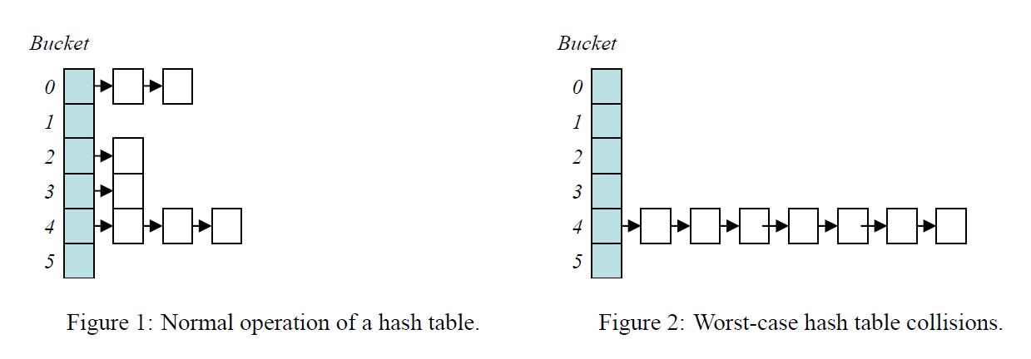
Hash table example
Source: Crosby, Scott A., and Dan S. Wallach.
Denial of Service via Algorithmic Complexity Attacks.
Usenix Security 2003.

Slide 74
Hash collision impact
Klink & Wälde: Not only can you precompute, but you can often calculate “backwards” to make attacks especially easy
One client, 1 Gbit/s connection, can keep busy:
  PHP 5: 10,000 i7 cores
  ASP.NET: 30,000 Core2 cores
  Java + Tomcat 6.0.32: 100,000 i7 cores
  Python + Plone: 50,000 Core2 cores
  Ruby 1.8: 1,000,000 (one million) i7 cores
Source: Klink, Alexander “alech” and Julian “zeri” Wälde.
“Efficient Denial of Service Attacks on Web Application Platforms”.
December 28th, 2011. 28th Chaos Communication Congress.

Slide 75
Some hash collision countermeasures
Randomized hash function
  Typically best approach, but adds overhead, makes non-deterministic, & in many cases must be done at language implementation level
  “Universal hash function” is an especially efficient hash function for use in adverse environment by a language infrastructure
  Cryptographic hashes typically don’t help by themselves
    If map to small number of buckets, attacker can still just precompute
Use another data structure (e.g., treemaps) for mapping user data in app that isn’t vulnerable to a predictable worst-case situation
Limit the number of worst-case situations in each HTTP request
  Limit the number of different HTTP request parameters
  Limit HTTP POST and GET request lengths
Limit max CPU time/request
Add “random” data to value to be hashed when writing app
  Hand-creates randomness, but extra work for developers
  If you’re using Java HashMap or String.hashCode, consider this

Slide 76
Implementation vulnerabilities
Hash collision countermeasures included in:
  Perl >= 5.8.1 (5.8.2 auto-randomizes when needed, 5.18 changes randomization algorithm)*
  JRuby >= 1.6.5.1
  PHP >= 5.3.9, >= 5.4.0RC4
  Python >= 2.6.8, >= 2.7.3, >= 3.1.5, >= 3.2.3 (but only if –R provided; hash randomization disabled by default); >= 3.4 (by default, see PEP 456)
  Ruby >= 1.8.7-p357, 1.9.x
  Apache Tomcat >= 5.5.35, >= 6.0.35, >= 7.0.23
  Jetty >= 7.6.0.RC3
  Rack >= 1.4.0, >= 1.3.6, >= 1.2.5, >= 1.1.3
  .NET framework’s hash algorithm >= 4.5 (but only if UseRandomizedStringHashAlgorithm set)
Oracle Glassfish - addressed in Oracle Critical Patch Update - January 2012
No hash collision countermeasure included, as of December 2013:
  Java – beware of HashMap & String.hashCode (latter is specified in Java spec, ugh). Oracle has specifically decided to not to randomize; Java developers must know & manually compensate
  V8 JavaScript Engine
  Plone
  Apache Geronimo
  Rubinius
Sources: oCERT 2011-003 as of Dec 2013; perl per
http://www.perlmonks.org/?node_id=1005122 and
http://stackoverflow.com/questions/6685019/hash-randomization-in-perl-5;
.NET http://msdn.microsoft.com/en-us/library/jj152924%28v=vs.110%29.aspx

Slide 77
Some relevant resources
Crosby, Scott A., and Dan S. Wallach. “Denial of Service via Algorithmic Complexity Attacks”. Usenix Security 2003 – First discussed in detail
Klink, Alexander “alech” and Julian “zeri” Wälde. “Efficient Denial of Service Attacks on Web Application Platforms”. December 28th, 2011. 28th Chaos Communication Congress. Berlin, Germany. http://events.ccc.de/congress/2011/Fahrplan/attachments/2007_28C3_Effective_DoS_on_web_application_platforms.pdf – extended work, showed how to precalculate (“meet in the middle”) for wide exploitability
oCERT Advisory 2011-003. http://www.ocert.org/advisories/ocert-2011-003.html - lists some systems and what versions are vulnerable
My thanks to previous student Mohamed Elsabagh, who convinced me
that I needed to add information on hash collisions

Slide 78
Conclusions
Buffer overflows can be devastating
  C/C++/Objective-C vulnerable to them
  Most other languages not natively vulnerable
  But many components/languages in C/C++
Format strings/double-free also C/C++ problems
  Also allow attacker low-level control
C/C++/Objective-C often considered “unsafe”
  You can write secure software in them
  But it’s much harder, much easier to get wrong
  Buffer overflows & double-frees mostly non-problems in most other languages
Hash collisions can lead to loss of availability
  Use systems that counter it, or modify your code to compensate

Slide 79
Released under CC BY-SA 3.0
This presentation is released under the Creative Commons Attribution-ShareAlike 3.0 Unported (CC BY-SA 3.0) license
You are free:
  to Share — to copy, distribute and transmit the work
  to Remix — to adapt the work
  to make commercial use of the work
Under the following conditions:
  Attribution — You must attribute the work in the manner specified by the author or licensor (but not in any way that suggests that they endorse you or your use of the work)
  Share Alike — If you alter, transform, or build upon this work, you may distribute the resulting work only under the same or similar license to this one
These conditions can be waived by permission from the copyright holder
  dwheeler at dwheeler dot com
Details at: http://creativecommons.org/licenses/by-sa/3.0/
Attribute me as “David A. Wheeler”

