Slide 1
Module 11.2 Presentation
Milestone #4
Joe Huffer, David Amos, Victor Gregory Matos, Matthew Gamboa

Slide 2

Group Introduction
For our project we selected the Case Study “Outland Adventure”.
For Module 9 we created the Business rules and ERD for the Case Study (See slide 4).
For Module 10 we developed a SQL script that populated the Tables based on our ERD and then created a Python file that connected to that database to display the records of each table.
For Module 11 we added more records based on assumptions we made and created a new python file that interacted with that database to generate certain reports.

Slide 3

Brief Description of the Case Study
The company Outland Adventures was seeking to cater to people who enjoyed hiking and camping in far off places. They arrange guided trips, provide equipment, and develop advertising for their company.
To accommodate this company, we broke down the organization and needs to help grow their business through coordinated data storage.

Slide 4
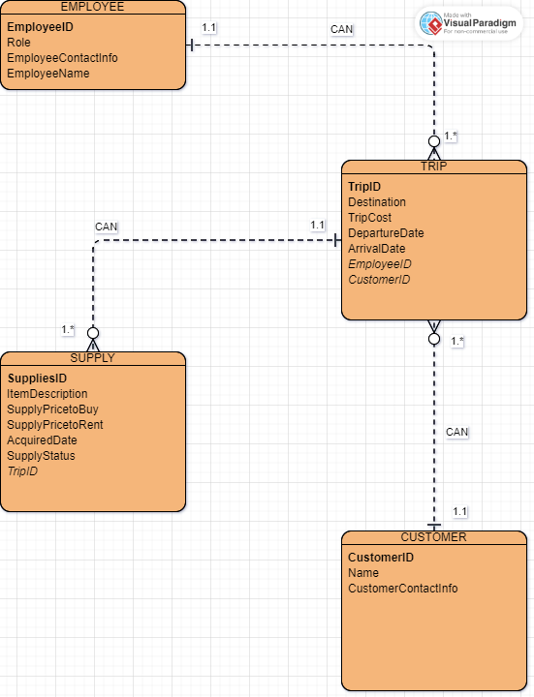
Finalized ERD

Slide 5
Reports Overview
After reading the case study, these are the command scenarios we chose to define.
1) Description: This query will display the number of items sold, the item description and the price to buy the item to show if enough customers buy equipment to keep equipment sales.
Owner’s Req: Help the business owners understand the sales performance of their equipment.
2) Description: This query will display the number of bookings by destination, year and month thus showing a downward trend based on destination.
Owner’s Req: Allow the owners to detect any downward trends in their bookings.
3) Description: This query will display the number of bookings by destination, year and month thus showing a downward trend based on destination.
Owner’s Req: Help the business owners monitor the age of their equipment.

Slide 6
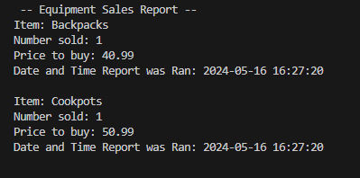
Report #1
Equipment Sales
Description: This query will display the number of items sold, the item description and the price to buy the item to show if enough customers buy equipment to keep equipment sales.
Command Ran: cursor.execute("select ItemDescription, COUNT(*), SupplyPricetoBuy, NOW() from Supply where supplystatus = 'bought' group by ItemDescription, SupplyPricetoBuy")

Slide 7
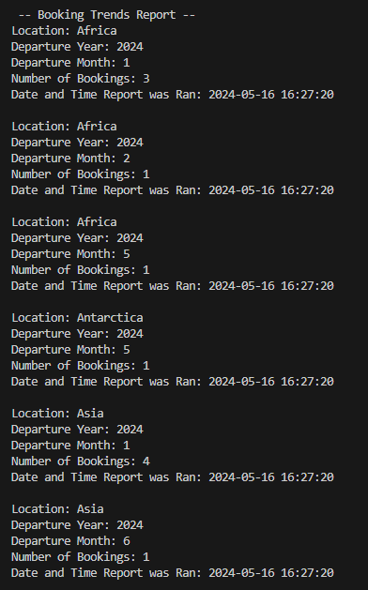
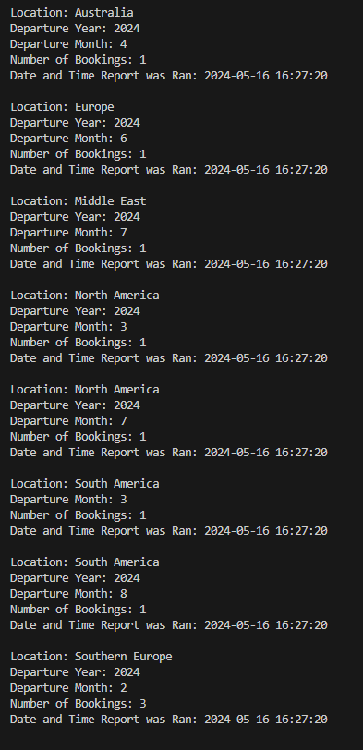
Report #2
Downward trend in bookings
Description: This query will display the number of bookings by destination, year and month thus showing a downward trend based on destination.
Command Ran: cursor.execute("select Destination, YEAR(DepartureDate), MONTH(DepartureDate), Count(*), NOW() from Trips Group by Destination, YEAR(DepartureDate), MONTH(DepartureDate) Order by Destination, YEAR(DepartureDate), MONTH(DepartureDate)")

Slide 8
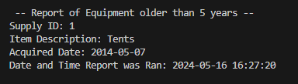
Report #3
Equipment older than 5 years
Description: This query will display the number of bookings by destination, year and month thus showing a downward trend based on destination.
Command Ran: cursor.execute("select SuppliesID, ItemDescription, AcquiredDate, NOW() from Supply WHERE YEAR(CURDATE()) - YEAR(AcquiredDate) > 5")

Slide 9
Assumptions
1) Relationships between each group is an assumption (Ex. Guide/Employee could have multiple trips).
2) Supply could have a NULL tripID if it hasn’t been bought or rented.
3) There is a downwards trend in visits to the African destination based on compiled data within database.
4) We are assuming that seasons were not factored. We were looking at trips taken based on month/year.

Slide 10
Conclusion
With this case study, we feel as though we have compiled the data requisitioned by the business owners so that the owners can keep up with inventory, trips taken, dates, costs, and keep employee information stored via SQL database.
As a group, we ran the compiled reports and collectively created and commented on code that should take place as well as manipulated a database. We also worked together in a small coding team to coordinate visits and calls as well as passing files between each-other in-order to complete the project!

