Slide 1
barriers to implementing a just culture
David Amos
Module 9 Assignment
2/22/2025

Slide 2
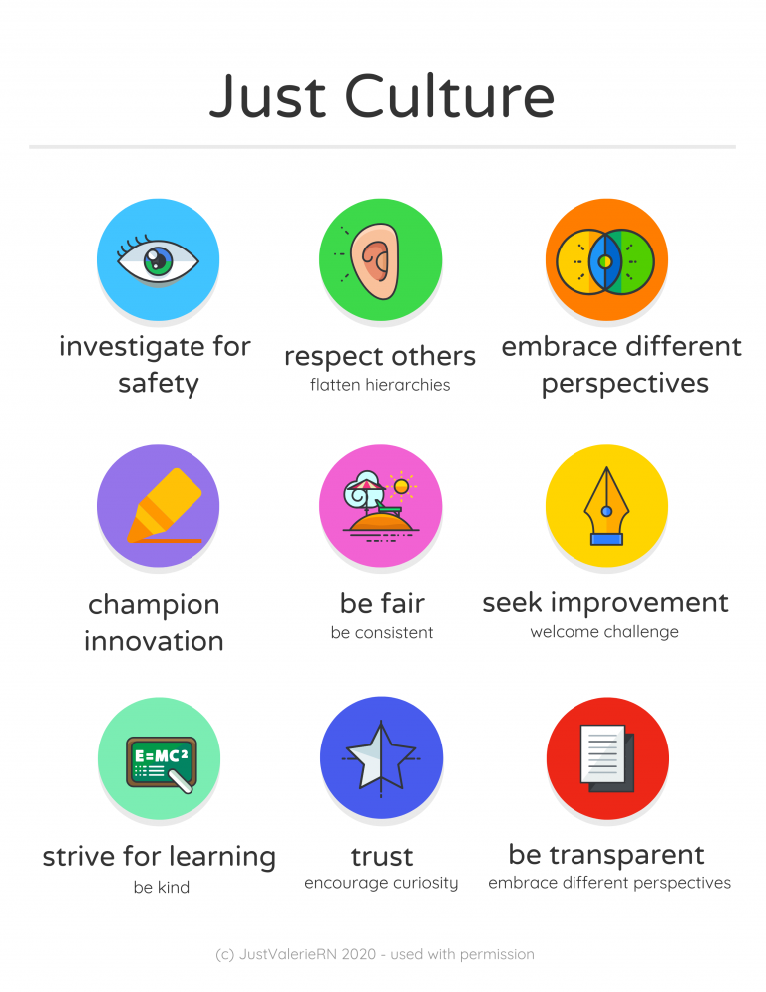
What is a Just culture
A just culture is one where mistakes are looked at as a learning experience, not a place to lay blame. It recognizes that human error is inevitable. Trying to lay blame only makes employees more secretive and less communicative.
Investigate failures from a standpoint of learning. Look to find what measures could be taken to prevent the error from occurring in the future.
Just culture is something that is encouraged in both the software industry as well as nursing.

Slide 3
Barriers
Blame
Outcome bias
Lack of transparency
Inconsistent assessment processes

Slide 4
Blame
It is natural when things to wrong to want to assign blame
Often the people involved did not have as much control than want other believe
Instead of assigning blame, look at what measures could have prevented the issue
Be aware of any bias you may have while looking at the situation with hindsight

Slide 5
Outcome bias
Knowing the outcome of a situation leads to outcome bias. Actions of the individuals involved should be assessed without considering what the outcome was.

Slide 6
Lack of transparency
Fear of being assigned blame made cause those involved to be less open about what happened. To help with this, be open about having a just culture and the procedures involved with investigating an error.

Slide 7
Inconsistent assessment processes
The assessment process needs to be consistent. Define a process of how incidents are evaluated. These assessments look for what to do better going forward, not blaming what happened on someone. The blameless post-mortem meetings described in the textbook are a great example. They allow the situation to be thoroughly and openly assessed without fear of punishment.

Slide 8
Conclusion
A just culture leads to open communication and effective problem solving. There are challenges to implementing just culture due to human nature and bias. Implementing a well defined and blame free assessment process helps to encourage a just culture

Slide 9
References
HQCA. (2025). Overcoming barriers to a just culture. HQCA Just Culture. https://justculture.hqca.ca/overcoming-barriers-to-a-just-culture/
Kim, G., Debois, P., Willis, J., Humble, J., & Allspaw, J. (2016). The devops handbook: How to create world-class agility, reliability, and security in technology organizations. IT Revolution Press.
WisTech Open. (2024). 5.4 culture of safety. Nursing Fundamentals 2e. https://wtcs.pressbooks.pub/nursingfundamentals/chapter/5-4-culture-of-safety/

