Slide 1
The Technology Value Stream
David Amos
1/6/2025
Module 1.2 Assignment

Slide 2

What is it?
The Technology Value Stream is how you take an idea and turn it into technology which serves the customer. This includes everything from writing up the work, to coding, testing, deploying, and anything in-between. Agile is a common modern way to process for value streams. It uses iteration to deliver business value quicker and often with better quality.

Slide 3
Importance of managing a value stream
An efficient value stream provides more value to a customer
Communication is very important
Effective management can reduce time waiting
Can open more time to paid tech dept
Decreases lead time

Slide 4
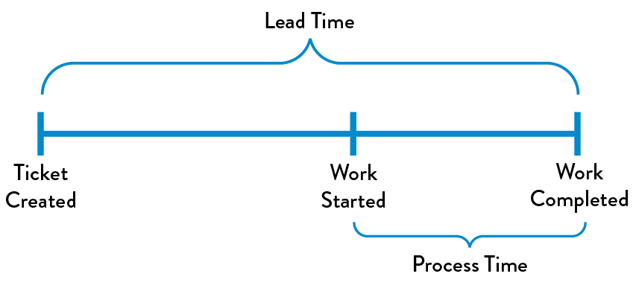
Lead Time vs processing time
Lead Time
Lead time refers to the time between a request being made and the completion of the work. This includes time where no work is being completed. This is the amount of time that matters to the requester because it is what they experience.
Processing Time
Processing Time is how long work takes once it has started. While processing time is important it does not give the full picture.

Slide 5

Lead times requiring months
Sometimes lead time can grow to even months. This can be often be due to handoffs from one group to another. Each handoff make it harder to understand the problem and then it takes longer to solve. It may also sit in a queue waiting to be evaluated each time. This can be reduced by organizing teams in an efficient way to reduce handoffs.

Slide 6
Lead time of minutes
How to get a lead time of minutes?
Environment creation – enable testing environments to be nimble enough to test on demand.
Code Deployment – automate safer, when possible, to reduce time for deploying code.
Test setup and run – automate testing to keep up with the rate of code deployment
Overly tight architecture – Create loosely coupled architecture so that changes are safer, and impacts are mitigated.

Slide 7
How to measure success
DORA metrics:
Lead time of changes
Rate of failure
Deployment frequency
Recovery time
Objectives and key results (OKRs)
Set expectations of what should be accomplished

Slide 8
References
Kim, G., Debois, P., Willis, J., Humble, J., & Allspaw, J. (2016). The devops handbook: How to create world-class agility, reliability, and security in technology organizations. IT Revolution Press.
Takakura, T. (2024). What is value stream management?. Atlassian. https://www.atlassian.com/agile/value-stream-management

