Slide 1
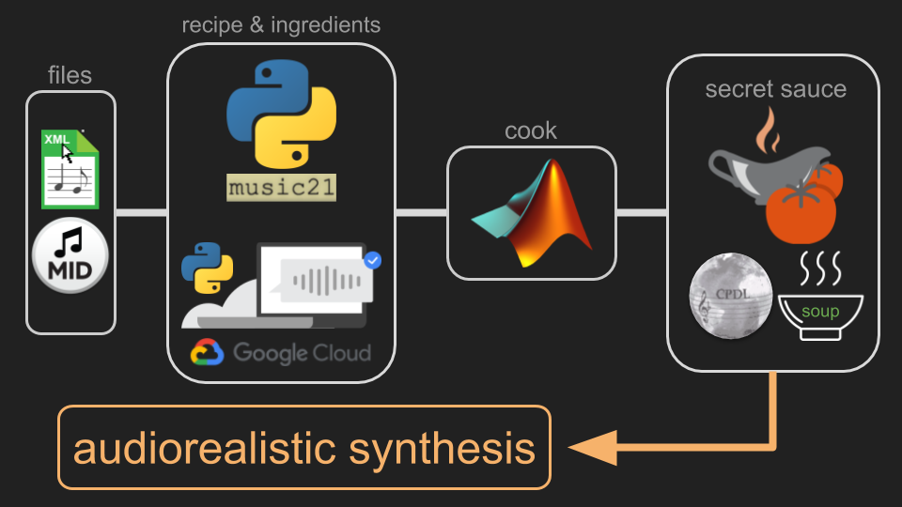
Ensemble

Slide 2
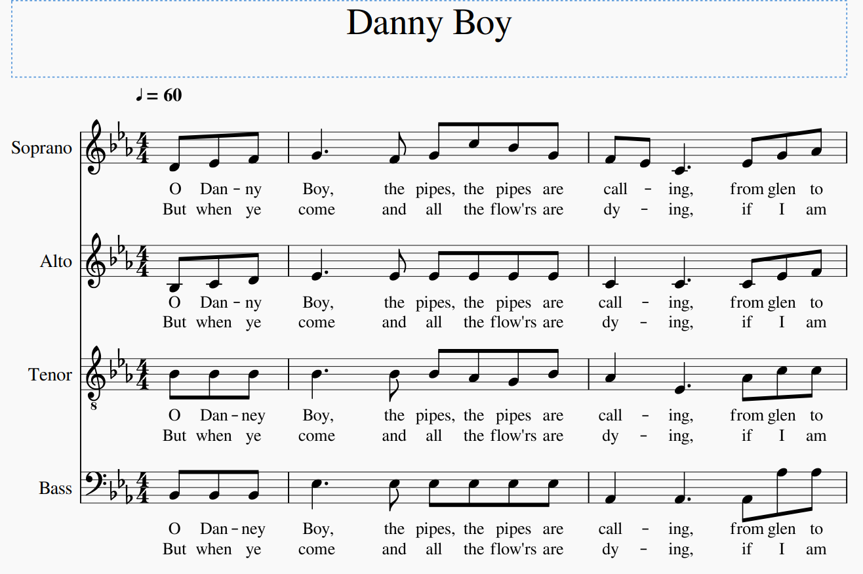
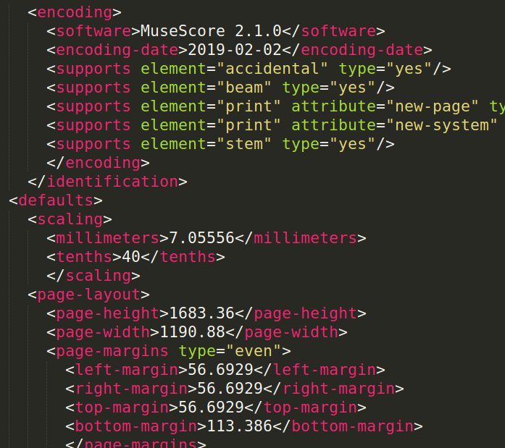
MusicXML
=

Slide 3
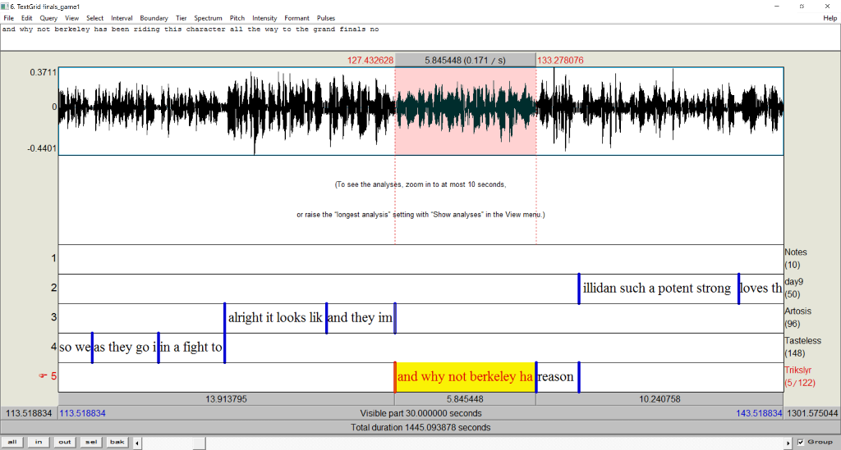
Montreal-Forced-Aligner

Slide 4

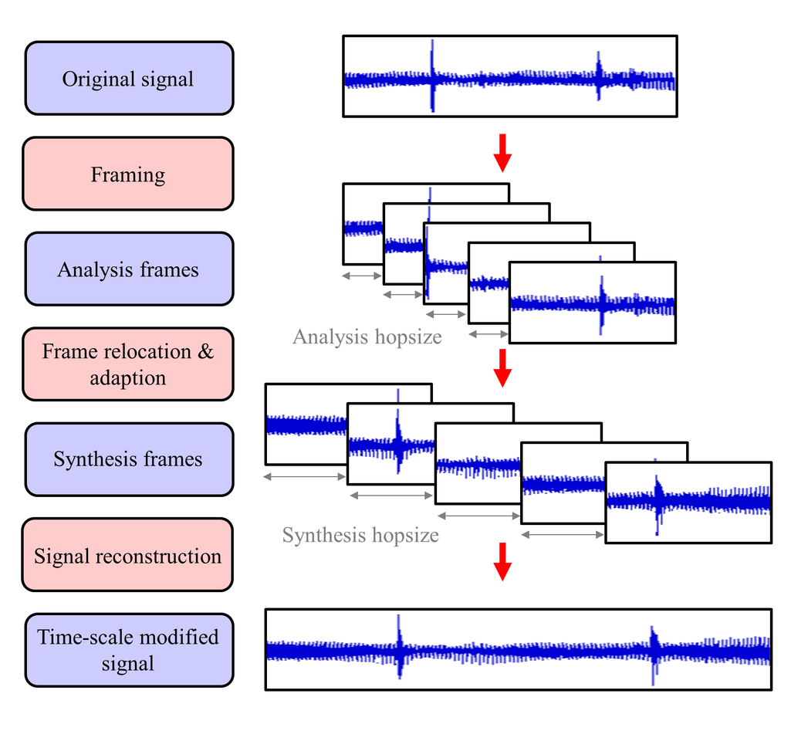
Auto-Tuning
→

Slide 5
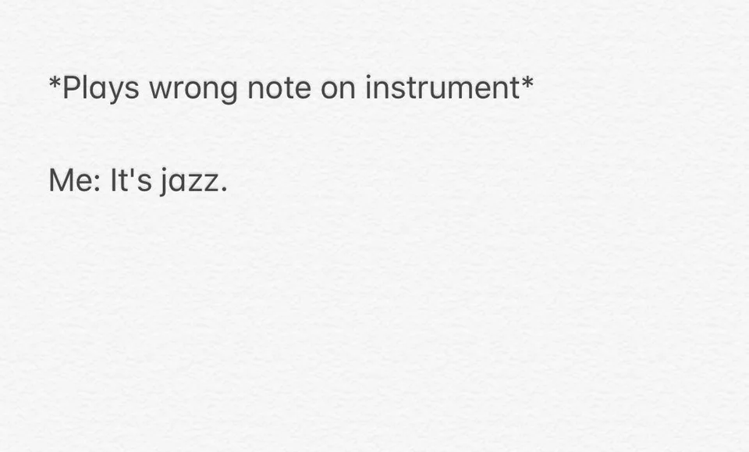
Issues
rudimentary pitch shifter
sometimes out of tune
forced aligner not very robust
naive splicing of samples

