Slide 1

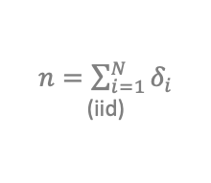

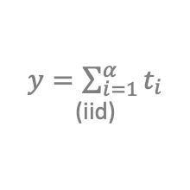






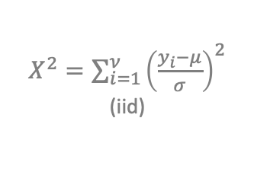















Key
Special case:
Limiting case:
”iid” = “independently identically distributed
”ind” = “independent”
$δ$~ Binomial(N, p)
y ~ Lognormal($μ$, $σ$)
$n=\sum_{i=1}^{N}{δ_{i}}$ (iid)
N=1
$$\log{(y)}$$
$$N→∞,μ=Np,$$
$$σ^{2}=Np(1−p)$$
n ~ Binomial(N, p)
K=2
n ~ Multinomial(N, p₁,…p_{K})
y ~ N($μ$, $σ$)
$X^{2}=\sum_{i=1}^{ν}{{\left(\frac{y_{i}−μ}{σ}\right)}^{2}}$ (iid)
$$N→∞, p→0,$$
$$λ=Np$$
y$\sim$Uniform $(0,1)$
y$\sim Beta(α,β)$
$$μ→∞, σ^{2}=μ$$
$α$=$β$=1
n$\sim$P$oisson(λ)$
n$\sim$Geometric $(p)$
$$X^{2}\sim χ^{2}(ν)$$
$$r→∞, \frac{p}{1−p}→0,λ=\frac{pr}{1−p}$$
$$N→∞ ;t=n/N;$$
$λ$=N$p$
$F=\frac{χ_{1}^{2}/ν_{1}}{χ_{2}^{2}/ν_{2}}$ (ind)
$y\sim$Gamma$(λ,α)$
“mirror image”
$$α=1$$
n ~ NegativeBinomial(p, r)
$y=\sum_{i=1}^{α}{t_{i}}$ (iid)
$$y=\sqrt{F}$$
$$ν_{1}=1$$
$$y\sim t(ν_{2})$$
$$F\sim F (ν_{1},ν_{2})$$
$t\sim$Exponential$(λ)$
$α=ν$/2; $λ$=0.5

