Slide 1
MRDS with cameras and unknown recaptures

Slide 2
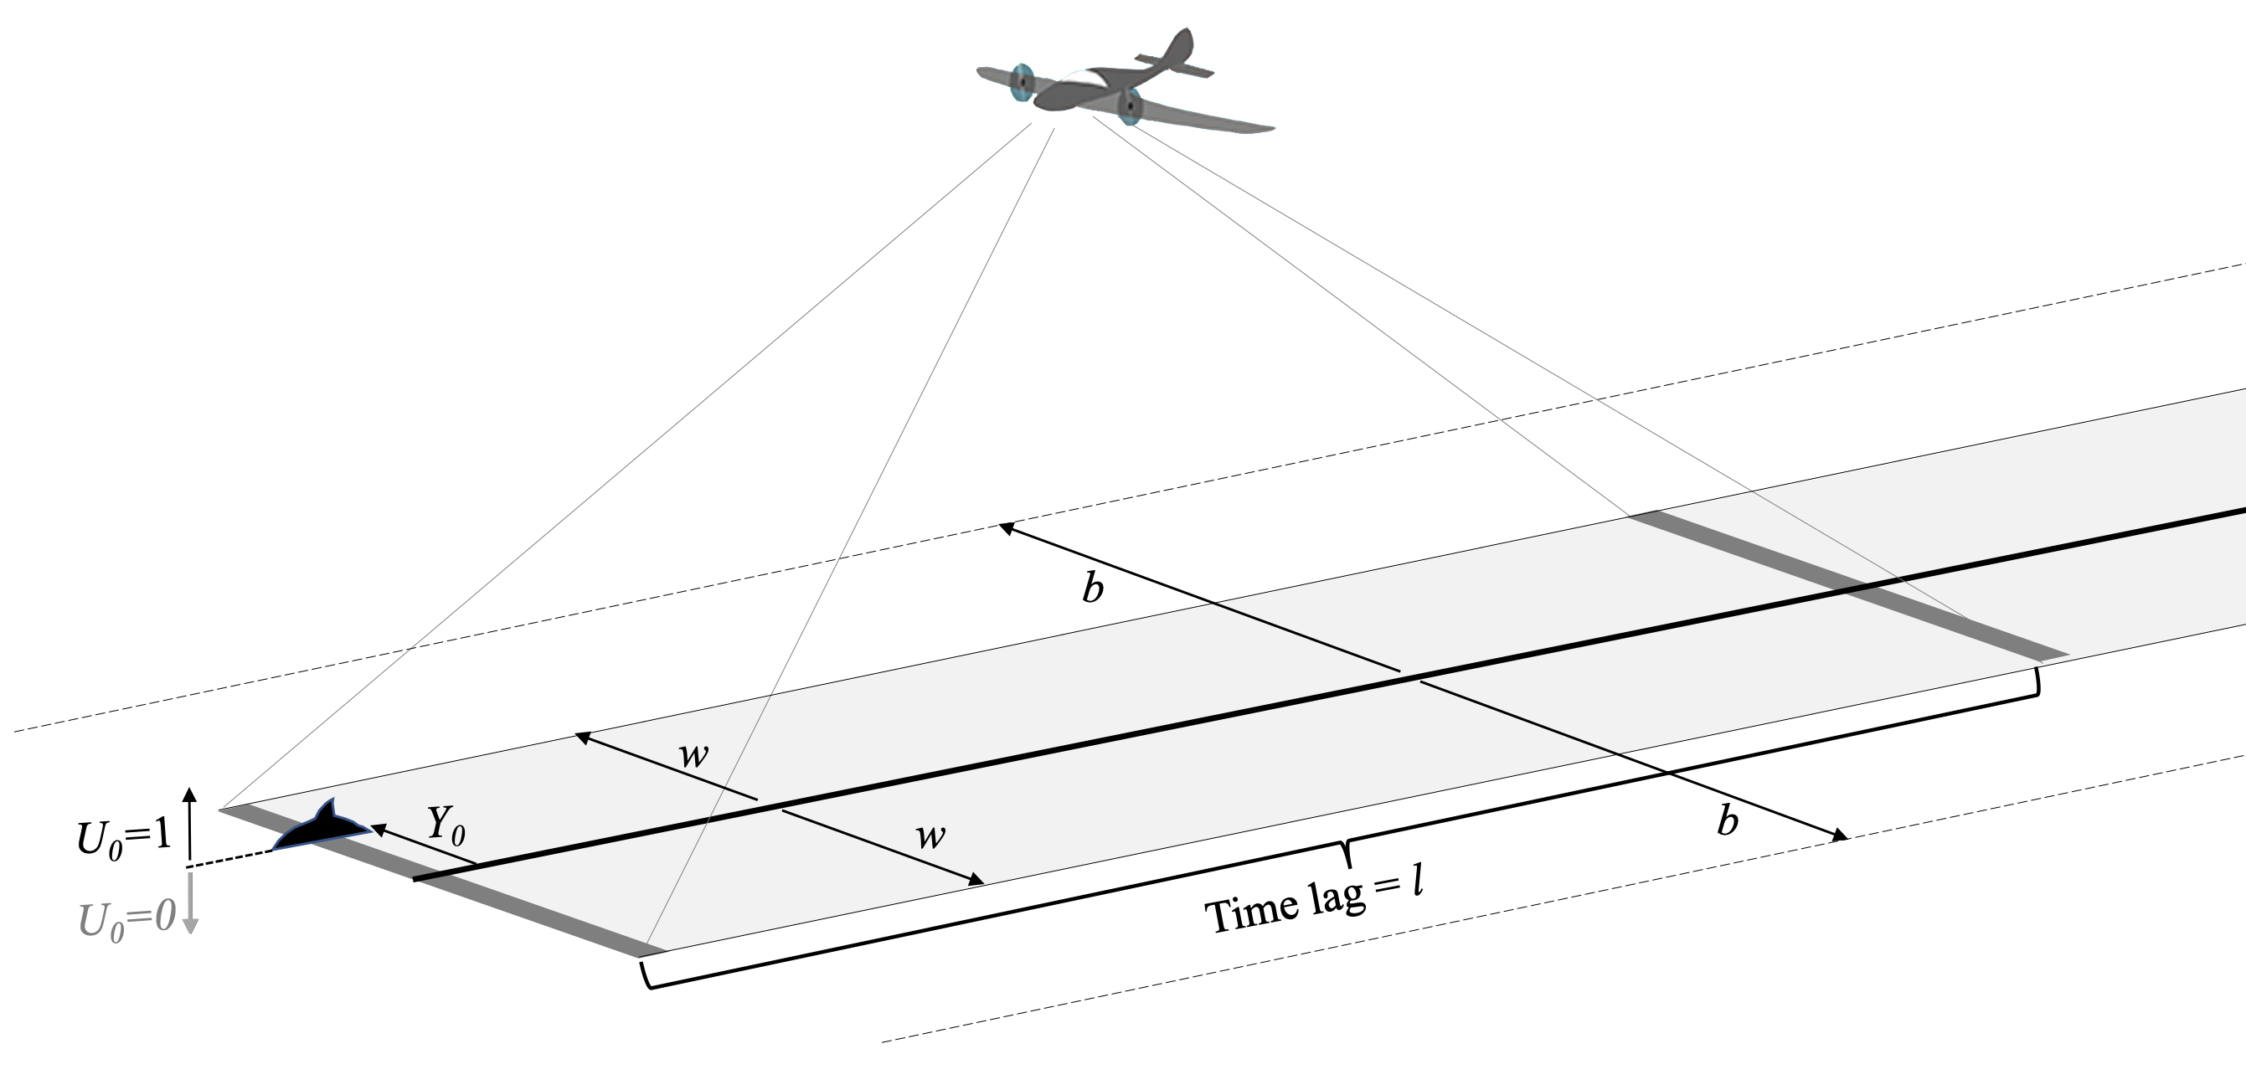
The Scenario (2 cameras on 1 plane or 2 separate planes)
29

Slide 3
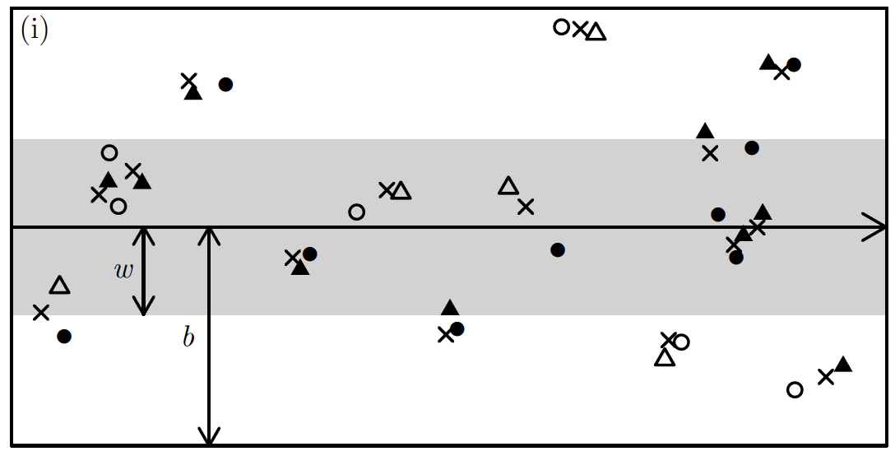
Data and Model components
Model:
Surfacing process:
Markov-modulated Poisson
Movement process:
Brownian motion
Detection process:
Constant hazard
30

Slide 4
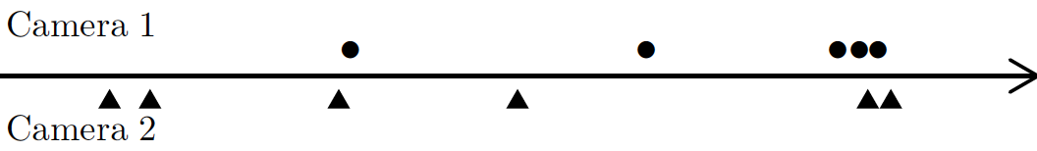
Uncertain “recapture” identities
Spatio-temporal clustering contains information about recaptures.
Two approaches:
“Excess” clustering at short distances, compared to what is expected if there were no recaptures, tells us how many recaptures there were
Sum over all possible pairings of Camera 1 and Camera 2 detections
31

Slide 5
Uncertain “recapture” identities
Spatio-temporal clustering contains information about recaptures.
Two approaches:
“Cluster Capture-Recapture”
Stevenson, B.C., Borchers, D.L. and Fewster, R.M. 2018. Cluster capture-recapture to account for identification uncertainty on aerial surveys of animal populations. Biometrics 75: 326-336.
“Latent Capture history Enumeration” (LCE)
Borchers, D.L., Nightingale, P., Stevenson, B.C. and Fewster, R.M. A latent capture history model for digital aerial surveys of marine mammals without recapture identification. Revision submitted to Biometrics, Aug 2020
31

Slide 6
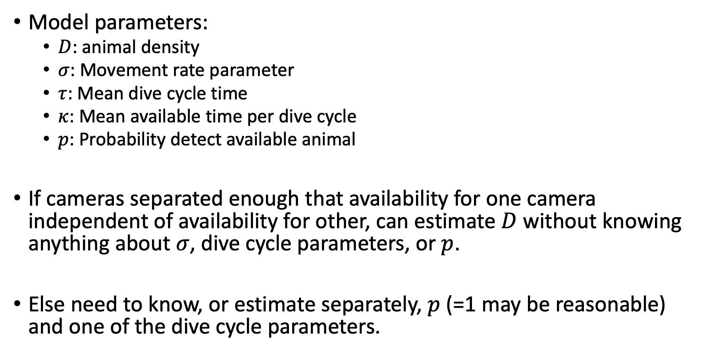
No completely free lunch
Model parameters:
$D$: animal density
$σ$: Movement rate parameter
$τ$: Mean dive cycle time
$κ$: Mean available time per dive cycle
$p$: Probability detect available animal
If cameras separated enough that availability for one camera independent of availability for other, can estimate $D$without knowing anything about $σ$, dive cycle parameters, or $p$.
Else need to know, or estimate separately, $p$ (=1 may be reasonable) and one of the dive cycle parameters.

Slide 7
CCR vs LCE
Data: both need perpendicular distance and distance along transect
LCE is a maximum likelihood estimator, CCR is not
Both asymptotically unbiased
LCE slightly more precise (but not much)
CCR scales well with sample size, LCE does not
Robust package for CCR (package “palm”, on CRAN)
Much less robust package on GitHub for LCE.

