Slide 1

CSCE 692 Design Principles of Computer Architecture Introduction
Dr Scott Graham
AFIT/ENG
Notes adapted from
David Patterson
Electrical Engineering and Computer Sciences
University of California, Berkeley

Slide 2
Administrative Details
Class
0800-0950 Tue/Thur,
Bldg 642, Room 338
Office hours:
1100-1200 Tuesdays,
1300-1400 Thursdays
by appt
Contact Info
Bldg 640, Rm 327
937-255-3636 x4581
scott.graham@afit.edu
Prerequisites
Operating Systems - CSCE 489
Computer Architecture - CSCE 492
Readings (book & slides)
Prior to each class
In-class style: Active student learning
Read ahead
Ask questions
Answer others questions
Significant interaction

Slide 3
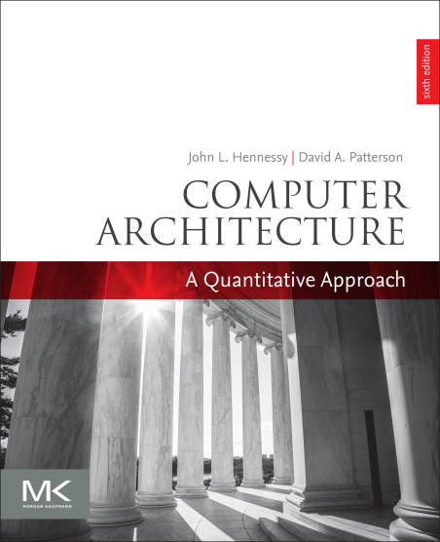
Course information
Course materials:
Required:
Computer Architecture A Quantitative Approach 6th Edition Hennessy and Patterson
Simulator Website: www.simplescalar.com
Additional course material is found on CANVAS

Slide 4
Course Objectives
The objective of this course is for the student to:
Build upon principles of von Neumann computer architecture
understand how modern architectures are designed.
Key themes of the course: performance thru exploitation of
instruction-level parallelism
thread/data level parallelism
multiprocessor architectures
An emphasis is placed upon the use of quantitative metrics to evaluate performance/cost tradeoffs.
Architecture is great material, but also good practice for research

Slide 5
Grading
Grades based on the following
Homework/quizzes 25%
Midterm 25%
Project 25%
Final Exam 25%

Slide 6
Homework Instructions
Top of first page: Name, Date, Class
Number each page (last name-pg)
State the complete problem
Show your work (after problem statement)
Clearly indicate your answer

Slide 7
Labs
Lab 1 exercises a simple cache simulator
Labs 2 and 3 focus on design tradeoffs to study their performance and performance/cost impacts
Tools:
SimpleScalar Simulator (www.simplescalar.com)
Material located in course directory
You will need an AFIT/EN Linux account (Help Desk), or your own Linux machine (physical or virtual).
Start Early!!!!!

Slide 8
Honor Code
AFIT Honor Code will be strictly enforced in this course
All examinations and homework assignments are expected to be your own individual work unless otherwise noted
While I encourage collaboration on homework…
DON’T copy – what you turn in must be your own work!
If you have any doubt:
Refer to Syllabus and ENOI 36-107 (dated 1 Jul 10)
Ask me

Slide 9
Some Resources
CPU Data Base - http://cpudb.stanford.edu/
Project related resources
CygWin - https://www.cygwin.com/
Linux-like environment for Windows…
The Simple Scalar software can be used in this environment
Linux – I’ve had good experience with Ubuntu
Ubuntu - http://www.ubuntu.com/
Other Distributions: http://www.linux.com/directory/Distributions
Simulation Software (Simple Scalar)
http://www.simplescalar.com/
Getting an AFIT/EN Linux Account
I have to submit a ticket to get them established
Please let me know if you want/need an account for this course

Slide 10
Course Schedule
See the course CANVAS page.
The schedule may change throughout the duration of the course. Each time a change is made the “AS OF” date is also updated in order to ensure you are referring to the current version of the schedule.

