Slide 1
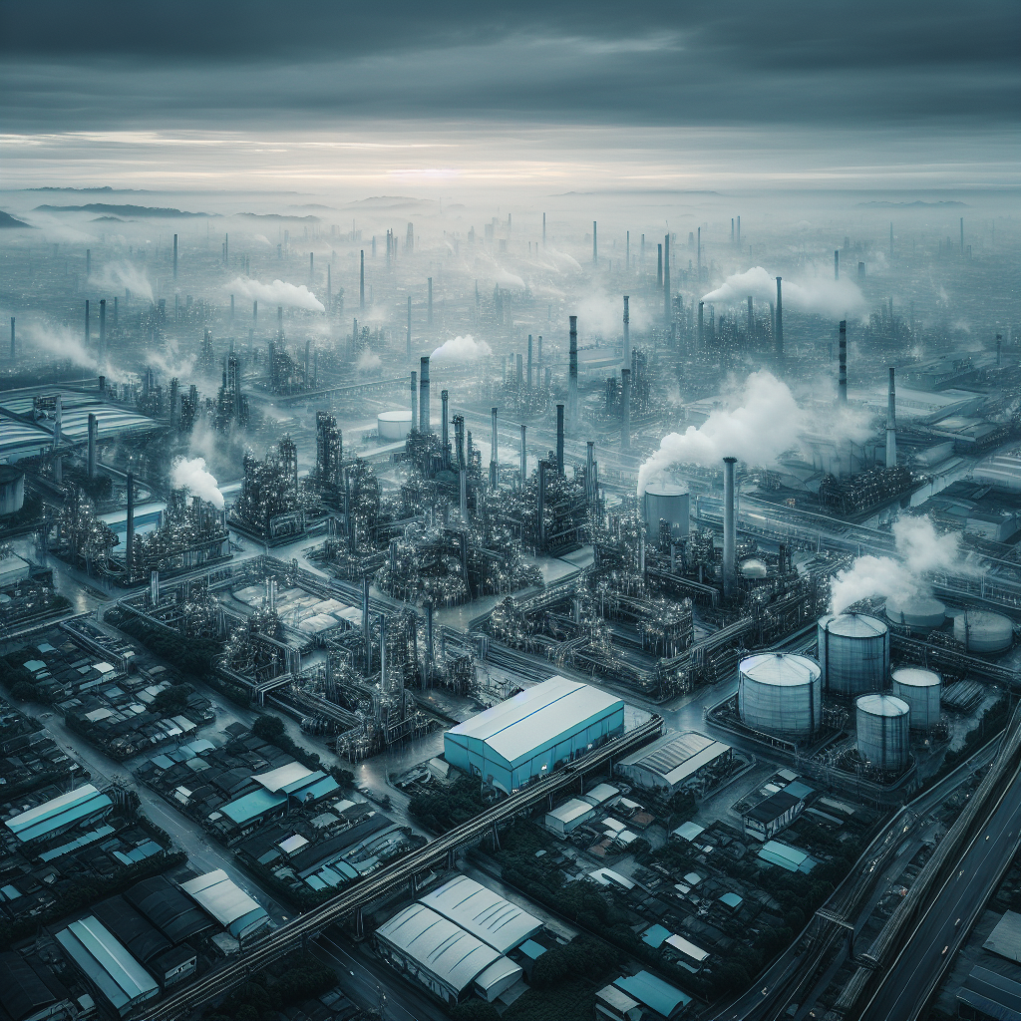

AI in Industrial Analytics

Slide 2

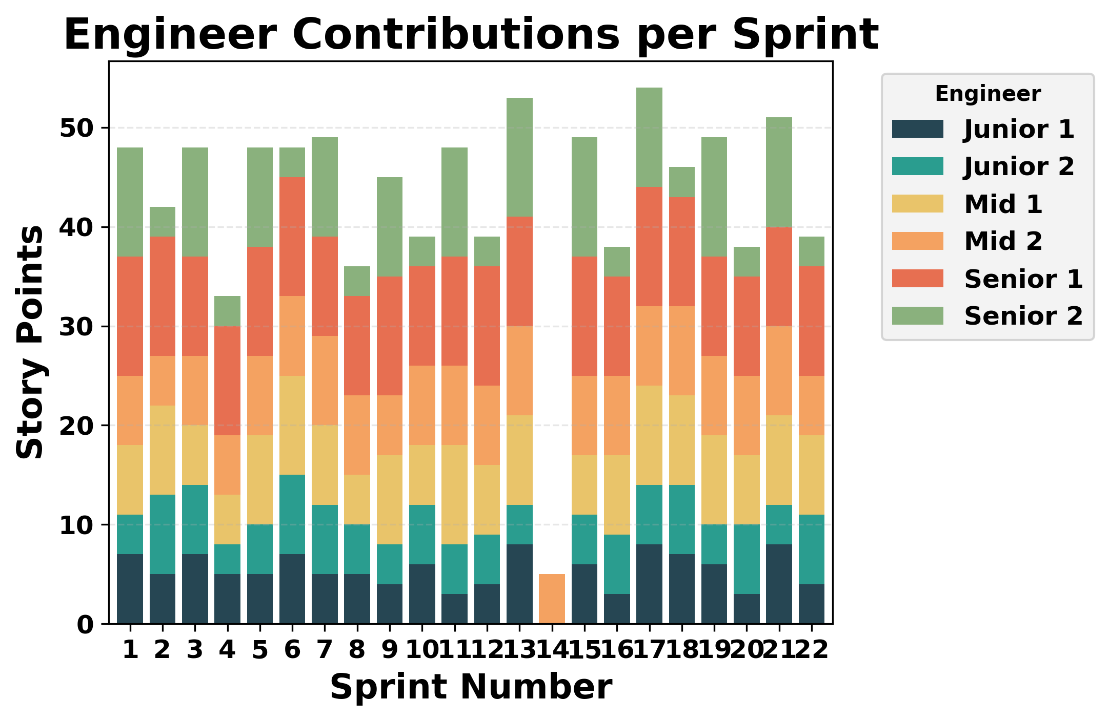

Slide 3
