Slide 1
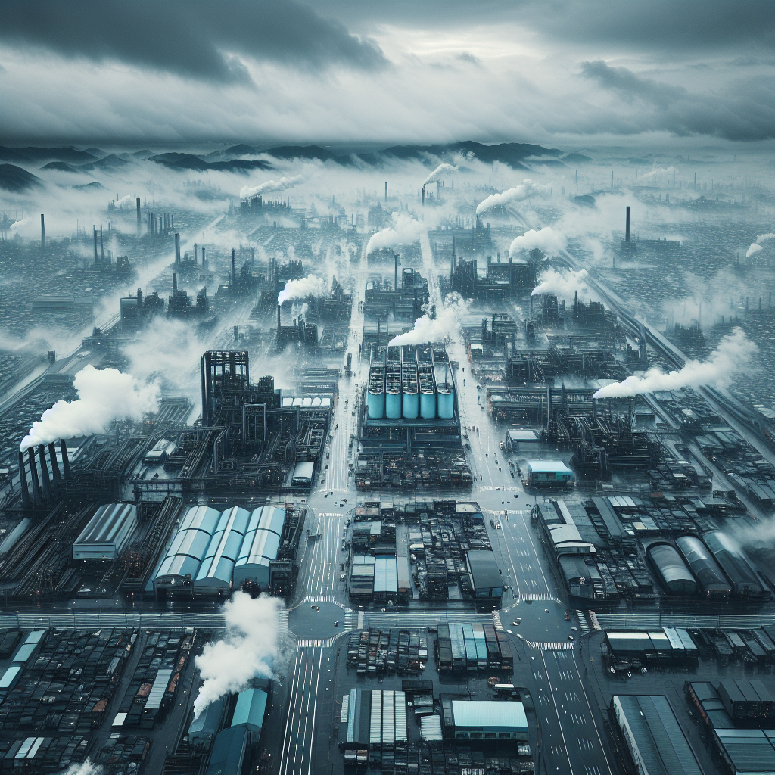

AI-Generated Landscape

