Slide 1
Cinema Vocabulary
☺

Slide 2
01
¿Cómo dirías?

Slide 3
¿Te gustaría ir al cine?

Slide 4
Would you like to go to the cinema?

Slide 5
¿Cuándo estas libre?

Slide 6
When you are free?

Slide 7
¿Cuándo podemos ir?

Slide 8
When can we go?

Slide 9
Which: Cual

Slide 10
Which color is your favourite? Red or black

Slide 11
Cual pelicula te gustaria ver?

Slide 12
Which movie would you like to watch?

Slide 13
02
Vocabulary

Slide 14
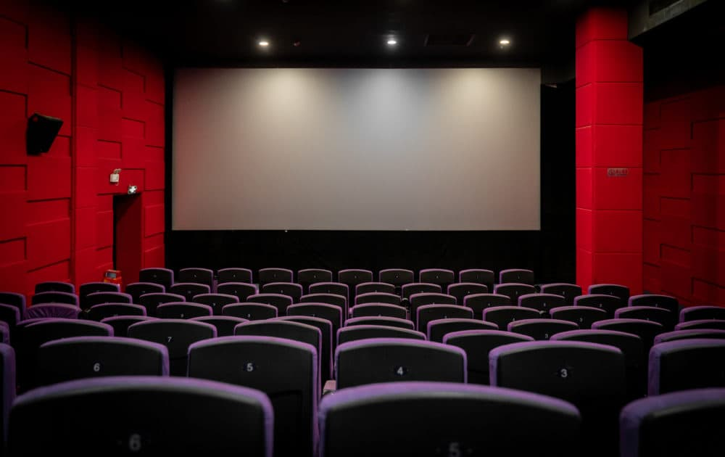
Movie Theater

Slide 15
Seats

Slide 16
Movie screen

Slide 17

Tickets

Slide 18

Actor

Slide 19

Actress

Slide 20
03
Genre

Slide 21
Genres
01
02
03
04
05
06
Horror film
Silent film
Period drama
Science fiction
Sci-Fi
Comedy
Action movie

Slide 22
Genres
07
08
09
10
11
12
Thriller
Animation
Romance
Western
War Film
Musical

Slide 23
03
Oscar night

Slide 24

Red carpet

Slide 25
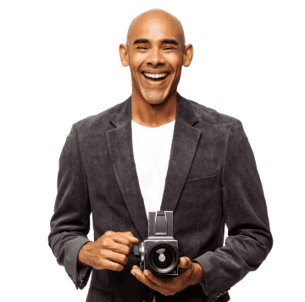
Photographers

Slide 26
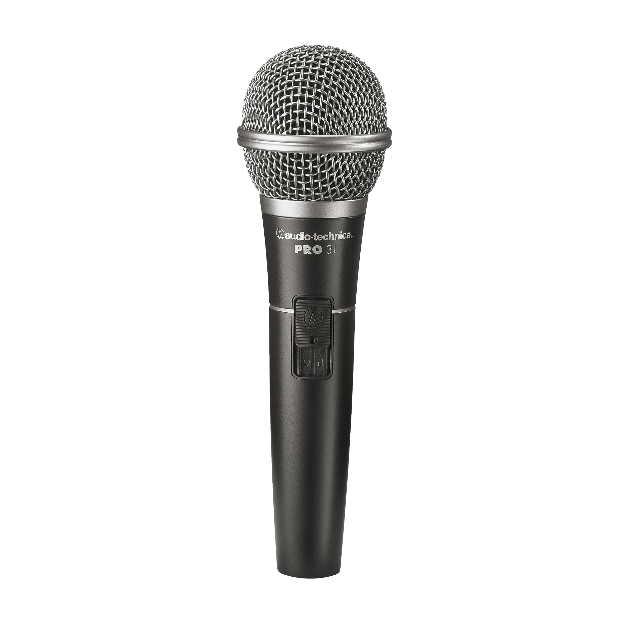
Interview

Slide 27
Speech

Slide 28
Speech = discurso

Slide 29
Speechless = Sin palabras

Slide 30
Speechless = Sin palabras I am spechless

