Slide 1
Final Project Pitch Book
FiNM 33150
David Du, Jiayi Lin, Xiaomeng Wang

Slide 2
Directional Change(DC) Strategy
This strategy identifies upward and downward trends in Foreign Exchange rates and profits from continuation of trend
Strong quantitative foundation
Investment process emphasizes risk control
Strategy gains an annual return of 72%
Backtests suggest lower than -5% VaR at 90% confidence level

Slide 3
Investment Universe And Securities
The investment universe contains:
All foreign currencies available for feasible trading and borrowing
Focus more on low interest rate currencies
Execution uses seven straight currency pairs
The strategy generates:
Long and short positions in Foreign-Currency/USD
Portfolios of the long/short positions for the seven straight pairs we use

Slide 4
Competitive Edge
Active Trading & Portfolio Management Strategy: trade at least 2/3 of times in year
High market liquidity, short holding period, and stop loss execution for risk control
Minimized Value at Risk for both 90% and 99% confidence level
Multiple forms of DC strategy for selection to customize your investment need
Strong mathematical foundation to allow different execution under different market conditions

Slide 5
Model Construction
Directional Change models introduced by E. Tsang (2010)
Stochastic risk and volatility
Fixed and Dynamic Thresholds
Currency Portfolio
Use the model to:
Identify upward and downward trend
Infer further rates movements

Slide 6
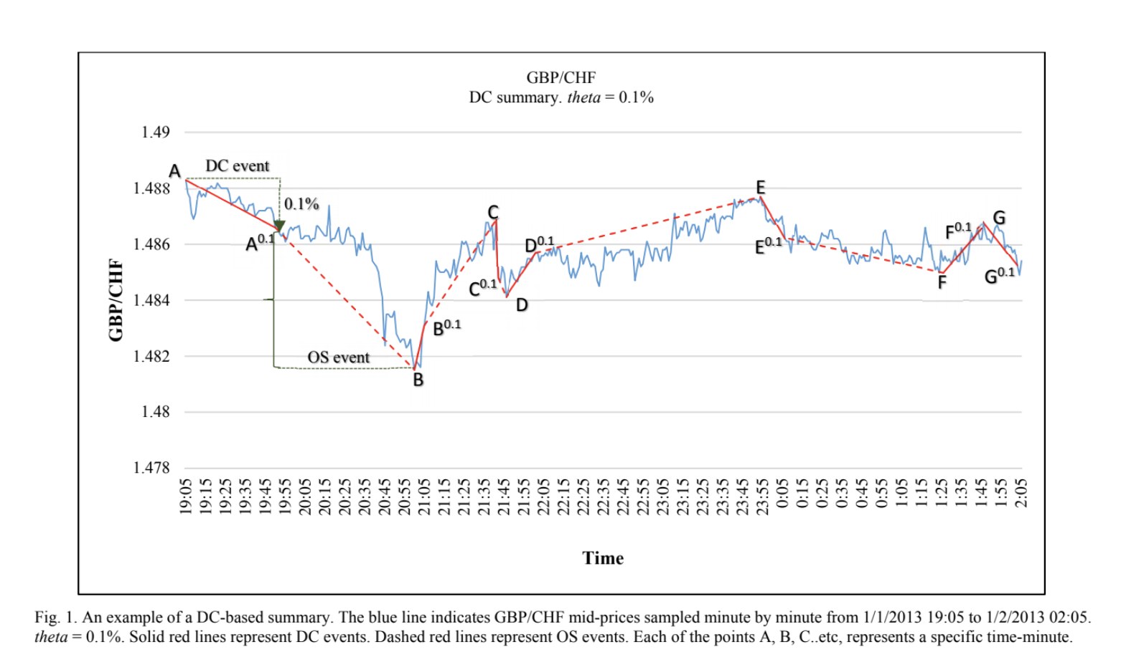
Empirical Exploration
From the graph we can see that after successfully identifying an uptrend or downtrend, there is a period of overshoot.

Slide 7
Implications of Empirical Exploration
After identifying up and downtrends, the overshoot period presents an attractive investment opportunity
When the trend reverses, a trend-following position will be no longer unfavorable, so there is need for risk-control: we close our position whenever stop-loss order is hit

Slide 8
Our Implementations
Motivated by the conclusions of the empirical explorations, we:
Buy foreign currency and sell US Dollars when Foreign/USD rate is in downtrend (foreign currency is appreciating) and vice versa
Borrow the selling currency with short-term interest rates
Exit position when cumulative loss of that position is more than 10% of invested capital
We review active positions daily
We review potential investments daily
We generate two versions for DC-based portfolio management strategy:
-Static Threshold(ST) and Dynamic Threshold(DT)

Slide 9
Backtesting
Training Period : 2013/01/01 – 2014/12/31
Testing Period : 2015/01/01 – 2019/12/31
Incorporation of costs and fees:
Transaction costs : 1 basis point
Funding costs : short term interests rates
Allowing 5x Leverage

Slide 10
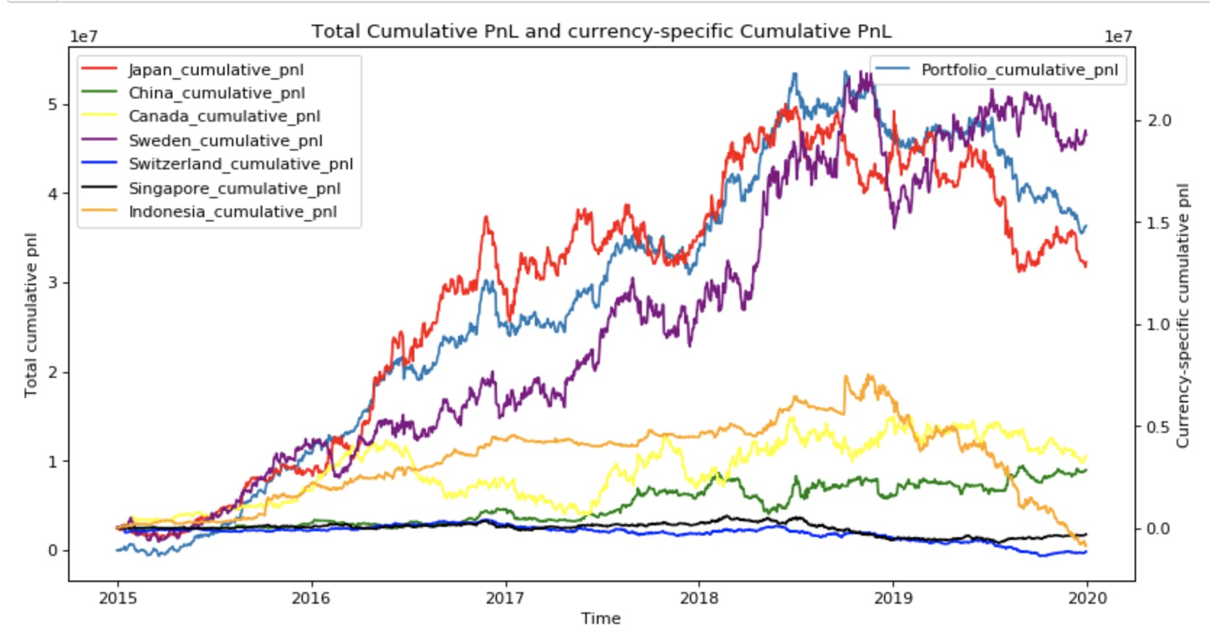
ST Portfolio Strategy PNL Results
Optimized parameters using training set
Total Return 360%
Annual Return 72%

Slide 11
ST Portfolio Strategy Evaluation Metrics
 | Sharpe Ratio | Sortino Ratio | Maximum DD | VaR @ 90 C.L | VaR @ 99% C.L
Allocation by even weighting | 1.27 | 1.48 | 32.96% | -1.93% | -6.14%
Allocation by training weights | 1.75 | 2.40 | 28.55% | -3.45% | -11.17%
High maximum drawdown but solid Value at Risk from stop loss
Solid Sharpe Ratio and Sortino Ratio despite high volatility of return
Allocation by training weights via implied Sortino Ratio enhances result

Slide 12
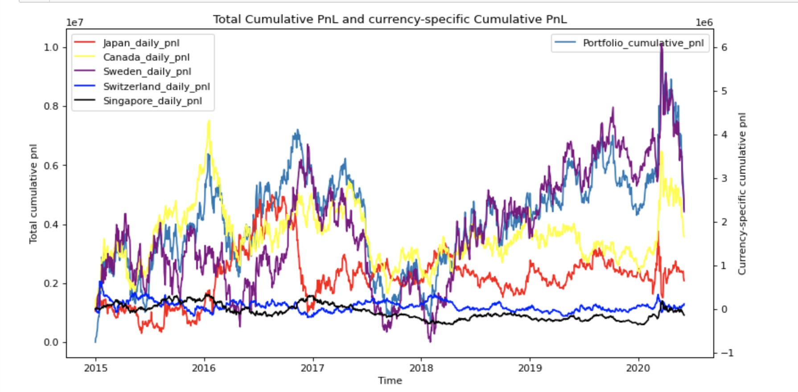
DT Portfolio Strategy PNL Results
Optimized parameters using training set
Total return 43%
Annual return 8.7%

Slide 13
DT Portfolio Strategy Evaluation Metrics
 | Sharpe Ratio | Sortino Ratio | Maximum DD | VaR @ 90 C.L | VaR @ 99% C.L
5 sets of parameter, even allocation | 0.38 | 0.67 | 28.90% | -1.66% | -3.71%
1 set of parameter, even allocation | 0.38 | 0.67 | 28.90% | -1.66% | -3.71%
1 set of parameter, trained allocation | 0.41 | 0.66 | 44.22% | 3.25% | 6.46%
Less attractive Sharpe Ratio and Sortino Ratio with high volatility of return
Allocation by training allocation via implied Sortino Ratio enhances result
Less attractive result compared to that of ST Portfolio Strategy because rough simple computation of Threshold could cause false detection of events

Slide 14
Risk Management
Diversified Portfolio of developing and developed countries’ currency
Uses 5x leverage to control total position
Stop loss of 10% of capital (2% of position)

Slide 15
Summary
High risk high return strategy that identifies upward and downward trend to identify potential trading opportunity during the overshoot period
The Static Threshold strategy shows a high profitability of 72% annualized return
The Dynamic Threshold strategy less attractive
There is no very effective ways of hedging because we are betting on momentum
We still manage risk by setting stop-loss and achieve strong VaR result

