Slide 1
Are Speckle patterns crop-specific?
2nd Dec 2025

Slide 2

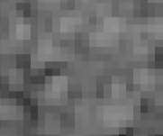


Hypothesis
A Neural Network can distinguish classes in normalized images.
→ This would mean distinguishing speckle patterns
Class A
Class B
Sentinel 1 GRD
Acquisition
(Raw)
Normalization:
X2 = X – Mean(X)
Normalized
(Zeromean)

Slide 3
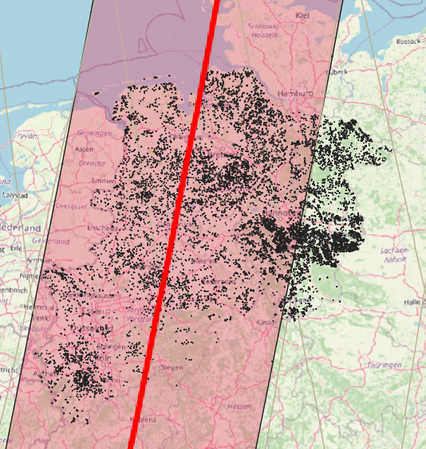


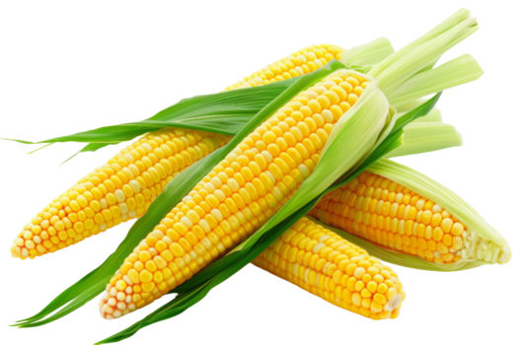

Test setup:
Region:
NRW + Niedersachesn
Class selection:
Meadows Corn Beet Wheat
1 4 6 12
Data: Sentinel 1 GRD Orbit D139
Date: 11. Juni 2022 (und 23. Juni 2022)
N training samples both dates:
"train_samples": 54 212
"validation_samples": 17 756
"test_samples": 17 864

Slide 4
NN network NR. 1; „test_conv2d“
Model Architecture: test_conv2d
----------------------------------------------------------------
Layer (type) Output Shape Param #
================================================================
Conv2d-1 [-1, 32, 10, 10] 576
BatchNorm2d-2 [-1, 32, 10, 10] 64
Conv2d-3 [-1, 64, 10, 10] 18,432
BatchNorm2d-4 [-1, 64, 10, 10] 128
Conv2d-5 [-1, 128, 10, 10] 73,728
BatchNorm2d-6 [-1, 128, 10, 10] 256
AdaptiveAvgPool2d-7 [-1, 128, 1, 1] 0
Dropout-8 [-1, 128] 0
Linear-9 [-1, 4] 516
================================================================
Total params: 93,700
Trainable params: 93,700
Non-trainable params: 0

Slide 5
NN network Nr. 2: „test_conv2d_n2“
Model Architecture: test_conv2d_n2
----------------------------------------------------------------
Layer (type) Output Shape Param #
================================================================
Conv2d-1 [-1, 8, 10, 10] 152
BatchNorm2d-2 [-1, 8, 10, 10] 16
Conv2d-3 [-1, 16, 10, 10] 1,168
BatchNorm2d-4 [-1, 16, 10, 10] 32
AdaptiveAvgPool2d-5 [-1, 16, 1, 1] 0
Dropout-6 [-1, 16] 0
Linear-7 [-1, 4] 68
================================================================
Total params: 1,436
Trainable params: 1,436
Non-trainable params: 0

Slide 6
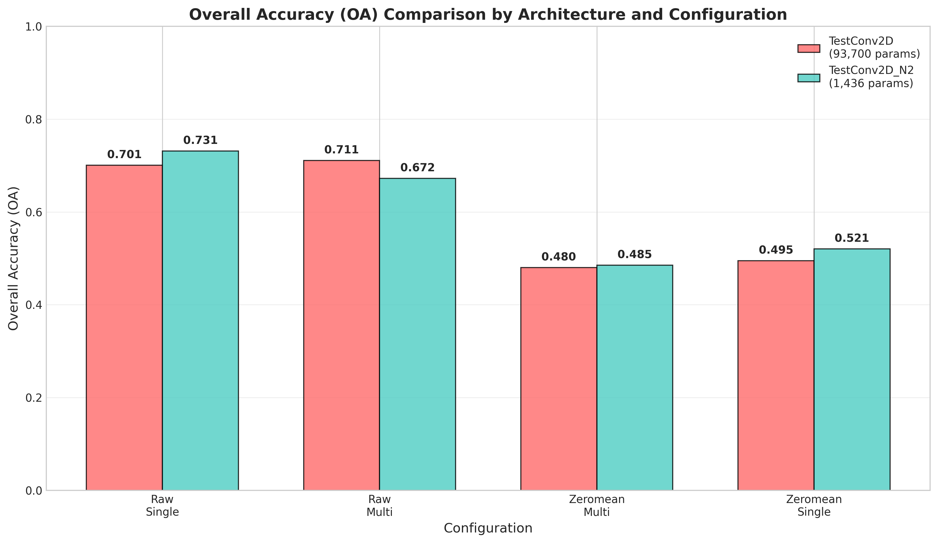
Results : Overall accuracy
Raw = no Normalization
Zeromean = Normalized
Single = 11.06.2022
Multi = 11.06.2022 and 23.06.2022
25% → Accuracy of a random classifier
Next slide

Slide 7
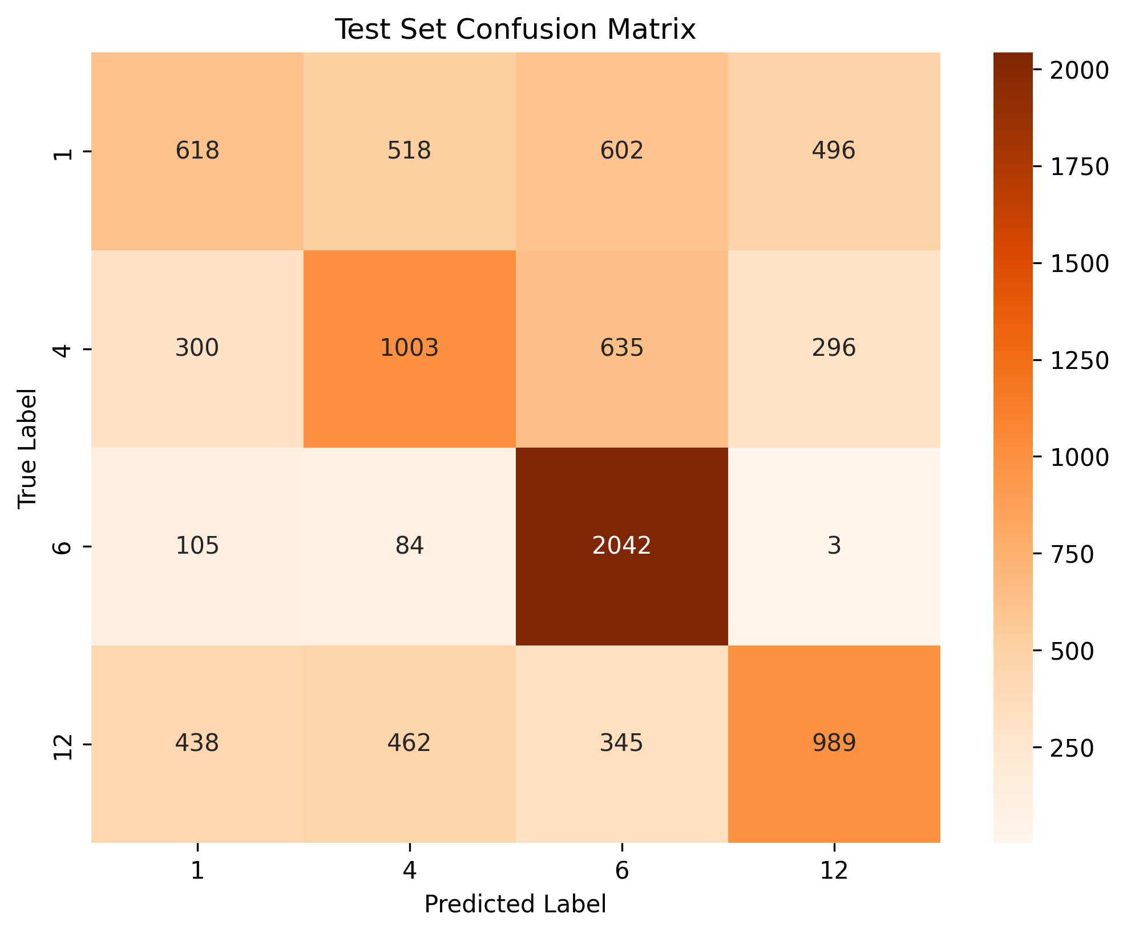
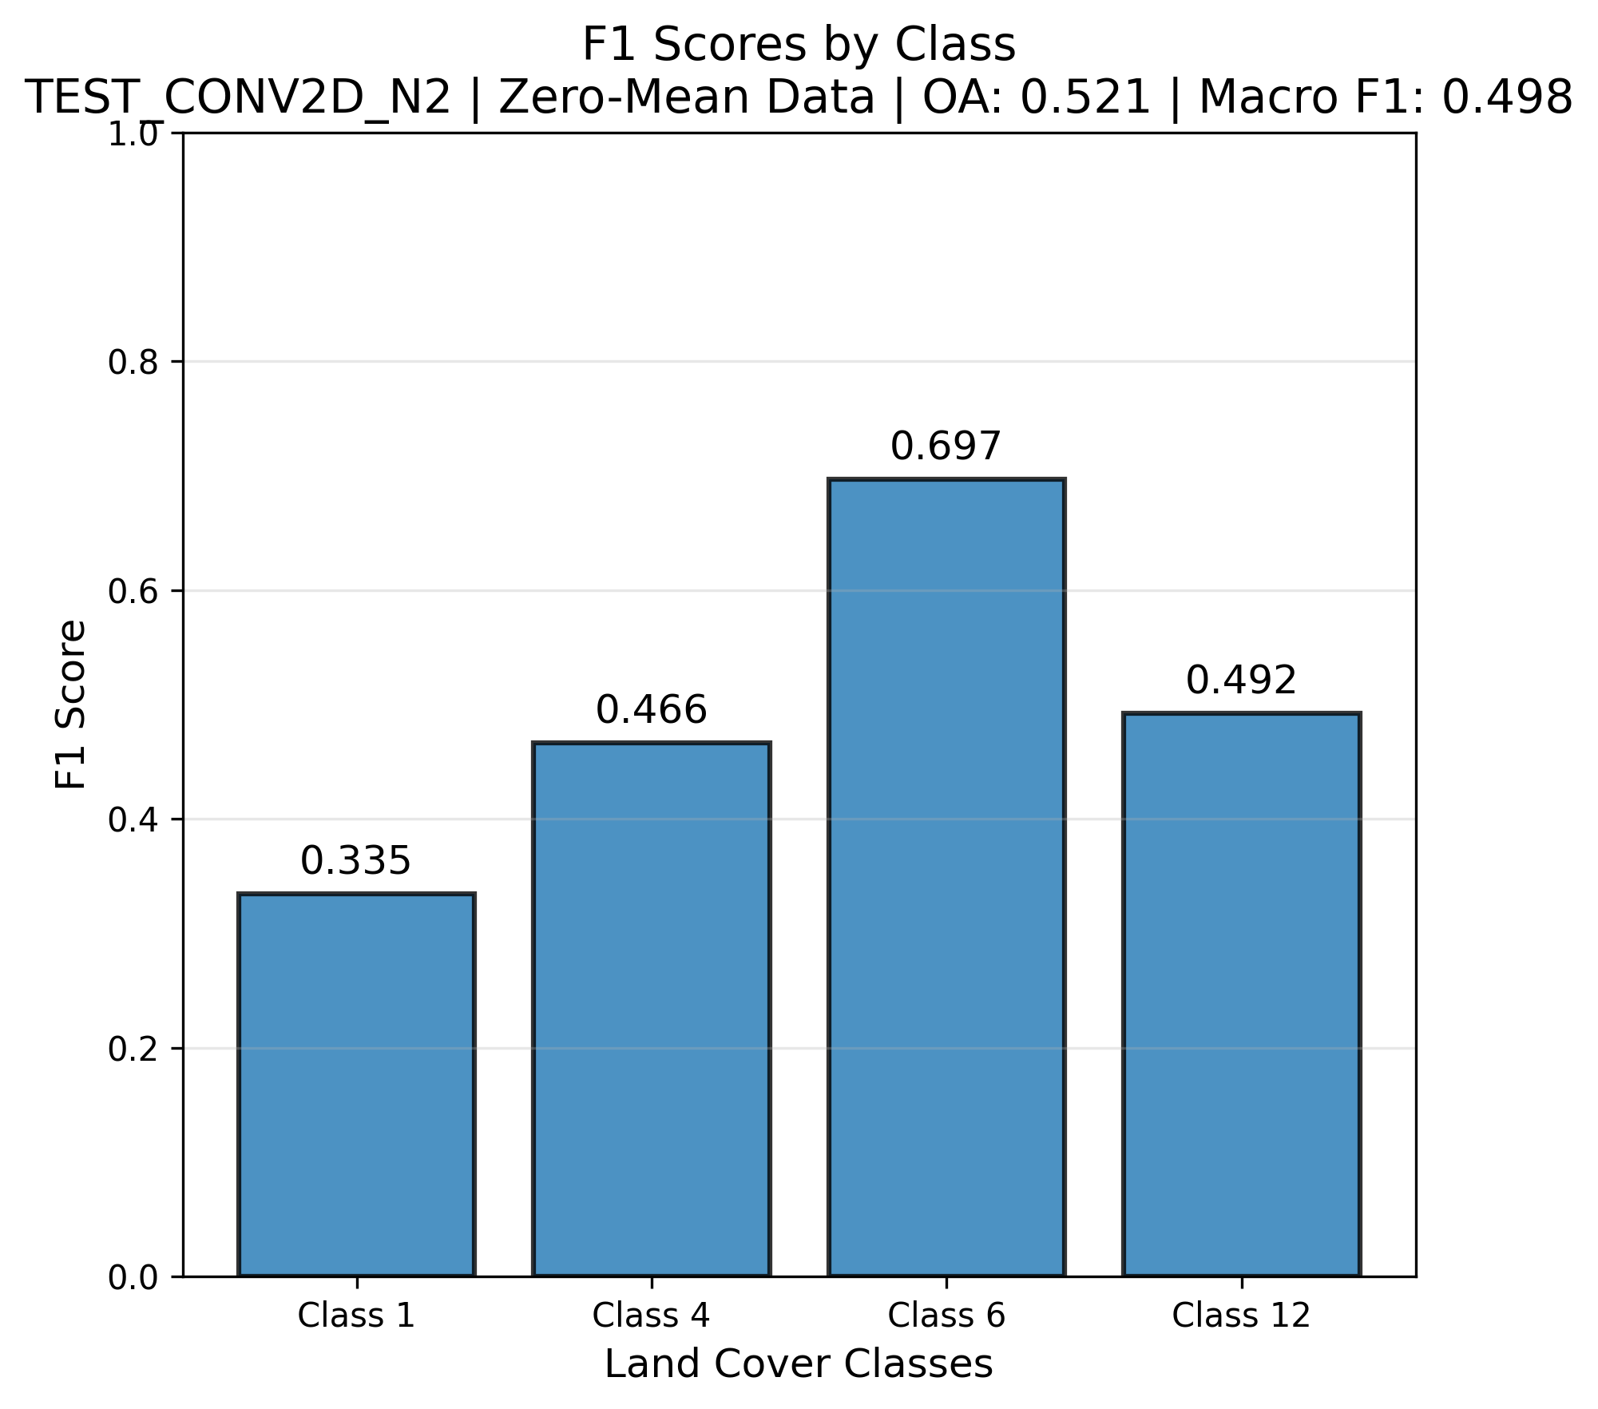
Results: zeromean, 1 date, test_conv2d_n2

Slide 8
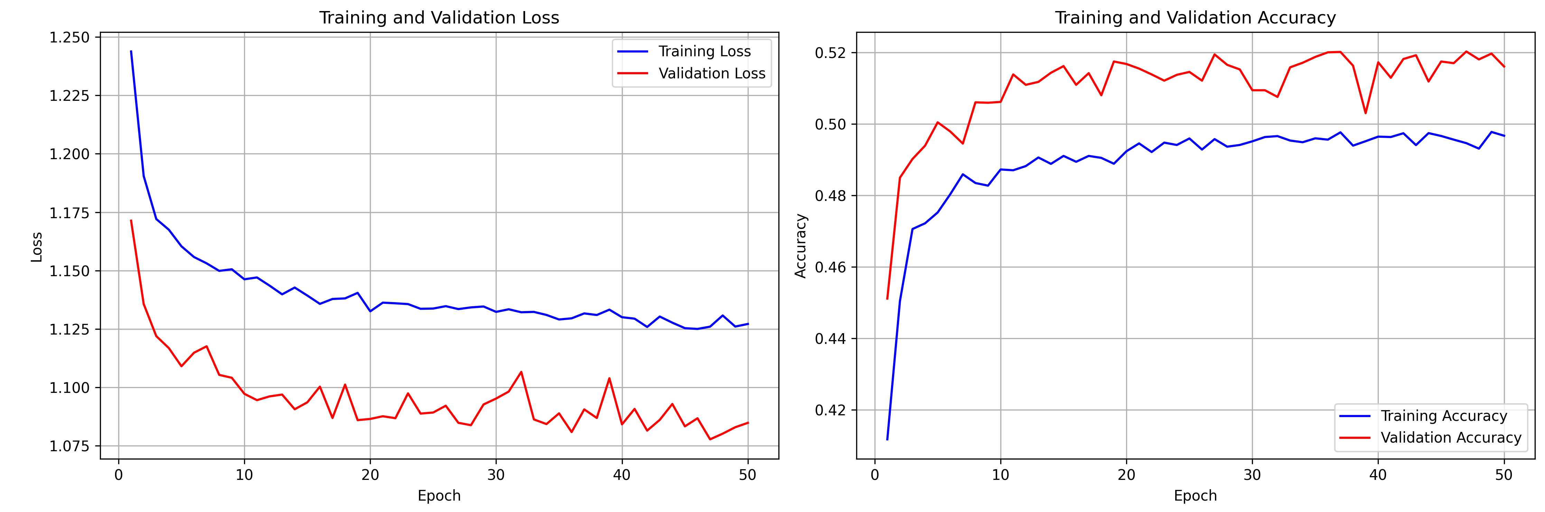
Results: zeromean, 1 date, test_conv2d_n2

Slide 9
Data leak check
Model: zeromean, 1 date, test_conv2d_n2
All class labels are shuffled at the raw-data level
The whole script is run to test if a data leak causes the high accuracies
Results:
Overall accuracy: 25.2 %
Mean F1 score: 23.3 %

Slide 10
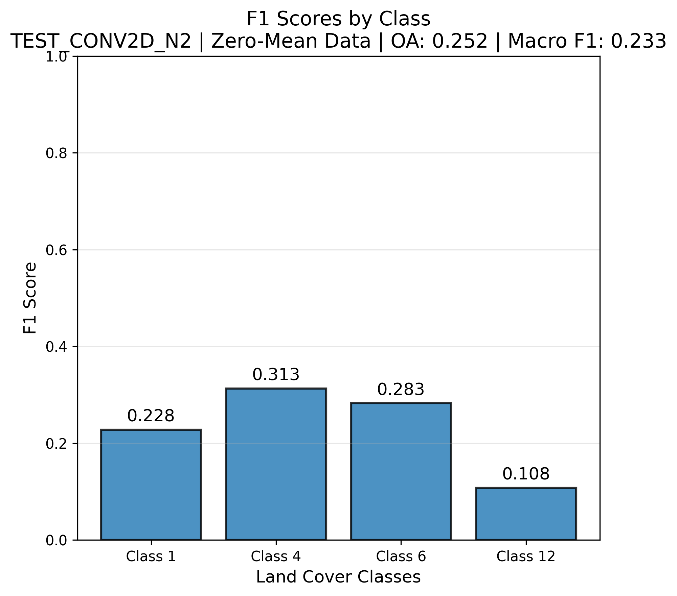
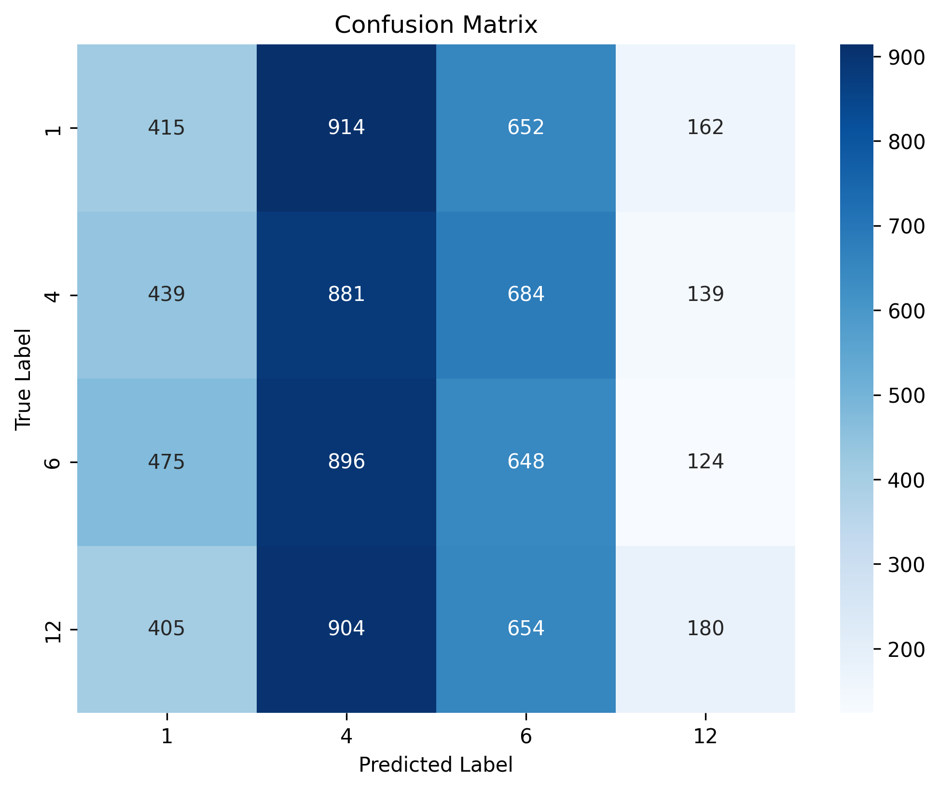
Data leak check
Model: zeromean, 1 date, test_conv2d_n2

Slide 11
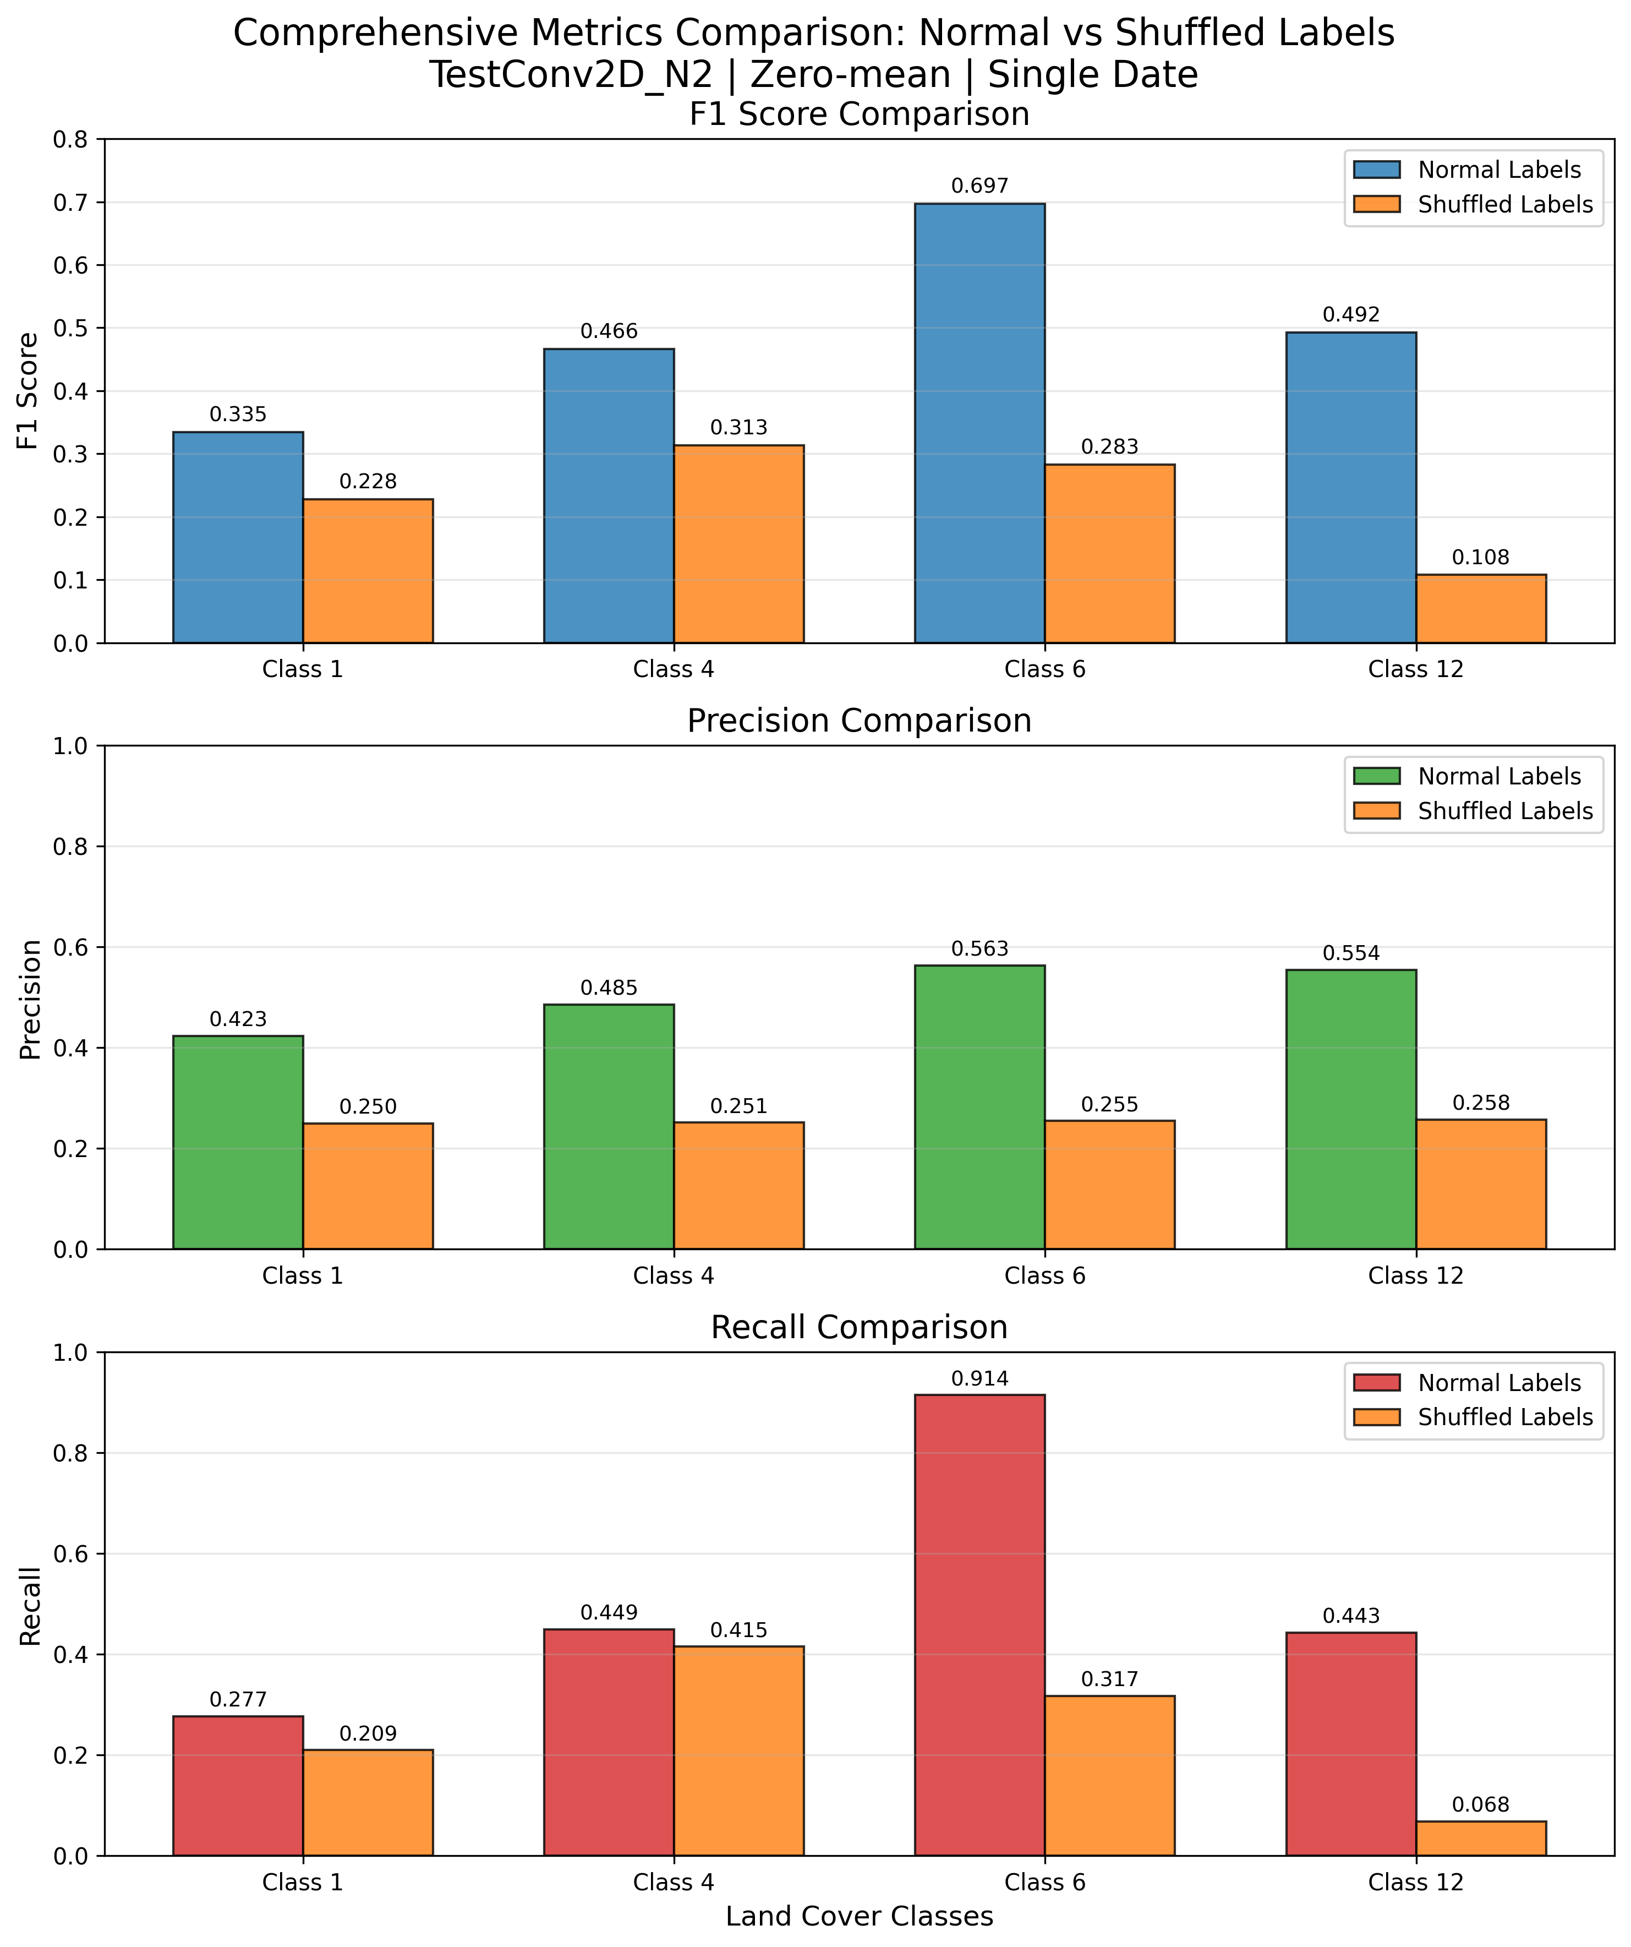
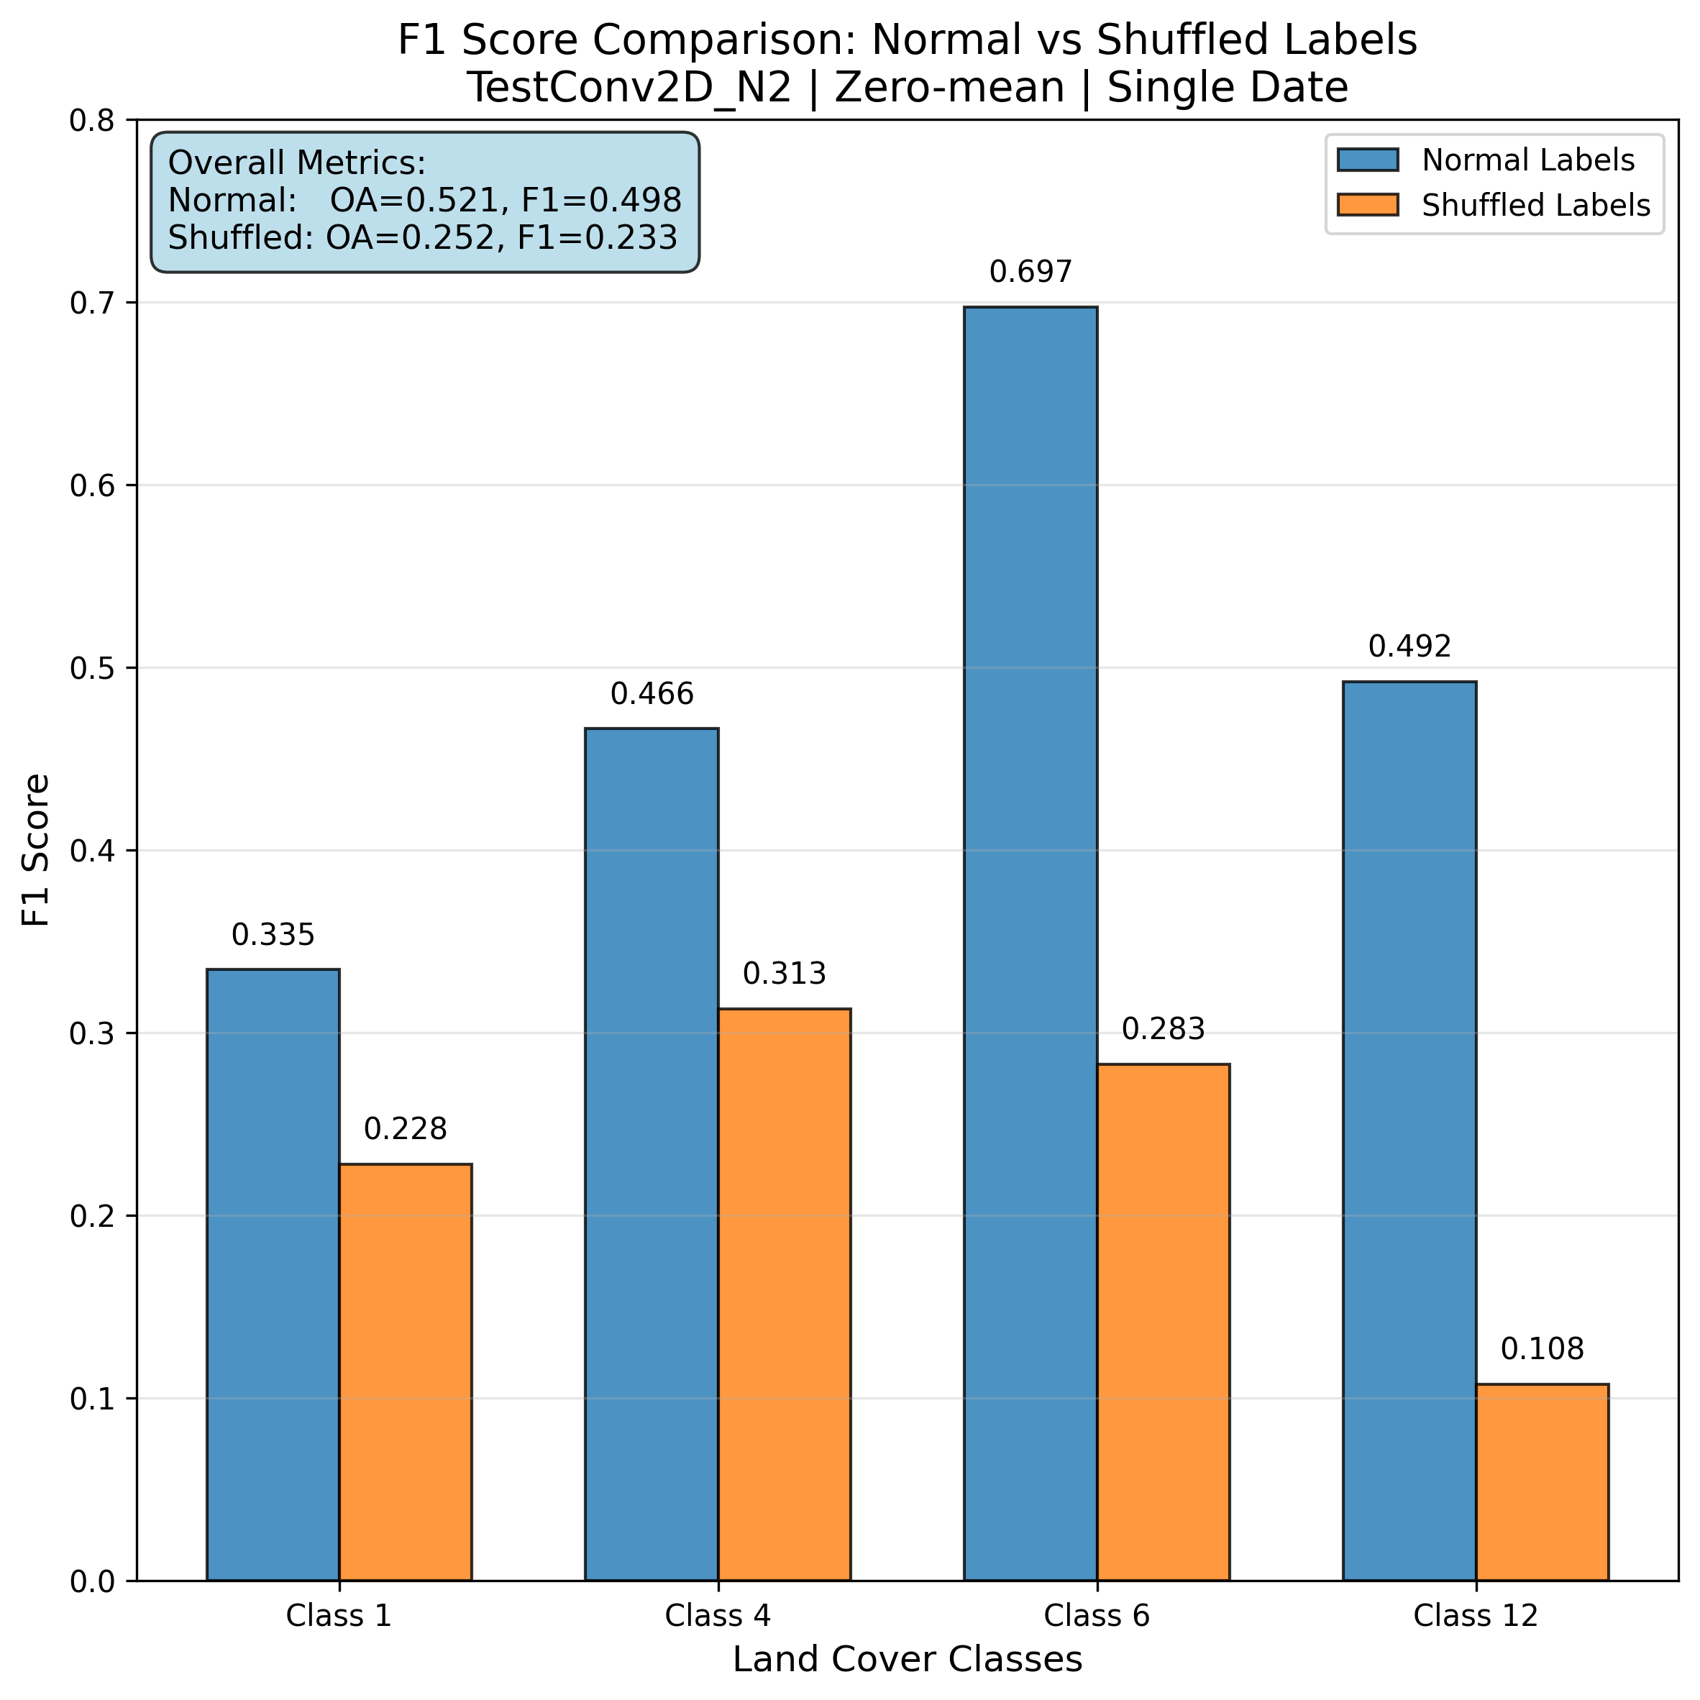
F1 score gain best model vs random model

