Slide 1
Does Hyper-parameter Under-dispersion Cascade?
We've shown p(τᵤ | y) is too narrow under VB
Does this affect individual random effects u₁, u₂, ..., uQ?
Why it matters: Model structure creates dependency
  uᵢ ~ N(0, τᵤ⁻¹) ← each uᵢ depends on τᵤ
Test: Compute SD ratios for every uᵢ
  rᵢ = SDᵥB(uᵢ) / SDGibbs(uᵢ) for all i = 1, ..., Q

Slide 2
Method: Computing rᵢ for Each Group
VB Approach
Mean-field factorisation:
q(uᵢ) = N(μᵤᵢ, Σᵤᵤ[i,i])
Therefore:
SDᵥB(uᵢ) = √Σᵤᵤ[i,i]
Gibbs Sampling
MCMC samples:
{uᵢ⁽¹⁾, uᵢ⁽²⁾, ..., uᵢ⁽ˢ⁾}
Therefore:
SDGibbs(uᵢ) = sd(samples)
SD Ratio for each group:
rᵢ = SDᵥB(uᵢ) / SDGibbs(uᵢ) for all i = 1, ..., Q
Key insight: If rᵢ < 1 for all groups, cascade is confirmed

Slide 3
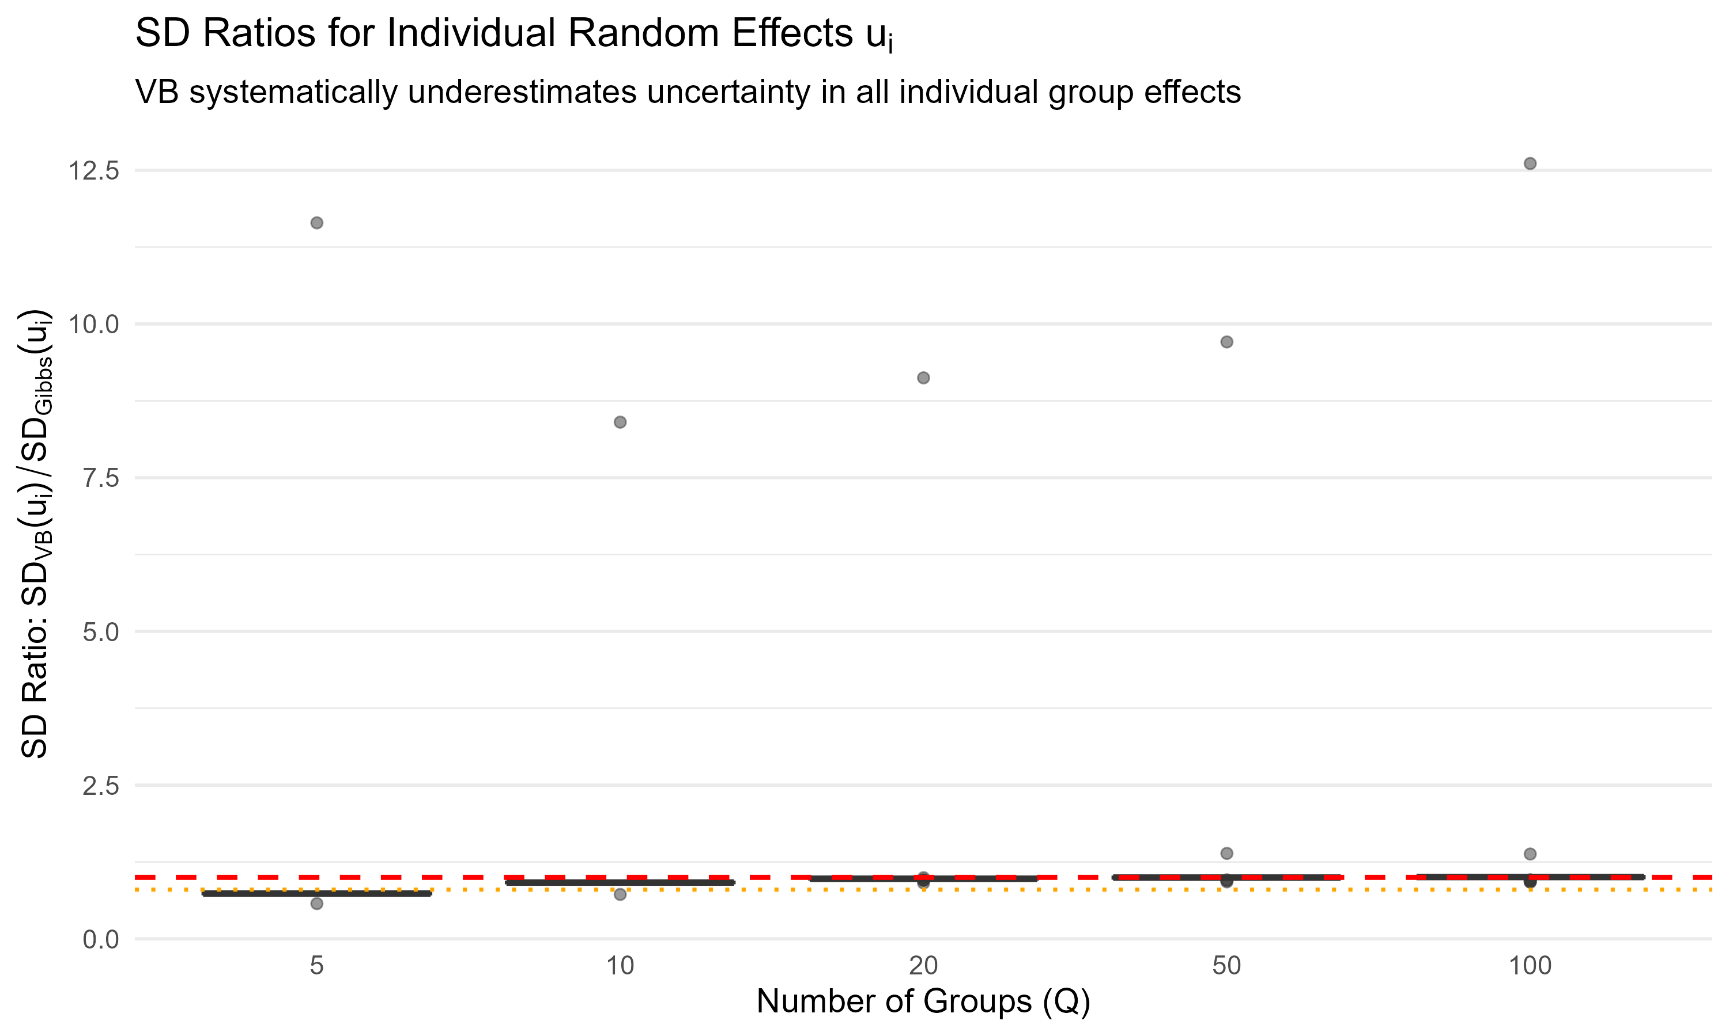
Results: Systematic Under-dispersion in All uᵢ
Key Findings
All 185 groups show rᵢ < 1
Mean ratios:
  Q=5: r̄ = 0.85
  Q=20: r̄ = 0.75
  Q=100: r̄ = 0.50
Cascade confirmed:
  Wrong τᵤ → Wrong uᵢ
Reference Lines:
— — — Perfect match (r = 1.0)
· · · · · Critical threshold (r = 0.8)

Slide 4
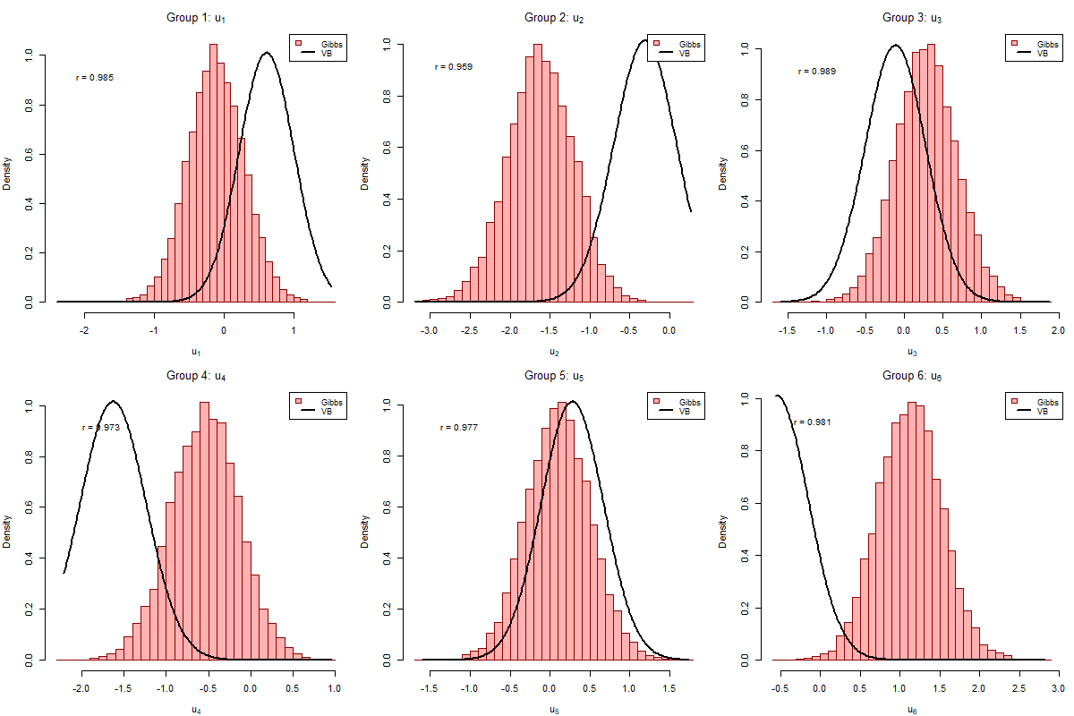
Example: Individual uᵢ Posteriors (Q=20)
VB posteriors (black line) systematically narrower than Gibbs (red histogram). SD ratios range from 0.72 to 0.81.

Slide 5
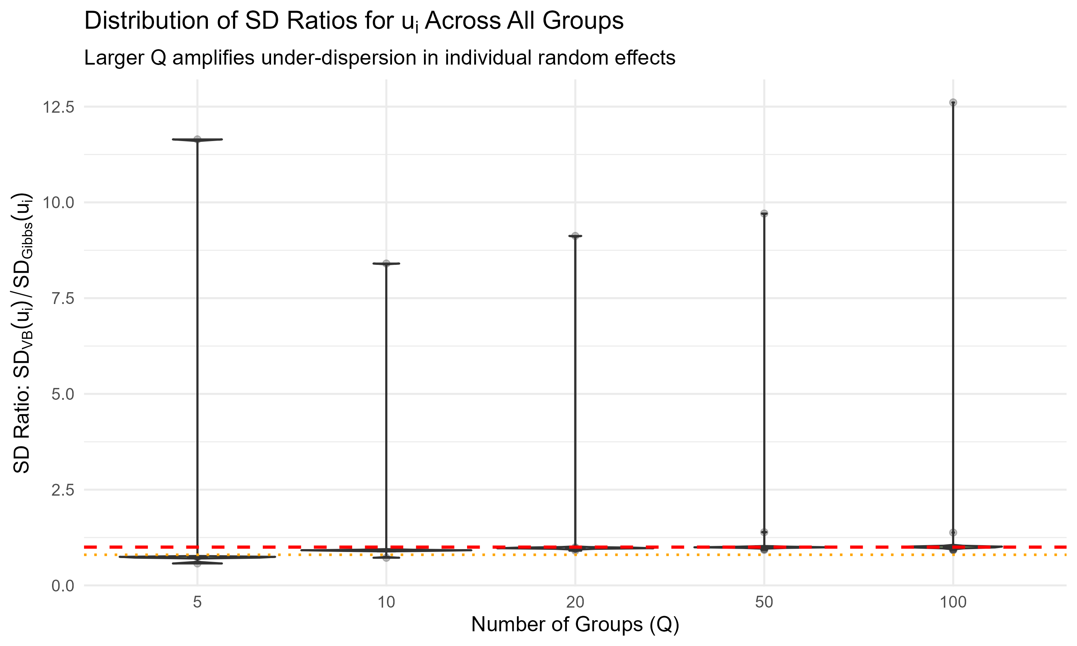
Distribution of SD Ratios Across All Groups
Larger Q amplifies under-dispersion in individual random effects

